Slide 1
A Lumped-Parameter Modeling, Calibration, and Capacity-Measure Framework for Flux Generation in Symmetric Multipole Electromagnetic Actuators

Slide 2
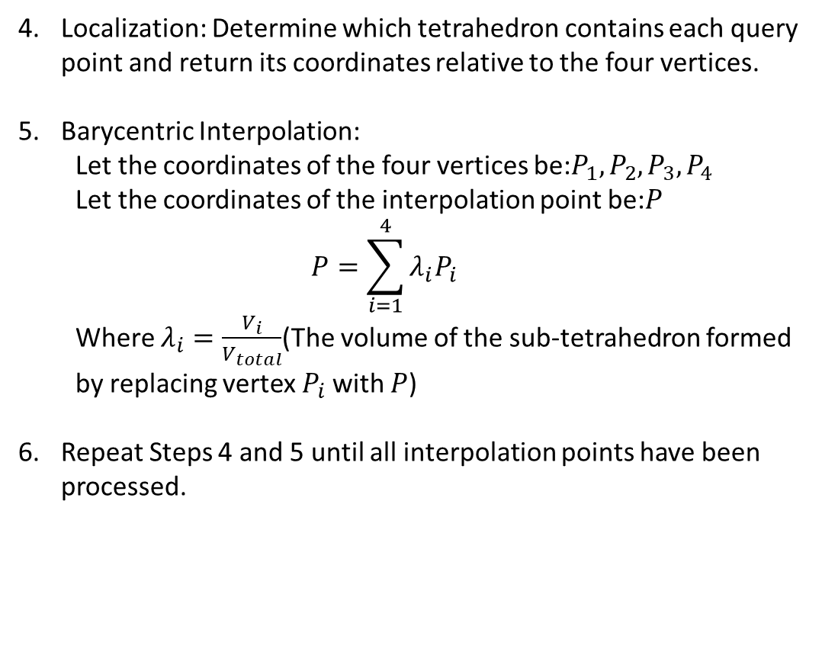
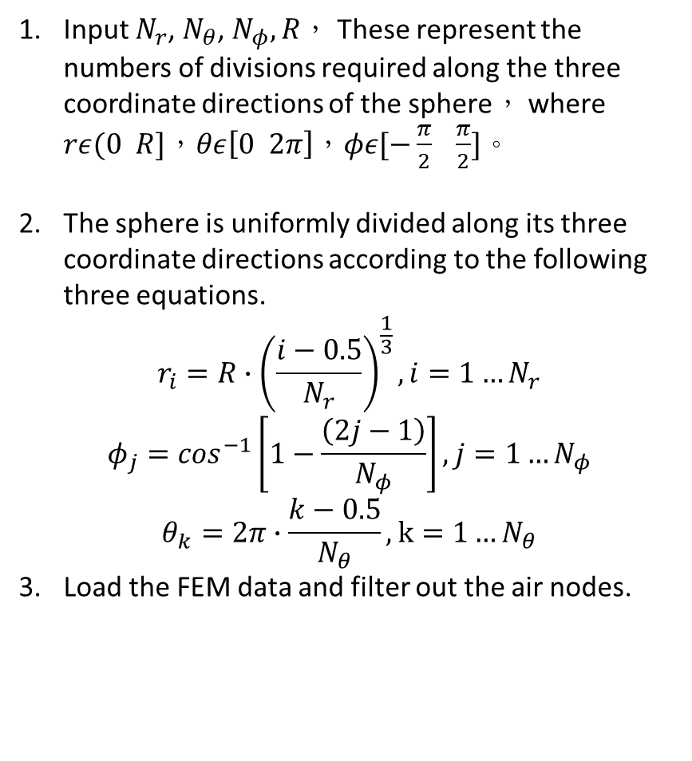

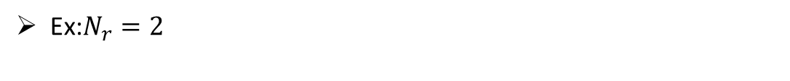
Current-based lumped-parameter modeling and calibration
E. Validation
Interpolation Point Algorithm for workspace
Input $N_{r}$, $N_{θ}$, $N_{φ},R$， These represent the numbers of divisions required along the three coordinate directions of the sphere， where $rε(0 R]$，$θε\left[0 2π\right]$，$φε[−\frac{π}{2} \frac{π}{2}]$。
The sphere is uniformly divided along its three coordinate directions according to the following three equations.
$$r_{i}=R∙{\left(\frac{i−0.5}{N_{r}}\right)}^{\frac{1}{3}},i=1…N_{r}$$
$$φ_{j}=\cos^{−1}\left[1−\frac{\left(2j−1\right)}{N_{φ}}\right],j=1…N_{φ}$$
$$θ_{k}=2π∙\frac{k−0.5}{N_{θ}},k=1…N_{θ}$$
Load the FEM data and filter out the air nodes.
Localization: Determine which tetrahedron contains each query point and return its coordinates relative to the four vertices.
Barycentric Interpolation:
Let the coordinates of the four vertices be:$P_{1},P_{2},P_{3},P_{4}$
Let the coordinates of the interpolation point be:$P$
$$P=\sum_{i=1}^{4}{λ_{i}P_{i}}$$
Where $λ_{i}=\frac{V_{i}}{V_{total}}$(The volume of the sub-tetrahedron formed by replacing vertex $P_{i}$ with $P$)
Repeat Steps 4 and 5 until all interpolation points have been processed.
Ex:$N_{r}=2$
$$r$$
Center
Sample point
Sample point

Slide 3
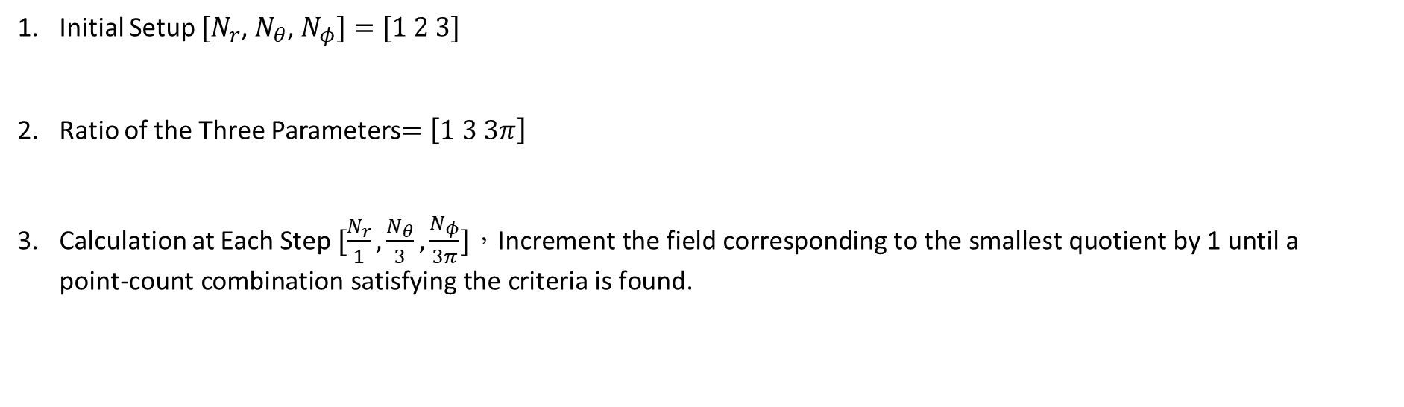
Current-based lumped-parameter modeling and calibration
E. Validation
Interpolation Point Algorithm
Initial Setup $[N_{r}$, $N_{θ}$, $N_{φ}]=[1 2 3]$
Ratio of the Three Parameters$=\left[1 3 3π\right]$
Calculation at Each Step $[\frac{N_{r}}{1},\frac{N_{θ}}{3},\frac{N_{φ}}{3π}]，\text{Increment} \text{the} \text{field} \text{corresponding} \text{to} \text{the} \text{smallest} \text{quotient} \text{by}\text{ 1 }\text{until} \text{a} \text{point}\text{−}\text{count} \text{combination} \text{satisfying} \text{the} \text{criteria} \text{is} \text{found}\text{.}$

Slide 4
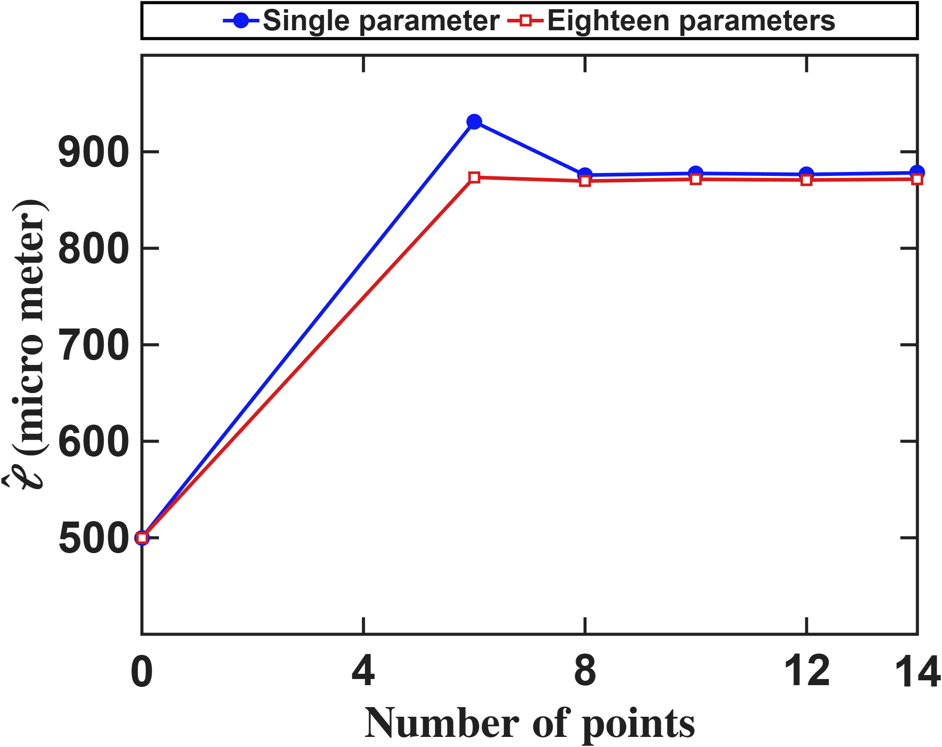
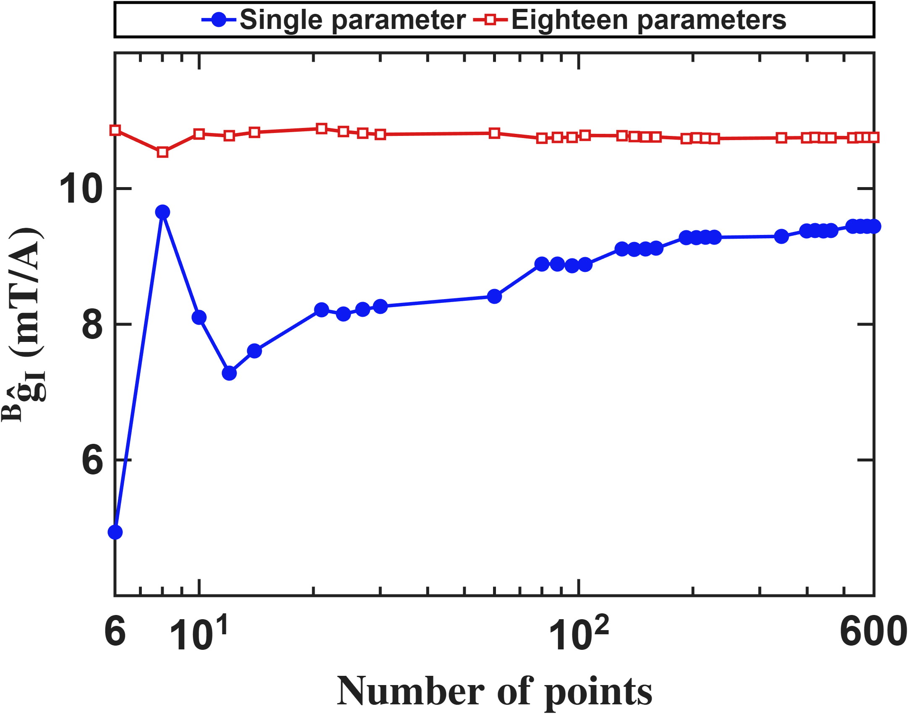


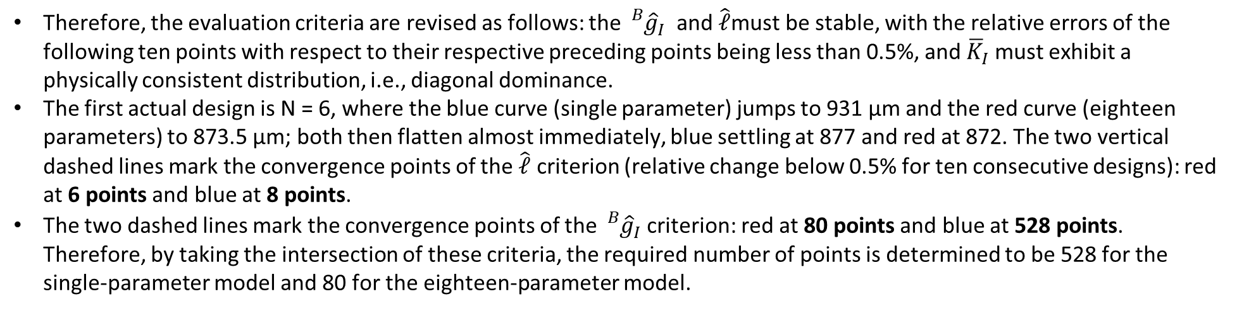
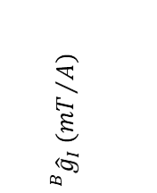
Current-based lumped-parameter modeling and calibration
E. Validation
Interpolation Point Algorithm
Therefore, the evaluation criteria are revised as follows: the ${}_{}^{B}{{\hat{g}}_{I}}$ and $\hat{ℓ}$must be stable, with the relative errors of the following ten points with respect to their respective preceding points being less than 0.5%, and ${\overline{K}}_{I}$​ must exhibit a physically consistent distribution, i.e., diagonal dominance.
The first actual design is N = 6, where the blue curve (single parameter) jumps to 931 µm and the red curve (eighteen parameters) to 873.5 µm; both then flatten almost immediately, blue settling at 877 and red at 872. The two vertical dashed lines mark the convergence points of the $\hat{ℓ}$ criterion (relative change below 0.5% for ten consecutive designs): red at 6 points and blue at 8 points.
The two dashed lines mark the convergence points of the ${}_{}^{B}{{\hat{g}}_{I}}$criterion: red at 80 points and blue at 528 points. Therefore, by taking the intersection of these criteria, the required number of points is determined to be 528 for the single-parameter model and 80 for the eighteen-parameter model.
$$\hat{ℓ} (μm)$$
$${}_{}^{B}{{\hat{g}}_{I}} ({mT}/A)$$
$$Number of points$$
$$Number of points$$

Slide 5

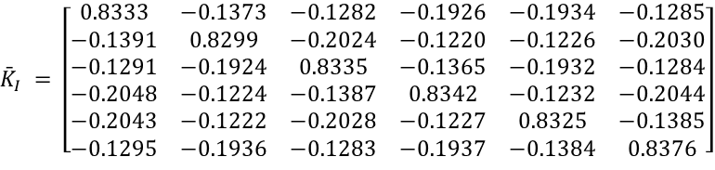

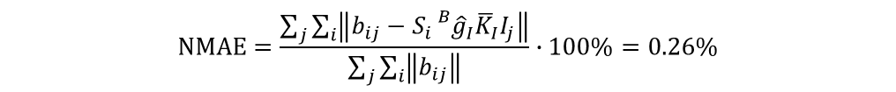


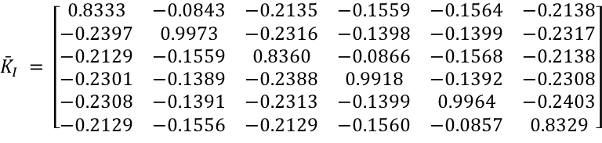
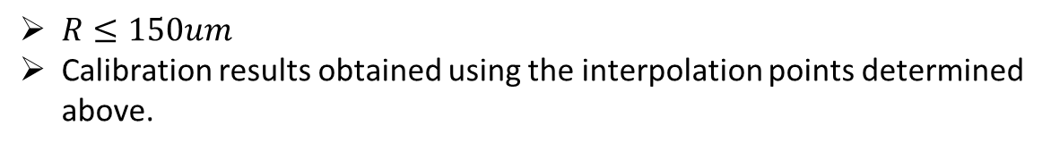
Current-based lumped-parameter modeling and calibration
E. Validation
Calibration results
$$Calibrate model→b_{ij}=S_{i}{}_{}^{B}{{\hat{g}}_{I}}{\overline{K}}_{I}I_{j}$$
$R≤150um$
Calibration results obtained using the interpolation points determined above.
Single parameter(528 points)
$${\bar{K}}_{I} = \left[\begin{matrix}0.8333 & −0.0843 & −0.2135 & −0.1559 & −0.1564 & −0.2138 \\ −0.2397 & 0.9973 & −0.2316 & −0.1398 & −0.1399 & −0.2317 \\ −0.2129 & −0.1559 & 0.8360 & −0.0866 & −0.1568 & −0.2138 \\ −0.2301 & −0.1389 & −0.2388 & 0.9918 & −0.1392 & −0.2308 \\ −0.2308 & −0.1391 & −0.2313 & −0.1399 & 0.9964 & −0.2403 \\ −0.2129 & −0.1556 & −0.2129 & −0.1560 & −0.0857 & 0.8329\end{matrix}\right]$$
$$NMAE=\frac{\sum_{j}{\sum_{i}{\left\|b_{ij}−S_{i}{}_{}^{B}{{\hat{g}}_{I}}{\overline{K}}_{I}I_{j}\right\|}}}{\sum_{j}{\sum_{i}{\left\|b_{ij}\right\|}}}∙100\%=2.85\%$$
$$\hat{ℓ} = 875.1 μm {}_{}^{B}{{\hat{g}}_{I}} = 9.4451 mT/A$$
Eighteen parameters(80 points)
$${\bar{K}}_{I} = \left[\begin{matrix}0.8333 & −0.1373 & −0.1282 & −0.1926 & −0.1934 & −0.1285 \\ −0.1391 & 0.8299 & −0.2024 & −0.1220 & −0.1226 & −0.2030 \\ −0.1291 & −0.1924 & 0.8335 & −0.1365 & −0.1932 & −0.1284 \\ −0.2048 & −0.1224 & −0.1387 & 0.8342 & −0.1232 & −0.2044 \\ −0.2043 & −0.1222 & −0.2028 & −0.1227 & 0.8325 & −0.1385 \\ −0.1295 & −0.1936 & −0.1283 & −0.1937 & −0.1384 & 0.8376\end{matrix}\right]$$
$$NMAE=\frac{\sum_{j}{\sum_{i}{\left\|b_{ij}−S_{i}{}_{}^{B}{{\hat{g}}_{I}}{\overline{K}}_{I}I_{j}\right\|}}}{\sum_{j}{\sum_{i}{\left\|b_{ij}\right\|}}}∙100\%=0.26\%$$
$$\hat{ℓ} = 873.0 μm {}_{}^{B}{{\hat{g}}_{I}} = 10.7405 mT/A$$
$$\hat{e}= \left[\begin{matrix}0.0185 & 0.0203 & −0.1173 & 0.0024 & 0.0018 & −0.1186 \\ −0.1183 & 0.0026 & 0.0168 & 0.0163 & 0.0019 & −0.1185 \\ 0.1182 & −0.0029 & 0.1166 & −0.0029 & −0.0186 & −0.0199\end{matrix}\right]$$

Slide 6
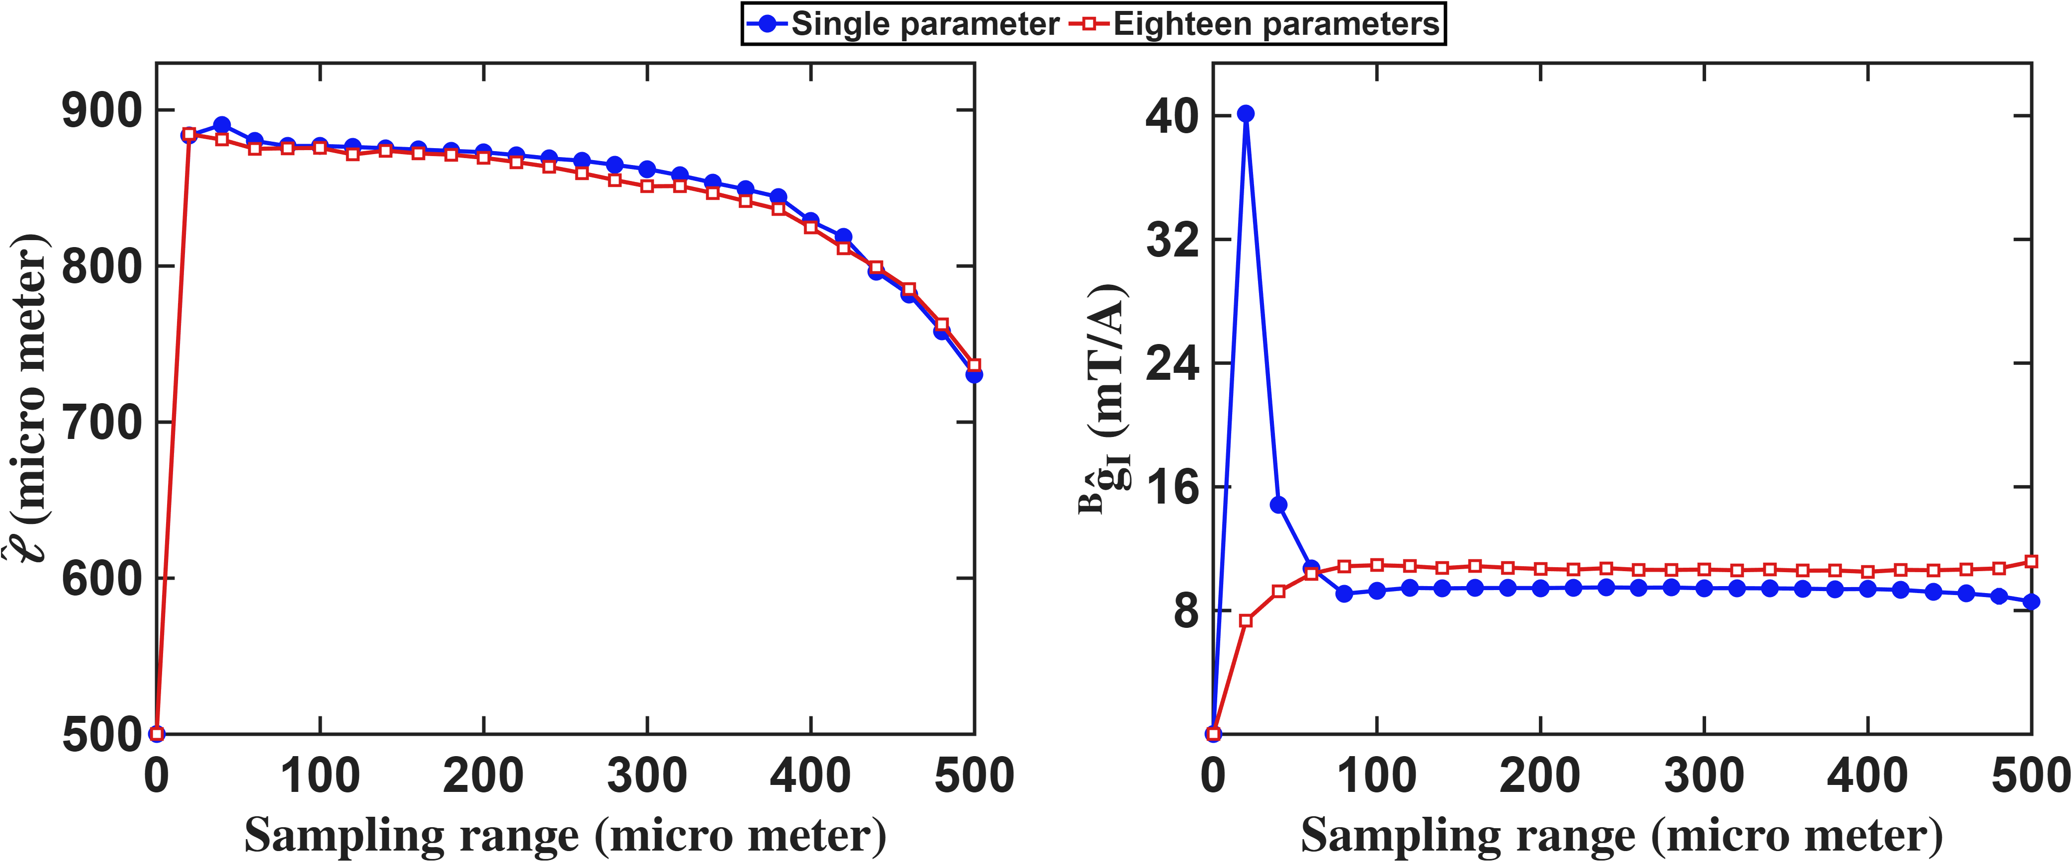
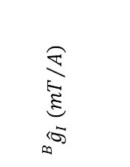
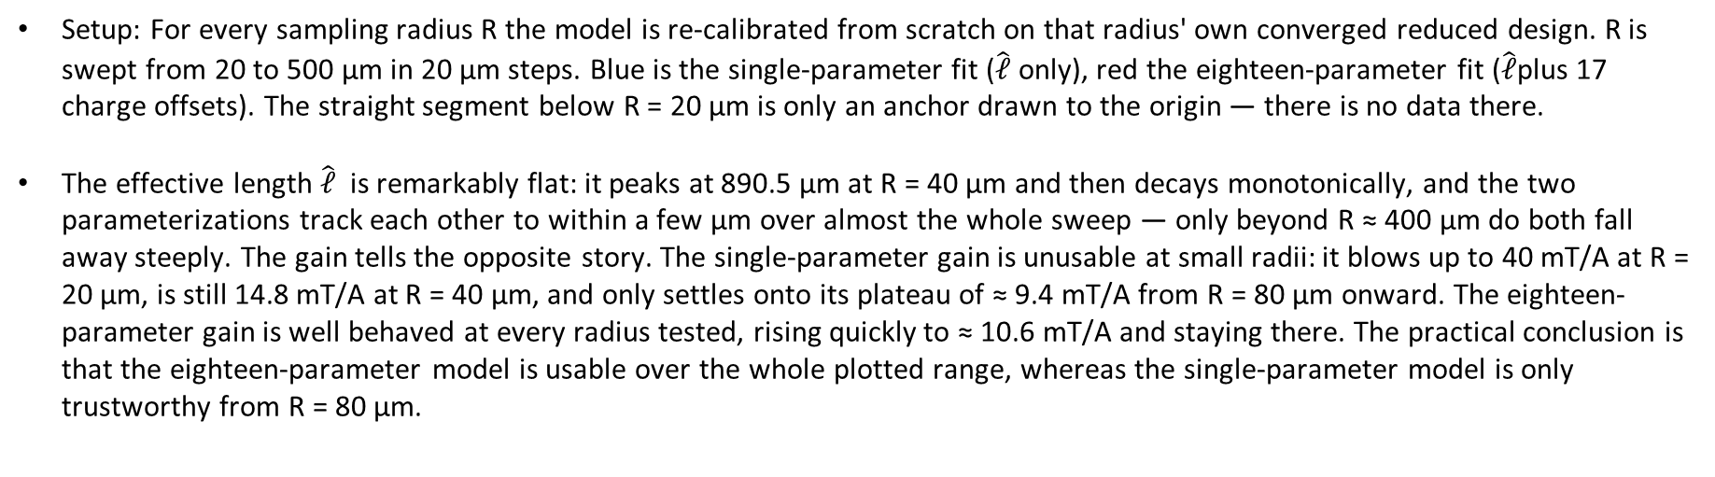



Current-based lumped-parameter modeling and calibration
E. Validation
Setup: For every sampling radius R the model is re-calibrated from scratch on that radius' own converged reduced design. R is swept from 20 to 500 µm in 20 µm steps. Blue is the single-parameter fit ($\hat{ℓ}$ only), red the eighteen-parameter fit ($\hat{ℓ}$plus 17 charge offsets). The straight segment below R = 20 µm is only an anchor drawn to the origin — there is no data there.
The effective length $\hat{ℓ}$ is remarkably flat: it peaks at 890.5 µm at R = 40 µm and then decays monotonically, and the two parameterizations track each other to within a few µm over almost the whole sweep — only beyond R ≈ 400 µm do both fall away steeply. The gain tells the opposite story. The single-parameter gain is unusable at small radii: it blows up to 40 mT/A at R = 20 µm, is still 14.8 mT/A at R = 40 µm, and only settles onto its plateau of ≈ 9.4 mT/A from R = 80 µm onward. The eighteen-parameter gain is well behaved at every radius tested, rising quickly to ≈ 10.6 mT/A and staying there. The practical conclusion is that the eighteen-parameter model is usable over the whole plotted range, whereas the single-parameter model is only trustworthy from R = 80 µm.
$$\hat{ℓ} (μm)$$
$${}_{}^{B}{{\hat{g}}_{I}} ({mT}/A)$$
$$Workspace radius(μm)$$
$$Workspace radius(μm)$$

Slide 7
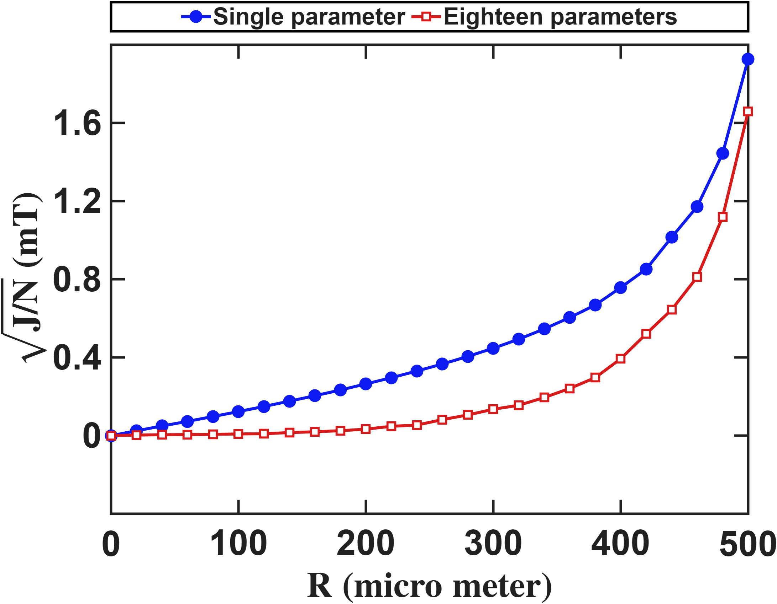


Current-based lumped-parameter modeling and calibration
E. Validation
Setup: The calibration side is identical to the previous slide: the same R sweep, the same converged reduced design at each R. What changes is the evaluation: the residual is computed on every real FEM node inside R.
The residual grows monotonically with the workspace radius for both models, as expected: the point-charge model is an inner expansion, so it degrades as the workspace boundary approaches the tip sphere (R = 500 µm). The eighteen-parameter model is better at every radius, but the gap between the two closes rapidly as R grows — 13× at R = 100 µm, 10× at R = 150 µm, 3.4× at R = 300 µm (0.449 vs 0.132 mT), and only 15% at R = 500 µm (1.98 vs 1.73 mT). The seventeen extra degrees of freedom therefore improve the fit only while the workspace is small compared with R; once its boundary reaches the pole tips both models fail alike.
$$Residual error (mT)$$
$$Workspace radius (μm)$$

Slide 8
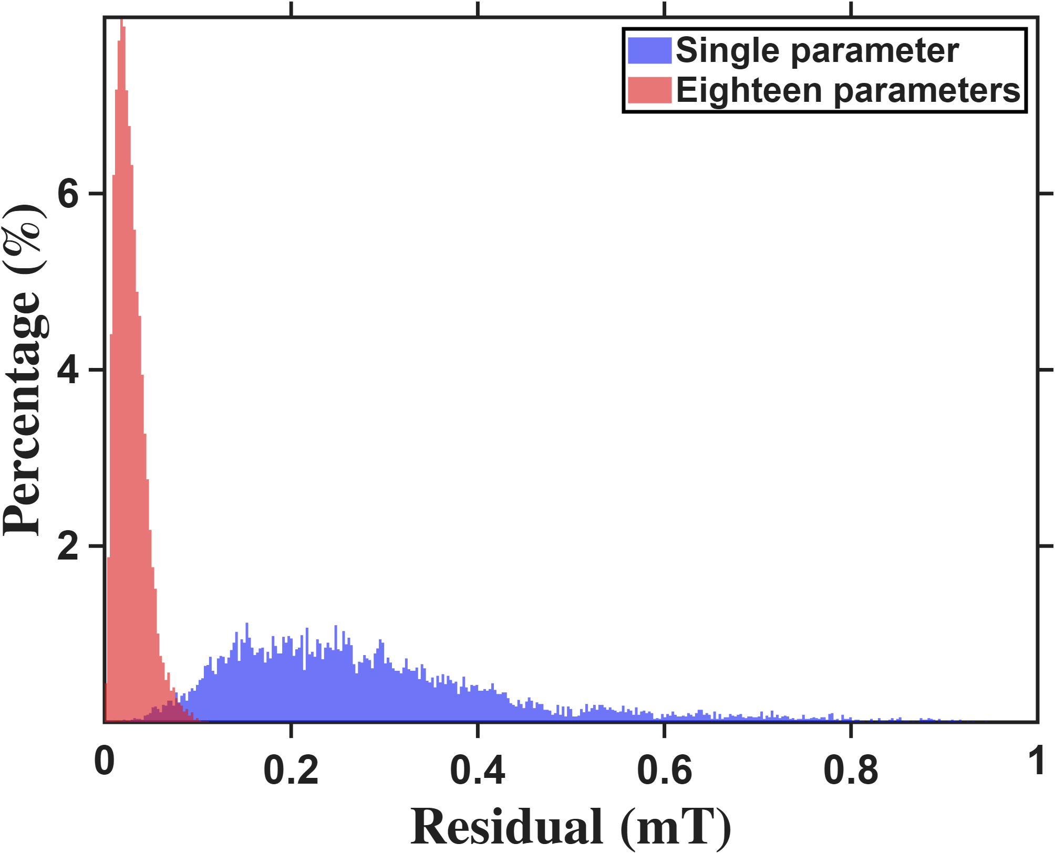
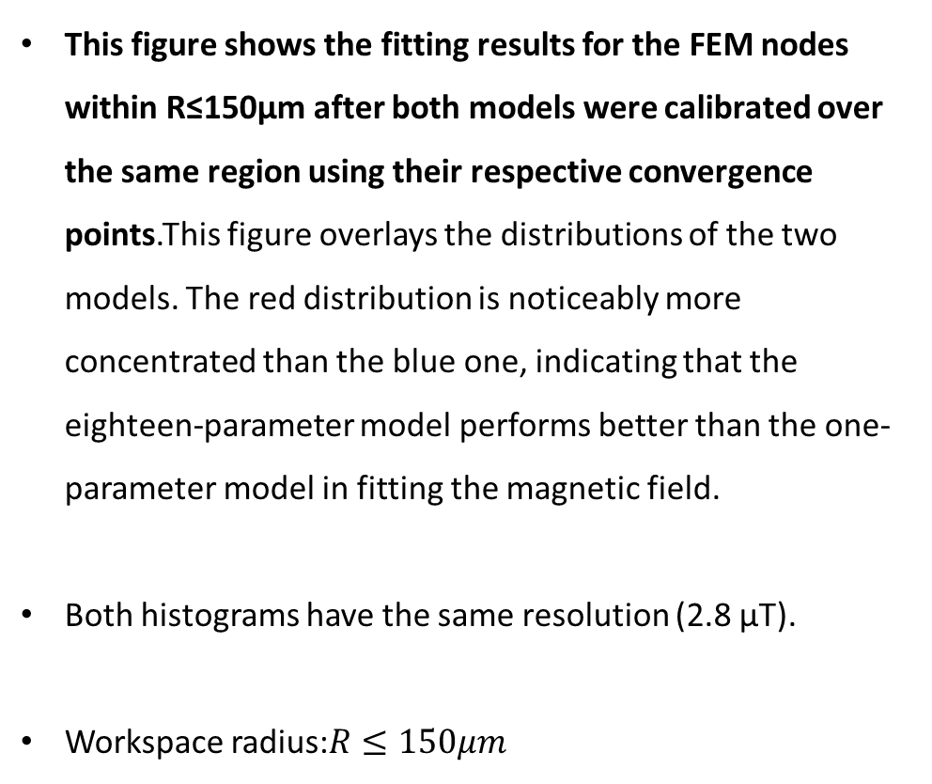



Current-based lumped-parameter modeling and calibration
E. Validation
$$Calibrate model→b_{ij}=S_{i}{}_{}^{B}{{\hat{g}}_{I}}{\overline{K}}_{I}I_{j}$$
This figure shows the fitting results for the FEM nodes within R≤150μm after both models were calibrated over the same region using their respective convergence points.This figure overlays the distributions of the two models. The red distribution is noticeably more concentrated than the blue one, indicating that the eighteen-parameter model performs better than the one-parameter model in fitting the magnetic field.
Both histograms have the same resolution (2.8 μT).
Workspace radius:$R≤150μm$
$$Percentage count(\%)$$
$$Residual error (mT)$$
 | Single | Eighteen
Mean error | 0.2876mT | 0.0277mT

Slide 9
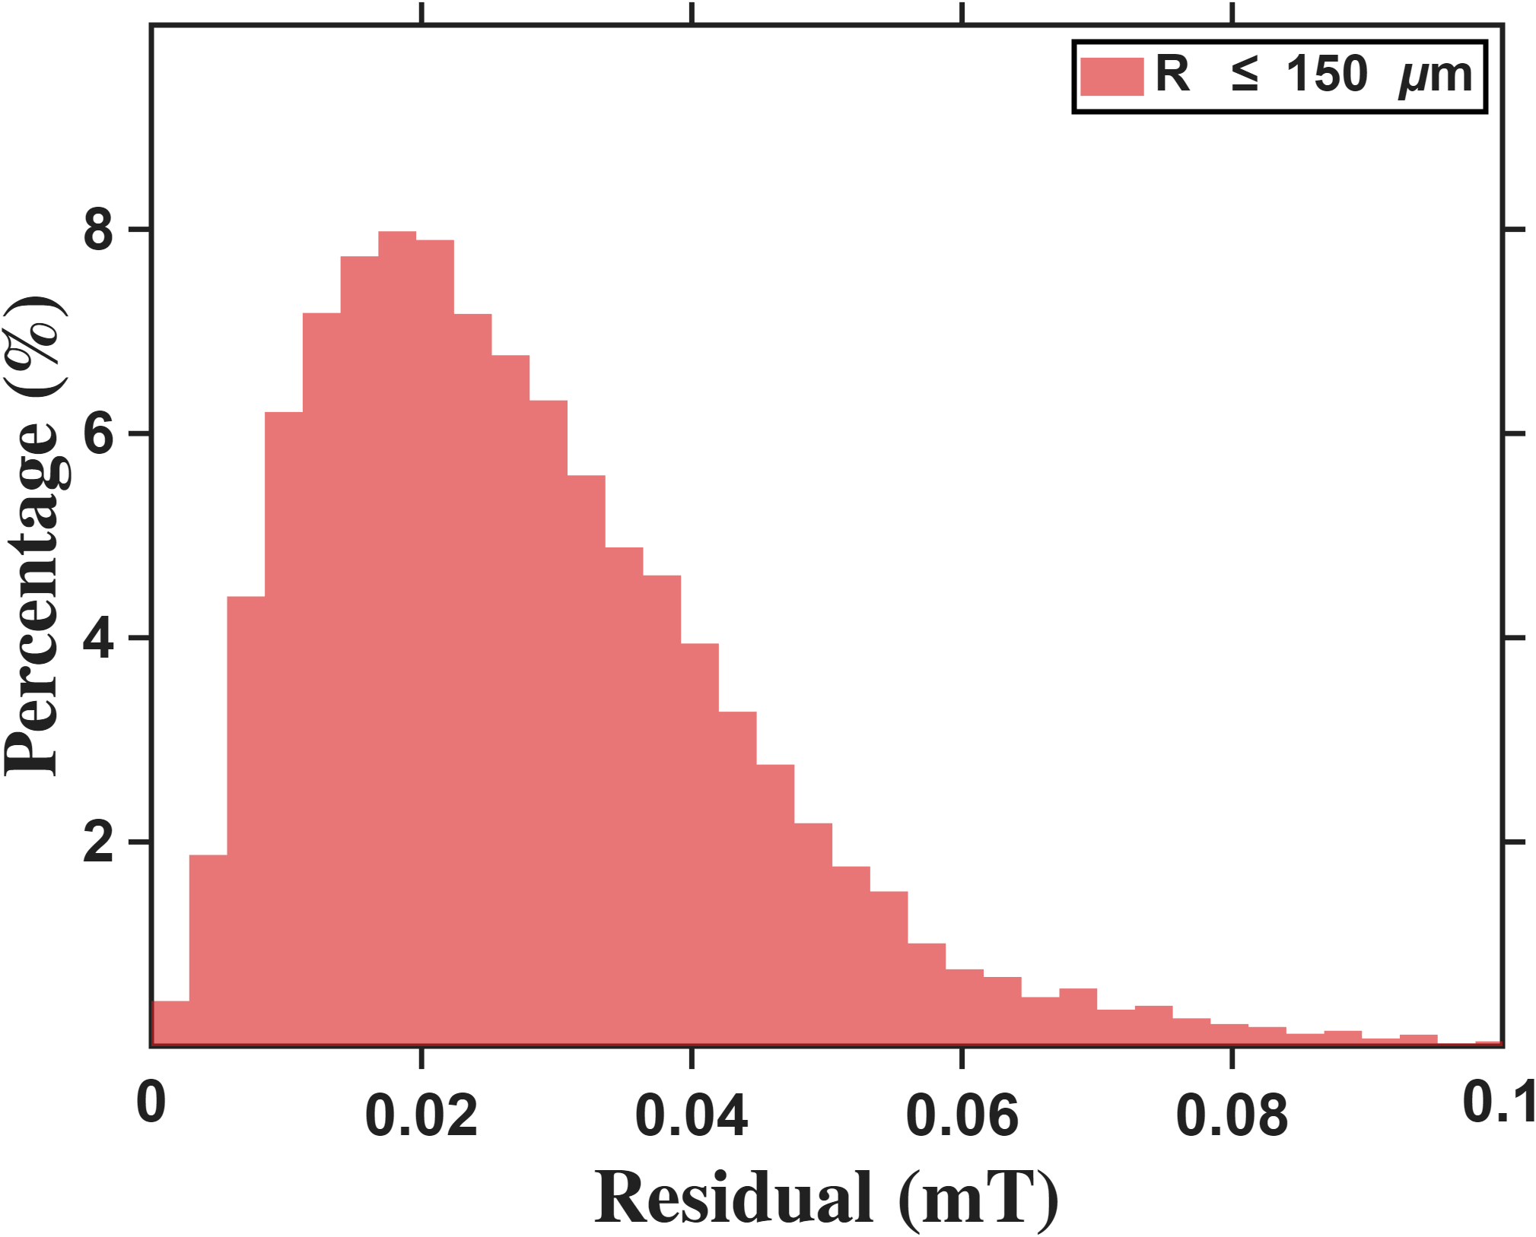
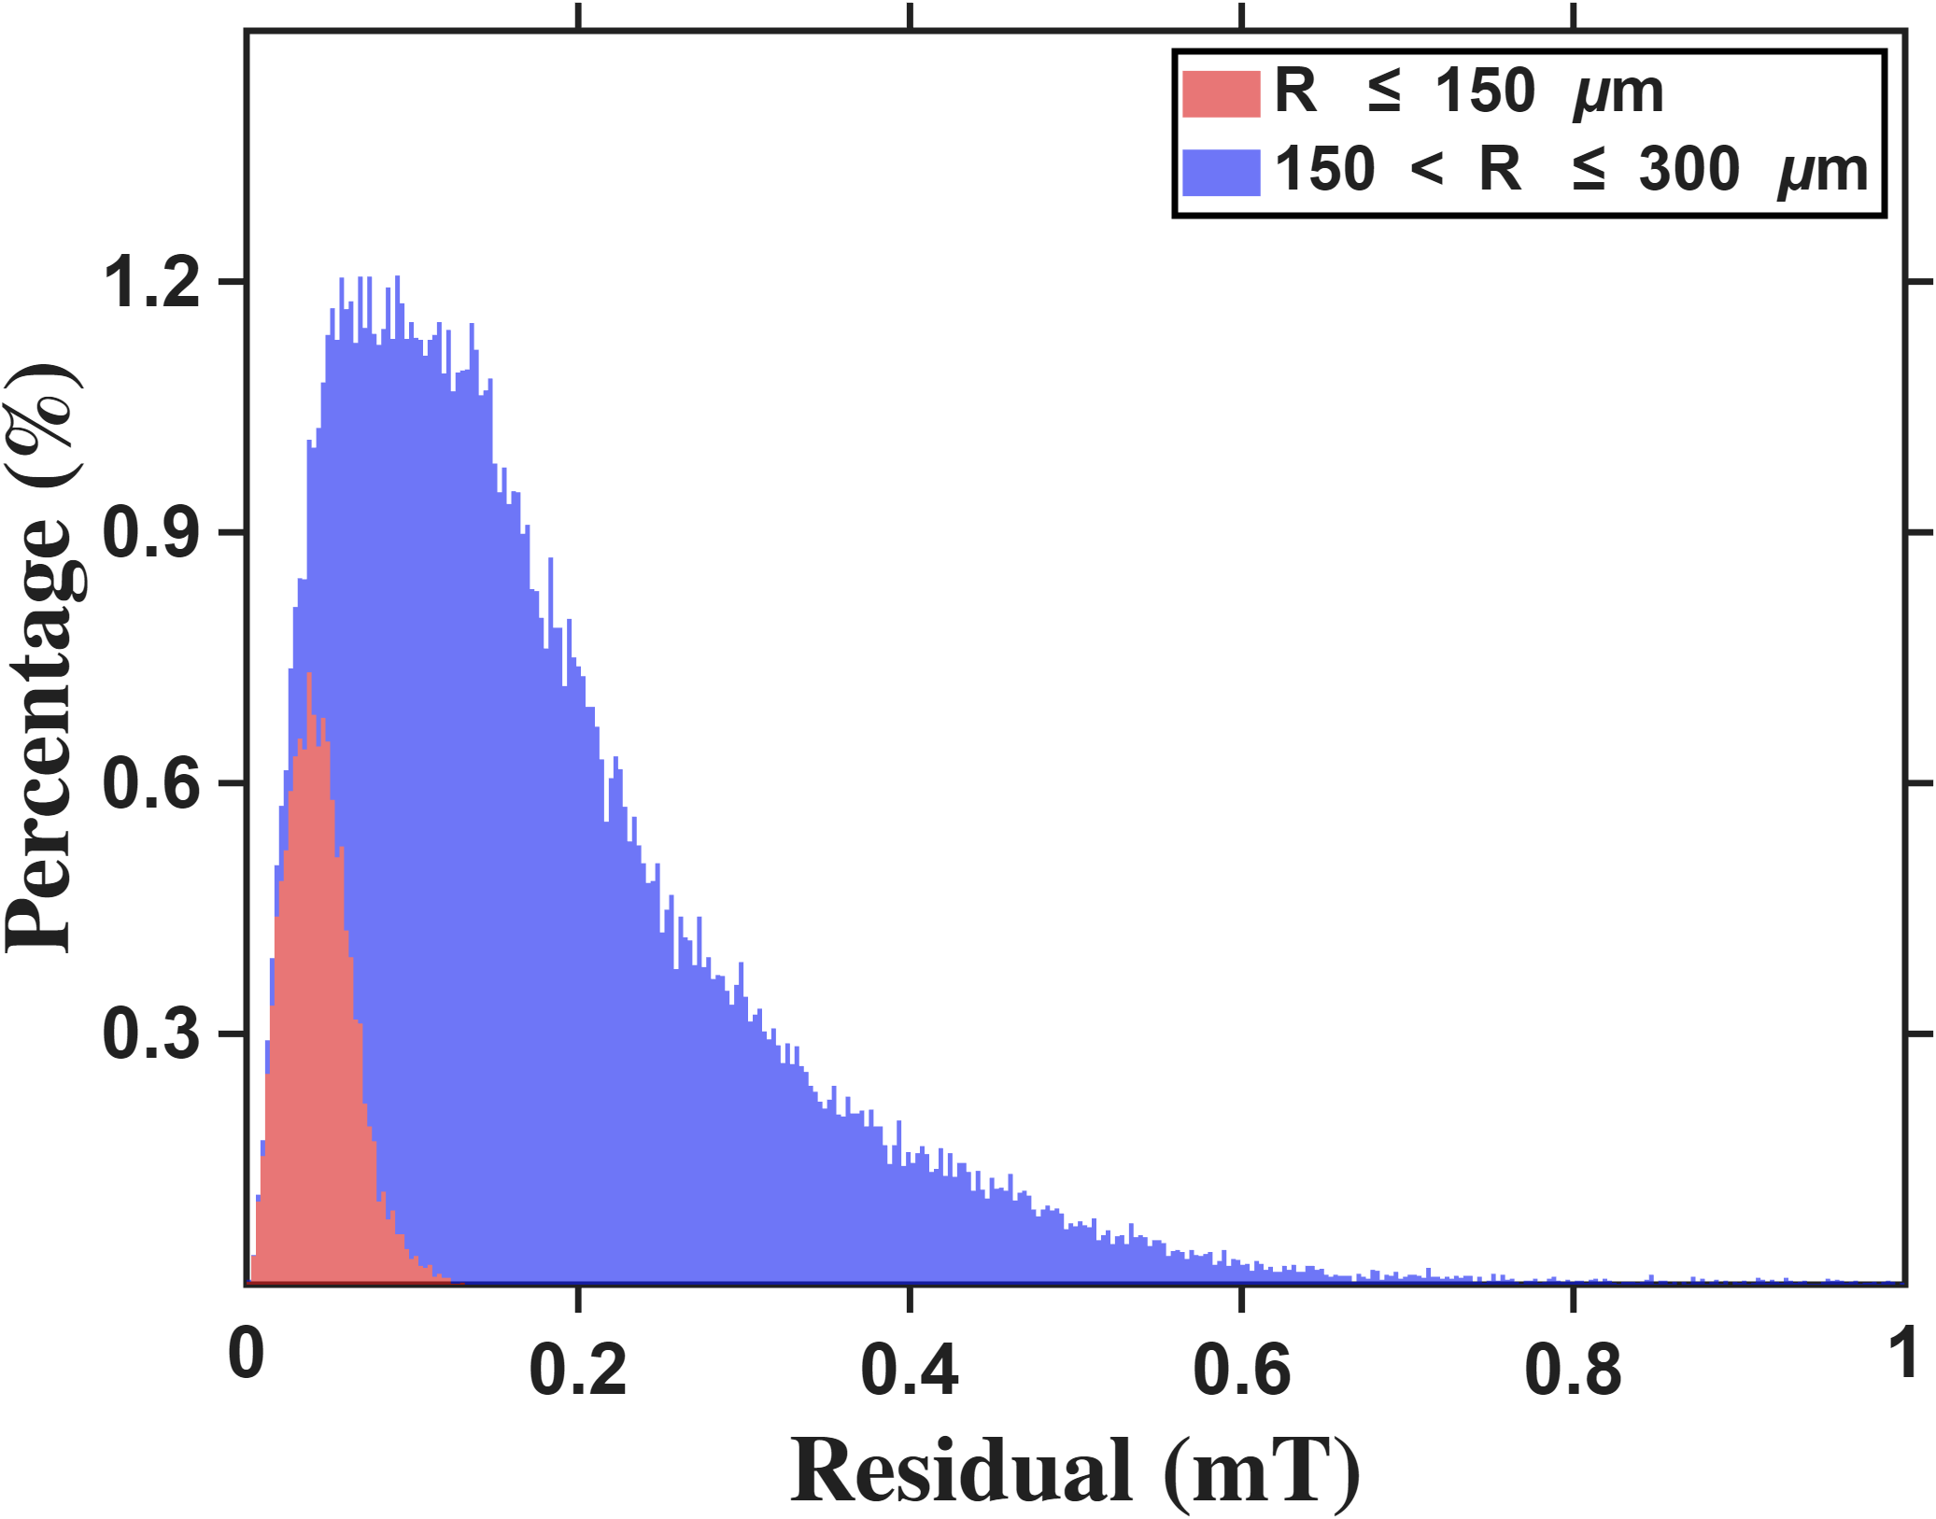


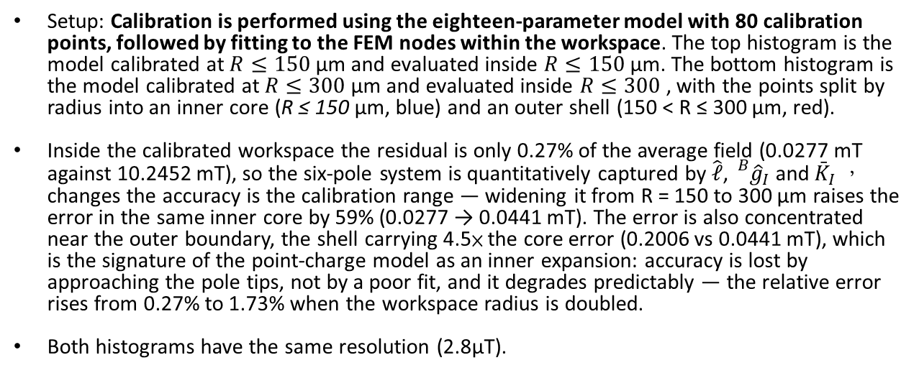



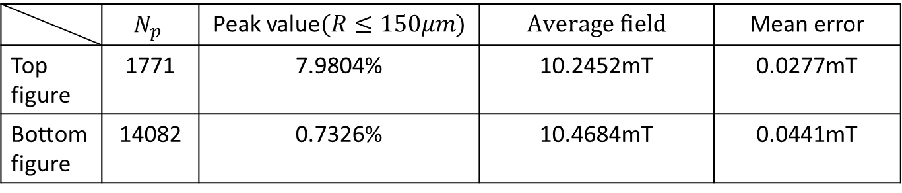
Current-based lumped-parameter modeling and calibration
E. Validation
Setup: Calibration is performed using the eighteen-parameter model with 80 calibration points, followed by fitting to the FEM nodes within the workspace. The top histogram is the model calibrated at $R≤150$ µm and evaluated inside $R≤150$ µm. The bottom histogram is the model calibrated at $R≤300$ µm and evaluated inside $R≤300$ , with the points split by radius into an inner core (R ≤ 150 µm, blue) and an outer shell (150 < R ≤ 300 µm, red).
Inside the calibrated workspace the residual is only 0.27% of the average field (0.0277 mT against 10.2452 mT), so the six-pole system is quantitatively captured by $\hat{ℓ}$, ${}_{}^{B}{{\hat{g}}_{I}}$and ${\bar{K}}_{I}$， changes the accuracy is the calibration range — widening it from R = 150 to 300 µm raises the error in the same inner core by 59% (0.0277 → 0.0441 mT). The error is also concentrated near the outer boundary, the shell carrying 4.5× the core error (0.2006 vs 0.0441 mT), which is the signature of the point-charge model as an inner expansion: accuracy is lost by approaching the pole tips, not by a poor fit, and it degrades predictably — the relative error rises from 0.27% to 1.73% when the workspace radius is doubled.
Both histograms have the same resolution (2.8μT).
$$Percentage count(\%)$$
$$Residual error (mT)$$
 | $$N_{p}$$ | Peak value$(R≤150μm)$ | $$Average field$$ | Mean error
Top figure | 1771 | 7.9804% | 10.2452mT | 0.0277mT
Bottom figure | 14082 | 0.7326% | 10.4684mT | 0.0441mT
$$Percentage count(\%)$$
$$\frac{14082}{1771}=7.95 ,\frac{7.9804}{0.7326}=10.9$$
$$Residual error (mT)$$
Under the condition of equal area, a peak height that is 1.37 times lower is equivalent to an effective distribution width that is 1.37 times wider (48.07 vs. 35.09 µT). This difference arises from the use of different calibration models.

Slide 10
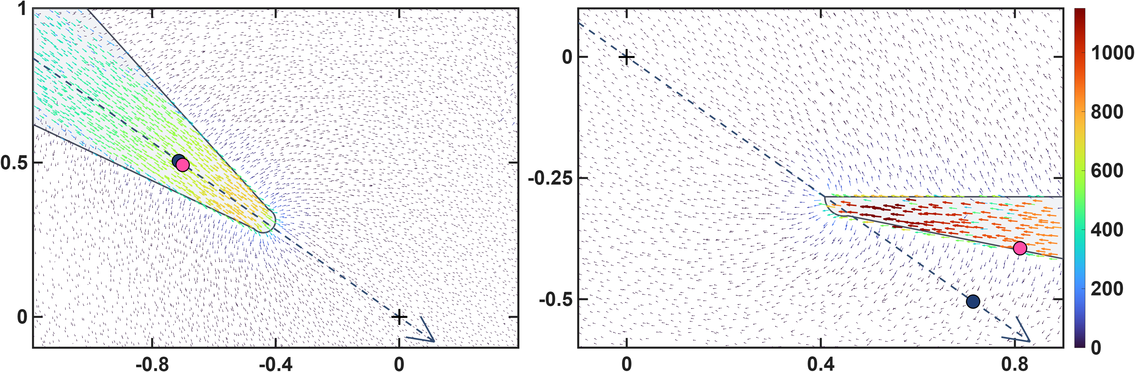








Current-based lumped-parameter modeling and calibration
E. Validation
$$Calibrate model→b_{ij}=S_{i}{}_{}^{B}{{\hat{g}}_{I}}{\overline{K}}_{I}I_{j}$$
These two figures show the differences in the calibrated magnetic charge locations between the two models. The upper row presents the magnetic charge locations calibrated by the one-parameter model, shown using side views of poles P1 and P2. It can be clearly seen that, for the lower pole, some of the magnetic charge locations are located outside the pole. This is because the one-parameter model constrains the magnetic charges to lie along the actuator coordinate axes. The lower row presents the results of the eighteen-parameter model, in which the magnetic charge locations of the lower pole move inside the pole. This is more consistent with the expected physical situation. Moreover, the error histograms shown above also indicate that these magnetic charge locations are more consistent with the theoretical positions.
$${\hat{x}}_{a}$$
$$z−axis(mm)$$
$$q_{c2}$$
$$\left\|b\right\|(mT)$$
$${\hat{x}}_{a}$$
$$q_{c1}$$
$$x−axis(mm)$$
$$x−axis(mm)$$

Slide 11
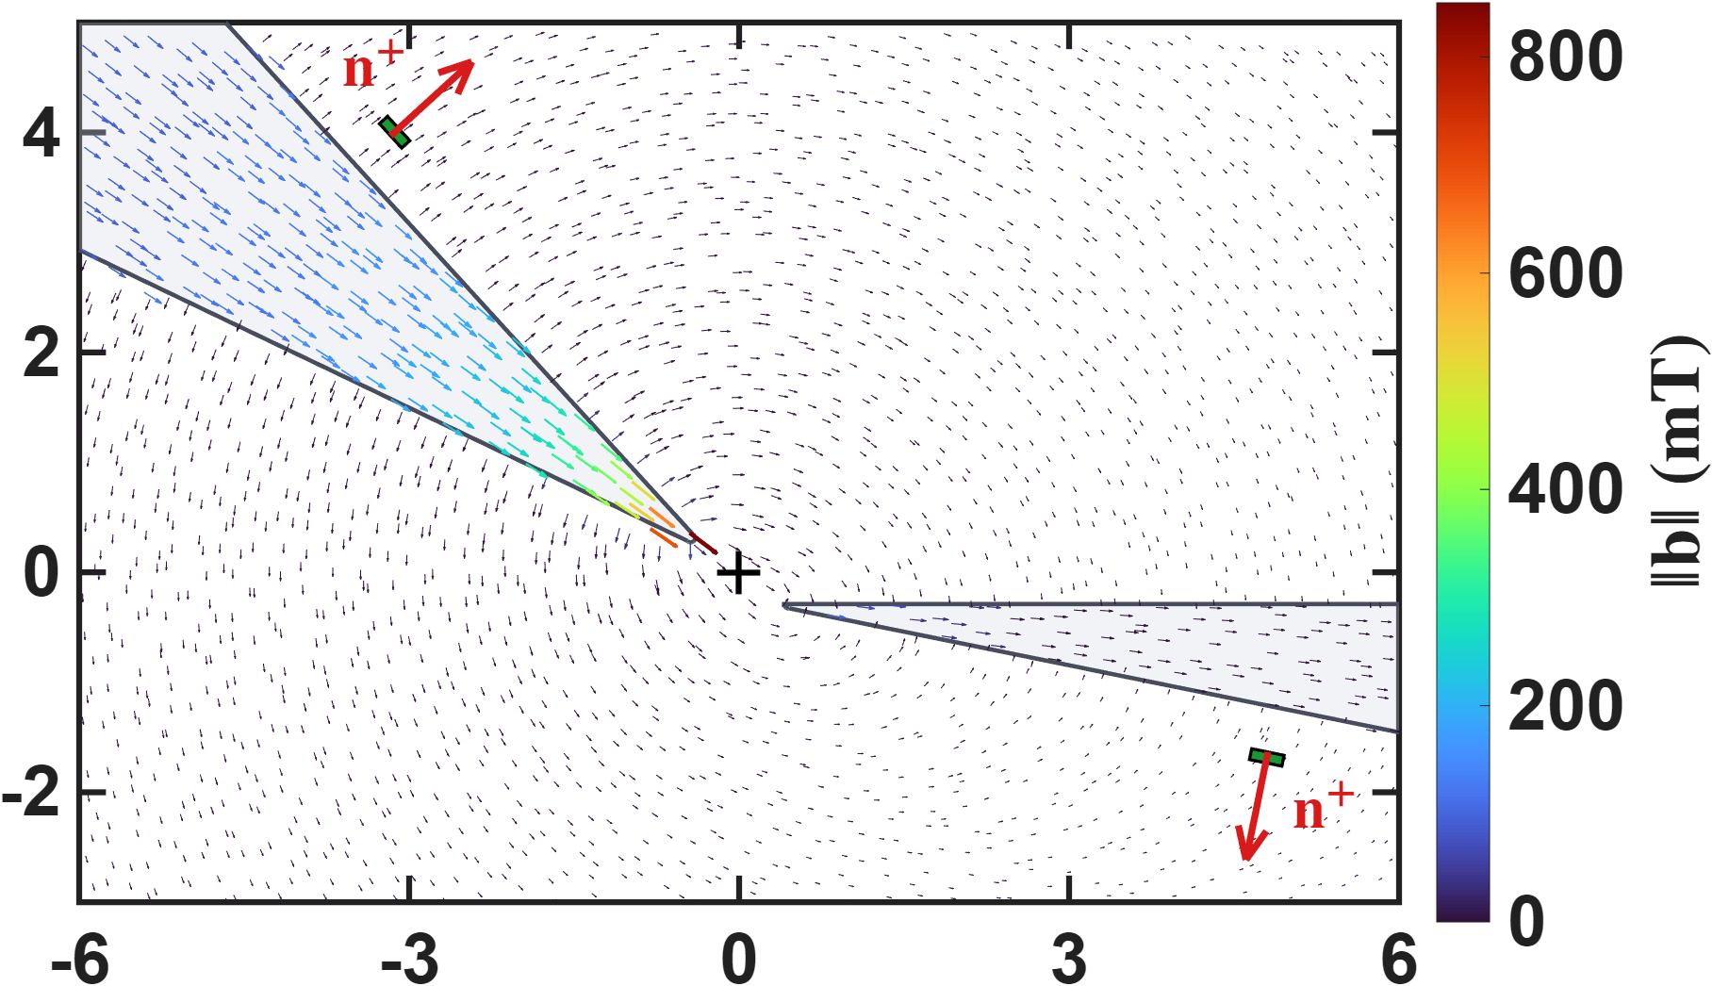



Hall-sensor-voltage-based lumped-parameter modeling and calibration
This figure conveys the sensing concept: the Hall sensor measures the pole's leakage flux. The colour-coded arrows show the flux channelled inside the cone toward the tip, while the dashed arrows around the pole are the part that escapes through the lateral surface and returns through the air. The sensor (green patch) is mounted on that surface, so it sits in the leakage field rather than in the field between the tips, and the red arrow n⁺ marks the positive sense of what it reads (b·n⁺).
$$z−axis(mm)$$
$$\left\|b\right\|(mT)$$
$$x−axis(mm)$$

Slide 12
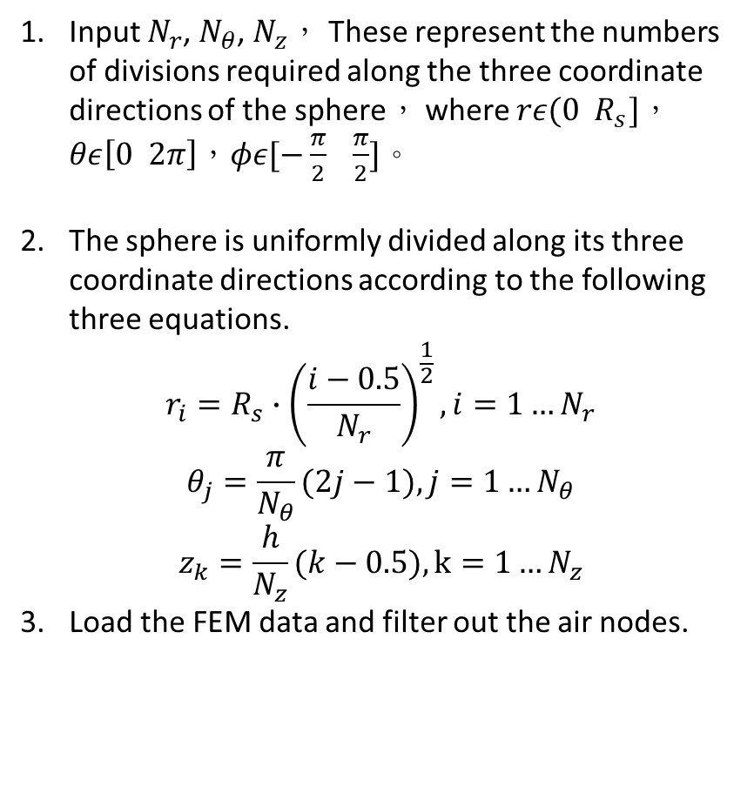
Hall-sensor-voltage-based lumped-parameter modeling and calibration
Interpolation Point Algorithm for sensor area
Input $N_{r}$, $N_{θ}$, $N_{z}$， These represent the numbers of divisions required along the three coordinate directions of the sphere， where $rε(0 R_{s}]$，$θε\left[0 2π\right]$，$φε[−\frac{π}{2} \frac{π}{2}]$。
The sphere is uniformly divided along its three coordinate directions according to the following three equations.
$$r_{i}=R_{s}∙{\left(\frac{i−0.5}{N_{r}}\right)}^{\frac{1}{2}},i=1…N_{r}$$
$$θ_{j}=\frac{π}{N_{θ}}(2j−1),j=1…N_{θ}$$
$$z_{k}=\frac{h}{N_{z}}(k−0.5),k=1…N_{z}$$
Load the FEM data and filter out the air nodes.
Localization: Determine which tetrahedron contains each query point and return its coordinates relative to the four vertices.
Barycentric Interpolation:
Let the coordinates of the four vertices be:$P_{1},P_{2},P_{3},P_{4}$
Let the coordinates of the interpolation point be:$P$
$$P=\sum_{i=1}^{4}{λ_{i}P_{i}}$$
Where $λ_{i}=\frac{V_{i}}{V_{total}}$(The volume of the sub-tetrahedron formed by replacing vertex $P_{i}$ with $P$)
Repeat Steps 4 and 5 until all interpolation points have been processed.

Slide 13
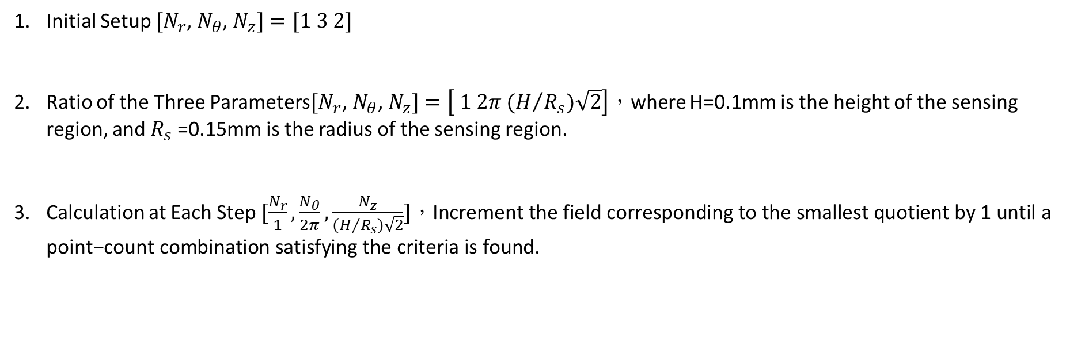
Hall-sensor-voltage-based lumped-parameter modeling and calibration
Interpolation Point Algorithm for sensor
Initial Setup $[N_{r}$, $N_{θ}$, $N_{z}]=[1 3 2]$
Ratio of the Three Parameters$[N_{r}\text{, }N_{θ}\text{, }N_{z}]=\left[ 1 2π (H/{R_{s})\sqrt{2}}\right]$，where H=0.1mm is the height of the sensing region, and $R_{s}$=0.15mm is the radius of the sensing region.
Calculation at Each Step $[\frac{N_{r}}{1},\frac{N_{θ}}{2π},\frac{N_{z}}{(H/{R_{s})\sqrt{2}}}]，\text{Increment} \text{the} \text{field} \text{corresponding} \text{to} \text{the} \text{smallest} \text{quotient} \text{by}\text{ 1 }\text{until} \text{a} \text{point}\text{−}\text{count} \text{combination} \text{satisfying} \text{the} \text{criteria} \text{is} \text{found}\text{.}$
A checkpoint is considered a convergence point if the rates of change of the subsequent ten points relative to their respective preceding points are all less than 0.5%.

Slide 14
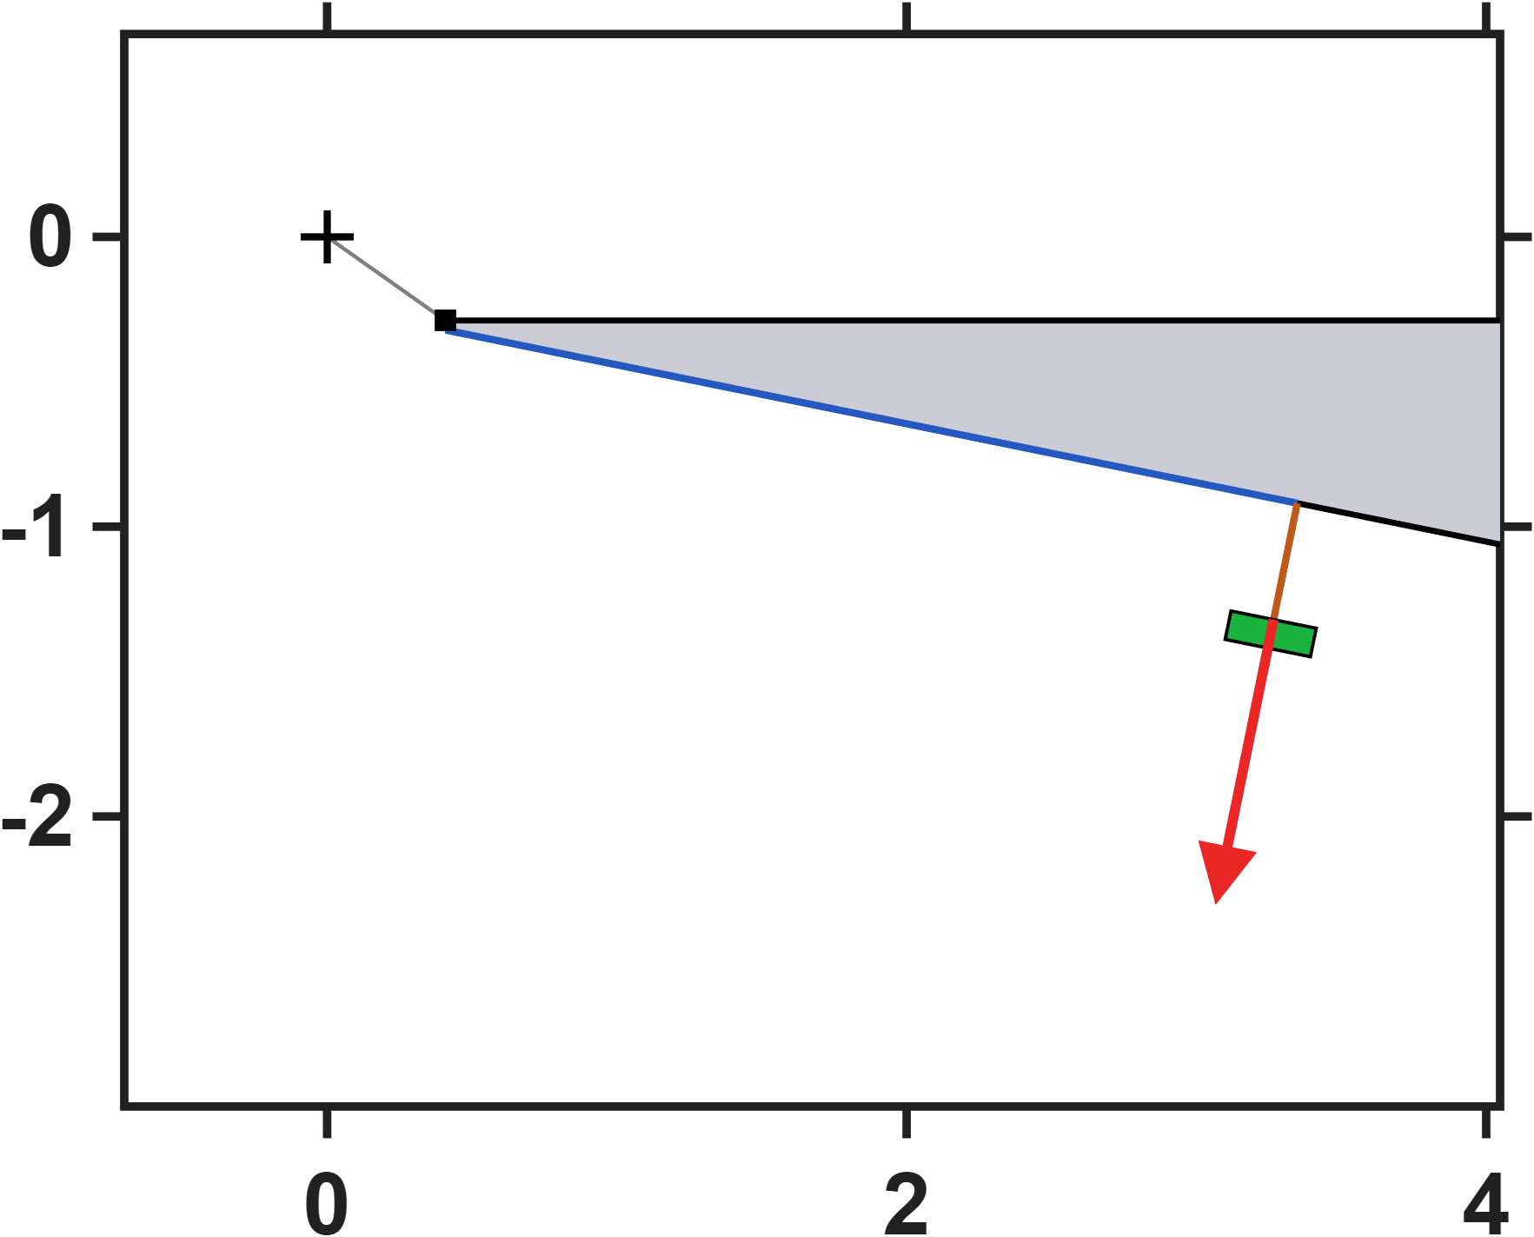
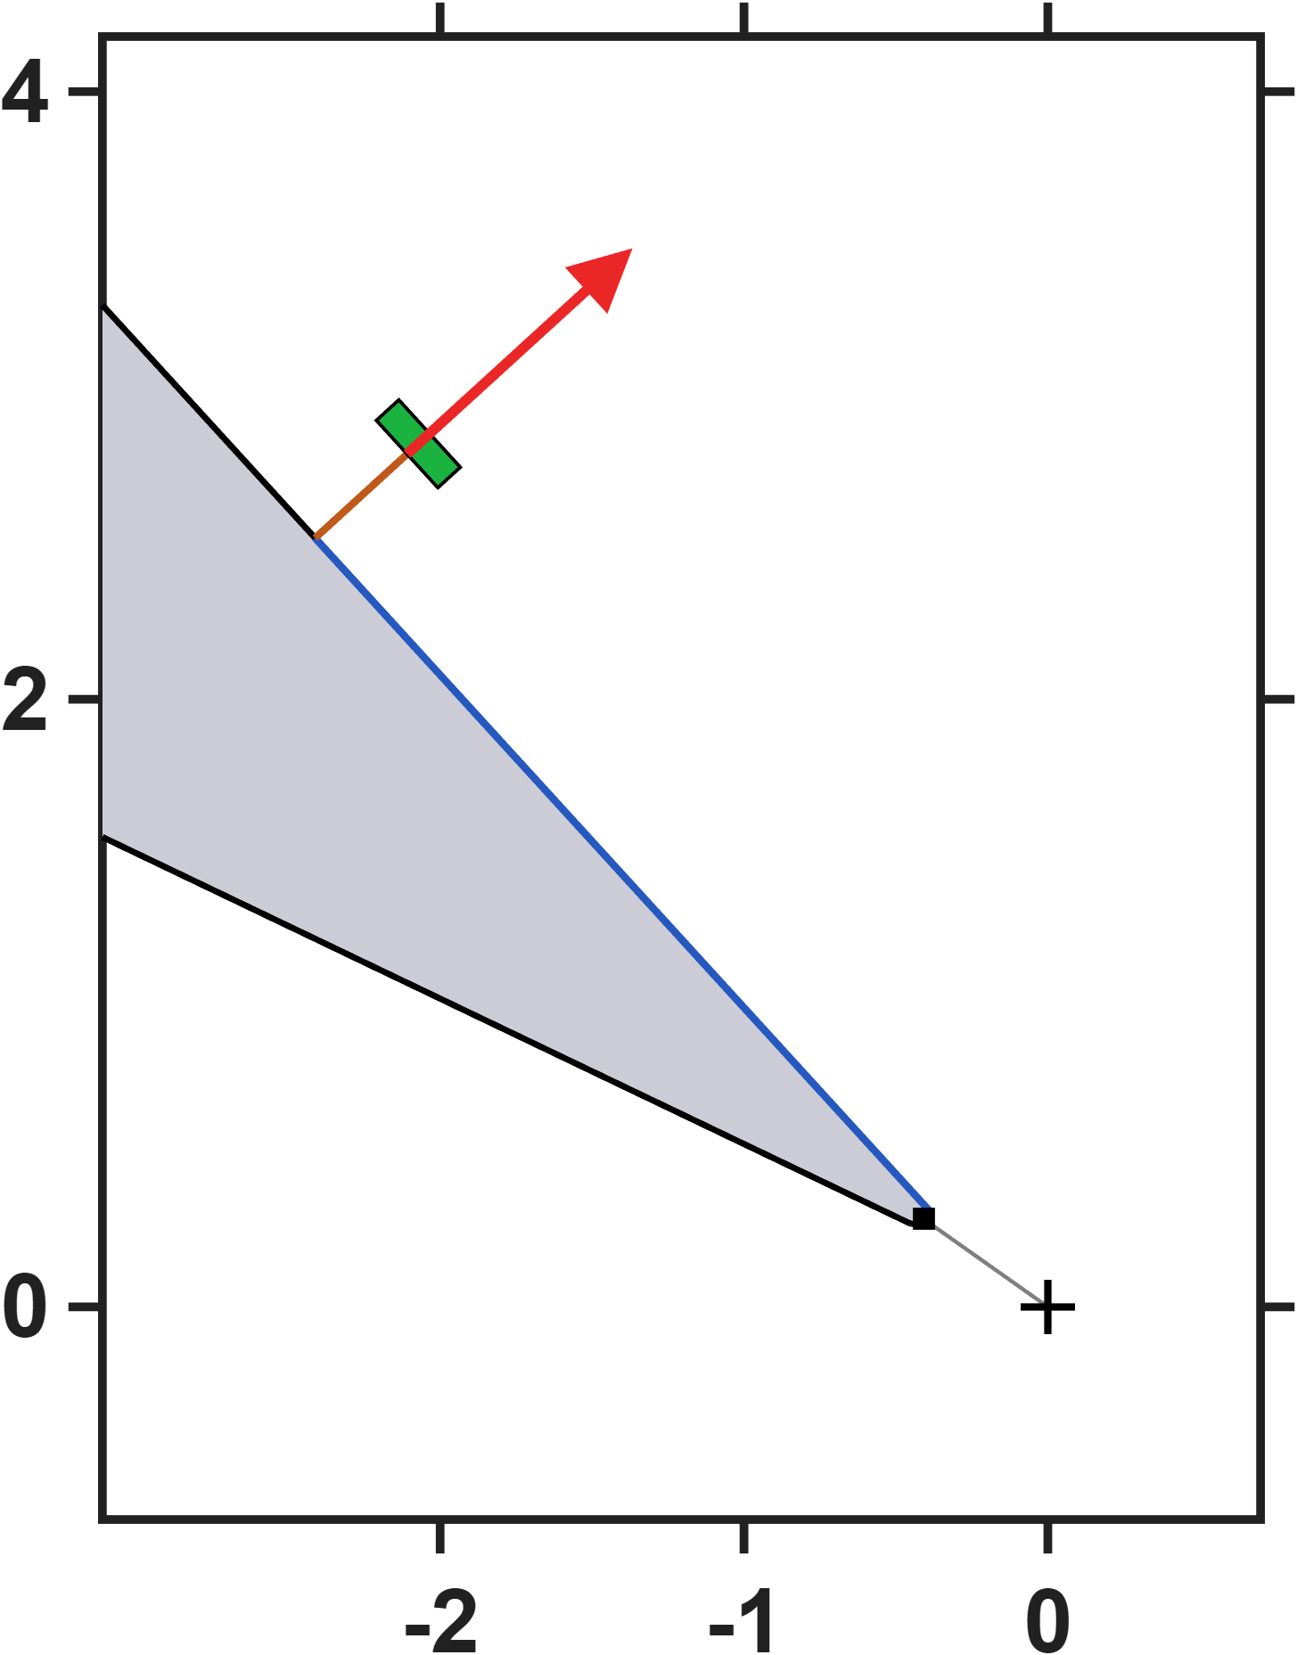



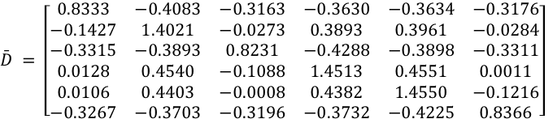


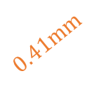



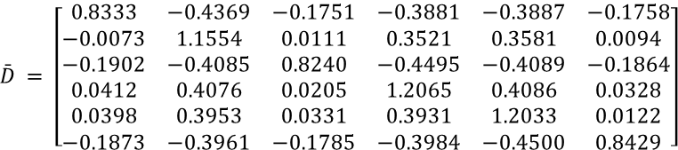
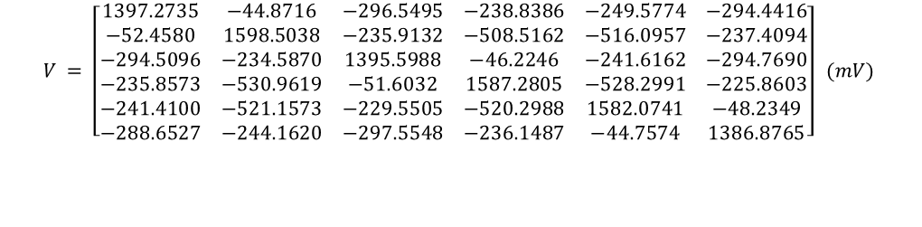



Hall-sensor-voltage-based lumped-parameter modeling and calibration
$$Calibrate model→b_{ij}=S_{i}{}_{}^{B}{{\hat{g}}_{V}}\overline{D}V_{j}$$
Single parameter
$$\bar{D} = \left[\begin{matrix}0.8333 & −0.4091 & −0.3164 & −0.3630 & −0.3643 & −0.3180 \\ −0.1435 & 1.4020 & −0.0278 & 0.3880 & 0.3952 & −0.0290 \\ −0.3316 & −0.3895 & 0.8224 & −0.4285 & −0.3899 & −0.3315 \\ 0.0136 & 0.4566 & −0.1075 & 1.4521 & 0.4570 & 0.0024 \\ 0.0122 & 0.4436 & 0.0012 & 0.4406 & 1.4588 & −0.1197 \\ −0.3275 & −0.3723 & −0.3205 & −0.3744 & −0.4241 & 0.8360\end{matrix}\right]$$
$$NMAE=\frac{\sum_{j}{\sum_{i}{\left\|b_{ij}−S_{i}{}_{}^{B}{{\hat{g}}_{V}}\overline{D}V_{j}\right\|}}}{\sum_{j}{\sum_{i}{\left\|b_{ij}\right\|}}}∙100\%=2.85\%$$
$$z−axis(mm)$$
$$3mm$$
$$0.41mm$$
$$\hat{ℓ} = 875.1 μm {}_{}^{B}{{\hat{g}}_{V}} = 5.0964×{10}^{−3} mT/mV$$
Eighteen parameters
$$\bar{D} = \left[\begin{matrix}0.8333 & −0.4379 & −0.1755 & −0.3883 & −0.3898 & −0.1761 \\ −0.0079 & 1.1555 & 0.0106 & 0.3511 & 0.3574 & 0.0090 \\ −0.1904 & −0.4090 & 0.8233 & −0.4494 & −0.4093 & −0.1868 \\ 0.0418 & 0.4099 & 0.0215 & 1.2072 & 0.4102 & 0.0339 \\ 0.0411 & 0.3980 & 0.0345 & 0.3950 & 1.2064 & 0.0138 \\ −0.1882 & −0.3982 & −0.1795 & −0.3997 & −0.4518 & 0.8425\end{matrix}\right]$$
$$NMAE=\frac{\sum_{j}{\sum_{i}{\left\|b_{ij}−S_{i}{}_{}^{B}{{\hat{g}}_{V}}\overline{D}V_{j}\right\|}}}{\sum_{j}{\sum_{i}{\left\|b_{ij}\right\|}}}∙100\%=0.26\%$$
$$x−axis(mm)$$
$$\hat{e}= \left[\begin{matrix}0.0185 & 0.0203 & −0.1173 & 0.0024 & 0.0018 & −0.1186 \\ −0.1183 & 0.0026 & 0.0168 & 0.0163 & 0.0019 & −0.1185 \\ 0.1182 & −0.0029 & 0.1166 & −0.0029 & −0.0186 & −0.0199\end{matrix}\right]$$
$$0.41mm$$
$$z−axis(mm)$$
$$\hat{ℓ} = 873.0 μm {}_{}^{B}{{\hat{g}}_{V}} = 6.0657×{10}^{−3} mT/mV$$
$$3mm$$
$$V = \left[\begin{matrix}1397.5153 & −44.8949 & −296.4434 & −239.1196 & −249.0026 & −294.9264 \\ −52.3899 & 1598.4115 & −236.0011 & −508.1098 & −515.4042 & −237.3949 \\ −294.5246 & −235.2099 & 1397.1511 & −46.2959 & −241.8620 & −295.1847 \\ −235.7501 & −532.4126 & −51.6440 & 1588.6363 & −528.6298 & −226.1507 \\ −241.2077 & −521.3975 & −229.4493 & −520.3586 & 1580.8644 & −48.3108 \\ −288.5384 & −243.6843 & −297.2197 & −235.9084 & −44.7064 & 1386.2112\end{matrix}\right] (mV)$$
$$x−axis(mm)$$
Number of Interpolation Points:180(six sensor)

Slide 15
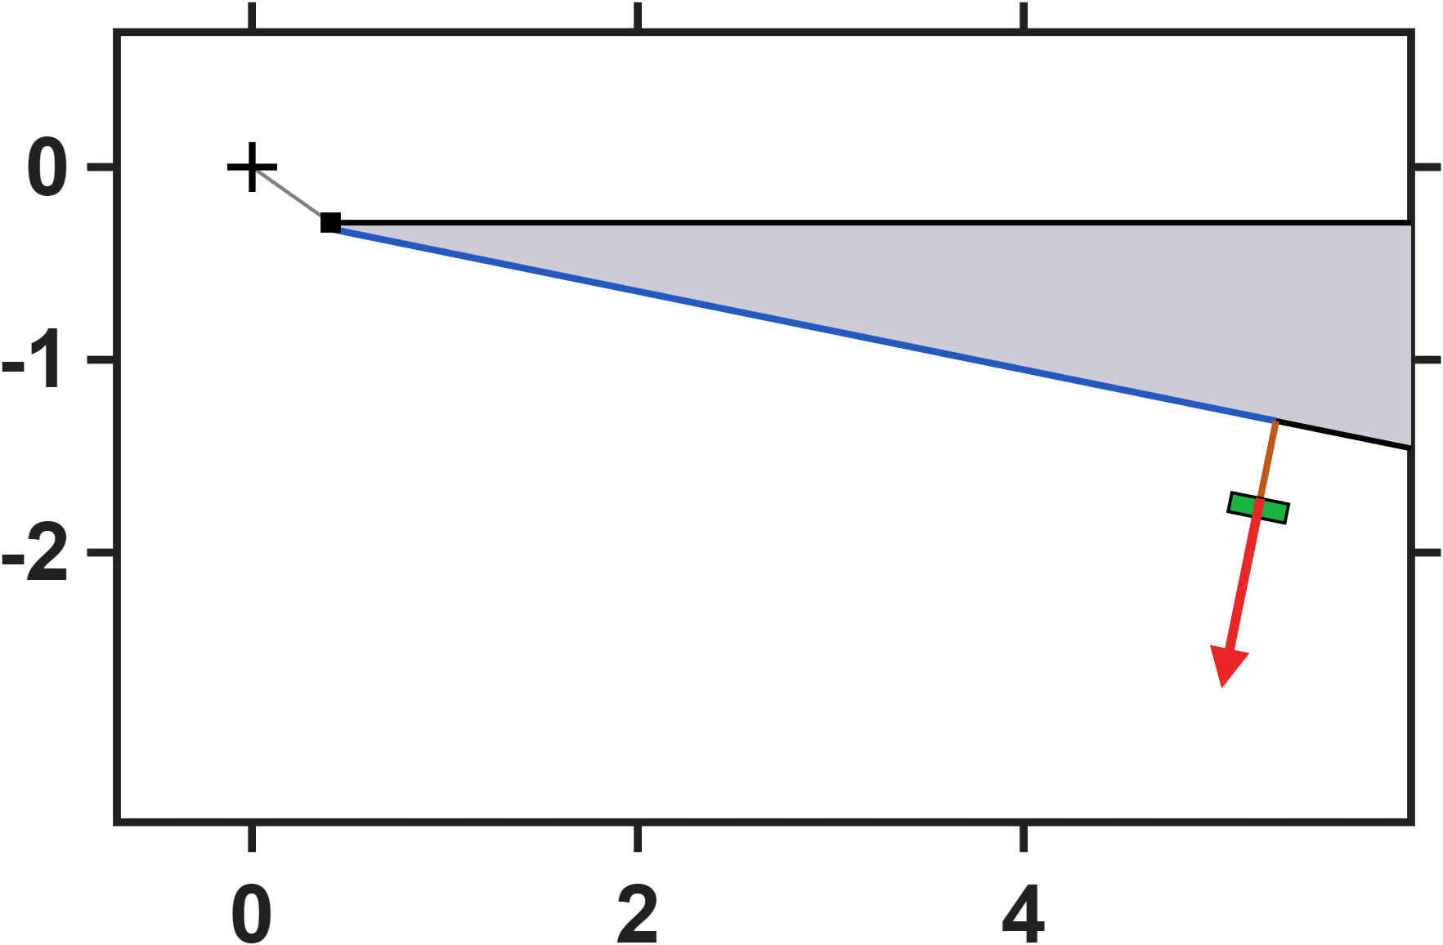
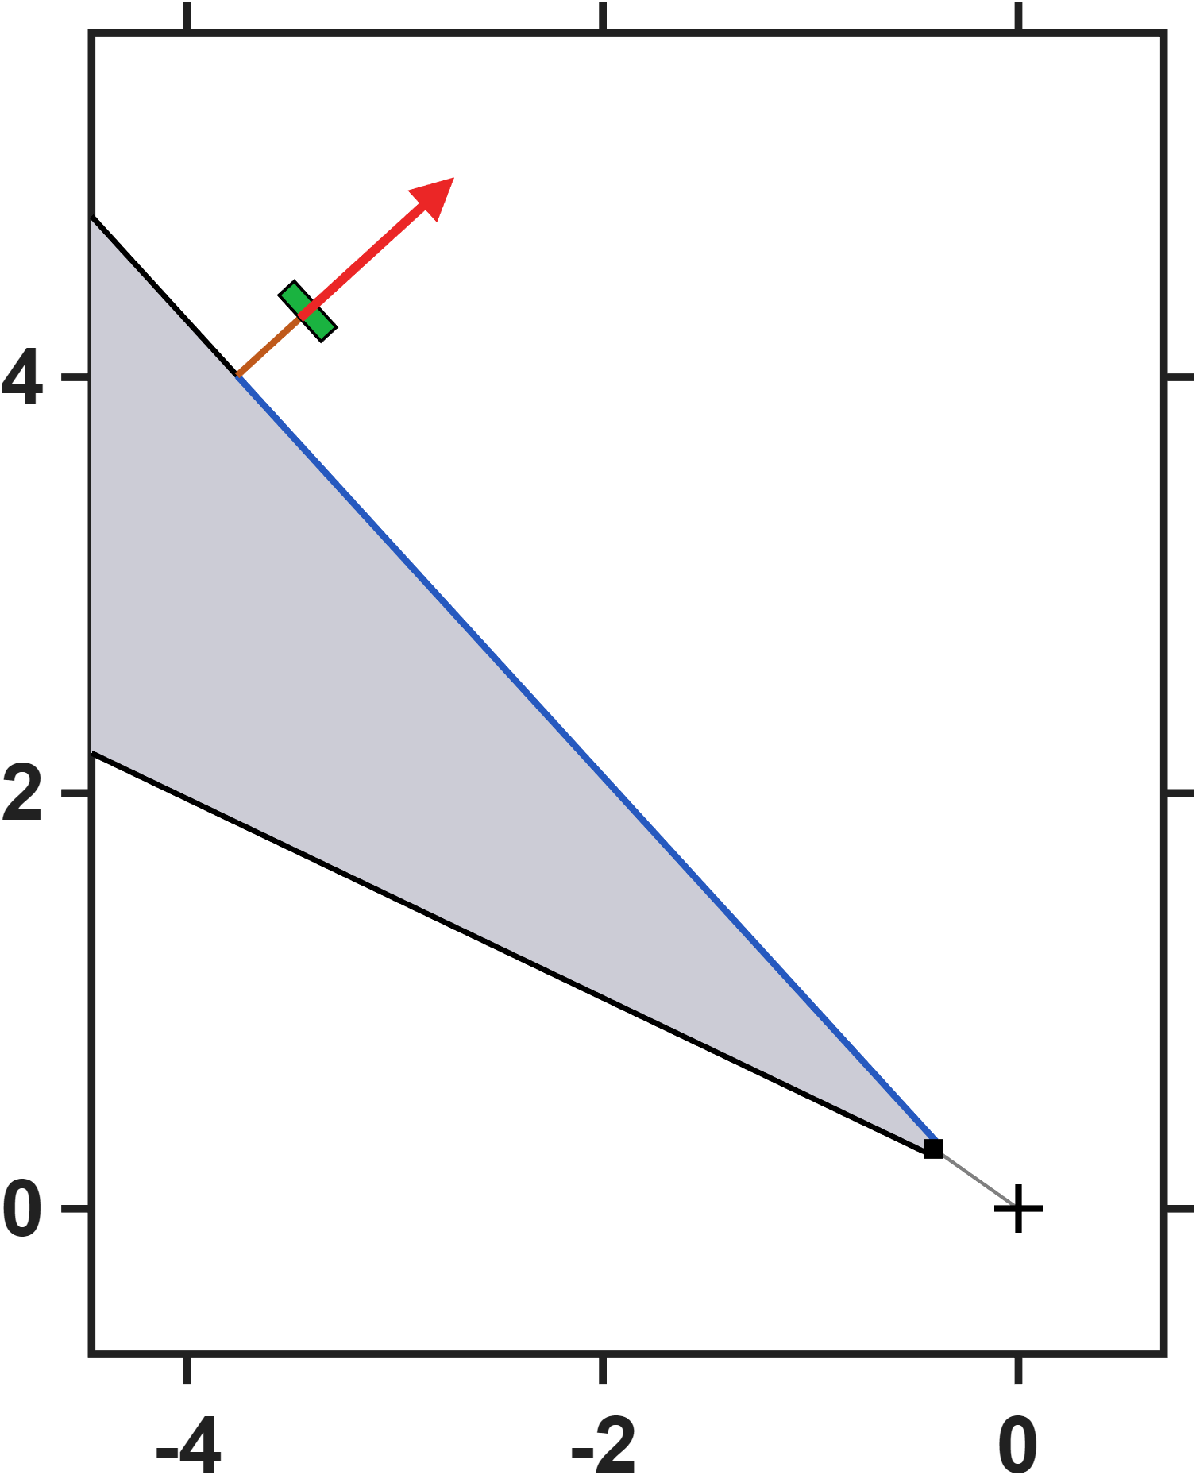


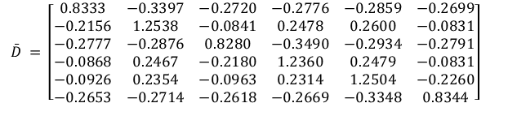


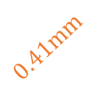
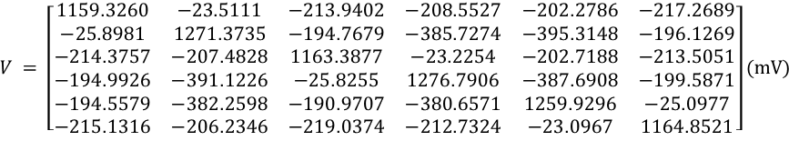


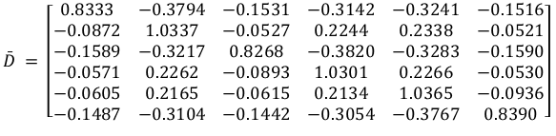




Hall-sensor-voltage-based lumped-parameter modeling and calibration
$$Calibrate model→b_{ij}=S_{i}{}_{}^{B}{{\hat{g}}_{V}}\overline{D}V_{j}$$
Single parameter
$$\bar{D} = \left[\begin{matrix}0.8333 & −0.3405 & −0.2722 & −0.2776 & −0.2864 & −0.2702 \\ −0.2154 & 1.2558 & −0.0837 & 0.2482 & 0.2607 & −0.0826 \\ −0.2775 & −0.2878 & 0.8279 & −0.3486 & −0.2934 & −0.2794 \\ −0.0873 & 0.2468 & −0.2180 & 1.2346 & 0.2477 & −0.0829 \\ −0.0922 & 0.2368 & −0.0955 & 0.2320 & 1.2519 & −0.2255 \\ −0.2655 & −0.2723 & −0.2622 & −0.2671 & −0.3353 & 0.8344\end{matrix}\right]$$
$$NMAE=\frac{\sum_{j}{\sum_{i}{\left\|b_{ij}−S_{i}{}_{}^{B}{{\hat{g}}_{V}}\overline{D}V_{j}\right\|}}}{\sum_{j}{\sum_{i}{\left\|b_{ij}\right\|}}}∙100\%=2.85\%$$
$$z−axis(mm)$$
$$5mm$$
$$0.41mm$$
$$\hat{ℓ} = 875.1 μm {}_{}^{B}{{\hat{g}}_{V}} = 6.5513×{10}^{−3} mT/mV$$
Eighteen parameters
$$x−axis(mm)$$
$$\bar{D} = \left[\begin{matrix}0.8333 & −0.3802 & −0.1534 & −0.3142 & −0.3247 & −0.1519 \\ −0.0870 & 1.0354 & −0.0524 & 0.2247 & 0.2344 & −0.0516 \\ −0.1588 & −0.3220 & 0.8266 & −0.3816 & −0.3284 & −0.1591 \\ −0.0575 & 0.2264 & −0.0893 & 1.0290 & 0.2265 & −0.0527 \\ −0.0602 & 0.2176 & −0.0609 & 0.2139 & 1.0378 & −0.0931 \\ −0.1489 & −0.3113 & −0.1447 & −0.3055 & −0.3773 & 0.8390\end{matrix}\right]$$
$$NMAE=\frac{\sum_{j}{\sum_{i}{\left\|b_{ij}−S_{i}{}_{}^{B}{{\hat{g}}_{V}}\overline{D}V_{j}\right\|}}}{\sum_{j}{\sum_{i}{\left\|b_{ij}\right\|}}}∙100\%=0.26\%$$
$$0.41mm$$
$$\hat{e}= \left[\begin{matrix}0.0185 & 0.0203 & −0.1173 & 0.0024 & 0.0018 & −0.1186 \\ −0.1183 & 0.0026 & 0.0168 & 0.0163 & 0.0019 & −0.1185 \\ 0.1182 & −0.0029 & 0.1166 & −0.0029 & −0.0186 & −0.0199\end{matrix}\right]$$
$$\hat{ℓ} = 873.0 μm {}_{}^{B}{{\hat{g}}_{V}} = 7.6756×{10}^{−3} mT/mV$$
$$5mm$$
$$V = \left[\begin{matrix}1159.5668 & −23.5248 & −213.7308 & −208.7612 & −202.0178 & −217.6552 \\ −25.8751 & 1270.3779 & −194.5319 & −385.6372 & −395.0217 & −196.1640 \\ −214.4977 & −207.8367 & 1164.1663 & −23.2533 & −202.7730 & −213.7765 \\ −194.8479 & −391.6311 & −25.8715 & 1278.5043 & −387.9531 & −200.2446 \\ −194.4885 & −382.5715 & −191.0582 & −380.5290 & 1259.5404 & −25.1148 \\ −215.1006 & −206.1265 & −218.6404 & −212.7699 & −23.0765 & 1164.4823\end{matrix}\right](mV)$$
$$z−axis(mm)$$
Moving the sensors further out along the pole flank leaves the field model completely untouched: the effective length, the charge-offset matrix and the fit error are identical to the closer mounting — and identical to the current-based results as well, since both reduce to the same transfer matrix. Only the voltage scale changes: further from the tip the leakage field is weaker, so the measured voltages drop and the voltage gain rises to compensate. This is structural rather than coincidental — the field model is fitted from the workspace field alone, and the sensor geometry enters only afterwards, when the excitation is re-expressed in volts. The predictive accuracy of the model is therefore independent of where the sensor is mounted, and the mounting position becomes a free design choice, bounded in practice only by keeping the sensor voltage within its linear range.
$$x−axis(mm)$$

Slide 16
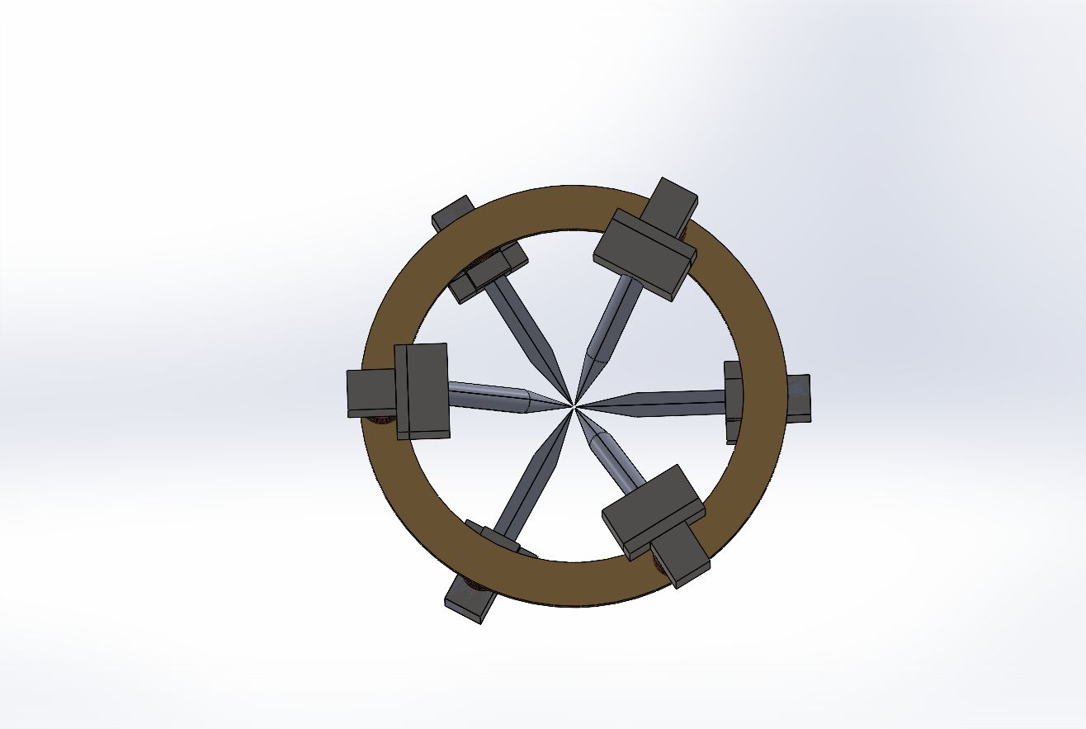
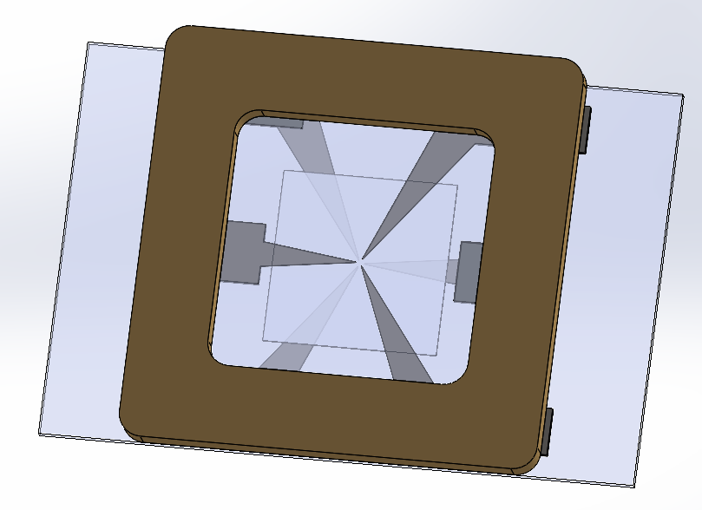
Quantitative Assessment of Multi-Pole Actuators
Setup: The assessment that follows compares two six-pole actuator designs, Design 1 on a circular yoke and Design 2 on a planar square frame. Both are described by the same lumped-parameter model and use the pole numbering P1-P6 shown here.
Sharing the model form and the pole numbering, the two differ only in geometry, so their calibrated parameters can be compared directly in the following slides.
DesignA
DesignB
P3
P3
P5
P2
P5
P2
P1
P6
P1
P6
P4
P4

Slide 17
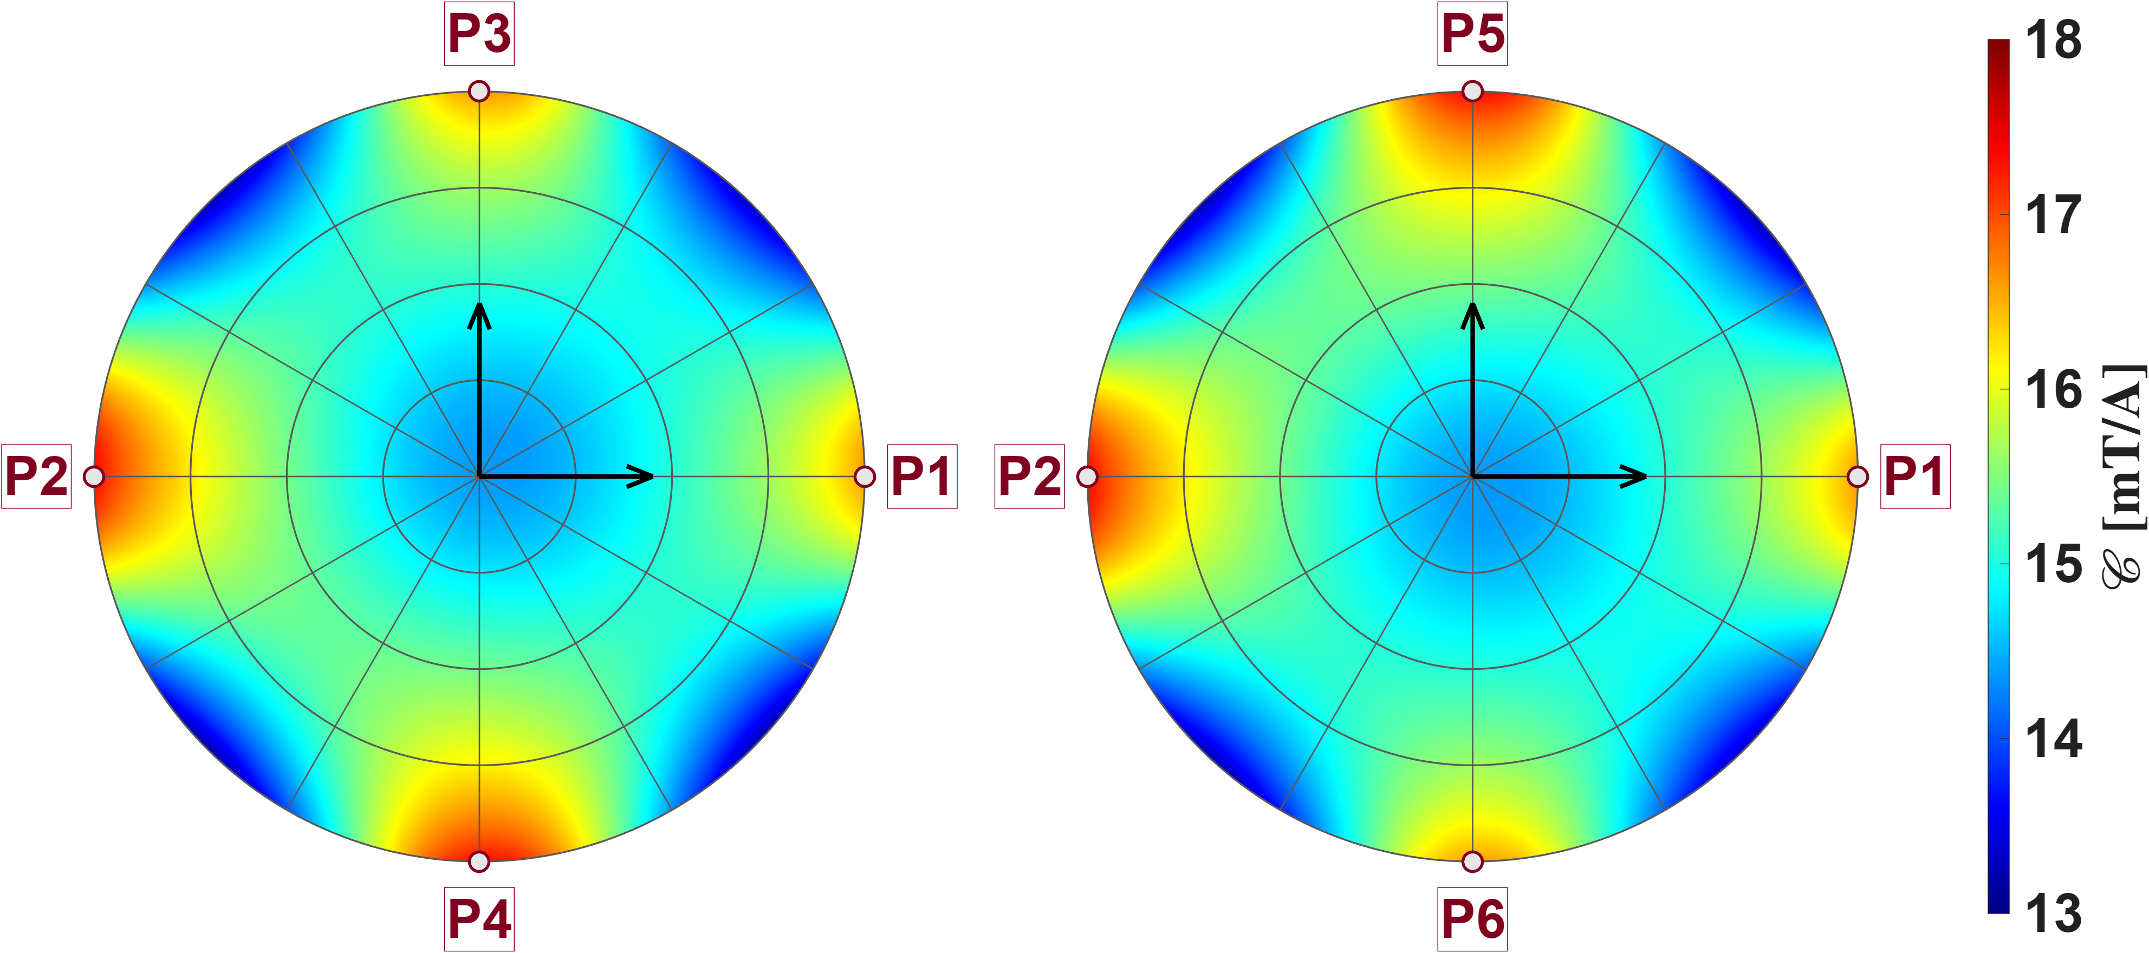
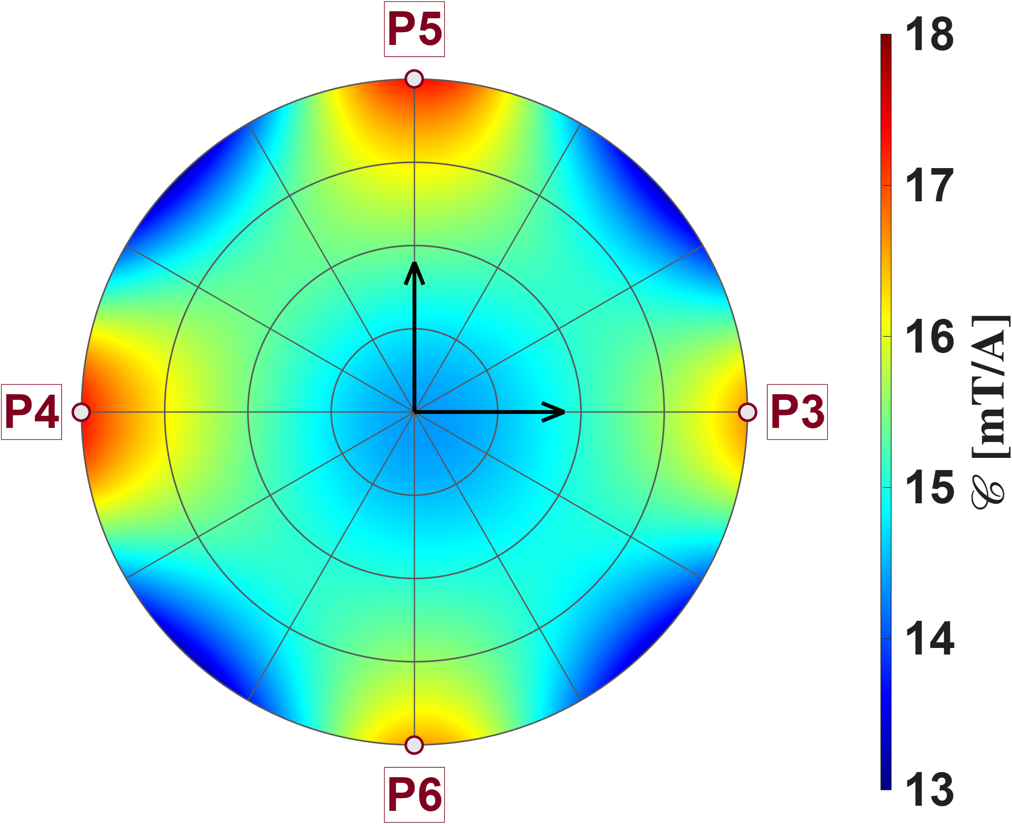

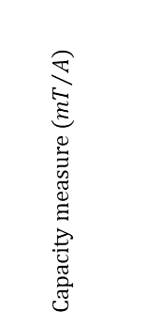
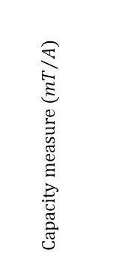





Quantitative Assessment of Multi-Pole Actuators
DesignA
P3
P5
The three reference planes are mutually orthogonal and all pass through the origin; the inset shows how they sit inside the pole-tip sphere, each disc extending out to that sphere. On every plane the calibrated model is evaluated point by point and the capacity measure is mapped in polar form, with the two pole pairs lying in that plane marked on the rim. The pattern is the same everywhere: the capacity is lowest at the center, grows steadily outwards, and reaches its maxima in four lobes pointing at the in-plane poles, with troughs between them. This is the gain signature of Design A: the gain is not uniform over the workspace but is smallest at the center and largest along the pole axes near the tips, and its variation with direction follows the pole layout directly. Because the three maps are indistinguishable, the gain field carries the full symmetry of the six-pole arrangement — six poles of equal strength, arranged as three opposing pairs whose axes are mutually perpendicular. The consequence is that the gain is limited not by any particular plane or direction, but by radial position: the lowest gain of the whole workspace sits at its center.
$$y_{a}$$
$$z_{a}$$
P2
P2
$$Capacity measure ({mT}/A)$$
$$x_{a}$$
P1
$$x_{a}$$
P1
P4
P6
P5
$$z_{a}$$
P4
$$Capacity measure ({mT}/A)$$
$$y_{a}$$
P3
P6

Slide 18
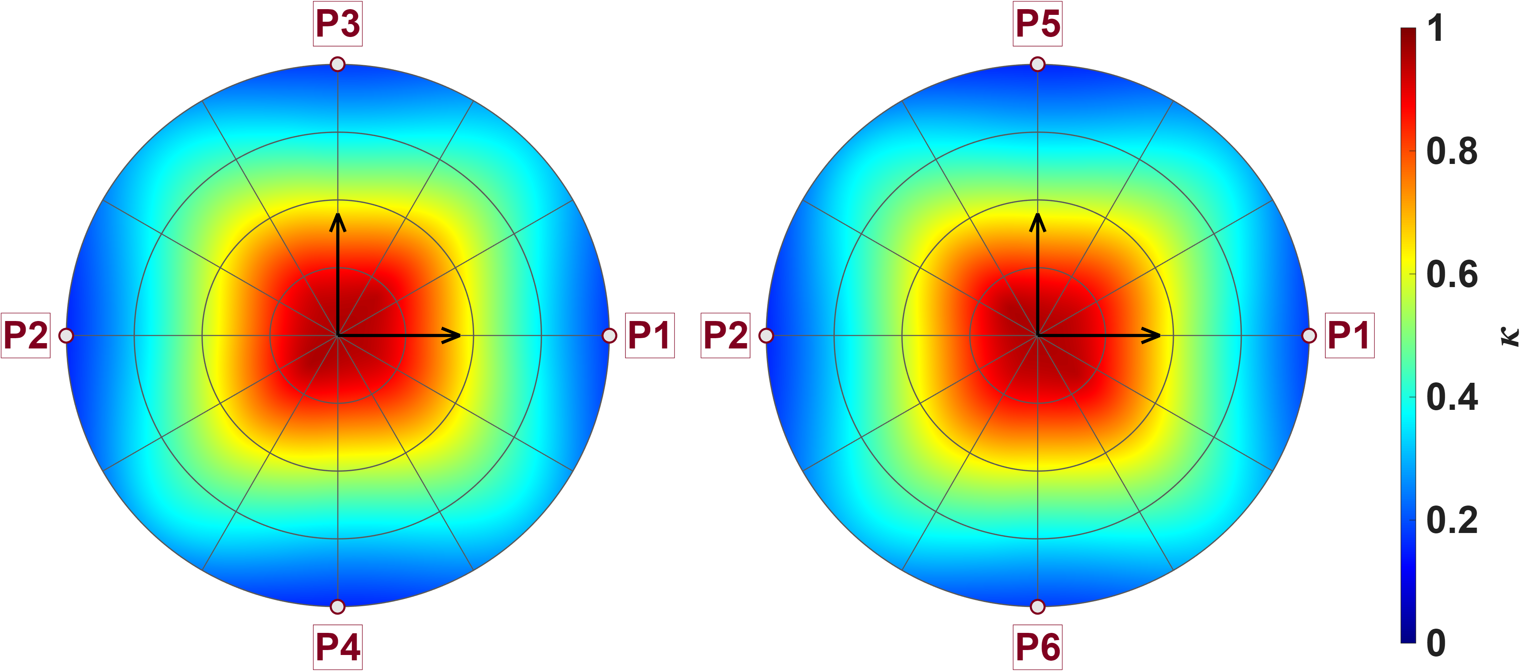
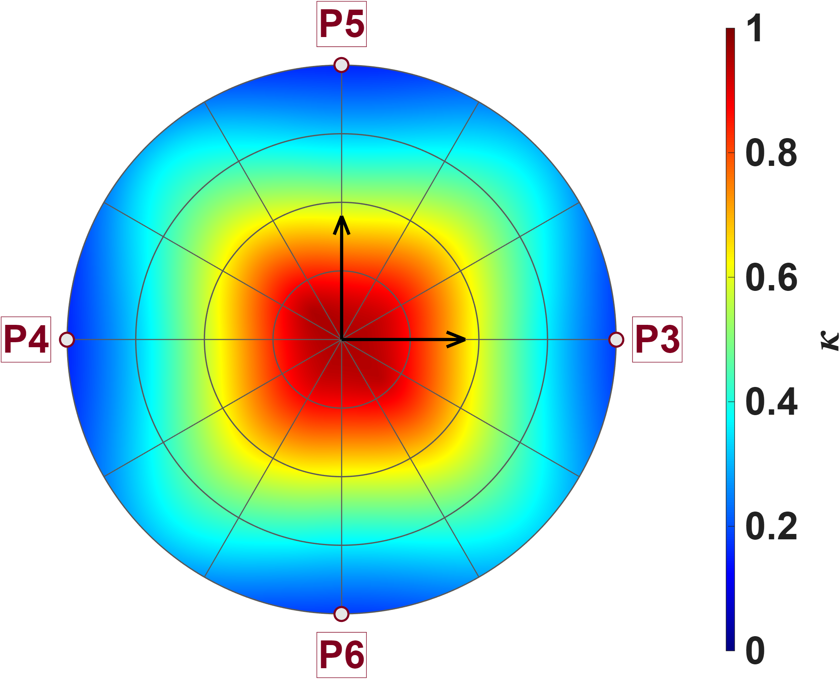



Quantitative Assessment of Multi-Pole Actuators
DesignA
P3
P5
Same three planes and the same calibrated model as before, but now mapping the isotropy. The picture is the exact complement of the capacity map: isotropy is highest at the centre and decays outwards in an almost circular pattern, reaching its lowest values at the rim. The reason is geometric — at the centre all six poles are equidistant, so the three singular values are nearly equal and the system can push with almost the same strength in any direction; moving outwards means approaching one pole pair while receding from the other two, so one singular value grows while the others shrink and the ratio collapses. Again the three planes are indistinguishable, confirming that the isotropy inherits the symmetry of the pole layout.
$$y_{a}$$
$$z_{a}$$
P2
P2
$$Isotropy$$
$$x_{a}$$
P1
$$x_{a}$$
P1
P4
P6
P5
$$z_{a}$$
P4
$$Isotropy$$
$$y_{a}$$
P3
P6

Slide 19
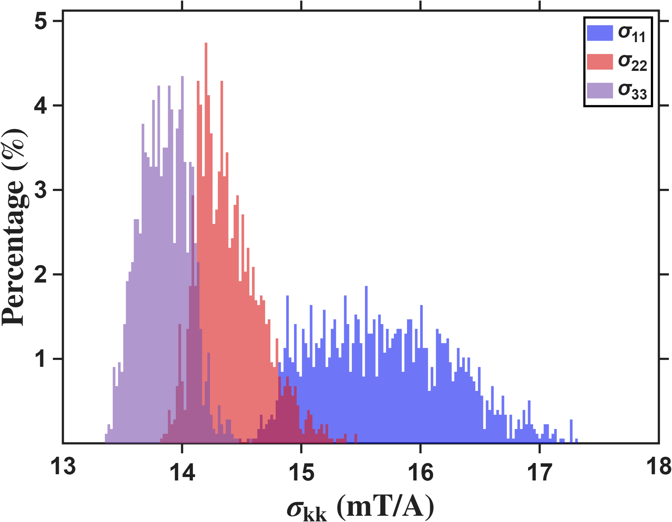
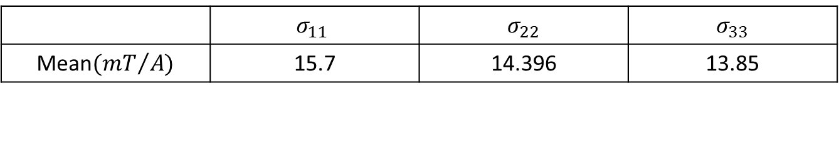

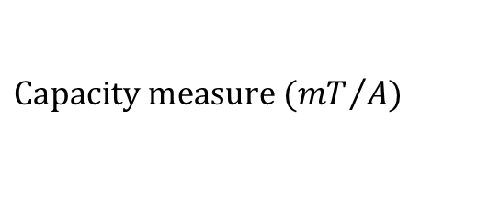
Quantitative Assessment of Multi-Pole Actuators
DesignA
The three distributions separate clearly, and the separation is asymmetric: the largest singular value is roughly twice the other two and spreads over a wide range with a long tail towards high values, while the second and third are narrow and overlap heavily. Over most of its workspace Design A therefore has one dominant direction and two comparable, weaker ones, rather than three directions of similar strength; the isotropy deficit seen on the previous slide is driven mainly by the strong axis pulling away, not by the weakest axis collapsing. The long tail belongs to the points closest to the pole tips — the same points that form the four red lobes of the capacity map on slide 14.
Both histograms have the same resolution (22.04uT/A).
$$Percentage count(\%)$$
$$Capacity measure ({mT}/A)$$
 | $$σ_{11}$$ | $$σ_{22}$$ | $$σ_{33}$$
Mean$({mT}/{A)}$ | 15.7 | 14.396 | 13.85

Slide 20


Quantitative Assessment of Multi-Pole Actuators
DesignB
Zhi-Peng delivers 2.71× the actuation strength of Long Fei (39.58 vs 14.62 mT/A). Both share the same pattern: weakest at the centre, strengthening toward the pole tips, and almost constant with direction within the calibration radius，the planar hexapole wins outright on strength, and it is a pure gain improvement — the field shape is not degraded, and the advantage holds uniformly across the workspace.

Slide 21


Quantitative Assessment of Multi-Pole Actuators
DesignB
Zhi-Peng reaches only 0.62× the isotropy of Long Fei (0.544 vs 0.884). Long Fei's high-κ region is concentric about the origin, whereas Zhi-Peng's is offset, split into two diagonal lobes, and decays faster with radius. the gain is bought at the cost of isotropy. More importantly, Zhi-Peng's best-isotropy point is not the origin — Long Fei gives the most balanced three-axis control simply by staying at the centre, whereas Zhi-Peng offers no such sweet spot.

Slide 22




Quantitative Assessment of Multi-Pole Actuators
DesignB
The three singular values are σ₁ = 50.25, σ₂ = 45.39 and σ₃ = 27.26 mT/A. σ₁ and σ₂ differ by only 10.7 %, whereas σ₃ falls 40 % below σ₂ (σ₁/σ₃ = 1.84). All three distributions are tight，the controllable set is an oblate ellipsoid — two strong axes and one weak — not a sphere. The weakest third axis is the bottleneck of the whole actuator, since it sets the force available in the worst direction.
$$Percentage count(\%)$$
$$Capacity measure ({mT}/A)$$
Both histograms have the same resolution (184uT/A).
 | $$σ_{11}$$ | $$σ_{22}$$ | $$σ_{33}$$
Mean$({mT}/{A)}$ | 50.253 | 45.386 | 27.257

Slide 23







Quantitative Assessment of Multi-Pole Actuators
Compare DesignA&B
The two designs are completely disjoint in both metrics. In gain, Design B reaches 2.71× Design A (39.58 vs 14.62 mT/A); in isotropy, only 0.62× (Isotropy = 0.544 vs 0.884). Design A is also the tighter of the two (CV = 0.93 % vs 1.66 % for Capacity, 4.67 % vs 8.02 % for isotropy). Each design sits at one end of a direct trade-off between strength and isotropy — neither is uniformly better. Design B suits applications demanding large force output, Design A those needing balanced three-axis control.
$R≤150um$
Capacity mean:A=$14.6246{mT}/A,B=39.5813{mT}/A$
Iso mean :A=$0.8836,B=0.5439$
$$Percentage count(\%)$$
$$Percentage count(\%)$$
$$Isotropy$$
$$Capacity measure ({mT}/A)$$
This figure resolution is 0.05mT/A
This figure resolution is 0.01

Slide 24







Reference
$Workspace radius=\hat{ℓ}$
$Flux distribution matrix={\overline{K}}_{I}$
$Current to field gain={}_{}^{B}{{\hat{g}}_{I}}$
$Voltage to field gain={}_{}^{B}{{\hat{g}}_{V}}$
$Residual error=\sqrt{\frac{minJ}{N}}$
$Capacity measure=𝒞 ({mT}/A)$
$Isotropy=κ$
$Average field=\frac{\sum_{j}{\sum_{i}{\left\|b_{ij}\right\|}}}{6×N_{p}}$

Slide 25









Reference
$Zhi peng calibrate result(no gap)$
$Single(24 points)$
$Eighteen$(10 points)
$${\bar{K}}_{I} = \left[\begin{matrix}0.8333 & −0.0795 & −0.2410 & −0.1255 & −0.1259 & −0.2382 \\ −0.0824 & 0.8293 & −0.1307 & −0.2399 & −0.2404 & −0.1280 \\ −0.2795 & −0.1247 & 0.7473 & −0.0646 & −0.0888 & −0.2562 \\ −0.1283 & −0.2802 & −0.0699 & 0.7452 & −0.2586 & −0.0914 \\ −0.1281 & −0.2802 & −0.0941 & −0.2580 & 0.7437 & −0.0668 \\ −0.2794 & −0.1248 & −0.2591 & −0.0883 & −0.0654 & 0.7507\end{matrix}\right]$$
$${\bar{K}}_{I} = \left[\begin{matrix}0.8333 & −0.1061 & −0.1152 & −0.1882 & −0.1888 & −0.1149 \\ −0.1119 & 0.8320 & −0.1939 & −0.1194 & −0.1191 & −0.1942 \\ −0.1342 & −0.1959 & 0.7514 & −0.0932 & −0.1592 & −0.1302 \\ −0.2011 & −0.1369 & −0.0963 & 0.7409 & −0.1334 & −0.1630 \\ −0.2013 & −0.1372 & −0.1625 & −0.1341 & 0.7421 & −0.0969 \\ −0.1337 & −0.1958 & −0.1296 & −0.1589 & −0.0928 & 0.7493\end{matrix}\right]$$
$$\hat{ℓ} = 751.8 μm {}_{}^{B}{{\hat{g}}_{I}} = 32.9574 mT/A$$
$$\hat{ℓ} = 603.8 μm {}_{}^{B}{{\hat{g}}_{I}} = 37.3823 mT/A$$
$$NMAE=\frac{\sum_{j}{\sum_{i}{\left\|b_{ij}−S_{i}{}_{}^{B}{{\hat{g}}_{I}}{\overline{K}}_{I}I_{j}\right\|}}}{\sum_{j}{\sum_{i}{\left\|b_{ij}\right\|}}}∙100\%=11.02\%$$
$$NMAE=\frac{\sum_{j}{\sum_{i}{\left\|b_{ij}−S_{i}{}_{}^{B}{{\hat{g}}_{I}}{\overline{K}}_{I}I_{j}\right\|}}}{\sum_{j}{\sum_{i}{\left\|b_{ij}\right\|}}}∙100\%=0.65\%$$
$$\hat{e}= \left[\begin{matrix}−0.0025 & 0.0001 & −0.2172 & 0.2154 & 0.2168 & −0.2171 \\ −0.2164 & 0.2161 & 0.0020 & 0.0002 & 0.2178 & −0.2163 \\ 0.2167 & −0.2166 & 0.2164 & −0.2176 & 0.0005 & −0.0002\end{matrix}\right]$$

