Slide 1
A Lumped-Parameter Modeling, Calibration, and Capacity-Measure Framework for Flux Generation in Symmetric
Multipole Electromagnetic Actuators

Slide 2
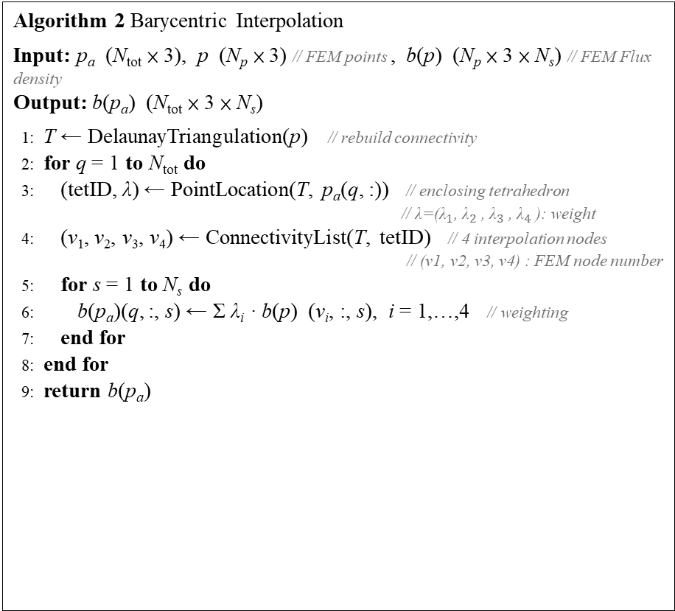
Current-based lumped-parameter modeling and calibration
E. Validation
Interpolation Point Algorithm for workspace pseudocode
Algorithm 1 Generate Interpolation Points
Input: N_{a}, R
Output: p_{a} (N_{tot} × 3) // interpolation point
1: d ← R / N_{a} // point to point distance
2: N_{tot} ← 1 + 6·N_{a} // total number of points
3: p_{a} ← zeros(N_{tot}, 3)
4: E ← eye(3) // unit vectors of three axes
5: cnt ← 1; p_{a}(cnt, :) ← [0, 0, 0] // center point
6: for j = 1 to 3 do
7: for s ∈ {+1, −1} do // ± direction
8: for i= 1 to N_{a} do
9: cnt ← cnt + 1
10: p_{a}(cnt, :) ← s · i · d · E(j, :) // i-th point on axis j
11: end for
12: end for
13: end for
14: return p_{a}
Algorithm 2 Barycentric Interpolation
Input: p_{a} (N_{tot} × 3), p (N_{p} × 3) // FEM points , b(p) (N_{p} × 3 × N_{s}) // FEM Flux density
Output: b(p_{a}) (N_{tot} × 3 × N_{s})
1: T ← DelaunayTriangulation(p) // rebuild connectivity
2: for q = 1 to N_{tot} do
3: (tetID, λ) ← PointLocation(T, p_{a}(q, :)) // enclosing tetrahedron
// λ=(${\text{λ}}_{1}$​, ${\text{λ}}_{2}$​, ${\text{λ}}_{3}$​, ${\text{λ}}_{4}$​): weight
4: (v₁, v₂, v₃, v₄) ← ConnectivityList(T, tetID) // 4 interpolation nodes
    // (v1, v2, v3, v4) : FEM node number
5: for s = 1 to N_{s} do
6: b(p_{a})(q, :, s) ← Σ λ_{i} · b(p) (v_{i}, :, s), i = 1,…,4 // weighting
7: end for
8: end for
9: return b(p_{a})

Slide 3
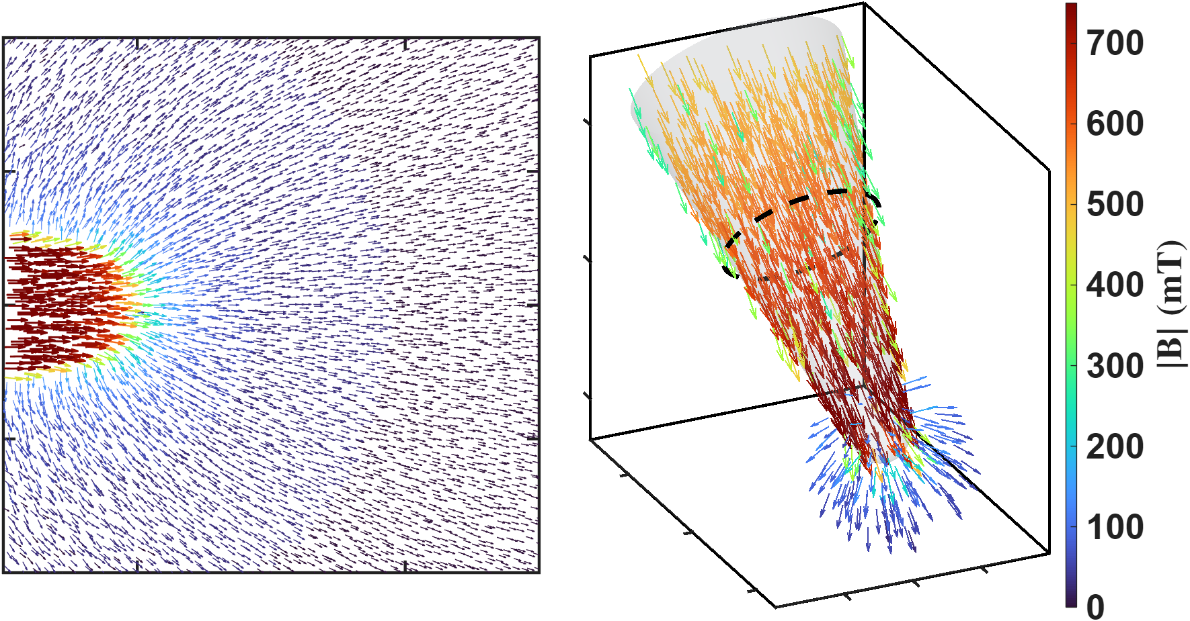



Current-based lumped-parameter modeling and calibration
E. Validation
This figure illustrates the magnetic flux path when pole P2 is excited. The left figure presents a top view, with the theoretical magnetic charge locations labeled to clarify the magnetic charge concept used in this study. The right figure shows a three-dimensional view of the same model, in which the theoretical magnetic charge locations and the magnetic flux distribution can be clearly observed.
The threshold used in the 3D plot on the right is 0.1 mT, meaning that only values greater than 0.1 mT are displayed in the figure.
$$Φ$$
$$q$$
$$q$$

Slide 4
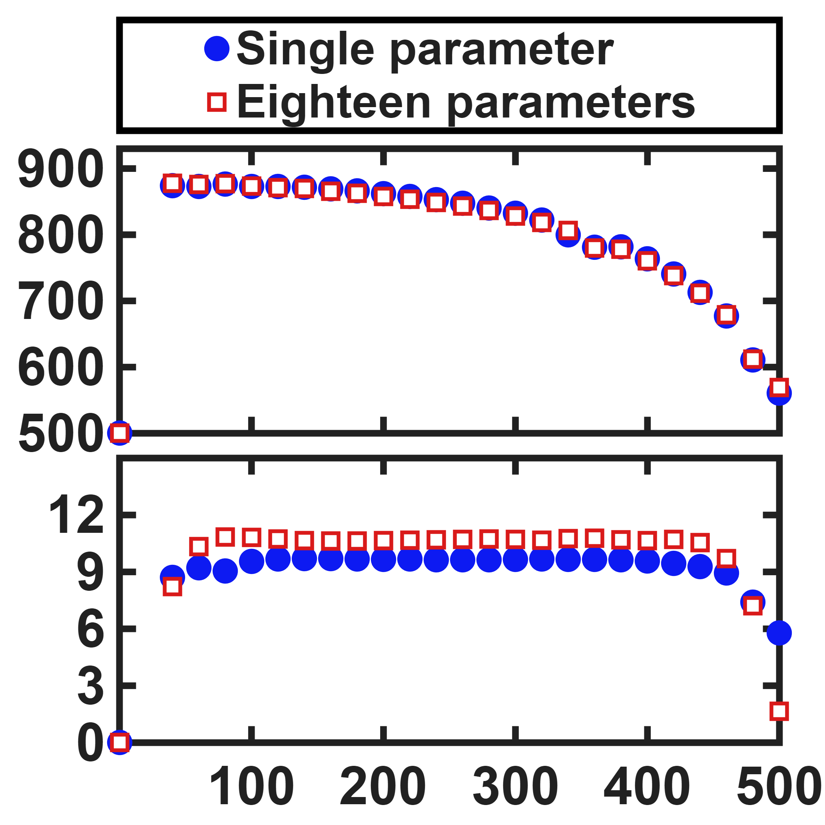
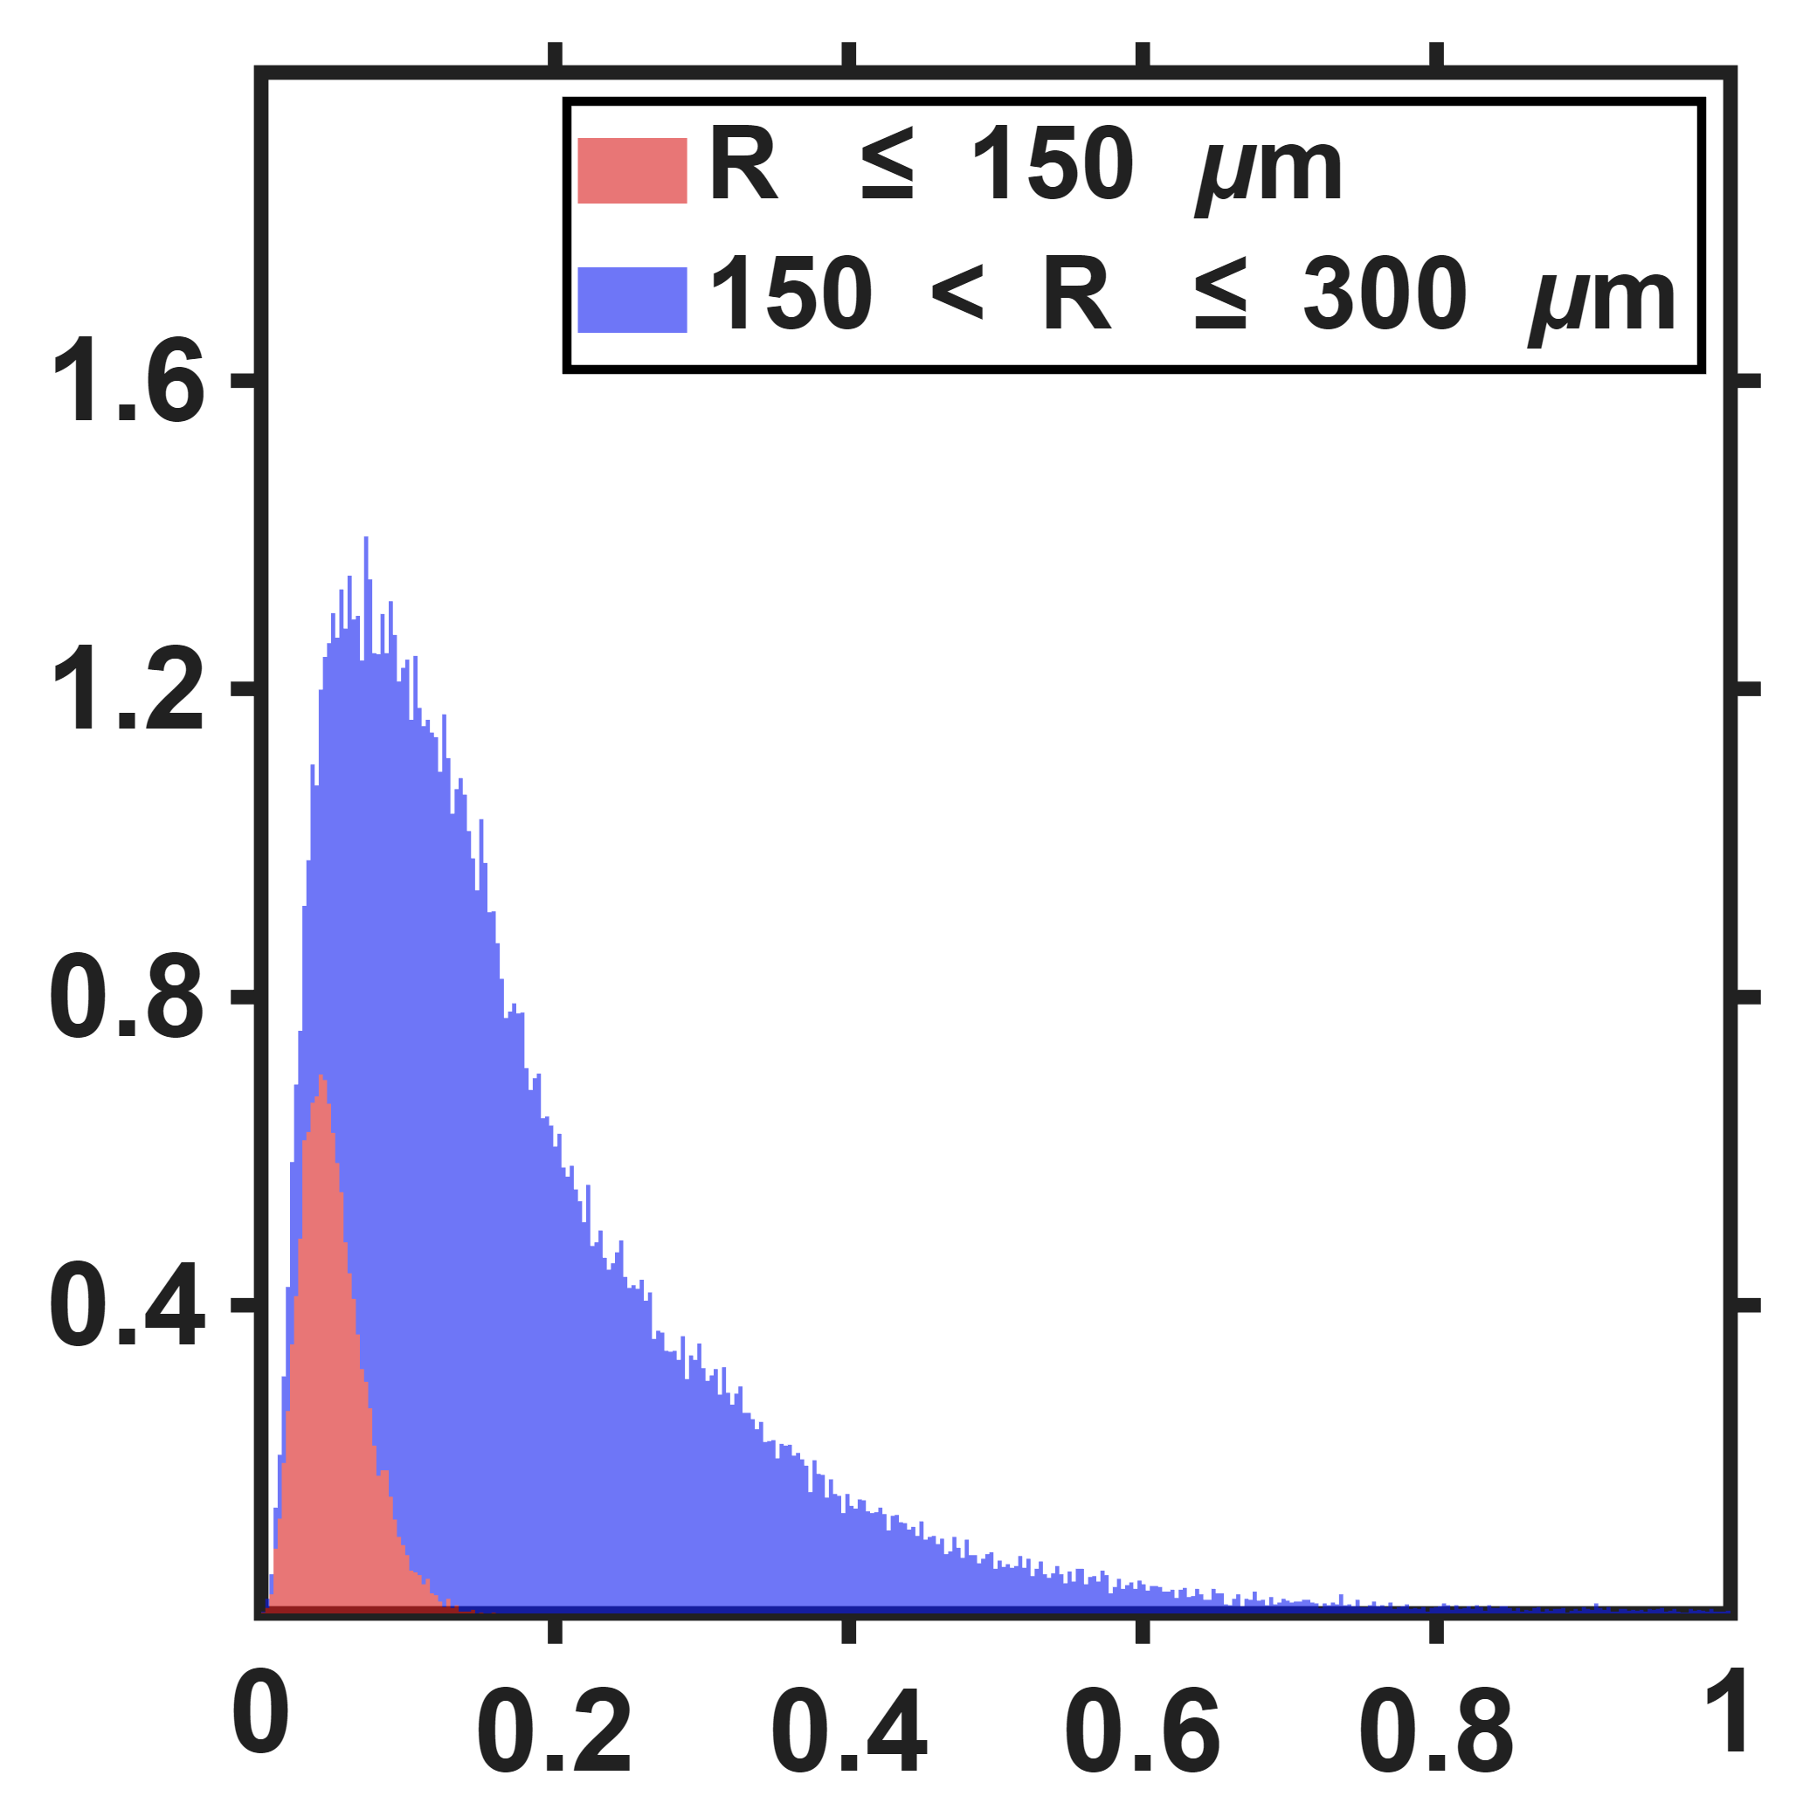



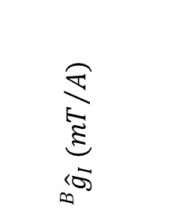

Current-based lumped-parameter modeling and calibration
E. Validation
$$\hat{ℓ} (μm)$$
Percentage count $(\%)$
$${}_{}^{B}{{\hat{g}}_{I}} ({mT}/A)$$
Workspace radius $(μm)$
Modeling error $(mT)$

Slide 5
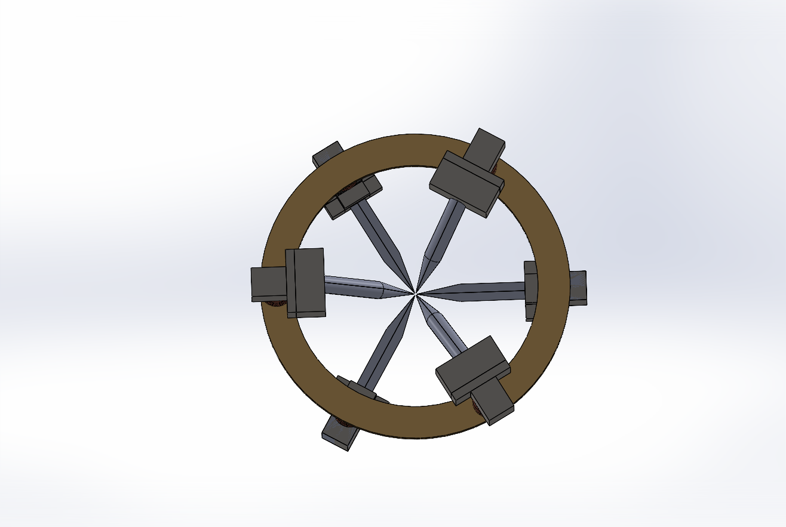
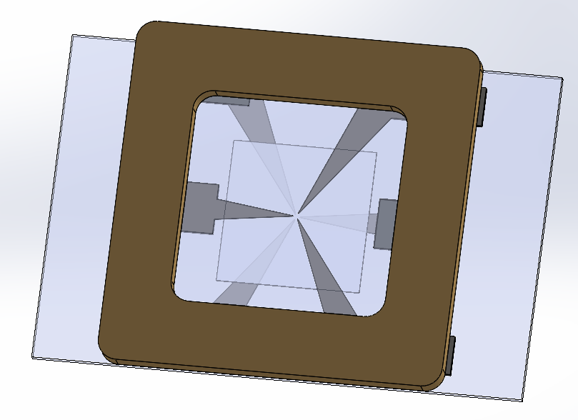
Quantitative Assessment of Multi-Pole Actuators
Setup: The assessment that follows compares two six-pole actuator designs, Design 1 on a circular yoke and Design 2 on a planar square frame. Both are described by the same lumped-parameter model and use the pole numbering P1-P6 shown here.
Sharing the model form and the pole numbering, the two differ only in geometry, so their calibrated parameters can be compared directly in the following slides.
DesignA
DesignB
P3
P3
P5
P2
P5
P2
P1
P6
P1
P6
P4
P4

Slide 6
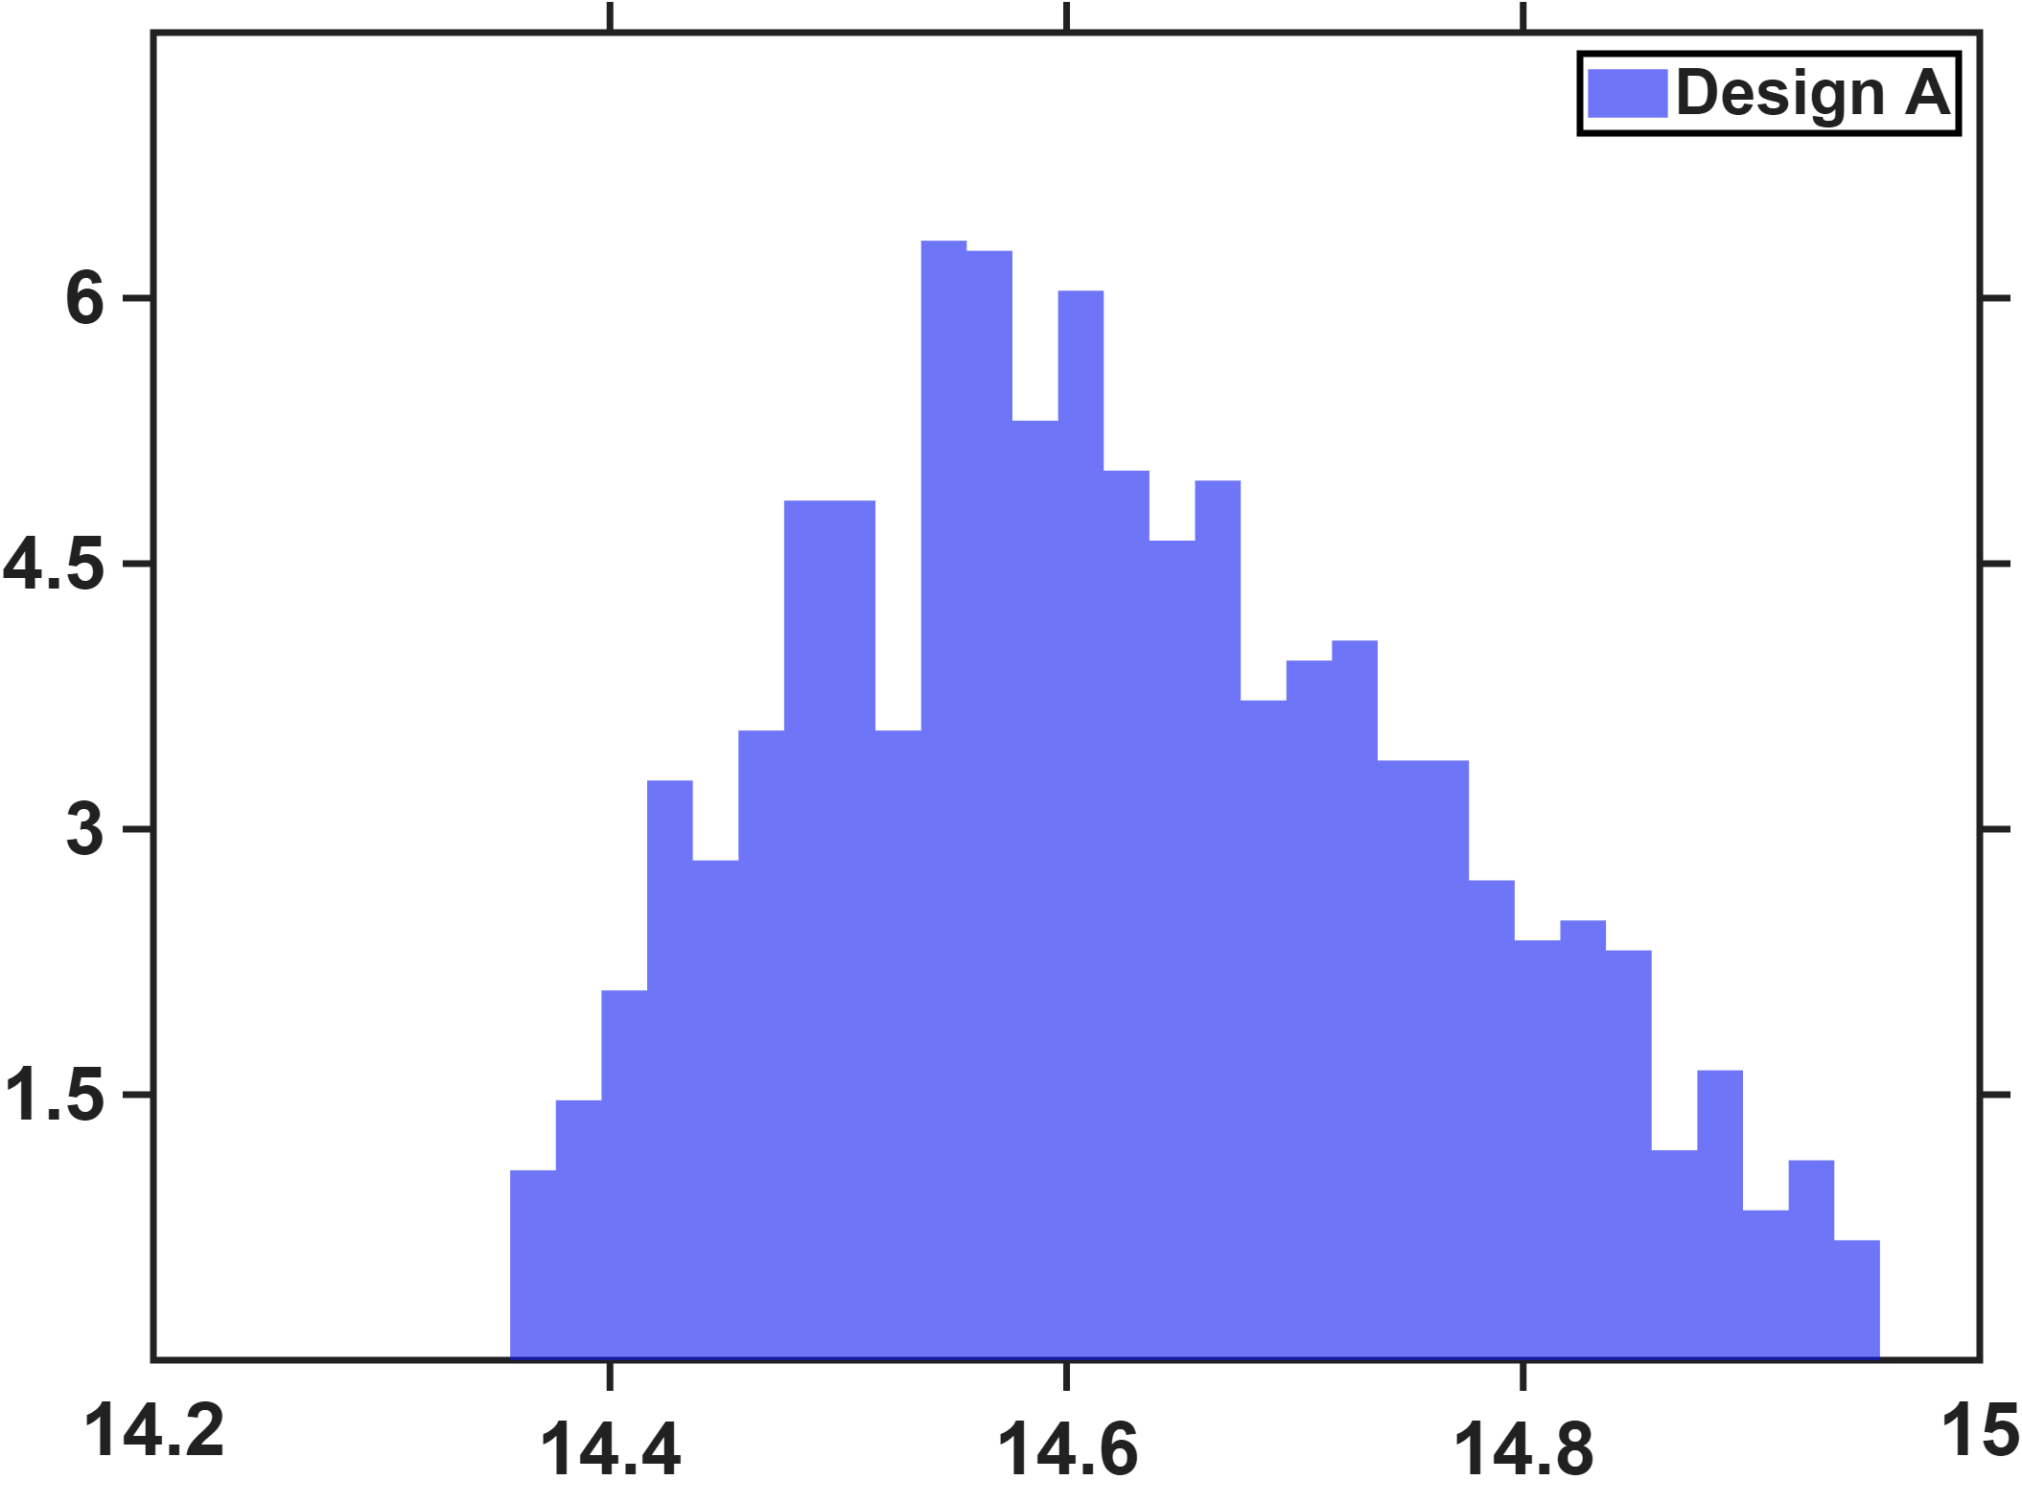
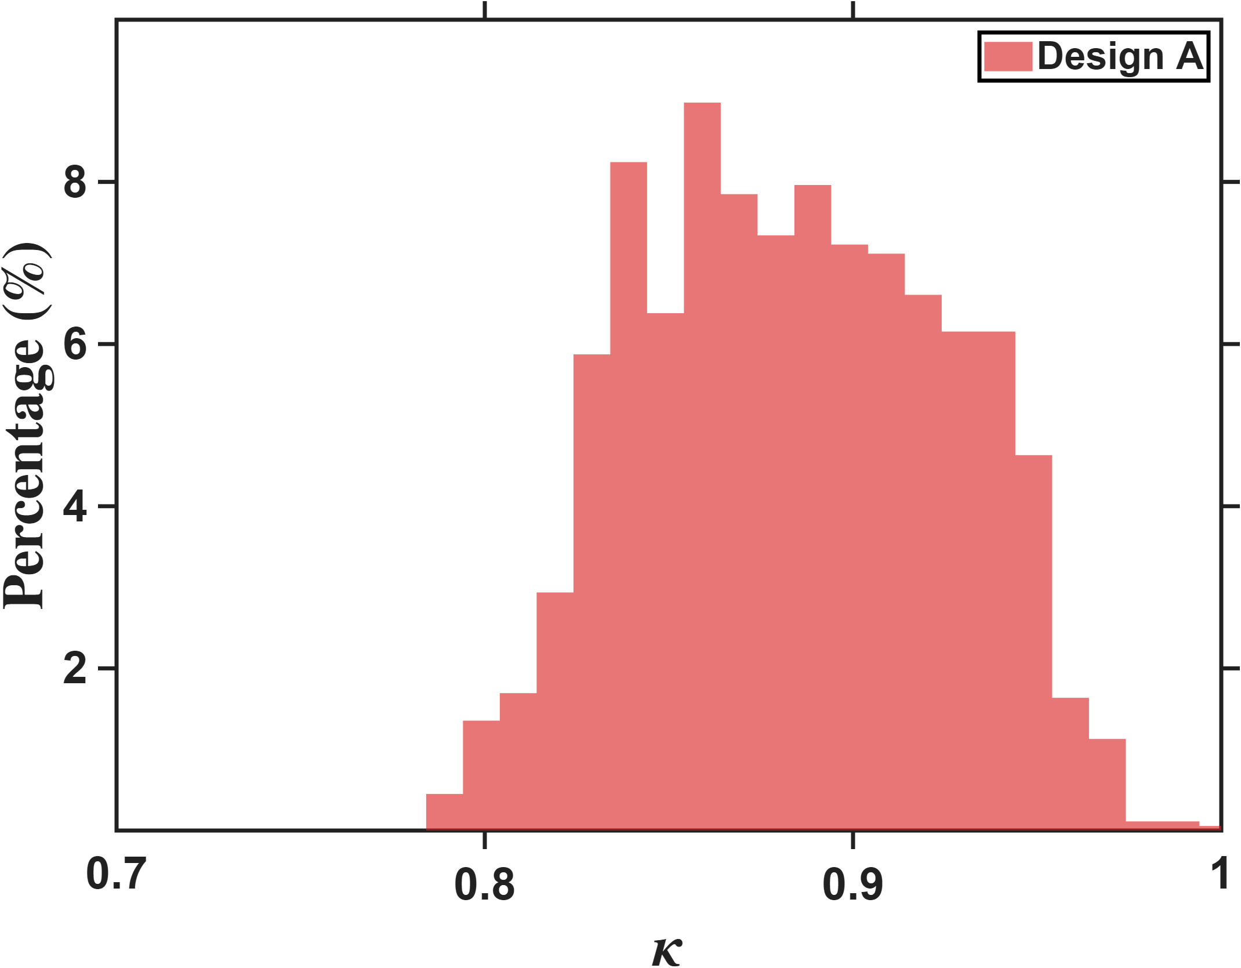

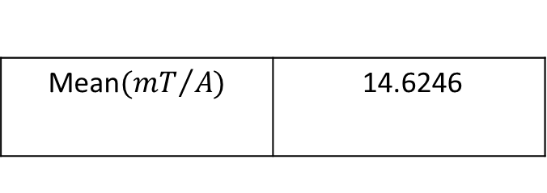
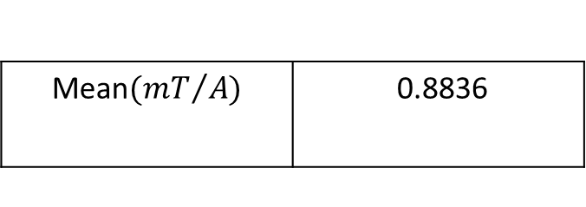

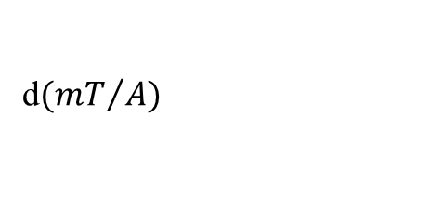
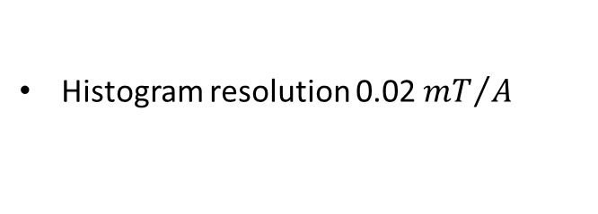
Quantitative Assessment of Multi-Pole Actuators
DesignA
Percentage count$(\%)$
Percentage count$(\%)$
d$({mT}/A)$
Isotropy
Histogram resolution 0.02 ${mT}/A$
Histogram resolution 0.01
Mean$({mT}/{A)}$ | 14.6246
Mean$({mT}/{A)}$ | 0.8836

Slide 7
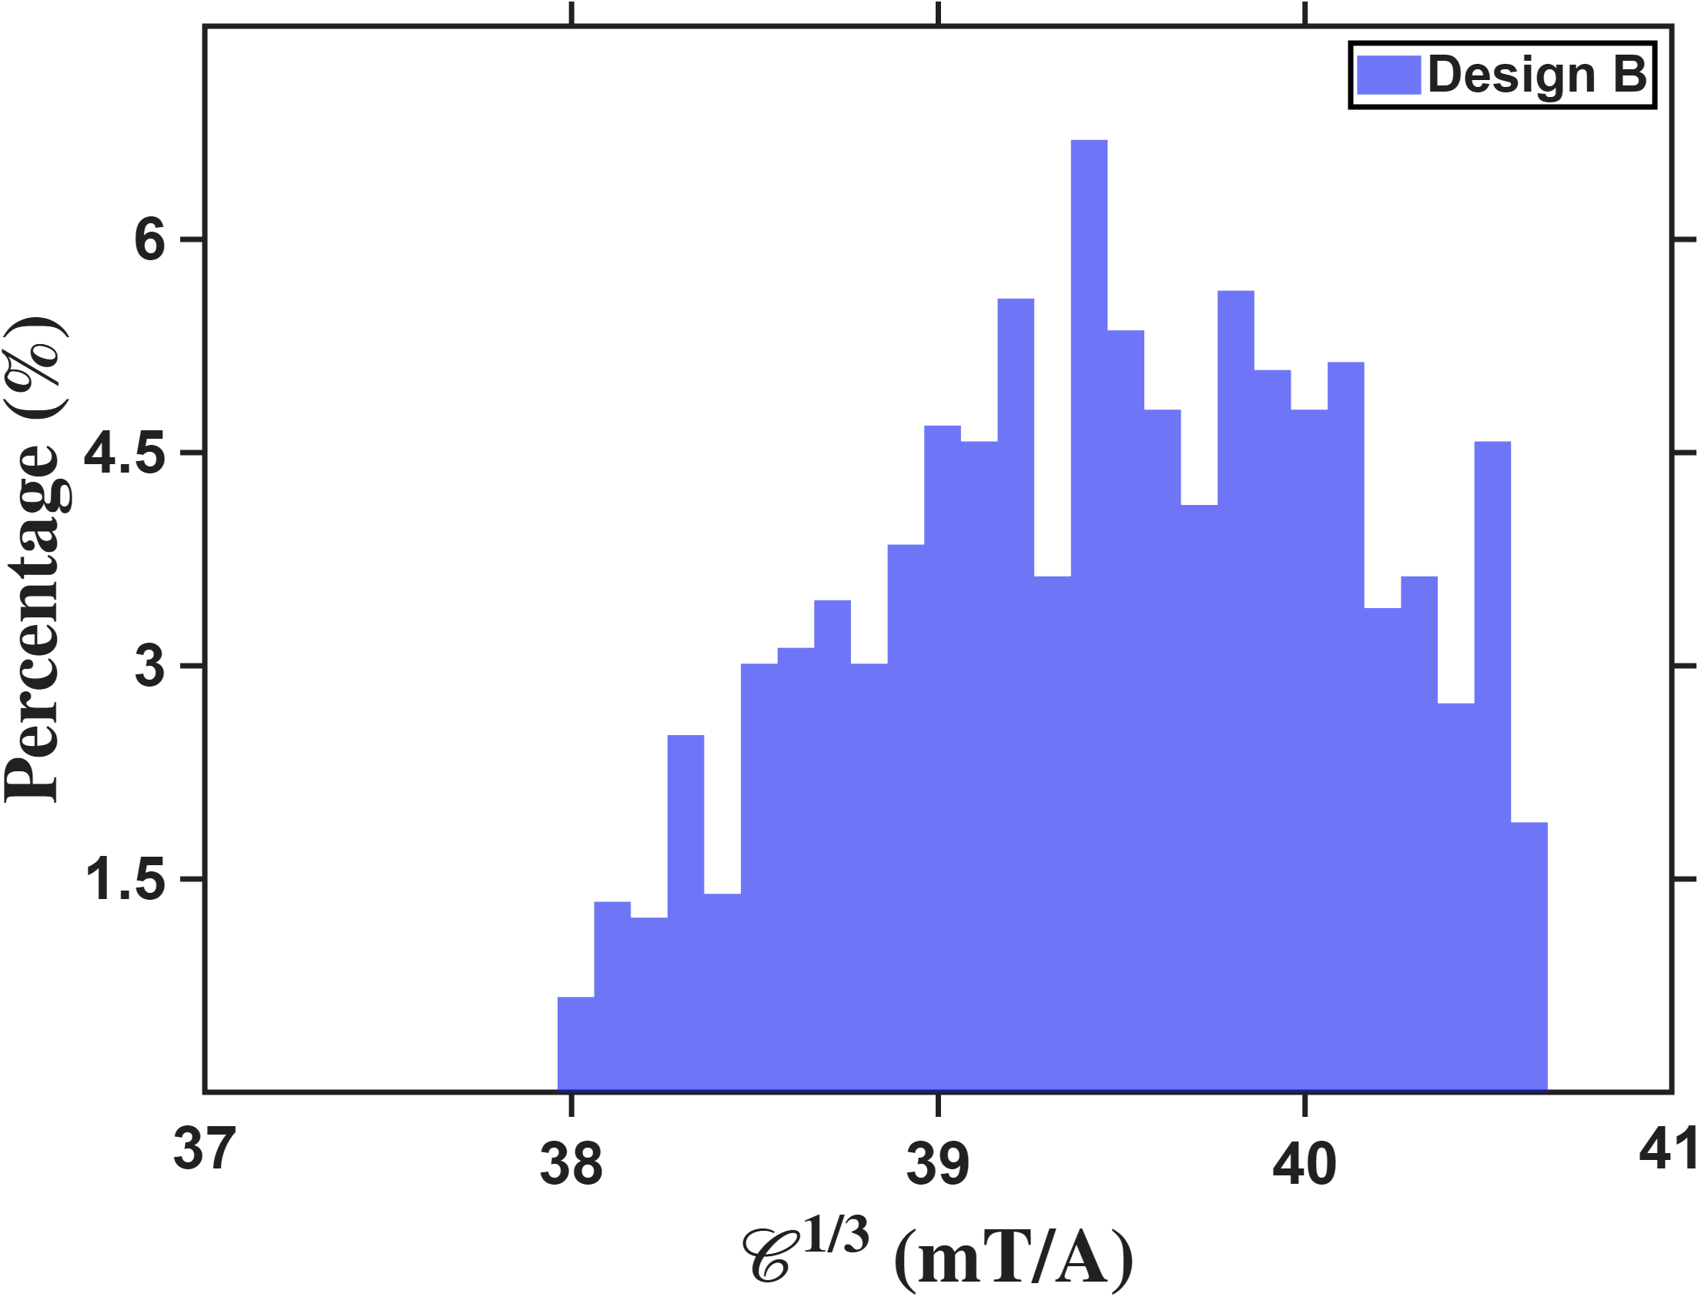
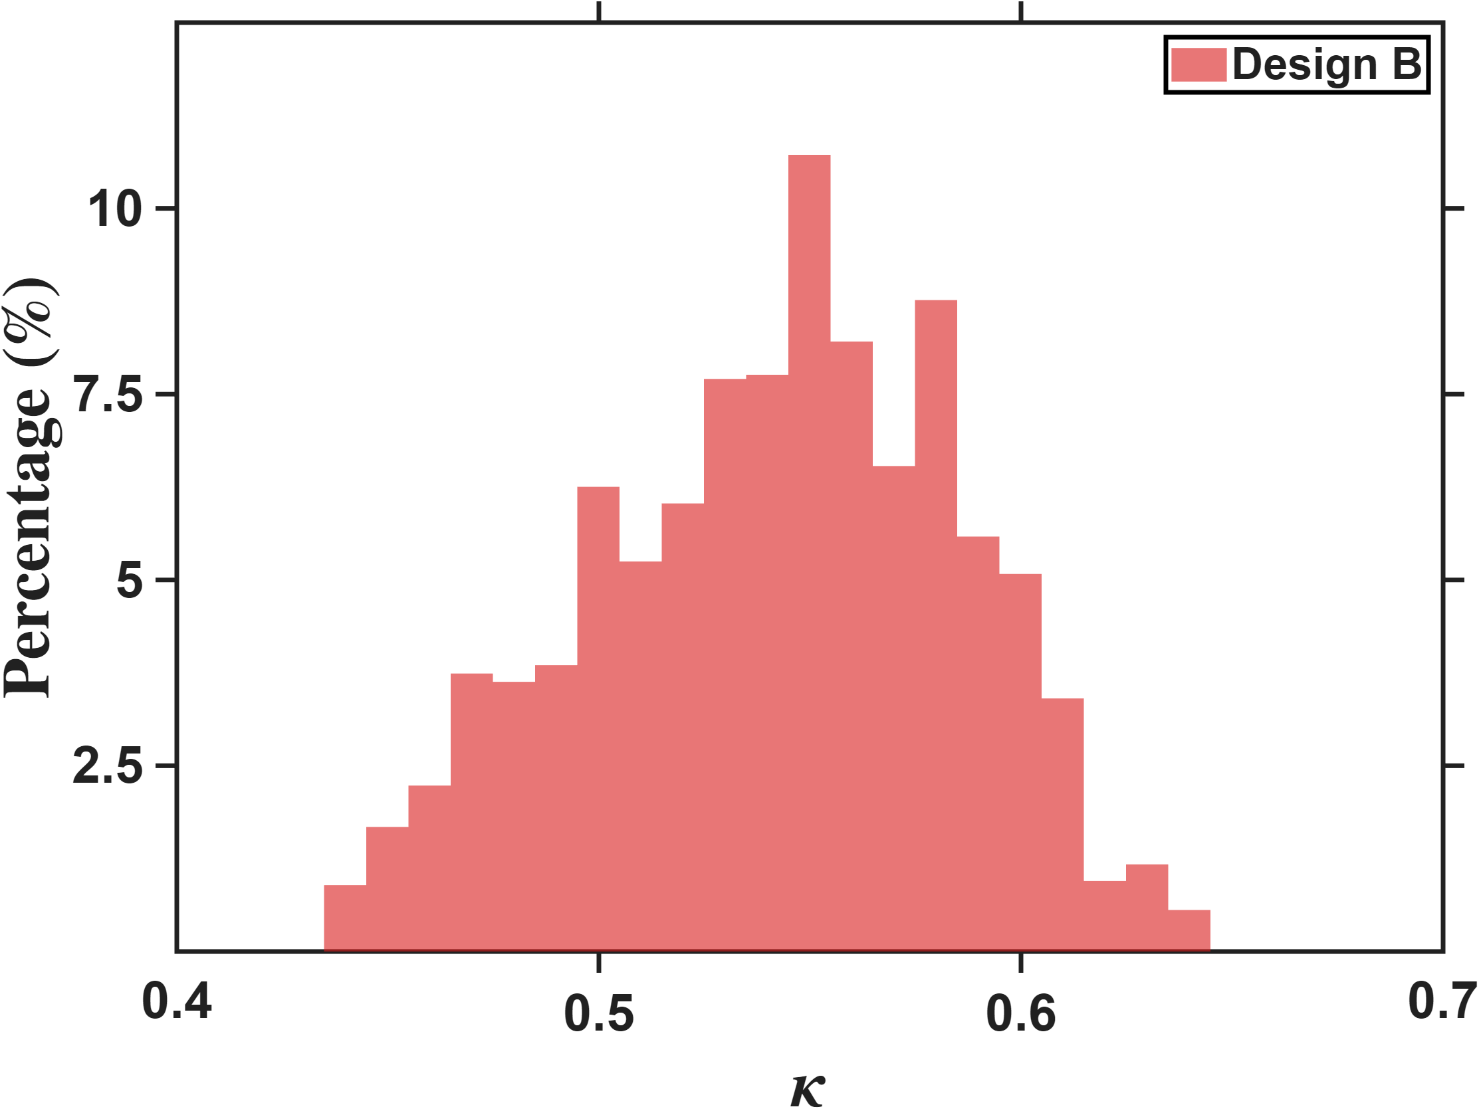
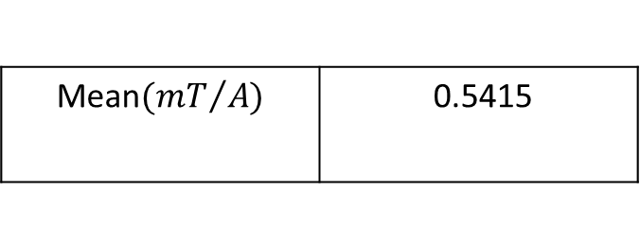

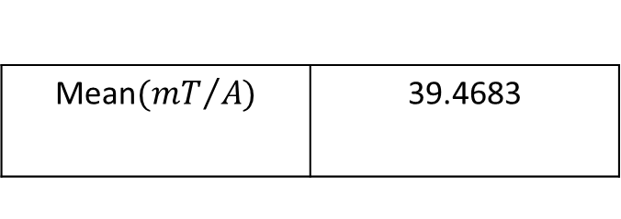
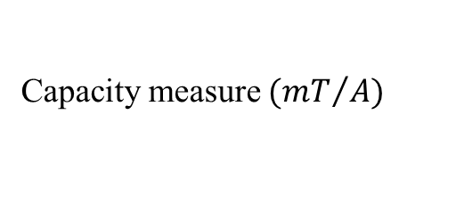
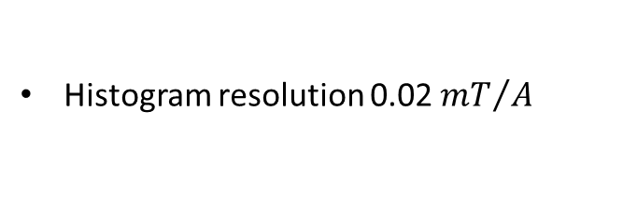

Quantitative Assessment of Multi-Pole Actuators
DesignB
Percentage count$(\%)$
Percentage count$(\%)$
Capacity measure $({mT}/A)$
Isotropy
Histogram resolution 0.02 ${mT}/A$
Histogram resolution 0.01
Mean$({mT}/{A)}$ | 39.4683
Mean$({mT}/{A)}$ | 0.5415

Slide 8
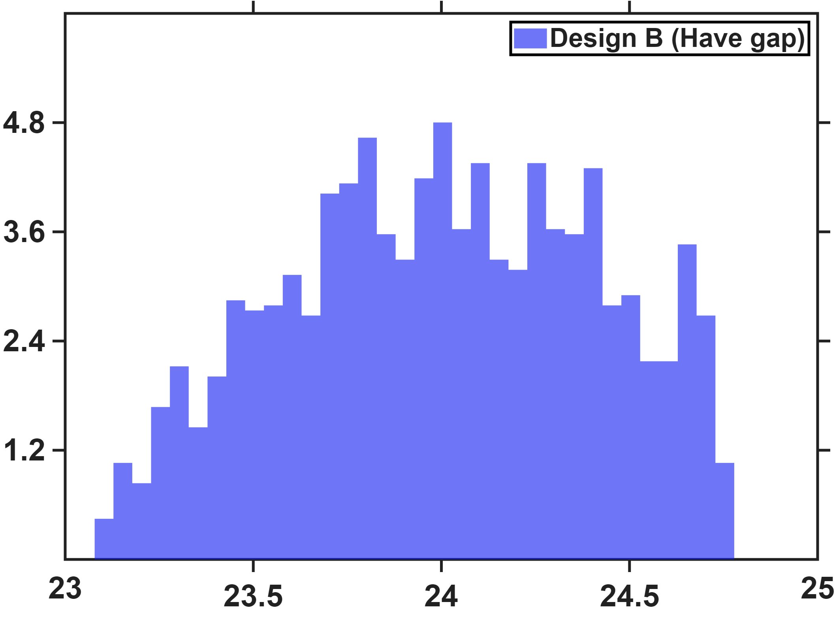
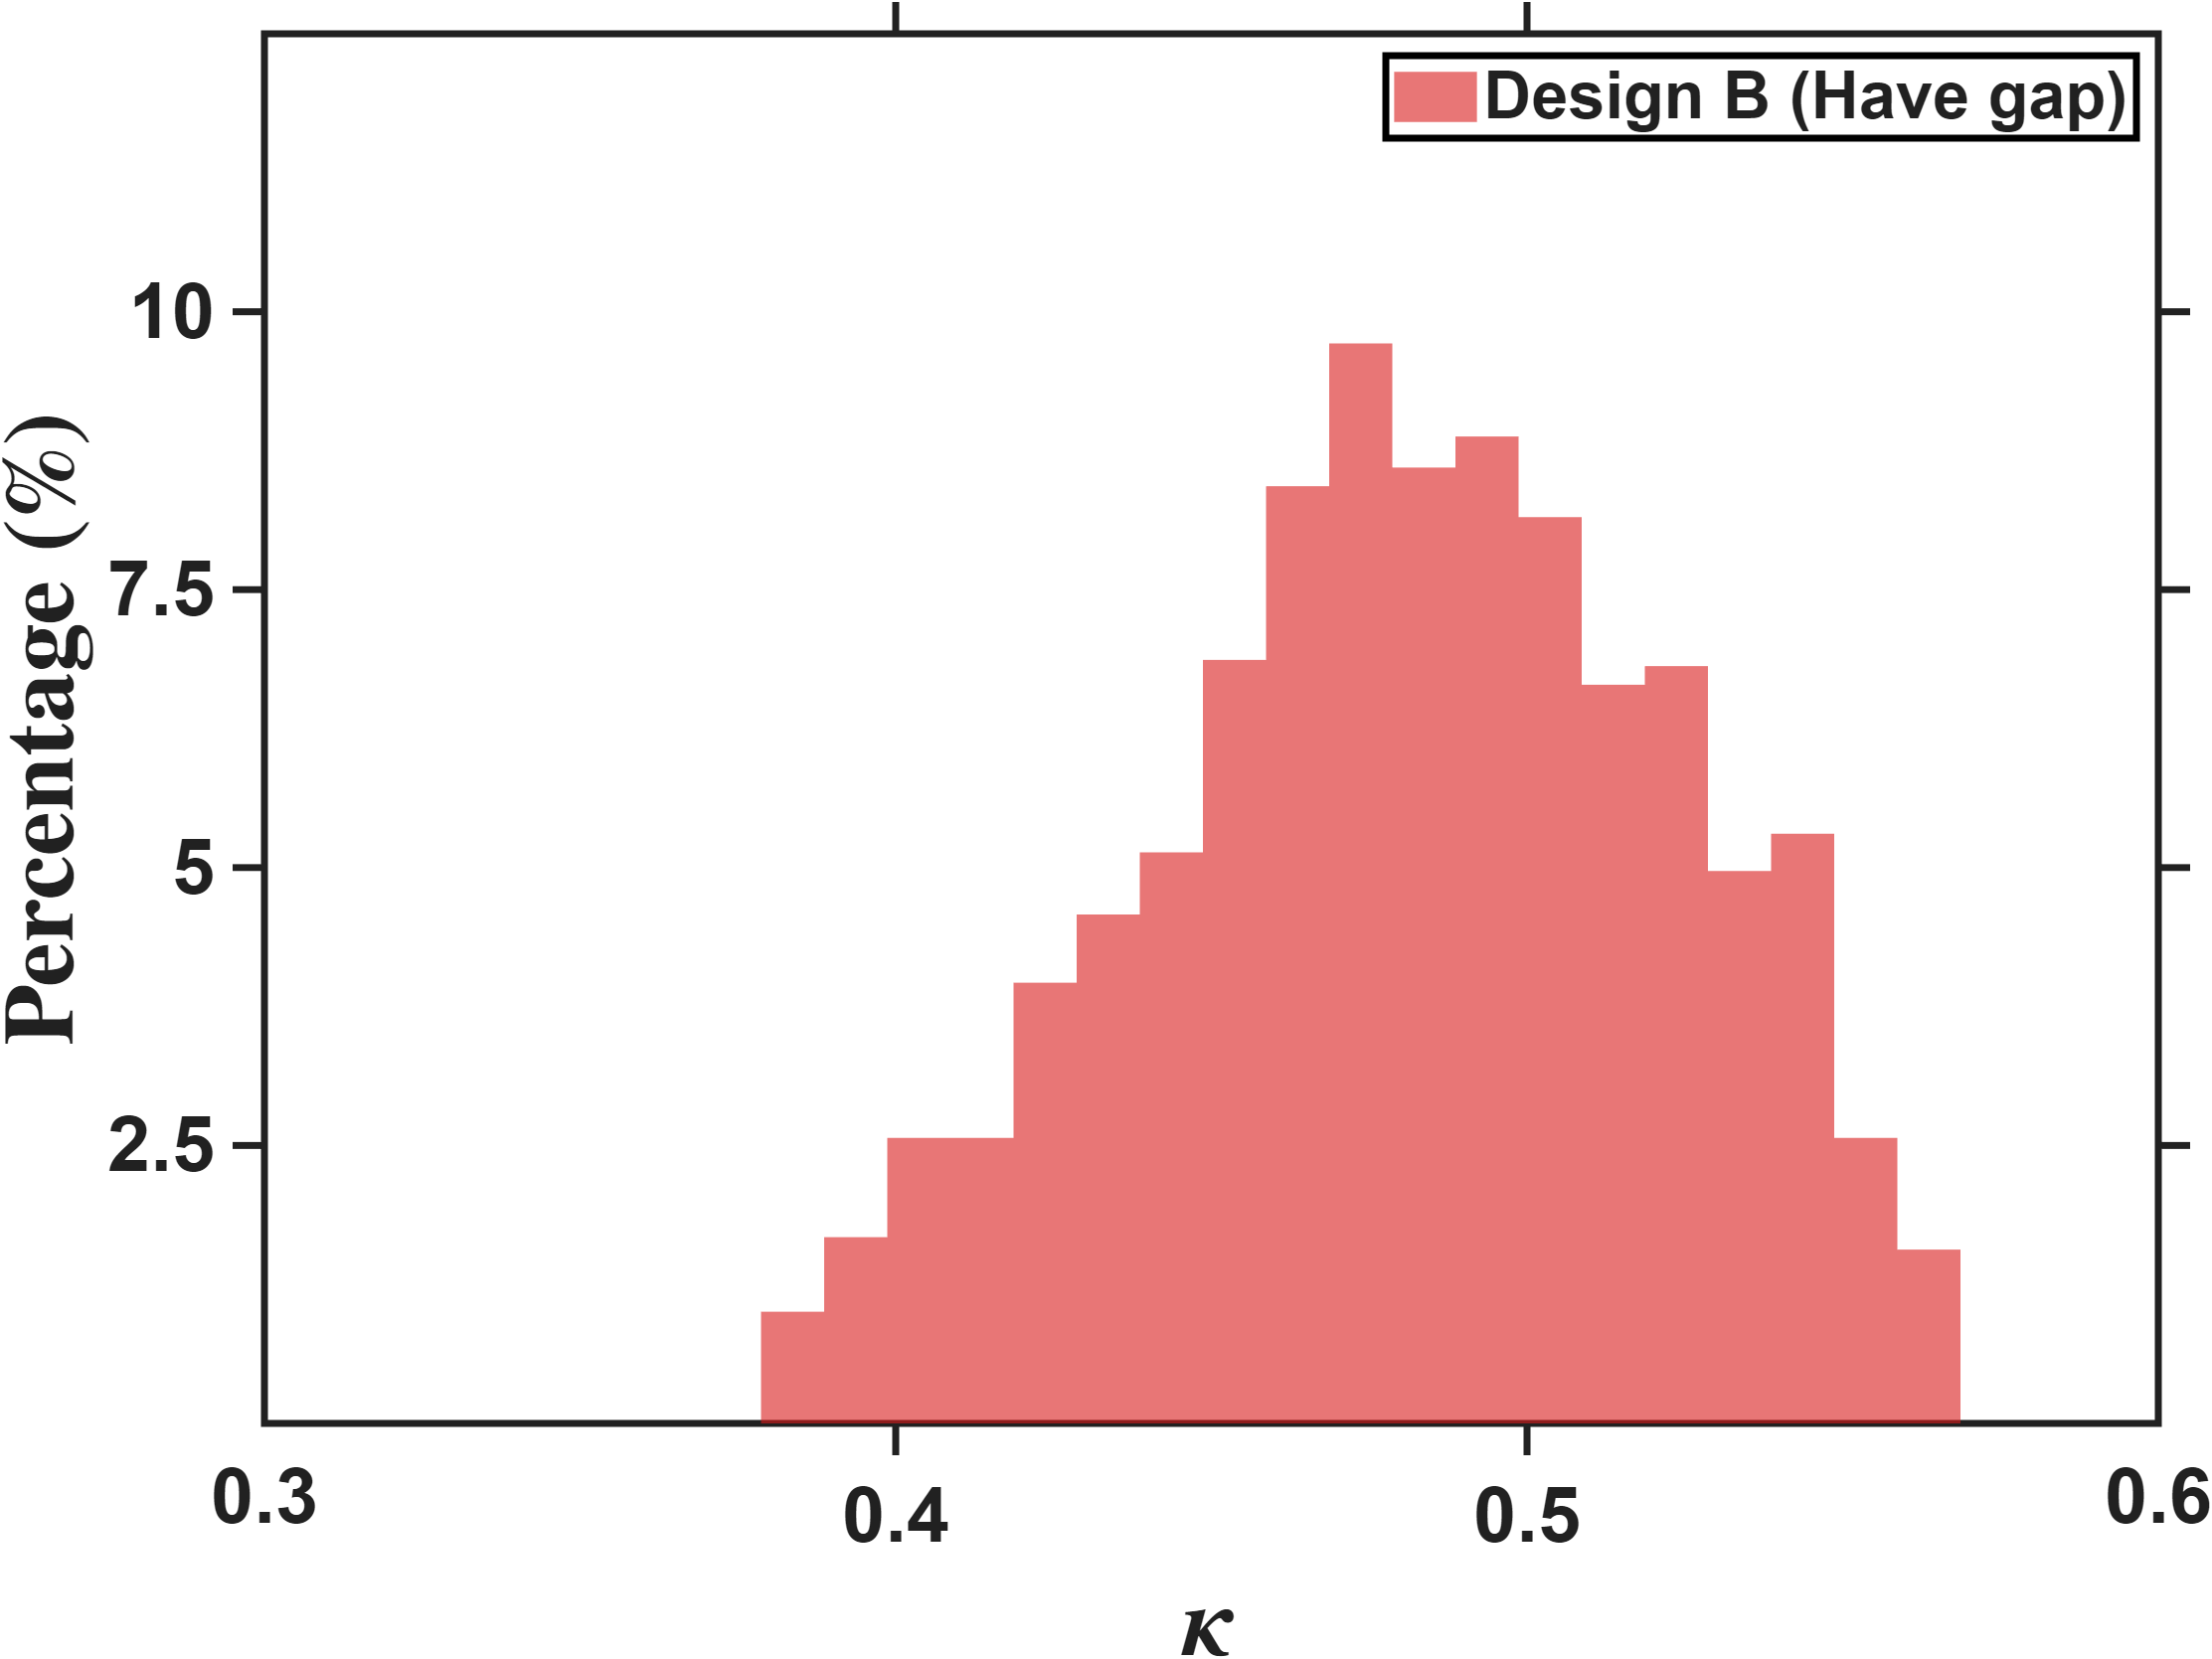
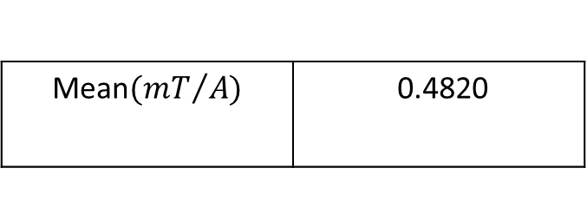

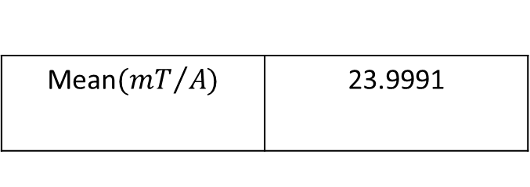
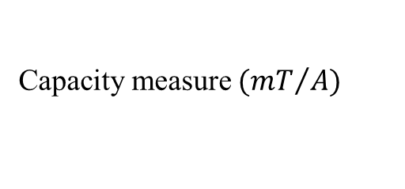
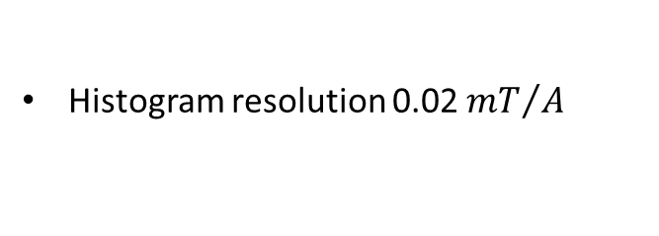

Quantitative Assessment of Multi-Pole Actuators
DesignB(Have gap)
Percentage count$(\%)$
Percentage count$(\%)$
Capacity measure $({mT}/A)$
Isotropy
Histogram resolution 0.02 ${mT}/A$
Histogram resolution 0.01
Mean$({mT}/{A)}$ | 23.9991
Mean$({mT}/{A)}$ | 0.4820

Slide 9



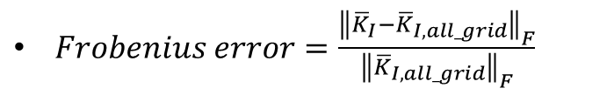
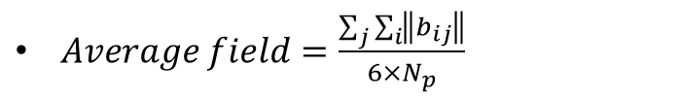

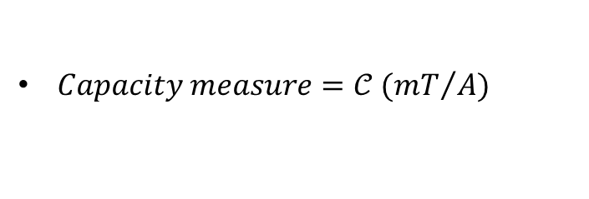
Reference
$Workspace radius=\hat{ℓ}$
$Flux distribution matrix={\overline{K}}_{I}$
$Current to field gain={}_{}^{B}{{\hat{g}}_{I}}$
$Voltage to field gain={}_{}^{B}{{\hat{g}}_{V}}$
$Predict error=\sqrt{\frac{J}{N_{p}}}$, where $J=\sum_{j}{\sum_{i}{{ε_{ij}}^{T}ε_{ij}}}$
$Capacity measure=𝒞 ({mT}/A)$
$Isotropy=κ$
$Frobenius error=\frac{{\left\|{\overline{K}}_{I}−{\overline{K}}_{I,all_grid}\right\|}_{F}}{{\left\|{\overline{K}}_{I,all_grid}\right\|}_{F}}$
$Average field=\frac{\sum_{j}{\sum_{i}{\left\|b_{ij}\right\|}}}{6×N_{p}}$

