Slide 1
A Lumped-Parameter Modeling, Calibration, and Capacity-Measure Framework for Flux Generation in Symmetric
Multipole Electromagnetic Actuators

Slide 2
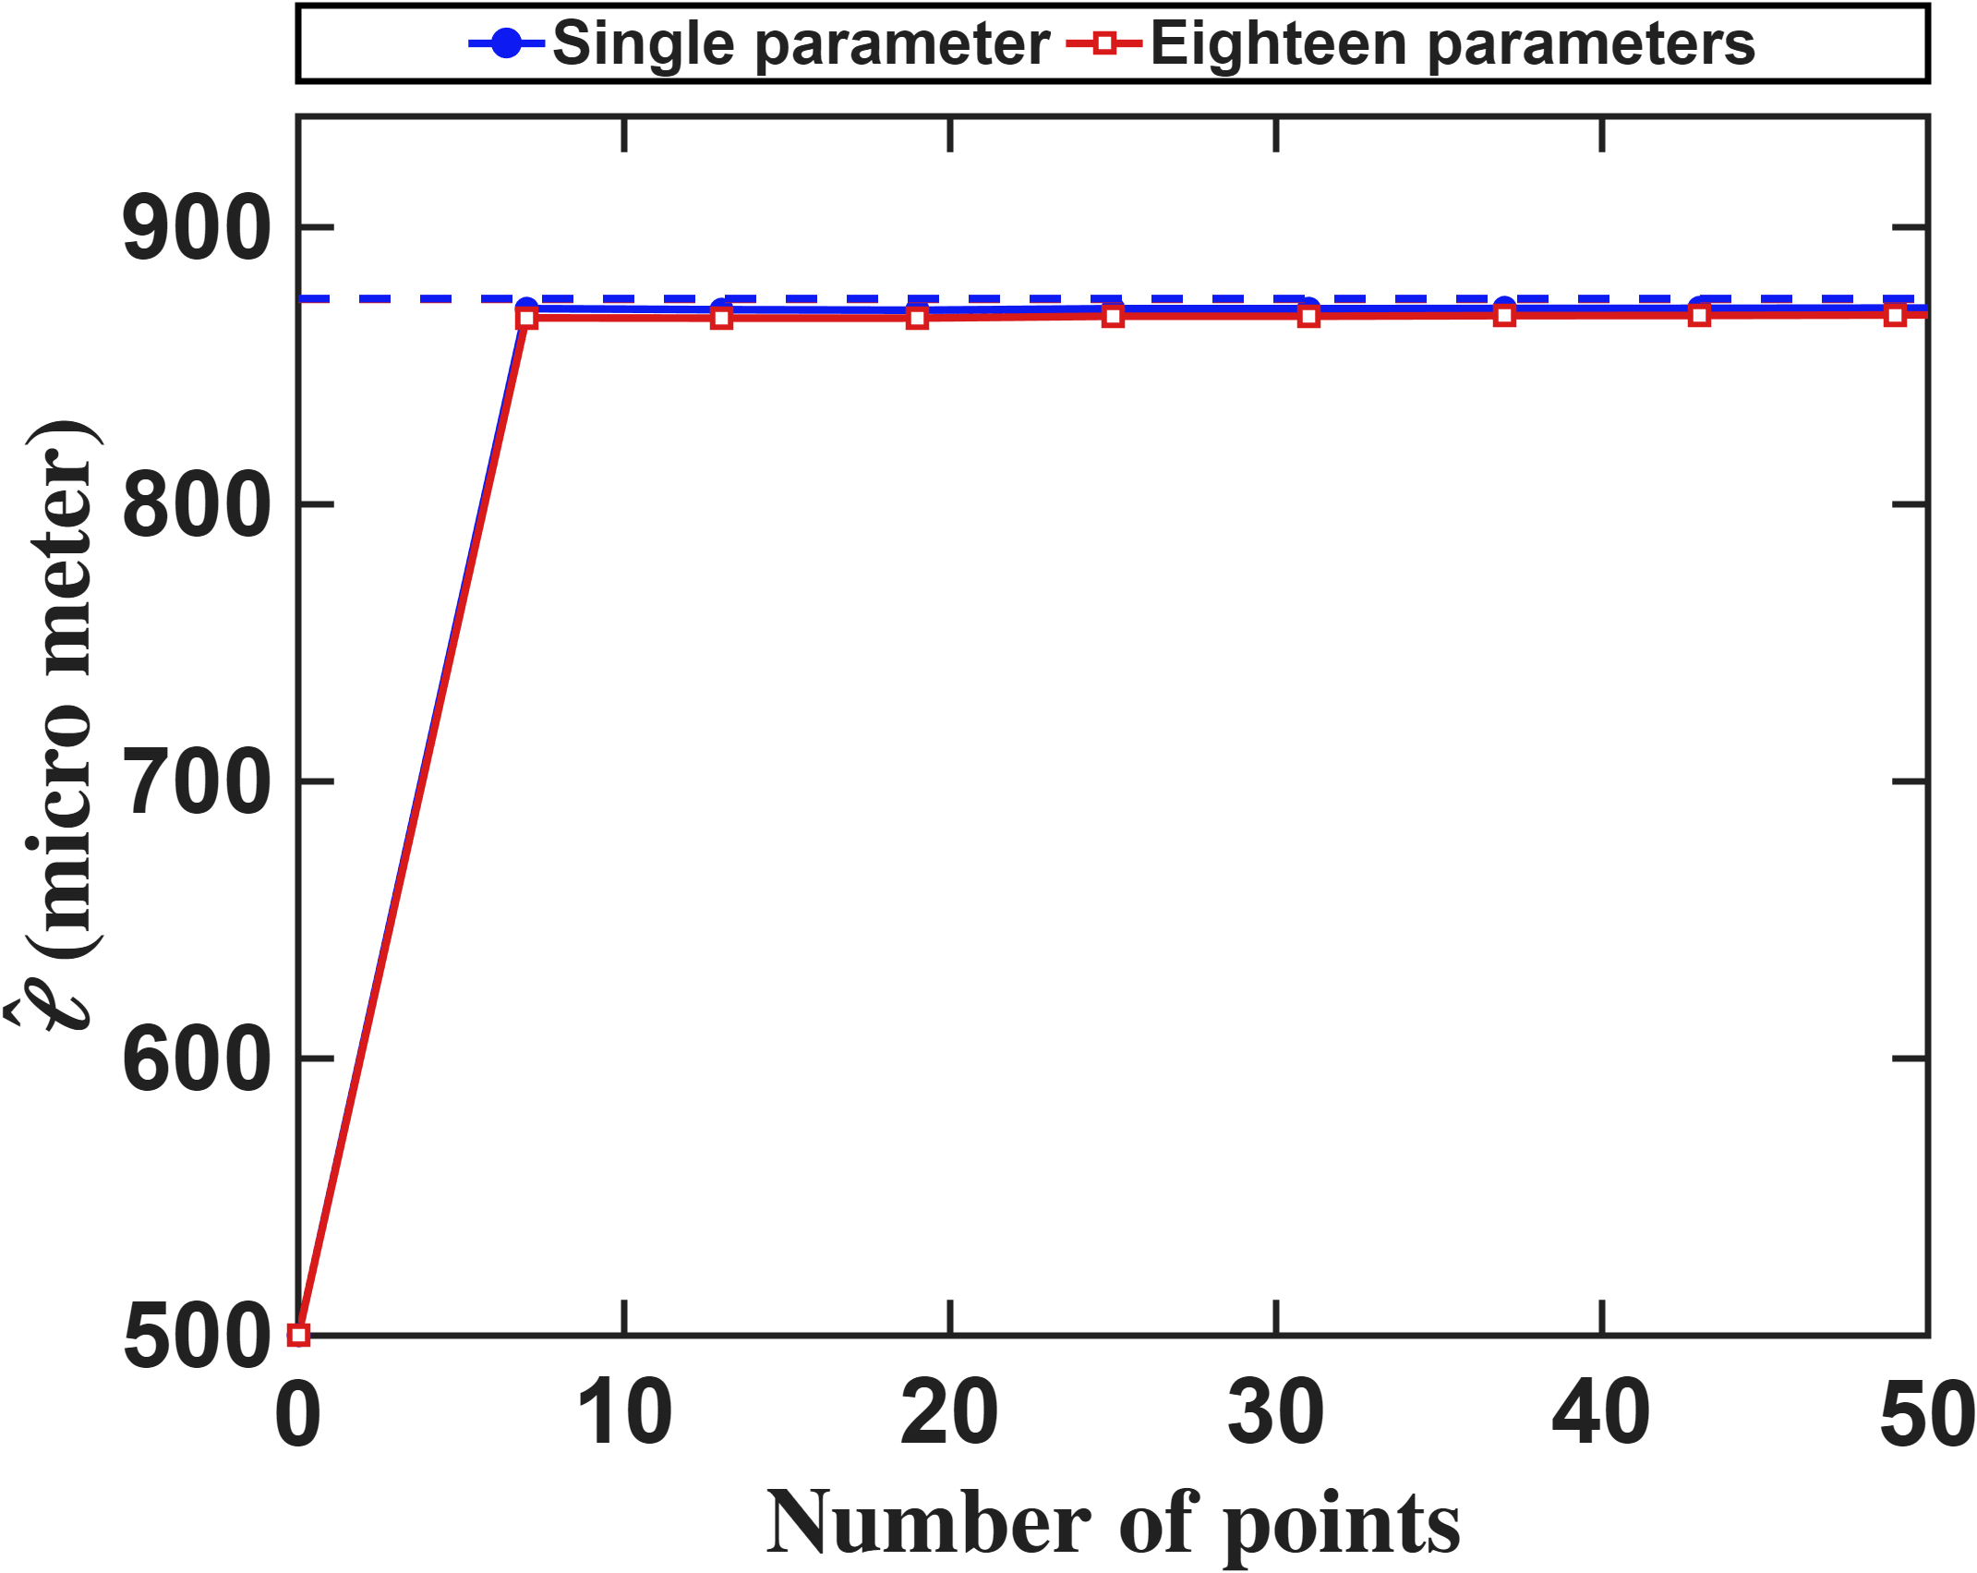
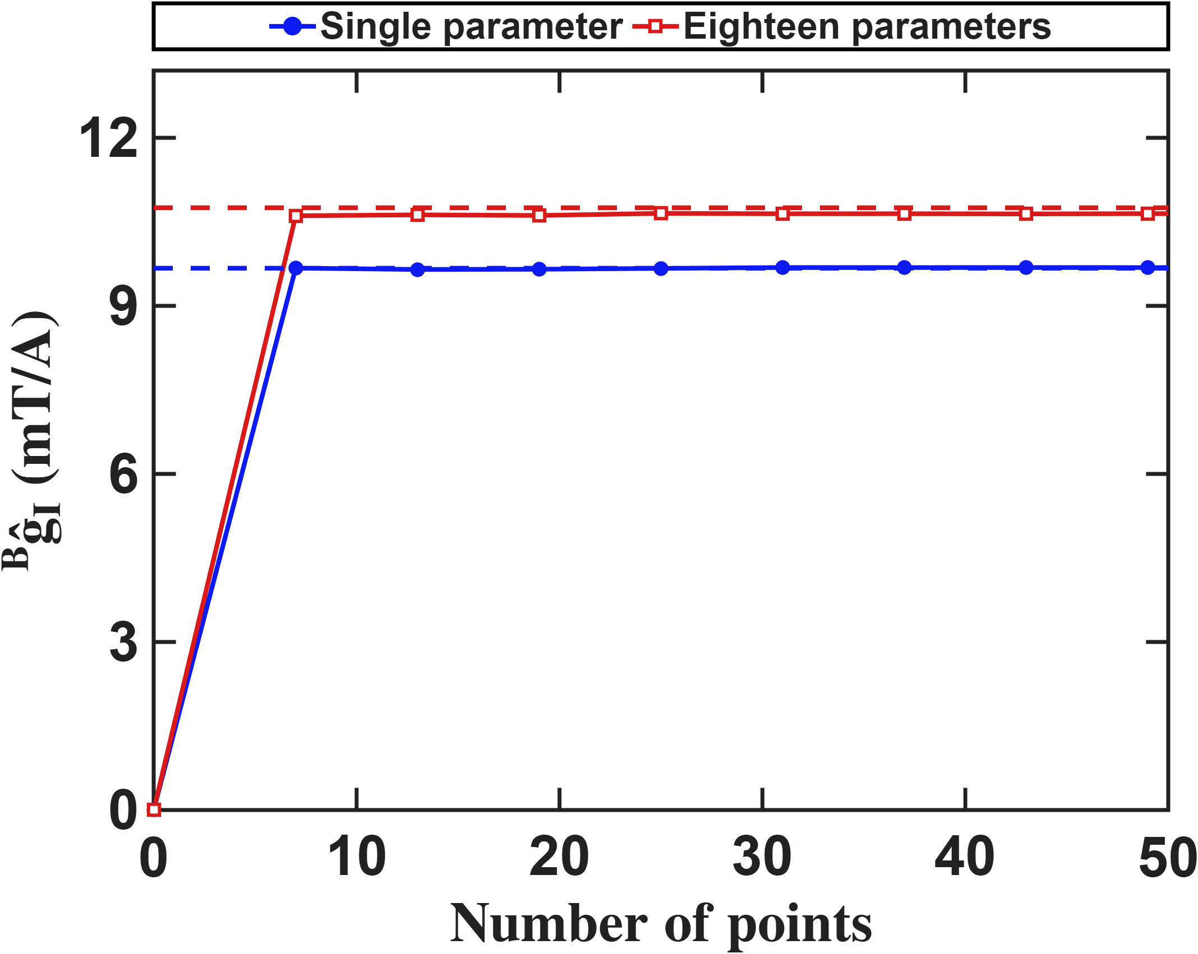

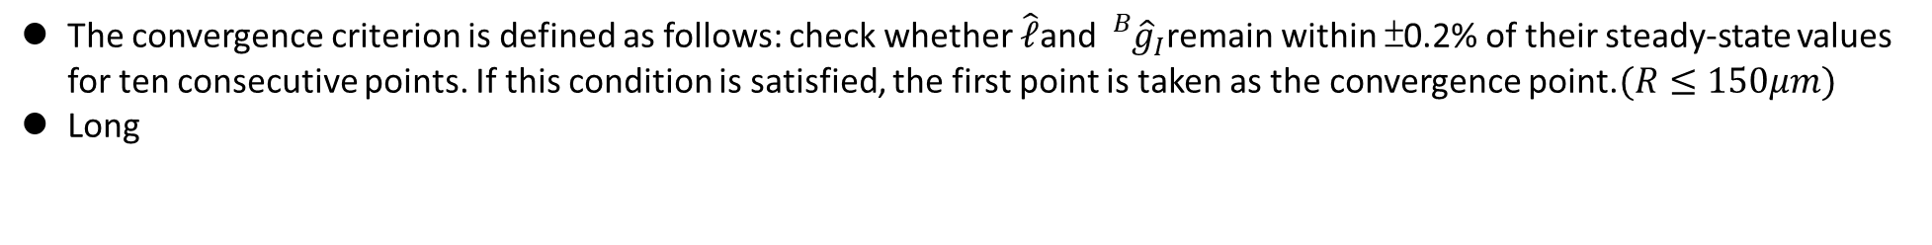
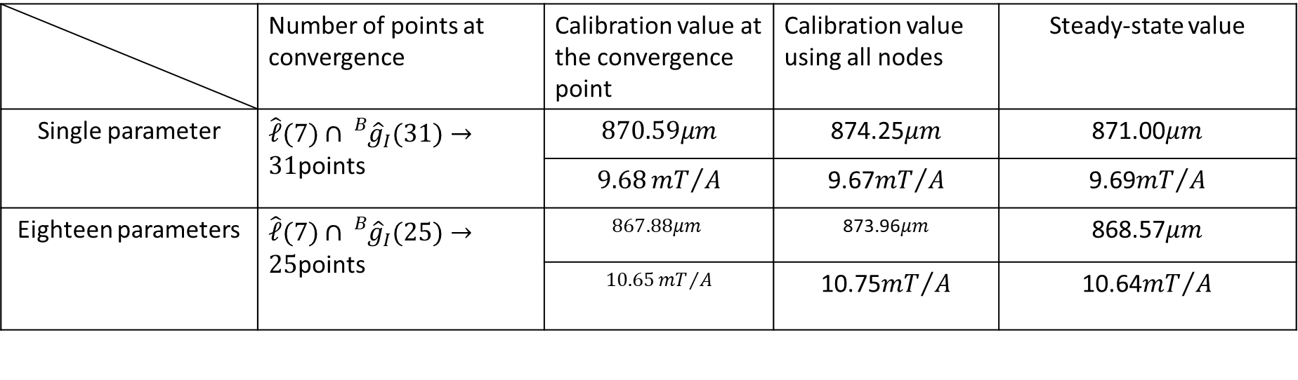


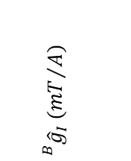
Current-based lumped-parameter modeling and calibration
E. Validation
The convergence criterion is defined as follows: check whether $\hat{ℓ}$and ${}_{}^{B}{{\hat{g}}_{I}}$remain within ±0.2% of their steady-state values for ten consecutive points. If this condition is satisfied, the first point is taken as the convergence point.$(R≤150μm)$
Long
$$\hat{ℓ} (μm)$$
$${}_{}^{B}{{\hat{g}}_{I}} ({mT}/A)$$
$$Number of points$$
$$Number of points$$
 | Number of points at convergence | Calibration value at the convergence point | Calibration value using all nodes | Steady-state value
Single parameter | $\hat{ℓ}(7)∩{}_{}^{B}{{\hat{g}}_{I}(31)}→31$points | $$870.59μm$$ | 874.25$μm$ | 871.00$μm$
 |  | $$9.68{mT}/A$$ | 9.67${mT}/A$ | 9.69${mT}/A$
Eighteen parameters | $\hat{ℓ}(7)∩{}_{}^{B}{{\hat{g}}_{I}(25)}→25$points | $$867.88μm$$ | 873.96$μm$ | 868.57$μm$
 |  | $$10.65{mT}/A$$ | 10.75${mT}/A$ | 10.64${mT}/A$

Slide 3
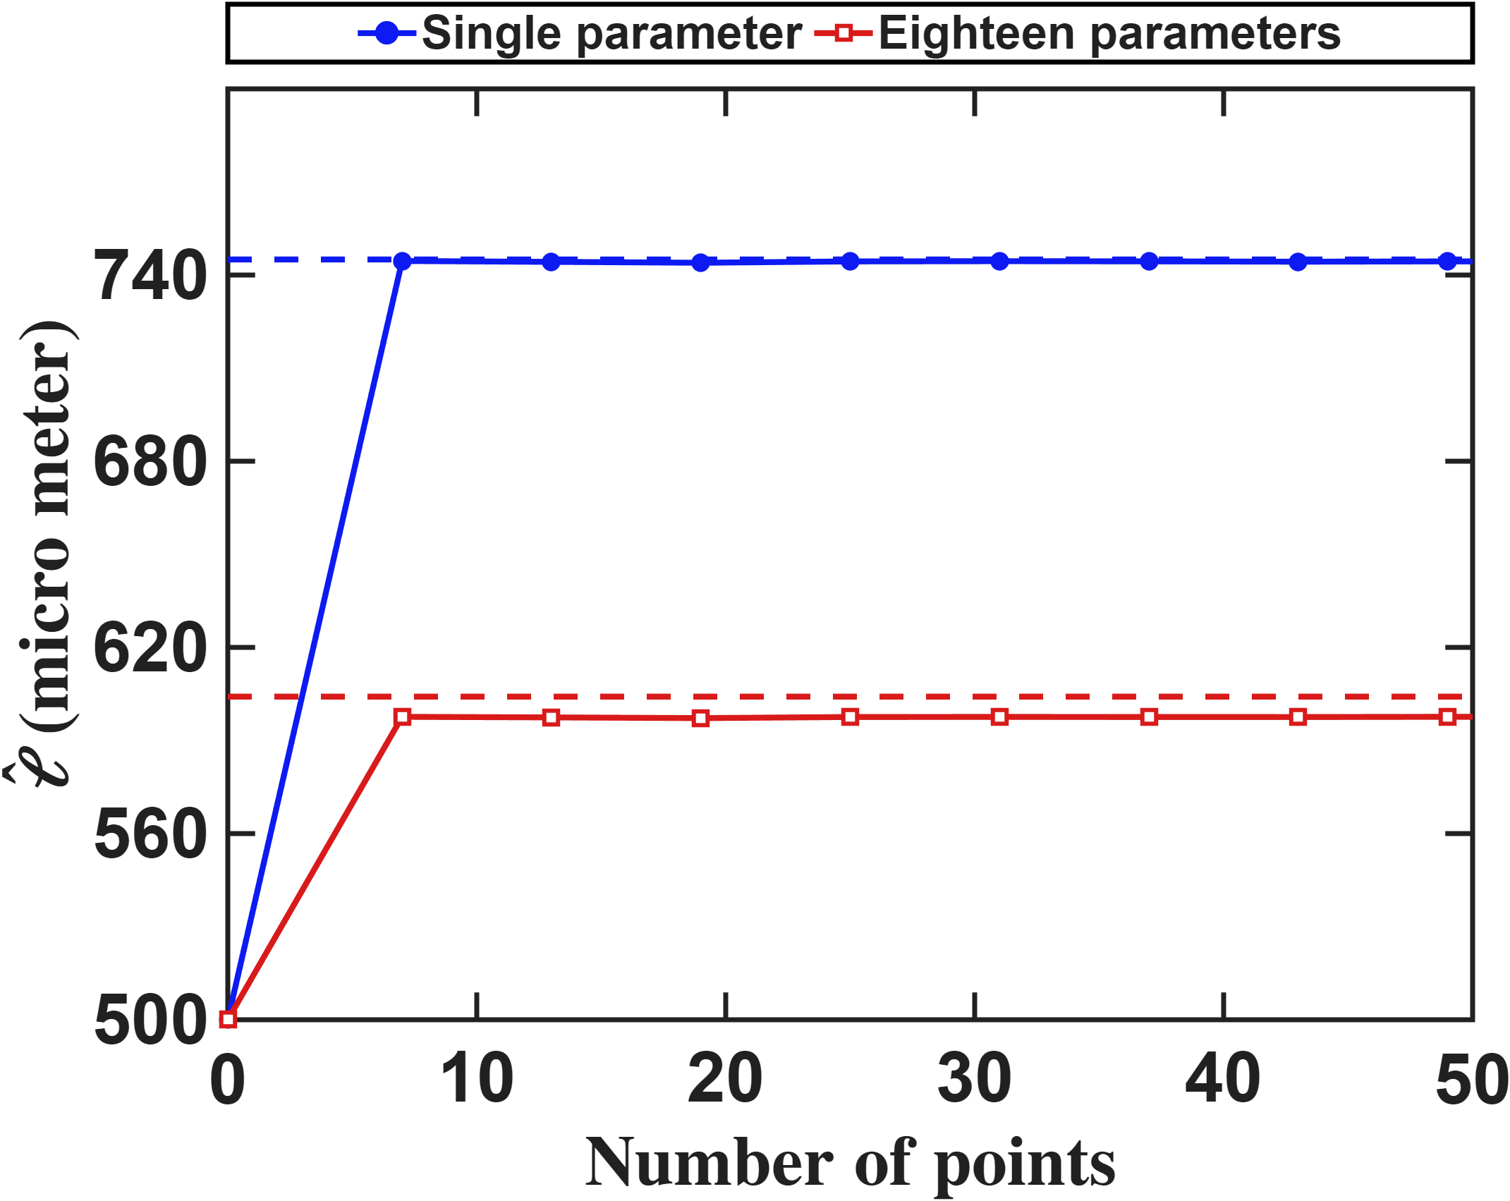
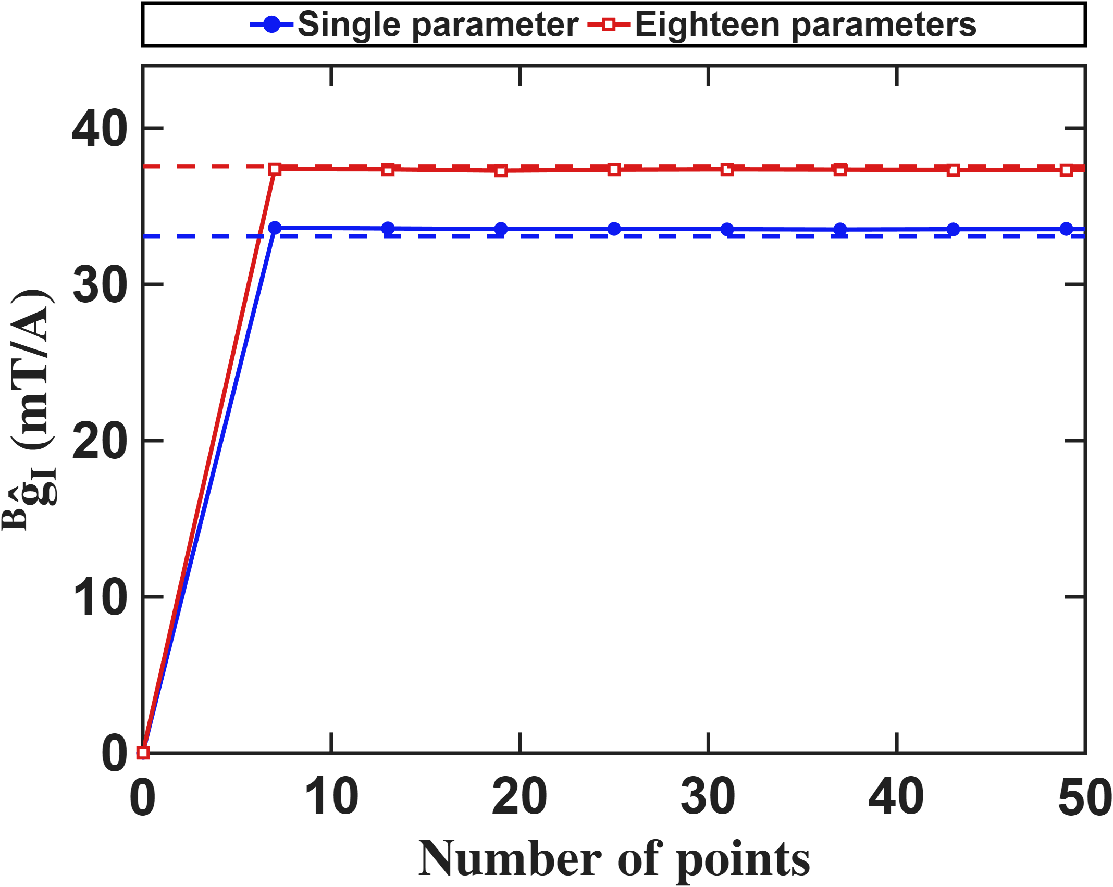
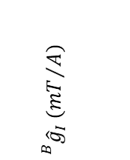
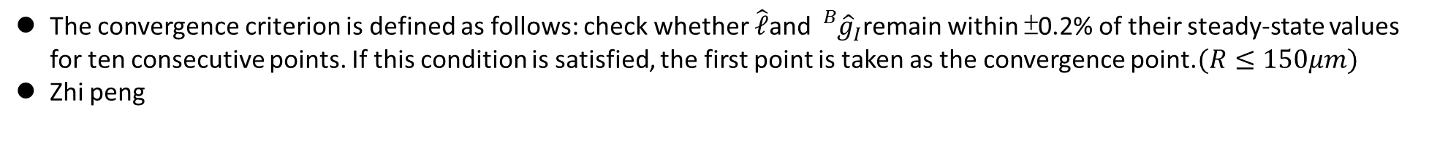


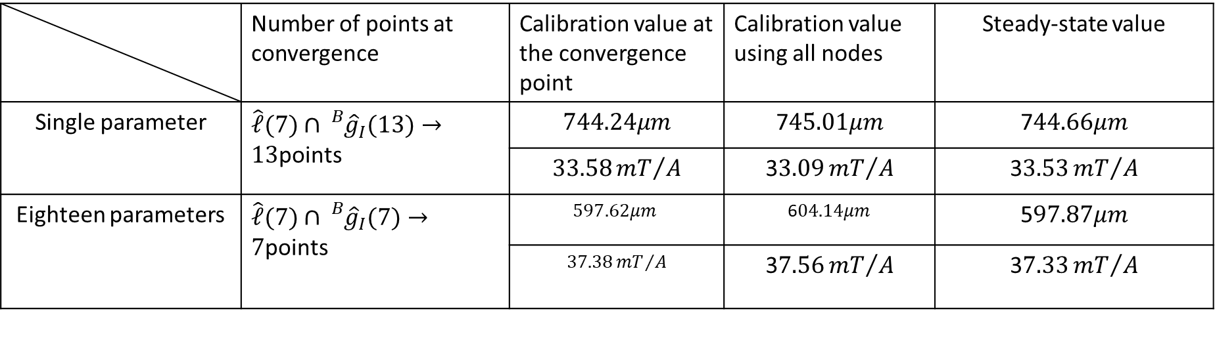
Current-based lumped-parameter modeling and calibration
E. Validation
The convergence criterion is defined as follows: check whether $\hat{ℓ}$and ${}_{}^{B}{{\hat{g}}_{I}}$remain within ±0.2% of their steady-state values for ten consecutive points. If this condition is satisfied, the first point is taken as the convergence point.$(R≤150μm)$
Zhi peng
$$\hat{ℓ} (μm)$$
$${}_{}^{B}{{\hat{g}}_{I}} ({mT}/A)$$
$$Number of points$$
$$Number of points$$
 | Number of points at convergence | Calibration value at the convergence point | Calibration value using all nodes | Steady-state value
Single parameter | $\hat{ℓ}(7)∩{}_{}^{B}{{\hat{g}}_{I}(13)}→13$points | $$744.24μm$$ | 7$45.01μm$ | 7$44.66μm$
 |  | $$33.58{mT}/A$$ | 3$3.09{mT}/A$ | 3$3.53{mT}/A$
Eighteen parameters | $\hat{ℓ}(7)∩{}_{}^{B}{{\hat{g}}_{I}(7)}→7$points | $$597.62μm$$ | 6$04.14μm$ | 5$97.87μm$
 |  | $$37.38{mT}/A$$ | 3$7.56{mT}/A$ | 3$7.33{mT}/A$

Slide 4
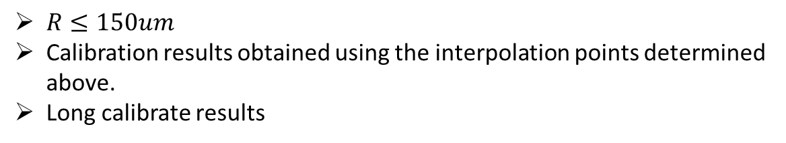





Current-based lumped-parameter modeling and calibration
E. Validation
Calibration results
$$Calibrate model→b_{ij}=S_{i}{}_{}^{B}{{\hat{g}}_{I}}{\overline{K}}_{I}I_{j}$$
$R≤150um$
Calibration results obtained using the interpolation points determined above.
Long calibrate results
Single parameter(31 points)
$${\bar{K}}_{I} = \left[\begin{matrix}0.8333 & −0.0957 & −0.1988 & −0.1664 & −0.1723 & −0.1957 \\ −0.2134 & 0.9601 & −0.2167 & −0.1508 & −0.1562 & −0.2131 \\ −0.1889 & −0.1679 & 0.8259 & −0.0970 & −0.1722 & −0.1957 \\ −0.2057 & −0.1513 & −0.2225 & 0.9554 & −0.1552 & −0.2123 \\ −0.2064 & −0.1514 & −0.2163 & −0.1510 & 0.9542 & −0.2206 \\ −0.1888 & −0.1673 & −0.1984 & −0.1665 & −0.1016 & 0.8265\end{matrix}\right]$$
$$\hat{ℓ} = 870.6 μm {}_{}^{B}{{\hat{g}}_{I}} = 9.68mT/A$$
$$NMAE=\frac{\sum_{j}{\sum_{i}{\left\|b_{ij}−S_{i}{}_{}^{B}{{\hat{g}}_{I}}{\overline{K}}_{I}I_{j}\right\|}}}{\sum_{j}{\sum_{i}{\left\|b_{ij}\right\|}}}∙100\%=2.81\%$$
Eighteen parameters(25 points)
$${\bar{K}}_{I} = \left[\begin{matrix}0.8333 & −0.1378 & −0.1312 & −0.1901 & −0.1925 & −0.1306 \\ −0.1386 & 0.8367 & −0.2057 & −0.1225 & −0.1249 & −0.2050 \\ −0.1307 & −0.1972 & 0.8441 & −0.1363 & −0.1954 & −0.1327 \\ −0.2042 & −0.1256 & −0.1397 & 0.8414 & −0.1256 & −0.2067 \\ −0.2071 & −0.1270 & −0.2096 & −0.1254 & 0.8517 & −0.1424 \\ −0.1303 & −0.1964 & −0.1327 & −0.1929 & −0.1355 & 0.8392\end{matrix}\right]$$
$$\hat{ℓ} = 867.9 μm {}_{}^{B}{{\hat{g}}_{I}} = 10.65 mT/A$$
$$NMAE=\frac{\sum_{j}{\sum_{i}{\left\|b_{ij}−S_{i}{}_{}^{B}{{\hat{g}}_{I}}{\overline{K}}_{I}I_{j}\right\|}}}{\sum_{j}{\sum_{i}{\left\|b_{ij}\right\|}}}∙100\%=0.33\%$$
$$\hat{e}= \left[\begin{matrix}0.0140 & 0.0208 & −0.1167 & 0.0012 & 0.0004 & −0.1170 \\ −0.1150 & 0.0024 & 0.0192 & 0.0171 & 0.0010 & −0.1165 \\ 0.1153 & −0.0026 & 0.1160 & −0.0021 & −0.0131 & −0.0177\end{matrix}\right]$$

Slide 5
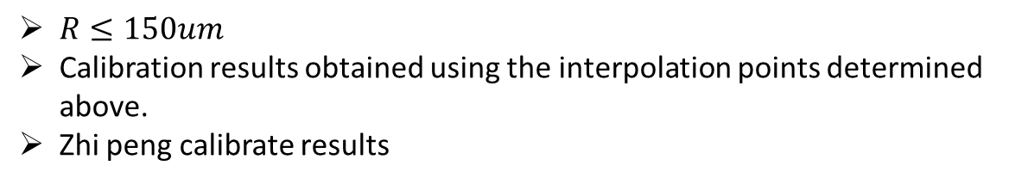



Current-based lumped-parameter modeling and calibration
E. Validation
Calibration results
$$Calibrate model→b_{ij}=S_{i}{}_{}^{B}{{\hat{g}}_{I}}{\overline{K}}_{I}I_{j}$$
$R≤150um$
Calibration results obtained using the interpolation points determined above.
Zhi peng calibrate results
Single parameter(13 points)
$${\bar{K}}_{I} = \left[\begin{matrix}0.8333 & −0.0645 & −0.2180 & −0.1078 & −0.1073 & −0.2164 \\ −0.0636 & 0.8255 & −0.1091 & −0.2206 & −0.2203 & −0.1074 \\ −0.2483 & −0.0993 & 0.7427 & −0.0564 & −0.0714 & −0.2344 \\ −0.0993 & −0.2525 & −0.0578 & 0.7369 & −0.2385 & −0.0723 \\ −0.0992 & −0.2524 & −0.0732 & −0.2386 & 0.7359 & −0.0560 \\ −0.2485 & −0.0993 & −0.2357 & −0.0716 & −0.0566 & 0.7447\end{matrix}\right]$$
$$\hat{ℓ} = 744.2 μm {}_{}^{B}{{\hat{g}}_{I}} = 33.58 mT/A$$
$$NMAE=\frac{\sum_{j}{\sum_{i}{\left\|b_{ij}−S_{i}{}_{}^{B}{{\hat{g}}_{I}}{\overline{K}}_{I}I_{j}\right\|}}}{\sum_{j}{\sum_{i}{\left\|b_{ij}\right\|}}}∙100\%=10.53\%$$
Eighteen parameters(7 points)
$${\bar{K}}_{I} = \left[\begin{matrix}0.8333 & −0.1078 & −0.1162 & −0.1870 & −0.1870 & −0.1162 \\ −0.1107 & 0.8260 & −0.1914 & −0.1201 & −0.1198 & −0.1906 \\ −0.1345 & −0.1938 & 0.7481 & −0.0935 & −0.1572 & −0.1313 \\ −0.1972 & −0.1383 & −0.0970 & 0.7389 & −0.1348 & −0.1609 \\ −0.1977 & −0.1385 & −0.1612 & −0.1353 & 0.7403 & −0.0971 \\ −0.1345 & −0.1936 & −0.1308 & −0.1569 & −0.0931 & 0.7466\end{matrix}\right]$$
$$\hat{ℓ} = 597.6 μm {}_{}^{B}{{\hat{g}}_{I}} = 37.38 mT/A$$
$$NMAE=\frac{\sum_{j}{\sum_{i}{\left\|b_{ij}−S_{i}{}_{}^{B}{{\hat{g}}_{I}}{\overline{K}}_{I}I_{j}\right\|}}}{\sum_{j}{\sum_{i}{\left\|b_{ij}\right\|}}}∙100\%=0.75\%$$
$$\hat{e}= \left[\begin{matrix}−0.0008 & 0.0013 & −0.2149 & 0.2140 & 0.2148 & −0.2140 \\ −0.2137 & 0.2139 & 0.0011 & 0.0002 & 0.2156 & −0.2138 \\ 0.2136 & −0.2143 & 0.2143 & −0.2150 & 0.0009 & −0.0003\end{matrix}\right]$$

Slide 6
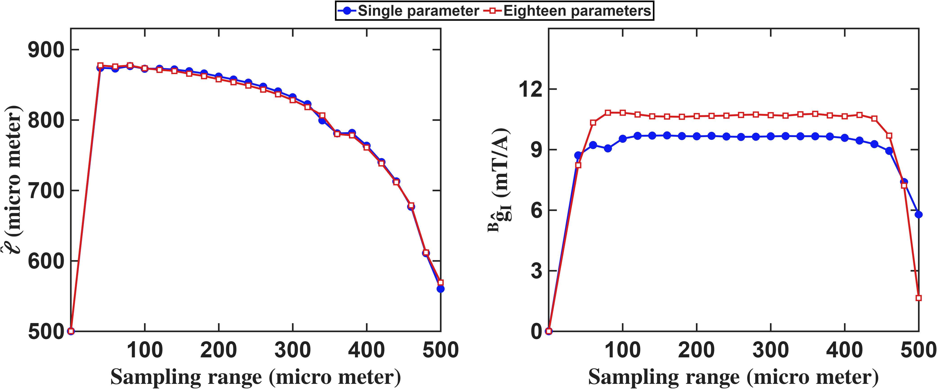
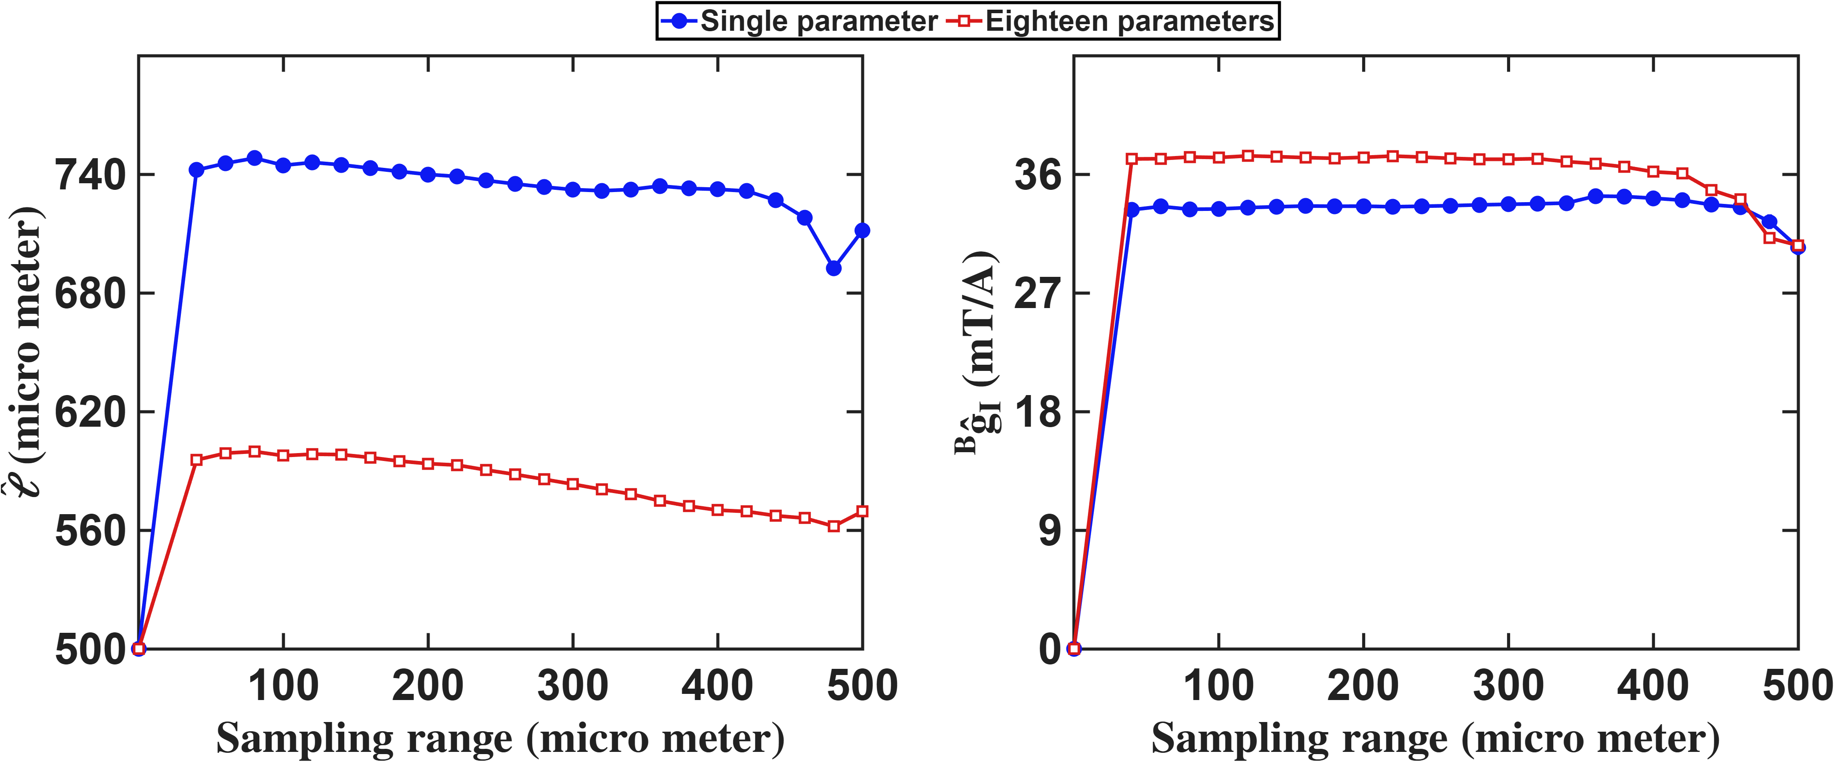

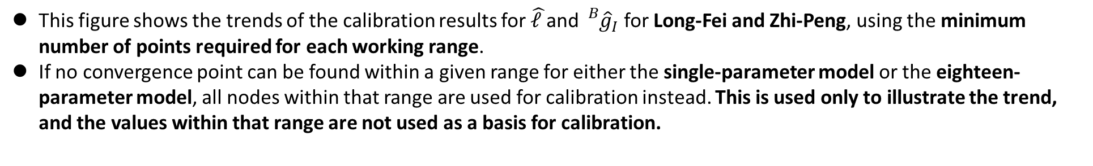
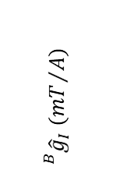
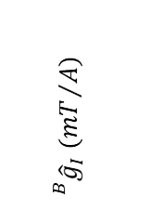





Current-based lumped-parameter modeling and calibration
E. Validation
This figure shows the trends of the calibration results for $\hat{ℓ }$and ${}_{}^{B}{{\hat{g}}_{I}}$ for Long-Fei and Zhi-Peng, using the minimum number of points required for each working range.
If no convergence point can be found within a given range for either the single-parameter model or the eighteen-parameter model, all nodes within that range are used for calibration instead. This is used only to illustrate the trend, and the values within that range are not used as a basis for calibration.
Long
Zhi peng
$$\hat{ℓ} (μm)$$
$${}_{}^{B}{{\hat{g}}_{I}} ({mT}/A)$$
$$\hat{ℓ} (μm)$$
$${}_{}^{B}{{\hat{g}}_{I}} ({mT}/A)$$
$$Workspace radius(μm)$$
$$Workspace radius(μm)$$
$$Workspace radius(μm)$$
$$Workspace radius(μm)$$

Slide 7
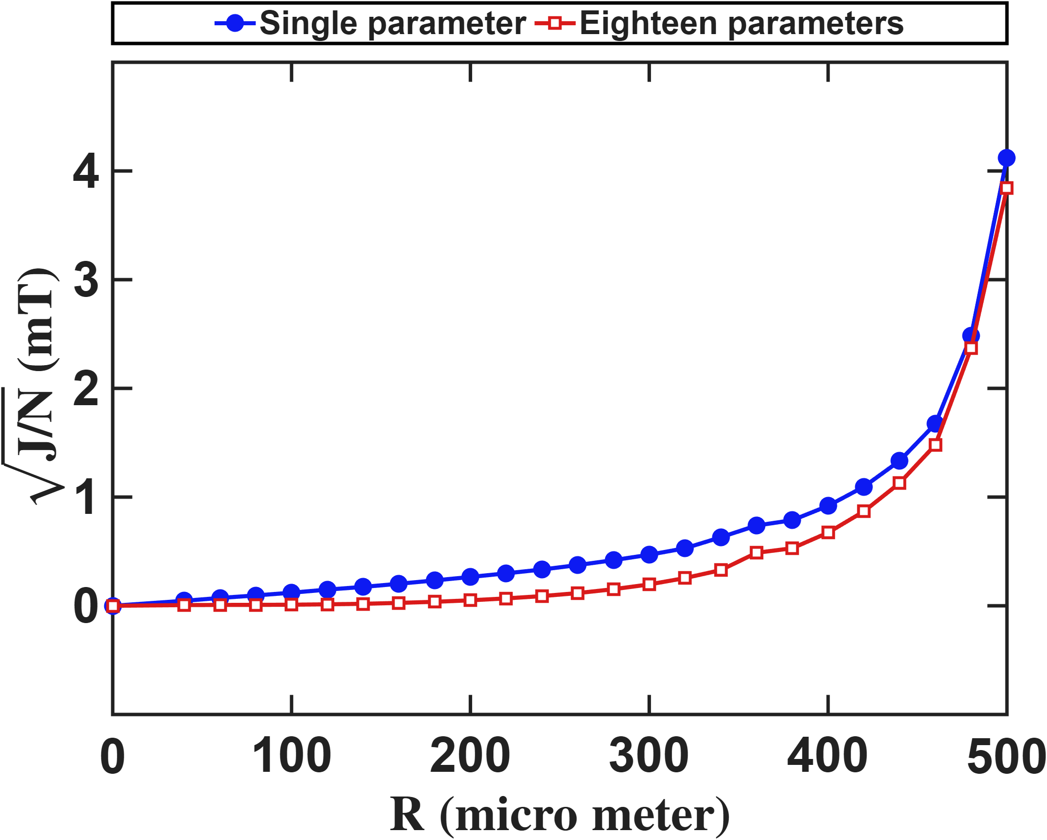
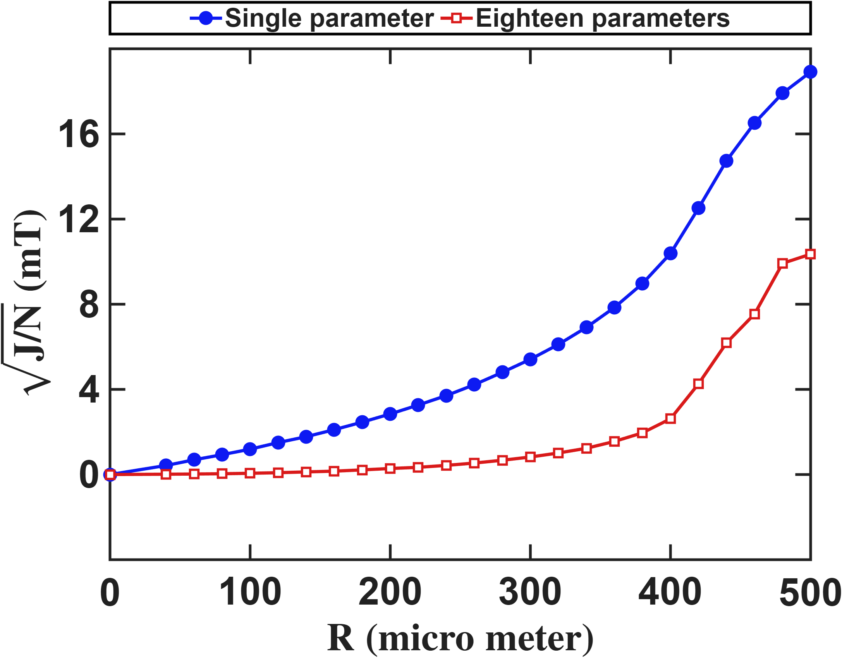




Current-based lumped-parameter modeling and calibration
E. Validation
Setup: The calibration side is identical to the previous slide: the same R sweep, the same converged reduced design at each R. What changes is the evaluation: the predict is computed on every real FEM node inside R.
Long
Zhi peng
$$Predict error (mT)$$
$$Predict error (mT)$$
$$Workspace radius (μm)$$
$$Workspace radius (μm)$$

Slide 8
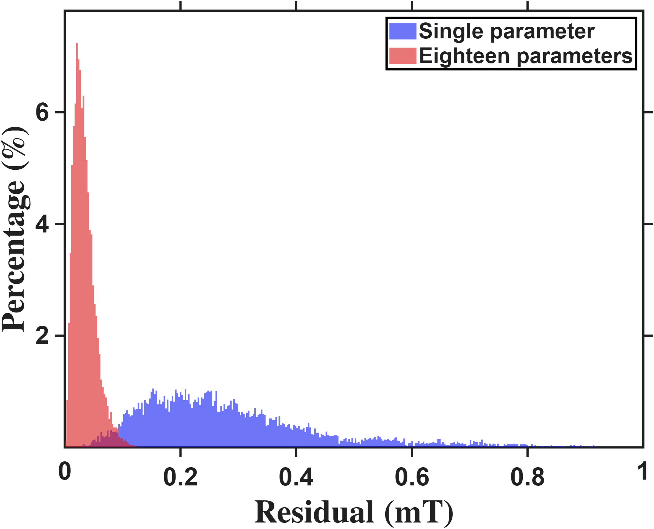
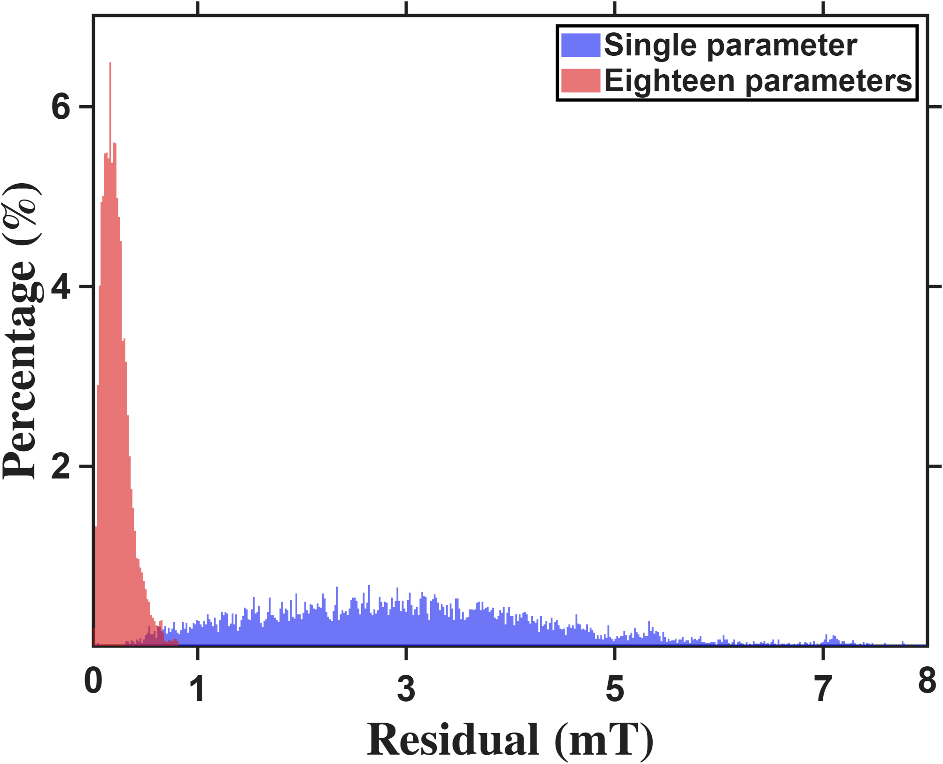

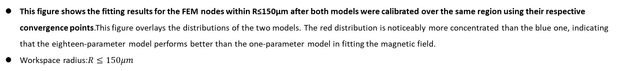






Current-based lumped-parameter modeling and calibration
E. Validation
$$Calibrate model→b_{ij}=S_{i}{}_{}^{B}{{\hat{g}}_{I}}{\overline{K}}_{I}I_{j}$$
This figure shows the fitting results for the FEM nodes within R≤150μm after both models were calibrated over the same region using their respective convergence points.This figure overlays the distributions of the two models. The red distribution is noticeably more concentrated than the blue one, indicating that the eighteen-parameter model performs better than the one-parameter model in fitting the magnetic field.
Workspace radius:$R≤150μm$
Long($N_{p}$:1771)
Zhi peng ($N_{p}$:1791)
$$Percentage count(\%)$$
$$Percentage count(\%)$$
$$Predict error (mT)$$
$$Predict error (mT)$$
Resolution:2.8uT
Resolution:17uT
 | Single | Eighteen
Mean | 0.2878mT | 0.0340mT
 | Single | Eighteen
Mean | 3.0658mT | 0.2190mT

Slide 9
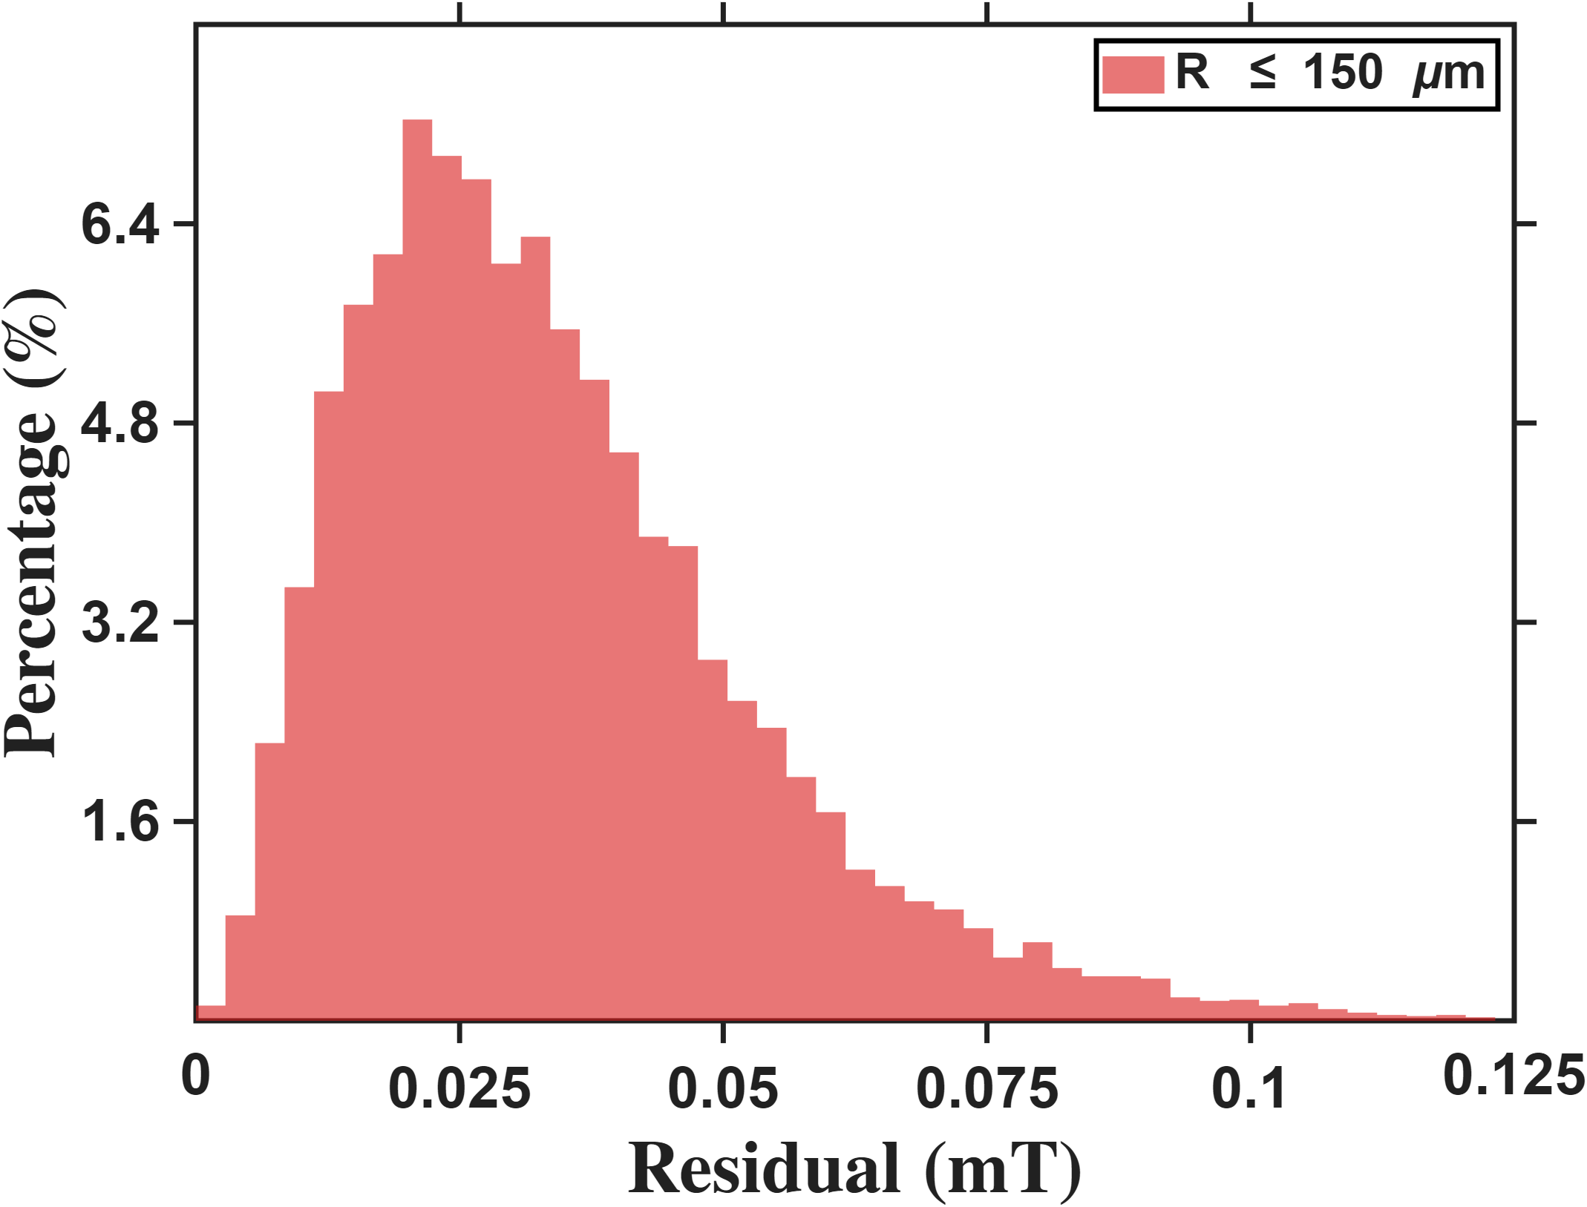
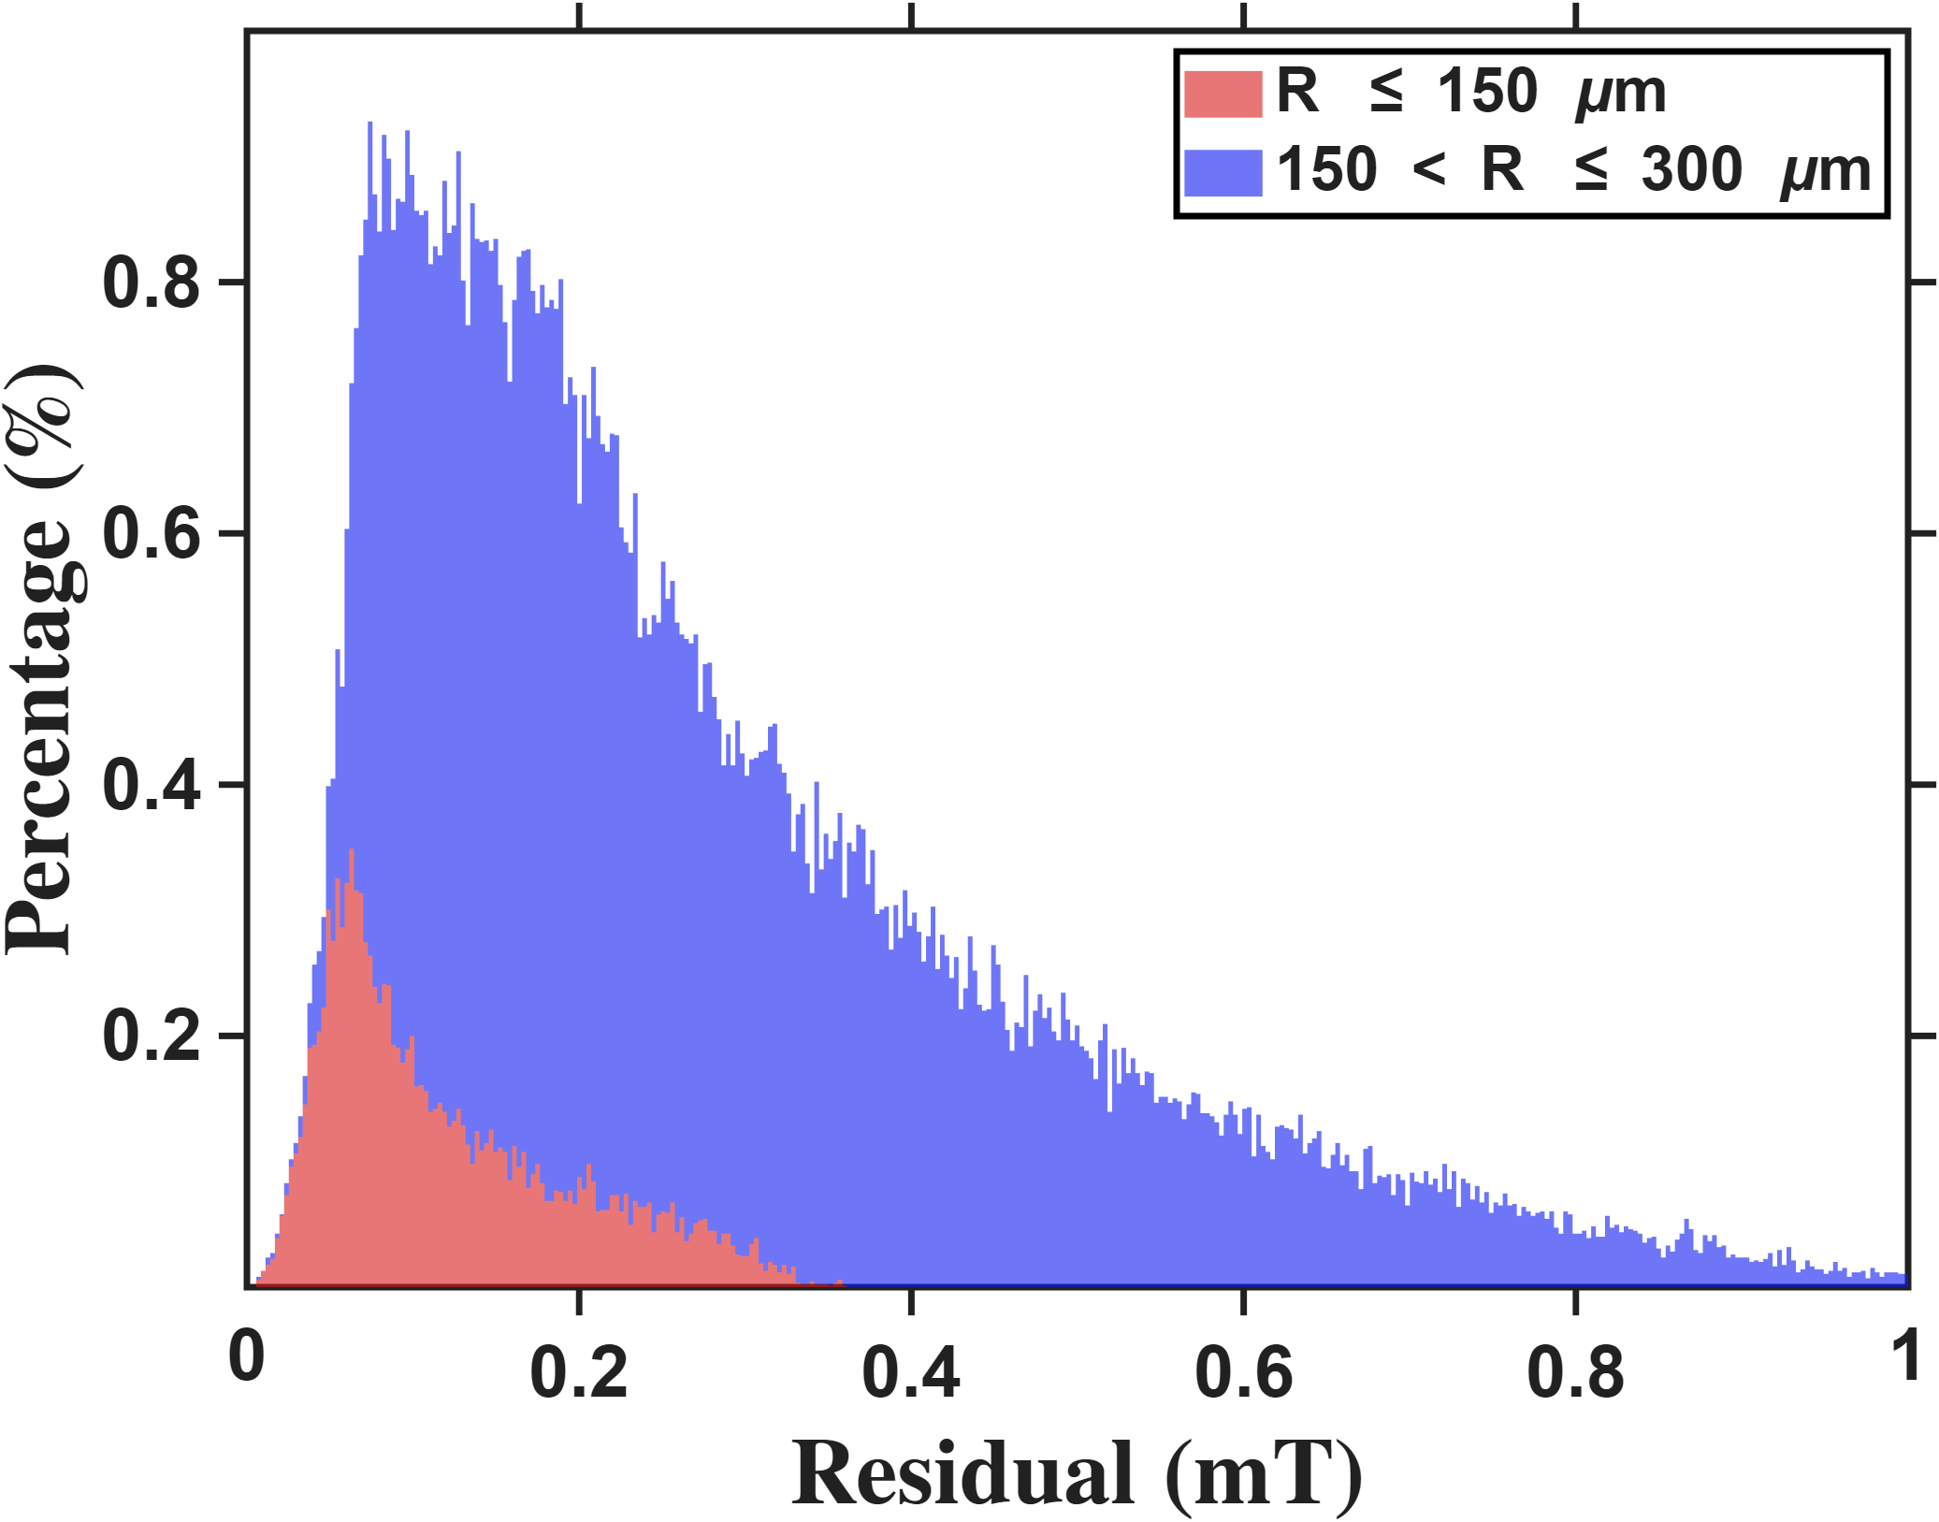




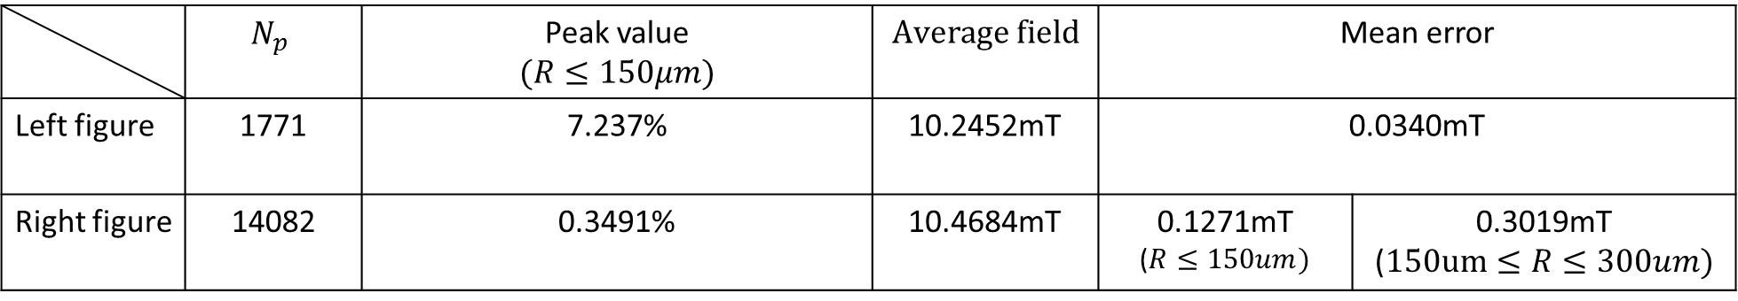
Current-based lumped-parameter modeling and calibration
E. Validation
Setup: Calibration is performed using the eighteen-parameter calibration points, followed by fitting to the FEM nodes within the workspace.
Long
$$Percentage count(\%)$$
$$Percentage count(\%)$$
$$Predict error (mT)$$
$$Predict error (mT)$$
 | $$N_{p}$$ | Peak value $$(R≤150μm)$$ | $$Average field$$ | Mean error
Left figure | 1771 | 7.237% | 10.2452mT | 0.0340mT
Right figure | 14082 | 0.3491% | 10.4684mT | 0.1271mT ($R≤150um)$ | 0.3019mT ($150um≤R≤300um)$
Resolution:2.8uT

Slide 10
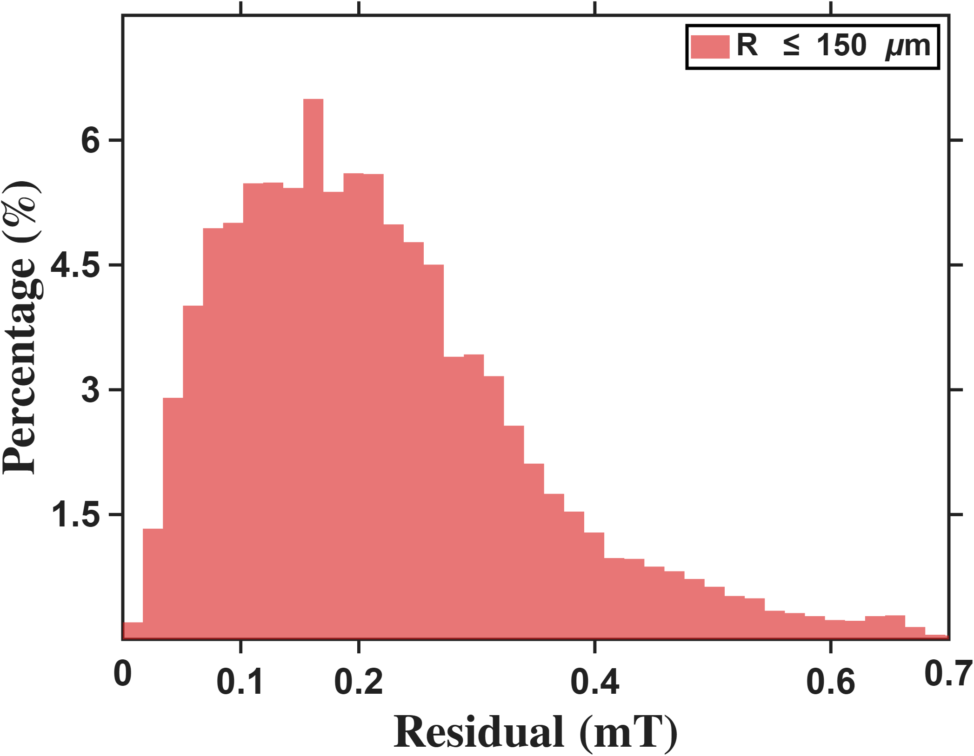
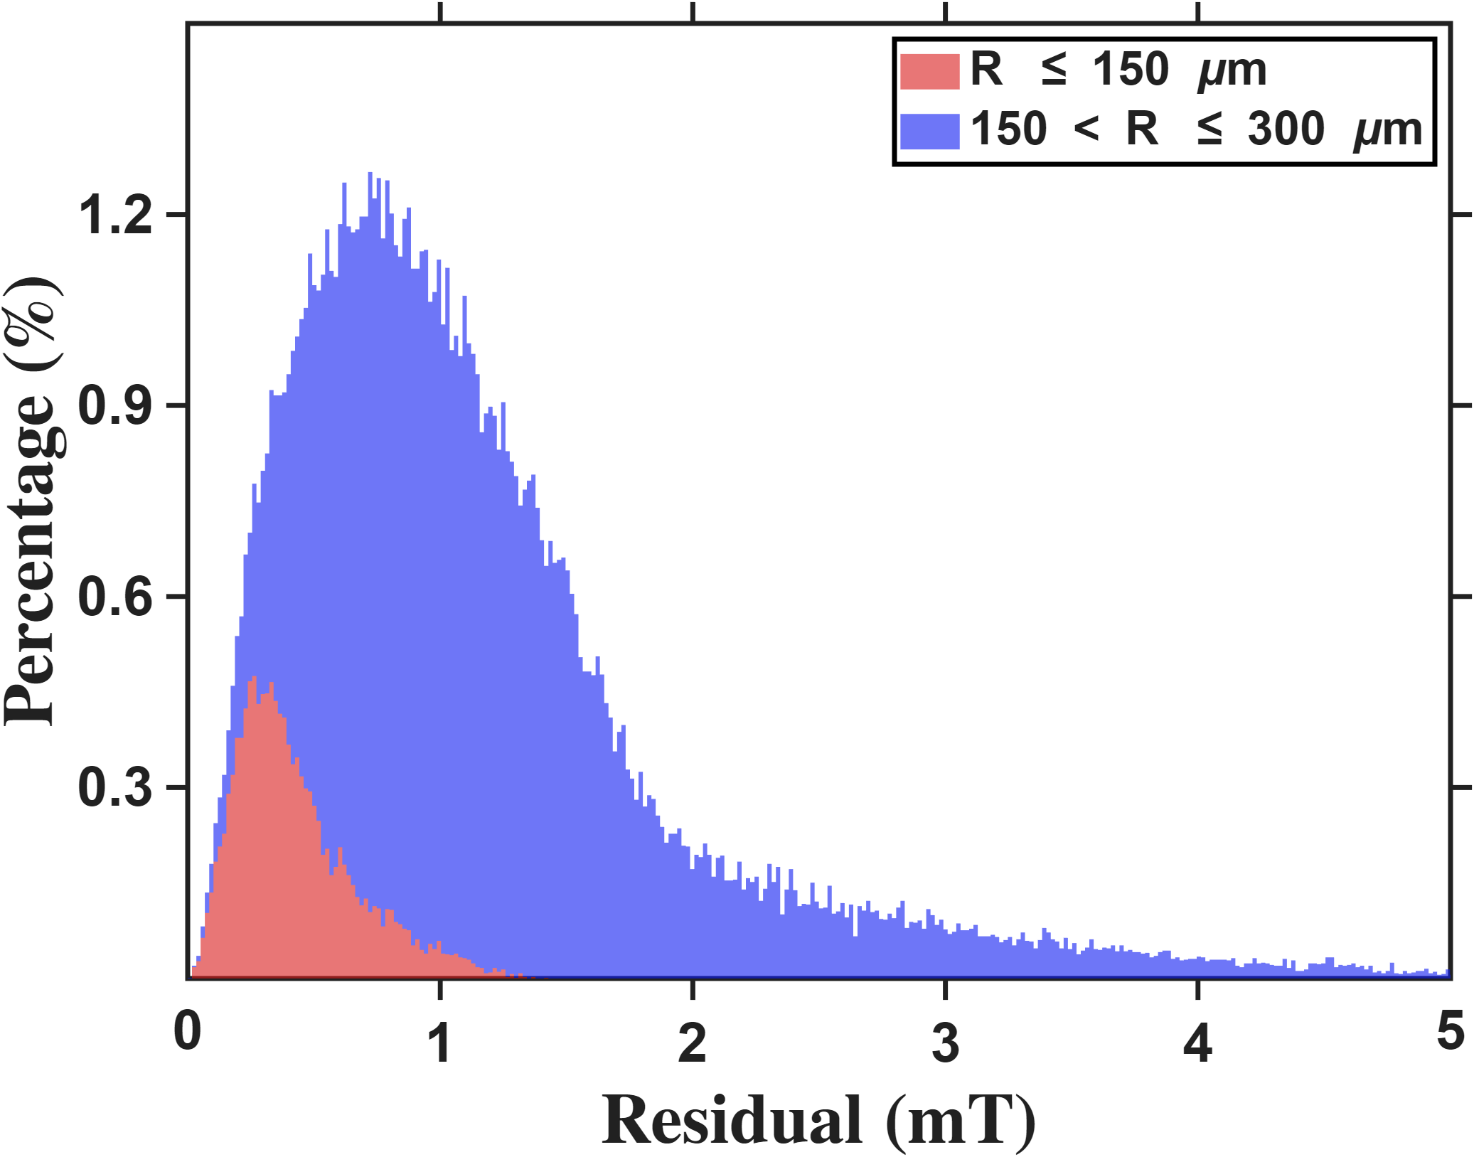
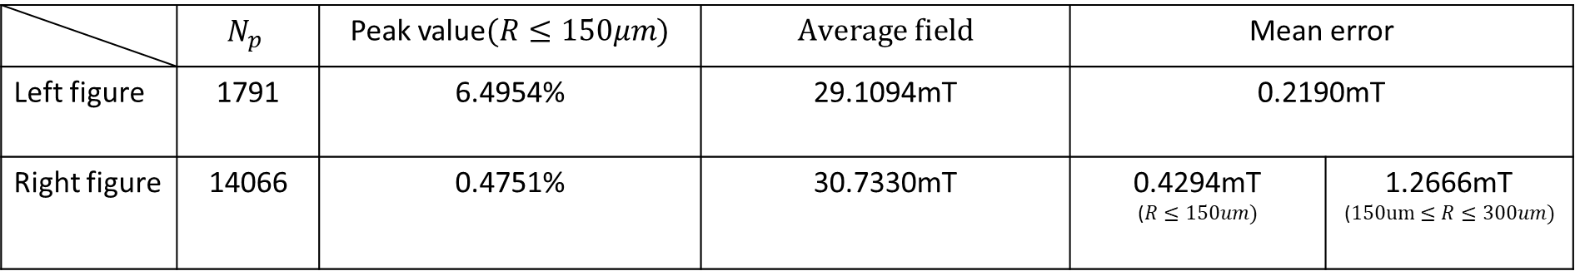




Current-based lumped-parameter modeling and calibration
E. Validation
Setup: Calibration is performed using the eighteen-parameter calibration points, followed by fitting to the FEM nodes within the workspace.
Zhi peng
$$Percentage count(\%)$$
$$Percentage count(\%)$$
$$Residual error (mT)$$
$$Residual error (mT)$$
 | $$N_{p}$$ | Peak value$(R≤150μm)$ | $$Average field$$ | Mean error
Left figure | 1791 | 6.4954% | 29.1094mT | 0.2190mT
Right figure | 14066 | 0.4751% | 30.7330mT | 0.4294mT ($R≤150um)$ | 1.2666mT ($150um≤R≤300um)$
Resolution:17uT

Slide 11



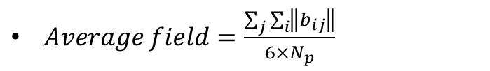

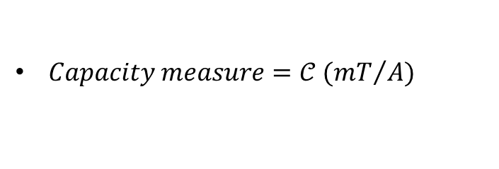
Reference
$Workspace radius=\hat{ℓ}$
$Flux distribution matrix={\overline{K}}_{I}$
$Current to field gain={}_{}^{B}{{\hat{g}}_{I}}$
$Voltage to field gain={}_{}^{B}{{\hat{g}}_{V}}$
$Predict error=\sqrt{\frac{J}{N_{p}}}$, where $J=\sum_{j}{\sum_{i}{{ε_{ij}}^{T}ε_{ij}}}$
$Capacity measure=𝒞 ({mT}/A)$
$Isotropy=κ$
$Average field=\frac{\sum_{j}{\sum_{i}{\left\|b_{ij}\right\|}}}{6×N_{p}}$

Slide 12




Reference
$Long calibrate result(N_{p}=1771)$
$Single(1771 points)$
$Eighteen$(1771 points)
$${\bar{K}}_{I} = \left[\begin{matrix}0.8333 & −0.1046 & −0.1809 & −0.1745 & −0.1737 & −0.1827 \\ −0.2145 & 0.9517 & −0.1986 & −0.1589 & −0.1576 & −0.2002 \\ −0.1870 & −0.1737 & 0.8427 & −0.1076 & −0.1740 & −0.1827 \\ −0.2040 & −0.1571 & −0.2068 & 0.9456 & −0.1569 & −0.1994 \\ −0.2045 & −0.1573 & −0.1983 & −0.1589 & 0.9514 & −0.2097 \\ −0.1870 & −0.1734 & −0.1804 & −0.1746 & −0.1054 & 0.8382\end{matrix}\right]$$
$${\bar{K}}_{I} = \left[\begin{matrix}0.8333 & −0.1369 & −0.1291 & −0.1933 & −0.1926 & −0.1289 \\ −0.1380 & 0.8309 & −0.2033 & −0.1231 & −0.1230 & −0.2030 \\ −0.1276 & −0.1923 & 0.8291 & −0.1358 & −0.1920 & −0.1284 \\ −0.2042 & −0.1233 & −0.1403 & 0.8365 & −0.1235 & −0.2048 \\ −0.2033 & −0.1230 & −0.2038 & −0.1234 & 0.8338 & −0.1392 \\ −0.1279 & −0.1928 & −0.1288 & −0.1936 & −0.1366 & 0.8328\end{matrix}\right]$$
$$\hat{ℓ} =\text{874.25}μm {}_{}^{B}{{\hat{g}}_{I}} = 9.67 mT/A$$
$$\hat{ℓ} = 874.0μm {}_{}^{B}{{\hat{g}}_{I}} = 10.75 mT/A$$
$$NMAE=\frac{\sum_{j}{\sum_{i}{\left\|b_{ij}−S_{i}{}_{}^{B}{{\hat{g}}_{I}}{\overline{K}}_{I}I_{j}\right\|}}}{\sum_{j}{\sum_{i}{\left\|b_{ij}\right\|}}}∙100\%=2.81\%$$
$$NMAE=\frac{\sum_{j}{\sum_{i}{\left\|b_{ij}−S_{i}{}_{}^{B}{{\hat{g}}_{I}}{\overline{K}}_{I}I_{j}\right\|}}}{\sum_{j}{\sum_{i}{\left\|b_{ij}\right\|}}}∙100\%=0.27\%$$
$$\hat{e}= \left[\begin{matrix}0.0183 & 0.0195 & −0.1173 & 0.0021 & 0.0012 & −0.1180 \\ −0.1178 & 0.0024 & 0.0155 & 0.0147 & 0.0016 & −0.1180 \\ 0.1176 & −0.0022 & 0.1167 & −0.0029 & −0.0178 & −0.0181\end{matrix}\right]$$

Slide 13


Reference
$Zhi peng calibrate result(N_{p}=1791)$
$Single(1791 points)$
$Eighteen$(1791 points)
$${\bar{K}}_{I} = \left[\begin{matrix}0.8333 & −0.0649 & −0.2224 & −0.1009 & −0.1009 & −0.2226 \\ −0.0764 & 0.8376 & −0.1125 & −0.2147 & −0.2148 & −0.1127 \\ −0.2595 & −0.0965 & 0.7482 & −0.0526 & −0.0643 & −0.2407 \\ −0.1091 & −0.2511 & −0.0638 & 0.7518 & −0.2331 & −0.0768 \\ −0.1090 & −0.2510 & −0.0765 & −0.2329 & 0.7509 & −0.0638 \\ −0.2596 & −0.0966 & −0.2405 & −0.0643 & −0.0529 & 0.7485\end{matrix}\right]$$
$${\bar{K}}_{I} = \left[\begin{matrix}0.8333 & −0.1070 & −0.1150 & −0.1879 & −0.1878 & −0.1150 \\ −0.1106 & 0.8267 & −0.1923 & −0.1191 & −0.1190 & −0.1923 \\ −0.1328 & −0.1947 & 0.7452 & −0.0927 & −0.1569 & −0.1292 \\ −0.1986 & −0.1368 & −0.0967 & 0.7376 & −0.1333 & −0.1617 \\ −0.1985 & −0.1367 & −0.1616 & −0.1333 & 0.7371 & −0.0967 \\ −0.1328 & −0.1946 & −0.1292 & −0.1571 & −0.0926 & 0.7454\end{matrix}\right]$$
$$\hat{ℓ} = 745.0 μm {}_{}^{B}{{\hat{g}}_{I}} = 33.09 mT/A$$
$$\hat{ℓ} = 604.1 μm {}_{}^{B}{{\hat{g}}_{I}} = 37.56 mT/A$$
$$NMAE=\frac{\sum_{j}{\sum_{i}{\left\|b_{ij}−S_{i}{}_{}^{B}{{\hat{g}}_{I}}{\overline{K}}_{I}I_{j}\right\|}}}{\sum_{j}{\sum_{i}{\left\|b_{ij}\right\|}}}∙100\%=10.50\%$$
$$NMAE=\frac{\sum_{j}{\sum_{i}{\left\|b_{ij}−S_{i}{}_{}^{B}{{\hat{g}}_{I}}{\overline{K}}_{I}I_{j}\right\|}}}{\sum_{j}{\sum_{i}{\left\|b_{ij}\right\|}}}∙100\%=0.68\%$$
$$\hat{e}= \left[\begin{matrix}−0.0002 & 0.0004 & −0.2164 & 0.2160 & 0.2165 & −0.2161 \\ −0.2162 & 0.2165 & 0.0003 & −0.0000 & 0.2168 & −0.2161 \\ 0.2161 & −0.2164 & 0.2162 & −0.2166 & −0.0001 & −0.0003\end{matrix}\right]$$

Slide 14
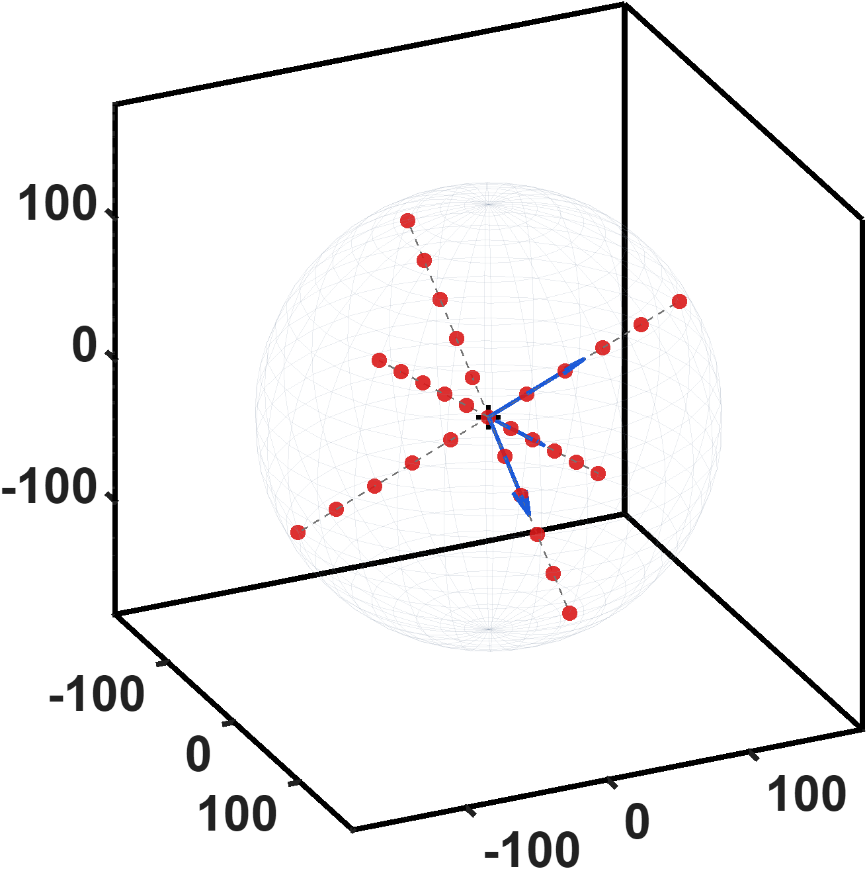
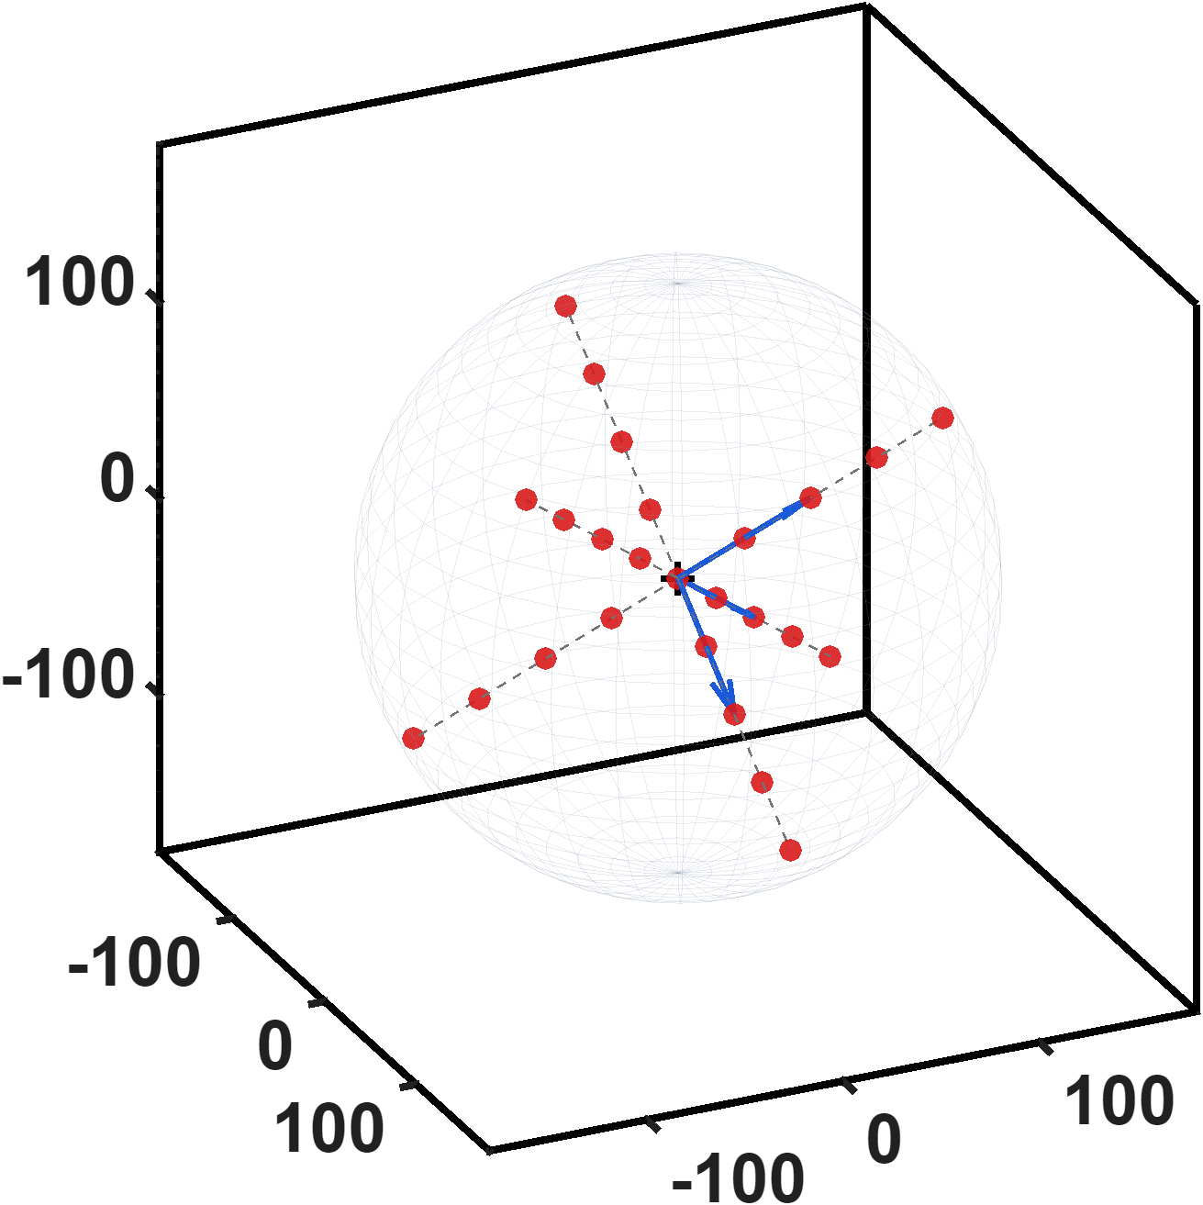

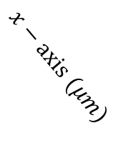





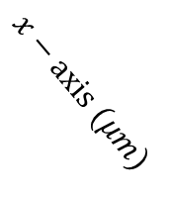






Reference
$Point distribution(Long at R≤150um)$
$Single(31 points)$
$Eighteen$(25 points)
$$z−axis (μm)$$
$$z_{a}$$
$$z_{a}$$
$$z−axis (μm)$$
$$y_{a}$$
$$y_{a}$$
$$x_{a}$$
$$x_{a}$$
$$x−axis (μm)$$
$$x−axis (μm)$$
$$y−axis (μm)$$
$$y−axis (μm)$$

Slide 15
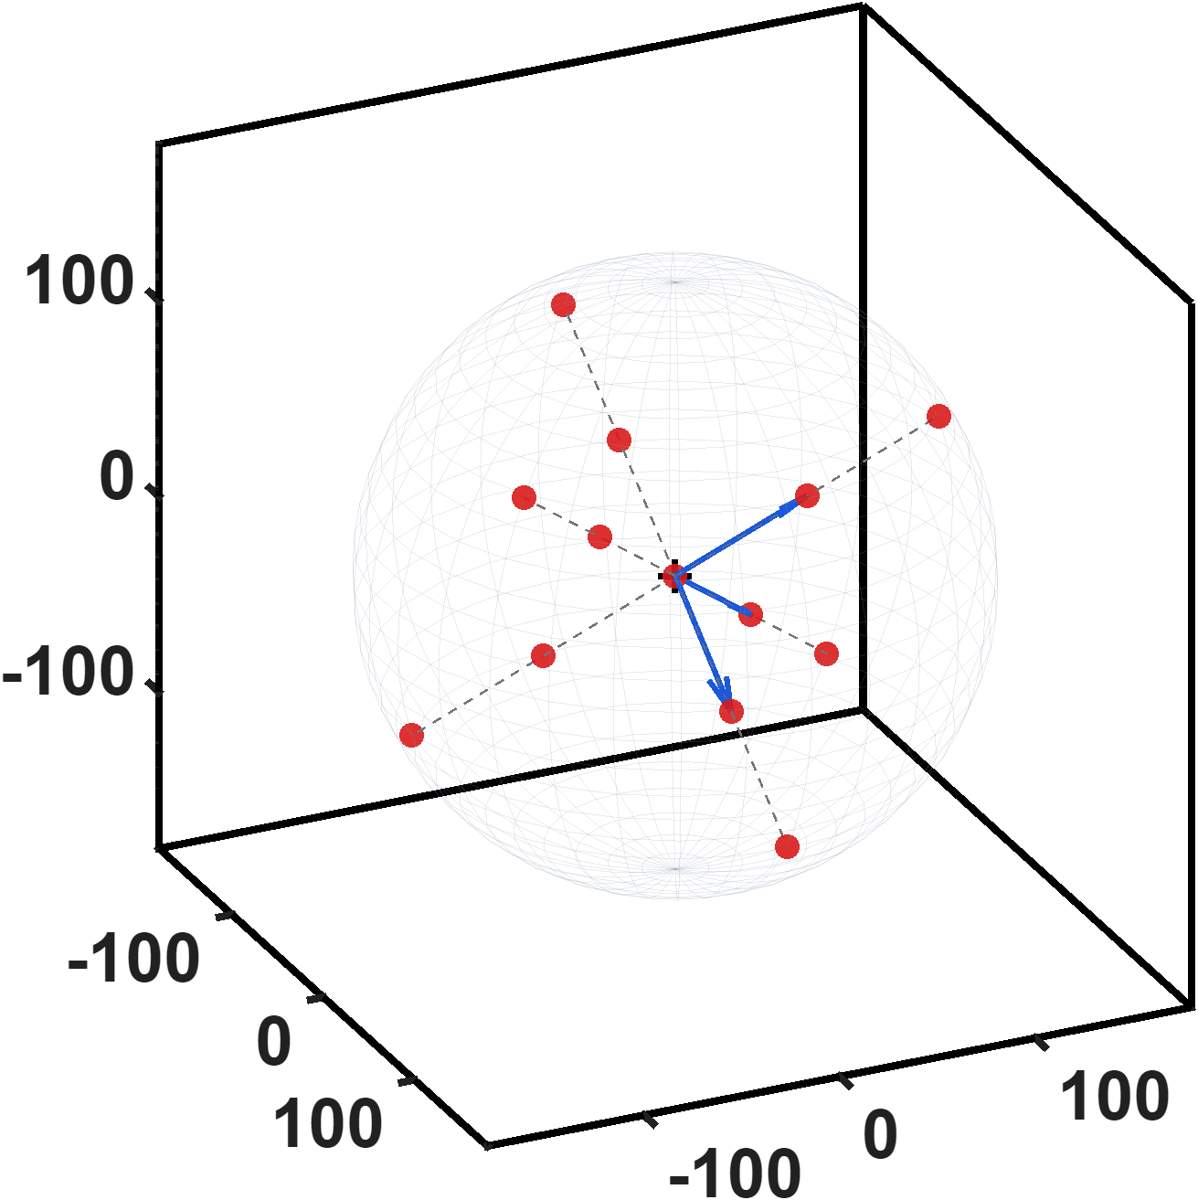
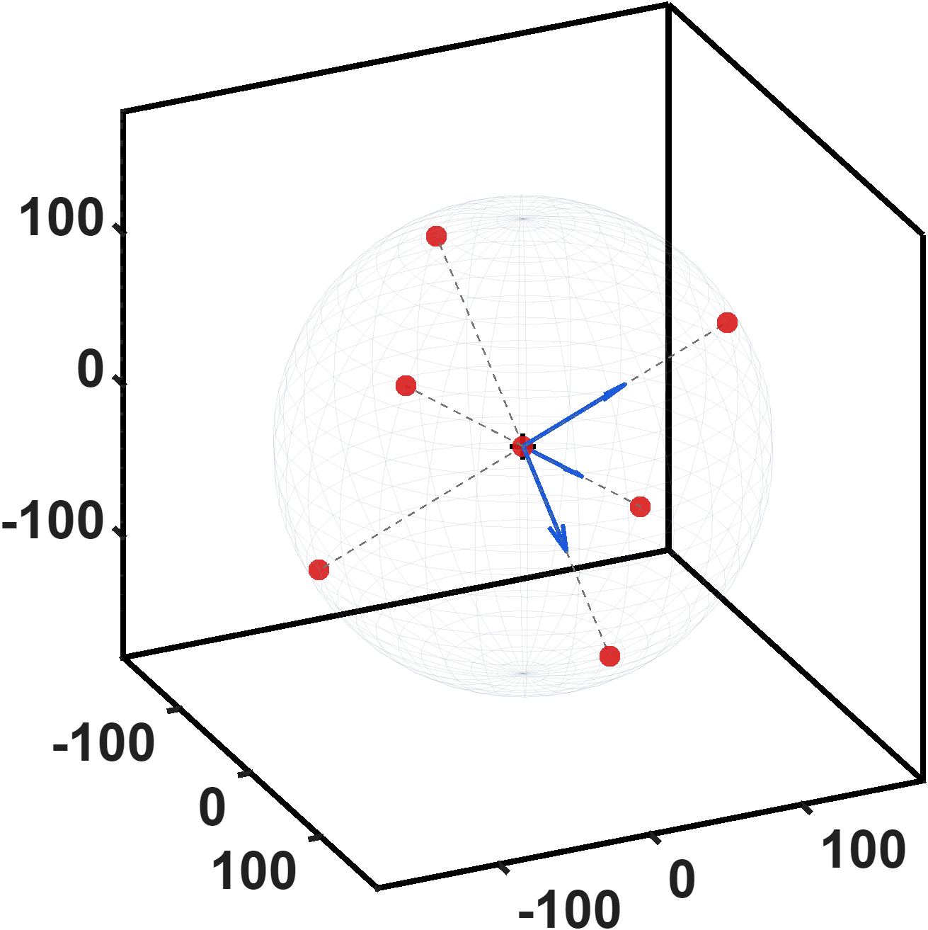

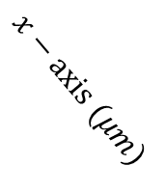





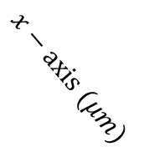






Reference
$Point distribution(Zhi peng at R≤150um)$
$Single(13 points)$
$Eighteen$(7 points)
$$z−axis (μm)$$
$$z_{a}$$
$$z−axis (μm)$$
$$z_{a}$$
$$y_{a}$$
$$y_{a}$$
$$x_{a}$$
$$x_{a}$$
$$x−axis (μm)$$
$$x−axis (μm)$$
$$y−axis (μm)$$
$$y−axis (μm)$$

