Slide 1
A Lumped-Parameter Modeling, Calibration, and Capacity-Measure Framework for Flux Generation in Symmetric
Multipole Electromagnetic Actuators

Slide 2
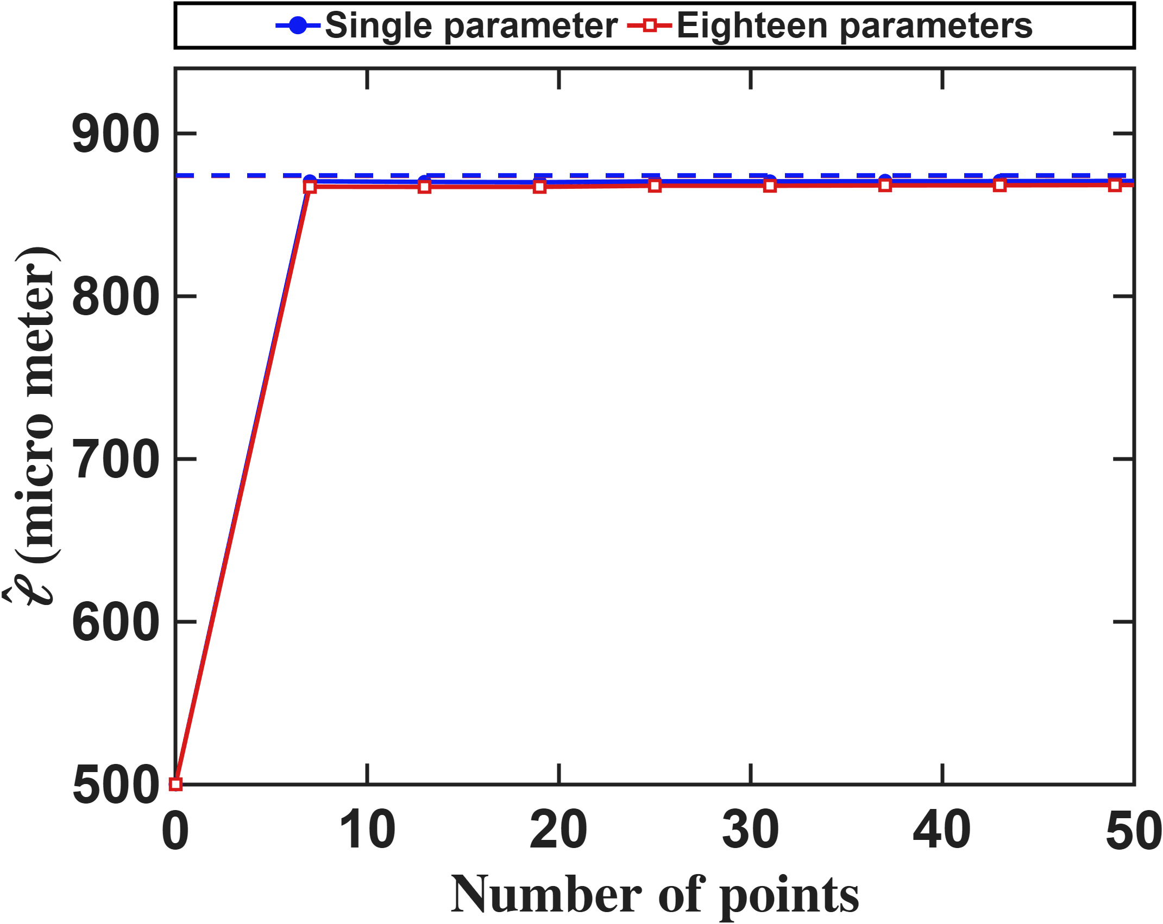
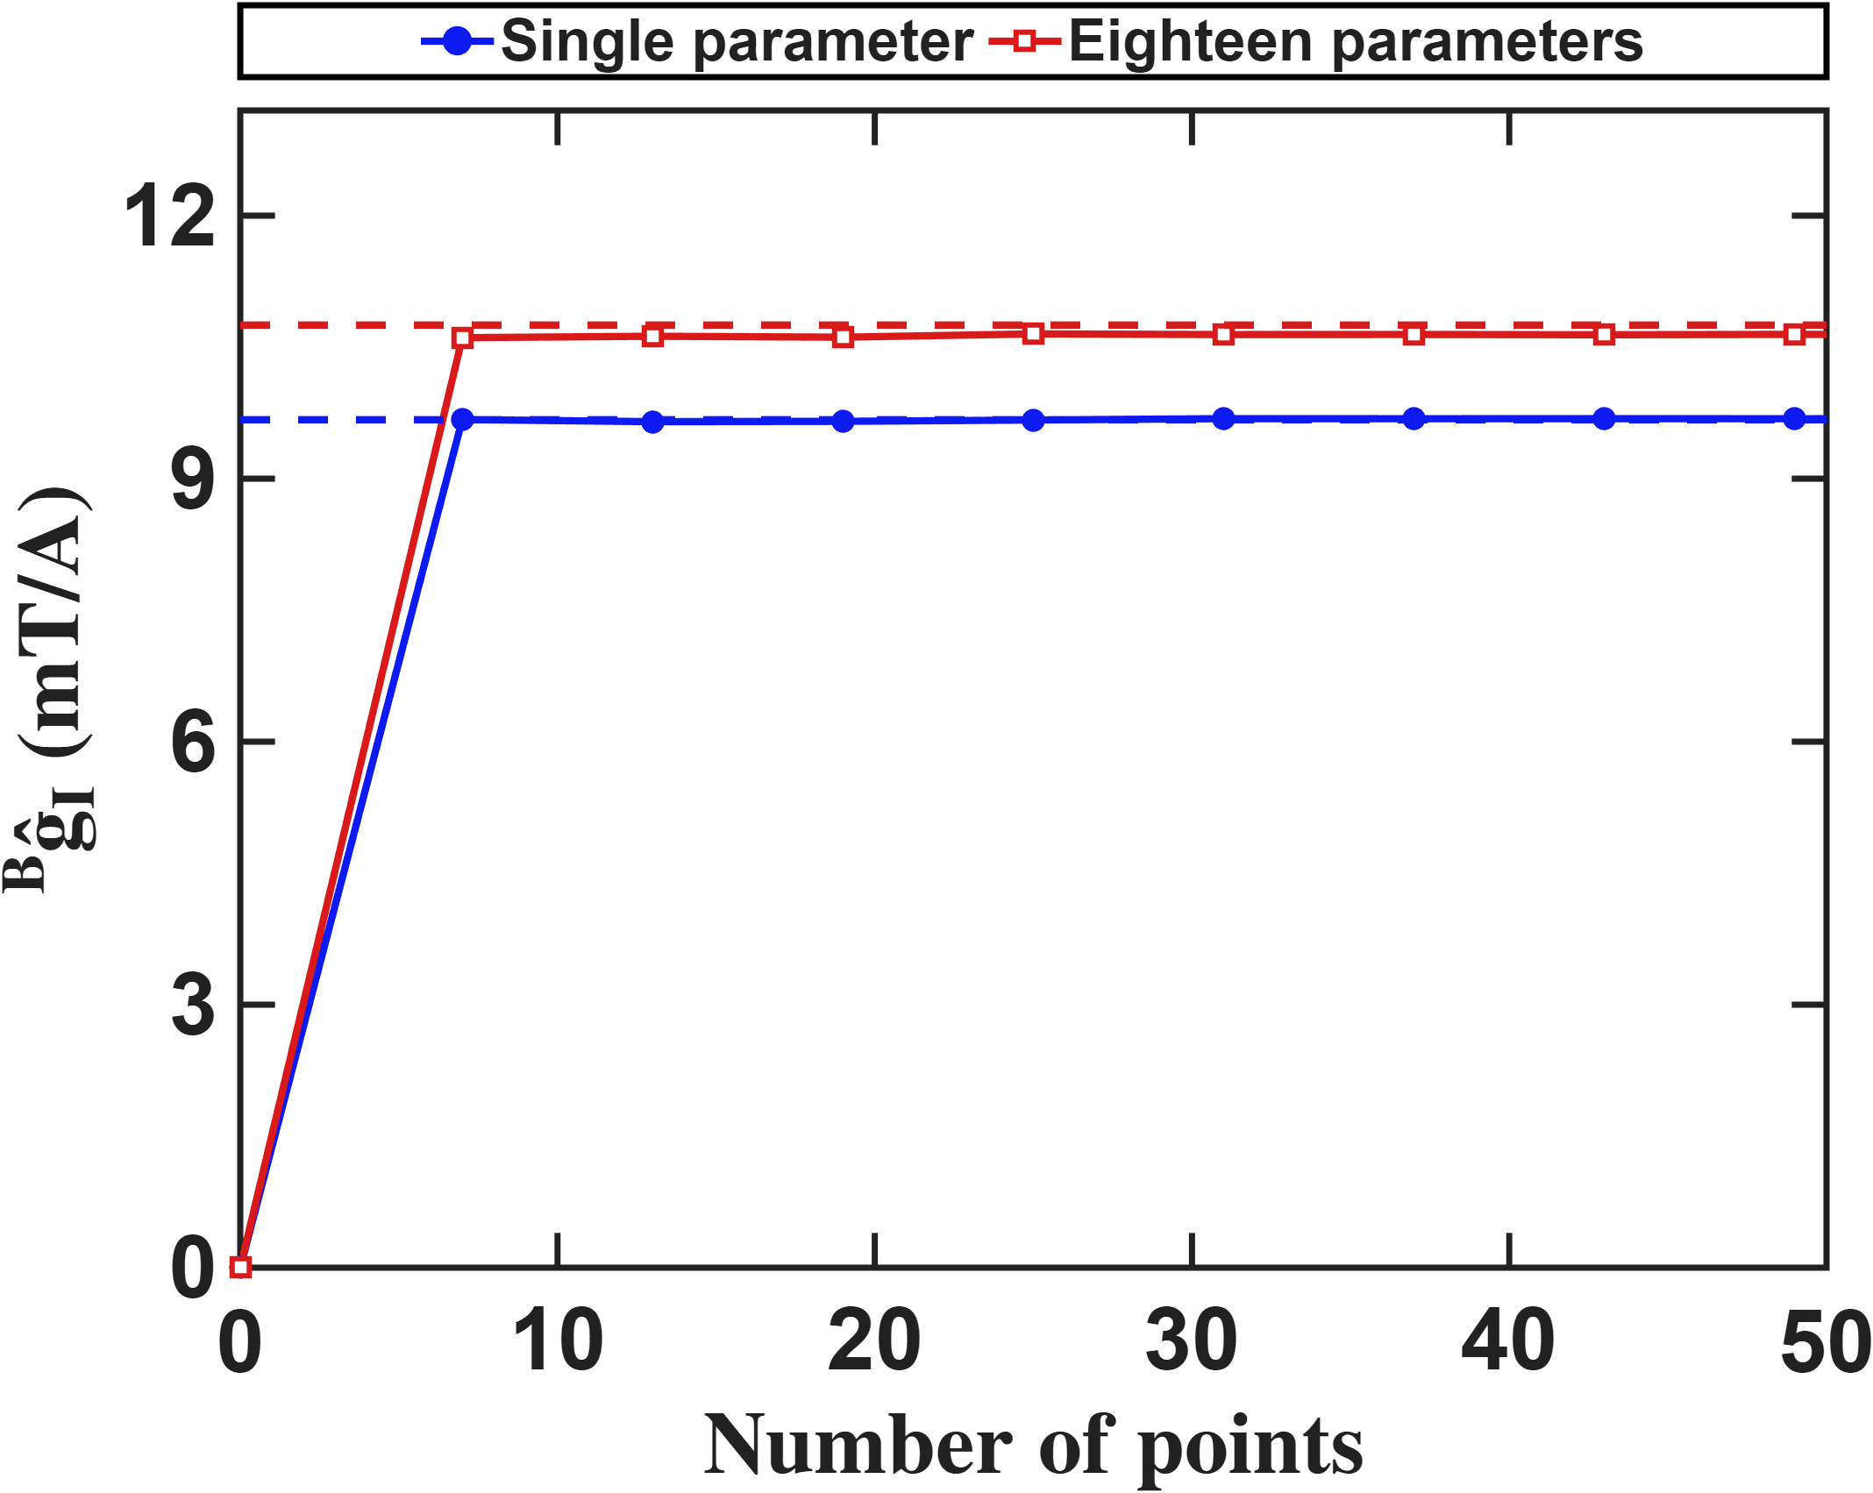

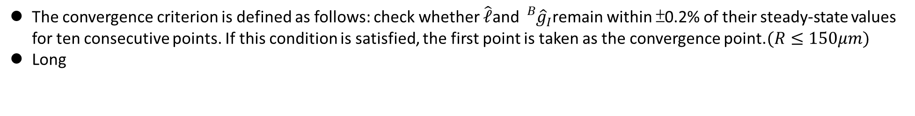
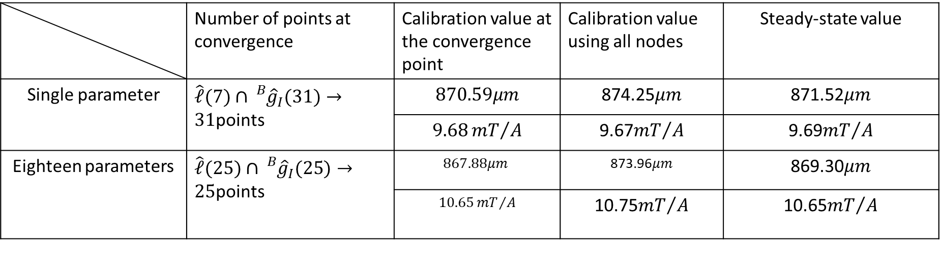


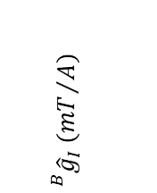
Current-based lumped-parameter modeling and calibration
E. Validation
The convergence criterion is defined as follows: check whether $\hat{ℓ}$and ${}_{}^{B}{{\hat{g}}_{I}}$remain within ±0.2% of their steady-state values for ten consecutive points. If this condition is satisfied, the first point is taken as the convergence point.$(R≤150μm)$
Long
$$\hat{ℓ} (μm)$$
$${}_{}^{B}{{\hat{g}}_{I}} ({mT}/A)$$
$$Number of points$$
$$Number of points$$
 | Number of points at convergence | Calibration value at the convergence point | Calibration value using all nodes | Steady-state value
Single parameter | $\hat{ℓ}(7)∩{}_{}^{B}{{\hat{g}}_{I}(31)}→31$points | $$870.59μm$$ | 874.25$μm$ | 871.52$μm$
 |  | $$9.68{mT}/A$$ | 9.67${mT}/A$ | 9.69${mT}/A$
Eighteen parameters | $\hat{ℓ}(25)∩{}_{}^{B}{{\hat{g}}_{I}(25)}→25$points | $$867.88μm$$ | 873.96$μm$ | 869.30$μm$
 |  | $$10.65{mT}/A$$ | 10.75${mT}/A$ | 10.65${mT}/A$

Slide 3

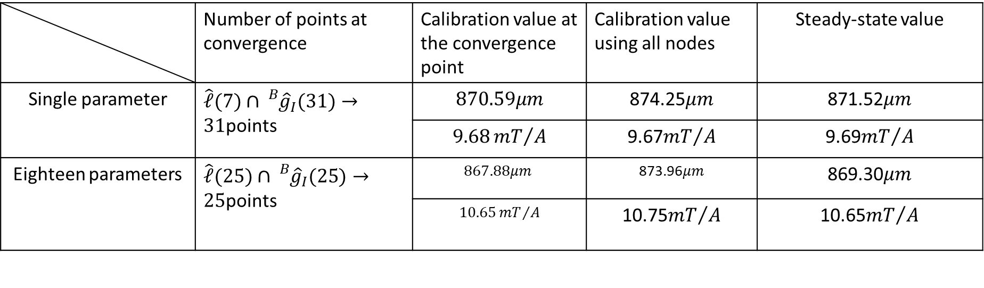
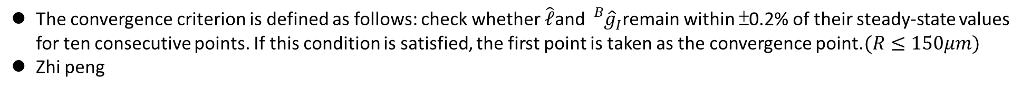

Current-based lumped-parameter modeling and calibration
E. Validation
The convergence criterion is defined as follows: check whether $\hat{ℓ}$and ${}_{}^{B}{{\hat{g}}_{I}}$remain within ±0.2% of their steady-state values for ten consecutive points. If this condition is satisfied, the first point is taken as the convergence point.$(R≤150μm)$
Zhi peng
$$\hat{ℓ} (μm)$$
$${}_{}^{B}{{\hat{g}}_{I}} ({mT}/A)$$
$$Number of points$$
$$Number of points$$
 | Number of points at convergence | Calibration value at the convergence point | Calibration value using all nodes | Steady-state value
Single parameter | $\hat{ℓ}(7)∩{}_{}^{B}{{\hat{g}}_{I}(31)}→31$points | $$870.59μm$$ | 874.25$μm$ | 871.52$μm$
 |  | $$9.68{mT}/A$$ | 9.67${mT}/A$ | 9.69${mT}/A$
Eighteen parameters | $\hat{ℓ}(25)∩{}_{}^{B}{{\hat{g}}_{I}(25)}→25$points | $$867.88μm$$ | 873.96$μm$ | 869.30$μm$
 |  | $$10.65{mT}/A$$ | 10.75${mT}/A$ | 10.65${mT}/A$

Slide 4
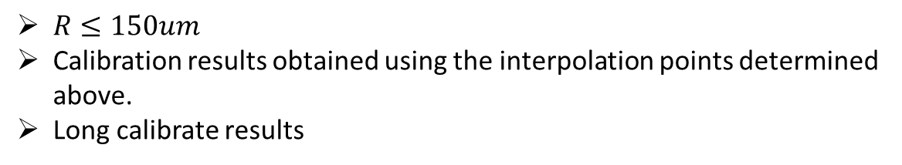



Current-based lumped-parameter modeling and calibration
E. Validation
Calibration results
$$Calibrate model→b_{ij}=S_{i}{}_{}^{B}{{\hat{g}}_{I}}{\overline{K}}_{I}I_{j}$$
$R≤150um$
Calibration results obtained using the interpolation points determined above.
Long calibrate results
Single parameter(25 points)
$${\bar{K}}_{I} = \left[\begin{matrix}0.8333 & −0.0275 & −0.2621 & −0.1369 & −0.1245 & −0.2658 \\ −0.2048 & 1.0189 & −0.2795 & −0.1212 & −0.1086 & −0.2829 \\ −0.1794 & −0.0974 & 0.7548 & −0.0691 & −0.1240 & −0.2661 \\ −0.1961 & −0.0809 & −0.2855 & 0.9744 & −0.1071 & −0.2825 \\ −0.1965 & −0.0811 & −0.2796 & −0.1207 & 0.9920 & −0.2904 \\ −0.1792 & −0.0973 & −0.2620 & −0.1362 & −0.0553 & 0.7483\end{matrix}\right]$$
$$\hat{ℓ} = 875.1 μm {}_{}^{B}{{\hat{g}}_{I}} = 9.7618 mT/A$$
$$NMAE=\frac{\sum_{j}{\sum_{i}{\left\|b_{ij}−S_{i}{}_{}^{B}{{\hat{g}}_{I}}{\overline{K}}_{I}I_{j}\right\|}}}{\sum_{j}{\sum_{i}{\left\|b_{ij}\right\|}}}∙100\%=2.81\%$$
Eighteen parameters(25 points)
$${\bar{K}}_{I} = \left[\begin{matrix}0.8333 & −0.1354 & −0.1290 & −0.1948 & −0.1935 & −0.1300 \\ −0.1407 & 0.8375 & −0.2040 & −0.1241 & −0.1243 & −0.2053 \\ −0.1293 & −0.1912 & 0.8307 & −0.1372 & −0.1916 & −0.1291 \\ −0.2052 & −0.1223 & −0.1396 & 0.8352 & −0.1228 & −0.2056 \\ −0.2060 & −0.1231 & −0.2047 & −0.1239 & 0.8392 & −0.1404 \\ −0.1302 & −0.1930 & −0.1291 & −0.1946 & −0.1365 & 0.8358\end{matrix}\right]$$
$$\hat{ℓ} = 873.3 μm {}_{}^{B}{{\hat{g}}_{I}} = 10.7181 mT/A$$
$$NMAE=\frac{\sum_{j}{\sum_{i}{\left\|b_{ij}−S_{i}{}_{}^{B}{{\hat{g}}_{I}}{\overline{K}}_{I}I_{j}\right\|}}}{\sum_{j}{\sum_{i}{\left\|b_{ij}\right\|}}}∙100\%=0.27\%$$
$$\hat{e}= \left[\begin{matrix}0.0181 & 0.0179 & −0.1169 & 0.0025 & 0.0013 & −0.1184 \\ −0.1182 & 0.0022 & 0.0146 & 0.0166 & 0.0015 & −0.1189 \\ 0.1183 & −0.0024 & 0.1167 & −0.0031 & −0.0167 & −0.0185\end{matrix}\right]$$

Slide 5
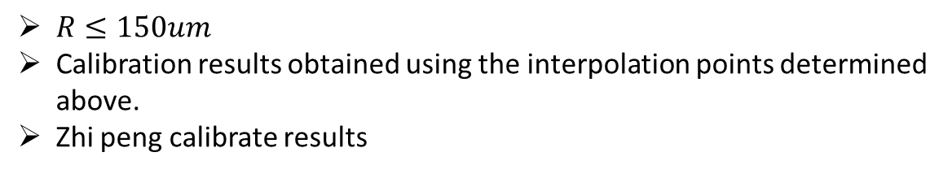

Current-based lumped-parameter modeling and calibration
E. Validation
Calibration results
$$Calibrate model→b_{ij}=S_{i}{}_{}^{B}{{\hat{g}}_{I}}{\overline{K}}_{I}I_{j}$$
$R≤150um$
Calibration results obtained using the interpolation points determined above.
Zhi peng calibrate results
Single parameter(35 points)
$${\bar{K}}_{I} = \left[\begin{matrix}0.8333 & −0.0480 & −0.2315 & −0.0873 & −0.0853 & −0.2303 \\ −0.0842 & 0.8625 & −0.1198 & −0.2032 & −0.2014 & −0.1185 \\ −0.2645 & −0.0755 & 0.7436 & −0.0436 & −0.0481 & −0.2480 \\ −0.1121 & −0.2322 & −0.0759 & 0.7685 & −0.2192 & −0.0821 \\ −0.1121 & −0.2321 & −0.0830 & −0.2211 & 0.7695 & −0.0744 \\ −0.2645 & −0.0755 & −0.2491 & −0.0502 & −0.0420 & 0.7454\end{matrix}\right]$$
$$\hat{ℓ} = 744.9 μm {}_{}^{B}{{\hat{g}}_{I}} = 32.7350 mT/A$$
$$NMAE=\frac{\sum_{j}{\sum_{i}{\left\|b_{ij}−S_{i}{}_{}^{B}{{\hat{g}}_{I}}{\overline{K}}_{I}I_{j}\right\|}}}{\sum_{j}{\sum_{i}{\left\|b_{ij}\right\|}}}∙100\%=10.50\%$$
Eighteen parameters(35 points)
$${\bar{K}}_{I} = \left[\begin{matrix}0.8333 & −0.1068 & −0.1150 & −0.1881 & −0.1875 & −0.1150 \\ −0.1114 & 0.8296 & −0.1932 & −0.1195 & −0.1193 & −0.1928 \\ −0.1336 & −0.1957 & 0.7488 & −0.0923 & −0.1578 & −0.1300 \\ −0.2009 & −0.1382 & −0.0977 & 0.7452 & −0.1346 & −0.1634 \\ −0.2002 & −0.1378 & −0.1631 & −0.1345 & 0.7427 & −0.0970 \\ −0.1335 & −0.1954 & −0.1298 & −0.1585 & −0.0925 & 0.7492\end{matrix}\right]$$
$$\hat{ℓ} = 604.8 μm {}_{}^{B}{{\hat{g}}_{I}} = 37.3928 mT/A$$
$$NMAE=\frac{\sum_{j}{\sum_{i}{\left\|b_{ij}−S_{i}{}_{}^{B}{{\hat{g}}_{I}}{\overline{K}}_{I}I_{j}\right\|}}}{\sum_{j}{\sum_{i}{\left\|b_{ij}\right\|}}}∙100\%=0.68\%$$
$$\hat{e}= \left[\begin{matrix}−0.0024 & 0.0010 & −0.2168 & 0.2168 & 0.2165 & −0.2164 \\ −0.2162 & 0.2166 & 0.0001 & −0.0020 & 0.2173 & −0.2162 \\ 0.2159 & −0.2162 & 0.2165 & −0.2176 & 0.0010 & −0.0003\end{matrix}\right]$$

Slide 6
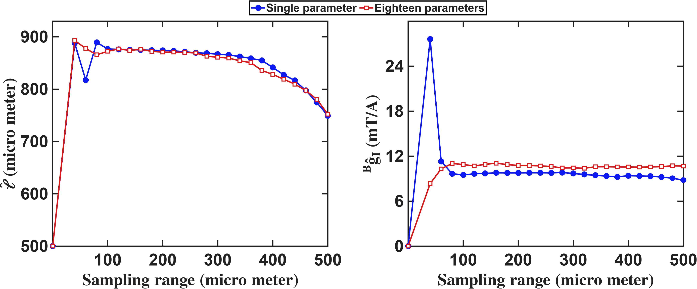
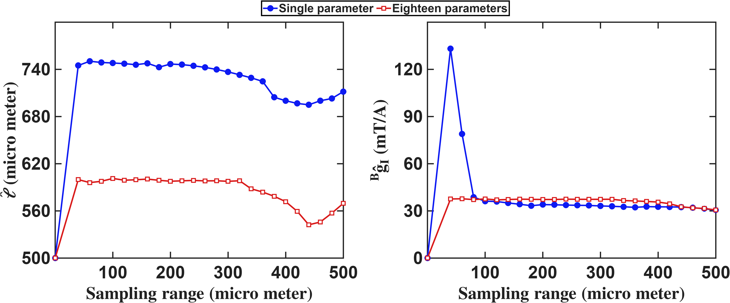

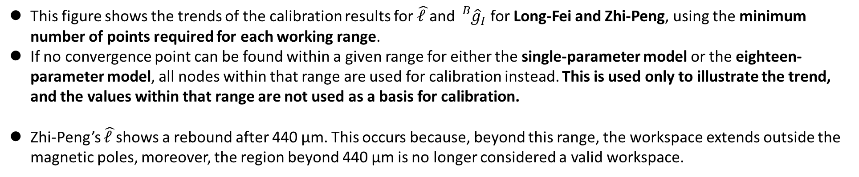
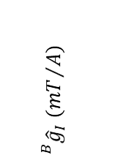
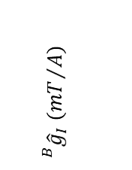




Current-based lumped-parameter modeling and calibration
E. Validation
This figure shows the trends of the calibration results for $\hat{ℓ }$and ${}_{}^{B}{{\hat{g}}_{I}}$ for Long-Fei and Zhi-Peng, using the minimum number of points required for each working range.
If no convergence point can be found within a given range for either the single-parameter model or the eighteen-parameter model, all nodes within that range are used for calibration instead. This is used only to illustrate the trend, and the values within that range are not used as a basis for calibration.
Zhi-Peng’s $\hat{ℓ }$shows a rebound after 440 μm. This occurs because, beyond this range, the workspace extends outside the magnetic poles, moreover, the region beyond 440 μm is no longer considered a valid workspace.
Long
Zhi peng
$$\hat{ℓ} (μm)$$
$${}_{}^{B}{{\hat{g}}_{I}} ({mT}/A)$$
$$\hat{ℓ} (μm)$$
$${}_{}^{B}{{\hat{g}}_{I}} ({mT}/A)$$
$$Workspace radius(μm)$$
$$Workspace radius(μm)$$
$$Workspace radius(μm)$$
$$Workspace radius(μm)$$

Slide 7
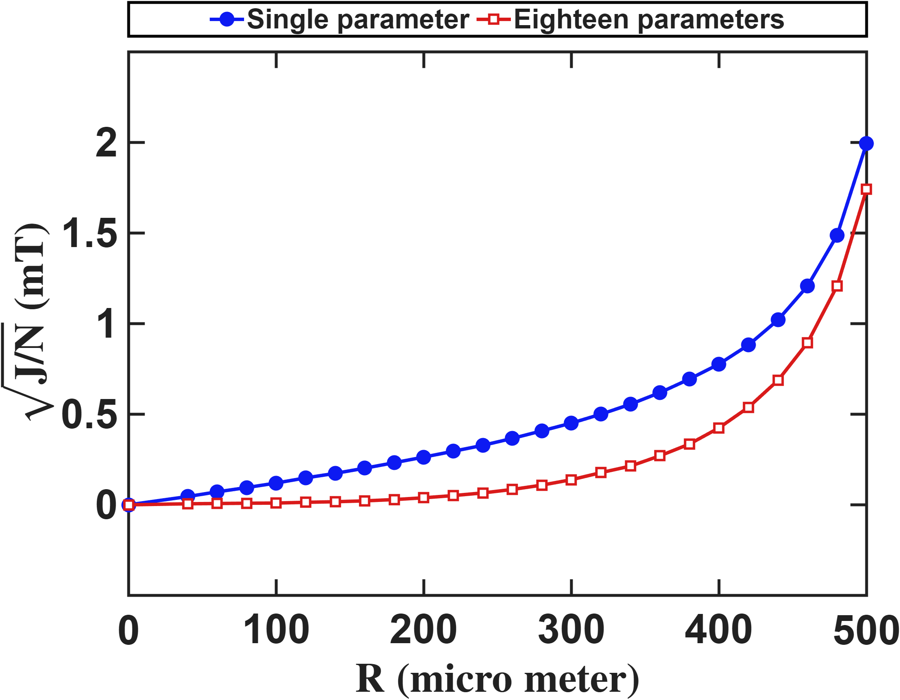
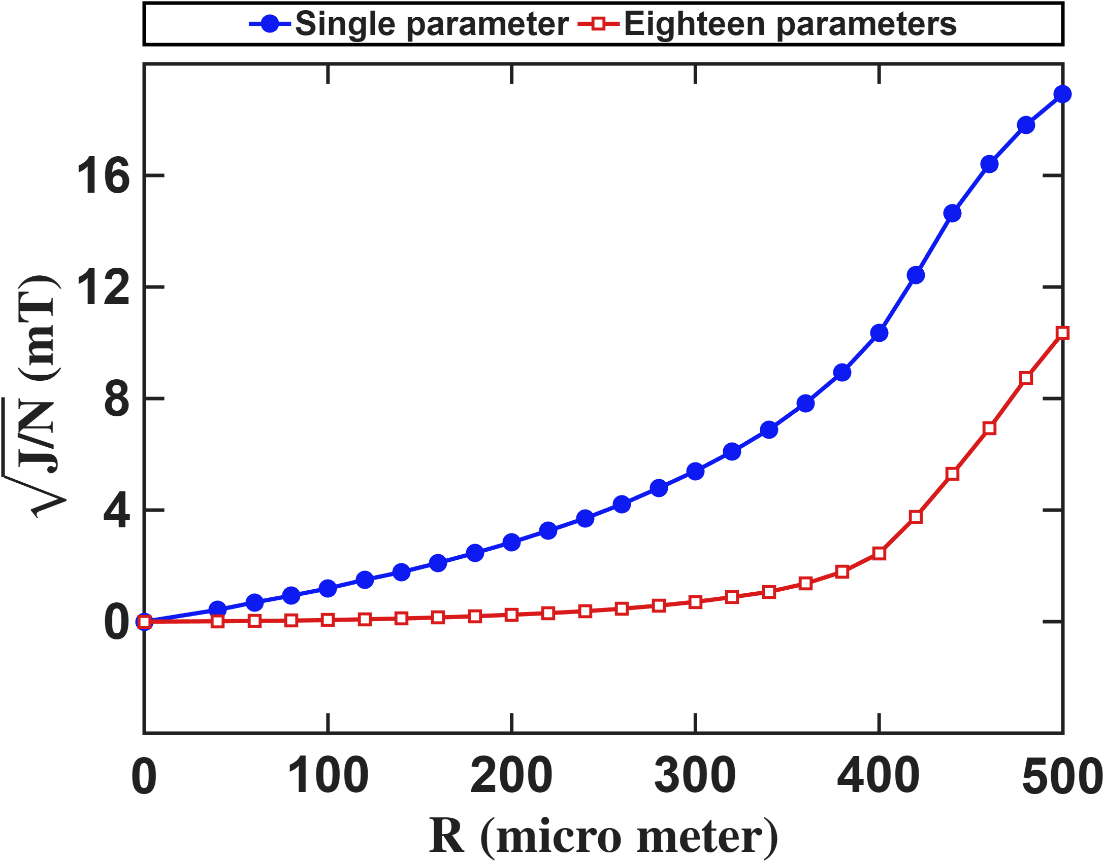




Current-based lumped-parameter modeling and calibration
E. Validation
Setup: The calibration side is identical to the previous slide: the same R sweep, the same converged reduced design at each R. What changes is the evaluation: the predict is computed on every real FEM node inside R.
Long
Zhi peng
$$Predict error (mT)$$
$$Predict error (mT)$$
$$Workspace radius (μm)$$
$$Workspace radius (μm)$$

Slide 8
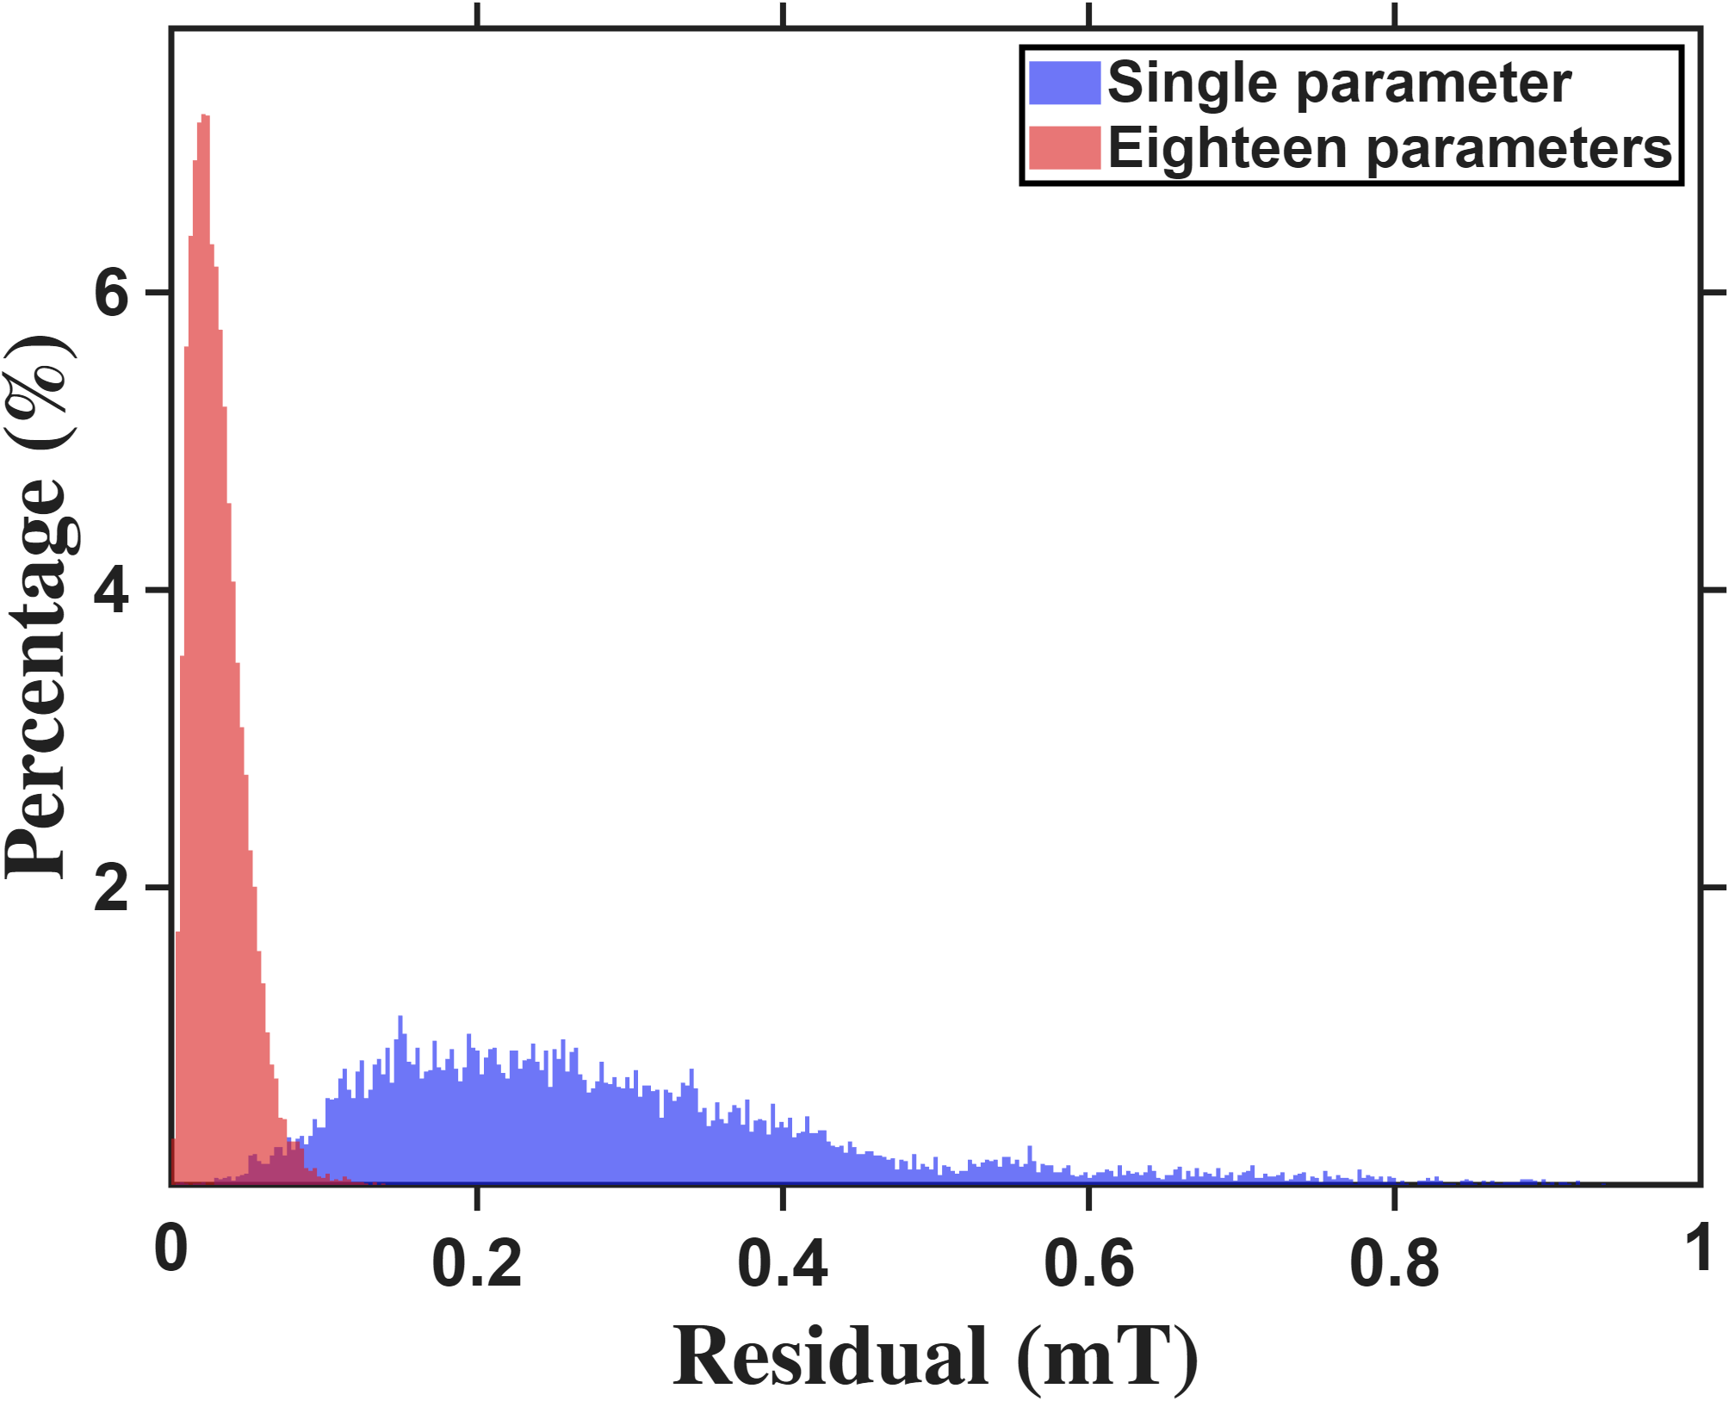
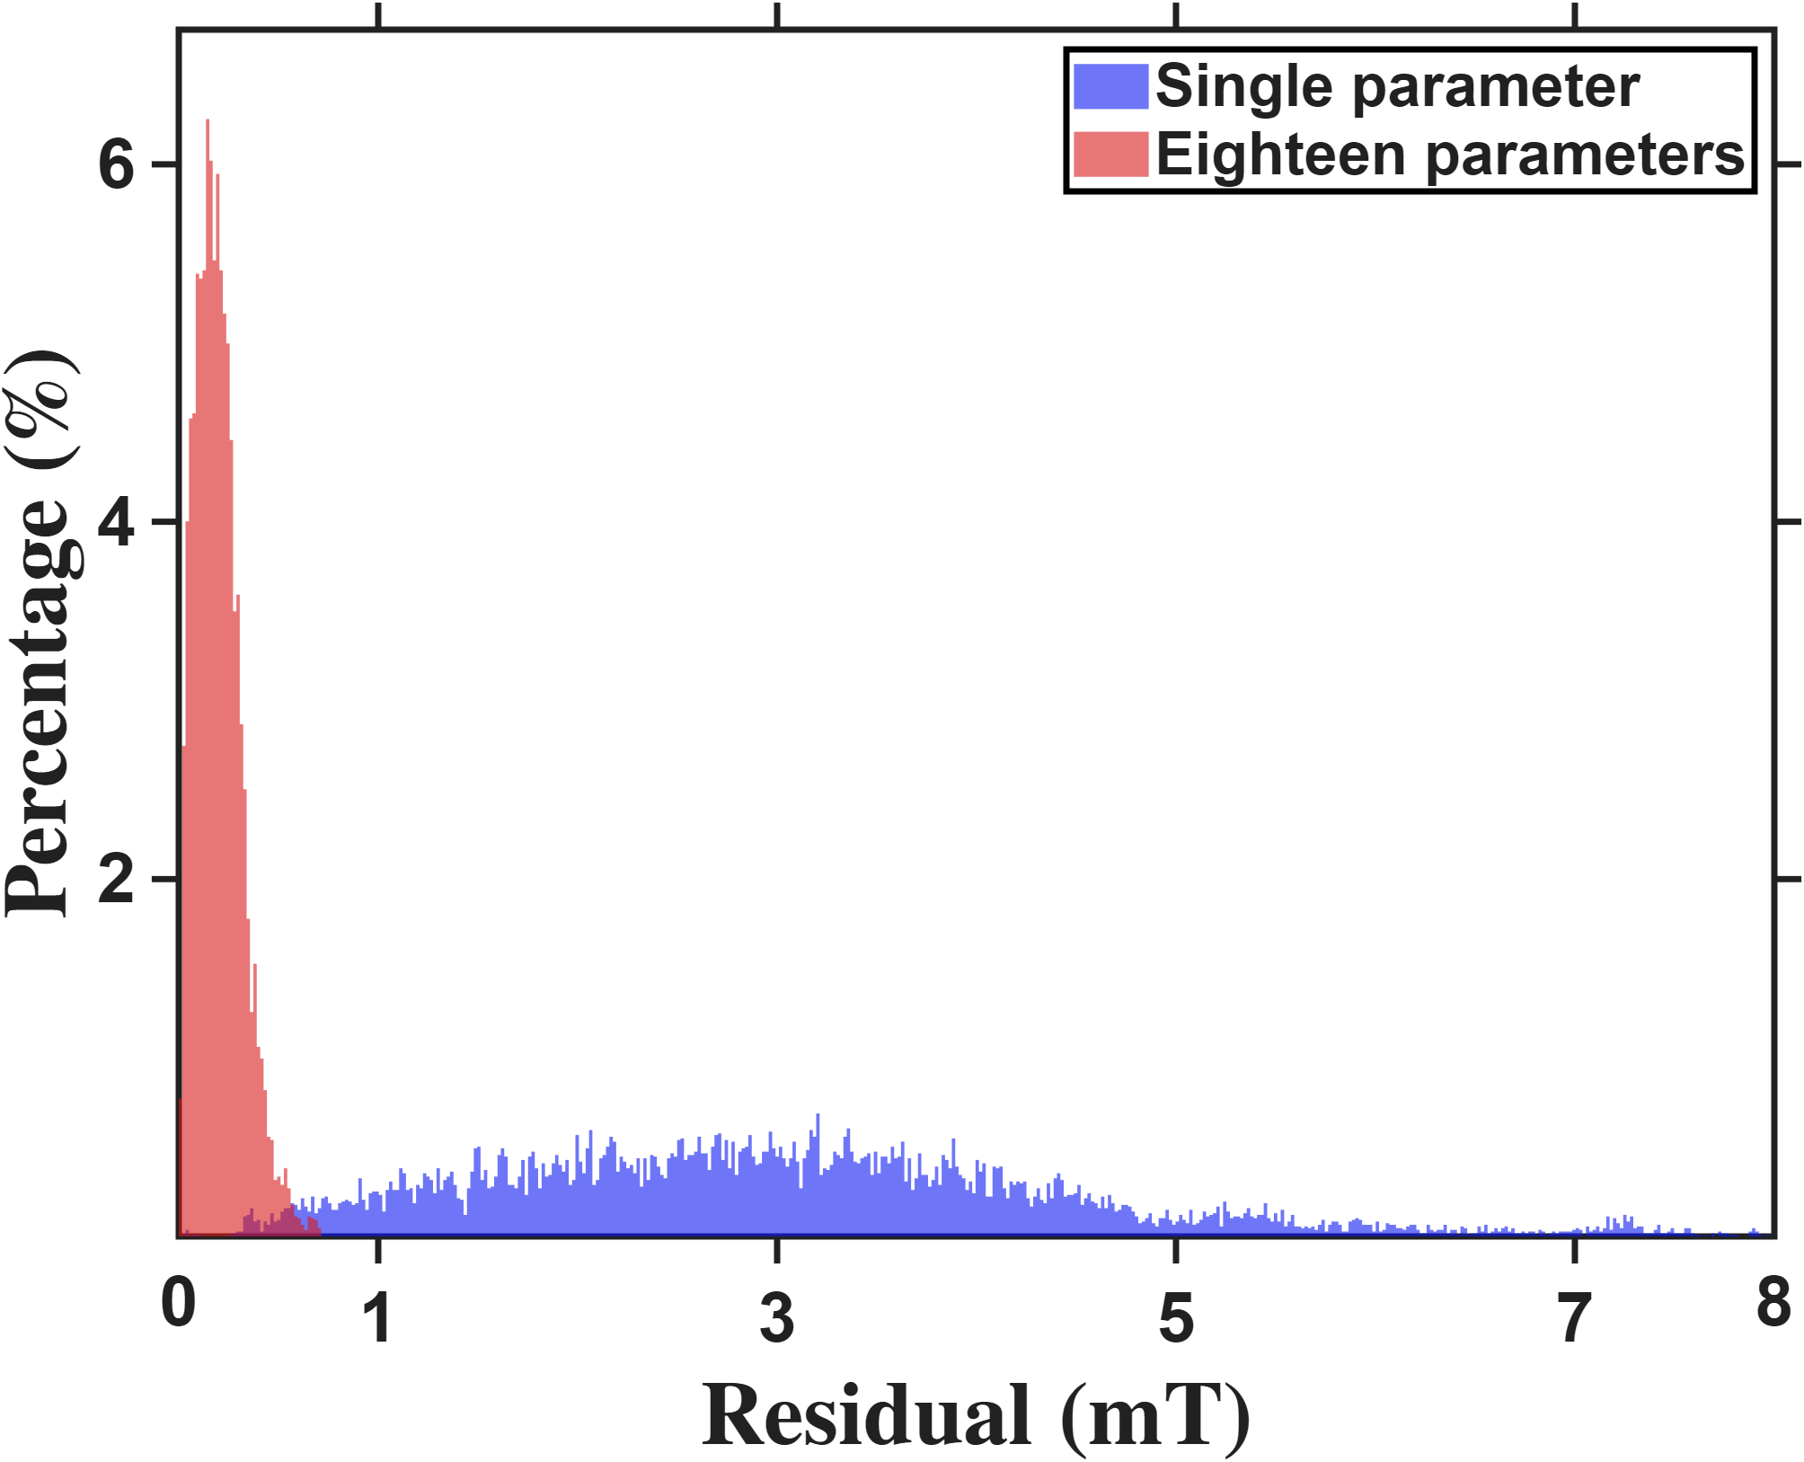

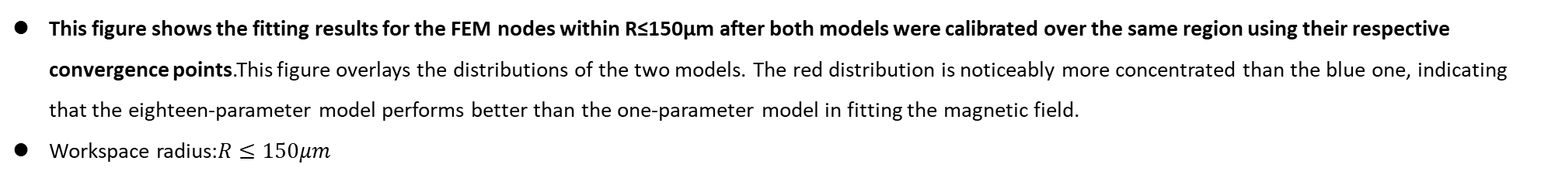






Current-based lumped-parameter modeling and calibration
E. Validation
$$Calibrate model→b_{ij}=S_{i}{}_{}^{B}{{\hat{g}}_{I}}{\overline{K}}_{I}I_{j}$$
This figure shows the fitting results for the FEM nodes within R≤150μm after both models were calibrated over the same region using their respective convergence points.This figure overlays the distributions of the two models. The red distribution is noticeably more concentrated than the blue one, indicating that the eighteen-parameter model performs better than the one-parameter model in fitting the magnetic field.
Workspace radius:$R≤150μm$
Long($N_{p}$:1771)
Zhi peng ($N_{p}$:1791)
$$Percentage count(\%)$$
$$Percentage count(\%)$$
$$Predict error (mT)$$
$$Predict error (mT)$$
Resolution:2.8uT
Resolution:17uT
 | Single | Eighteen
Mean | 0.2880mT | 0.0301mT
 | Single | Eighteen
Mean | 3.0555mT | 0.1991mT

Slide 9
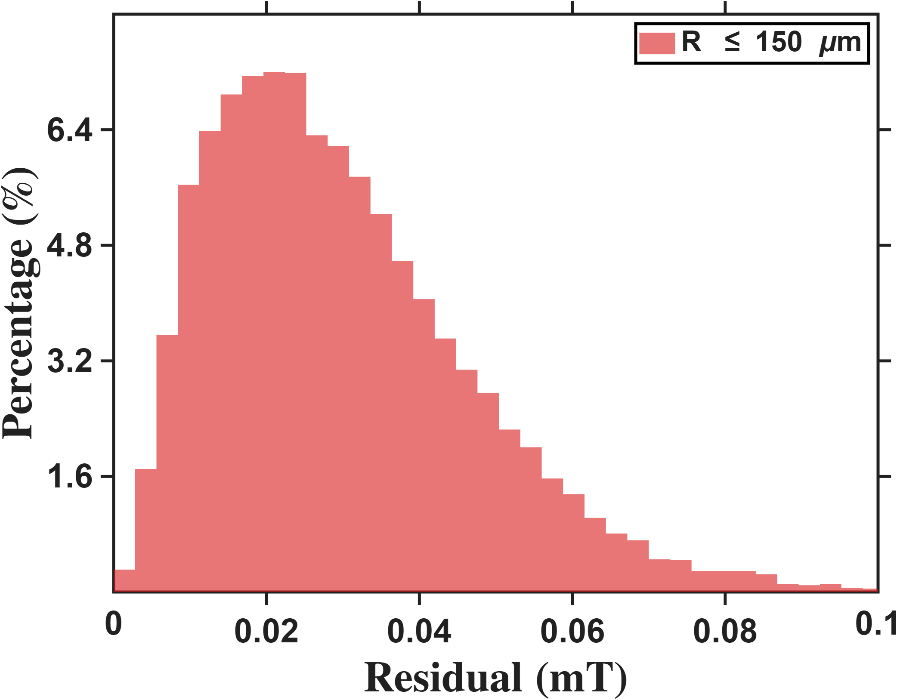
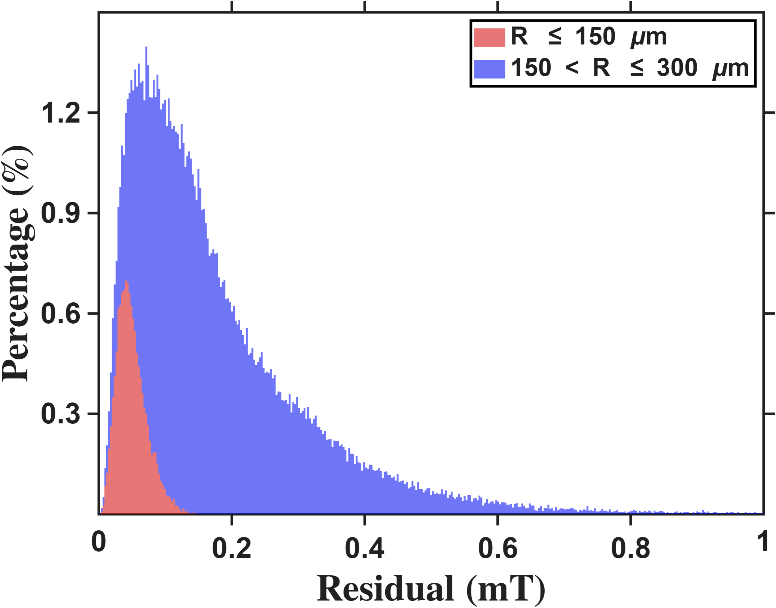




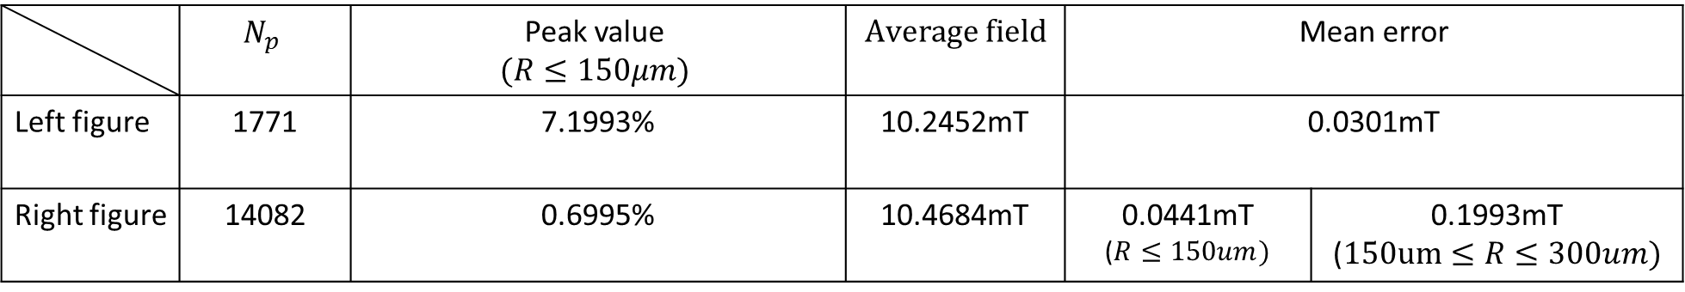
Current-based lumped-parameter modeling and calibration
E. Validation
Setup: Calibration is performed using the eighteen-parameter calibration points, followed by fitting to the FEM nodes within the workspace.
Long
$$Percentage count(\%)$$
$$Percentage count(\%)$$
$$Residual error (mT)$$
$$Residual error (mT)$$
 | $$N_{p}$$ | Peak value $$(R≤150μm)$$ | $$Average field$$ | Mean error
Left figure | 1771 | 7.1993% | 10.2452mT | 0.0301mT
Right figure | 14082 | 0.6995% | 10.4684mT | 0.0441mT ($R≤150um)$ | 0.1993mT ($150um≤R≤300um)$
Resolution:2.8uT

Slide 10
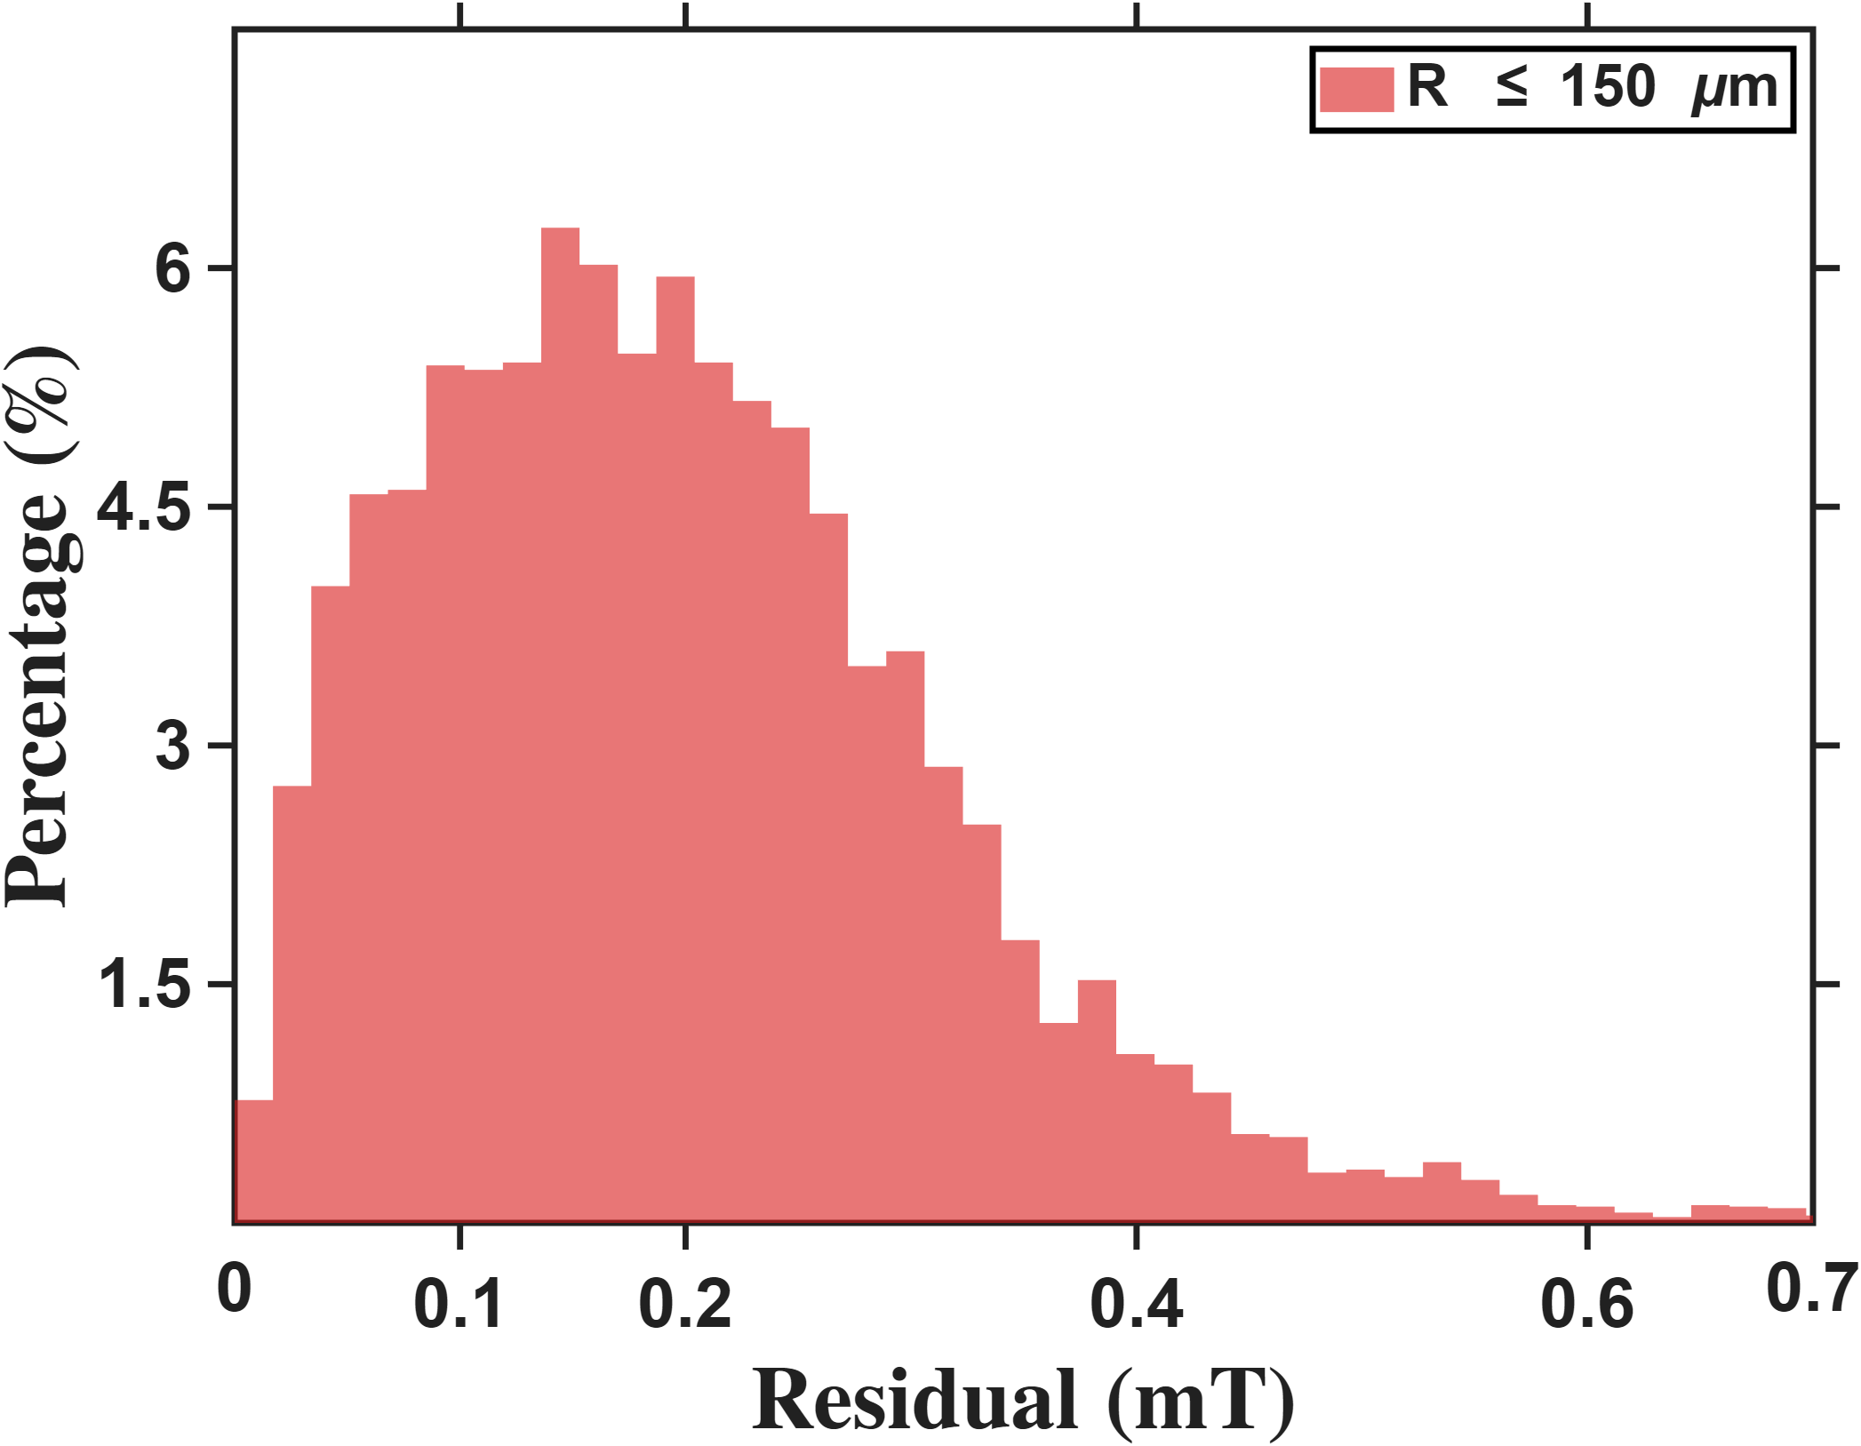
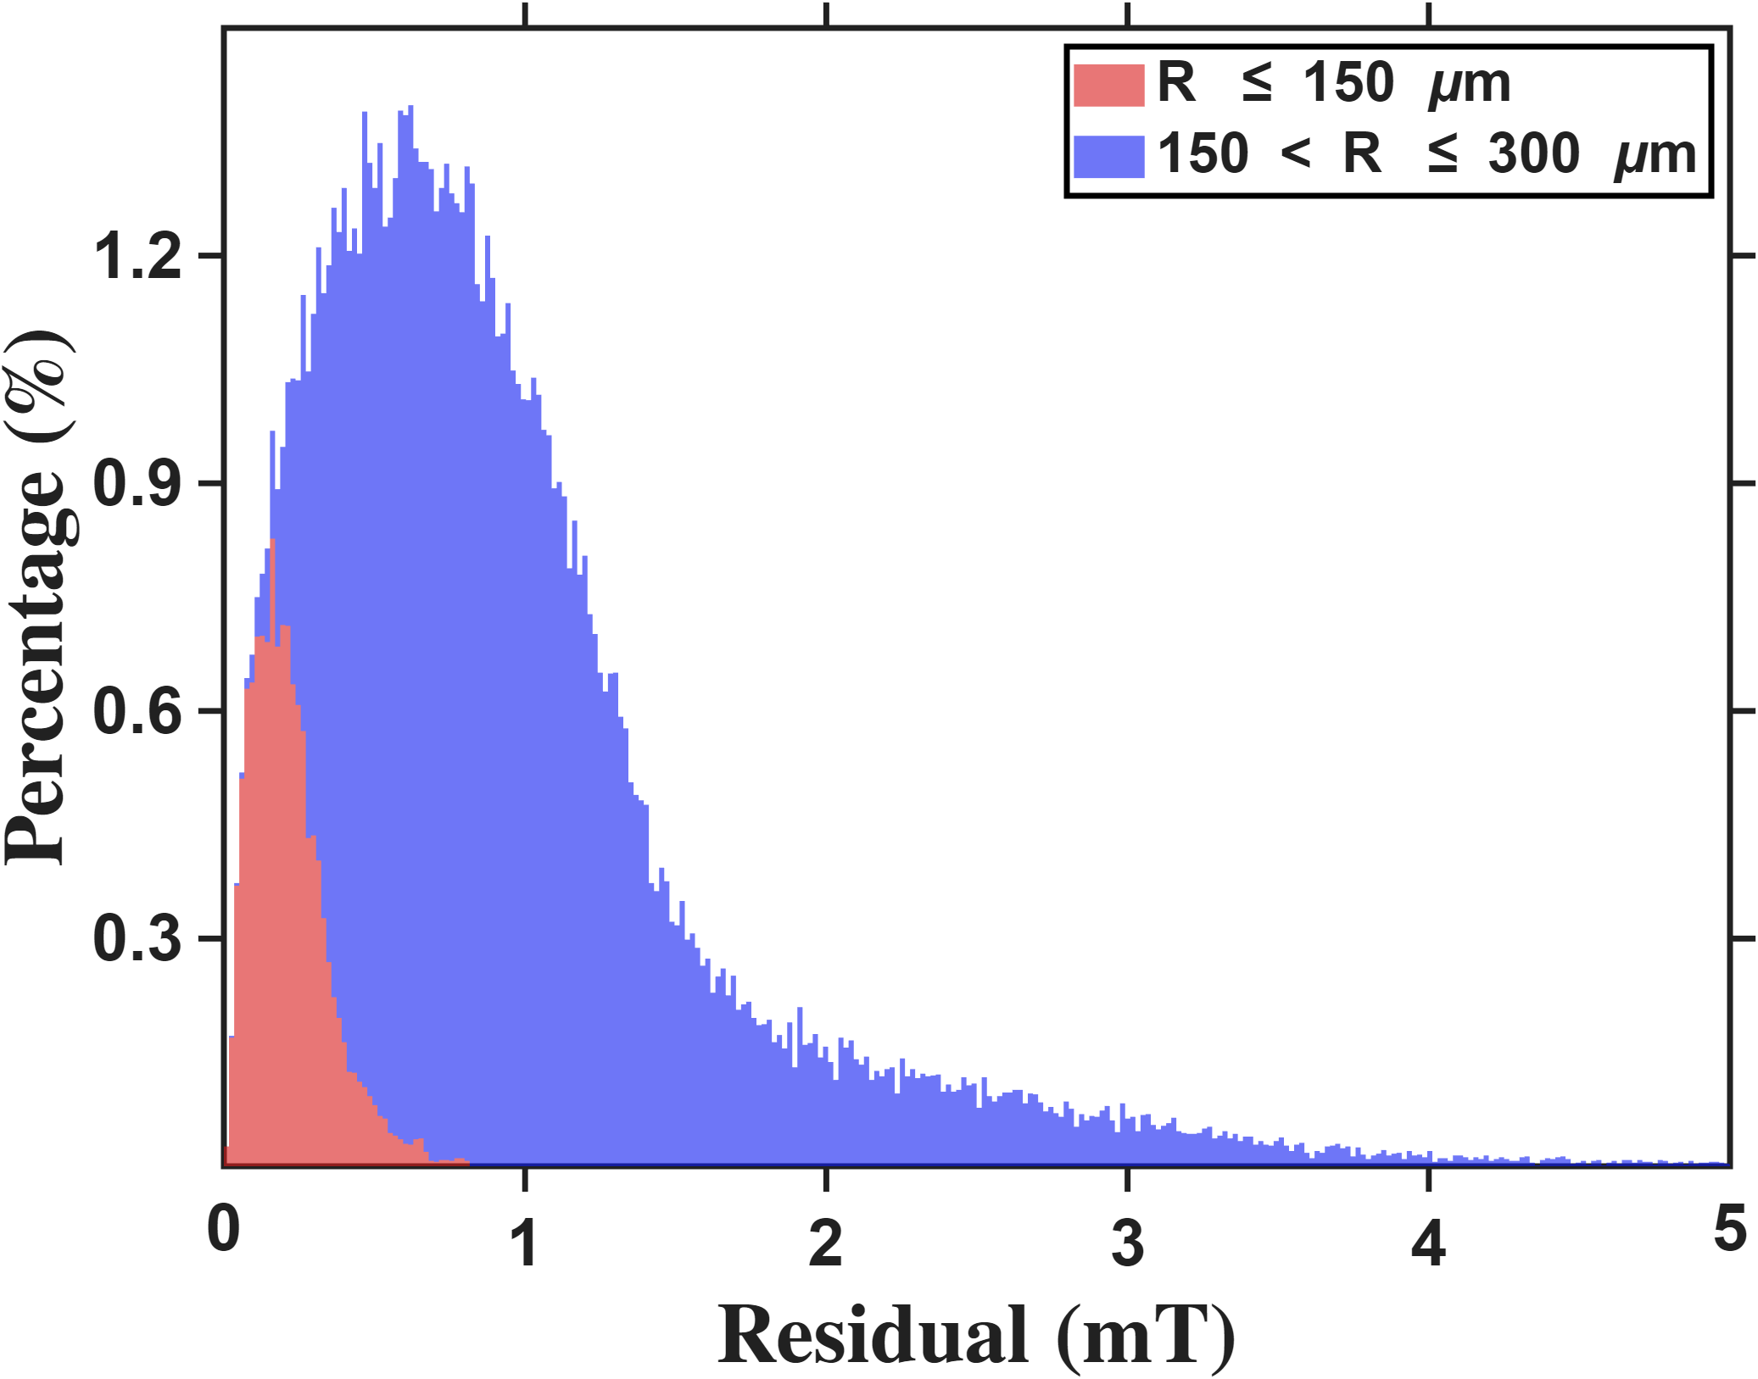




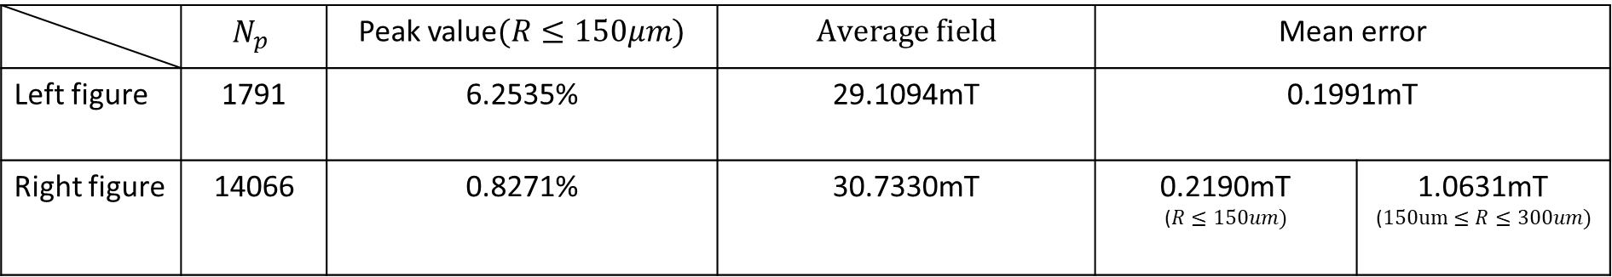
Current-based lumped-parameter modeling and calibration
E. Validation
Setup: Calibration is performed using the eighteen-parameter calibration points, followed by fitting to the FEM nodes within the workspace.
Zhi peng
$$Percentage count(\%)$$
$$Percentage count(\%)$$
$$Residual error (mT)$$
$$Residual error (mT)$$
 | $$N_{p}$$ | Peak value$(R≤150μm)$ | $$Average field$$ | Mean error
Left figure | 1791 | 6.2535% | 29.1094mT | 0.1991mT
Right figure | 14066 | 0.8271% | 30.7330mT | 0.2190mT ($R≤150um)$ | 1.0631mT ($150um≤R≤300um)$
Resolution:17uT

Slide 11
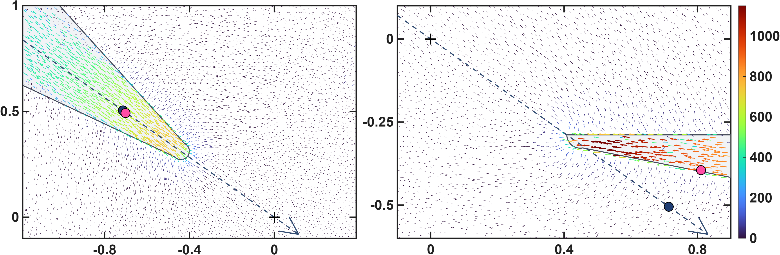








Current-based lumped-parameter modeling and calibration
E. Validation
$$Calibrate model→b_{ij}=S_{i}{}_{}^{B}{{\hat{g}}_{I}}{\overline{K}}_{I}I_{j}$$
These two figures show the differences in the calibrated magnetic charge locations between the two models. The upper row presents the magnetic charge locations calibrated by the one-parameter model, shown using side views of poles P1 and P2. It can be clearly seen that, for the lower pole, some of the magnetic charge locations are located outside the pole. This is because the one-parameter model constrains the magnetic charges to lie along the actuator coordinate axes. The lower row presents the results of the eighteen-parameter model, in which the magnetic charge locations of the lower pole move inside the pole. This is more consistent with the expected physical situation. Moreover, the error histograms shown above also indicate that these magnetic charge locations are more consistent with the theoretical positions.
$${\hat{x}}_{a}$$
$$z−axis(mm)$$
$$q_{c2}$$
$$\left\|b\right\|(mT)$$
$${\hat{x}}_{a}$$
$$q_{c1}$$
$$x−axis(mm)$$
$$x−axis(mm)$$

Slide 12
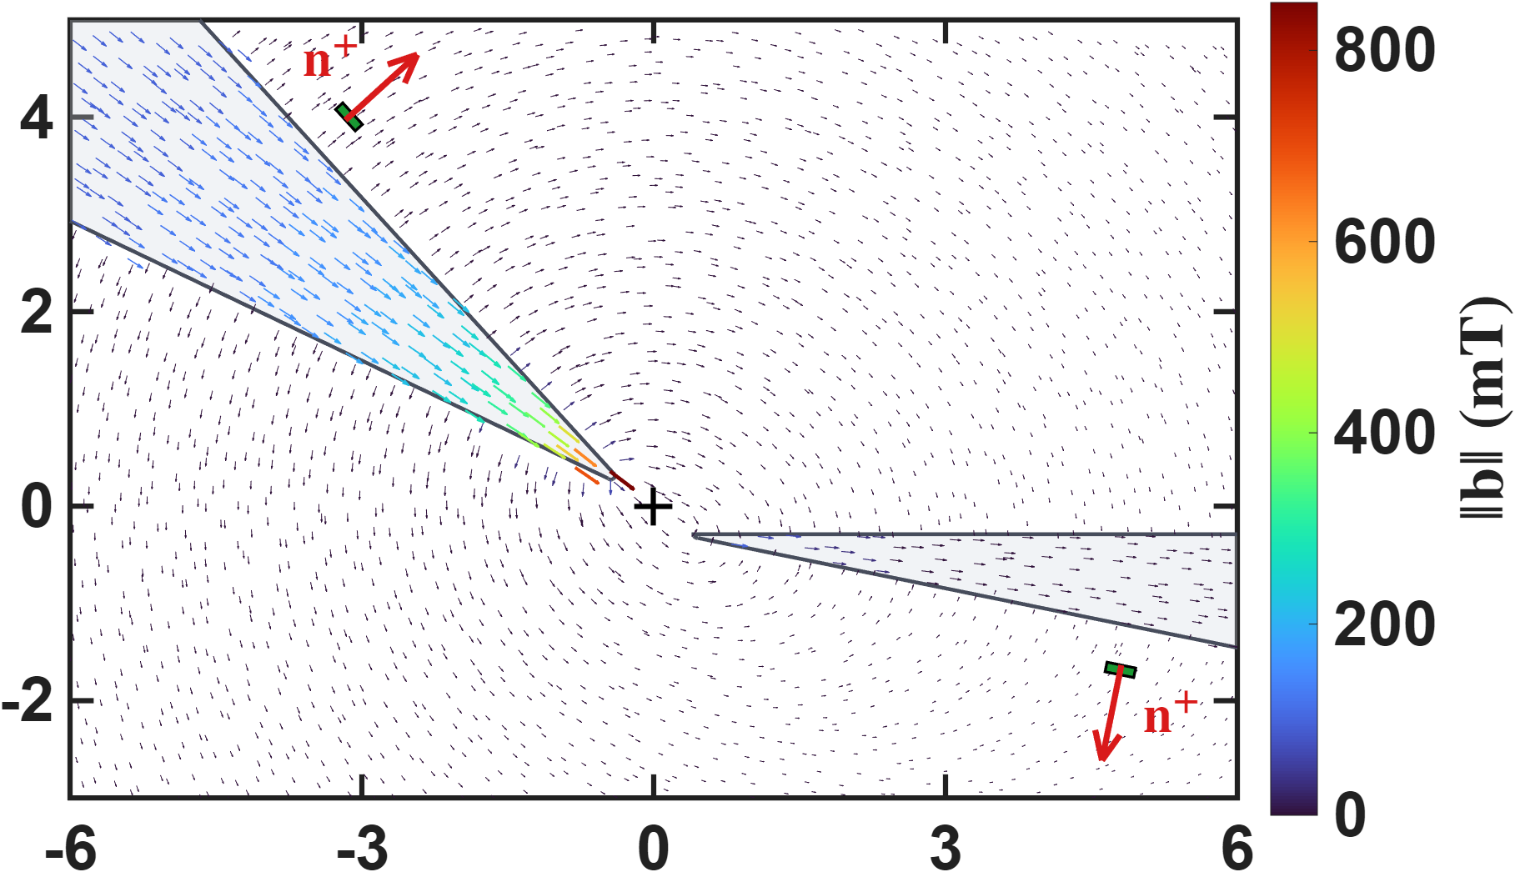



Hall-sensor-voltage-based lumped-parameter modeling and calibration
This figure conveys the sensing concept: the Hall sensor measures the pole's leakage flux. The colour-coded arrows show the flux channelled inside the cone toward the tip, while the dashed arrows around the pole are the part that escapes through the lateral surface and returns through the air. The sensor (green patch) is mounted on that surface, so it sits in the leakage field rather than in the field between the tips, and the red arrow n⁺ marks the positive sense of what it reads (b·n⁺).
$$z−axis(mm)$$
$$\left\|b\right\|(mT)$$
$$x−axis(mm)$$

Slide 13
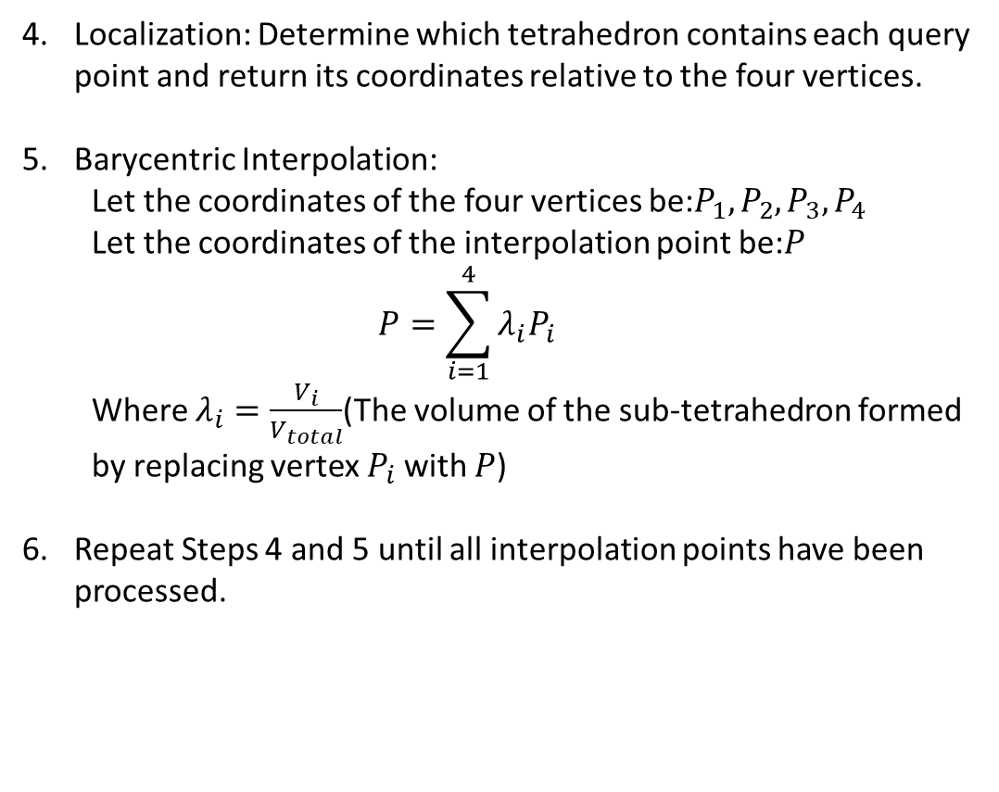
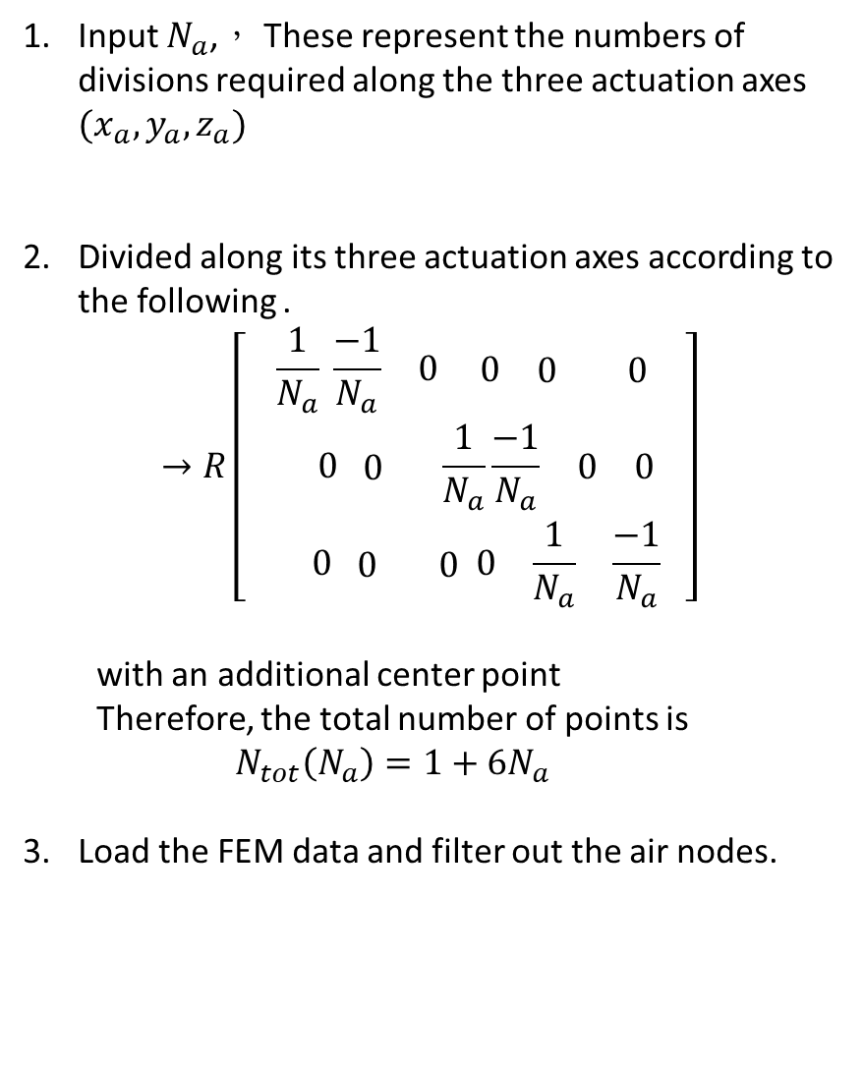
Hall-sensor-voltage-based lumped-parameter modeling and calibration
Interpolation Point Algorithm for sensor area
Input $N_{a}$,， These represent the numbers of divisions required along the three actuation axes $(x_{a},y_{a},z_{a})$
Divided along its three actuation axes according to the following .
$$→R\left[\begin{matrix}\frac{1}{N_{a}} \begin{matrix}\frac{−1}{N_{a}} & 0 \begin{matrix} 0 & \begin{matrix}0 & 0\end{matrix} \end{matrix}\end{matrix} \\ 0 \begin{matrix} 0 & \end{matrix}\frac{1}{N_{a}}\begin{matrix}\frac{−1}{N_{a}} & \begin{matrix}0 & 0\end{matrix}\end{matrix} \\ 0 \begin{matrix} 0 & 0\end{matrix} \begin{matrix} 0 & \begin{matrix}\frac{1}{N_{a}} & \frac{−1}{N_{a}}\end{matrix} \end{matrix}\end{matrix}\right]$$
  with an additional center point
  Therefore, the total number of points is
  $$N_{tot}\left(N_{a}\right)=1+6N_{a}$$
Load the FEM data and filter out the air nodes.
Localization: Determine which tetrahedron contains each query point and return its coordinates relative to the four vertices.
Barycentric Interpolation:
  Let the coordinates of the four vertices be:$P_{1},P_{2},P_{3},P_{4}$
  Let the coordinates of the interpolation point be:$P$
  $$P=\sum_{i=1}^{4}{λ_{i}P_{i}}$$
  Where $λ_{i}=\frac{V_{i}}{V_{total}}$(The volume of the sub-tetrahedron formed by replacing vertex $P_{i}$ with $P$)
Repeat Steps 4 and 5 until all interpolation points have been processed.

Slide 14
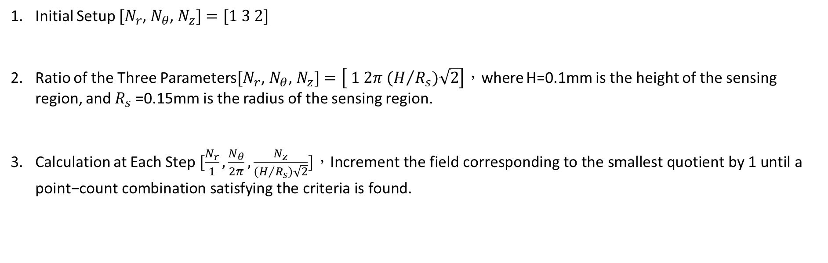
Hall-sensor-voltage-based lumped-parameter modeling and calibration
Interpolation Point Algorithm for sensor
Initial Setup $[N_{r}$, $N_{θ}$, $N_{z}]=[1 3 2]$
Ratio of the Three Parameters$[N_{r}\text{, }N_{θ}\text{, }N_{z}]=\left[ 1 2π (H/{R_{s})\sqrt{2}}\right]$，where H=0.1mm is the height of the sensing region, and $R_{s}$=0.15mm is the radius of the sensing region.
Calculation at Each Step $[\frac{N_{r}}{1},\frac{N_{θ}}{2π},\frac{N_{z}}{(H/{R_{s})\sqrt{2}}}]，\text{Increment} \text{the} \text{field} \text{corresponding} \text{to} \text{the} \text{smallest} \text{quotient} \text{by}\text{ 1 }\text{until} \text{a} \text{point}\text{−}\text{count} \text{combination} \text{satisfying} \text{the} \text{criteria} \text{is} \text{found}\text{.}$
A checkpoint is considered a convergence point if the rates of change of the subsequent ten points relative to their respective preceding points are all less than 0.5%.

Slide 15
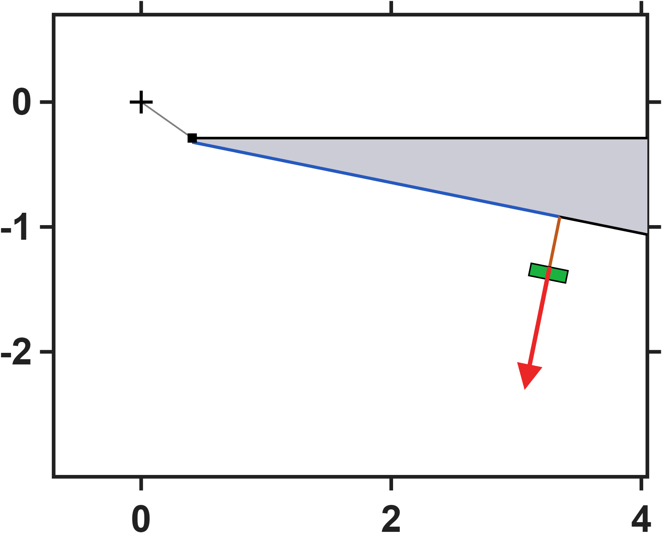
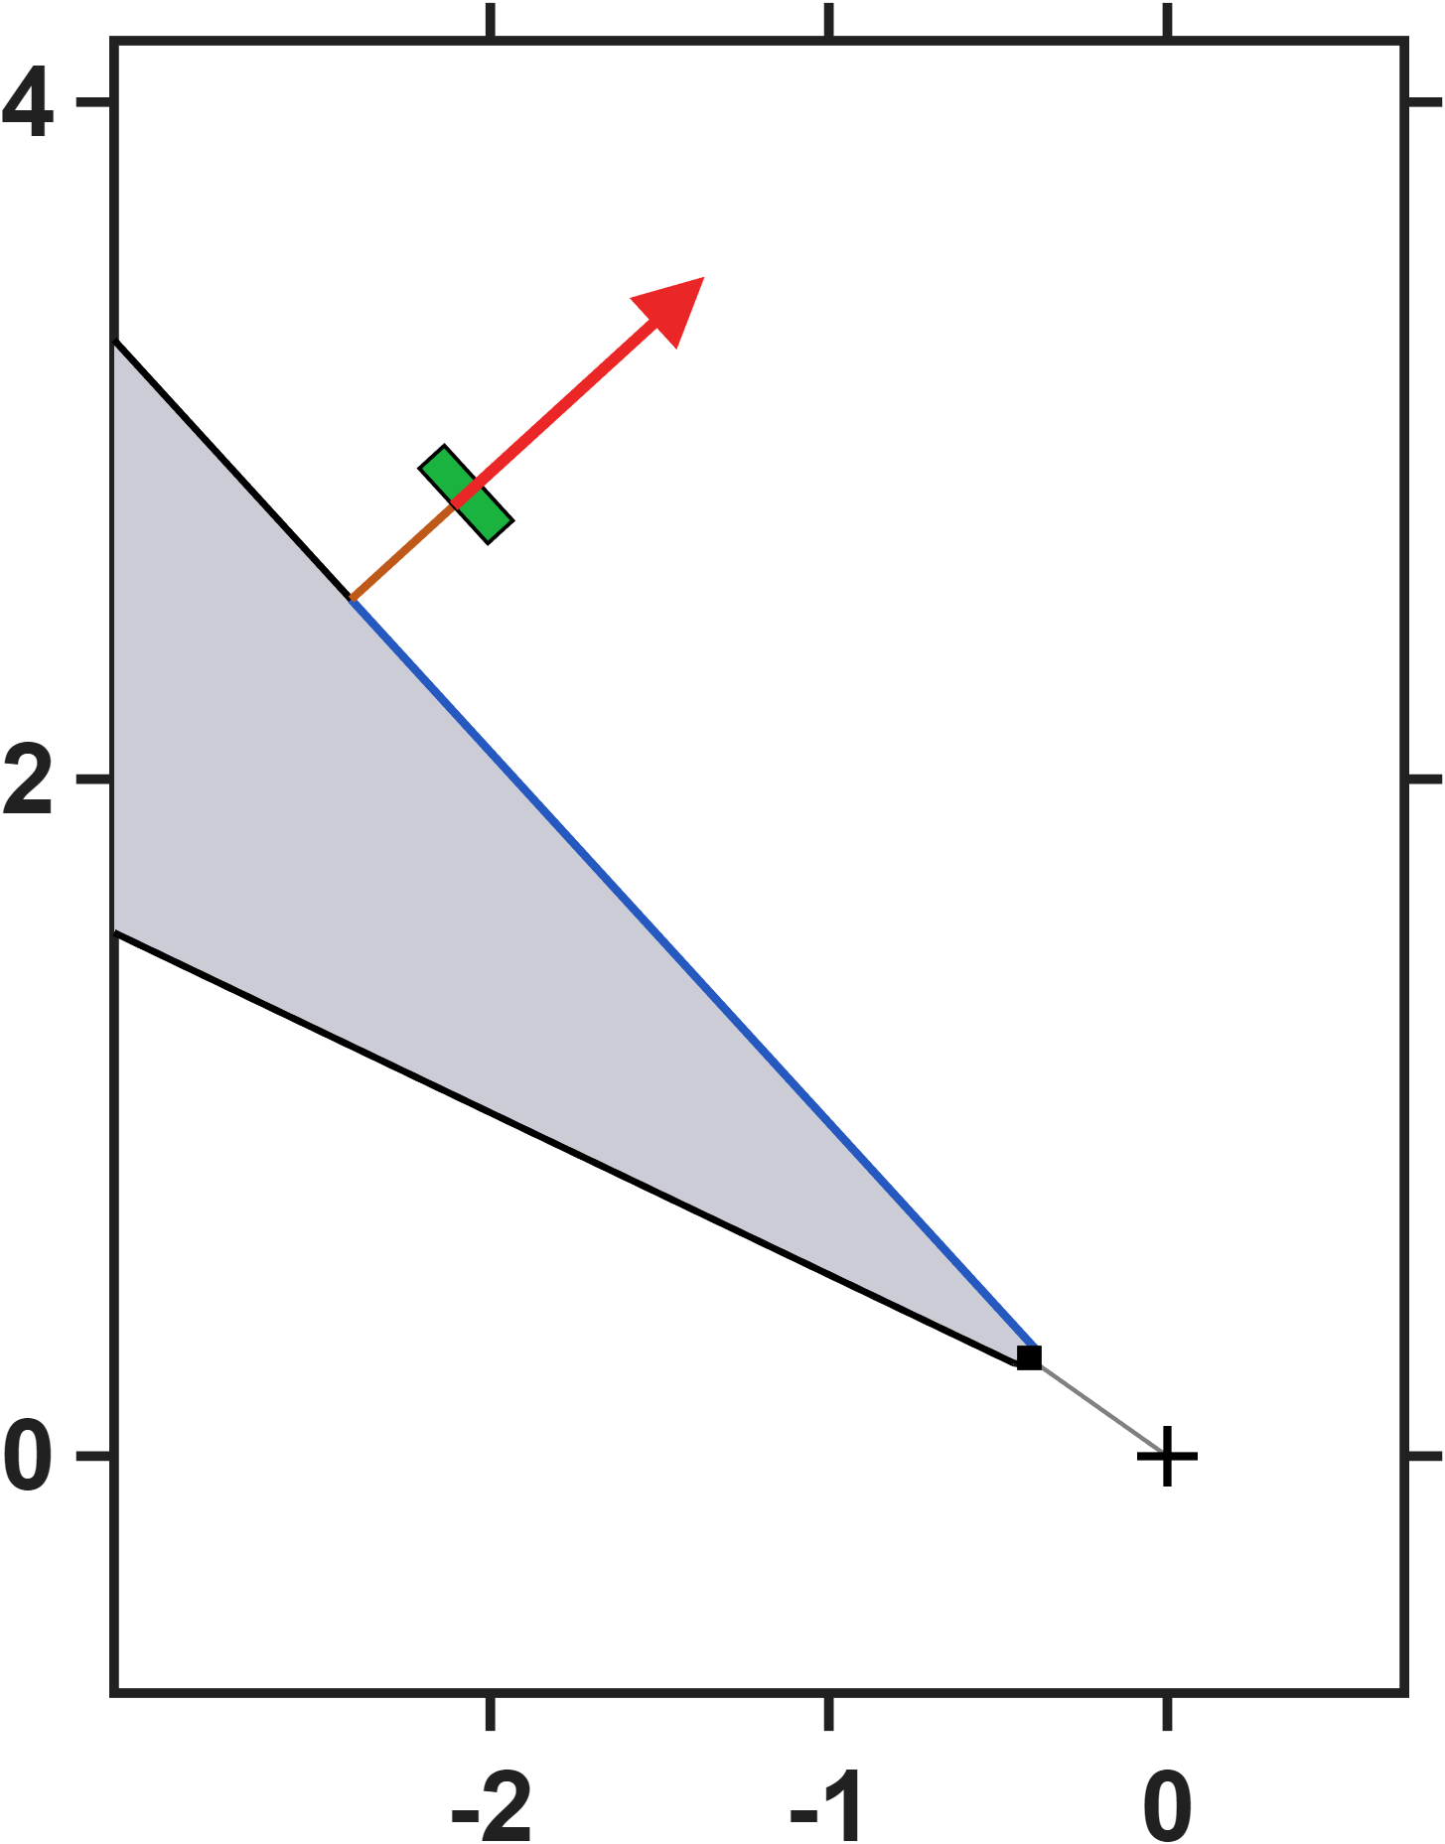



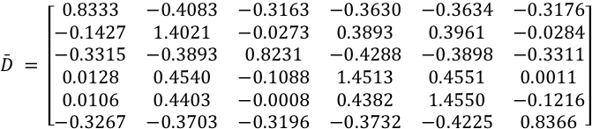


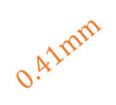



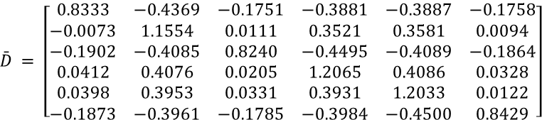
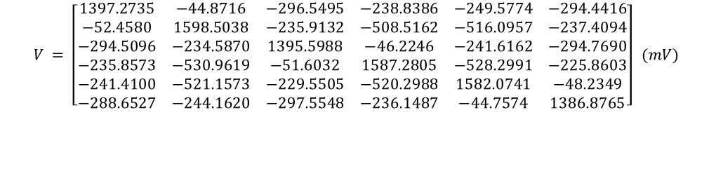



Hall-sensor-voltage-based lumped-parameter modeling and calibration
$$Calibrate model→b_{ij}=S_{i}{}_{}^{B}{{\hat{g}}_{V}}\overline{D}V_{j}$$
Single parameter
$$\bar{D} = \left[\begin{matrix}0.8333 & −0.4091 & −0.3164 & −0.3630 & −0.3643 & −0.3180 \\ −0.1435 & 1.4020 & −0.0278 & 0.3880 & 0.3952 & −0.0290 \\ −0.3316 & −0.3895 & 0.8224 & −0.4285 & −0.3899 & −0.3315 \\ 0.0136 & 0.4566 & −0.1075 & 1.4521 & 0.4570 & 0.0024 \\ 0.0122 & 0.4436 & 0.0012 & 0.4406 & 1.4588 & −0.1197 \\ −0.3275 & −0.3723 & −0.3205 & −0.3744 & −0.4241 & 0.8360\end{matrix}\right]$$
$$NMAE=\frac{\sum_{j}{\sum_{i}{\left\|b_{ij}−S_{i}{}_{}^{B}{{\hat{g}}_{V}}\overline{D}V_{j}\right\|}}}{\sum_{j}{\sum_{i}{\left\|b_{ij}\right\|}}}∙100\%=2.85\%$$
$$z−axis(mm)$$
$$3mm$$
$$0.41mm$$
$$\hat{ℓ} = 875.1 μm {}_{}^{B}{{\hat{g}}_{V}} = 5.0964×{10}^{−3} mT/mV$$
Eighteen parameters
$$\bar{D} = \left[\begin{matrix}0.8333 & −0.4379 & −0.1755 & −0.3883 & −0.3898 & −0.1761 \\ −0.0079 & 1.1555 & 0.0106 & 0.3511 & 0.3574 & 0.0090 \\ −0.1904 & −0.4090 & 0.8233 & −0.4494 & −0.4093 & −0.1868 \\ 0.0418 & 0.4099 & 0.0215 & 1.2072 & 0.4102 & 0.0339 \\ 0.0411 & 0.3980 & 0.0345 & 0.3950 & 1.2064 & 0.0138 \\ −0.1882 & −0.3982 & −0.1795 & −0.3997 & −0.4518 & 0.8425\end{matrix}\right]$$
$$NMAE=\frac{\sum_{j}{\sum_{i}{\left\|b_{ij}−S_{i}{}_{}^{B}{{\hat{g}}_{V}}\overline{D}V_{j}\right\|}}}{\sum_{j}{\sum_{i}{\left\|b_{ij}\right\|}}}∙100\%=0.26\%$$
$$x−axis(mm)$$
$$\hat{e}= \left[\begin{matrix}0.0185 & 0.0203 & −0.1173 & 0.0024 & 0.0018 & −0.1186 \\ −0.1183 & 0.0026 & 0.0168 & 0.0163 & 0.0019 & −0.1185 \\ 0.1182 & −0.0029 & 0.1166 & −0.0029 & −0.0186 & −0.0199\end{matrix}\right]$$
$$0.41mm$$
$$z−axis(mm)$$
$$\hat{ℓ} = 873.0 μm {}_{}^{B}{{\hat{g}}_{V}} = 6.0657×{10}^{−3} mT/mV$$
$$3mm$$
$$V = \left[\begin{matrix}1397.5153 & −44.8949 & −296.4434 & −239.1196 & −249.0026 & −294.9264 \\ −52.3899 & 1598.4115 & −236.0011 & −508.1098 & −515.4042 & −237.3949 \\ −294.5246 & −235.2099 & 1397.1511 & −46.2959 & −241.8620 & −295.1847 \\ −235.7501 & −532.4126 & −51.6440 & 1588.6363 & −528.6298 & −226.1507 \\ −241.2077 & −521.3975 & −229.4493 & −520.3586 & 1580.8644 & −48.3108 \\ −288.5384 & −243.6843 & −297.2197 & −235.9084 & −44.7064 & 1386.2112\end{matrix}\right] (mV)$$
$$x−axis(mm)$$
Number of Interpolation Points:180(six sensor)

Slide 16
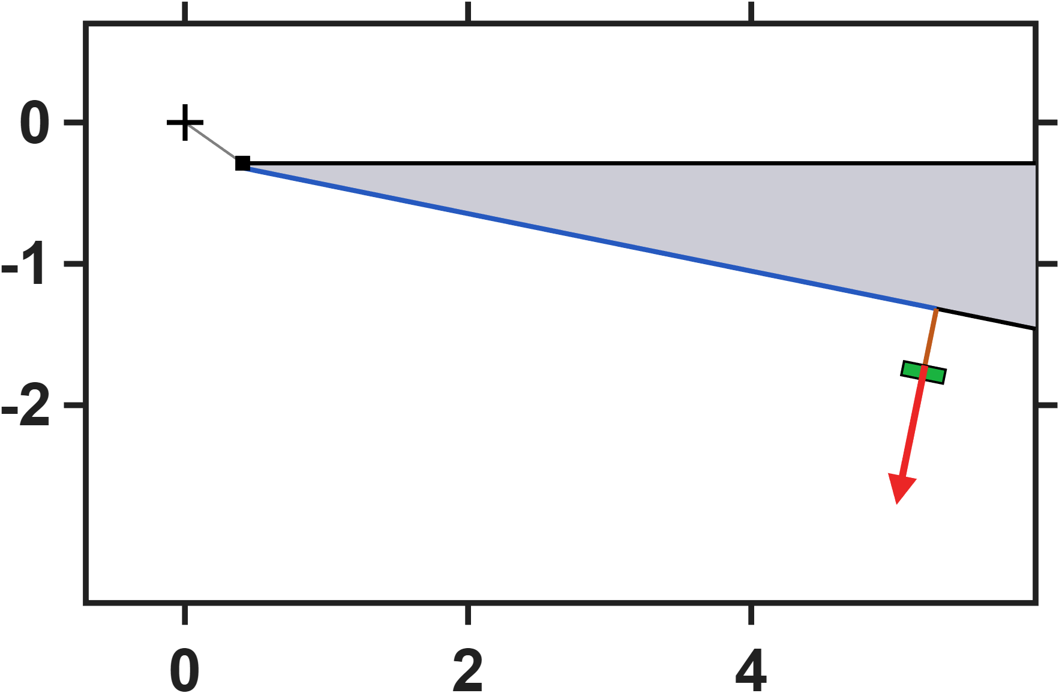
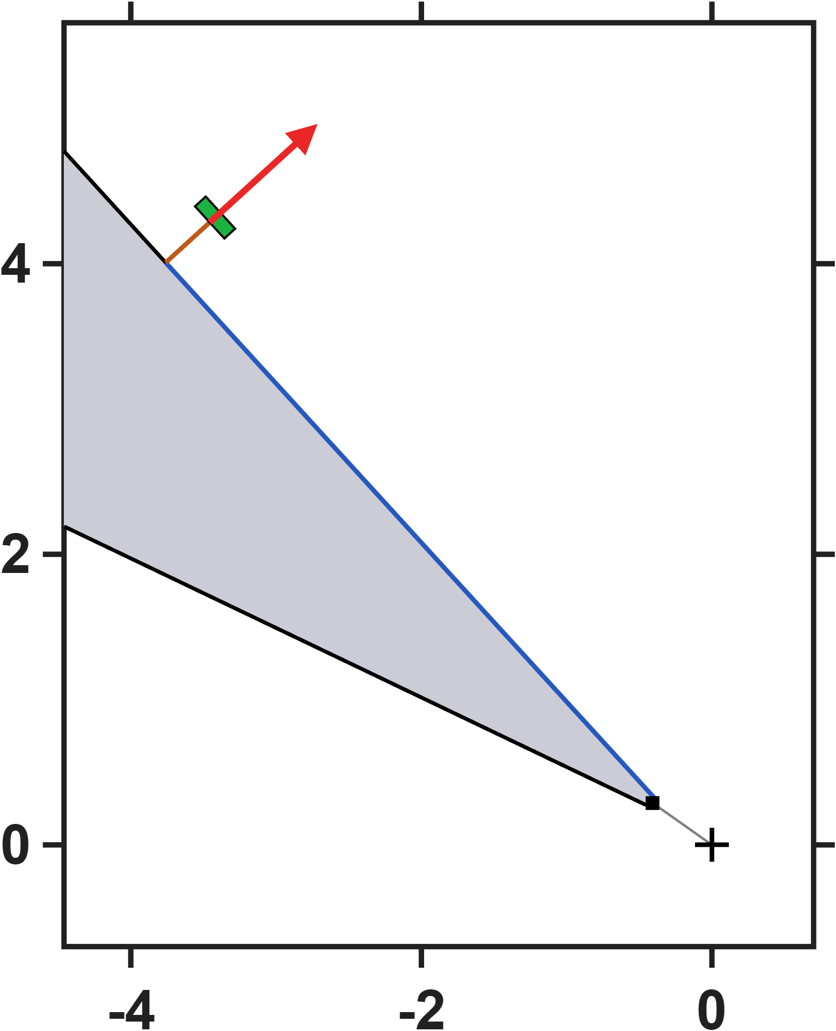


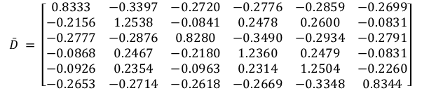


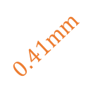
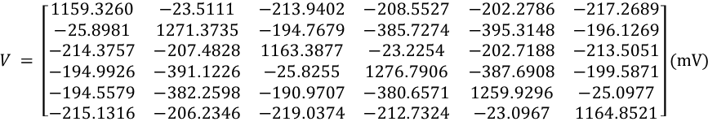


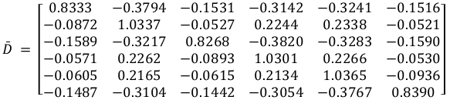




Hall-sensor-voltage-based lumped-parameter modeling and calibration
$$Calibrate model→b_{ij}=S_{i}{}_{}^{B}{{\hat{g}}_{V}}\overline{D}V_{j}$$
Single parameter
$$\bar{D} = \left[\begin{matrix}0.8333 & −0.3405 & −0.2722 & −0.2776 & −0.2864 & −0.2702 \\ −0.2154 & 1.2558 & −0.0837 & 0.2482 & 0.2607 & −0.0826 \\ −0.2775 & −0.2878 & 0.8279 & −0.3486 & −0.2934 & −0.2794 \\ −0.0873 & 0.2468 & −0.2180 & 1.2346 & 0.2477 & −0.0829 \\ −0.0922 & 0.2368 & −0.0955 & 0.2320 & 1.2519 & −0.2255 \\ −0.2655 & −0.2723 & −0.2622 & −0.2671 & −0.3353 & 0.8344\end{matrix}\right]$$
$$NMAE=\frac{\sum_{j}{\sum_{i}{\left\|b_{ij}−S_{i}{}_{}^{B}{{\hat{g}}_{V}}\overline{D}V_{j}\right\|}}}{\sum_{j}{\sum_{i}{\left\|b_{ij}\right\|}}}∙100\%=2.85\%$$
$$z−axis(mm)$$
$$5mm$$
$$0.41mm$$
$$\hat{ℓ} = 875.1 μm {}_{}^{B}{{\hat{g}}_{V}} = 6.5513×{10}^{−3} mT/mV$$
Eighteen parameters
$$x−axis(mm)$$
$$\bar{D} = \left[\begin{matrix}0.8333 & −0.3802 & −0.1534 & −0.3142 & −0.3247 & −0.1519 \\ −0.0870 & 1.0354 & −0.0524 & 0.2247 & 0.2344 & −0.0516 \\ −0.1588 & −0.3220 & 0.8266 & −0.3816 & −0.3284 & −0.1591 \\ −0.0575 & 0.2264 & −0.0893 & 1.0290 & 0.2265 & −0.0527 \\ −0.0602 & 0.2176 & −0.0609 & 0.2139 & 1.0378 & −0.0931 \\ −0.1489 & −0.3113 & −0.1447 & −0.3055 & −0.3773 & 0.8390\end{matrix}\right]$$
$$NMAE=\frac{\sum_{j}{\sum_{i}{\left\|b_{ij}−S_{i}{}_{}^{B}{{\hat{g}}_{V}}\overline{D}V_{j}\right\|}}}{\sum_{j}{\sum_{i}{\left\|b_{ij}\right\|}}}∙100\%=0.26\%$$
$$0.41mm$$
$$\hat{e}= \left[\begin{matrix}0.0185 & 0.0203 & −0.1173 & 0.0024 & 0.0018 & −0.1186 \\ −0.1183 & 0.0026 & 0.0168 & 0.0163 & 0.0019 & −0.1185 \\ 0.1182 & −0.0029 & 0.1166 & −0.0029 & −0.0186 & −0.0199\end{matrix}\right]$$
$$\hat{ℓ} = 873.0 μm {}_{}^{B}{{\hat{g}}_{V}} = 7.6756×{10}^{−3} mT/mV$$
$$5mm$$
$$V = \left[\begin{matrix}1159.5668 & −23.5248 & −213.7308 & −208.7612 & −202.0178 & −217.6552 \\ −25.8751 & 1270.3779 & −194.5319 & −385.6372 & −395.0217 & −196.1640 \\ −214.4977 & −207.8367 & 1164.1663 & −23.2533 & −202.7730 & −213.7765 \\ −194.8479 & −391.6311 & −25.8715 & 1278.5043 & −387.9531 & −200.2446 \\ −194.4885 & −382.5715 & −191.0582 & −380.5290 & 1259.5404 & −25.1148 \\ −215.1006 & −206.1265 & −218.6404 & −212.7699 & −23.0765 & 1164.4823\end{matrix}\right](mV)$$
$$z−axis(mm)$$
Moving the sensors further out along the pole flank leaves the field model completely untouched: the effective length, the charge-offset matrix and the fit error are identical to the closer mounting — and identical to the current-based results as well, since both reduce to the same transfer matrix. Only the voltage scale changes: further from the tip the leakage field is weaker, so the measured voltages drop and the voltage gain rises to compensate. This is structural rather than coincidental — the field model is fitted from the workspace field alone, and the sensor geometry enters only afterwards, when the excitation is re-expressed in volts. The predictive accuracy of the model is therefore independent of where the sensor is mounted, and the mounting position becomes a free design choice, bounded in practice only by keeping the sensor voltage within its linear range.
$$x−axis(mm)$$

Slide 17
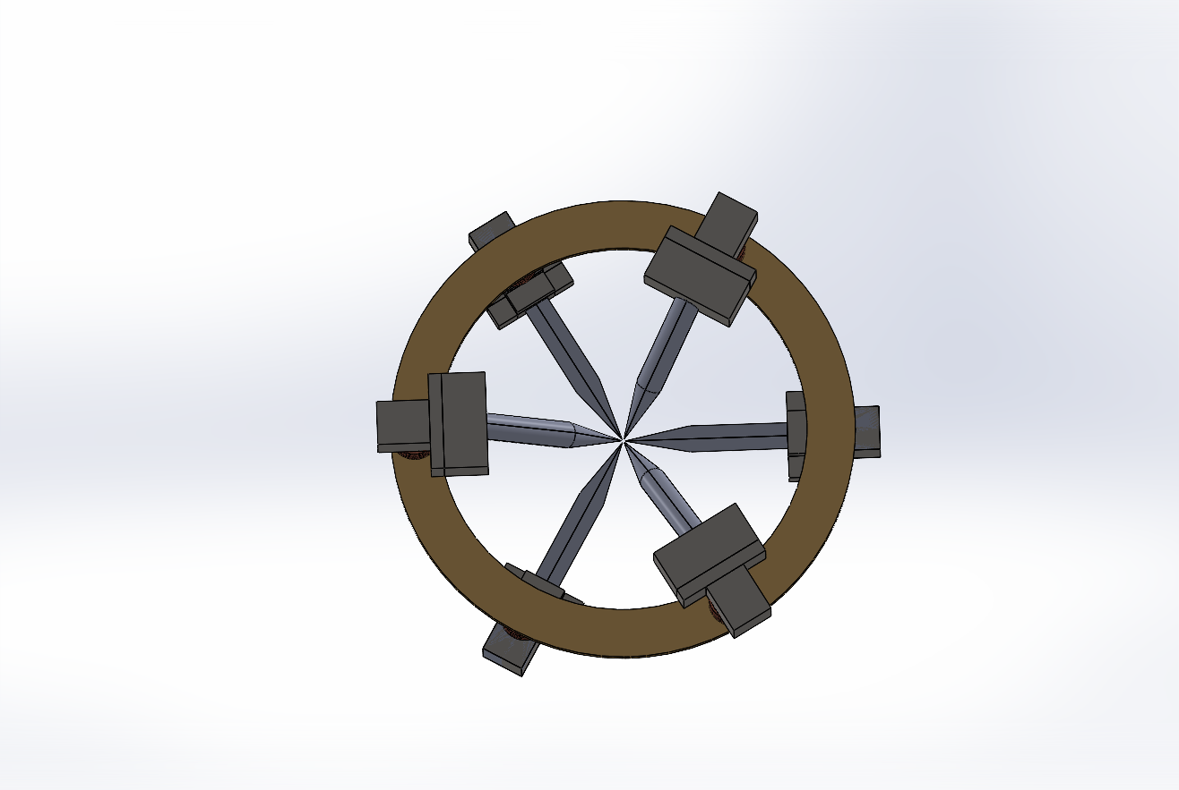
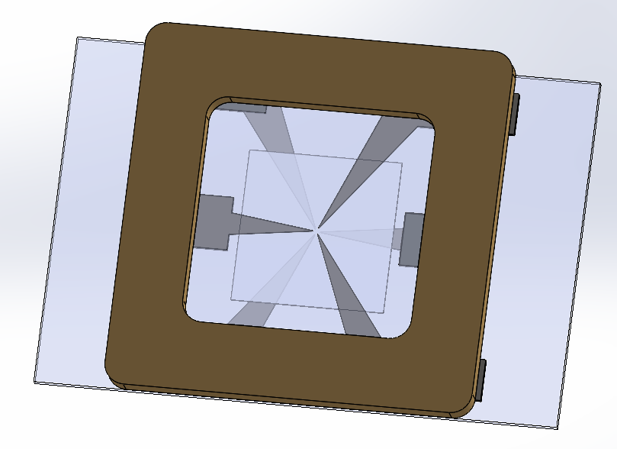
Quantitative Assessment of Multi-Pole Actuators
Setup: The assessment that follows compares two six-pole actuator designs, Design 1 on a circular yoke and Design 2 on a planar square frame. Both are described by the same lumped-parameter model and use the pole numbering P1-P6 shown here.
Sharing the model form and the pole numbering, the two differ only in geometry, so their calibrated parameters can be compared directly in the following slides.
DesignA
DesignB
P3
P3
P5
P2
P5
P2
P1
P6
P1
P6
P4
P4

Slide 18
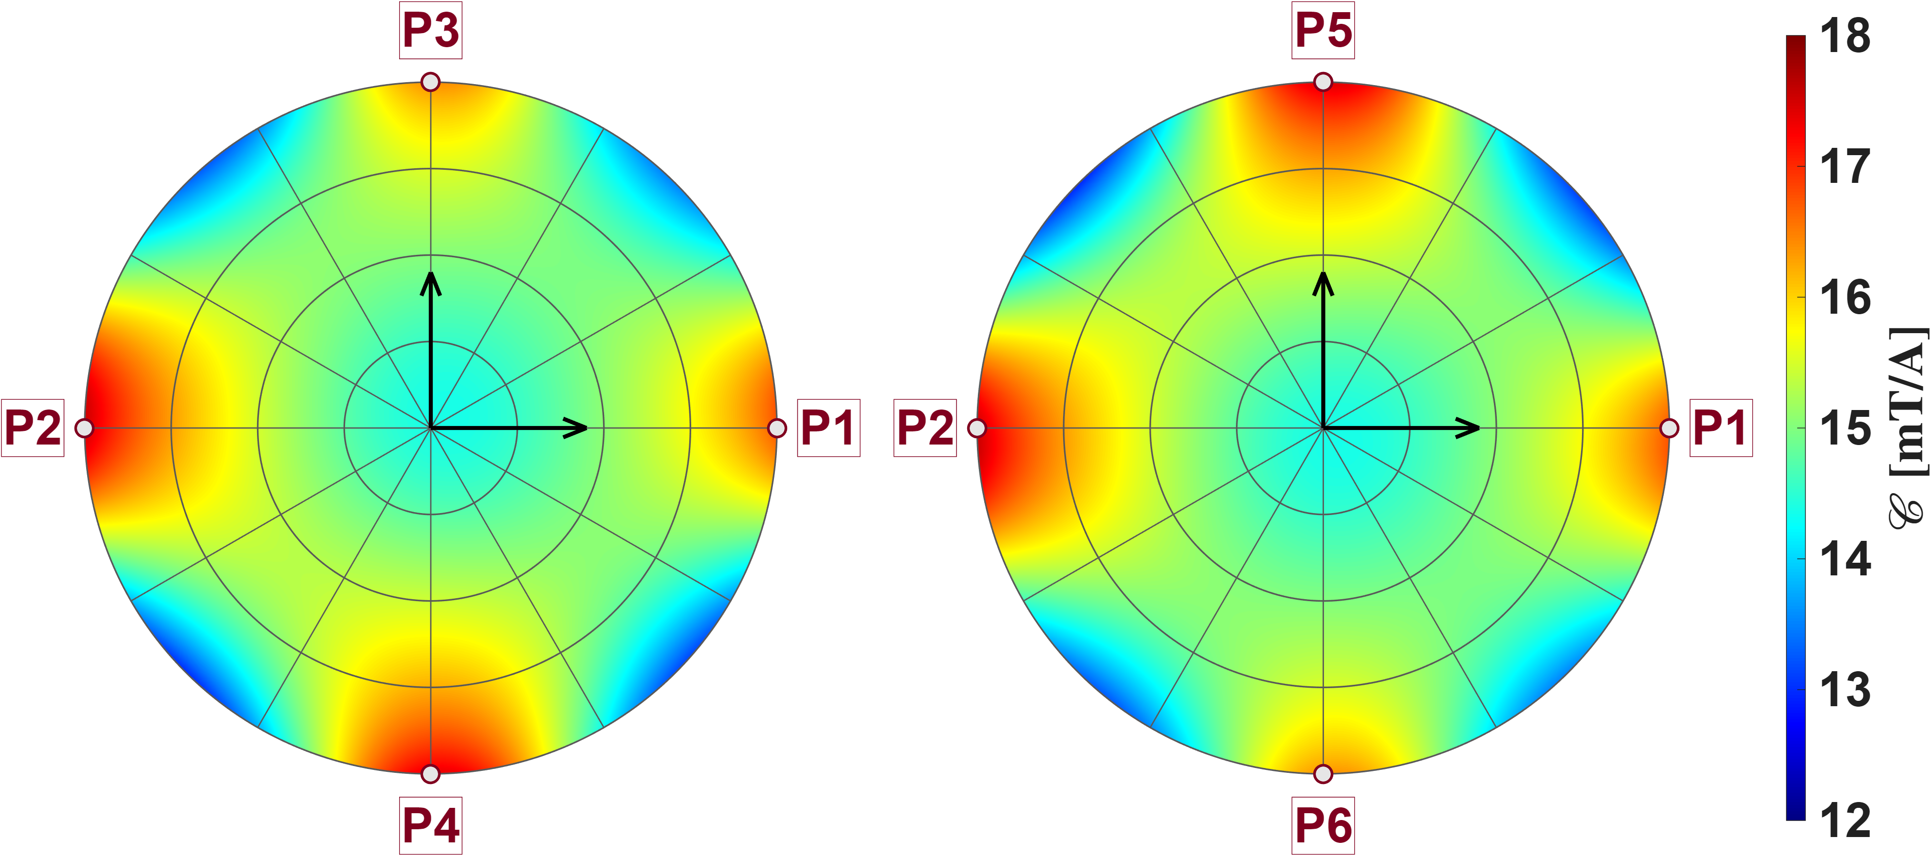
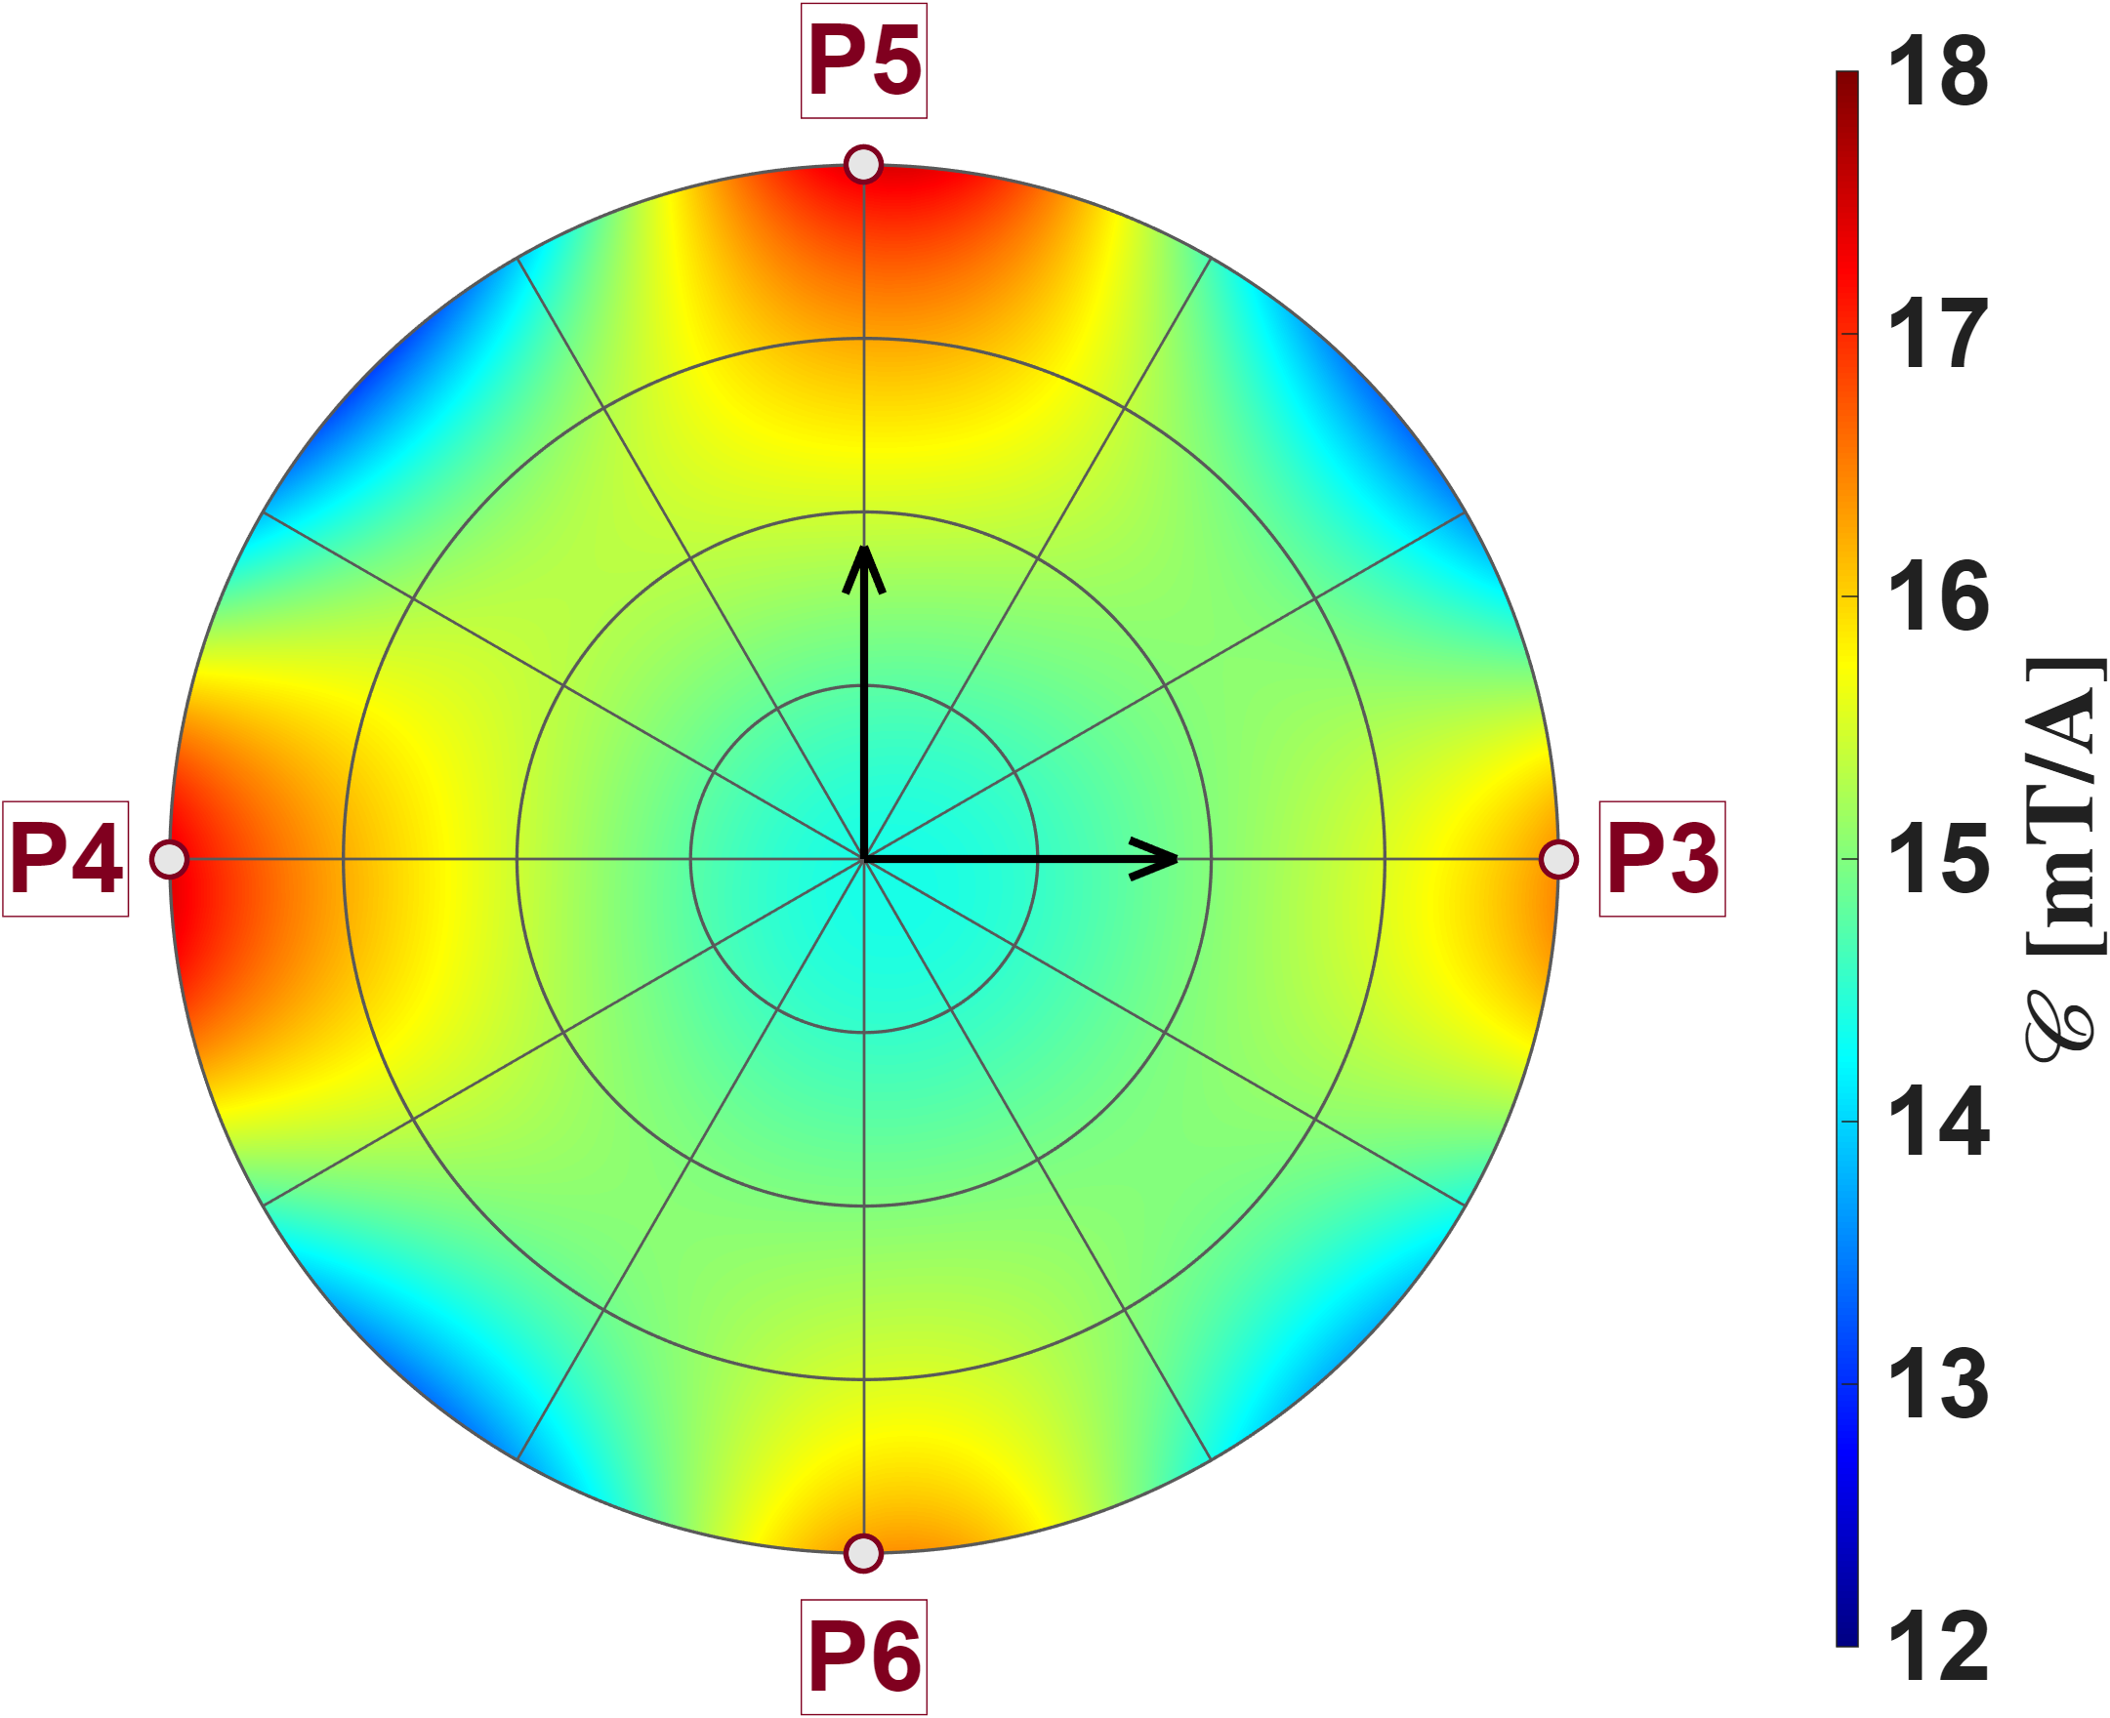

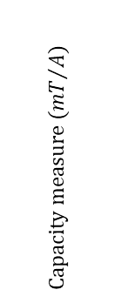
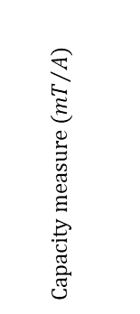





Quantitative Assessment of Multi-Pole Actuators
DesignA
P3
P5
The three reference planes are mutually orthogonal and all pass through the origin; the inset shows how they sit inside the pole-tip sphere, each disc extending out to that sphere. On every plane the calibrated model is evaluated point by point and the capacity measure is mapped in polar form, with the two pole pairs lying in that plane marked on the rim. The pattern is the same everywhere: the capacity is lowest at the center, grows steadily outwards, and reaches its maxima in four lobes pointing at the in-plane poles, with troughs between them. This is the gain signature of Design A: the gain is not uniform over the workspace but is smallest at the center and largest along the pole axes near the tips, and its variation with direction follows the pole layout directly. Because the three maps are indistinguishable, the gain field carries the full symmetry of the six-pole arrangement — six poles of equal strength, arranged as three opposing pairs whose axes are mutually perpendicular. The consequence is that the gain is limited not by any particular plane or direction, but by radial position: the lowest gain of the whole workspace sits at its center.
$$y_{a}$$
$$z_{a}$$
P2
P2
$$x_{a}$$
$$Capacity measure ({mT}/A)$$
P1
$$x_{a}$$
P1
P4
P6
P5
$$z_{a}$$
P4
$$Capacity measure ({mT}/A)$$
$$y_{a}$$
P3
P6

Slide 19
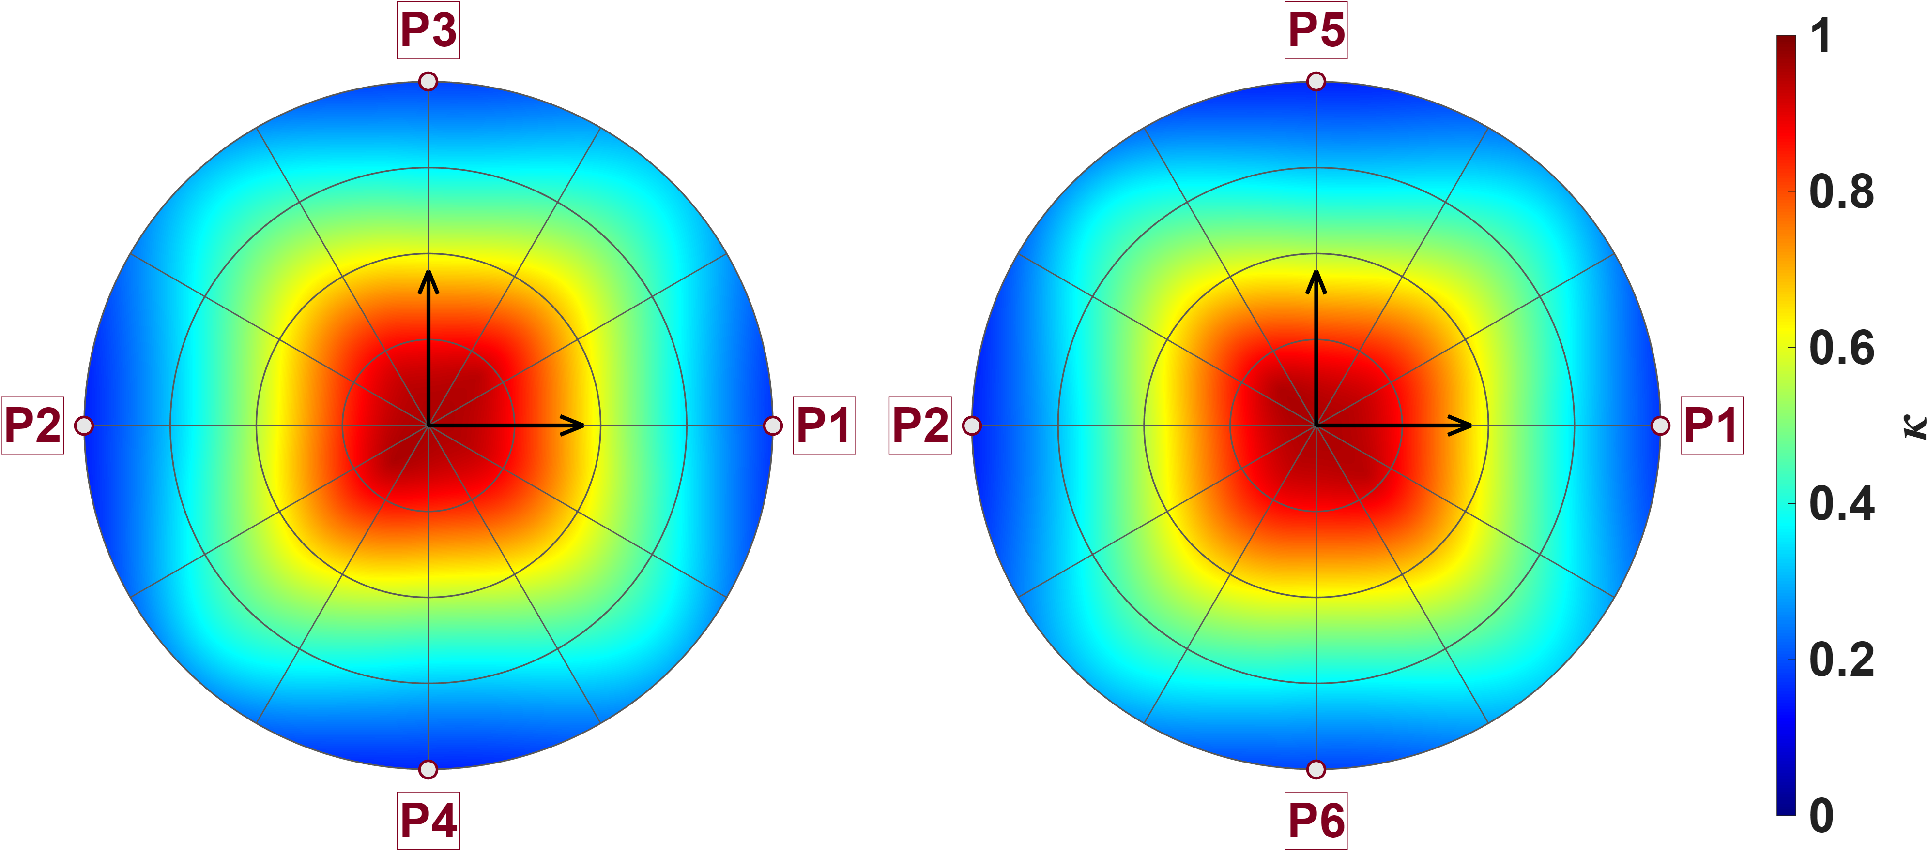
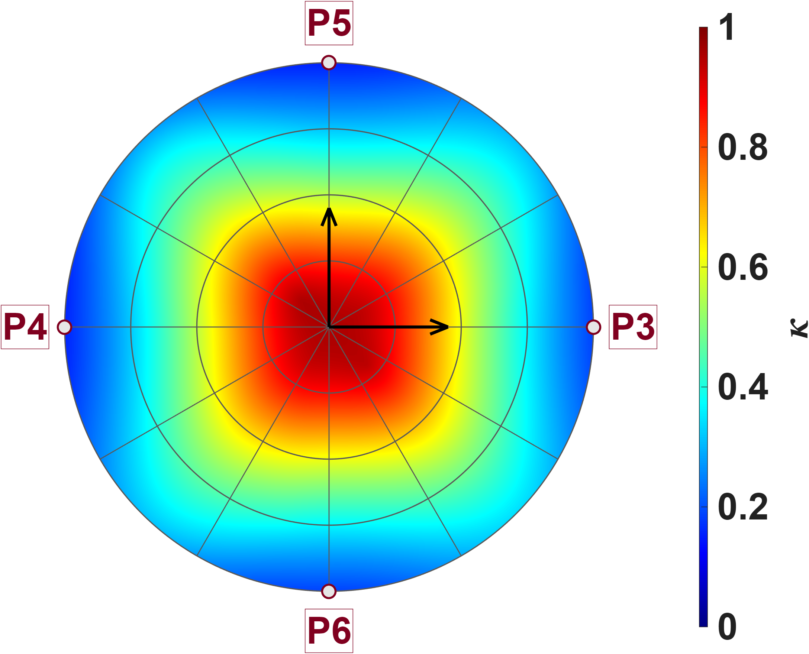





Quantitative Assessment of Multi-Pole Actuators
DesignA
P3
P5
Same three planes and the same calibrated model as before, but now mapping the isotropy. The picture is the exact complement of the capacity map: isotropy is highest at the centre and decays outwards in an almost circular pattern, reaching its lowest values at the rim. The reason is geometric — at the centre all six poles are equidistant, so the three singular values are nearly equal and the system can push with almost the same strength in any direction; moving outwards means approaching one pole pair while receding from the other two, so one singular value grows while the others shrink and the ratio collapses. Again the three planes are indistinguishable, confirming that the isotropy inherits the symmetry of the pole layout.
$$y_{a}$$
$$z_{a}$$
P2
P2
P1
$$x_{a}$$
$$Isotropy$$
$$x_{a}$$
P1
P4
P6
P5
$$z_{a}$$
P4
$$y_{a}$$
P3
$$Isotropy$$
P6

Slide 20




Quantitative Assessment of Multi-Pole Actuators
DesignA
The three distributions separate clearly, and the separation is asymmetric: the largest singular value is roughly twice the other two and spreads over a wide range with a long tail towards high values, while the second and third are narrow and overlap heavily. Over most of its workspace Design A therefore has one dominant direction and two comparable, weaker ones, rather than three directions of similar strength; the isotropy deficit seen on the previous slide is driven mainly by the strong axis pulling away, not by the weakest axis collapsing. The long tail belongs to the points closest to the pole tips — the same points that form the four red lobes of the capacity map on slide 14.
Both histograms have the same resolution (22.04uT/A).
$$Percentage count(\%)$$
$$Capacity measure ({mT}/A)$$
 | $$σ_{11}$$ | $$σ_{22}$$ | $$σ_{33}$$
Mean$({mT}/{A)}$ | 15.7 | 14.396 | 13.85

Slide 21







Quantitative Assessment of Multi-Pole Actuators
DesignB
Zhi-Peng delivers 2.71× the actuation strength of Long Fei (39.58 vs 14.62 mT/A). Both share the same pattern: weakest at the centre, strengthening toward the pole tips, and almost constant with direction within the calibration radius，the planar hexapole wins outright on strength, and it is a pure gain improvement — the field shape is not degraded, and the advantage holds uniformly across the workspace.
P3
P5
$$y_{a}$$
$$z_{a}$$
P2
P2
$$Capacity measure ({mT}/A)$$
$$x_{a}$$
P1
$$x_{a}$$
P1
P4
P6
P5
$$z_{a}$$
P4
$$Capacity measure ({mT}/A)$$
$$y_{a}$$
P3
P6

Slide 22





Quantitative Assessment of Multi-Pole Actuators
DesignB
P3
P5
Zhi-Peng reaches only 0.62× the isotropy of Long Fei (0.544 vs 0.884). Long Fei's high-κ region is concentric about the origin, whereas Zhi-Peng's is offset, split into two diagonal lobes, and decays faster with radius. the gain is bought at the cost of isotropy. More importantly, Zhi-Peng's best-isotropy point is not the origin — Long Fei gives the most balanced three-axis control simply by staying at the centre, whereas Zhi-Peng offers no such sweet spot.
$$y_{a}$$
$$z_{a}$$
P2
P2
$$Isotropy$$
$$x_{a}$$
P1
$$x_{a}$$
P1
P4
P6
P5
$$z_{a}$$
P4
$$Isotropy$$
$$y_{a}$$
P3
P6

Slide 23




Quantitative Assessment of Multi-Pole Actuators
DesignB
The three singular values are σ₁ = 50.25, σ₂ = 45.39 and σ₃ = 27.26 mT/A. σ₁ and σ₂ differ by only 10.7 %, whereas σ₃ falls 40 % below σ₂ (σ₁/σ₃ = 1.84). All three distributions are tight，the controllable set is an oblate ellipsoid — two strong axes and one weak — not a sphere. The weakest third axis is the bottleneck of the whole actuator, since it sets the force available in the worst direction.
$$Percentage count(\%)$$
Both histograms have the same resolution (184uT/A).
$$Capacity measure ({mT}/A)$$
 | $$σ_{11}$$ | $$σ_{22}$$ | $$σ_{33}$$
Mean$({mT}/{A)}$ | 50.253 | 45.386 | 27.257

Slide 24







Quantitative Assessment of Multi-Pole Actuators
Compare DesignA&B
The two designs are completely disjoint in both metrics. In gain, Design B reaches 2.71× Design A (39.58 vs 14.62 mT/A); in isotropy, only 0.62× (Isotropy = 0.544 vs 0.884). Design A is also the tighter of the two (CV = 0.93 % vs 1.66 % for Capacity, 4.67 % vs 8.02 % for isotropy). Each design sits at one end of a direct trade-off between strength and isotropy — neither is uniformly better. Design B suits applications demanding large force output, Design A those needing balanced three-axis control.
$R≤150um$
  Capacity mean:A=$14.6246{mT}/A,B=39.5813{mT}/A$
  Iso mean :A=$0.8836,B=0.5439$
$$Percentage count(\%)$$
$$Percentage count(\%)$$
$$Isotropy$$
$$Capacity measure ({mT}/A)$$
This figure resolution is 0.05mT/A
This figure resolution is 0.01

Slide 25






Reference
$Workspace radius=\hat{ℓ}$
$Flux distribution matrix={\overline{K}}_{I}$
$Current to field gain={}_{}^{B}{{\hat{g}}_{I}}$
$Voltage to field gain={}_{}^{B}{{\hat{g}}_{V}}$
$Predict error=\sqrt{\frac{J}{N_{p}}}$, where $J=\sum_{j}{\sum_{i}{{ε_{ij}}^{T}ε_{ij}}}$
$Capacity measure=𝒞 ({mT}/A)$
$Isotropy=κ$
$Average field=\frac{\sum_{j}{\sum_{i}{\left\|b_{ij}\right\|}}}{6×N_{p}}$

Slide 26









Reference
$Zhi peng calibrate result(no gap)$
$Single(24 points)$
$Eighteen$(10 points)
$${\bar{K}}_{I} = \left[\begin{matrix}0.8333 & −0.0795 & −0.2410 & −0.1255 & −0.1259 & −0.2382 \\ −0.0824 & 0.8293 & −0.1307 & −0.2399 & −0.2404 & −0.1280 \\ −0.2795 & −0.1247 & 0.7473 & −0.0646 & −0.0888 & −0.2562 \\ −0.1283 & −0.2802 & −0.0699 & 0.7452 & −0.2586 & −0.0914 \\ −0.1281 & −0.2802 & −0.0941 & −0.2580 & 0.7437 & −0.0668 \\ −0.2794 & −0.1248 & −0.2591 & −0.0883 & −0.0654 & 0.7507\end{matrix}\right]$$
$${\bar{K}}_{I} = \left[\begin{matrix}0.8333 & −0.1061 & −0.1152 & −0.1882 & −0.1888 & −0.1149 \\ −0.1119 & 0.8320 & −0.1939 & −0.1194 & −0.1191 & −0.1942 \\ −0.1342 & −0.1959 & 0.7514 & −0.0932 & −0.1592 & −0.1302 \\ −0.2011 & −0.1369 & −0.0963 & 0.7409 & −0.1334 & −0.1630 \\ −0.2013 & −0.1372 & −0.1625 & −0.1341 & 0.7421 & −0.0969 \\ −0.1337 & −0.1958 & −0.1296 & −0.1589 & −0.0928 & 0.7493\end{matrix}\right]$$
$$\hat{ℓ} = 751.8 μm {}_{}^{B}{{\hat{g}}_{I}} = 32.9574 mT/A$$
$$\hat{ℓ} = 603.8 μm {}_{}^{B}{{\hat{g}}_{I}} = 37.3823 mT/A$$
$$NMAE=\frac{\sum_{j}{\sum_{i}{\left\|b_{ij}−S_{i}{}_{}^{B}{{\hat{g}}_{I}}{\overline{K}}_{I}I_{j}\right\|}}}{\sum_{j}{\sum_{i}{\left\|b_{ij}\right\|}}}∙100\%=11.02\%$$
$$NMAE=\frac{\sum_{j}{\sum_{i}{\left\|b_{ij}−S_{i}{}_{}^{B}{{\hat{g}}_{I}}{\overline{K}}_{I}I_{j}\right\|}}}{\sum_{j}{\sum_{i}{\left\|b_{ij}\right\|}}}∙100\%=0.65\%$$
$$\hat{e}= \left[\begin{matrix}−0.0025 & 0.0001 & −0.2172 & 0.2154 & 0.2168 & −0.2171 \\ −0.2164 & 0.2161 & 0.0020 & 0.0002 & 0.2178 & −0.2163 \\ 0.2167 & −0.2166 & 0.2164 & −0.2176 & 0.0005 & −0.0002\end{matrix}\right]$$

