Slide 1
A Lumped-Parameter Modeling, Calibration, and Capacity-Measure Framework for Flux Generation in Symmetric Multipole Electromagnetic Actuators
KUO,CHIEN-CHI

Slide 2
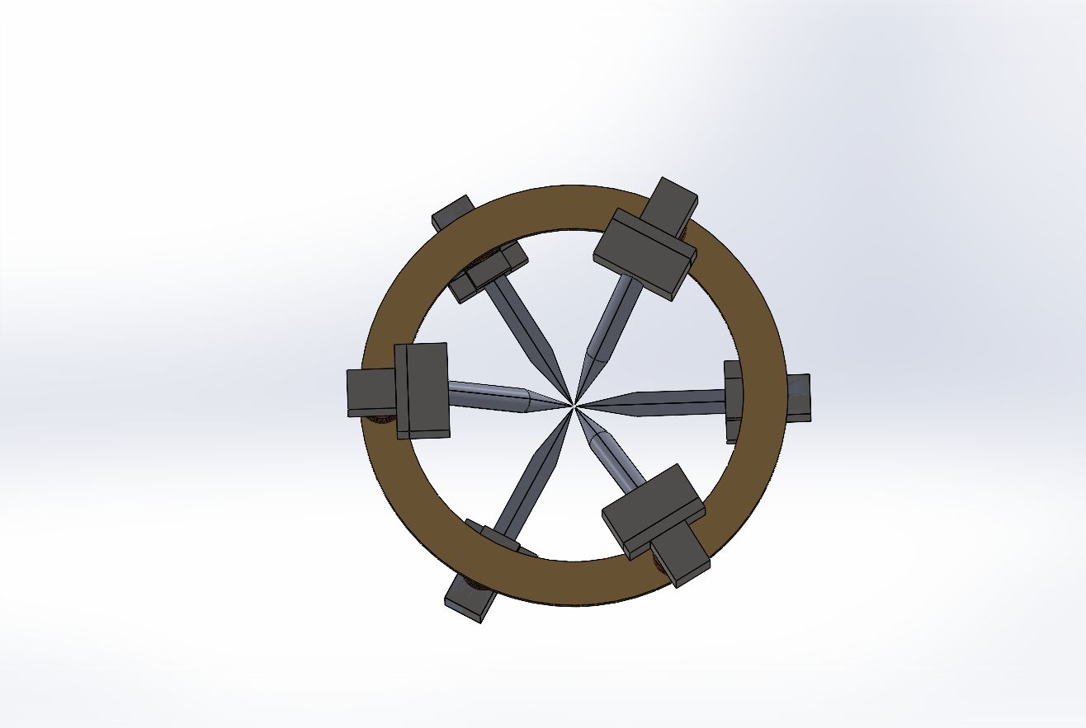
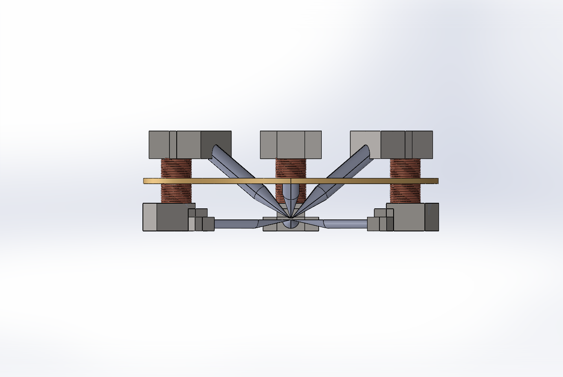
Current-based lumped-parameter modeling and calibration
Multiple-electromagnetic-pole actuation
The two figures present Longfei’s geometric model. View 1 labels the six magnetic poles individually, while View 2 provides a side view. From the side view, the coil wound around the magnetic core to generate the magnetic field, as well as the yoke structure, can be observed. The number of coil turns shown does not correspond to the actual number of turns; the purpose of the figure is to illustrate the coil location and function.
 | Long
View1
View2
P3
P5
P2
P1
P6
P4
Coil
Yoke

Slide 3
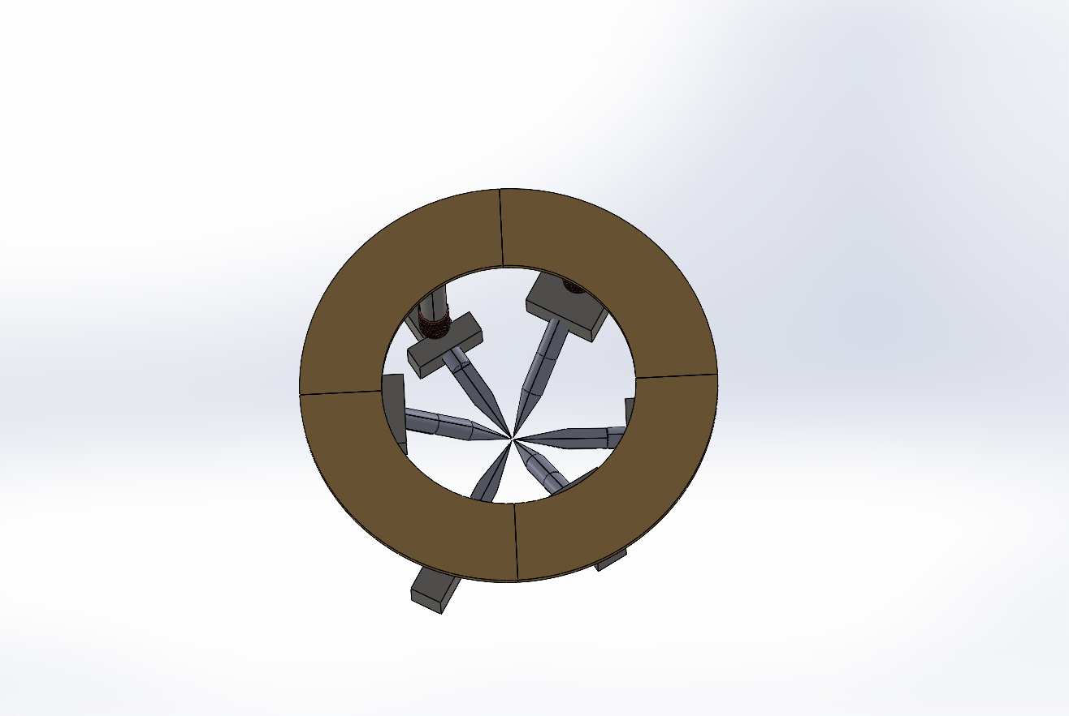
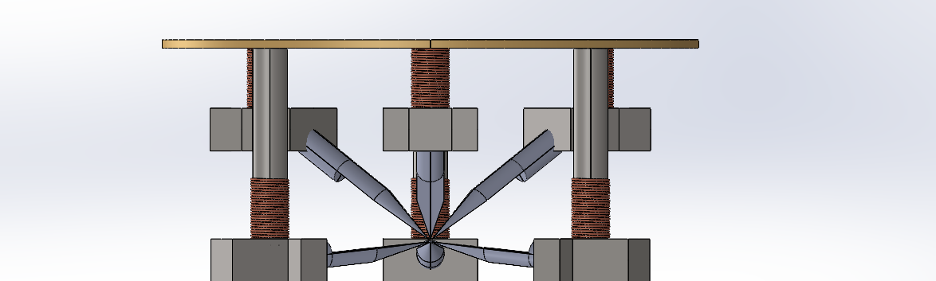
Current-based lumped-parameter modeling and calibration
Multiple-electromagnetic-pole actuation
 | Hung
View1
View2
The two figures present Hung’s geometric model. View 1 labels the six magnetic poles individually, while View 2 provides a side view. From the side view, the coil wound around the magnetic core to generate the magnetic field, as well as the yoke structure, can be observed. The number of coil turns shown does not correspond to the actual number of turns; the purpose of the figure is to illustrate the coil location and function.
P3
P5
P2
P1
P6
P4
Yoke
Coil

Slide 4
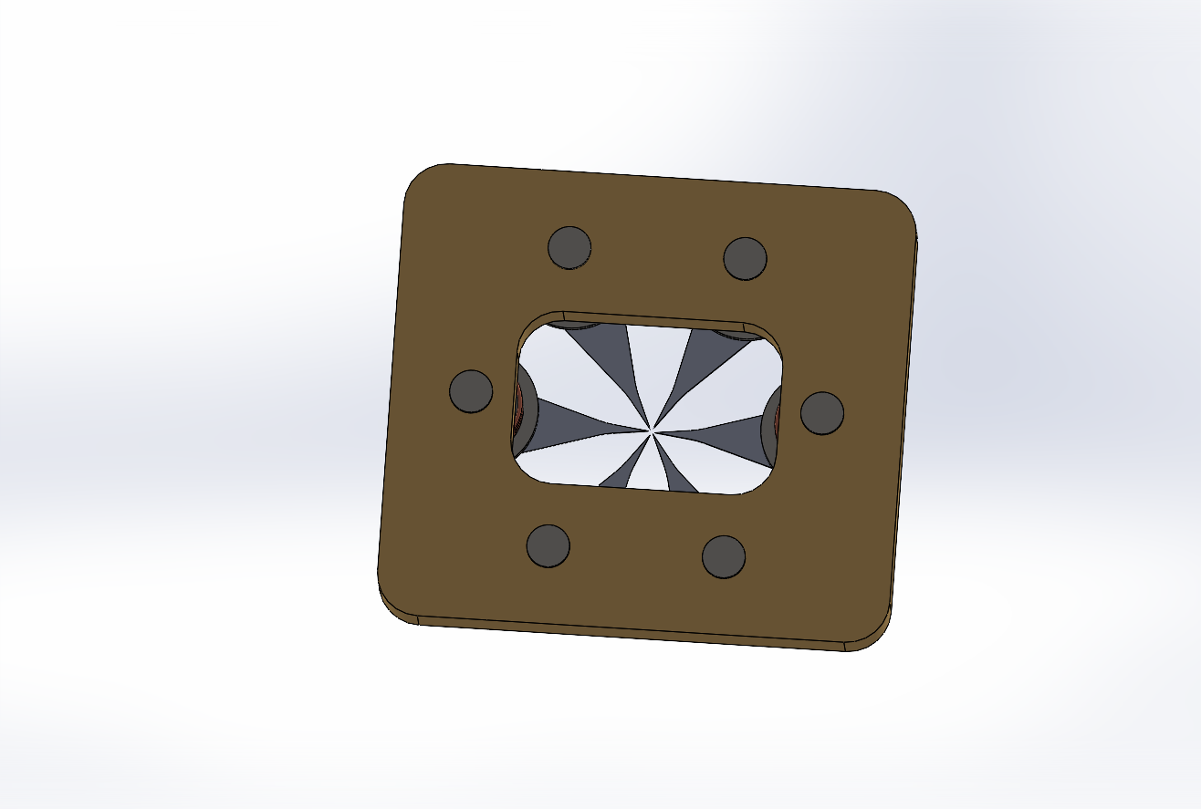
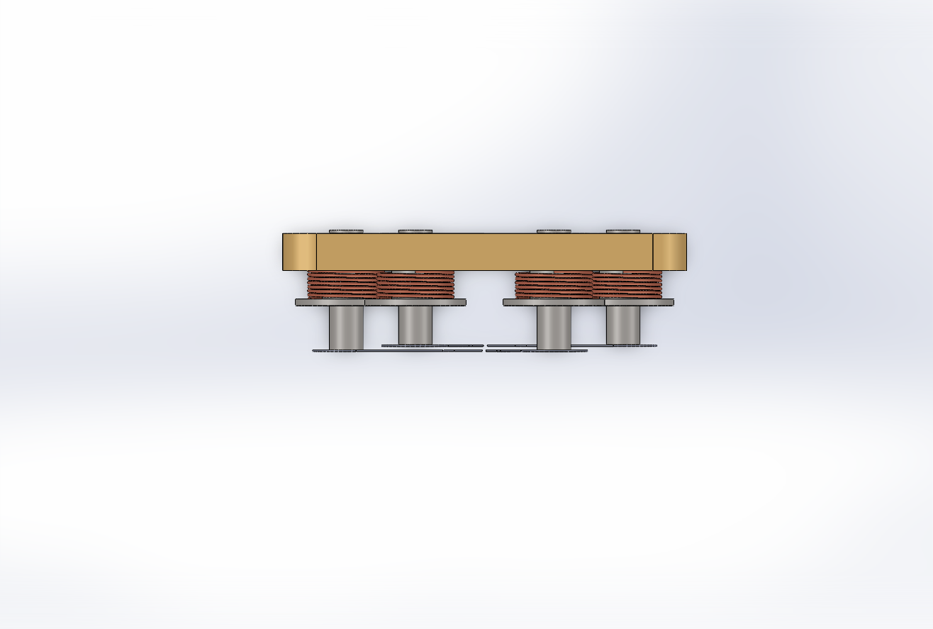
Current-based lumped-parameter modeling and calibration
Multiple-electromagnetic-pole actuation
 | NTU
View1
View2
The two figures present NTU’s geometric model. View 1 labels the six magnetic poles individually, while View 2 provides a side view. From the side view, the coil wound around the magnetic core to generate the magnetic field, as well as the yoke structure, can be observed. The number of coil turns shown does not correspond to the actual number of turns; the purpose of the figure is to illustrate the coil location and function.
P3
P5
P2
P1
P6
P4
Yoke
Coil

Slide 5
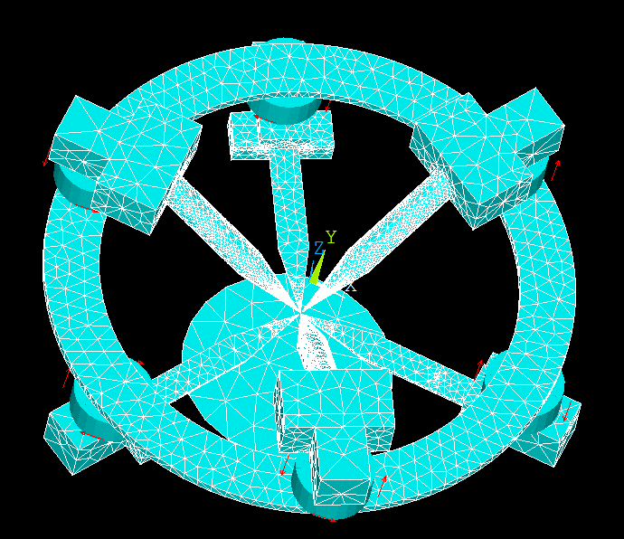
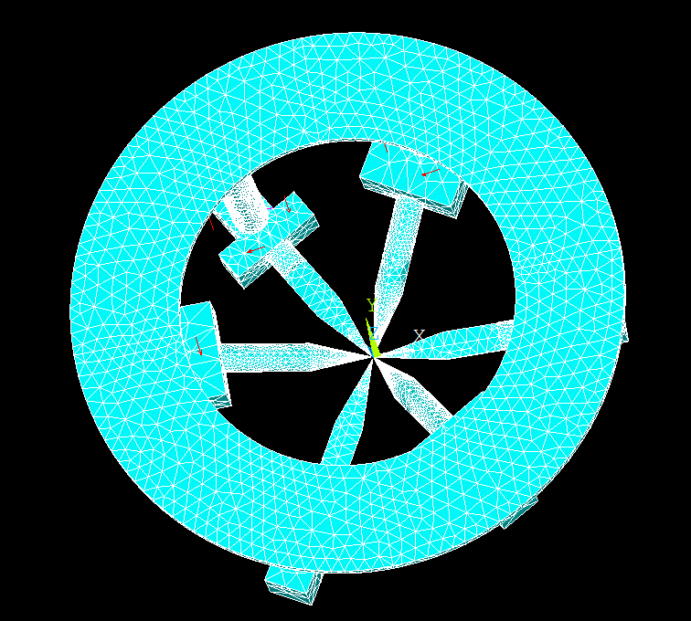
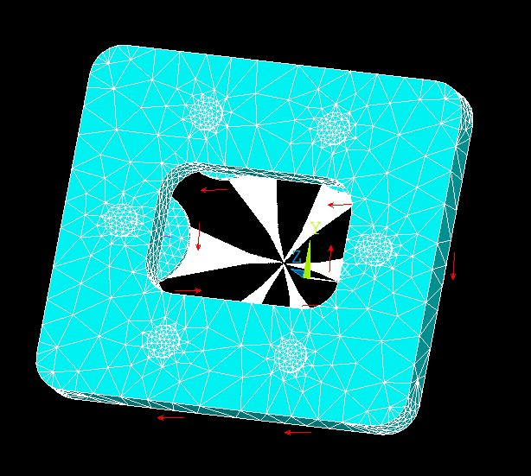
Current-based lumped-parameter modeling and calibration
Multiple-electromagnetic-pole actuation
Long | Hung | NTU
The simulation environment used in this study is ANSYS Mechanical APDL 2025 R2. After the geometric model is created in SolidWorks, the dimensions of each component are extracted and used as parameters in an APDL script to reconstruct the geometry. Once the geometry has been generated, the model is meshed and solved. The red arrows in the figure indicate the location and winding direction of the coils, which correspond to the coil positions shown on the previous slide.

Slide 6
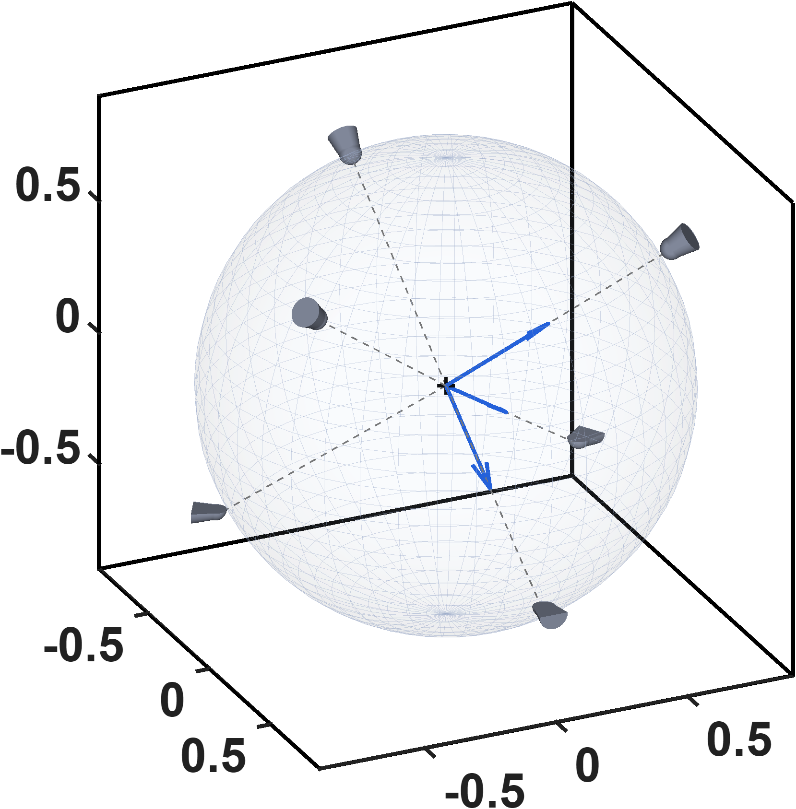






Current-based lumped-parameter modeling and calibration
Multiple-electromagnetic-pole actuation
P2
P5
P4
$$z_{a}$$
$$z(mm)$$
$$y_{a}$$
P3
$$x_{a}$$
P6
P1
$$x(mm)$$
$$y(mm)$$
This figure shows the actuator coordinate system defined for the multipole electromagnetic actuator, with the corresponding magnetic pole numbers labeled. All subsequent model calibration and analysis are conducted in this coordinate system. In addition, the tips of the six magnetic poles lie on a common spherical surface, whose radius is determined by the geometric design of the magnetic tweezer.

Slide 7
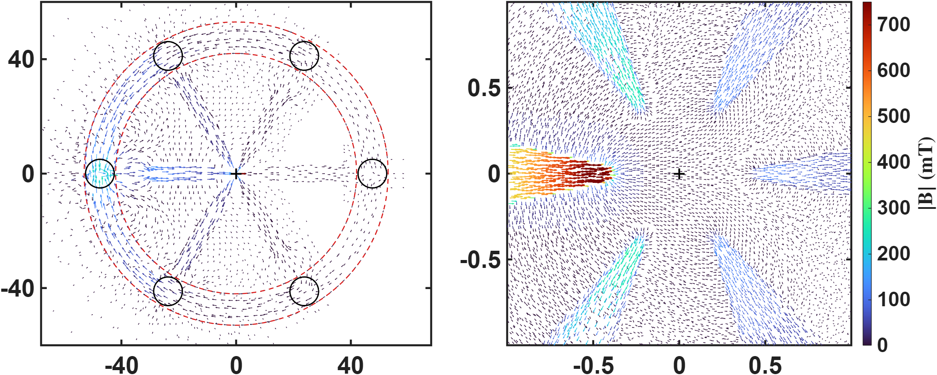




Current-based lumped-parameter modeling and calibration
Multiple-electromagnetic-pole actuation
P3
P5
P2
$$y(mm)$$
$$y(mm)$$
P1
P6
P4
$$x(mm)$$
$$x(mm)$$
The simulation conditions are an excitation current of 1 A and a 70-turn coil, and the results shown are obtained from Long’s model. The left figure presents a top view of the magnetic flux path through the entire structure when pole P2 is excited. The magnetic flux emerges from pole P2, enters the other poles, and then returns through the yoke. The right figure is an enlarged view of the central region in the left figure, allowing the magnetic flux path to be observed more clearly.

Slide 8
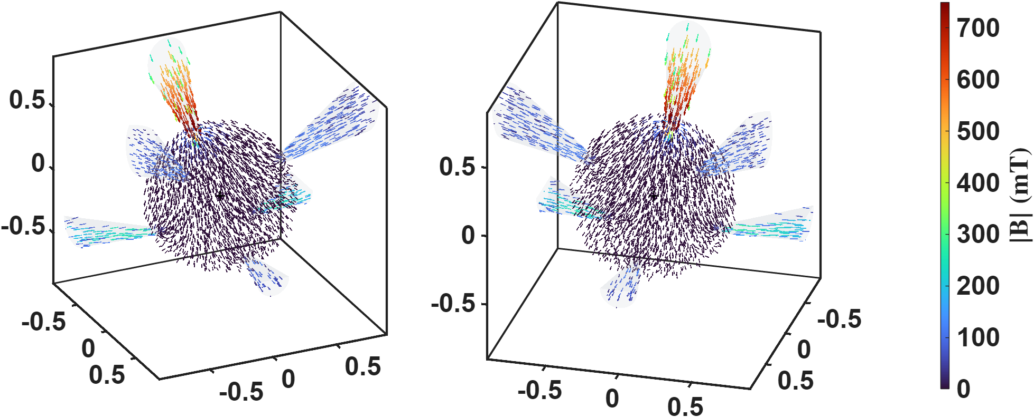
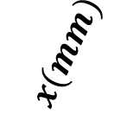
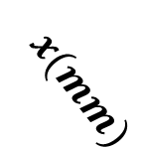
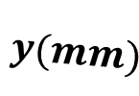


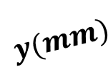
Current-based lumped-parameter modeling and calibration
Multiple-electromagnetic-pole actuation
$$z(mm)$$
$$z(mm)$$
$$x(mm)$$
$$x(mm)$$
$$y(mm)$$
$$y(mm)$$
Two 3D views of the central spherical region are also presented. These views clearly show that the magnetic flux emerges from pole P2 and is then received by the other magnetic poles.

Slide 9
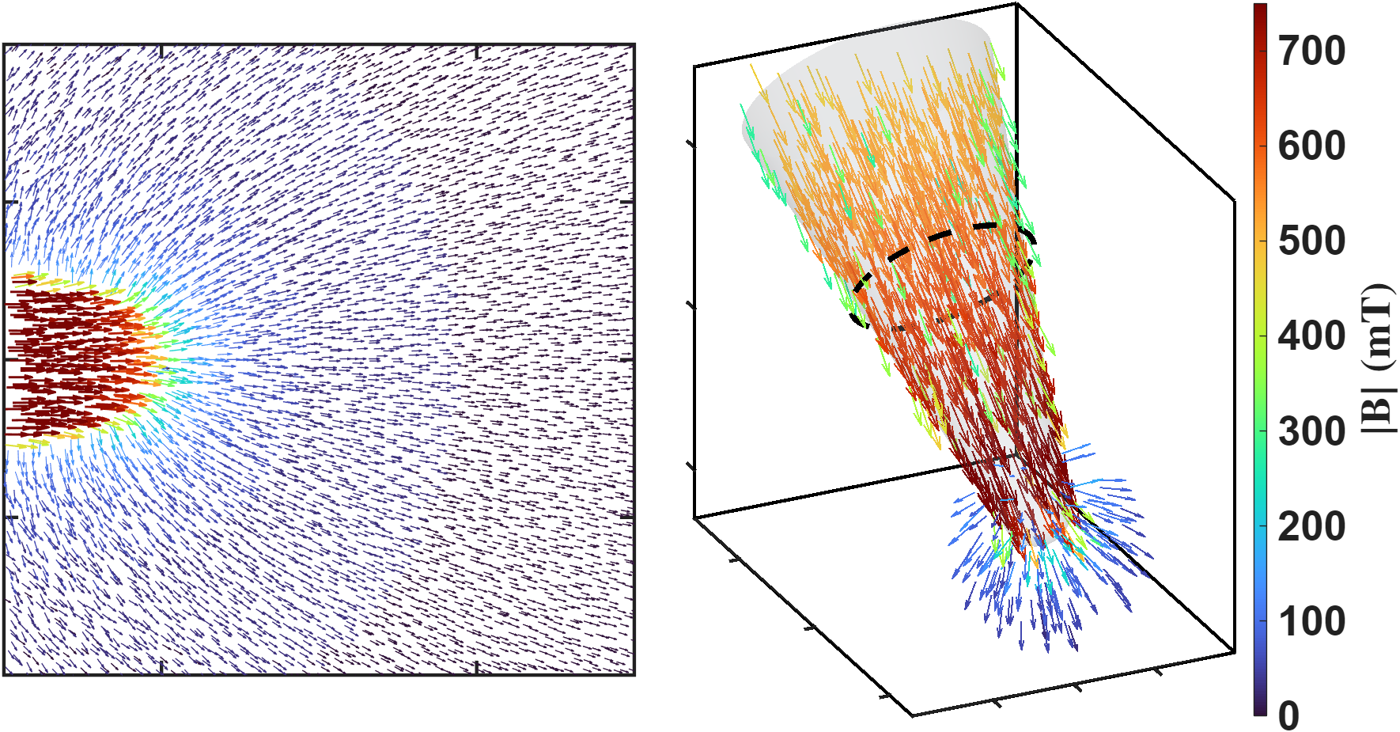



Current-based lumped-parameter modeling and calibration
C. Charge-location model
This figure illustrates the magnetic flux path when pole P2 is excited. The left figure presents a top view, with the theoretical magnetic charge locations labeled to clarify the magnetic charge concept used in this study. The right figure shows a three-dimensional view of the same model, in which the theoretical magnetic charge locations and the magnetic flux distribution can be clearly observed.
$$Φ$$
$$q$$
$$q$$

Slide 10
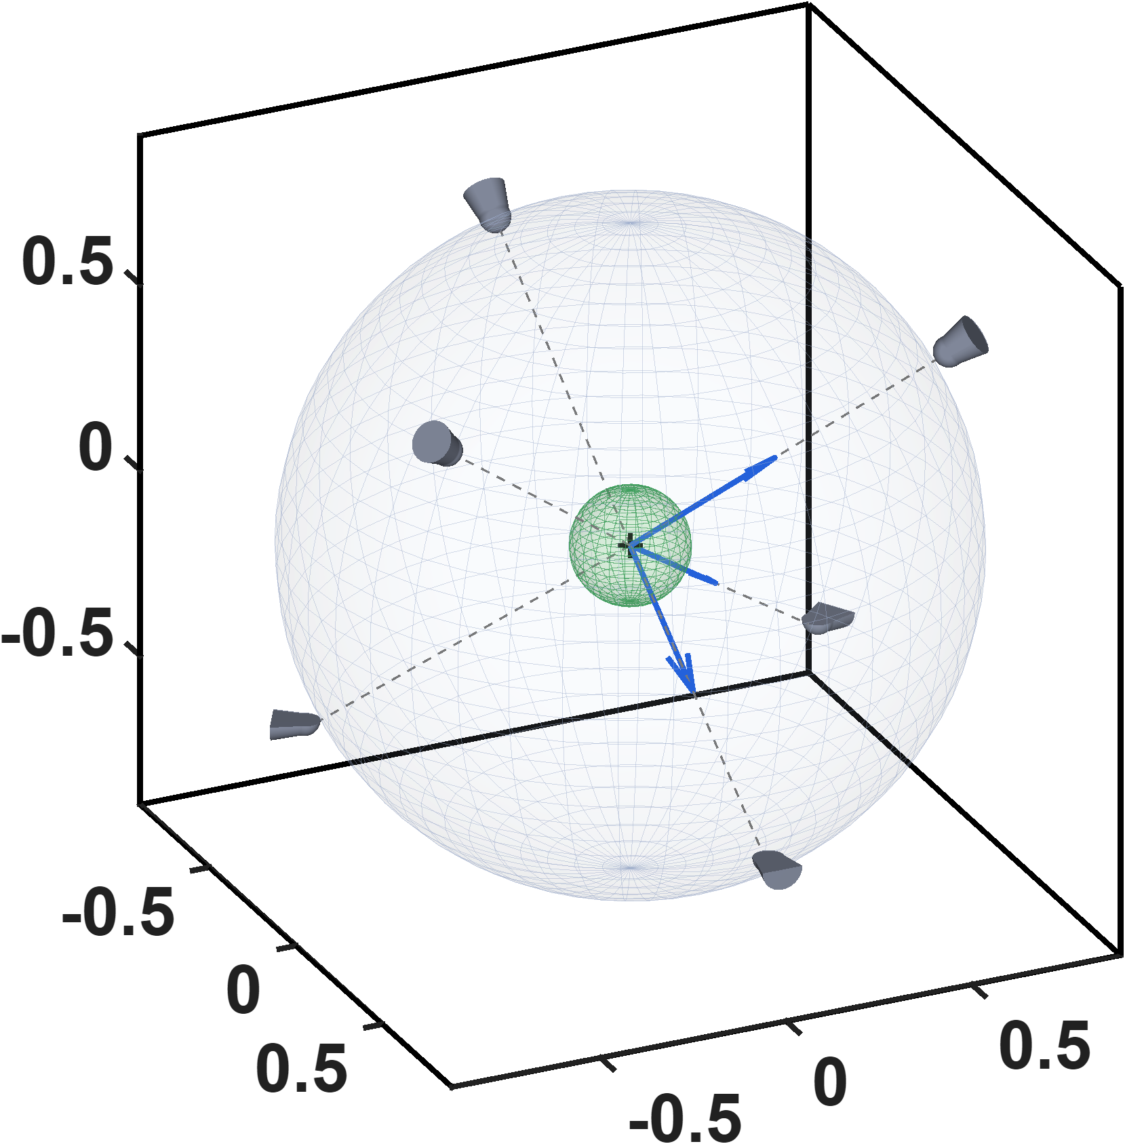
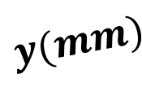
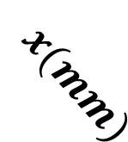





Current-based lumped-parameter modeling and calibration
E. Validation
$$Calibrate model→b_{ij}=S_{i}{}_{}^{B}{{\hat{g}}_{I}}\overline{K}I_{j}$$
This figure consists of two parts. The first part shows the outer spherical surface formed by the six magnetic pole tips, as described previously. The size of this spherical surface is determined by the geometric design of the magnetic tweezer. The second part, shown in green, represents the model’s sampling region. It is recommended that the sampling region cover the entire operating range, because the model exhibits reduced performance outside the sampled region.
$$z_{a}$$
$$z(mm)$$
$$y_{a}$$
$$x_{a}$$
$$x(mm)$$
$$y(mm)$$

Slide 11
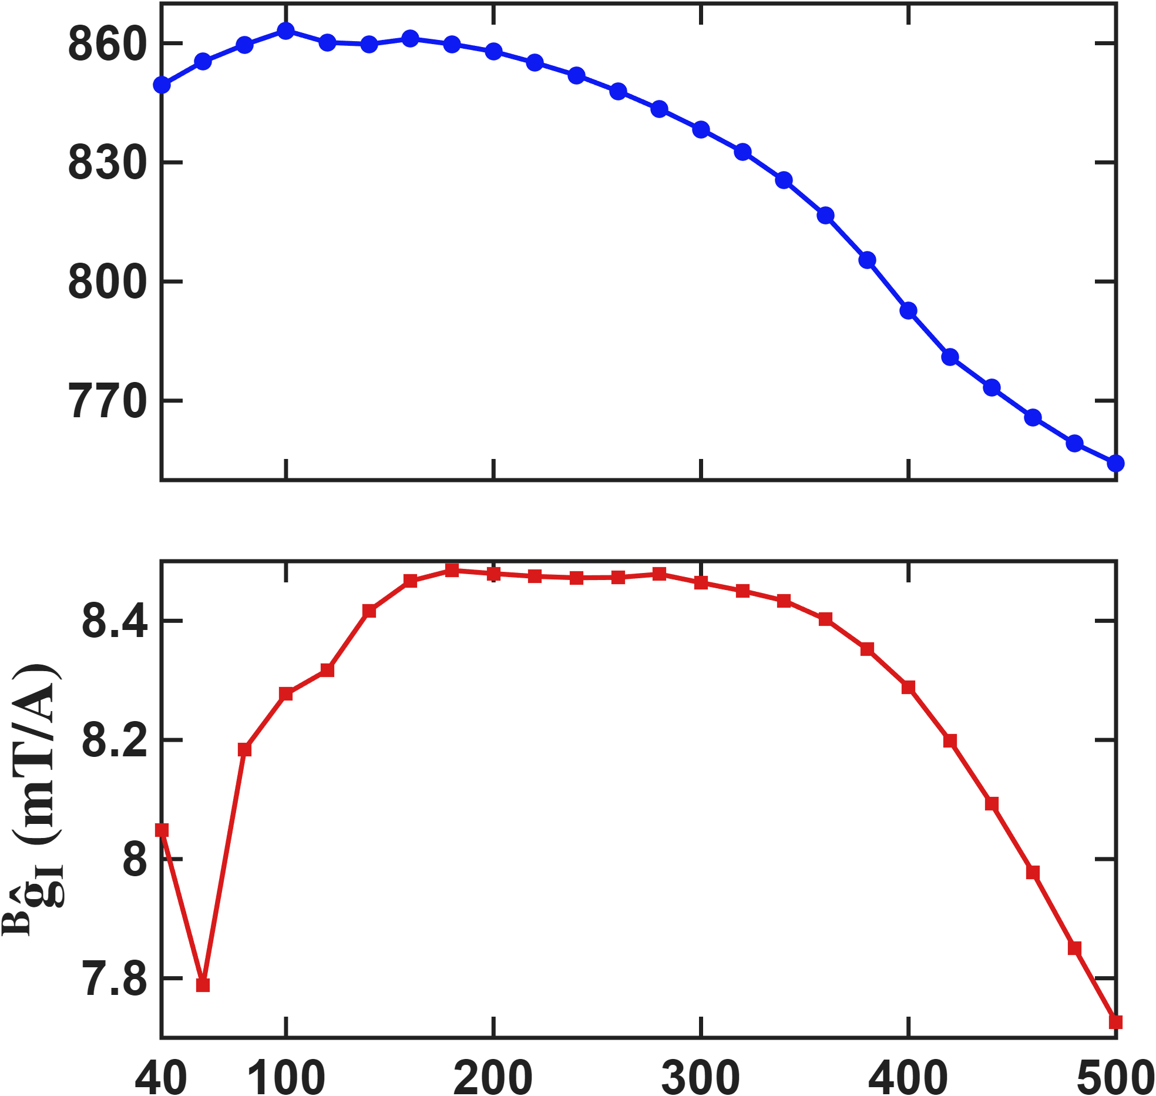




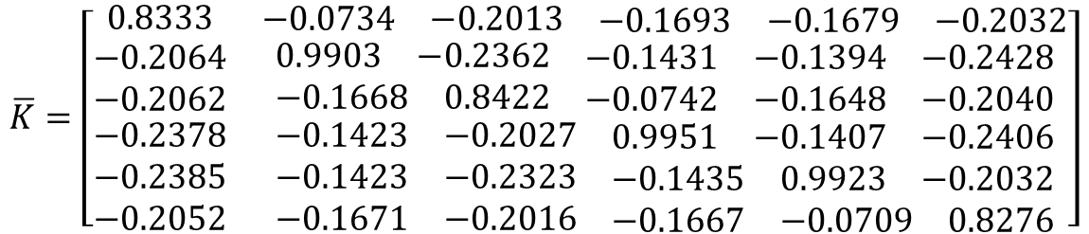

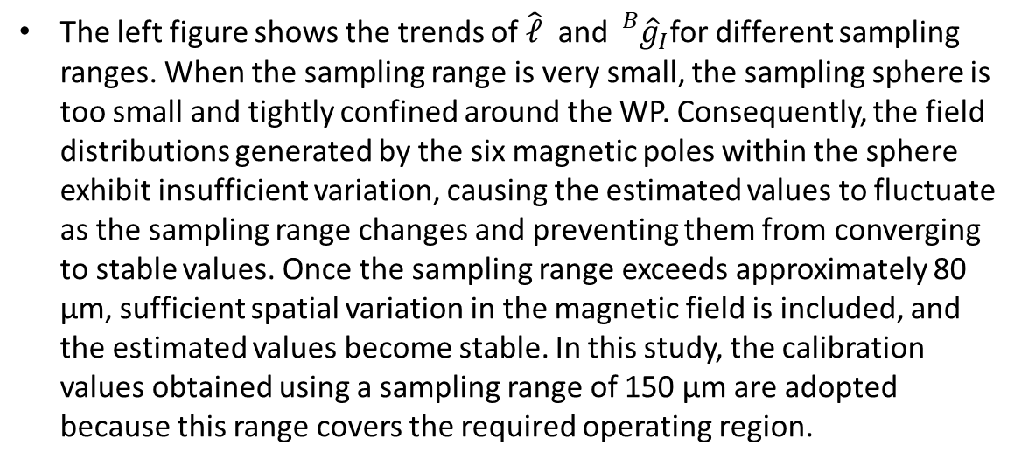
Current-based lumped-parameter modeling and calibration
E. Validation
$$Calibrate model→b_{ij}=S_{i}{}_{}^{B}{{\hat{g}}_{I}}\overline{K}I_{j}$$
Fitting results
$$\overline{K}=\left[\begin{matrix}0.8333 & \begin{matrix}−0.0734 & −0.2013 & \begin{matrix}−0.1693 & −0.1679 & −0.2032\end{matrix}\end{matrix} \\ \begin{matrix}−0.2064 \\ −0.2062 \\ \begin{matrix}−0.2378 \\ −0.2385 \\ −0.2052\end{matrix}\end{matrix} & \begin{matrix}\begin{matrix}0.9903 & −0.2362 & \begin{matrix}−0.1431 & −0.1394 & −0.2428\end{matrix}\end{matrix} \\ \begin{matrix}−0.1668 & 0.8422 & \begin{matrix}−0.0742 & −0.1648 & −0.2040\end{matrix}\end{matrix} \\ \begin{matrix}\begin{matrix}−0.1423 & −0.2027 & \begin{matrix}0.9951 & −0.1407 & −0.2406\end{matrix}\end{matrix} \\ \begin{matrix}−0.1423 & −0.2323 & \begin{matrix}−0.1435 & 0.9923 & −0.2032\end{matrix}\end{matrix} \\ \begin{matrix}−0.1671 & −0.2016 & \begin{matrix}−0.1667 & −0.0709 & 0.8276\end{matrix}\end{matrix}\end{matrix}\end{matrix}\end{matrix}\right]$$
$$\hat{𝓵} (um)$$
$$\hat{ℓ}=860.3 um$$
$${}_{}^{B}{{\hat{g}}_{I}=8. 4534mT/A}$$
The left figure shows the trends of $\hat{ℓ}$ and ${}_{}^{B}{{\hat{g}}_{I}}$for different sampling ranges. When the sampling range is very small, the sampling sphere is too small and tightly confined around the WP. Consequently, the field distributions generated by the six magnetic poles within the sphere exhibit insufficient variation, causing the estimated values to fluctuate as the sampling range changes and preventing them from converging to stable values. Once the sampling range exceeds approximately 80 μm, sufficient spatial variation in the magnetic field is included, and the estimated values become stable. In this study, the calibration values obtained using a sampling range of 150 μm are adopted because this range covers the required operating region.
$$Sampling range(um)$$

Slide 12
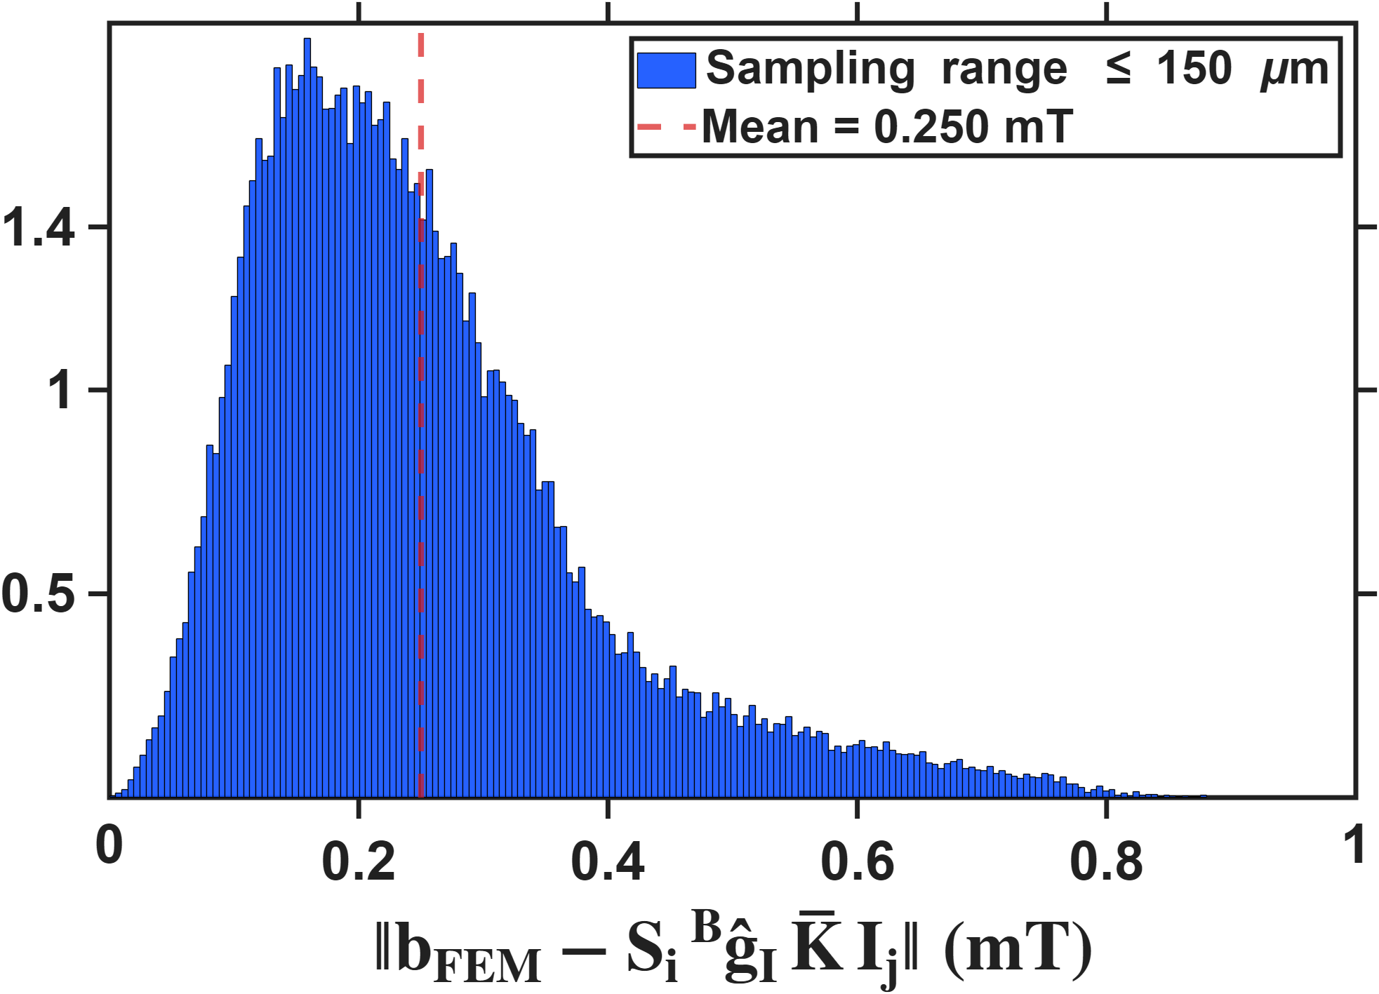

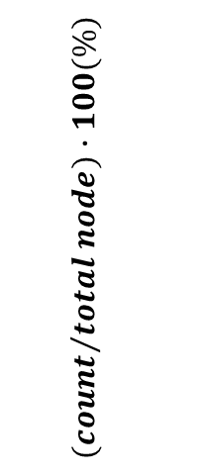
Current-based lumped-parameter modeling and calibration
E. Validation
$$Calibrate model→b_{ij}=S_{i}{}_{}^{B}{{\hat{g}}_{I}}\overline{K}I_{j}$$
This figure presents the error histogram of the parametric model. The horizontal axis represents the absolute difference between the magnetic-field magnitude obtained from the simulation and that predicted by the model. The vertical axis represents the number of samples within each error interval divided by the total number of samples in the sampling region.
$${(count}/{total node})∙100(\%)$$

Slide 13
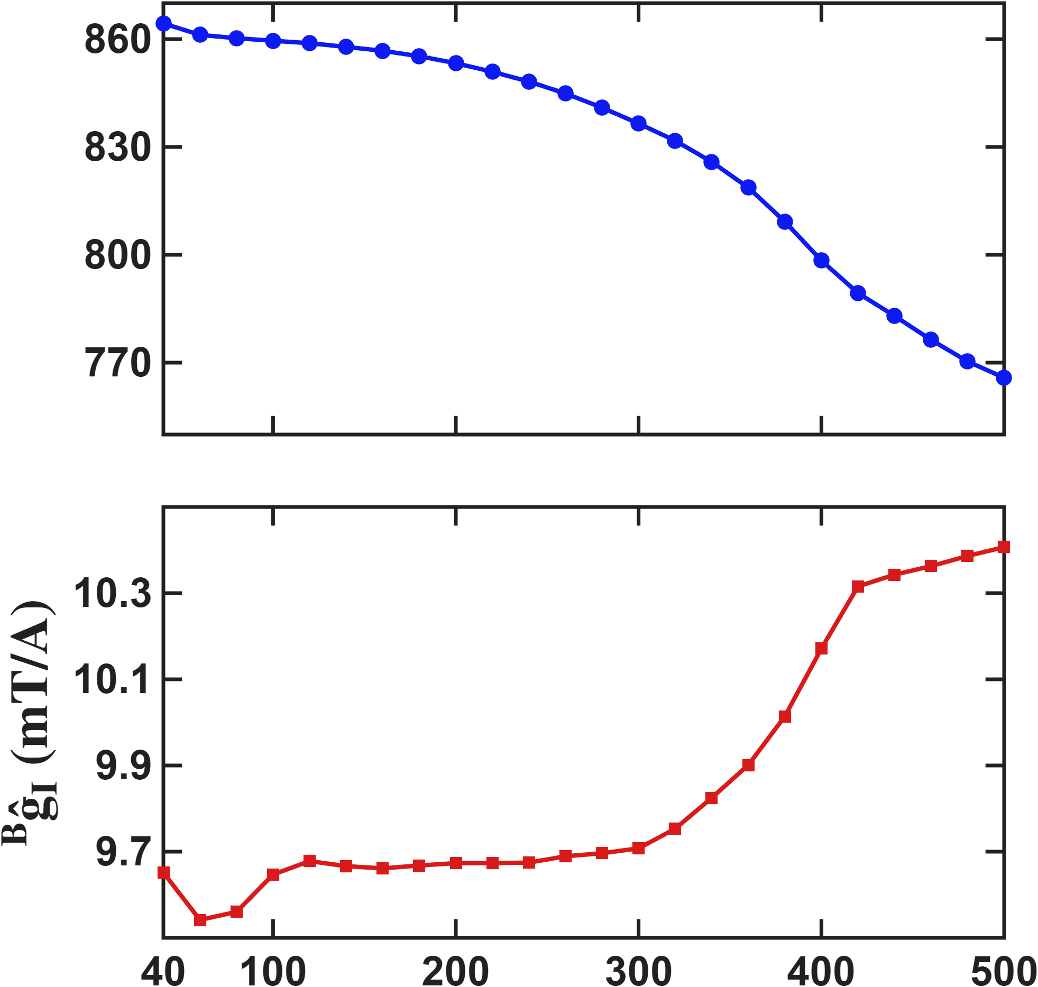



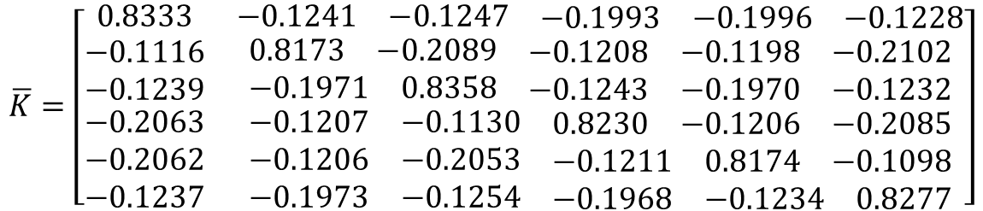

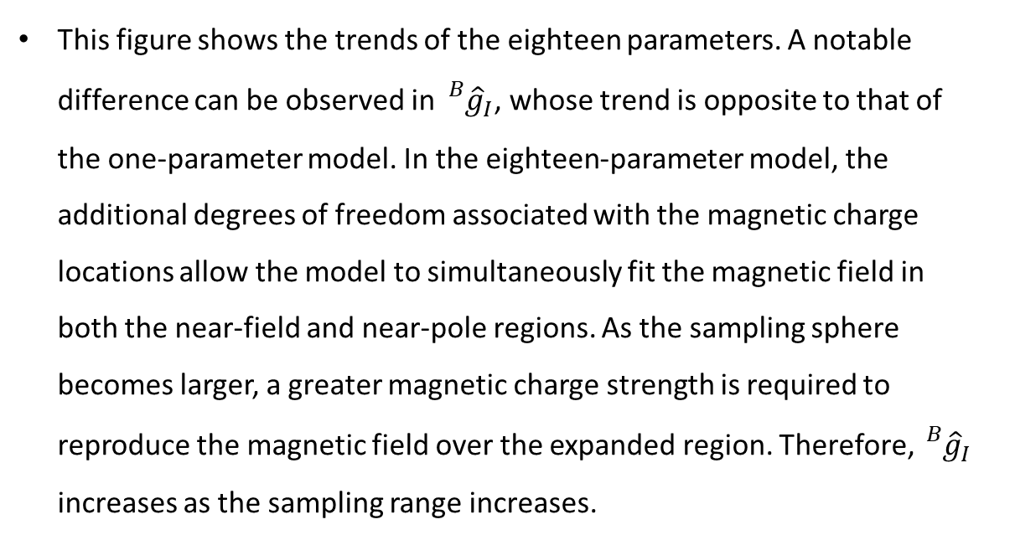
Current-based lumped-parameter modeling and calibration
E. Validation
Fitting results
$$Calibrate model→b_{ij}=S_{i}{}_{}^{B}{{\hat{g}}_{I}}\overline{K}I_{j}$$
$$\overline{K}=\left[\begin{matrix}0.8333 & \begin{matrix}−0.1241 & −0.1247 & \begin{matrix}−0.1993 & −0.1996 & −0.1228\end{matrix}\end{matrix} \\ \begin{matrix}−0.1116 \\ −0.1239 \\ \begin{matrix}−0.2063 \\ −0.2062 \\ −0.1237\end{matrix}\end{matrix} & \begin{matrix}\begin{matrix}0.8173 & −0.2089 & \begin{matrix}−0.1208 & −0.1198 & −0.2102\end{matrix}\end{matrix} \\ \begin{matrix}−0.1971 & 0.8358 & \begin{matrix}−0.1243 & −0.1970 & −0.1232\end{matrix}\end{matrix} \\ \begin{matrix}\begin{matrix}−0.1207 & −0.1130 & \begin{matrix}0.8230 & −0.1206 & −0.2085\end{matrix}\end{matrix} \\ \begin{matrix}−0.1206 & −0.2053 & \begin{matrix}−0.1211 & 0.8174 & −0.1098\end{matrix}\end{matrix} \\ \begin{matrix}−0.1973 & −0.1254 & \begin{matrix}−0.1968 & −0.1234 & 0.8277\end{matrix}\end{matrix}\end{matrix}\end{matrix}\end{matrix}\right]$$
$$\hat{𝓵} (um)$$
$$\hat{ℓ}=857.3 um$$
$${}_{}^{B}{{\hat{g}}_{I}=9.6603 mT/A}$$
This figure shows the trends of the eighteen parameters. A notable difference can be observed in ${}_{}^{B}{{\hat{g}}_{I}}$, whose trend is opposite to that of the one-parameter model. In the eighteen-parameter model, the additional degrees of freedom associated with the magnetic charge locations allow the model to simultaneously fit the magnetic field in both the near-field and near-pole regions. As the sampling sphere becomes larger, a greater magnetic charge strength is required to reproduce the magnetic field over the expanded region. Therefore, ${}_{}^{B}{{\hat{g}}_{I}}$ increases as the sampling range increases.
$$Sampling range(um)$$

Slide 14
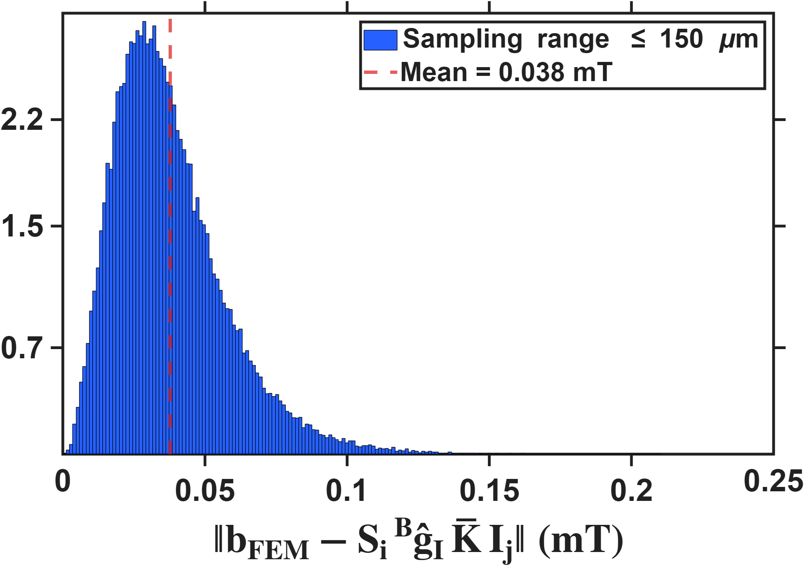
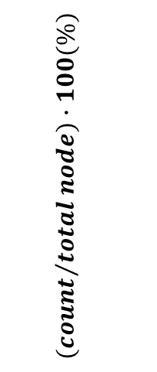

Current-based lumped-parameter modeling and calibration
E. Validation
$$Calibrate model→b_{ij}=S_{i}{}_{}^{B}{{\hat{g}}_{I}}\overline{K}I_{j}$$
This figure presents the error histogram of the eighteen-parameter model. The horizontal axis represents the absolute difference between the magnetic-field magnitude obtained from the simulation and that predicted by the model. The vertical axis represents the number of samples within each error interval divided by the total number of samples in the sampling region.
$${(count}/{total node})∙100(\%)$$

Slide 15
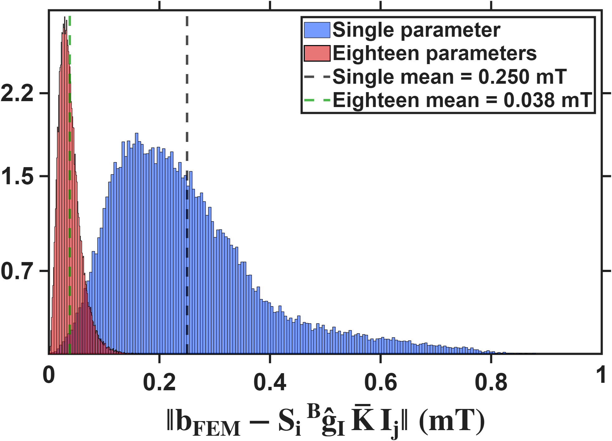
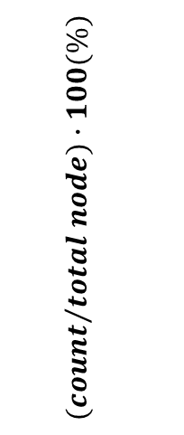
Current-based lumped-parameter modeling and calibration
E. Validation
$$Calibrate model→b_{ij}=S_{i}{}_{}^{B}{{\hat{g}}_{I}}\overline{K}I_{j}$$
This figure overlays the distributions of the two models. The red distribution is noticeably more concentrated than the blue one, indicating that the eighteen-parameter model performs better than the one-parameter model in fitting the magnetic field.
$${(count}/{total node})∙100(\%)$$

Slide 16
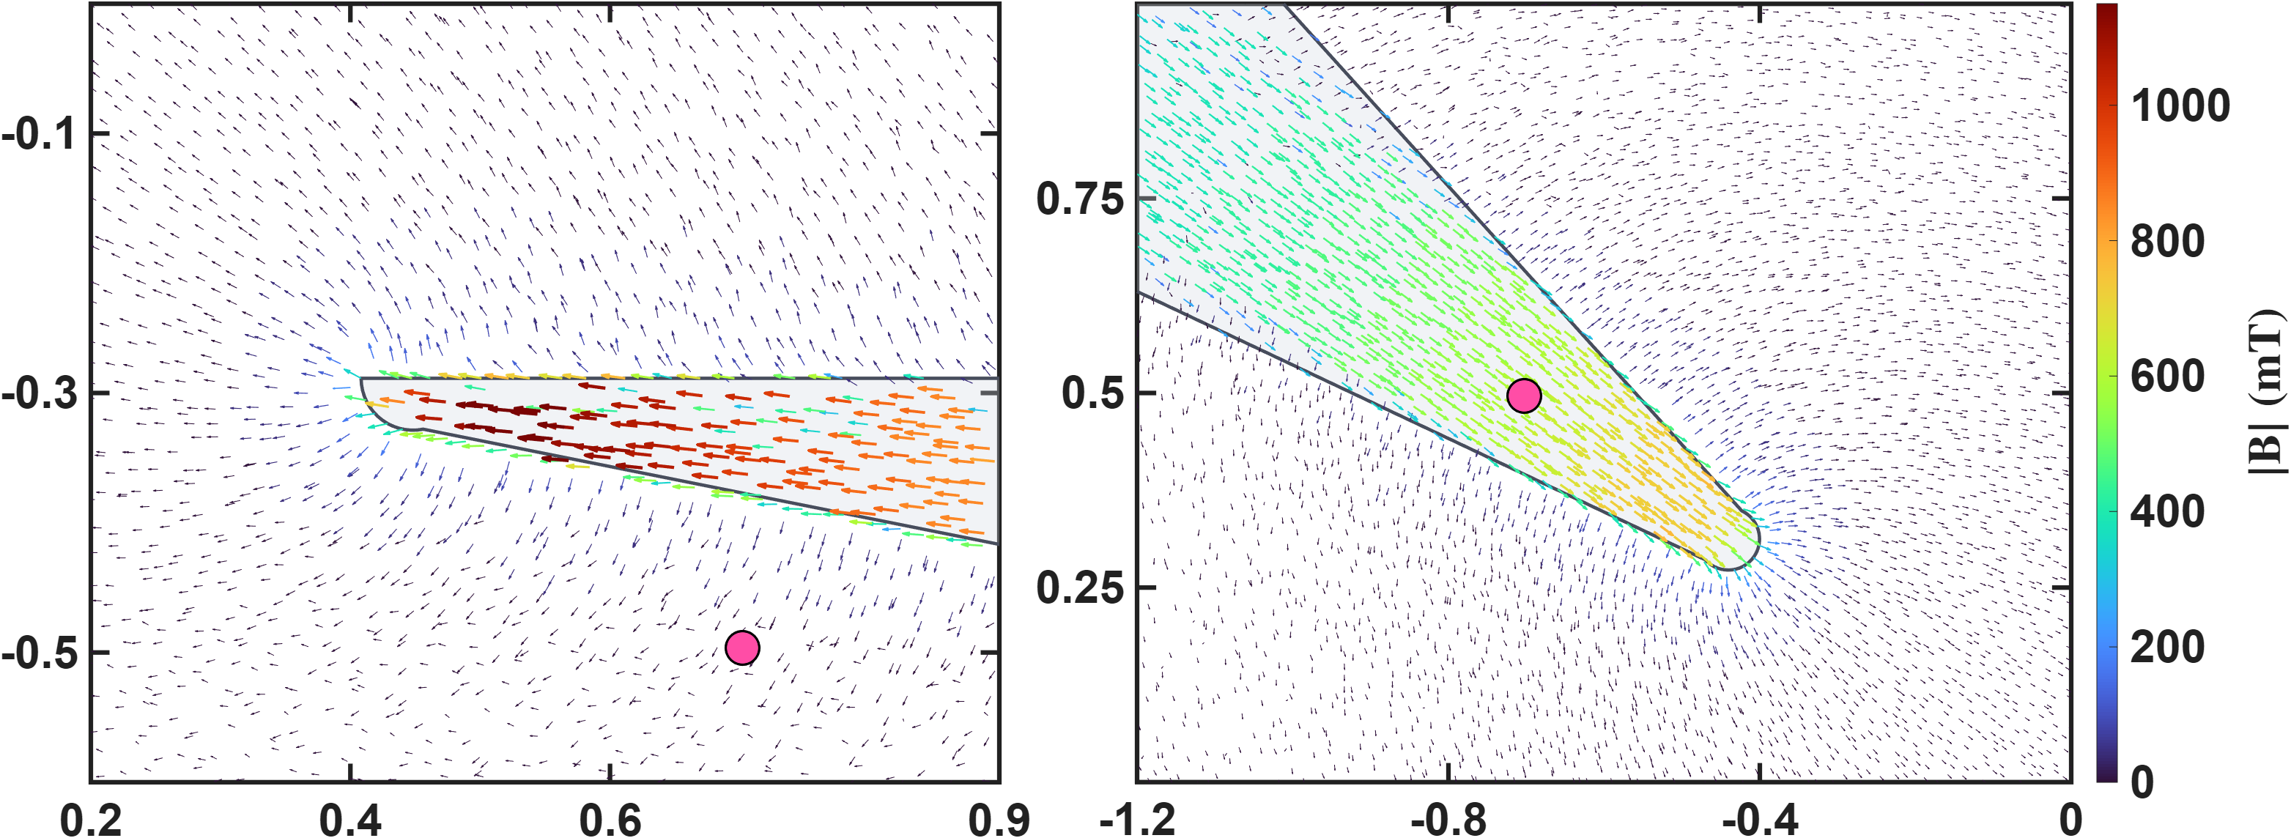
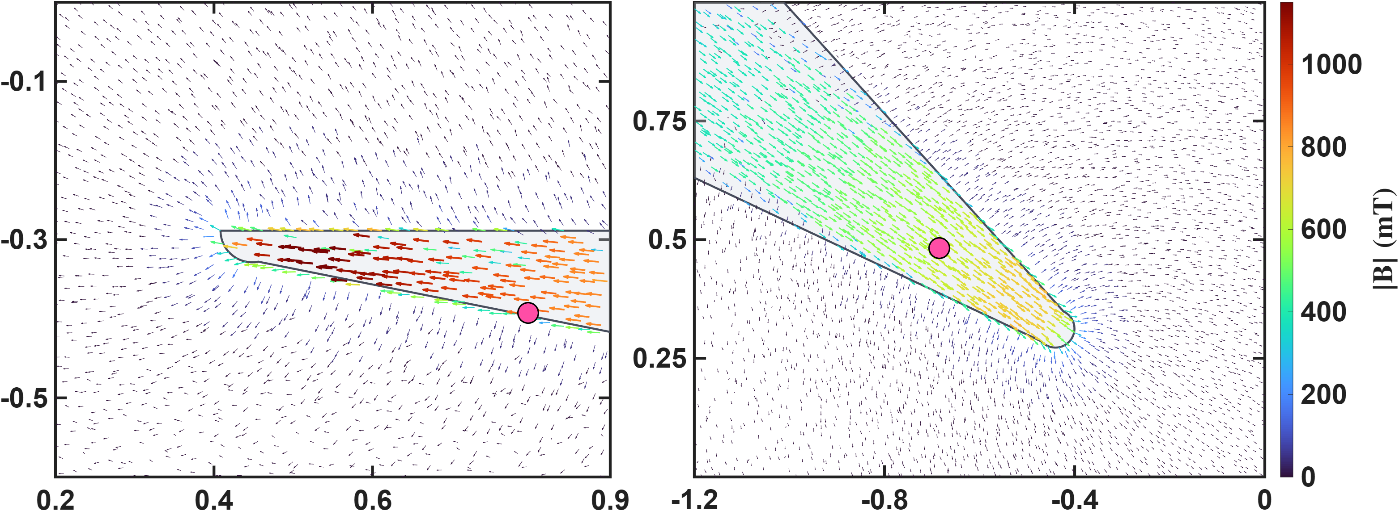




Current-based lumped-parameter modeling and calibration
E. Validation
$$Calibrate model→b_{ij}=S_{i}{}_{}^{B}{{\hat{g}}_{I}}\overline{K}I_{j}$$
These two figures show the differences in the calibrated magnetic charge locations between the two models. The upper row presents the magnetic charge locations calibrated by the one-parameter model, shown using side views of poles P1 and P2. It can be clearly seen that, for the lower pole, some of the magnetic charge locations are located outside the pole. This is because the one-parameter model constrains the magnetic charges to lie along the actuator coordinate axes. The lower row presents the results of the eighteen-parameter model, in which the magnetic charge locations of the lower pole move inside the pole. This is more consistent with the expected physical situation. Moreover, the error histograms shown above also indicate that these magnetic charge locations are more consistent with the theoretical positions.
$$q_{c2}$$
$$q_{c1}$$
$$q_{c2}$$
$$q_{c1}$$

Slide 17
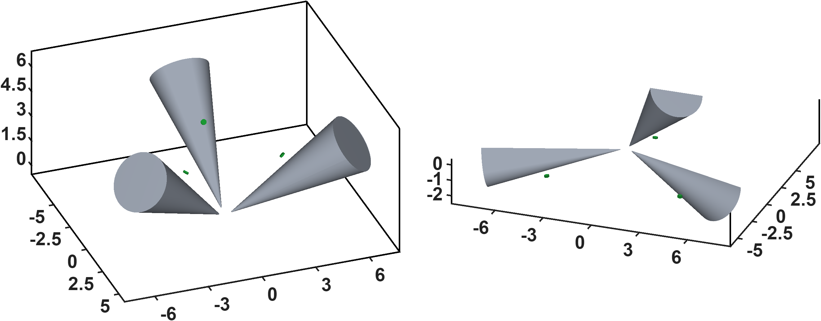
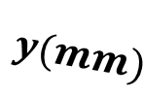





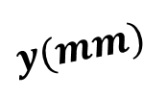


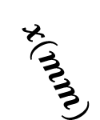
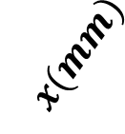

Hall-sensor-voltage-based lumped-parameter modeling and calibration
A. Voltage-based magnetic flux model
$$Calibrate model→b_{ij}=S_{i}{}_{}^{B}{{\hat{g}}_{I}}\overline{K}I_{j}$$
$$z(mm)$$
$$S_{2}$$
$$S_{4}$$
$$S_{5}$$
$$S_{1}$$
$$z(mm)$$
$$S_{6}$$
$$S_{3}$$
$$x(mm)$$
$$x(mm)$$
$$y(mm)$$
$$y(mm)$$

Slide 18
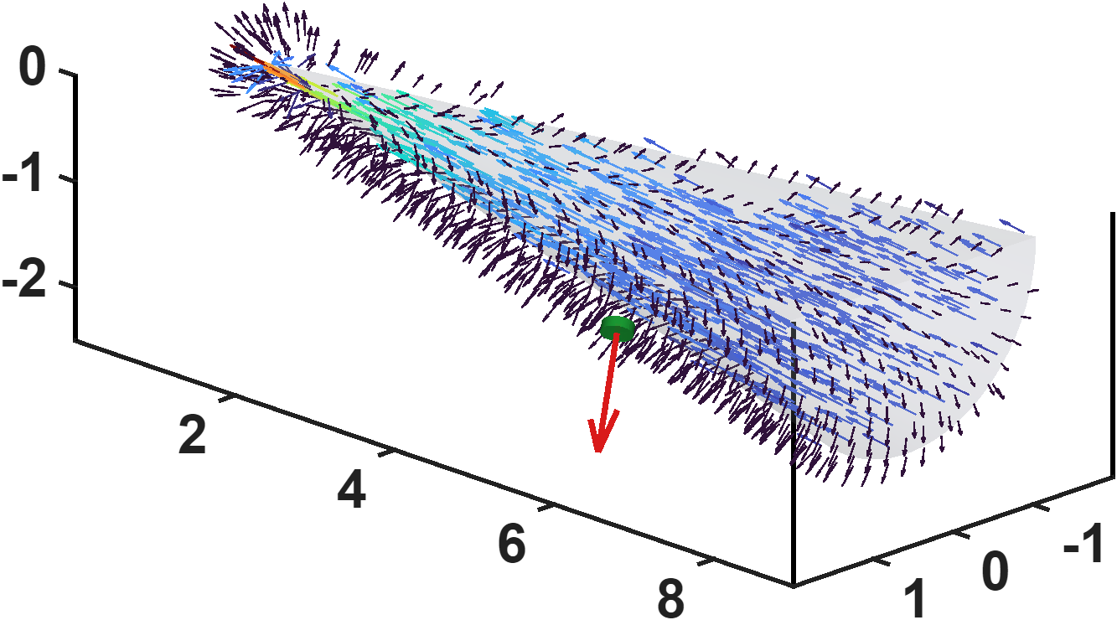
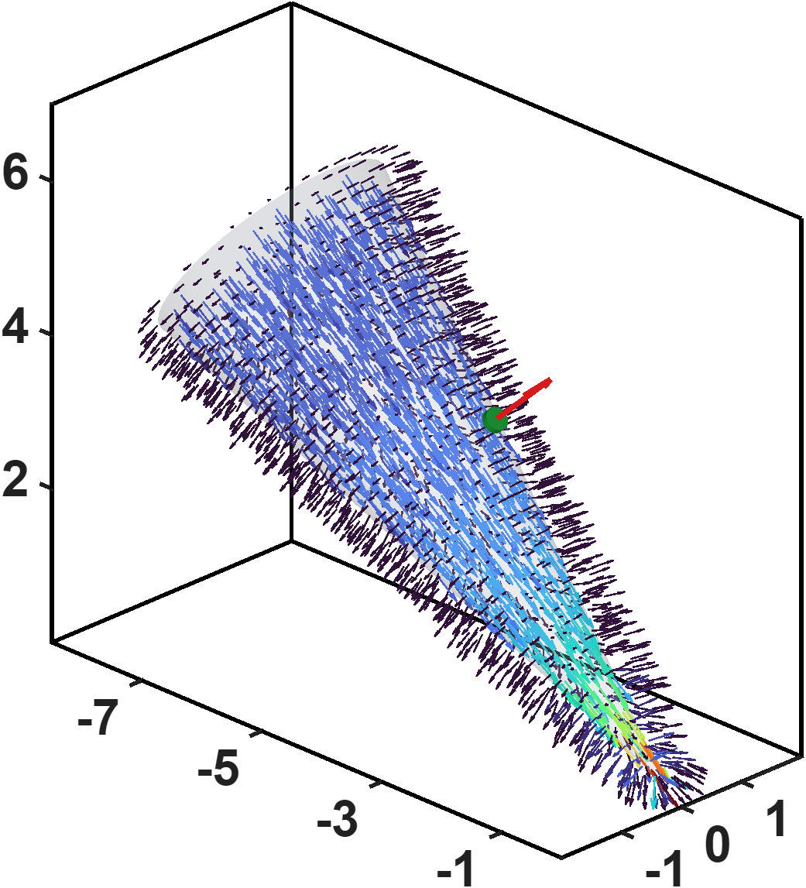








Hall-sensor-voltage-based lumped-parameter modeling and calibration
A. Voltage-based magnetic flux model
$$Calibrate model→b_{ij}=S_{i}{}_{}^{B}{{\hat{g}}_{I}}\overline{K}I_{j}$$
$$z(mm)$$
$$n^{+}$$
$$x(mm)$$
$$y(mm)$$
$$n^{+}$$
$$z(mm)$$
$$x(mm)$$
$$y(mm)$$

