Slide 1
A Lumped-Parameter Modeling, Calibration, and Capacity-Measure Framework for Flux Generation in Symmetric Multipole Electromagnetic Actuators
KUO,CHIEN-CHI

Slide 2
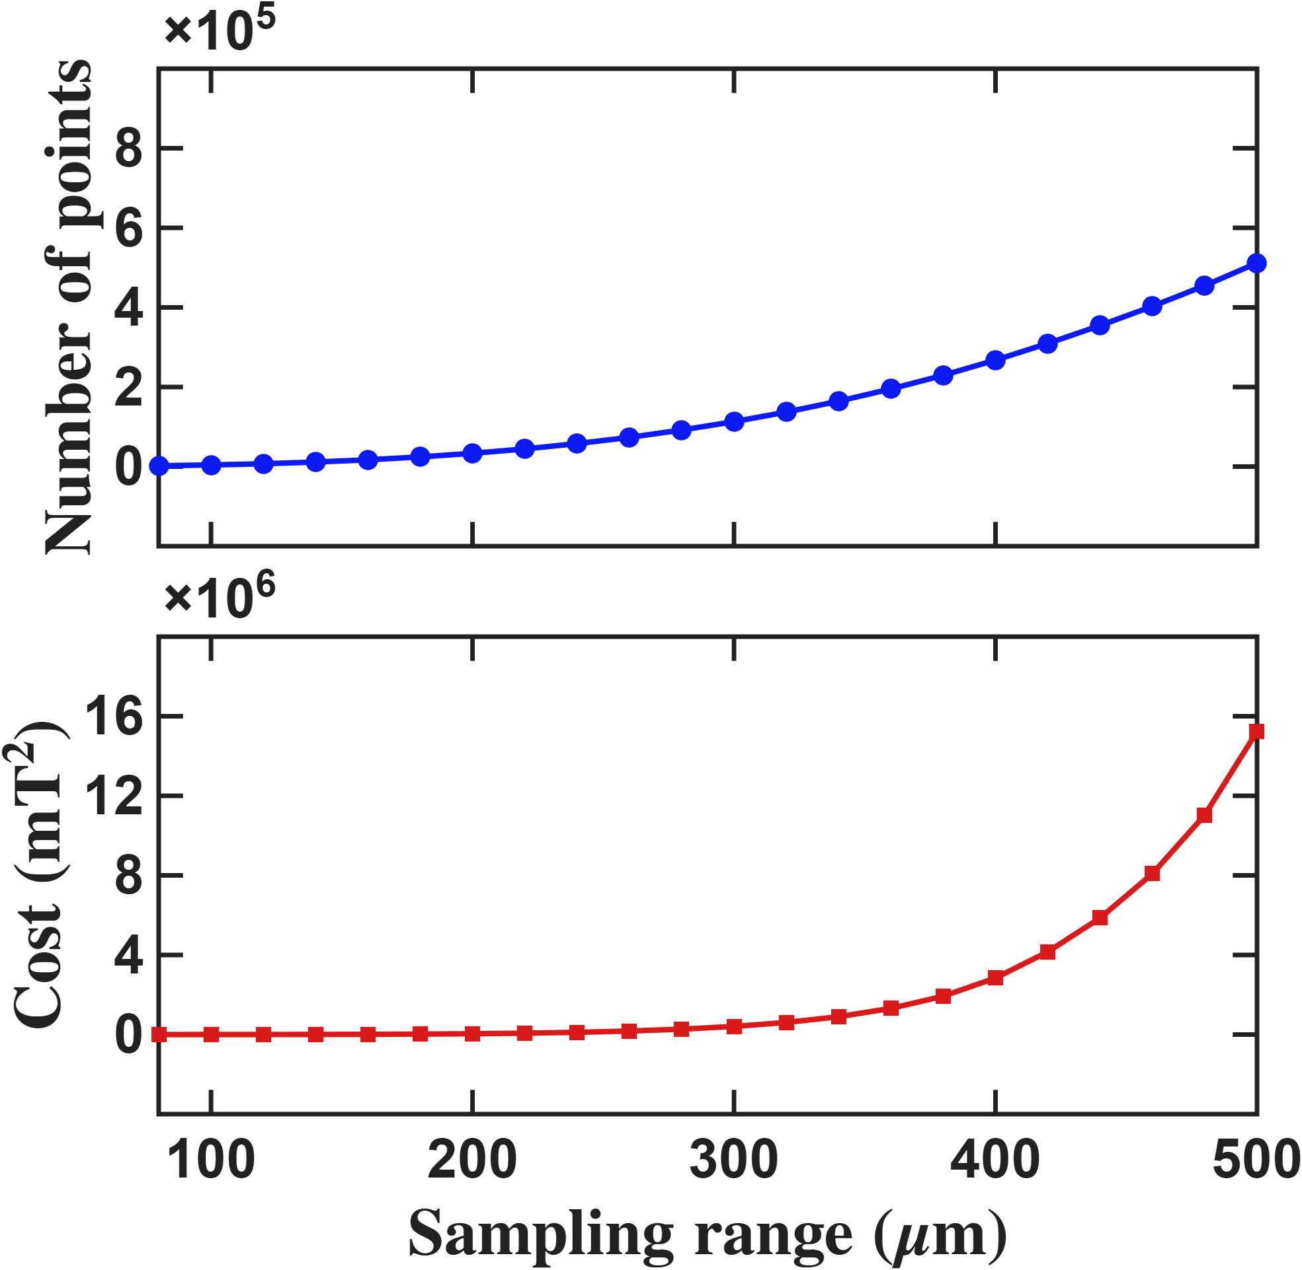
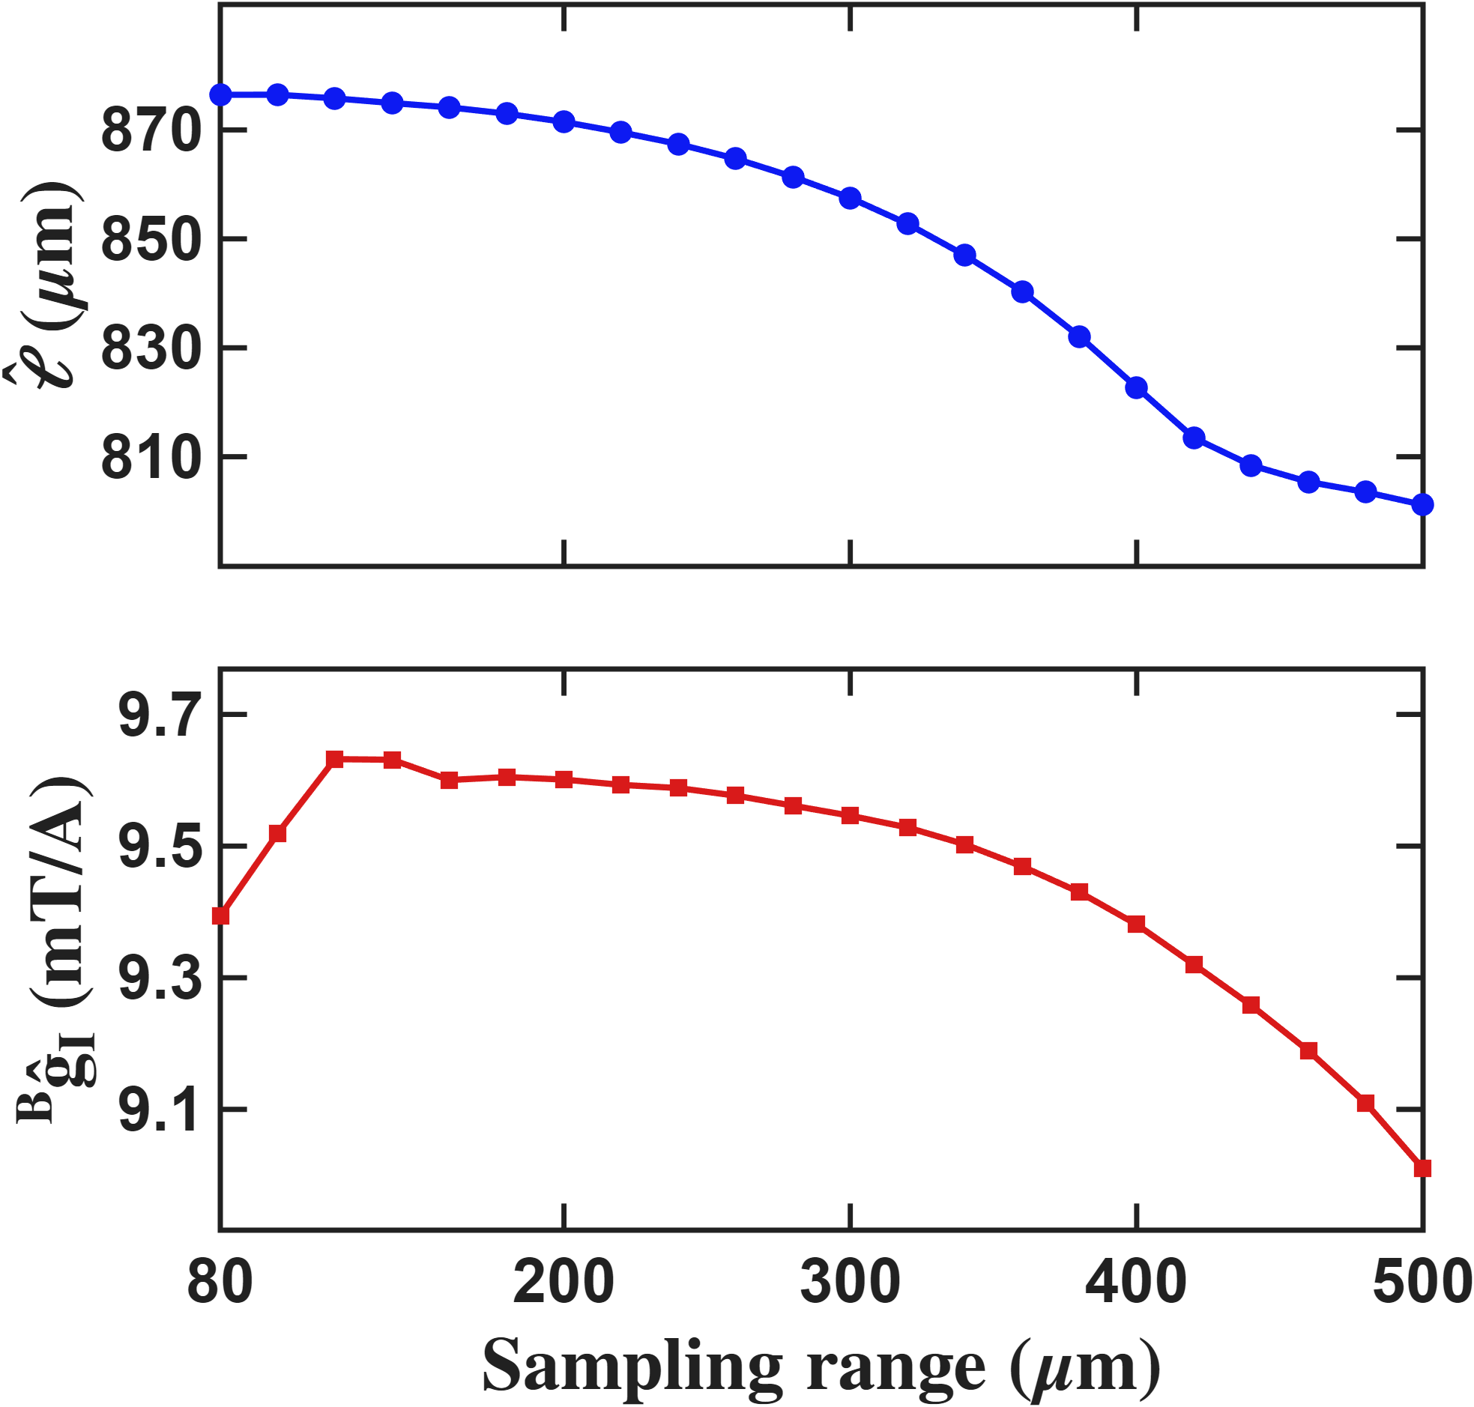
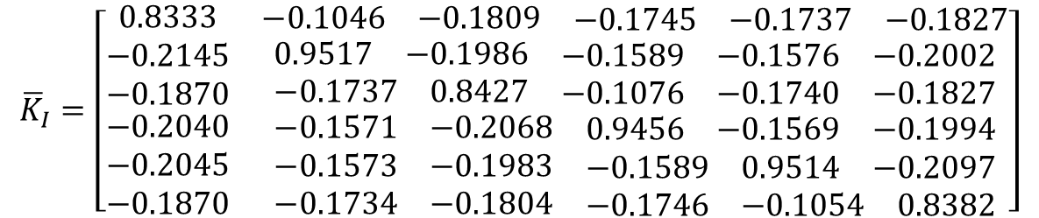



Current-based lumped-parameter modeling and calibration
E. Validation
Fitting results
$$Calibrate model→b_{ij}=S_{i}{}_{}^{B}{{\hat{g}}_{I}}\overline{K}I_{j}$$
$${\overline{K}}_{I}=\left[\begin{matrix}0.8333 & \begin{matrix}−0.1046 & −0.1809 & \begin{matrix}−0.1745 & −0.1737 & −0.1827\end{matrix}\end{matrix} \\ \begin{matrix}−0.2145 \\ −0.1870 \\ \begin{matrix}−0.2040 \\ −0.2045 \\ −0.1870\end{matrix}\end{matrix} & \begin{matrix}\begin{matrix}0.9517 & −0.1986 & \begin{matrix}−0.1589 & −0.1576 & −0.2002\end{matrix}\end{matrix} \\ \begin{matrix}−0.1737 & 0.8427 & \begin{matrix}−0.1076 & −0.1740 & −0.1827\end{matrix}\end{matrix} \\ \begin{matrix}\begin{matrix}−0.1571 & −0.2068 & \begin{matrix}0.9456 & −0.1569 & −0.1994\end{matrix}\end{matrix} \\ \begin{matrix}−0.1573 & −0.1983 & \begin{matrix}−0.1589 & 0.9514 & −0.2097\end{matrix}\end{matrix} \\ \begin{matrix}−0.1734 & −0.1804 & \begin{matrix}−0.1746 & −0.1054 & 0.8382\end{matrix}\end{matrix}\end{matrix}\end{matrix}\end{matrix}\right]$$
One parameter fitting results
Calibration region R<=150um
$$\hat{ℓ}=874.3 um$$
$${}_{}^{B}{{\hat{g}}_{I}=9.6717mT/A}$$

Slide 3
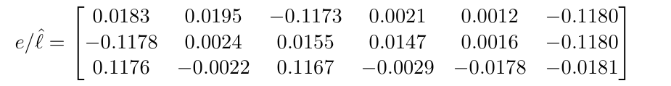
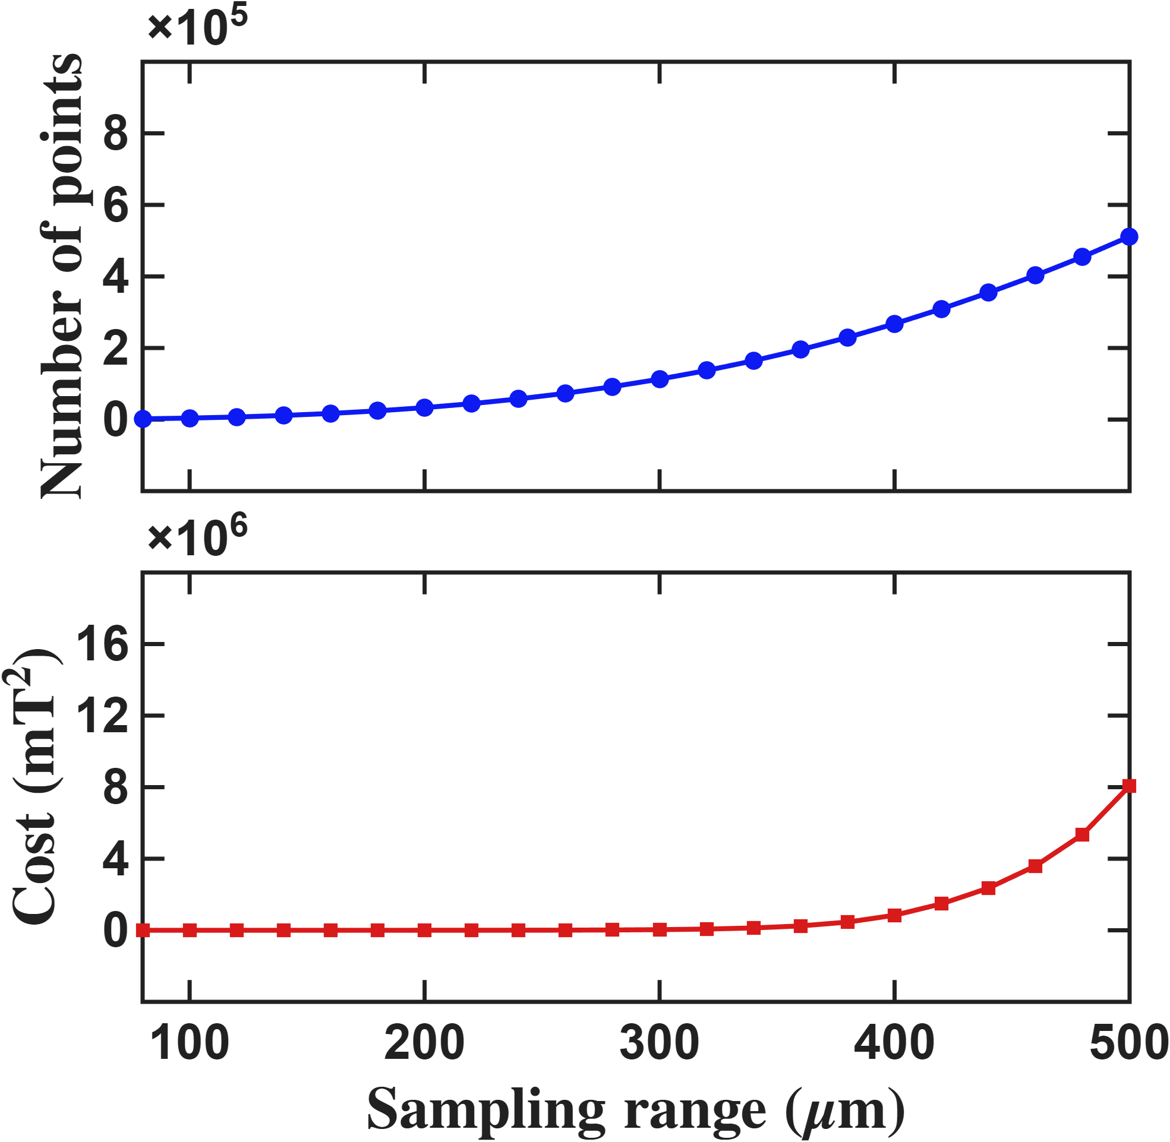
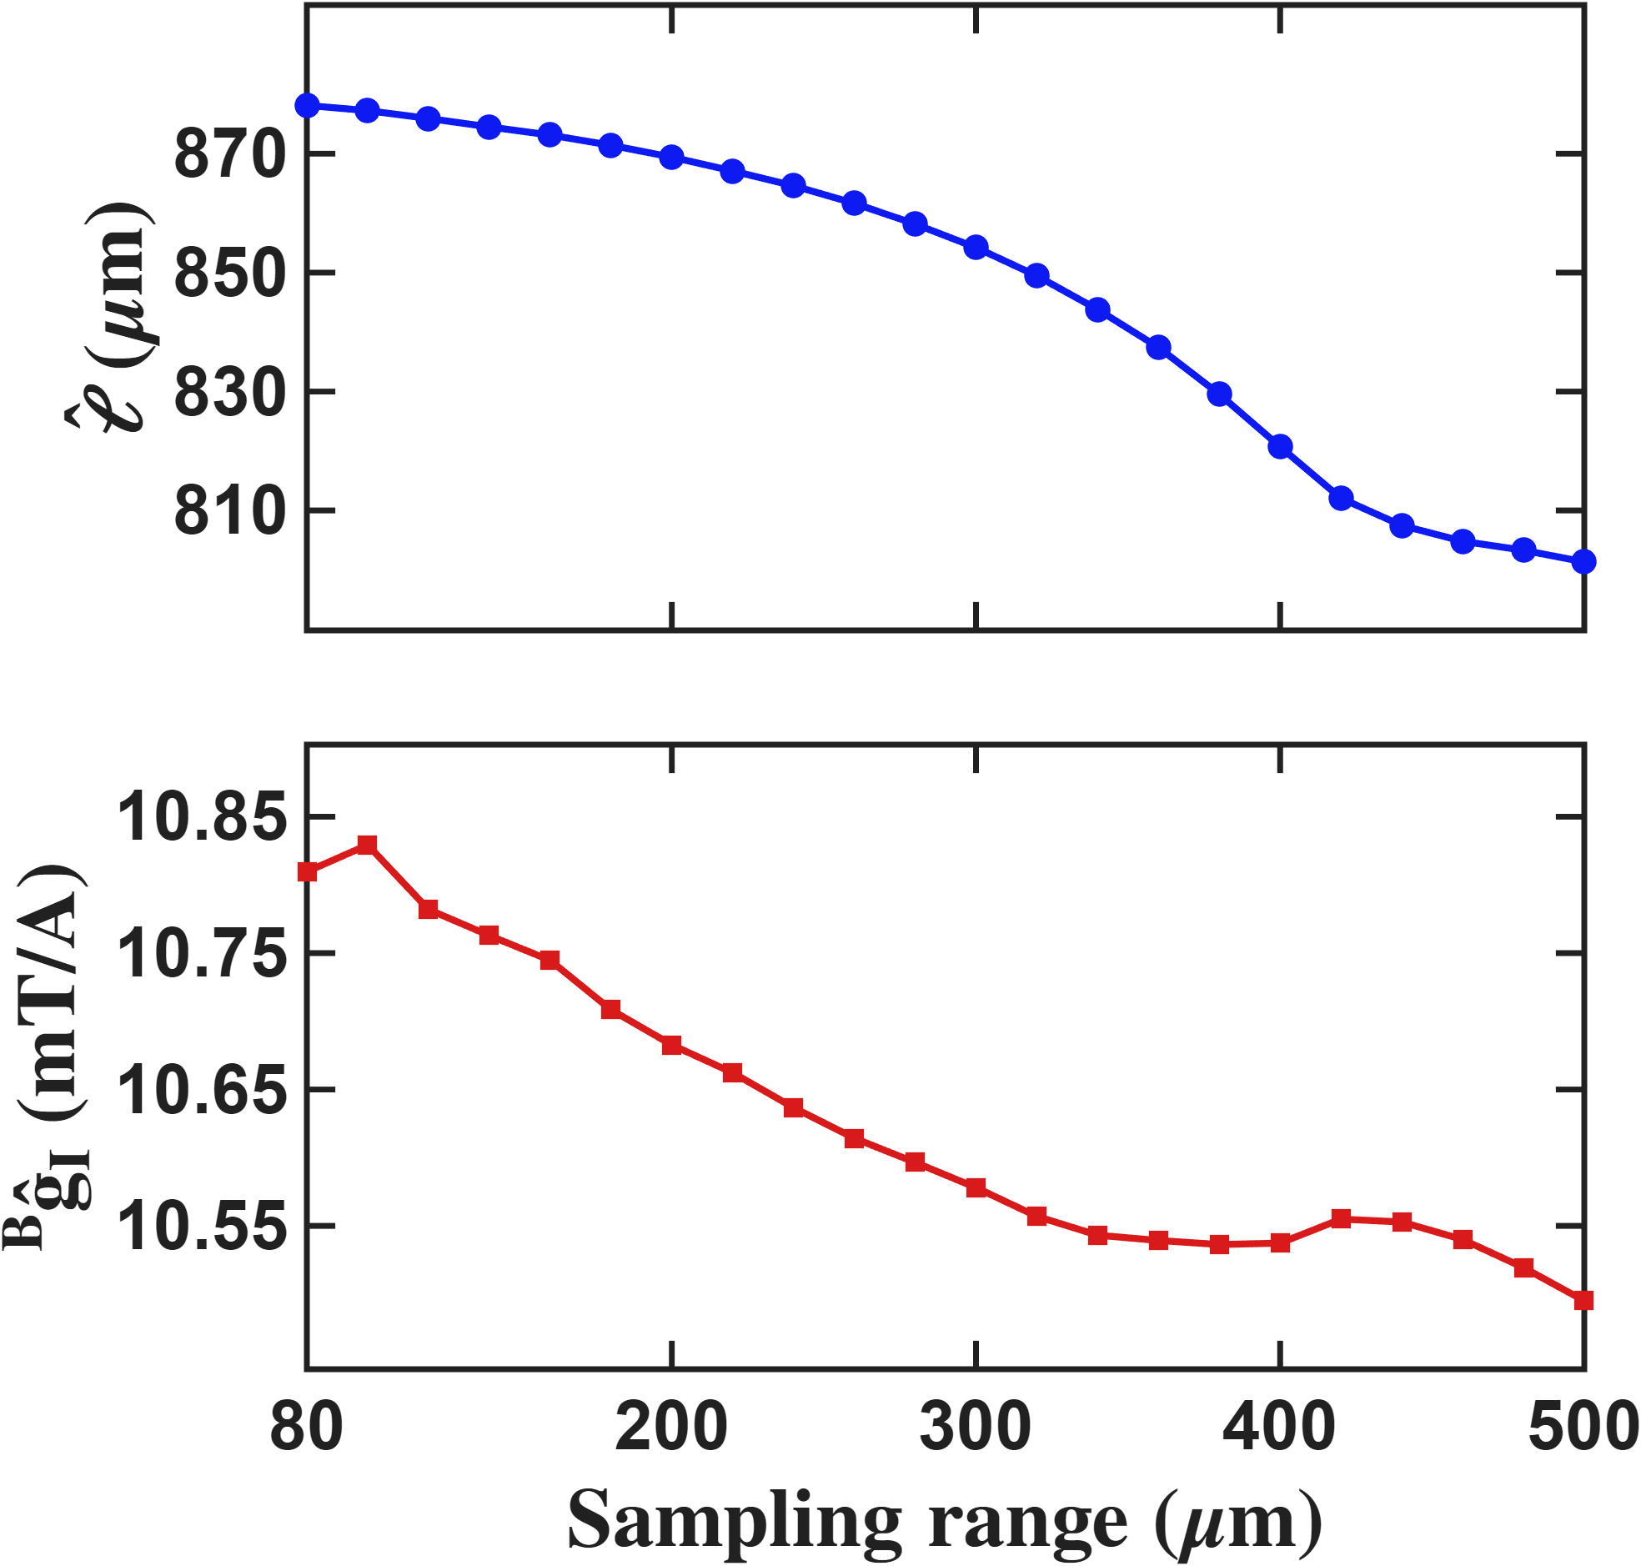
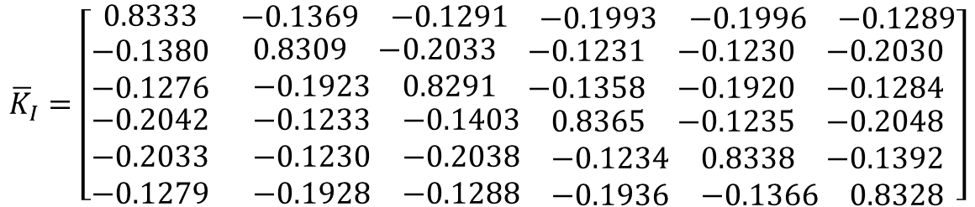



Current-based lumped-parameter modeling and calibration
E. Validation
Fitting results
$$Calibrate model→b_{ij}=S_{i}{}_{}^{B}{{\hat{g}}_{I}}\overline{K}I_{j}$$
$${\overline{K}}_{I}=\left[\begin{matrix}0.8333 & \begin{matrix}−0.1369 & −0.1291 & \begin{matrix}−0.1993 & −0.1996 & −0.1289\end{matrix}\end{matrix} \\ \begin{matrix}−0.1380 \\ −0.1276 \\ \begin{matrix}−0.2042 \\ −0.2033 \\ −0.1279\end{matrix}\end{matrix} & \begin{matrix}\begin{matrix}0.8309 & −0.2033 & \begin{matrix}−0.1231 & −0.1230 & −0.2030\end{matrix}\end{matrix} \\ \begin{matrix}−0.1923 & 0.8291 & \begin{matrix}−0.1358 & −0.1920 & −0.1284\end{matrix}\end{matrix} \\ \begin{matrix}\begin{matrix}−0.1233 & −0.1403 & \begin{matrix}0.8365 & −0.1235 & −0.2048\end{matrix}\end{matrix} \\ \begin{matrix}−0.1230 & −0.2038 & \begin{matrix}−0.1234 & 0.8338 & −0.1392\end{matrix}\end{matrix} \\ \begin{matrix}−0.1928 & −0.1288 & \begin{matrix}−0.1936 & −0.1366 & 0.8328\end{matrix}\end{matrix}\end{matrix}\end{matrix}\end{matrix}\right]$$
Eighteen parameter fitting results
Calibration region R<=150um
$$\hat{ℓ}=874. 0um$$
$${}_{}^{B}{{\hat{g}}_{I}=10.7518 mT/A}$$

Slide 4
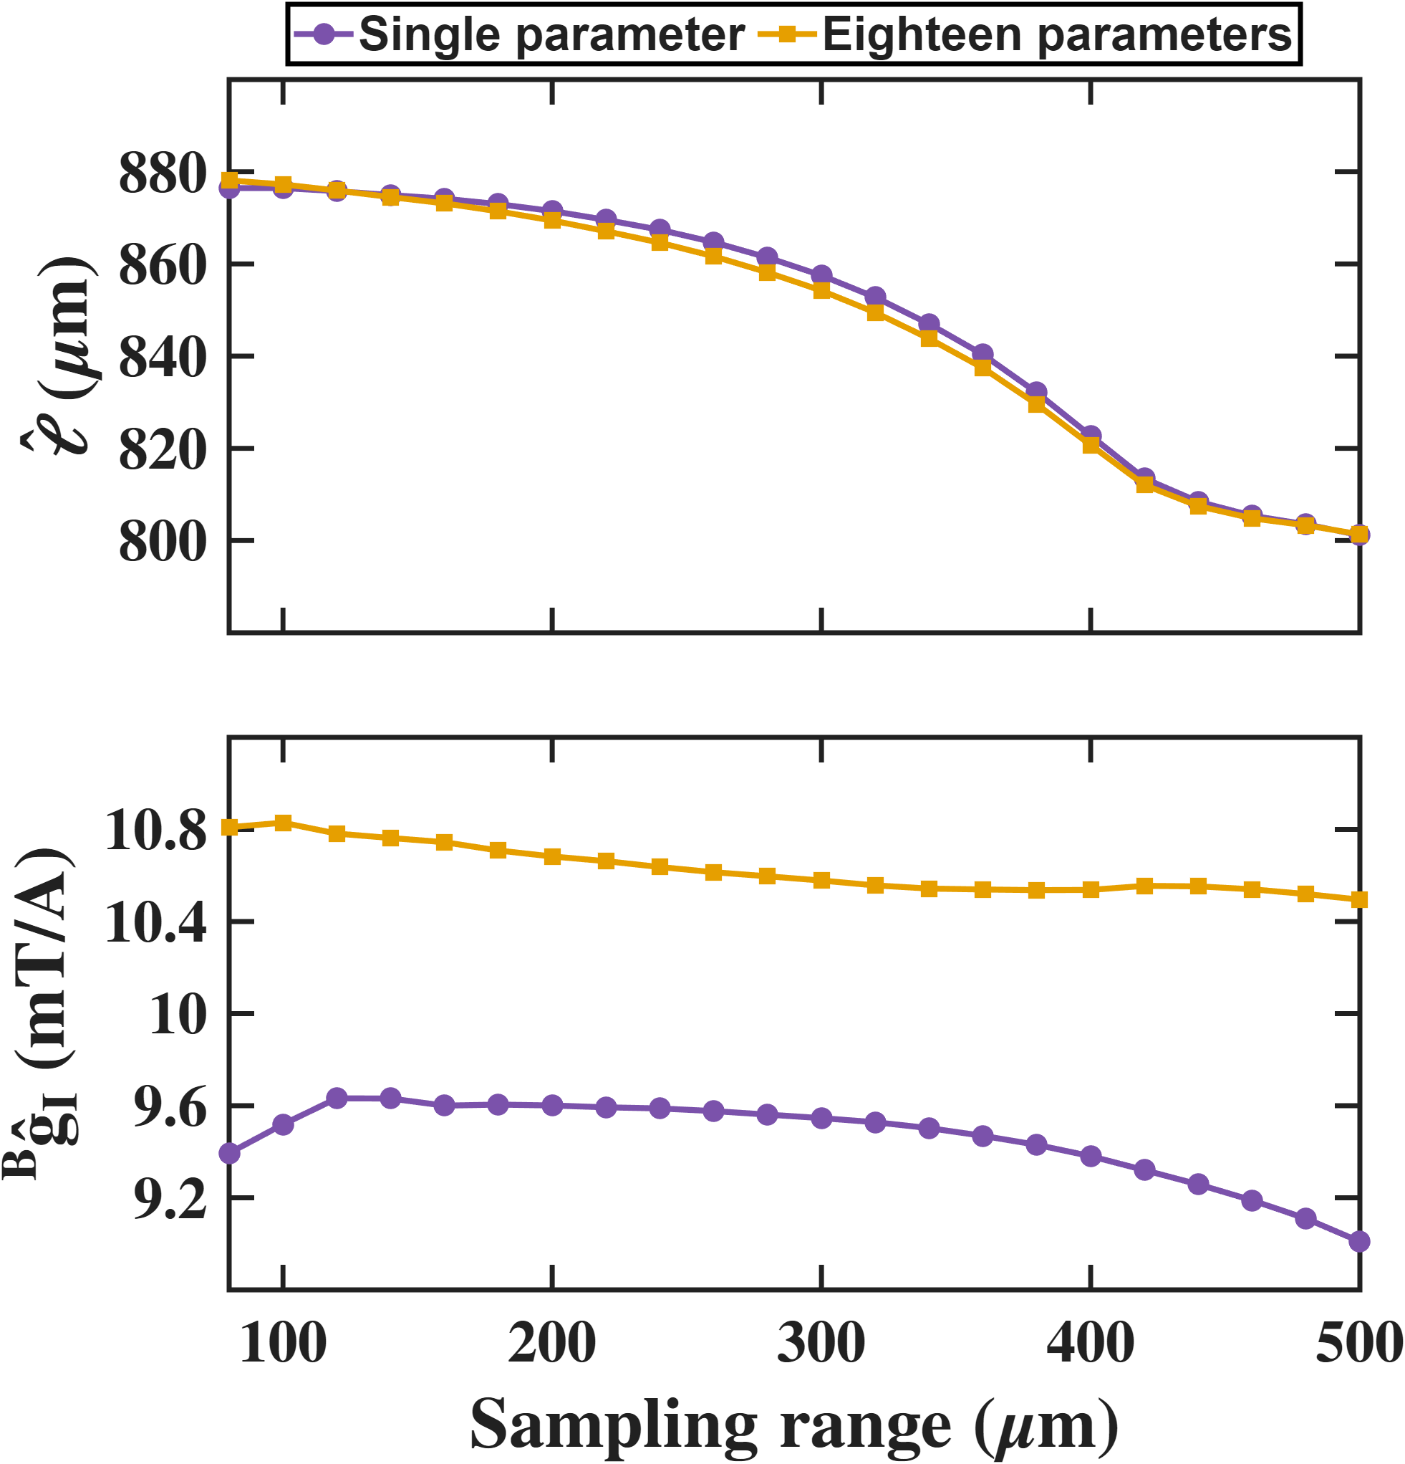
Current-based lumped-parameter modeling and calibration
E. Validation
Fitting results

Slide 5
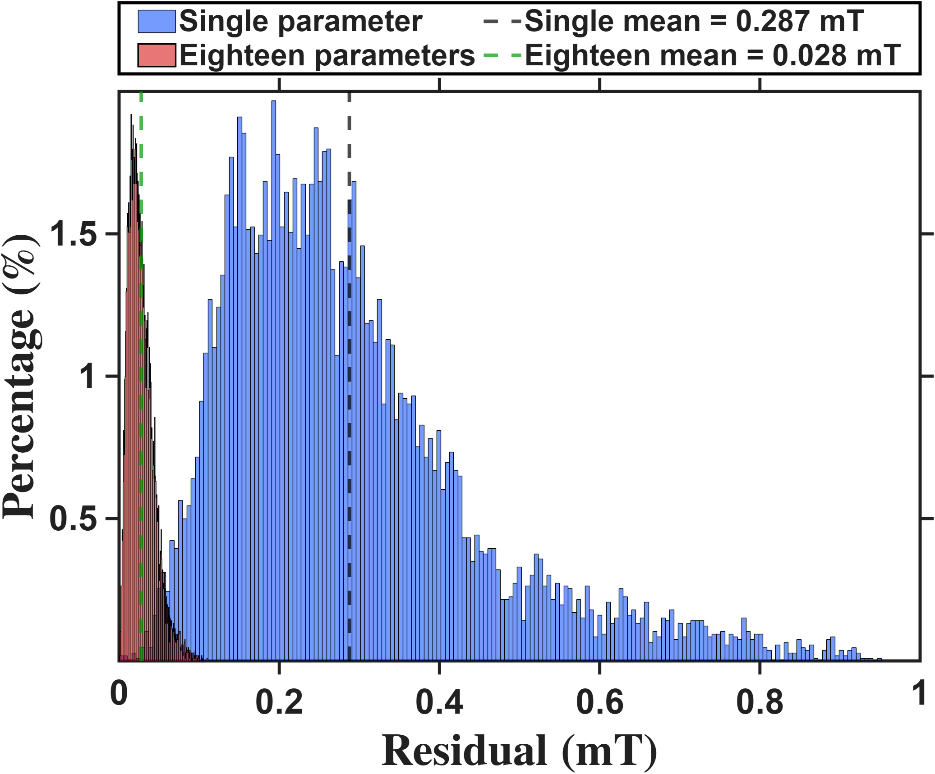
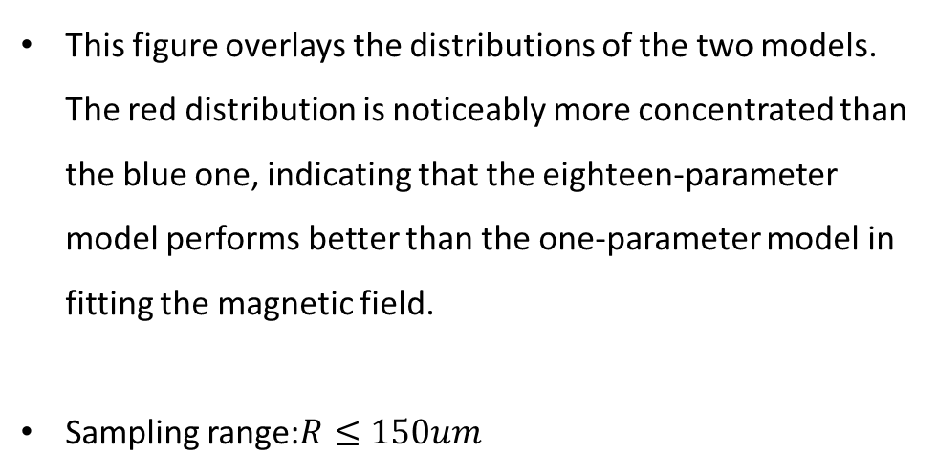

Current-based lumped-parameter modeling and calibration
E. Validation
$$Calibrate model→b_{ij}=S_{i}{}_{}^{B}{{\hat{g}}_{I}}\overline{K}I_{j}$$
This figure overlays the distributions of the two models. The red distribution is noticeably more concentrated than the blue one, indicating that the eighteen-parameter model performs better than the one-parameter model in fitting the magnetic field.
Sampling range:$R≤150um$

Slide 6
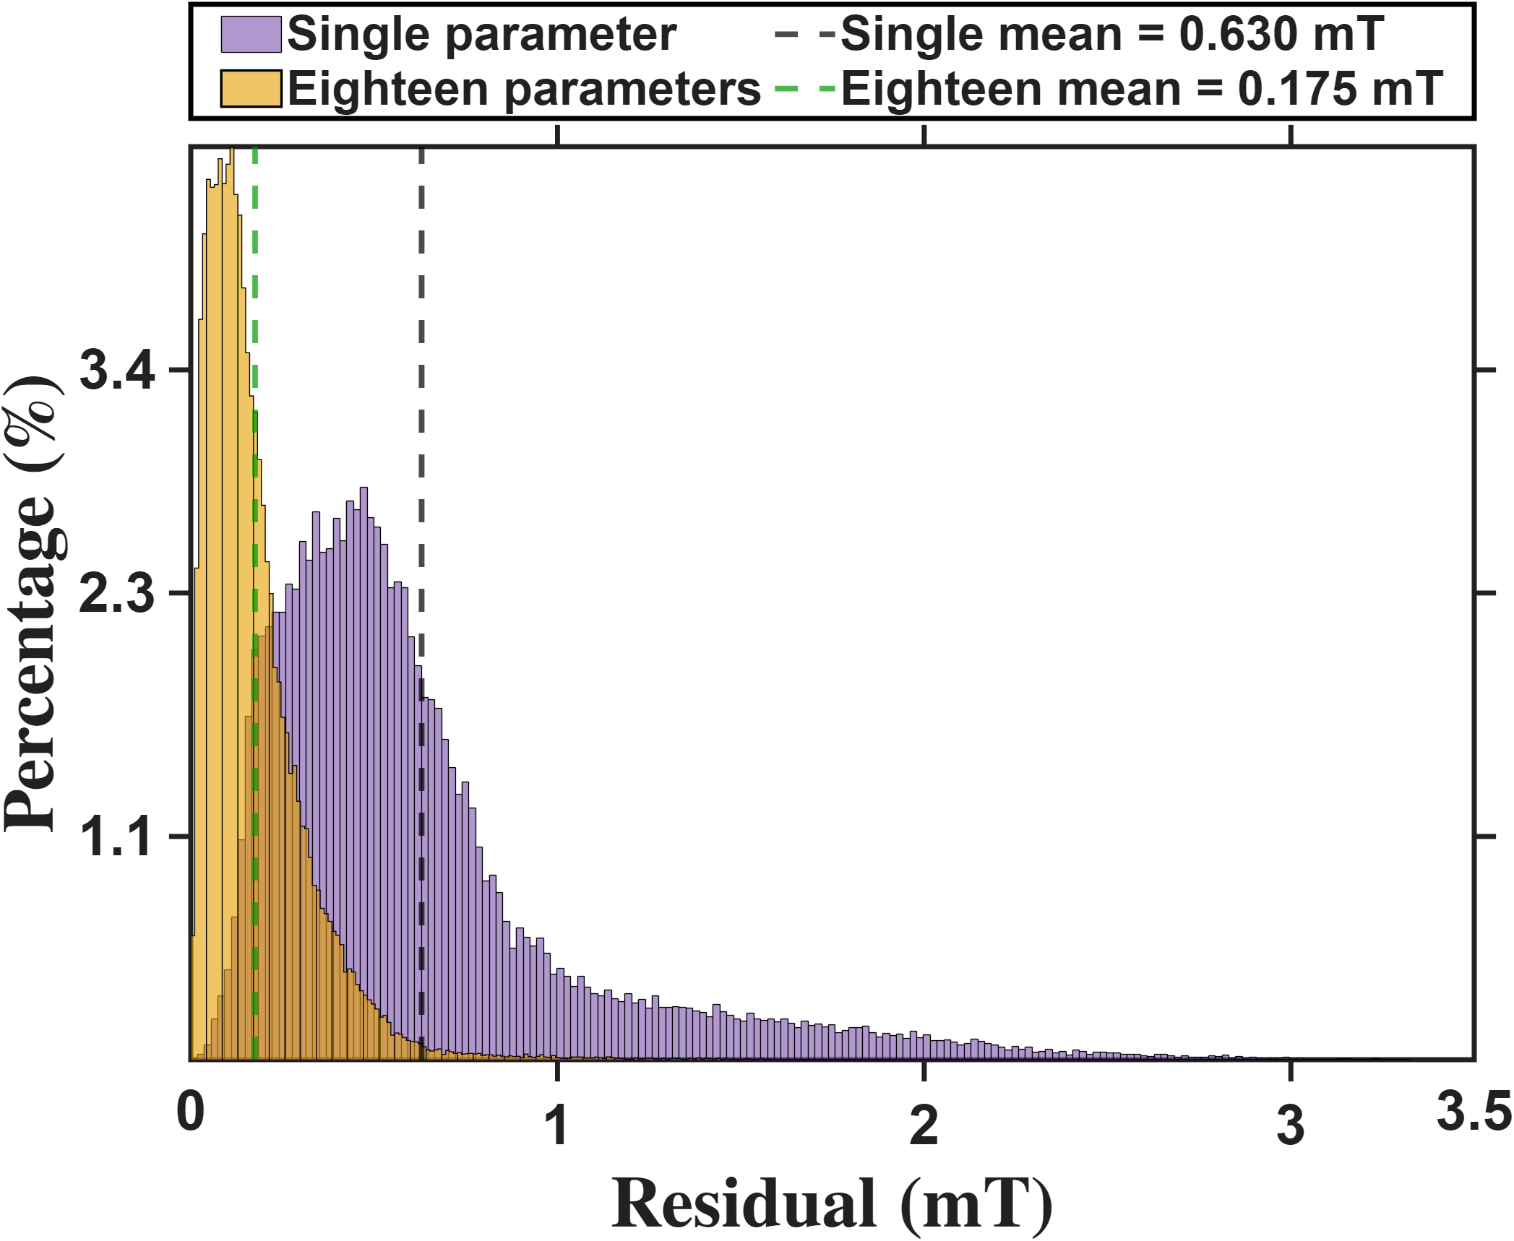
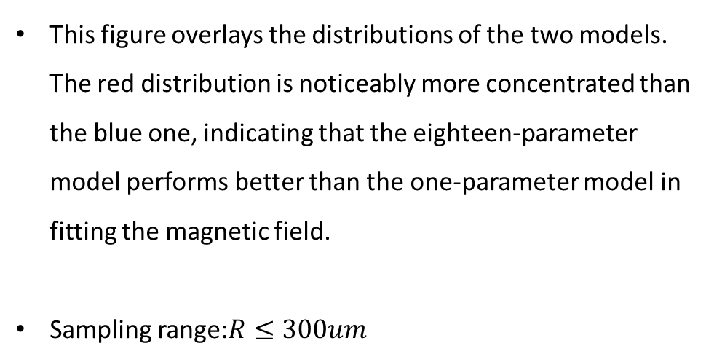
Current-based lumped-parameter modeling and calibration
E. Validation
$$Calibrate model→b_{ij}=S_{i}{}_{}^{B}{{\hat{g}}_{I}}\overline{K}I_{j}$$
This figure overlays the distributions of the two models. The red distribution is noticeably more concentrated than the blue one, indicating that the eighteen-parameter model performs better than the one-parameter model in fitting the magnetic field.
Sampling range:$R≤300um$

Slide 7
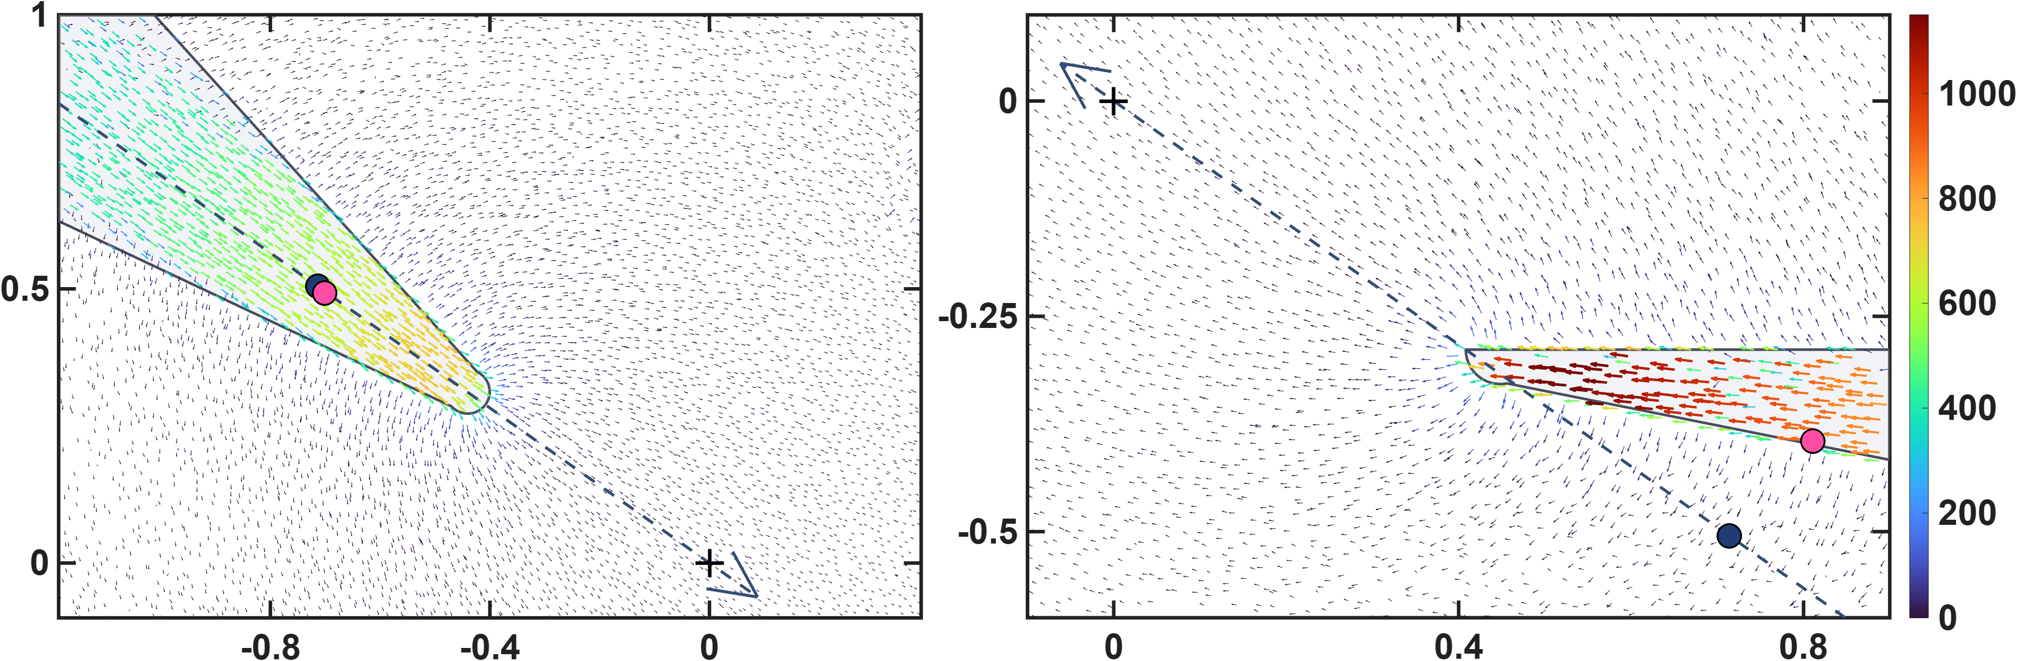








Current-based lumped-parameter modeling and calibration
E. Validation
$$Calibrate model→b_{ij}=S_{i}{}_{}^{B}{{\hat{g}}_{I}}\overline{K}I_{j}$$
These two figures show the differences in the calibrated magnetic charge locations between the two models. The upper row presents the magnetic charge locations calibrated by the one-parameter model, shown using side views of poles P1 and P2. It can be clearly seen that, for the lower pole, some of the magnetic charge locations are located outside the pole. This is because the one-parameter model constrains the magnetic charges to lie along the actuator coordinate axes. The lower row presents the results of the eighteen-parameter model, in which the magnetic charge locations of the lower pole move inside the pole. This is more consistent with the expected physical situation. Moreover, the error histograms shown above also indicate that these magnetic charge locations are more consistent with the theoretical positions.
$${\hat{x}}_{a}$$
$$\left\|b\right\|(mT)$$
$$z−axis(mm)$$
$$q_{c2}$$
$${\hat{x}}_{a}$$
$$q_{c1}$$
$$x−axis(mm)$$
$$x−axis(mm)$$

Slide 8
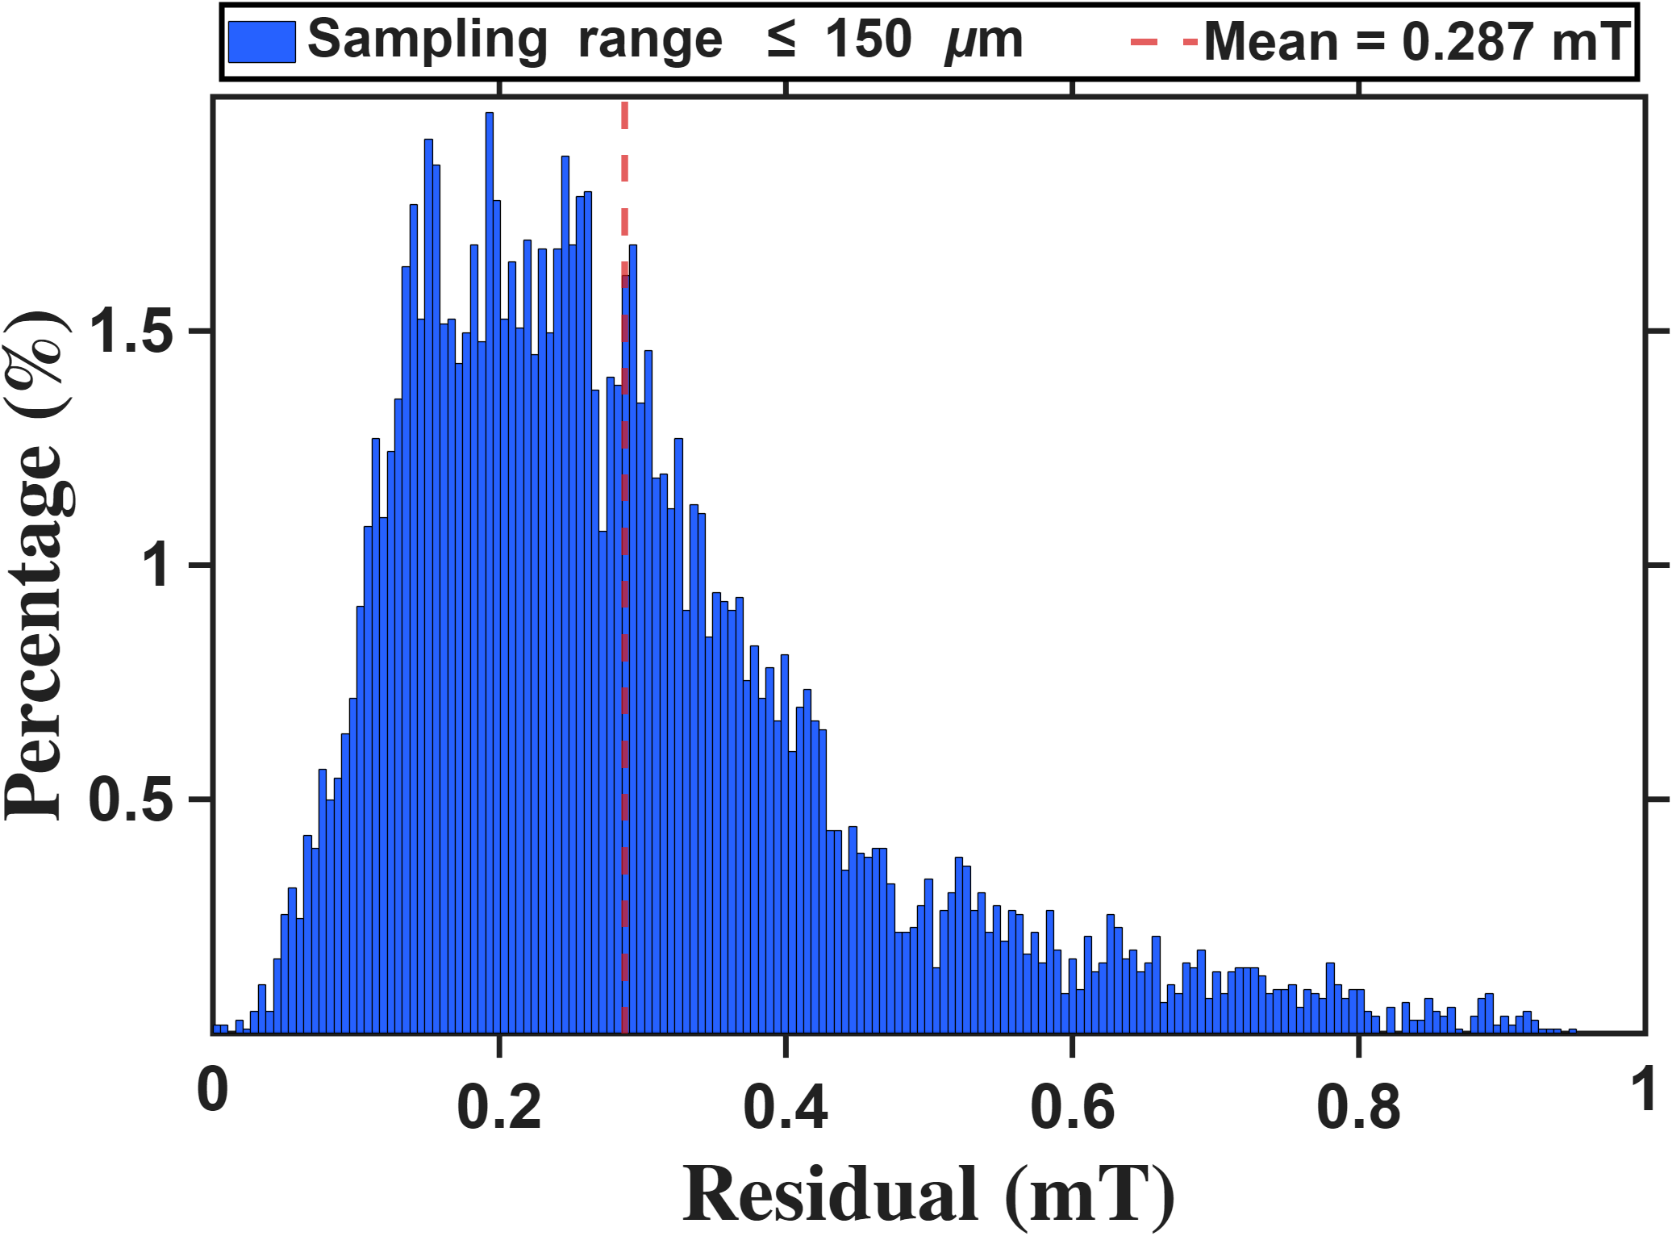
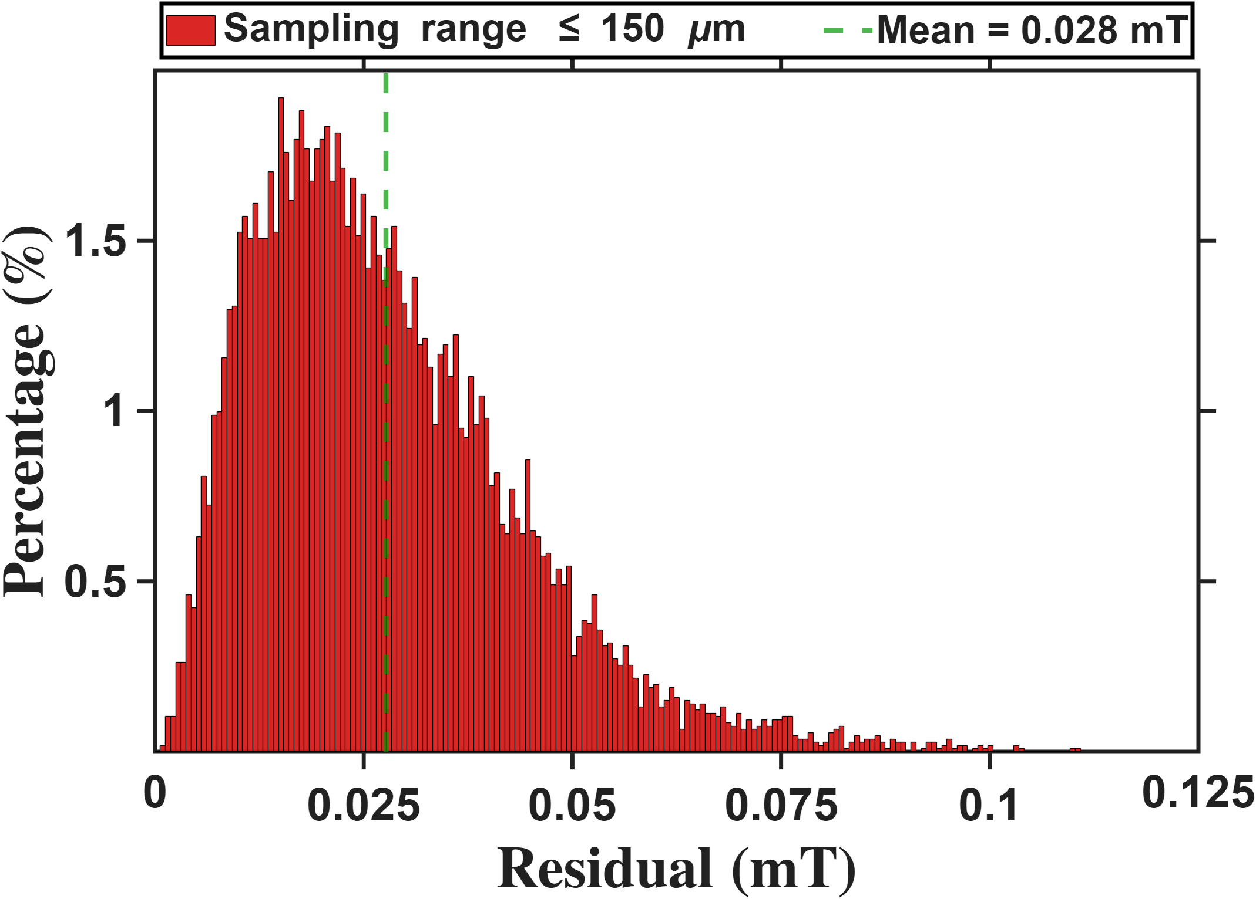
Reference
Histograms of the One-Parameter and Eighteen-Parameter Models within the Sampling Range $R≤150um$

Slide 9
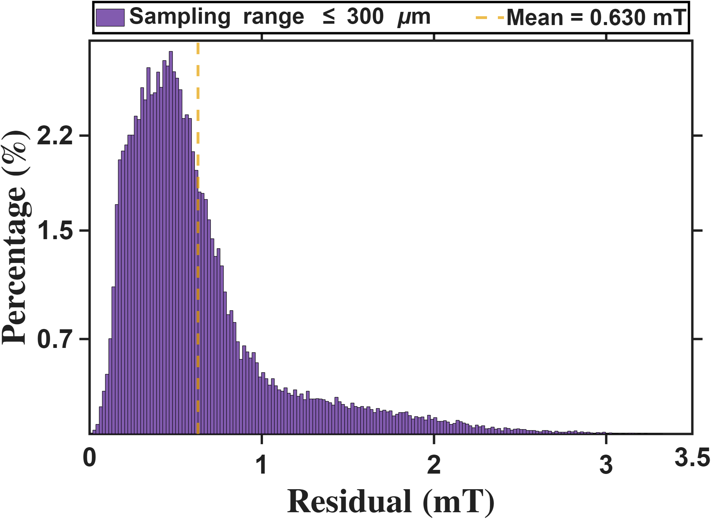
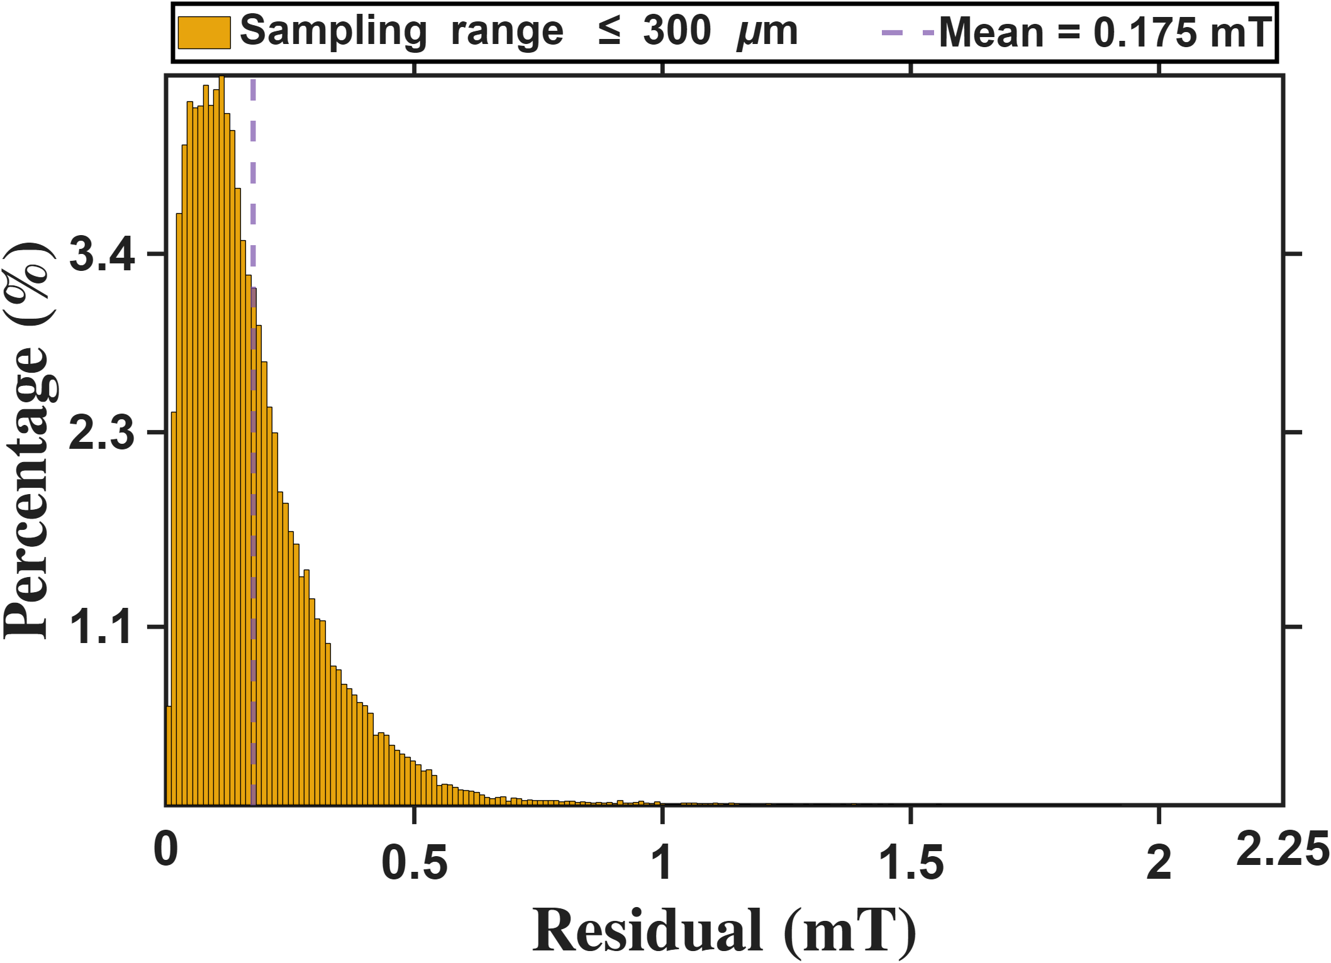
Reference
Histograms of the One-Parameter and Eighteen-Parameter Models within the Sampling Range $R≤300um$

Slide 10
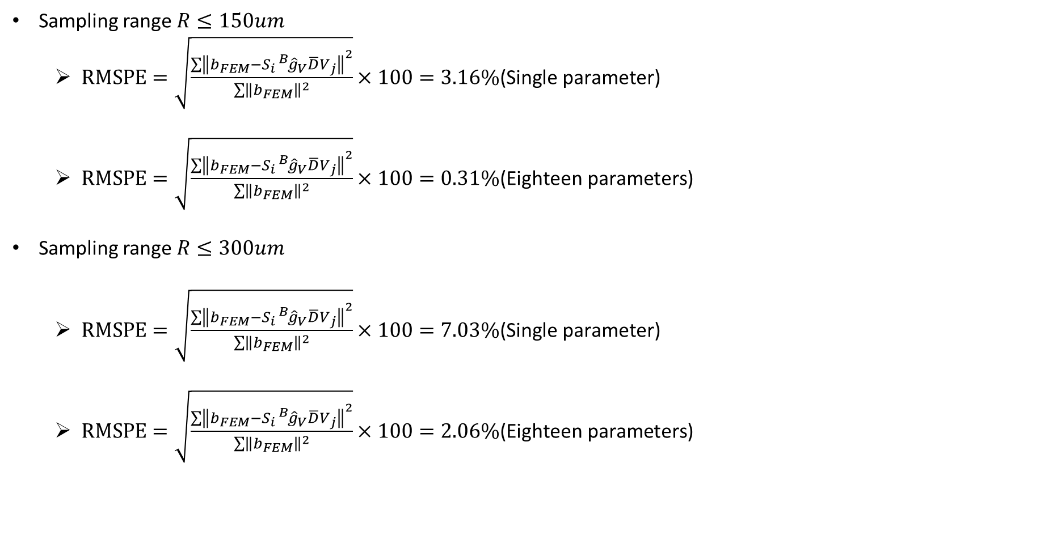
Reference
Sampling range $R≤150um$
$RMSPE=\sqrt{\frac{\sum{{\left\|b_{FEM}−S_{i}{}_{}^{B}{{\hat{g}}_{V}}\overline{D}V_{j}\right\|}^{2}}}{\sum{{\left\|b_{FEM}\right\|}^{2}}}}×100=3.16\%\text{(}\text{Single} \text{parameter}\text{)}$
$RMSPE=\sqrt{\frac{\sum{{\left\|b_{FEM}−S_{i}{}_{}^{B}{{\hat{g}}_{V}}\overline{D}V_{j}\right\|}^{2}}}{\sum{{\left\|b_{FEM}\right\|}^{2}}}}×100=0.31\%\text{(}\text{Eighteen} \text{parameters}\text{)}$
Sampling range $R≤300um$
$RMSPE=\sqrt{\frac{\sum{{\left\|b_{FEM}−S_{i}{}_{}^{B}{{\hat{g}}_{V}}\overline{D}V_{j}\right\|}^{2}}}{\sum{{\left\|b_{FEM}\right\|}^{2}}}}×100=7.03\%\text{(}\text{Single} \text{parameter}\text{)}$
$RMSPE=\sqrt{\frac{\sum{{\left\|b_{FEM}−S_{i}{}_{}^{B}{{\hat{g}}_{V}}\overline{D}V_{j}\right\|}^{2}}}{\sum{{\left\|b_{FEM}\right\|}^{2}}}}×100=2.06\%\text{(}\text{Eighteen} \text{parameters}\text{)}$

