Slide 1
A Lumped-Parameter Modeling, Calibration, and Capacity-Measure Framework for Flux Generation in Symmetric Multipole Electromagnetic Actuators
KUO,CHIEN-CHI

Slide 2
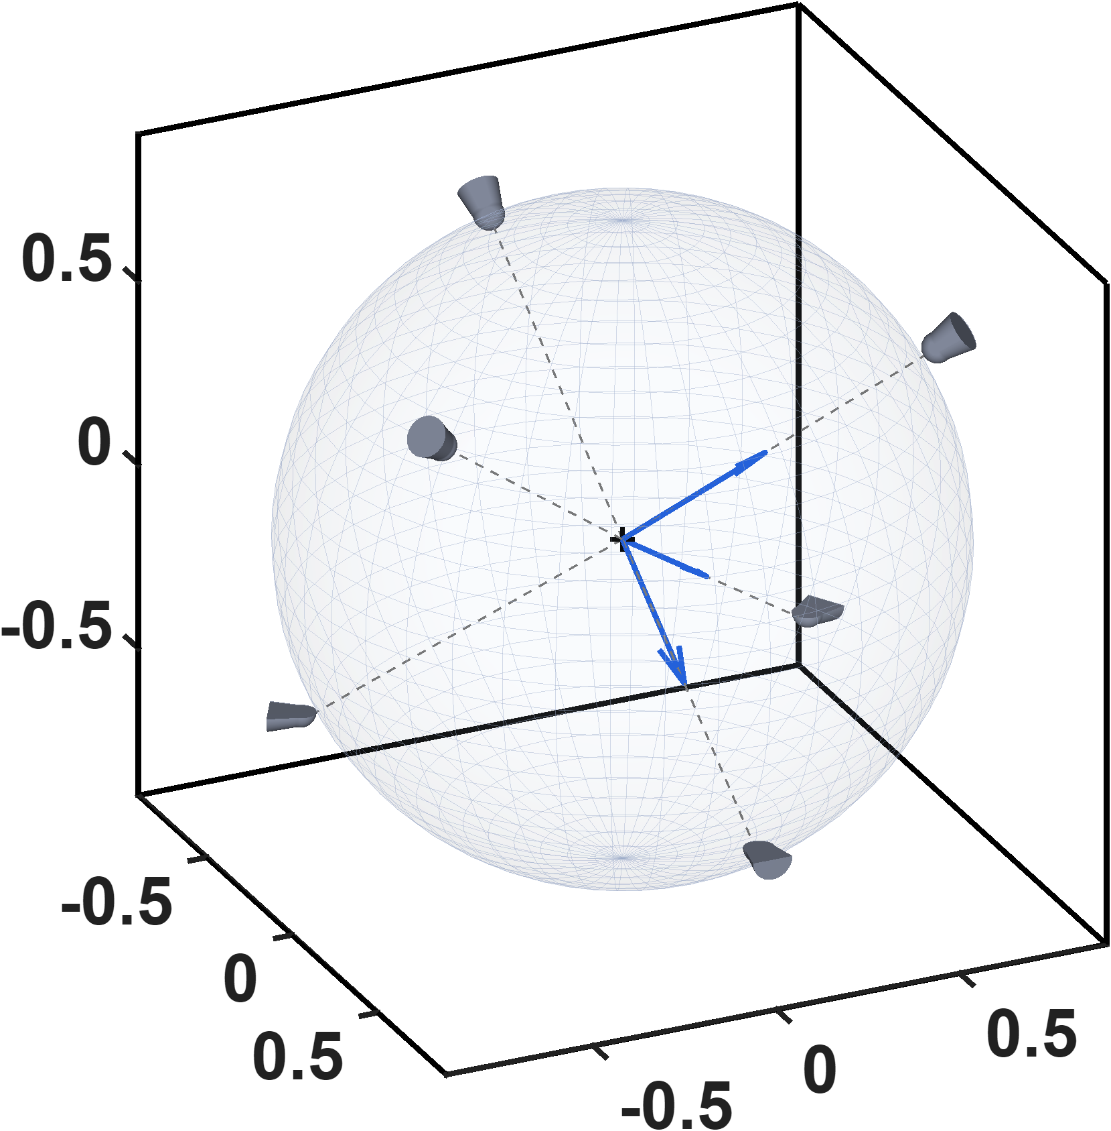






Current-based lumped-parameter modeling and calibration
Multiple-electromagnetic-pole actuation
P2
P5
P4
$$z_{a}$$
$$z(mm)$$
$$y_{a}$$
P3
P6
$$x_{a}$$
P1
$$x(mm)$$
$$y(mm)$$
This figure shows the actuator coordinate system defined for the multipole electromagnetic actuator, with the corresponding magnetic pole numbers labeled. All subsequent model calibration and analysis are conducted in this coordinate system. In addition, the tips of the six magnetic poles lie on a common spherical surface, whose radius is determined by the geometric design of the magnetic tweezer.

Slide 3
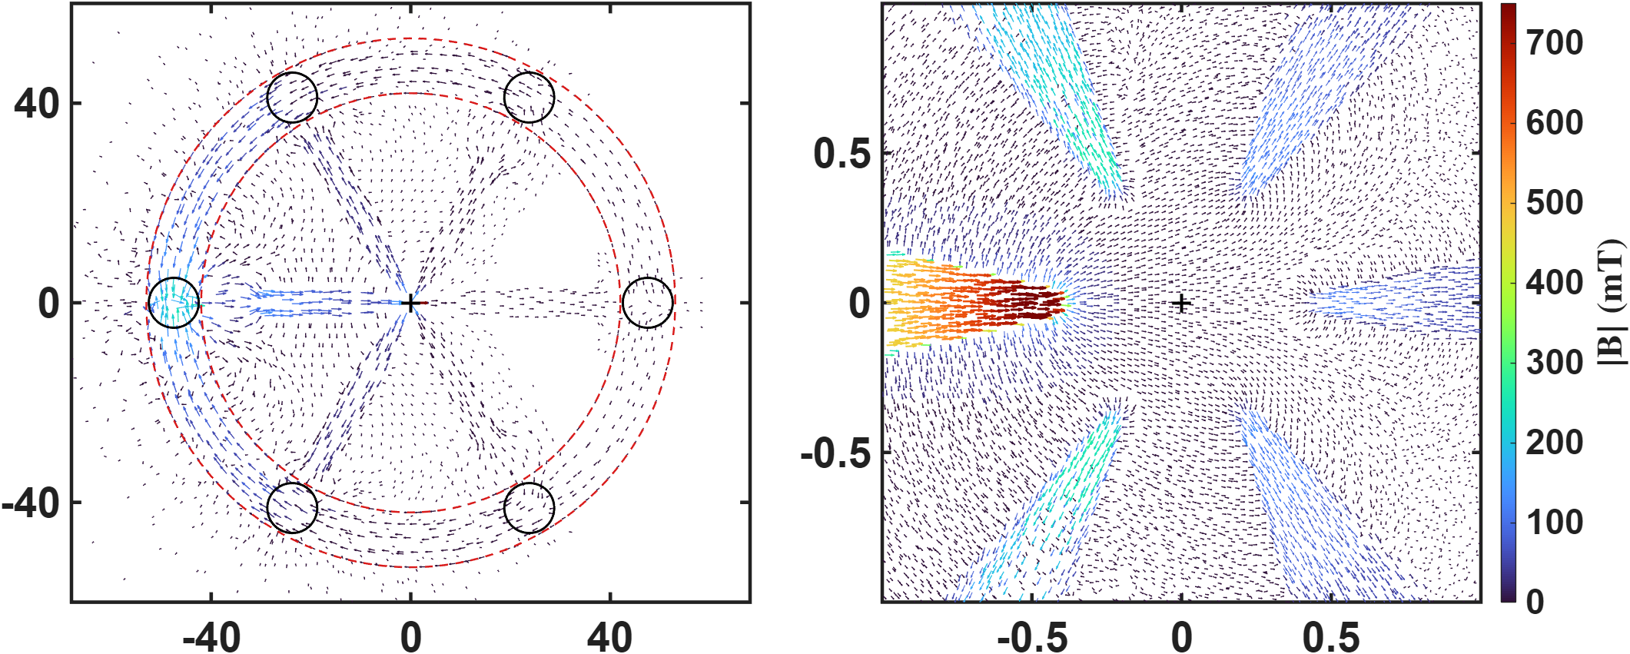




Current-based lumped-parameter modeling and calibration
Multiple-electromagnetic-pole actuation
P3
P5
P2
$$y(mm)$$
$$y(mm)$$
P1
P6
P4
$$x(mm)$$
$$x(mm)$$
The simulation conditions are an excitation current of 1 A and a 70-turn coil, and the results shown are obtained from Long’s model. The left figure presents a top view of the magnetic flux path through the entire structure when pole P2 is excited. The magnetic flux emerges from pole P2, enters the other poles, and then returns through the yoke. The right figure is an enlarged view of the central region in the left figure, allowing the magnetic flux path to be observed more clearly.

Slide 4
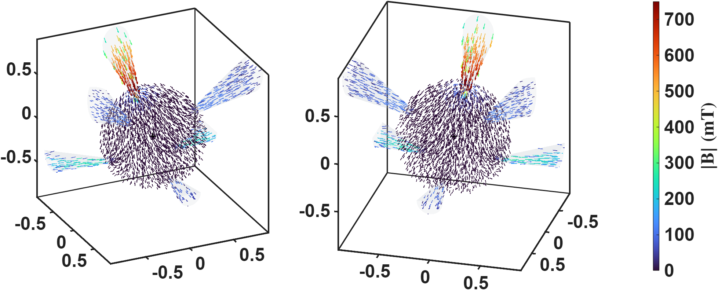
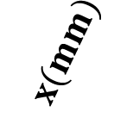
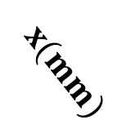
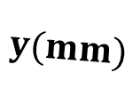


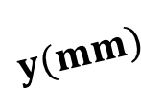
Current-based lumped-parameter modeling and calibration
Multiple-electromagnetic-pole actuation
$$z(mm)$$
$$z(mm)$$
$$x(mm)$$
$$x(mm)$$
$$y(mm)$$
$$y(mm)$$
Two 3D views of the central spherical region are also presented. These views clearly show that the magnetic flux emerges from pole P2 and is then received by the other magnetic poles.

Slide 5
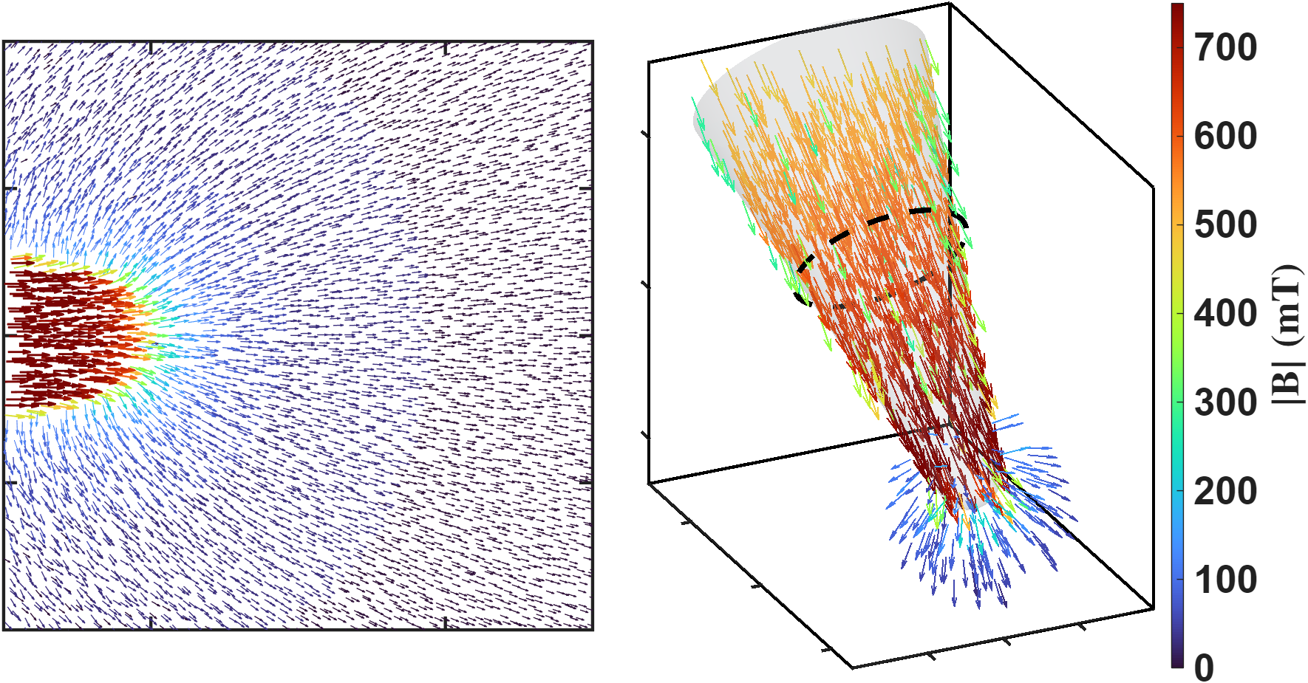



Current-based lumped-parameter modeling and calibration
C. Charge-location model
This figure illustrates the magnetic flux path when pole P2 is excited. The left figure presents a top view, with the theoretical magnetic charge locations labeled to clarify the magnetic charge concept used in this study. The right figure shows a three-dimensional view of the same model, in which the theoretical magnetic charge locations and the magnetic flux distribution can be clearly observed.
$$Φ$$
$$q$$
$$q$$

Slide 6
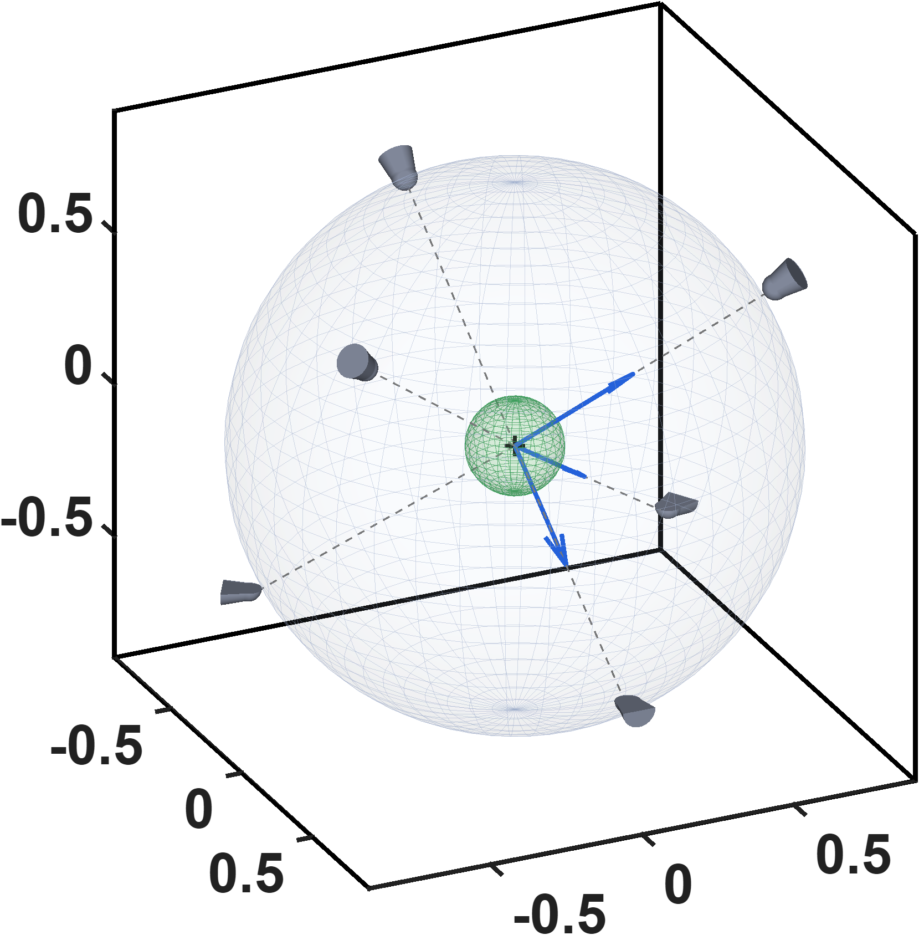
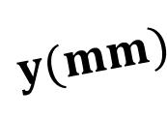





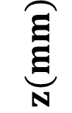
Current-based lumped-parameter modeling and calibration
E. Validation
$$Calibrate model→b_{ij}=S_{i}{}_{}^{B}{{\hat{g}}_{I}}\overline{K}I_{j}$$
This figure consists of two parts. The first part shows the outer spherical surface formed by the six magnetic pole tips, as described previously. The size of this spherical surface is determined by the geometric design of the magnetic tweezer. The second part, shown in green, represents the model’s sampling region. It is recommended that the sampling region cover the entire operating range, because the model exhibits reduced performance outside the sampled region.
$$z_{a}$$
$$z(mm)$$
$$y_{a}$$
$$x_{a}$$
$$x(mm)$$
$$y(mm)$$

Slide 7
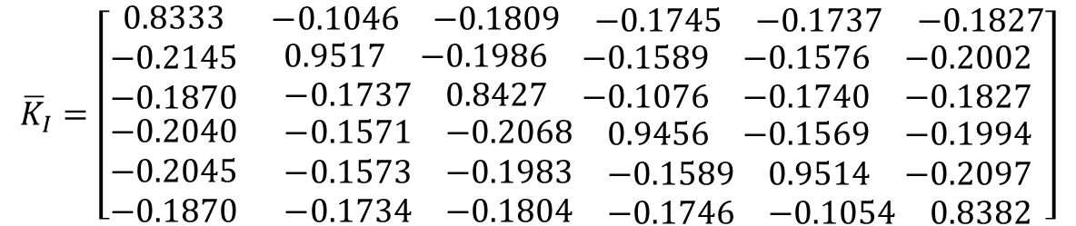



Current-based lumped-parameter modeling and calibration
E. Validation
$$Calibrate model→b_{ij}=S_{i}{}_{}^{B}{{\hat{g}}_{I}}\overline{K}I_{j}$$
Fitting results
$${\overline{K}}_{I}=\left[\begin{matrix}0.8333 & \begin{matrix}−0.1046 & −0.1809 & \begin{matrix}−0.1745 & −0.1737 & −0.1827\end{matrix}\end{matrix} \\ \begin{matrix}−0.2145 \\ −0.1870 \\ \begin{matrix}−0.2040 \\ −0.2045 \\ −0.1870\end{matrix}\end{matrix} & \begin{matrix}\begin{matrix}0.9517 & −0.1986 & \begin{matrix}−0.1589 & −0.1576 & −0.2002\end{matrix}\end{matrix} \\ \begin{matrix}−0.1737 & 0.8427 & \begin{matrix}−0.1076 & −0.1740 & −0.1827\end{matrix}\end{matrix} \\ \begin{matrix}\begin{matrix}−0.1571 & −0.2068 & \begin{matrix}0.9456 & −0.1569 & −0.1994\end{matrix}\end{matrix} \\ \begin{matrix}−0.1573 & −0.1983 & \begin{matrix}−0.1589 & 0.9514 & −0.2097\end{matrix}\end{matrix} \\ \begin{matrix}−0.1734 & −0.1804 & \begin{matrix}−0.1746 & −0.1054 & 0.8382\end{matrix}\end{matrix}\end{matrix}\end{matrix}\end{matrix}\right]$$
$$\hat{ℓ}=874.3 um$$
$${}_{}^{B}{{\hat{g}}_{I}=9.6717mT/A}$$
One parameter fitting results
Calibration region R<=150um

Slide 8
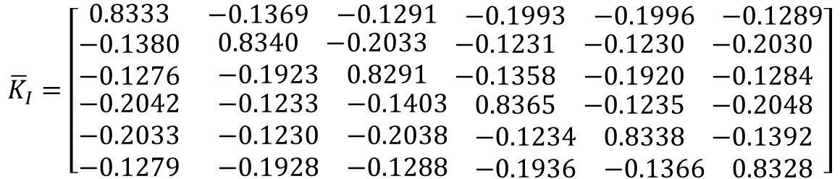


Current-based lumped-parameter modeling and calibration
E. Validation
Fitting results
$$Calibrate model→b_{ij}=S_{i}{}_{}^{B}{{\hat{g}}_{I}}\overline{K}I_{j}$$
$${\overline{K}}_{I}=\left[\begin{matrix}0.8333 & \begin{matrix}−0.1369 & −0.1291 & \begin{matrix}−0.1993 & −0.1996 & −0.1289\end{matrix}\end{matrix} \\ \begin{matrix}−0.1380 \\ −0.1276 \\ \begin{matrix}−0.2042 \\ −0.2033 \\ −0.1279\end{matrix}\end{matrix} & \begin{matrix}\begin{matrix}0.8340 & −0.2033 & \begin{matrix}−0.1231 & −0.1230 & −0.2030\end{matrix}\end{matrix} \\ \begin{matrix}−0.1923 & 0.8291 & \begin{matrix}−0.1358 & −0.1920 & −0.1284\end{matrix}\end{matrix} \\ \begin{matrix}\begin{matrix}−0.1233 & −0.1403 & \begin{matrix}0.8365 & −0.1235 & −0.2048\end{matrix}\end{matrix} \\ \begin{matrix}−0.1230 & −0.2038 & \begin{matrix}−0.1234 & 0.8338 & −0.1392\end{matrix}\end{matrix} \\ \begin{matrix}−0.1928 & −0.1288 & \begin{matrix}−0.1936 & −0.1366 & 0.8328\end{matrix}\end{matrix}\end{matrix}\end{matrix}\end{matrix}\right]$$
$$\hat{ℓ}=874. 0um$$
$${}_{}^{B}{{\hat{g}}_{I}=10.7518 mT/A}$$
Eighteen parameter fitting results
Calibration region R<=150um

Slide 9
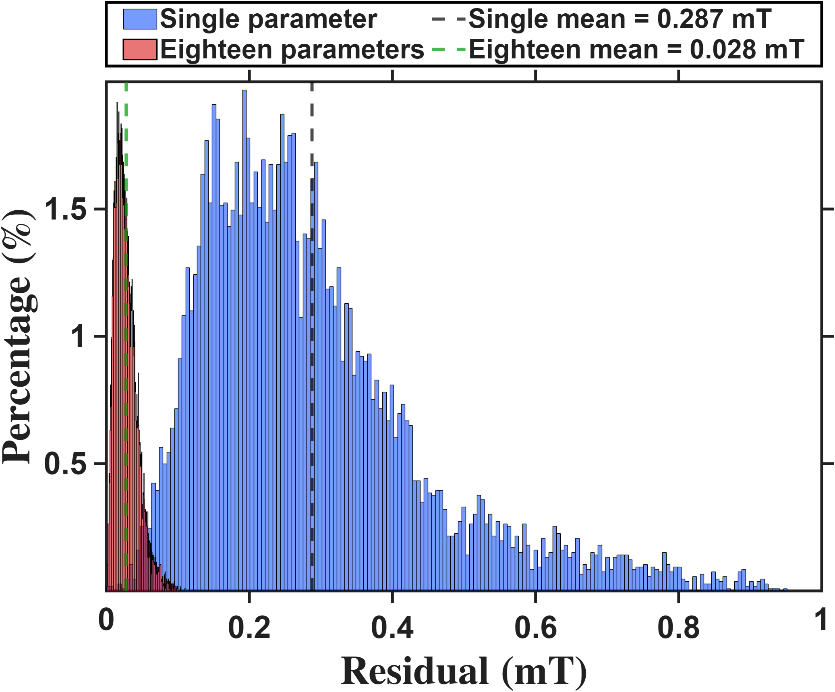

Current-based lumped-parameter modeling and calibration
E. Validation
$$Calibrate model→b_{ij}=S_{i}{}_{}^{B}{{\hat{g}}_{I}}\overline{K}I_{j}$$
This figure overlays the distributions of the two models. The red distribution is noticeably more concentrated than the blue one, indicating that the eighteen-parameter model performs better than the one-parameter model in fitting the magnetic field.

Slide 10
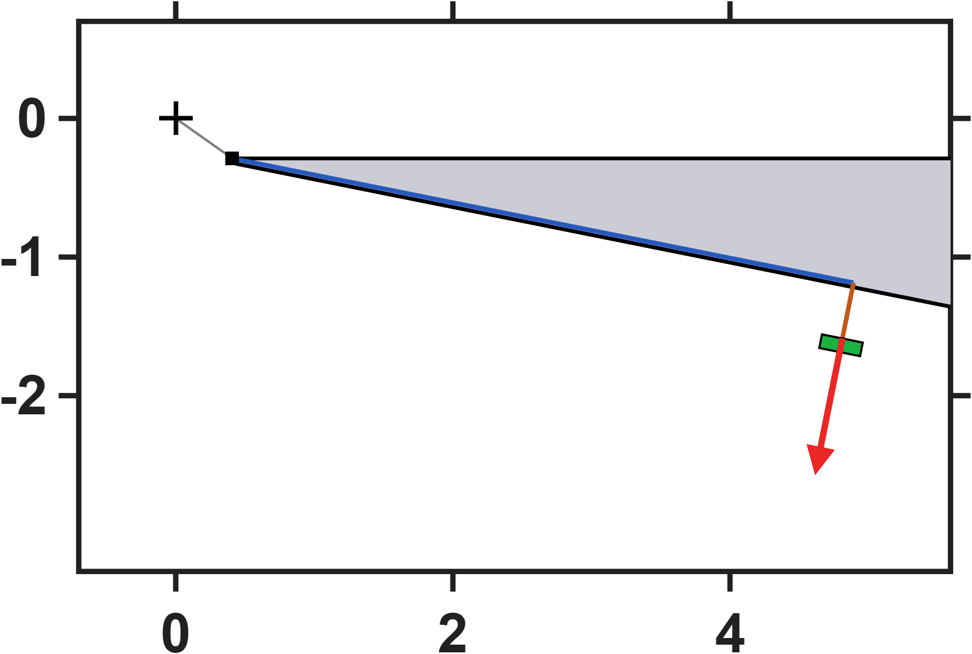
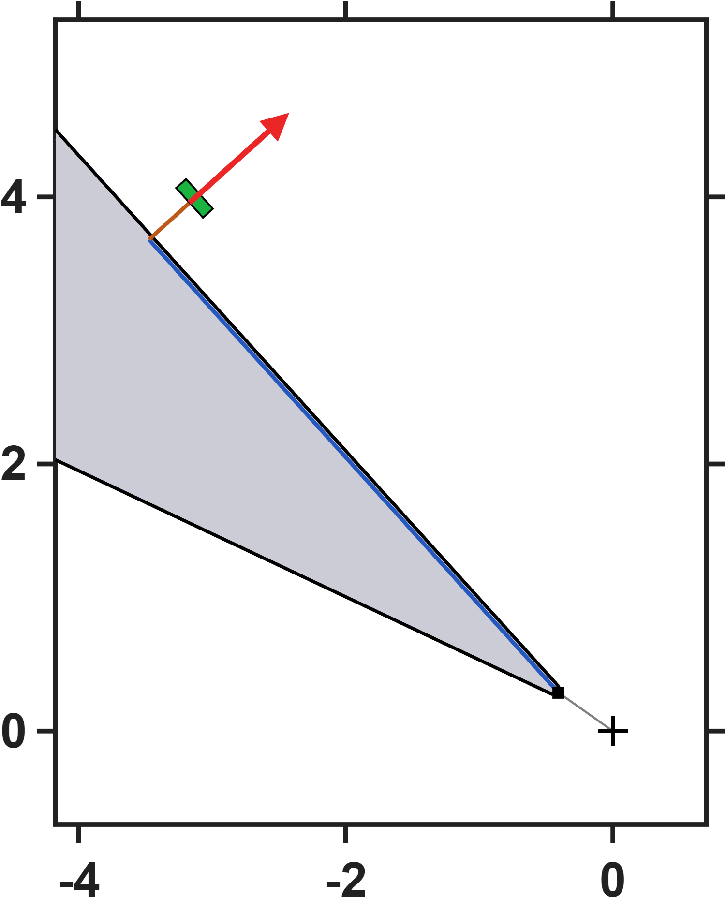










Hall-sensor-voltage-based lumped-parameter modeling and calibration
A. Voltage-based magnetic flux model
These two figures illustrate the simulated placement of the Hall sensors, using magnetic poles P1 and P2 as examples.
$$y(mm)$$
$$4.572mm$$
$$0.41mm$$
$$n^{+}$$
$$x(mm)$$
$$n^{+}$$
$$0.41mm$$
$$y(mm)$$
$$4.572mm$$
$$x(mm)$$

Slide 11
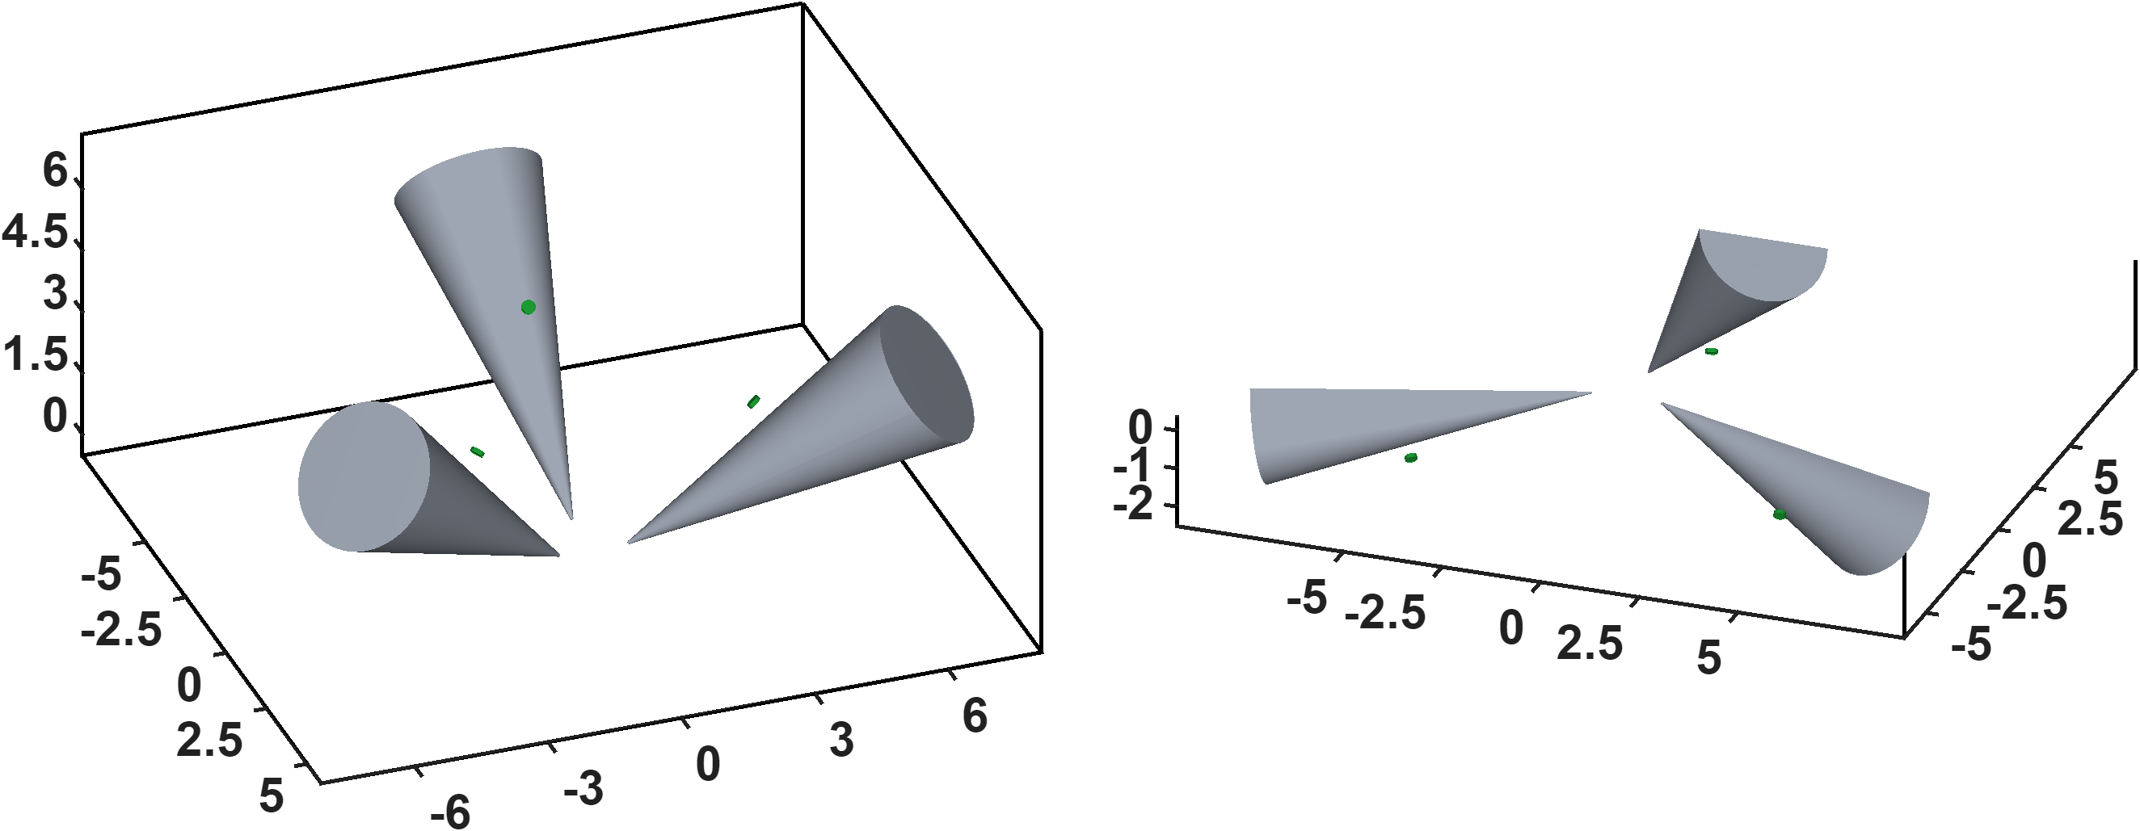
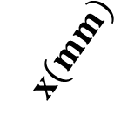


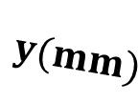





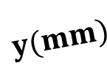


Hall-sensor-voltage-based lumped-parameter modeling and calibration
A. Voltage-based magnetic flux model
$$z(mm)$$
$$S_{2}$$
$$S_{4}$$
$$S_{5}$$
$$S_{1}$$
$$z(mm)$$
$$S_{6}$$
$$S_{3}$$
$$x(mm)$$
$$x(mm)$$
$$y(mm)$$
$$y(mm)$$
This figure shows the locations of the Hall sensors in the simulation model. The sensor placements are presented in two separate figures because a single view would make it difficult to clearly distinguish the Hall sensor locations on the upper and lower magnetic poles. Therefore, the upper- and lower-pole sensor arrangements are shown separately to provide a clearer representation of their respective positions.

Slide 12
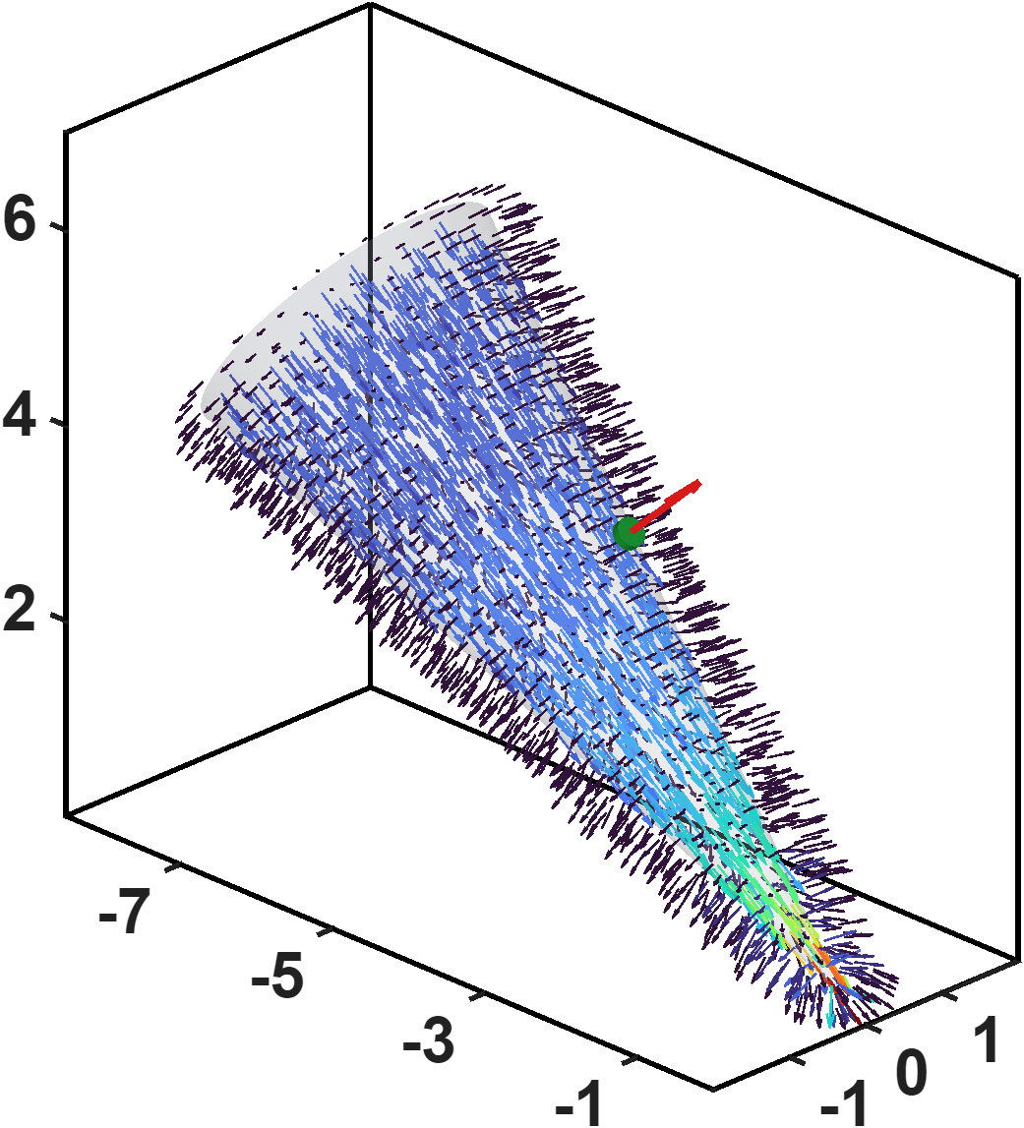
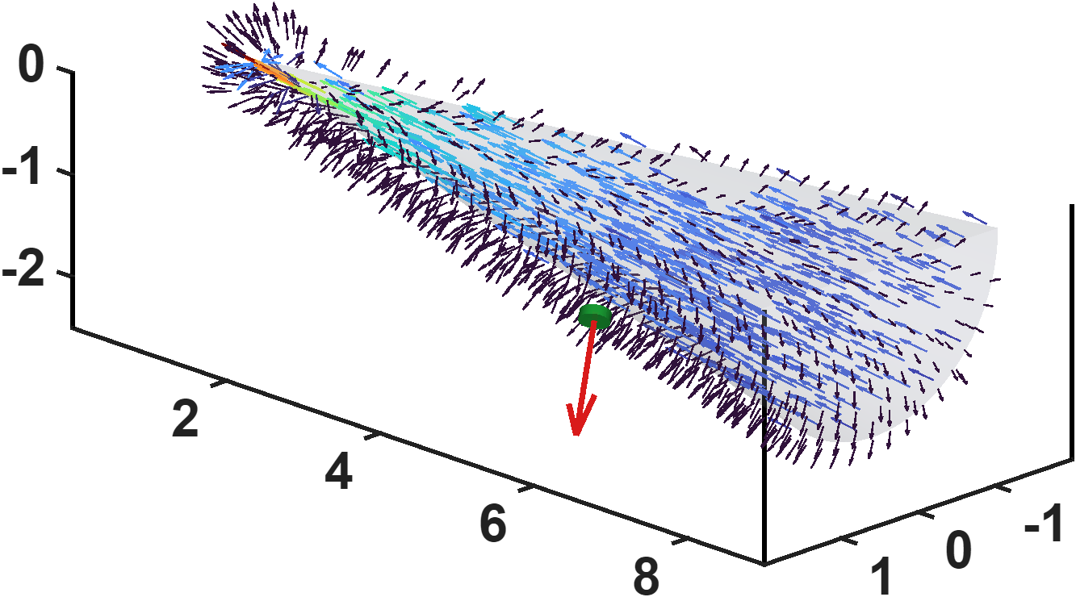
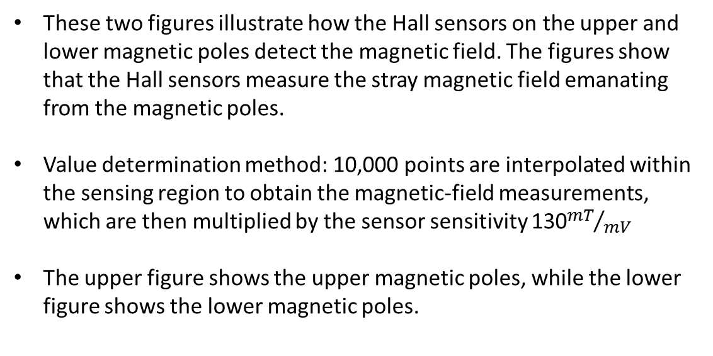





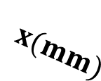


Hall-sensor-voltage-based lumped-parameter modeling and calibration
A. Voltage-based magnetic flux model
These two figures illustrate how the Hall sensors on the upper and lower magnetic poles detect the magnetic field. The figures show that the Hall sensors measure the stray magnetic field emanating from the magnetic poles.
Value determination method: 10,000 points are interpolated within the sensing region to obtain the magnetic-field measurements, which are then multiplied by the sensor sensitivity 130${mT}/{mV}$
The upper figure shows the upper magnetic poles, while the lower figure shows the lower magnetic poles.
$$n^{+}$$
$$z(mm)$$
$$x(mm)$$
$$y(mm)$$
$$z(mm)$$
$$n^{+}$$
$$x(mm)$$
$$y(mm)$$

Slide 13

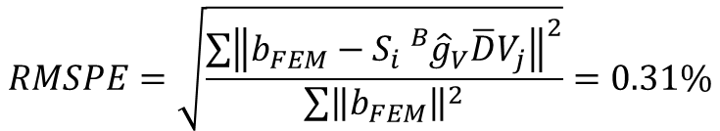

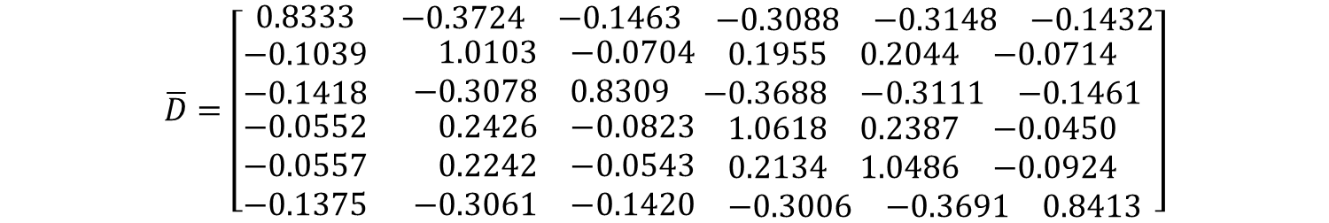
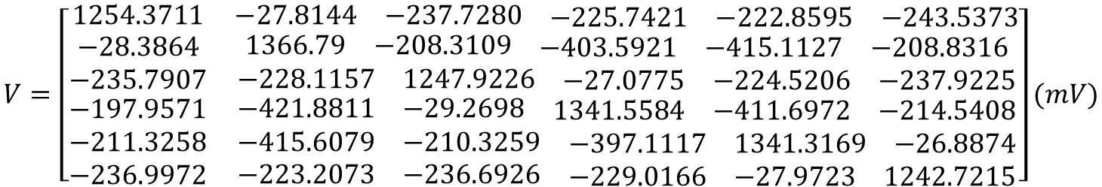
Hall-sensor-voltage-based lumped-parameter modeling and calibration
C. Validation
$$Calibrate model→b_{ij}=S_{i}{}_{}^{B}{{\hat{g}}_{V}}\overline{D}V_{j}$$
$$V=\left[\begin{matrix}1254.3711 & \begin{matrix}−27.8144 & −237.7280 & \begin{matrix}−225.7421 & −222.8595 & −243.5373\end{matrix}\end{matrix} \\ \begin{matrix}−28.3864 \\ −235.7907 \\ \begin{matrix}−197.9571 \\ −211.3258 \\ −236.9972\end{matrix}\end{matrix} & \begin{matrix}\begin{matrix}1366.79 & −208.3109 & \begin{matrix}−403.5921 & −415.1127 & −208.8316\end{matrix}\end{matrix} \\ \begin{matrix}−228.1157 & 1247.9226 & \begin{matrix}−27.0775 & −224.5206 & −237.9225\end{matrix}\end{matrix} \\ \begin{matrix}\begin{matrix}−421.8811 & −29.2698 & \begin{matrix}1341.5584 & −411.6972 & −214.5408\end{matrix}\end{matrix} \\ \begin{matrix}−415.6079 & −210.3259 & \begin{matrix}−397.1117 & 1341.3169 & −26.8874\end{matrix}\end{matrix} \\ \begin{matrix}−223.2073 & −236.6926 & \begin{matrix}−229.0166 & −27.9723 & 1242.7215\end{matrix}\end{matrix}\end{matrix}\end{matrix}\end{matrix}\right](mV)$$
$$\overline{D}=\left[\begin{matrix}0.8333 & \begin{matrix}−0.3724 & −0.1463 & \begin{matrix}−0.3088 & −0.3148 & −0.1432\end{matrix}\end{matrix} \\ \begin{matrix}−0.1039 \\ −0.1418 \\ \begin{matrix}−0.0552 \\ −0.0557 \\ −0.1375\end{matrix}\end{matrix} & \begin{matrix}\begin{matrix}1.0103 & −0.0704 & \begin{matrix}0.1955 & 0.2044 & −0.0714\end{matrix}\end{matrix} \\ \begin{matrix}−0.3078 & 0.8309 & \begin{matrix}−0.3688 & −0.3111 & −0.1461\end{matrix}\end{matrix} \\ \begin{matrix}\begin{matrix}0.2426 & −0.0823 & \begin{matrix}1.0618 & 0.2387 & −0.0450\end{matrix}\end{matrix} \\ \begin{matrix}0.2242 & −0.0543 & \begin{matrix}0.2134 & 1.0486 & −0.0924\end{matrix}\end{matrix} \\ \begin{matrix}−0.3061 & −0.1420 & \begin{matrix}−0.3006 & −0.3691 & 0.8413\end{matrix}\end{matrix}\end{matrix}\end{matrix}\end{matrix}\right]$$
$${}_{}^{B}{{\hat{g}}_{V}=7.156×{10}^{−3}(mT/mV})$$
Voltage base fitting results
Idea model
Calibration region R<=150um
$$RMSPE=\sqrt{\frac{\sum{{\left\|b_{FEM}−S_{i}{}_{}^{B}{{\hat{g}}_{V}}\overline{D}V_{j}\right\|}^{2}}}{\sum{{\left\|b_{FEM}\right\|}^{2}}}}=0.31\%$$

Slide 14
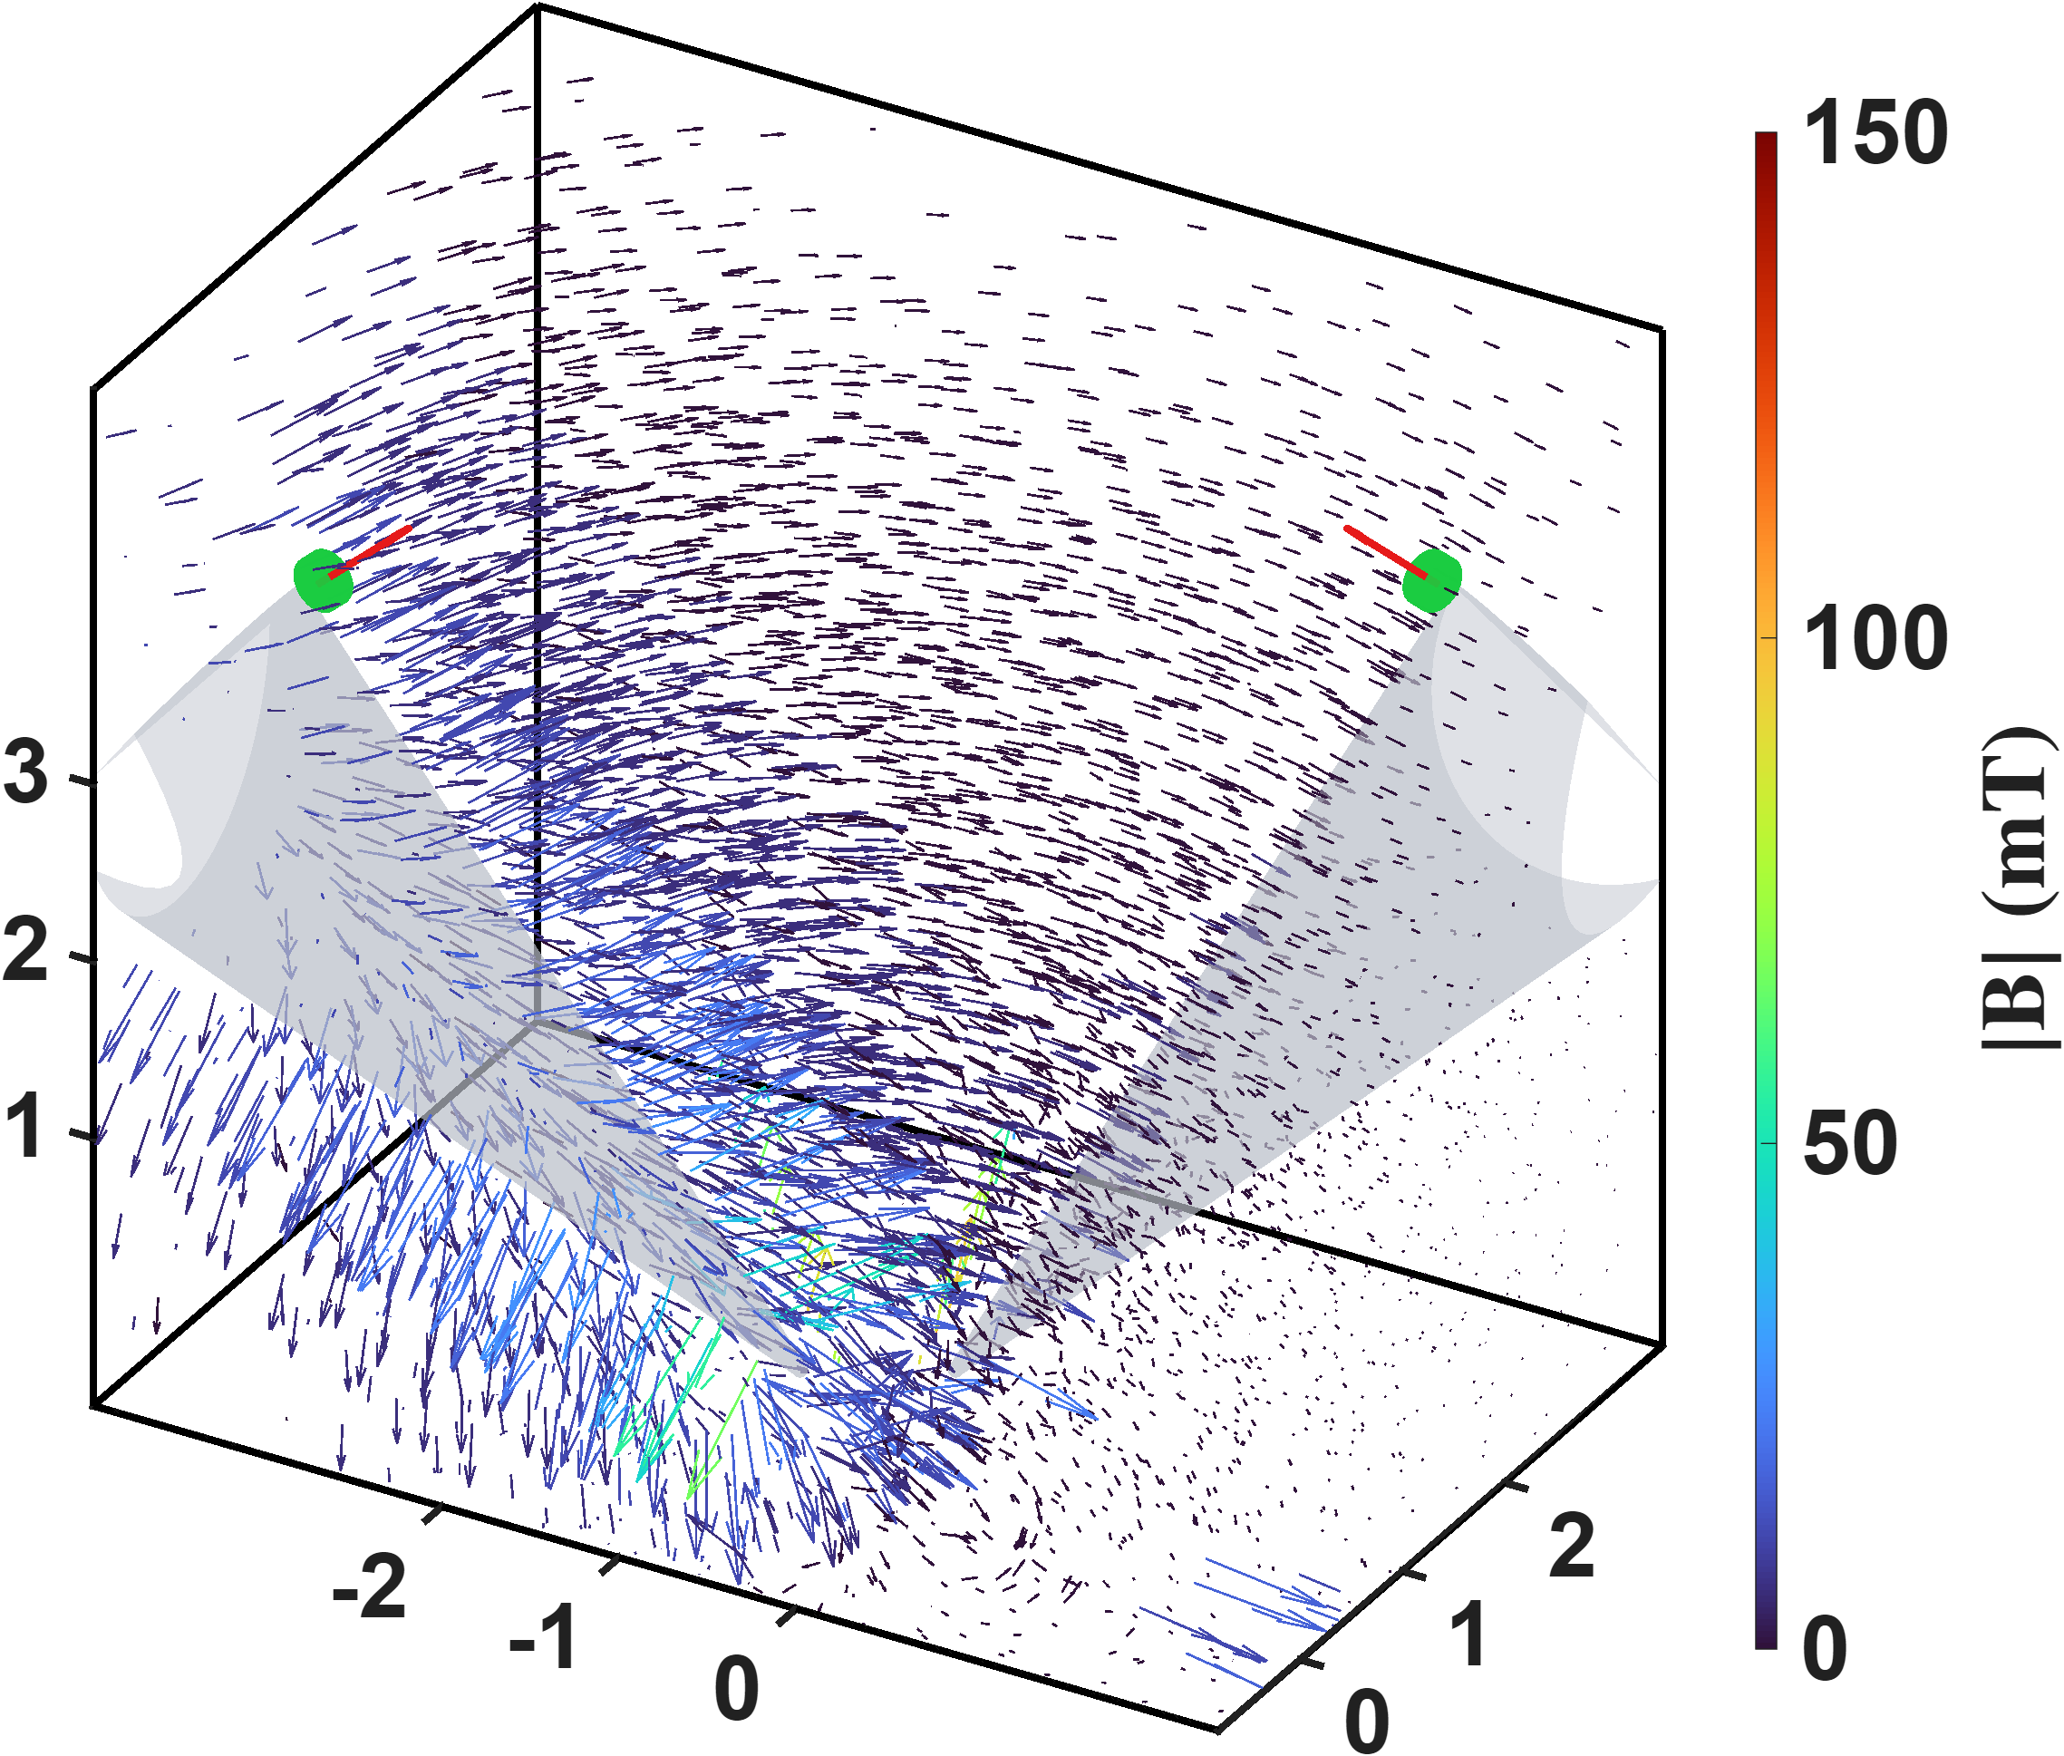


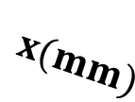

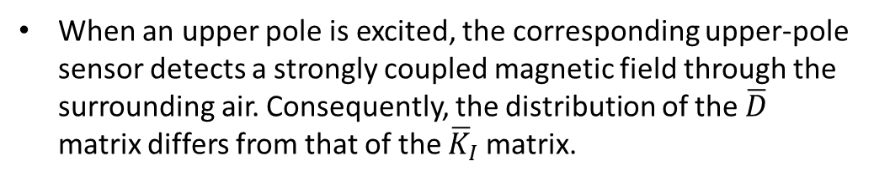

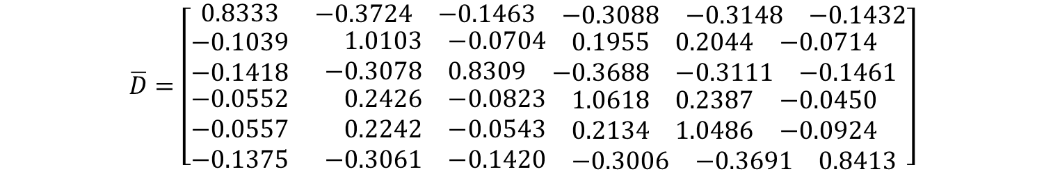

Hall-sensor-voltage-based lumped-parameter modeling and calibration
C. Validation
$$Calibrate model→b_{ij}=S_{i}{}_{}^{B}{{\hat{g}}_{V}}\overline{D}V_{j}$$
$$\overline{D}=GV^{T}{(VV^{T})}^{−1}$$
$$\overline{D}=\left[\begin{matrix}0.8333 & \begin{matrix}−0.3724 & −0.1463 & \begin{matrix}−0.3088 & −0.3148 & −0.1432\end{matrix}\end{matrix} \\ \begin{matrix}−0.1039 \\ −0.1418 \\ \begin{matrix}−0.0552 \\ −0.0557 \\ −0.1375\end{matrix}\end{matrix} & \begin{matrix}\begin{matrix}1.0103 & −0.0704 & \begin{matrix}0.1955 & 0.2044 & −0.0714\end{matrix}\end{matrix} \\ \begin{matrix}−0.3078 & 0.8309 & \begin{matrix}−0.3688 & −0.3111 & −0.1461\end{matrix}\end{matrix} \\ \begin{matrix}\begin{matrix}0.2426 & −0.0823 & \begin{matrix}1.0618 & 0.2387 & −0.0450\end{matrix}\end{matrix} \\ \begin{matrix}0.2242 & −0.0543 & \begin{matrix}0.2134 & 1.0486 & −0.0924\end{matrix}\end{matrix} \\ \begin{matrix}−0.3061 & −0.1420 & \begin{matrix}−0.3006 & −0.3691 & 0.8413\end{matrix}\end{matrix}\end{matrix}\end{matrix}\end{matrix}\right]$$
When an upper pole is excited, the corresponding upper-pole sensor detects a strongly coupled magnetic field through the surrounding air. Consequently, the distribution of the $\overline{D}$ matrix differs from that of the ${\overline{K}}_{I}$ matrix.
$$S_{2}$$
$$S_{5}$$
$$z(mm)$$
$$x(mm)$$
$$y(mm)$$

Slide 15
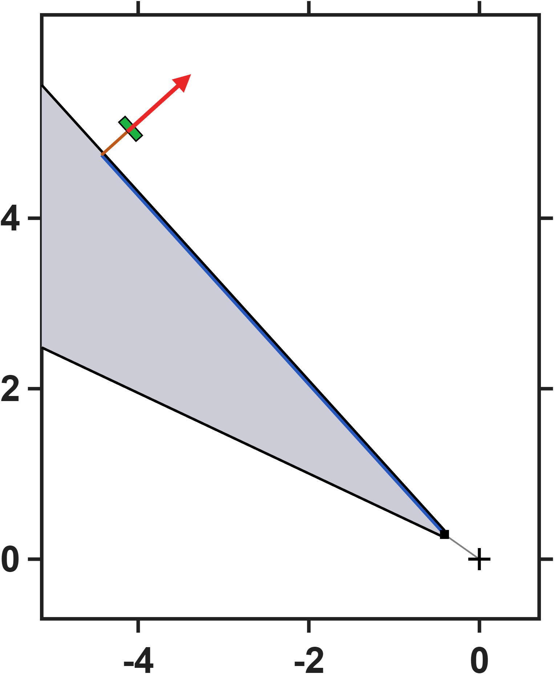
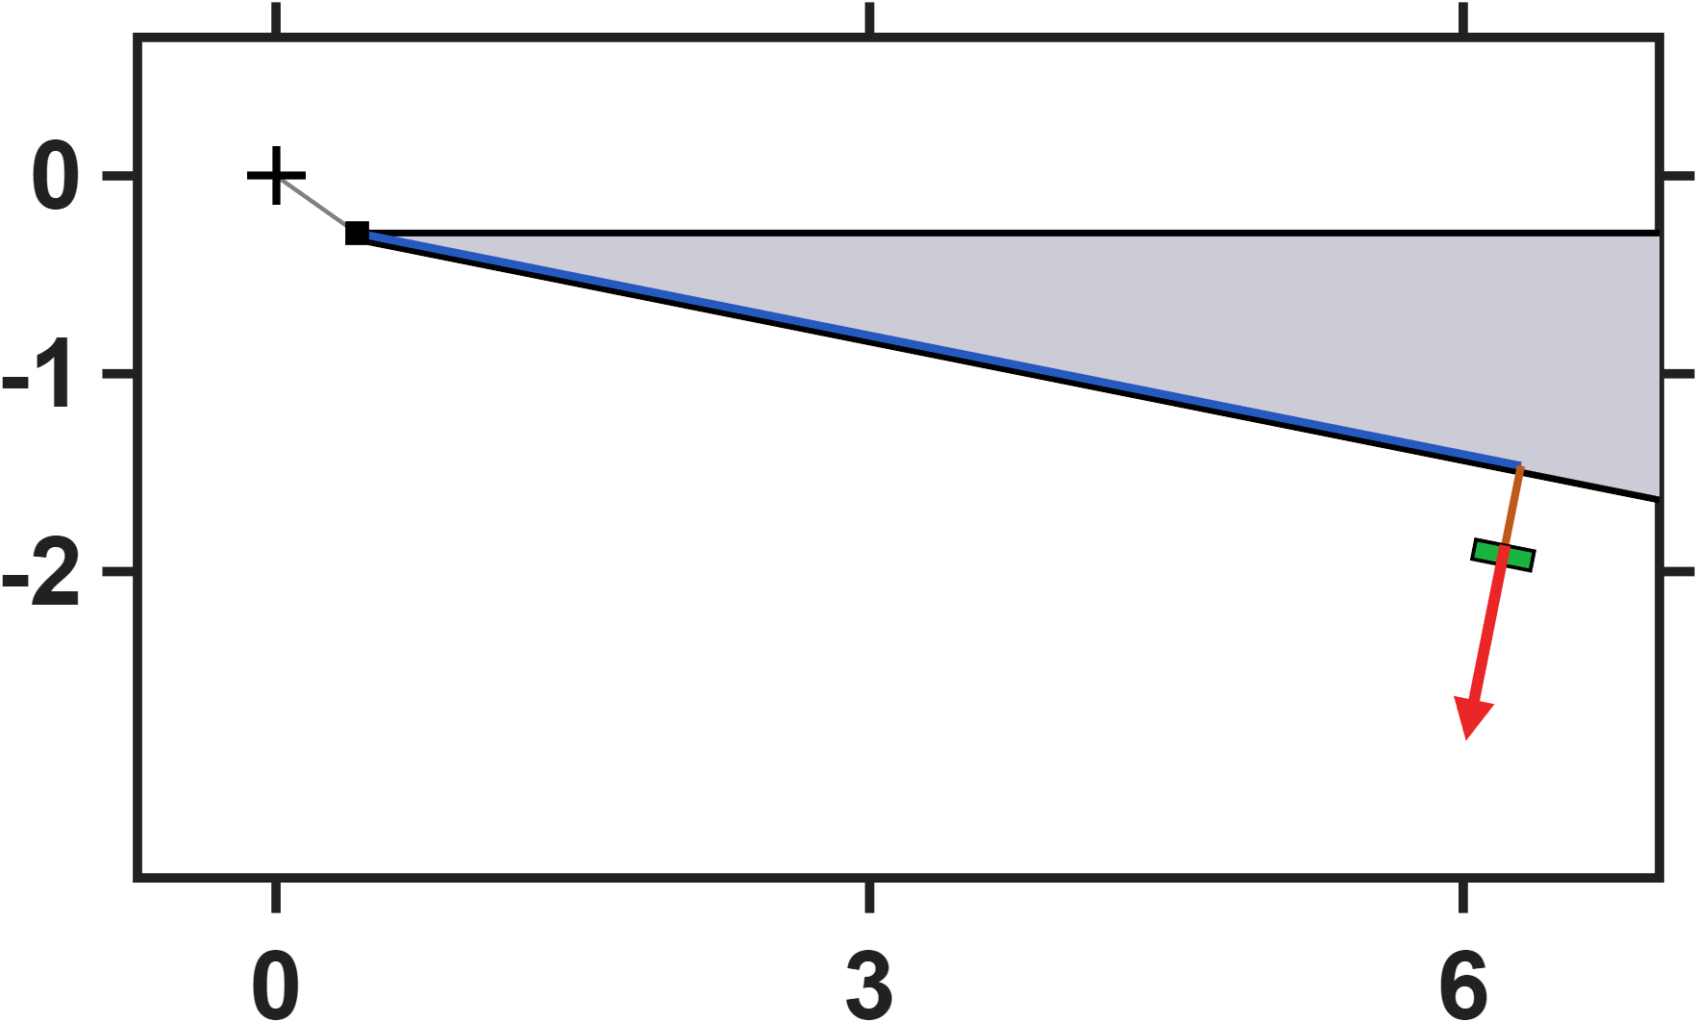
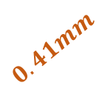



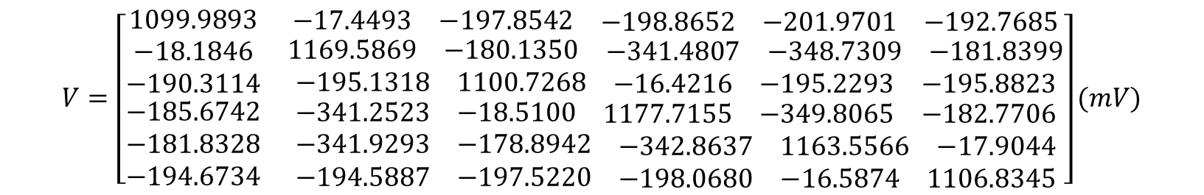



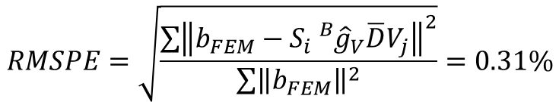



Hall-sensor-voltage-based lumped-parameter modeling and calibration
C. Validation
$$Calibrate model→b_{ij}=S_{i}{}_{}^{B}{{\hat{g}}_{V}}\overline{D}V_{j}$$
$$n^{+}$$
$$0.41mm$$
$$y(mm)$$
$$6mm$$
$$6mm$$
$$y(mm)$$
$$0.41mm$$
$$n^{+}$$
In this case, the sensor positions were varied. The figures above show the corresponding sensor locations, while the calibration results are presented below.
The sensor position does not affect the model’s prediction results.
$$x(mm)$$
$$x(mm)$$
$$RMSPE=\sqrt{\frac{\sum{{\left\|b_{FEM}−S_{i}{}_{}^{B}{{\hat{g}}_{V}}\overline{D}V_{j}\right\|}^{2}}}{\sum{{\left\|b_{FEM}\right\|}^{2}}}}=0.31\%$$
$$V=\left[\begin{matrix}1099.9893 & \begin{matrix}−17.4493 & −197.8542 & \begin{matrix}−198.8652 & −201.9701 & −192.7685\end{matrix}\end{matrix} \\ \begin{matrix}−18.1846 \\ −190.3114 \\ \begin{matrix}−185.6742 \\ −181.8328 \\ −194.6734\end{matrix}\end{matrix} & \begin{matrix}\begin{matrix}1169.5869 & −180.1350 & \begin{matrix}−341.4807 & −348.7309 & −181.8399\end{matrix}\end{matrix} \\ \begin{matrix}−195.1318 & 1100.7268 & \begin{matrix}−16.4216 & −195.2293 & −195.8823\end{matrix}\end{matrix} \\ \begin{matrix}\begin{matrix}−341.2523 & −18.5100 & \begin{matrix}1177.7155 & −349.8065 & −182.7706\end{matrix}\end{matrix} \\ \begin{matrix}−341.9293 & −178.8942 & \begin{matrix}−342.8637 & 1163.5566 & −17.9044\end{matrix}\end{matrix} \\ \begin{matrix}−194.5887 & −197.5220 & \begin{matrix}−198.0680 & −16.5874 & 1106.8345\end{matrix}\end{matrix}\end{matrix}\end{matrix}\end{matrix}\right](mV)$$

