Slide 1
A Lumped-Parameter Modeling, Calibration, and Capacity-Measure Framework for Flux Generation in Symmetric Multipole Electromagnetic Actuators

Slide 2
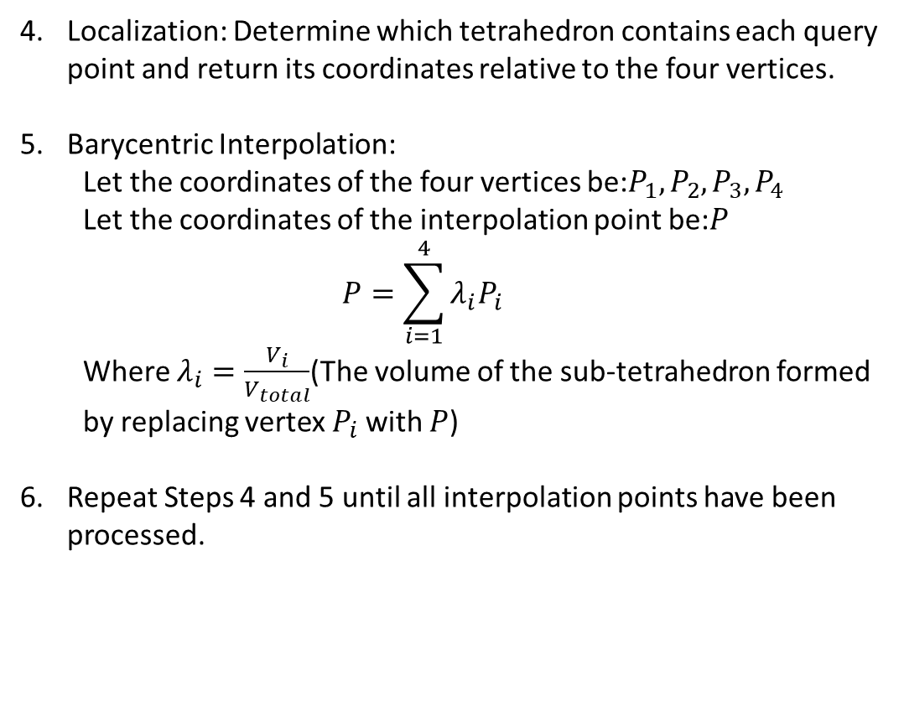
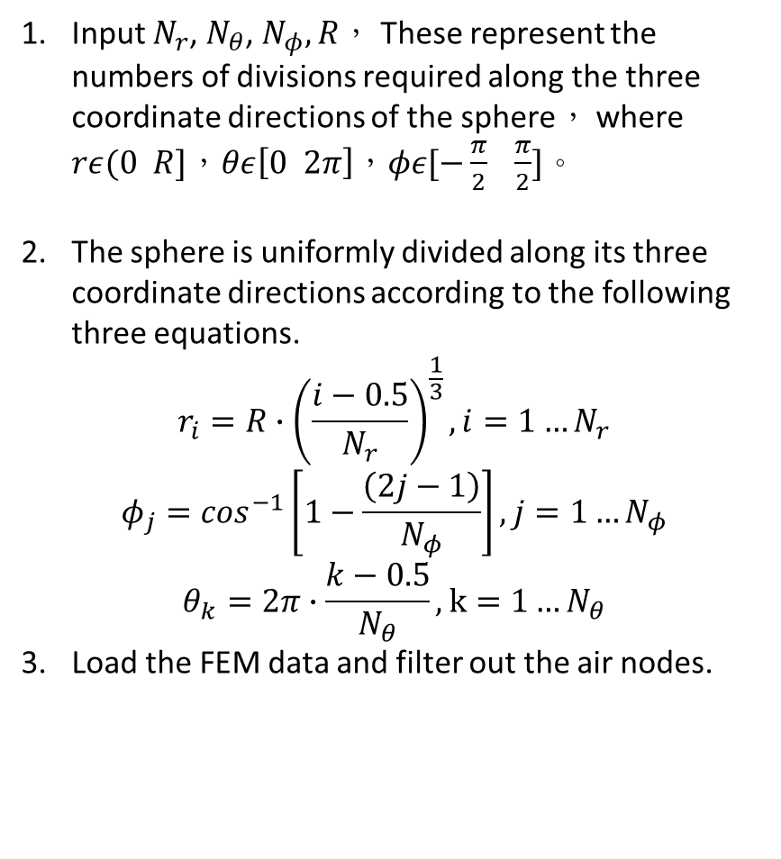
Current-based lumped-parameter modeling and calibration
E. Validation
Interpolation Point Algorithm
Input $N_{r}$, $N_{θ}$, $N_{φ},R$， These represent the numbers of divisions required along the three coordinate directions of the sphere， where $rε(0 R]$，$θε\left[0 2π\right]$，$φε[−\frac{π}{2} \frac{π}{2}]$。
The sphere is uniformly divided along its three coordinate directions according to the following three equations.
$$r_{i}=R∙{\left(\frac{i−0.5}{N_{r}}\right)}^{\frac{1}{3}},i=1…N_{r}$$
$$φ_{j}=\cos^{−1}\left[1−\frac{\left(2j−1\right)}{N_{φ}}\right],j=1…N_{φ}$$
$$θ_{k}=2π∙\frac{k−0.5}{N_{θ}},k=1…N_{θ}$$
Load the FEM data and filter out the air nodes.
Localization: Determine which tetrahedron contains each query point and return its coordinates relative to the four vertices.
Barycentric Interpolation:
Let the coordinates of the four vertices be:$P_{1},P_{2},P_{3},P_{4}$
Let the coordinates of the interpolation point be:$P$
$$P=\sum_{i=1}^{4}{λ_{i}P_{i}}$$
Where $λ_{i}=\frac{V_{i}}{V_{total}}$(The volume of the sub-tetrahedron formed by replacing vertex $P_{i}$ with $P$)
Repeat Steps 4 and 5 until all interpolation points have been processed.

Slide 3
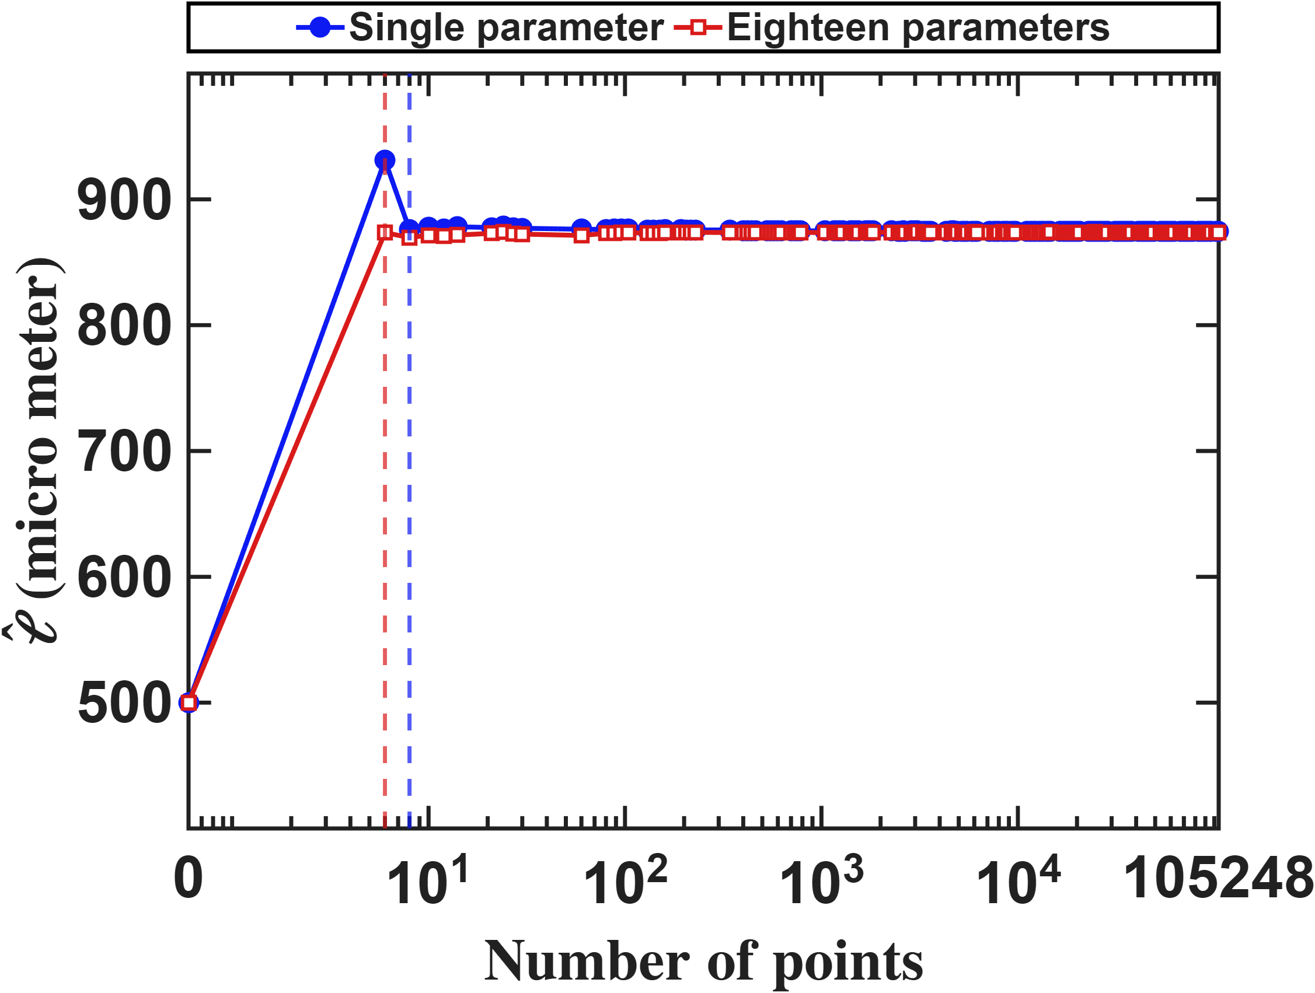
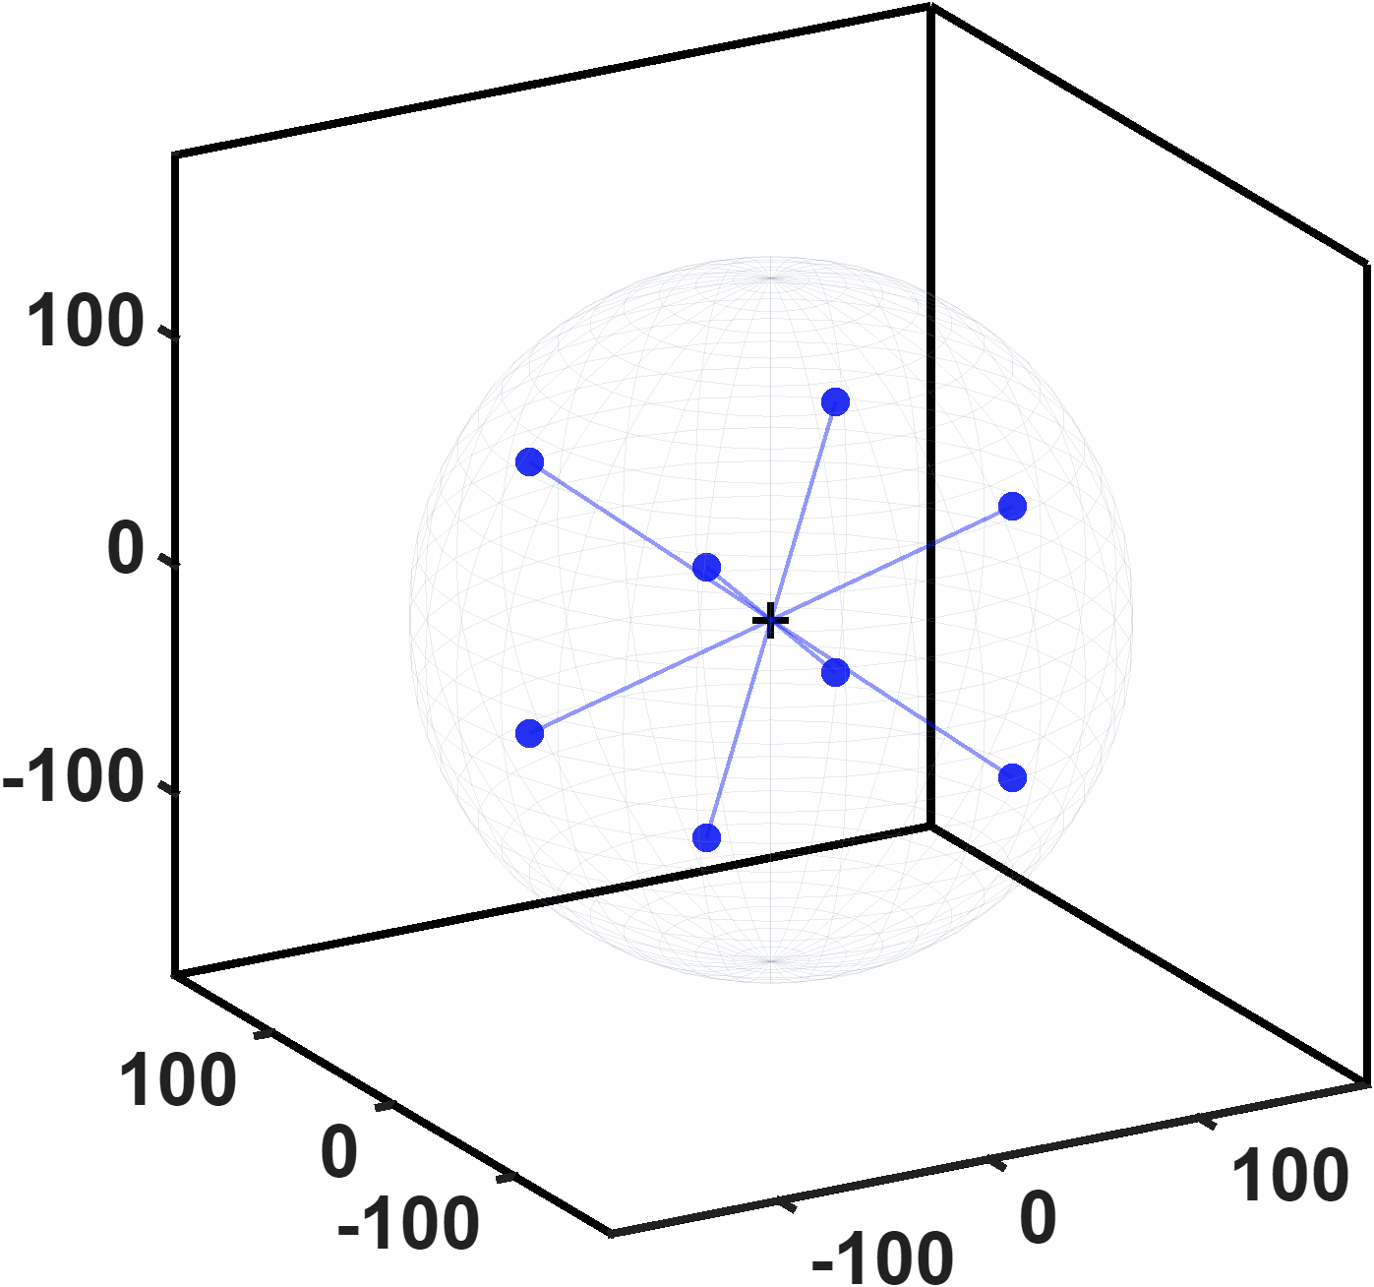
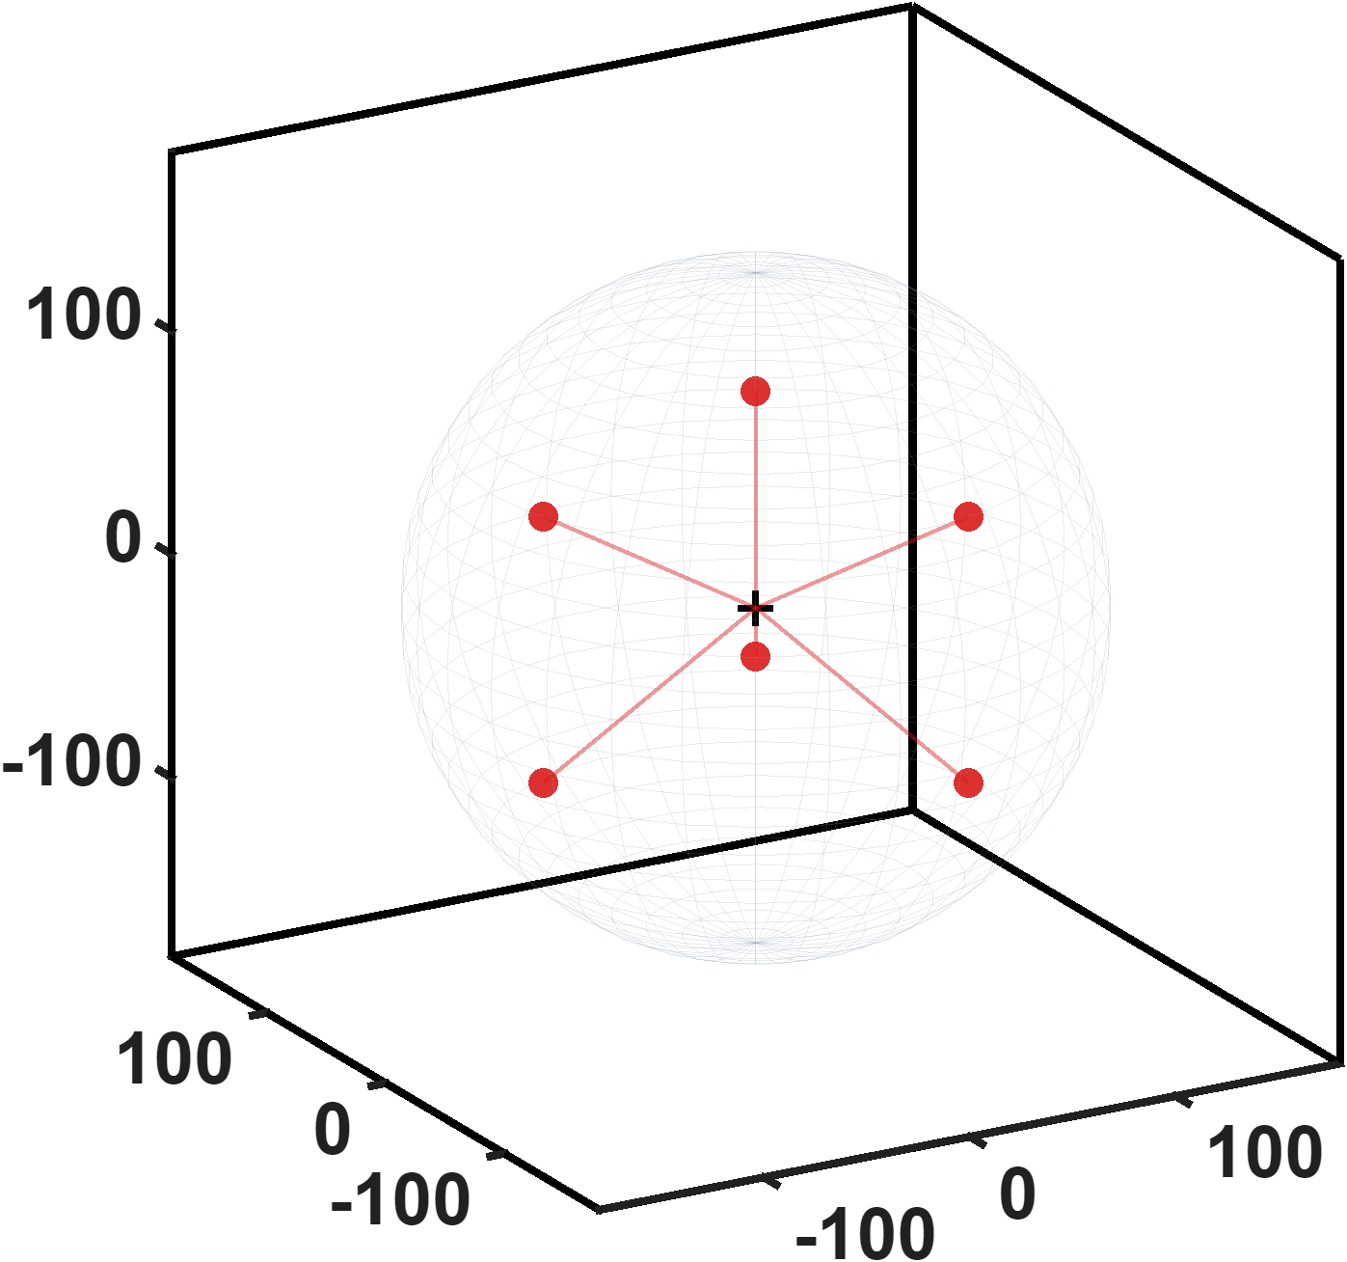

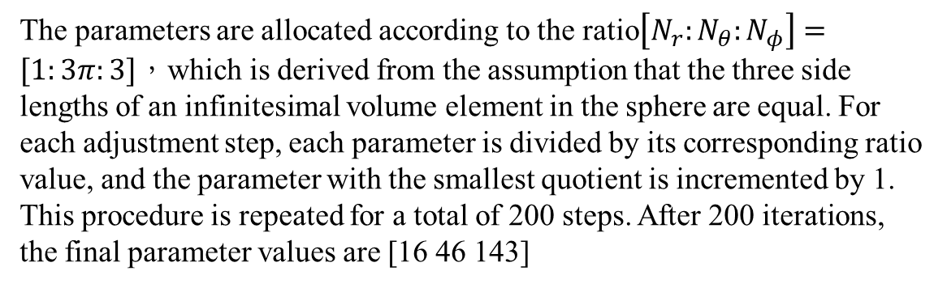


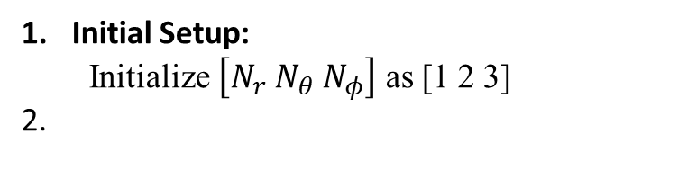
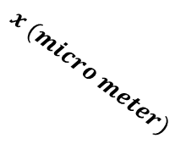
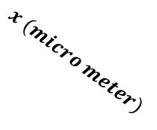


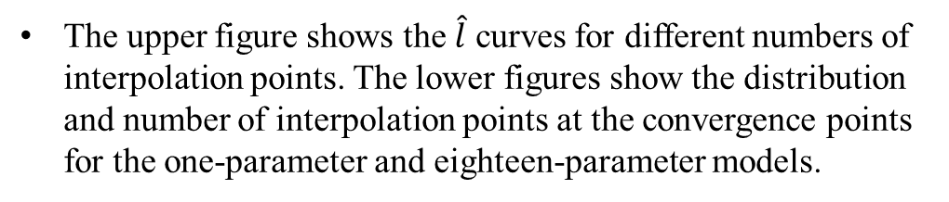

Current-based lumped-parameter modeling and calibration
E. Validation
Interpolation Point Algorithm
Initial Setup:
Initialize $\left[N_{r} N_{θ} N_{φ}\right]$ as [1 2 3]
$$\hat{𝓵}(micro meter)$$
The parameters are allocated according to the ratio$\left[N_{r}:N_{θ}:N_{φ}\right]=[1:3π:3]$，which is derived from the assumption that the three side lengths of an infinitesimal volume element in the sphere are equal. For each adjustment step, each parameter is divided by its corresponding ratio value, and the parameter with the smallest quotient is incremented by 1. This procedure is repeated for a total of 200 steps. After 200 iterations, the final parameter values are [16 46 143]
$$Number of points$$
Check for the convergence point:
The convergence criterion is evaluated sequentially over the 201 points by checking whether the relative errors of the following seven points with respect to their preceding points are all less than 0.5%.
$$z (micro meter)$$
$$z (micro meter)$$
The upper figure shows the $\hat{l}$ curves for different numbers of interpolation points. The lower figures show the distribution and number of interpolation points at the convergence points for the one-parameter and eighteen-parameter models.
$$x (micro meter)$$
$$x (micro meter)$$
$$y (micro meter)$$
$$y (micro meter)$$

Slide 4
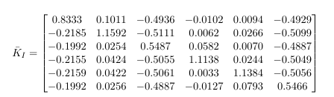
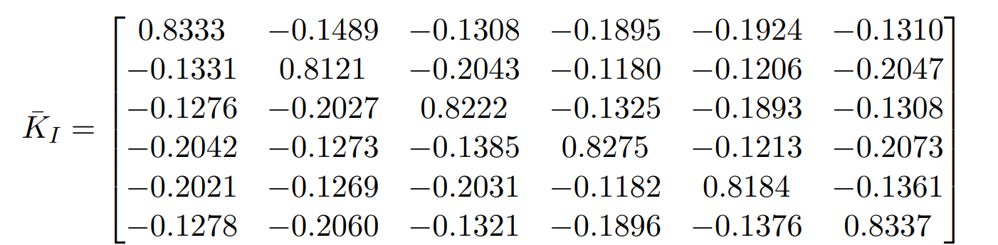



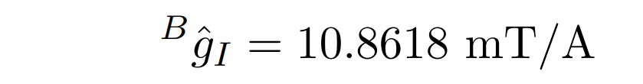

Current-based lumped-parameter modeling and calibration
E. Validation
Calibration results
$$Calibrate model→b_{ij}=S_{i}{}_{}^{B}{{\hat{g}}_{I}}{\overline{K}}_{I}I_{j}$$
Single parameter
Eighteen parameters

Slide 5
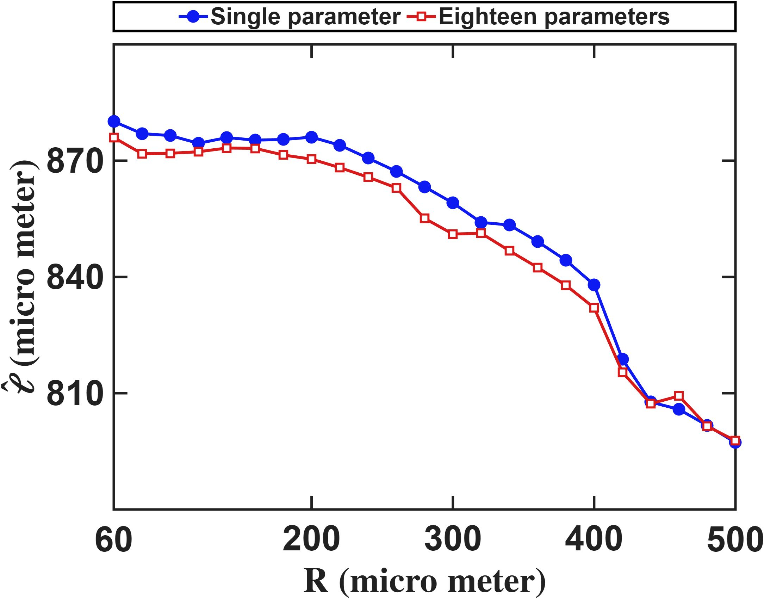
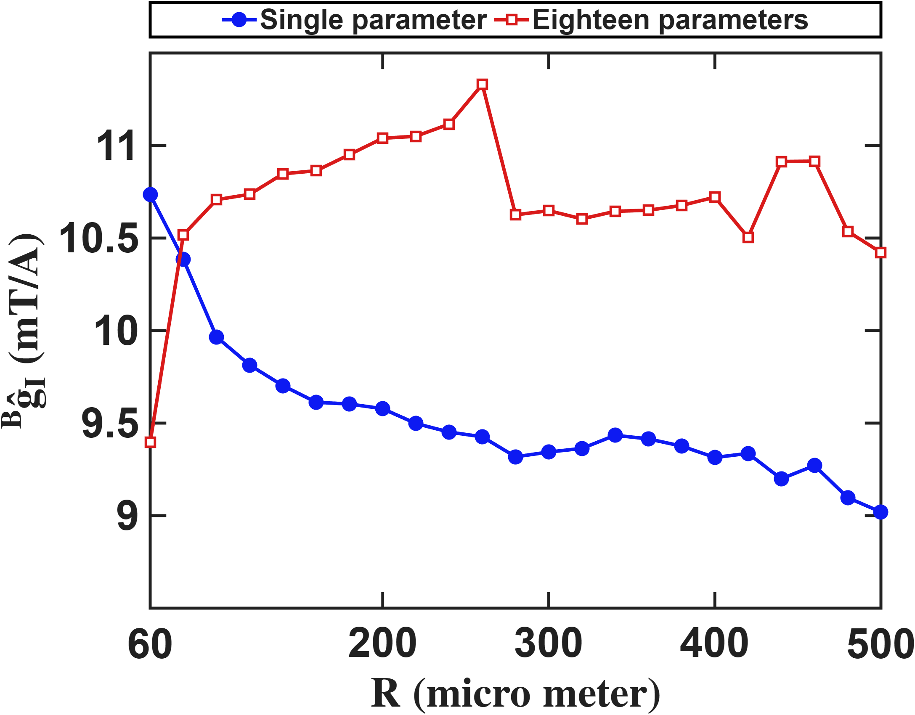
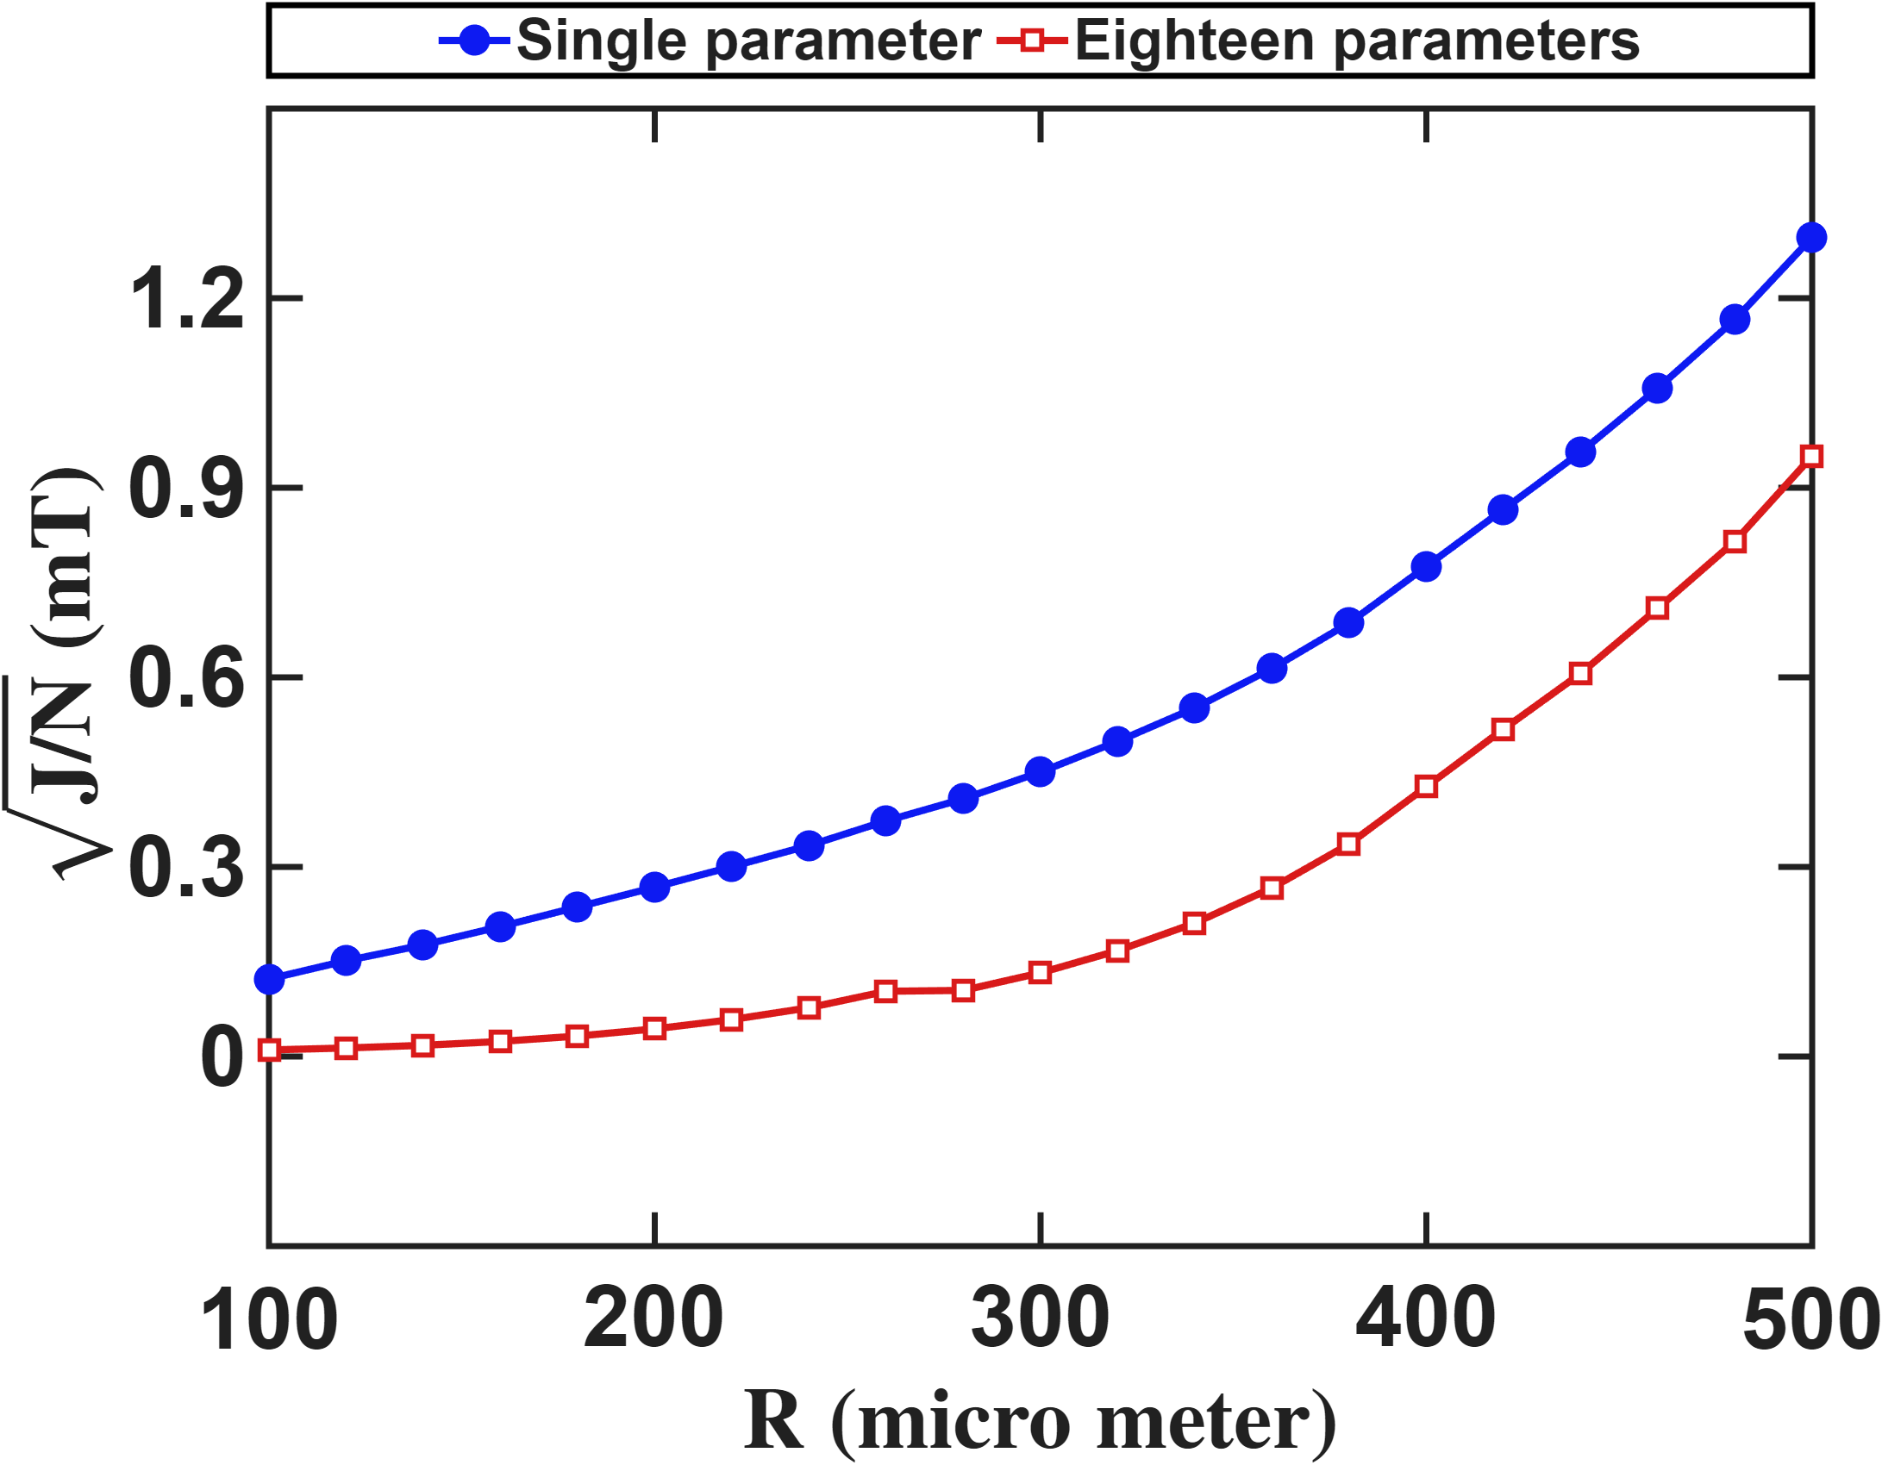
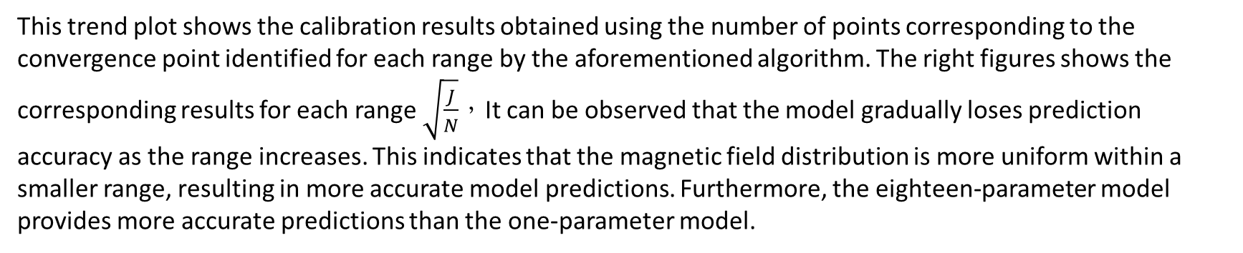
Current-based lumped-parameter modeling and calibration
E. Validation
Fitting results
This trend plot shows the calibration results obtained using the number of points corresponding to the convergence point identified for each range by the aforementioned algorithm. The right figures shows the corresponding results for each range $\sqrt{\frac{J}{N}}$，It can be observed that the model gradually loses prediction accuracy as the range increases. This indicates that the magnetic field distribution is more uniform within a smaller range, resulting in more accurate model predictions. Furthermore, the eighteen-parameter model provides more accurate predictions than the one-parameter model.

Slide 6

Current-based lumped-parameter modeling and calibration
E. Validation
$$Calibrate model→b_{ij}=S_{i}{}_{}^{B}{{\hat{g}}_{I}}{\overline{K}}_{I}I_{j}$$

Slide 7
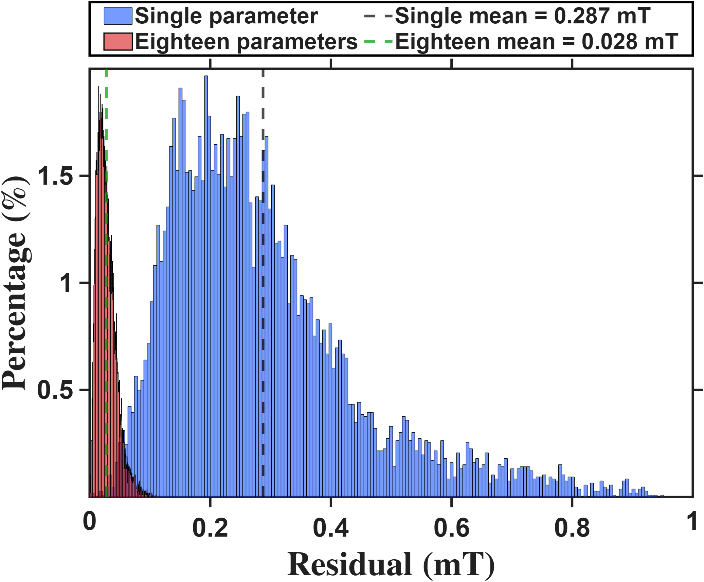
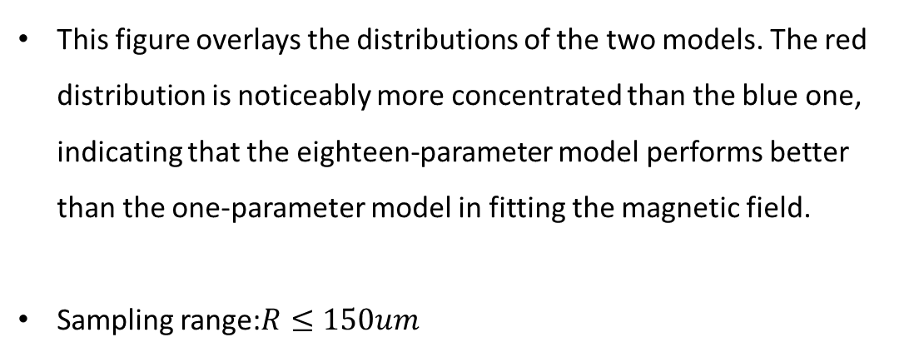

Current-based lumped-parameter modeling and calibration
E. Validation
$$Calibrate model→b_{ij}=S_{i}{}_{}^{B}{{\hat{g}}_{I}}{\overline{K}}_{I}I_{j}$$
This figure overlays the distributions of the two models. The red distribution is noticeably more concentrated than the blue one, indicating that the eighteen-parameter model performs better than the one-parameter model in fitting the magnetic field.
Sampling range:$R≤150um$

Slide 8
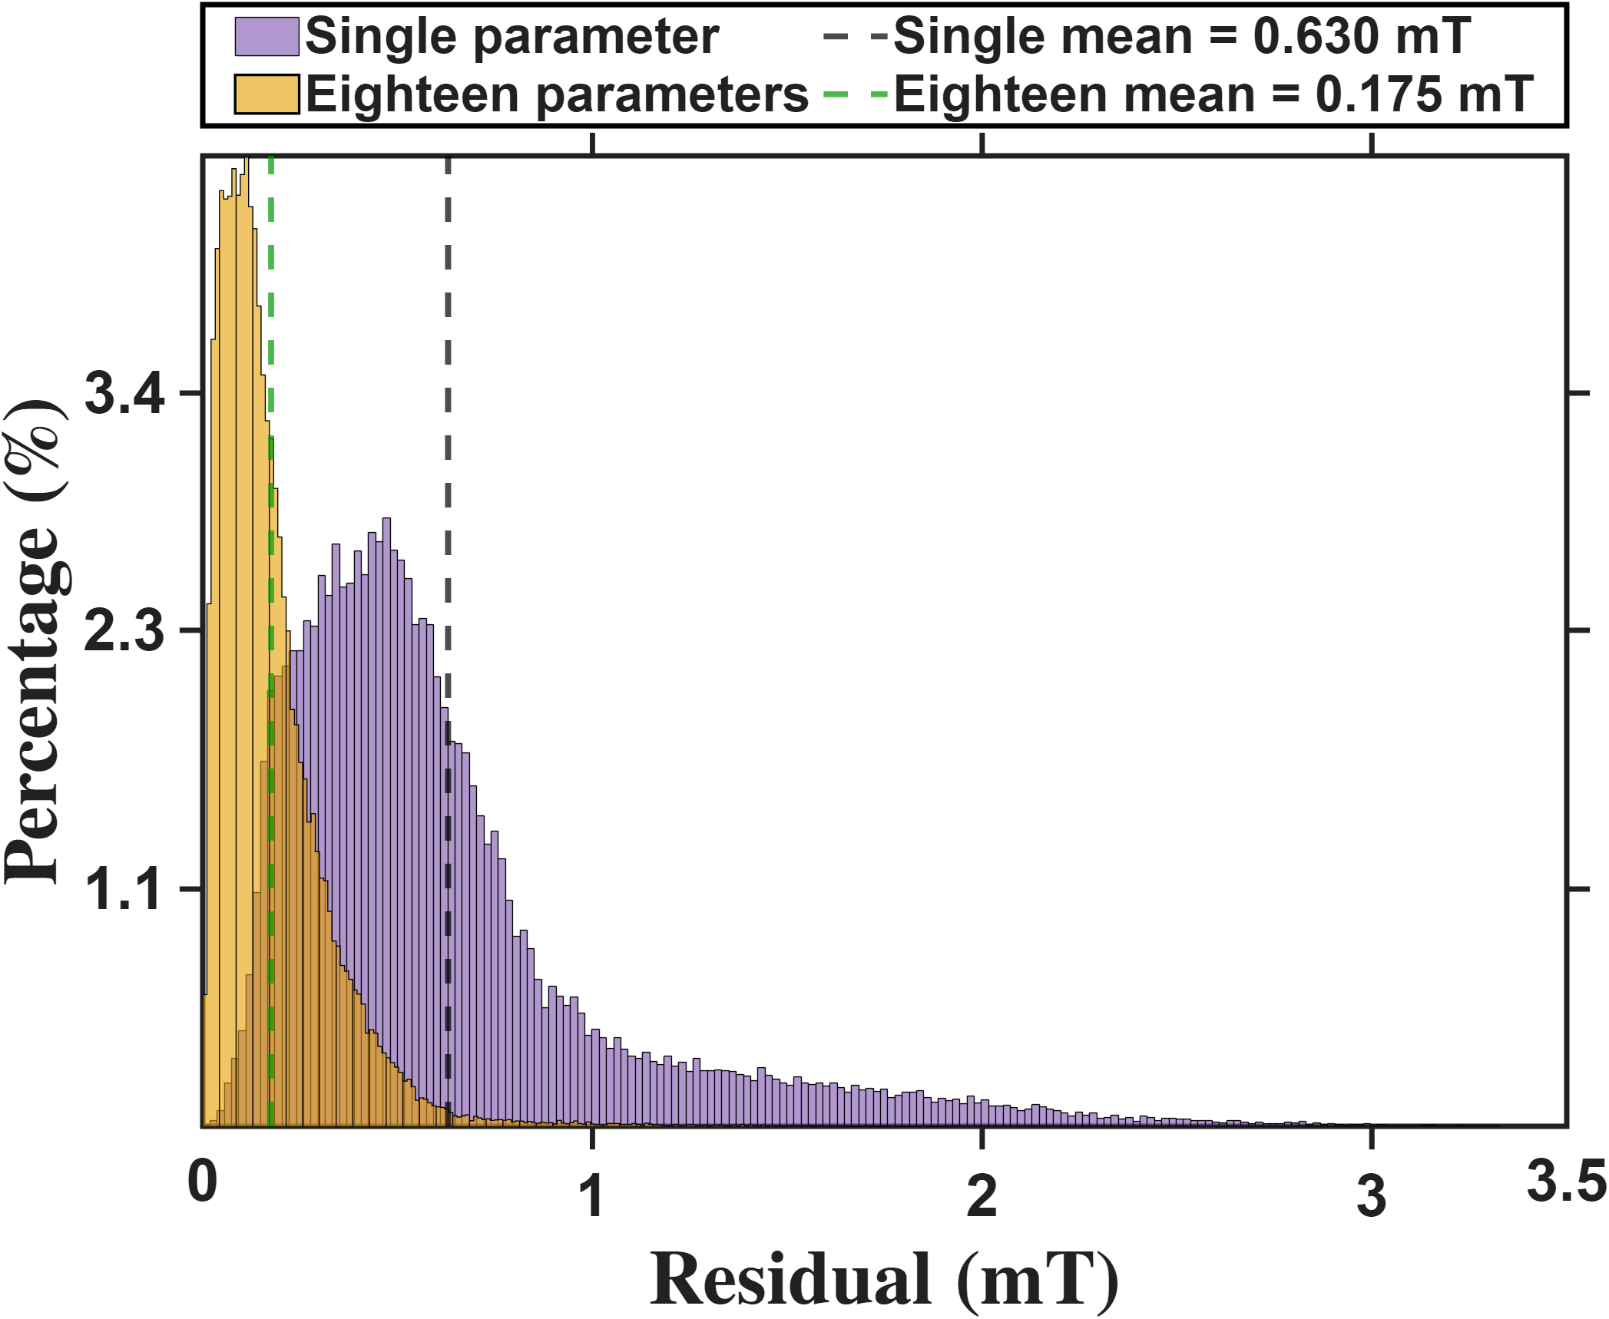
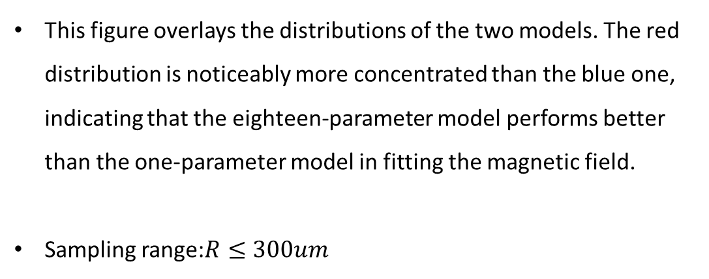
Current-based lumped-parameter modeling and calibration
E. Validation
$$Calibrate model→b_{ij}=S_{i}{}_{}^{B}{{\hat{g}}_{I}}{\overline{K}}_{I}I_{j}$$
This figure overlays the distributions of the two models. The red distribution is noticeably more concentrated than the blue one, indicating that the eighteen-parameter model performs better than the one-parameter model in fitting the magnetic field.
Sampling range:$R≤300um$

Slide 9
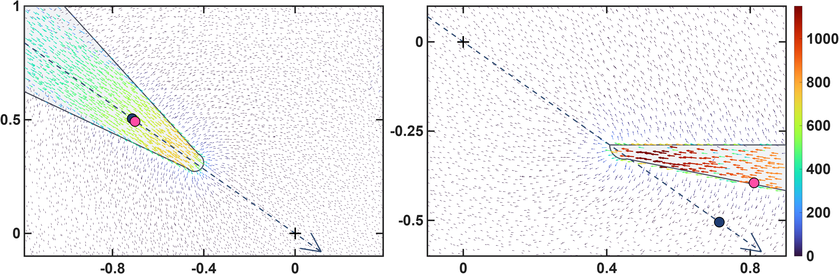








Current-based lumped-parameter modeling and calibration
E. Validation
$$Calibrate model→b_{ij}=S_{i}{}_{}^{B}{{\hat{g}}_{I}}{\overline{K}}_{I}I_{j}$$
These two figures show the differences in the calibrated magnetic charge locations between the two models. The upper row presents the magnetic charge locations calibrated by the one-parameter model, shown using side views of poles P1 and P2. It can be clearly seen that, for the lower pole, some of the magnetic charge locations are located outside the pole. This is because the one-parameter model constrains the magnetic charges to lie along the actuator coordinate axes. The lower row presents the results of the eighteen-parameter model, in which the magnetic charge locations of the lower pole move inside the pole. This is more consistent with the expected physical situation. Moreover, the error histograms shown above also indicate that these magnetic charge locations are more consistent with the theoretical positions.
$${\hat{x}}_{a}$$
$$z−axis(mm)$$
$$q_{c2}$$
$$\left\|b\right\|(mT)$$
$${\hat{x}}_{a}$$
$$q_{c1}$$
$$x−axis(mm)$$
$$x−axis(mm)$$

Slide 10

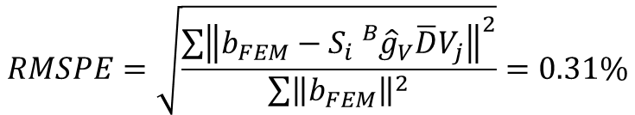

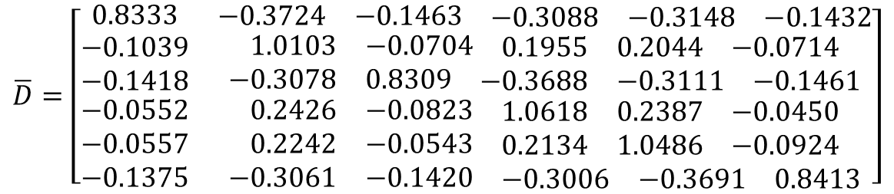
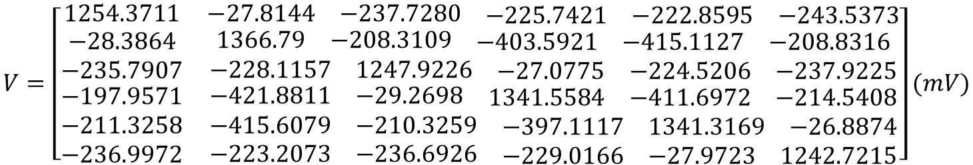
Hall-sensor-voltage-based lumped-parameter modeling and calibration
C. Validation
$$Calibrate model→b_{ij}=S_{i}{}_{}^{B}{{\hat{g}}_{V}}\overline{D}V_{j}$$
$$V=\left[\begin{matrix}1254.3711 & \begin{matrix}−27.8144 & −237.7280 & \begin{matrix}−225.7421 & −222.8595 & −243.5373\end{matrix}\end{matrix} \\ \begin{matrix}−28.3864 \\ −235.7907 \\ \begin{matrix}−197.9571 \\ −211.3258 \\ −236.9972\end{matrix}\end{matrix} & \begin{matrix}\begin{matrix}1366.79 & −208.3109 & \begin{matrix}−403.5921 & −415.1127 & −208.8316\end{matrix}\end{matrix} \\ \begin{matrix}−228.1157 & 1247.9226 & \begin{matrix}−27.0775 & −224.5206 & −237.9225\end{matrix}\end{matrix} \\ \begin{matrix}\begin{matrix}−421.8811 & −29.2698 & \begin{matrix}1341.5584 & −411.6972 & −214.5408\end{matrix}\end{matrix} \\ \begin{matrix}−415.6079 & −210.3259 & \begin{matrix}−397.1117 & 1341.3169 & −26.8874\end{matrix}\end{matrix} \\ \begin{matrix}−223.2073 & −236.6926 & \begin{matrix}−229.0166 & −27.9723 & 1242.7215\end{matrix}\end{matrix}\end{matrix}\end{matrix}\end{matrix}\right](mV)$$
$$\overline{D}=\left[\begin{matrix}0.8333 & \begin{matrix}−0.3724 & −0.1463 & \begin{matrix}−0.3088 & −0.3148 & −0.1432\end{matrix}\end{matrix} \\ \begin{matrix}−0.1039 \\ −0.1418 \\ \begin{matrix}−0.0552 \\ −0.0557 \\ −0.1375\end{matrix}\end{matrix} & \begin{matrix}\begin{matrix}1.0103 & −0.0704 & \begin{matrix}0.1955 & 0.2044 & −0.0714\end{matrix}\end{matrix} \\ \begin{matrix}−0.3078 & 0.8309 & \begin{matrix}−0.3688 & −0.3111 & −0.1461\end{matrix}\end{matrix} \\ \begin{matrix}\begin{matrix}0.2426 & −0.0823 & \begin{matrix}1.0618 & 0.2387 & −0.0450\end{matrix}\end{matrix} \\ \begin{matrix}0.2242 & −0.0543 & \begin{matrix}0.2134 & 1.0486 & −0.0924\end{matrix}\end{matrix} \\ \begin{matrix}−0.3061 & −0.1420 & \begin{matrix}−0.3006 & −0.3691 & 0.8413\end{matrix}\end{matrix}\end{matrix}\end{matrix}\end{matrix}\right]$$
$${}_{}^{B}{{\hat{g}}_{V}=7.156×{10}^{−3}(mT/mV})$$
Voltage base fitting results
Idea model
Calibration region R<=150um
$$RMSPE=\sqrt{\frac{\sum{{\left\|b_{FEM}−S_{i}{}_{}^{B}{{\hat{g}}_{V}}\overline{D}V_{j}\right\|}^{2}}}{\sum{{\left\|b_{FEM}\right\|}^{2}}}}=0.31\%$$

Slide 11
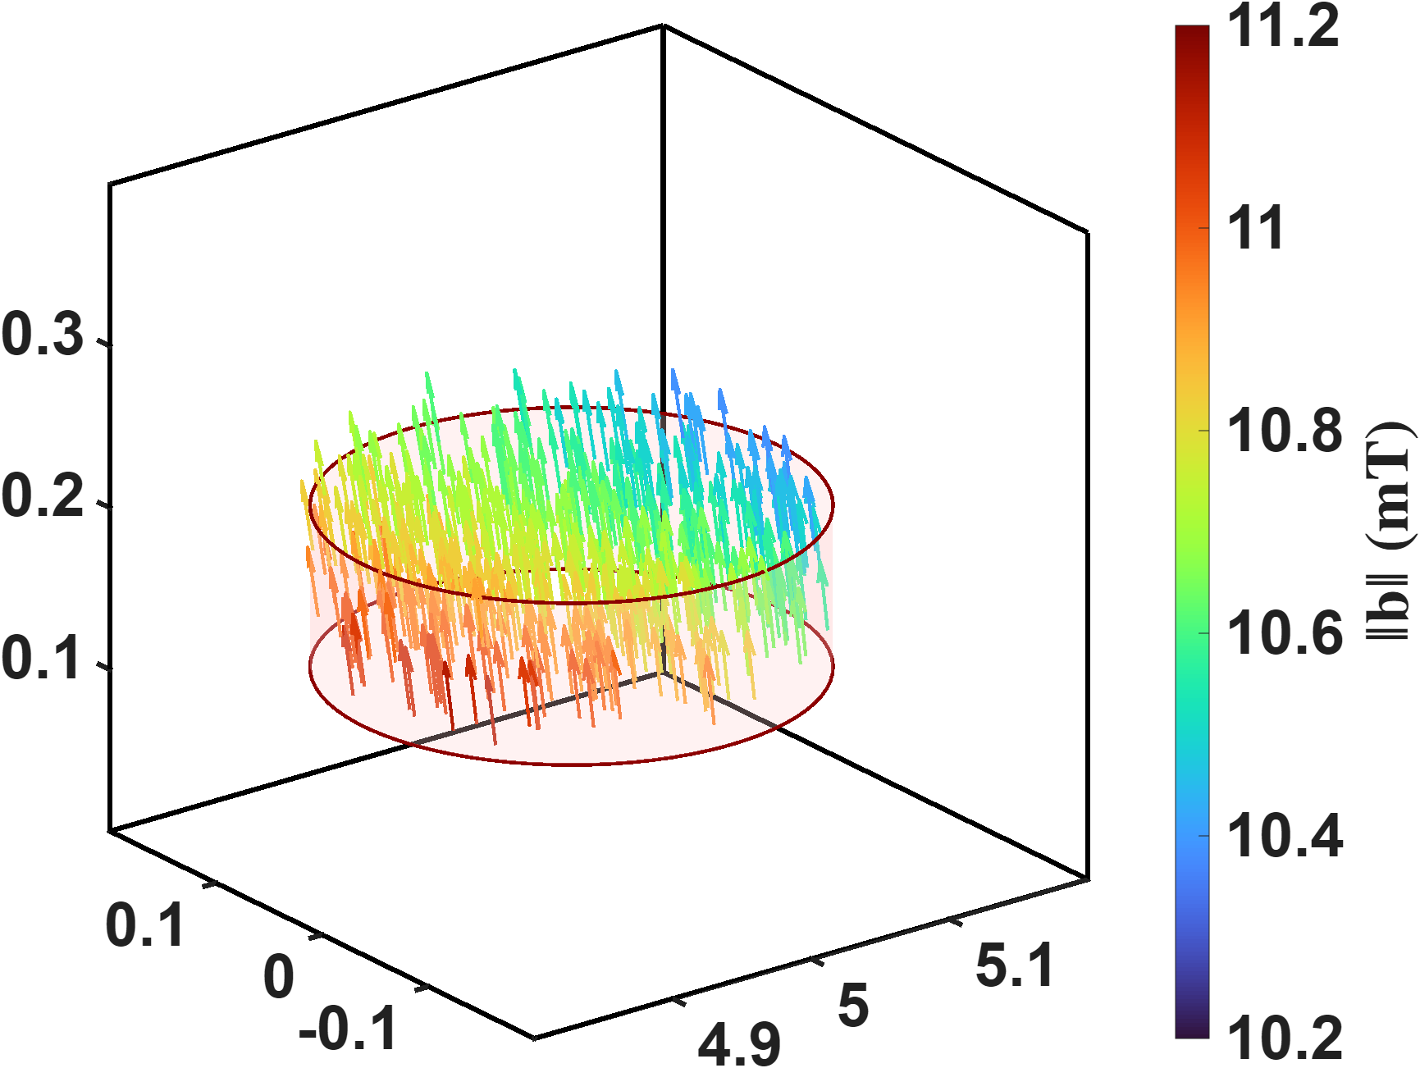
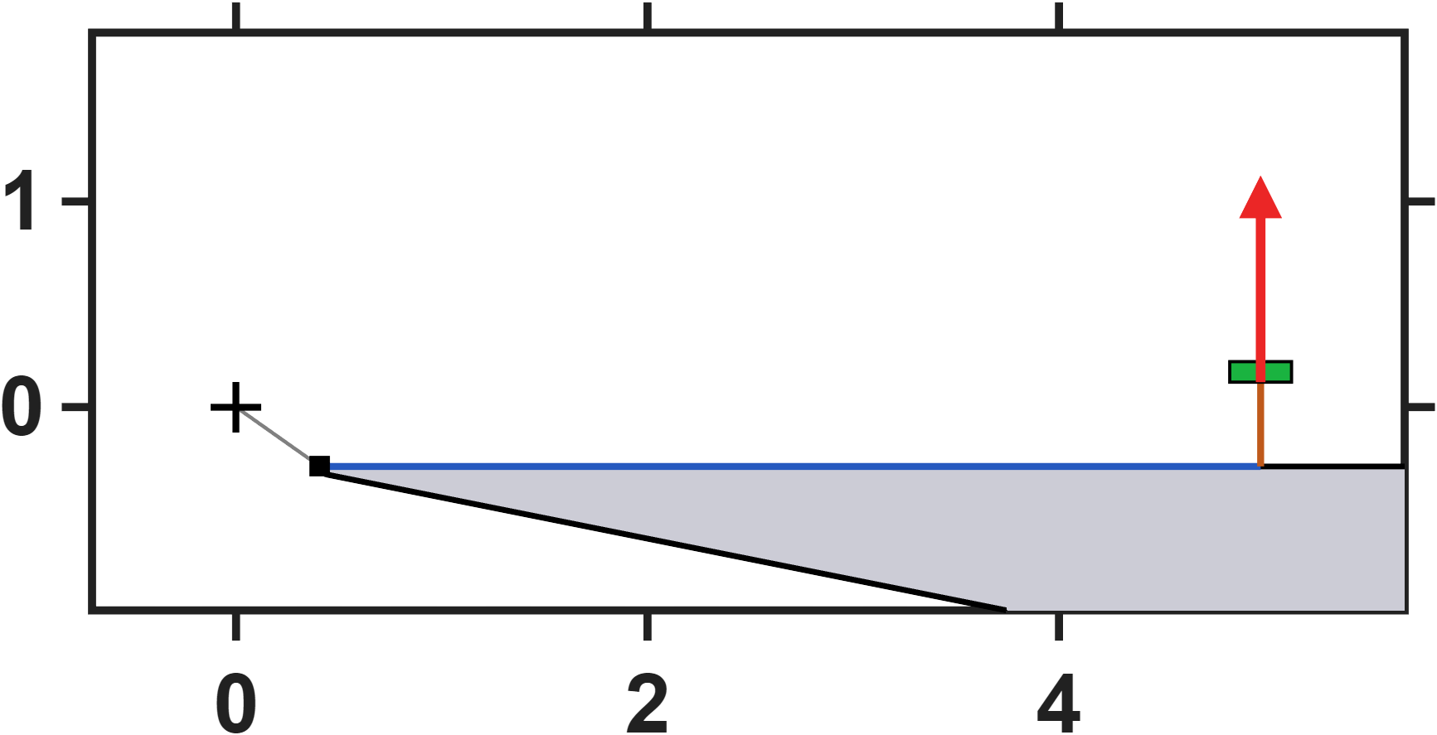
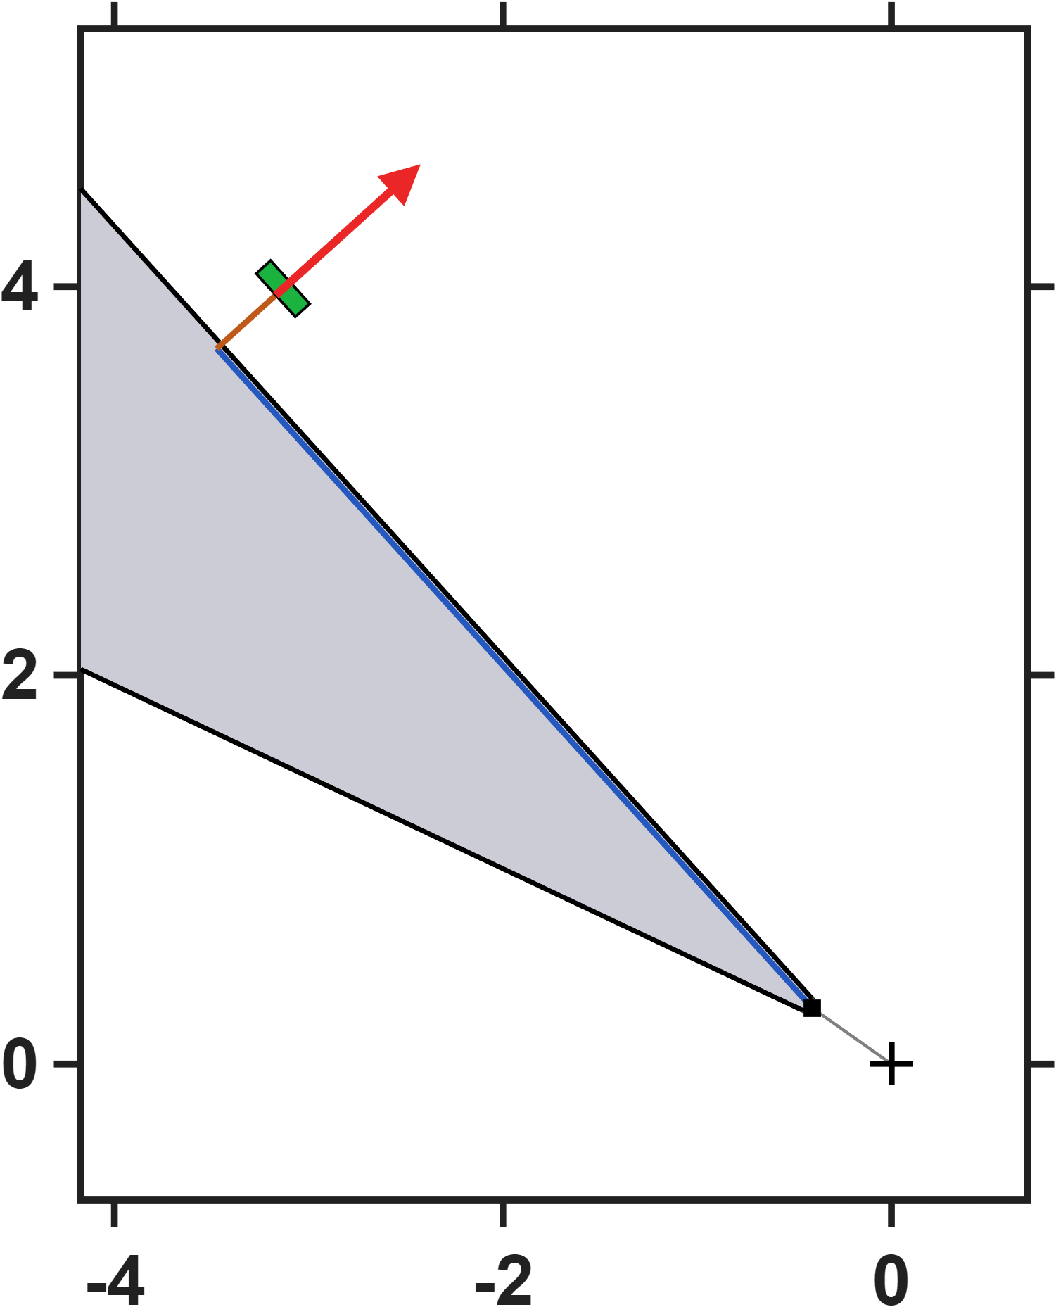
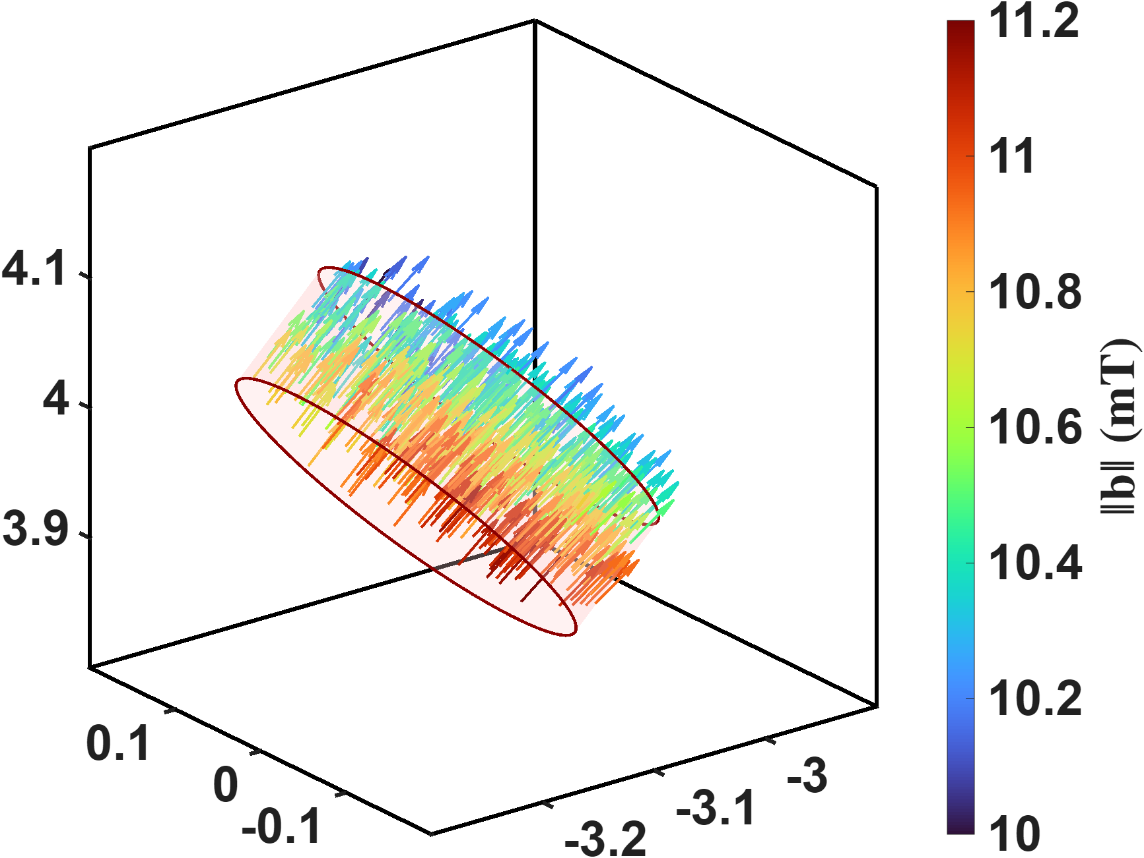





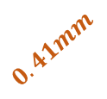








Hall-sensor-voltage-based lumped-parameter modeling and calibration
C. Validation
$<b∙n^{+}>$=10.6035mT
$$n^{+}$$
$$y(mm)$$
Range=[10.39 11.11](mT)
$$0.41mm$$
$$4.572mm$$
$$θ={8.83}^{°}$$
$$x(mm)$$
$$n^{+}$$
$$0.41mm$$
$<b∙n^{+}>$=10.5278mT
$$y(mm)$$
$$4.572mm$$
Range=[10.01 11.17](mT)
$$θ={7.39}^{°}$$
$$x(mm)$$

Slide 12
Hall-sensor-voltage-based lumped-parameter modeling and calibration
C. Validation
$<b∙n^{+}>$=10.6035mT
$$n^{+}$$
$$y(mm)$$
Range=[10.39 11.11](mT)
$$0.41mm$$
$$4.572mm$$
$$θ={8.83}^{°}$$
$$x(mm)$$
$$n^{+}$$
$$0.41mm$$
$<b∙n^{+}>$=10.5278mT
$$y(mm)$$
$$4.572mm$$
Range=[10.01 11.17](mT)
$$θ={7.39}^{°}$$
$$x(mm)$$

Slide 13
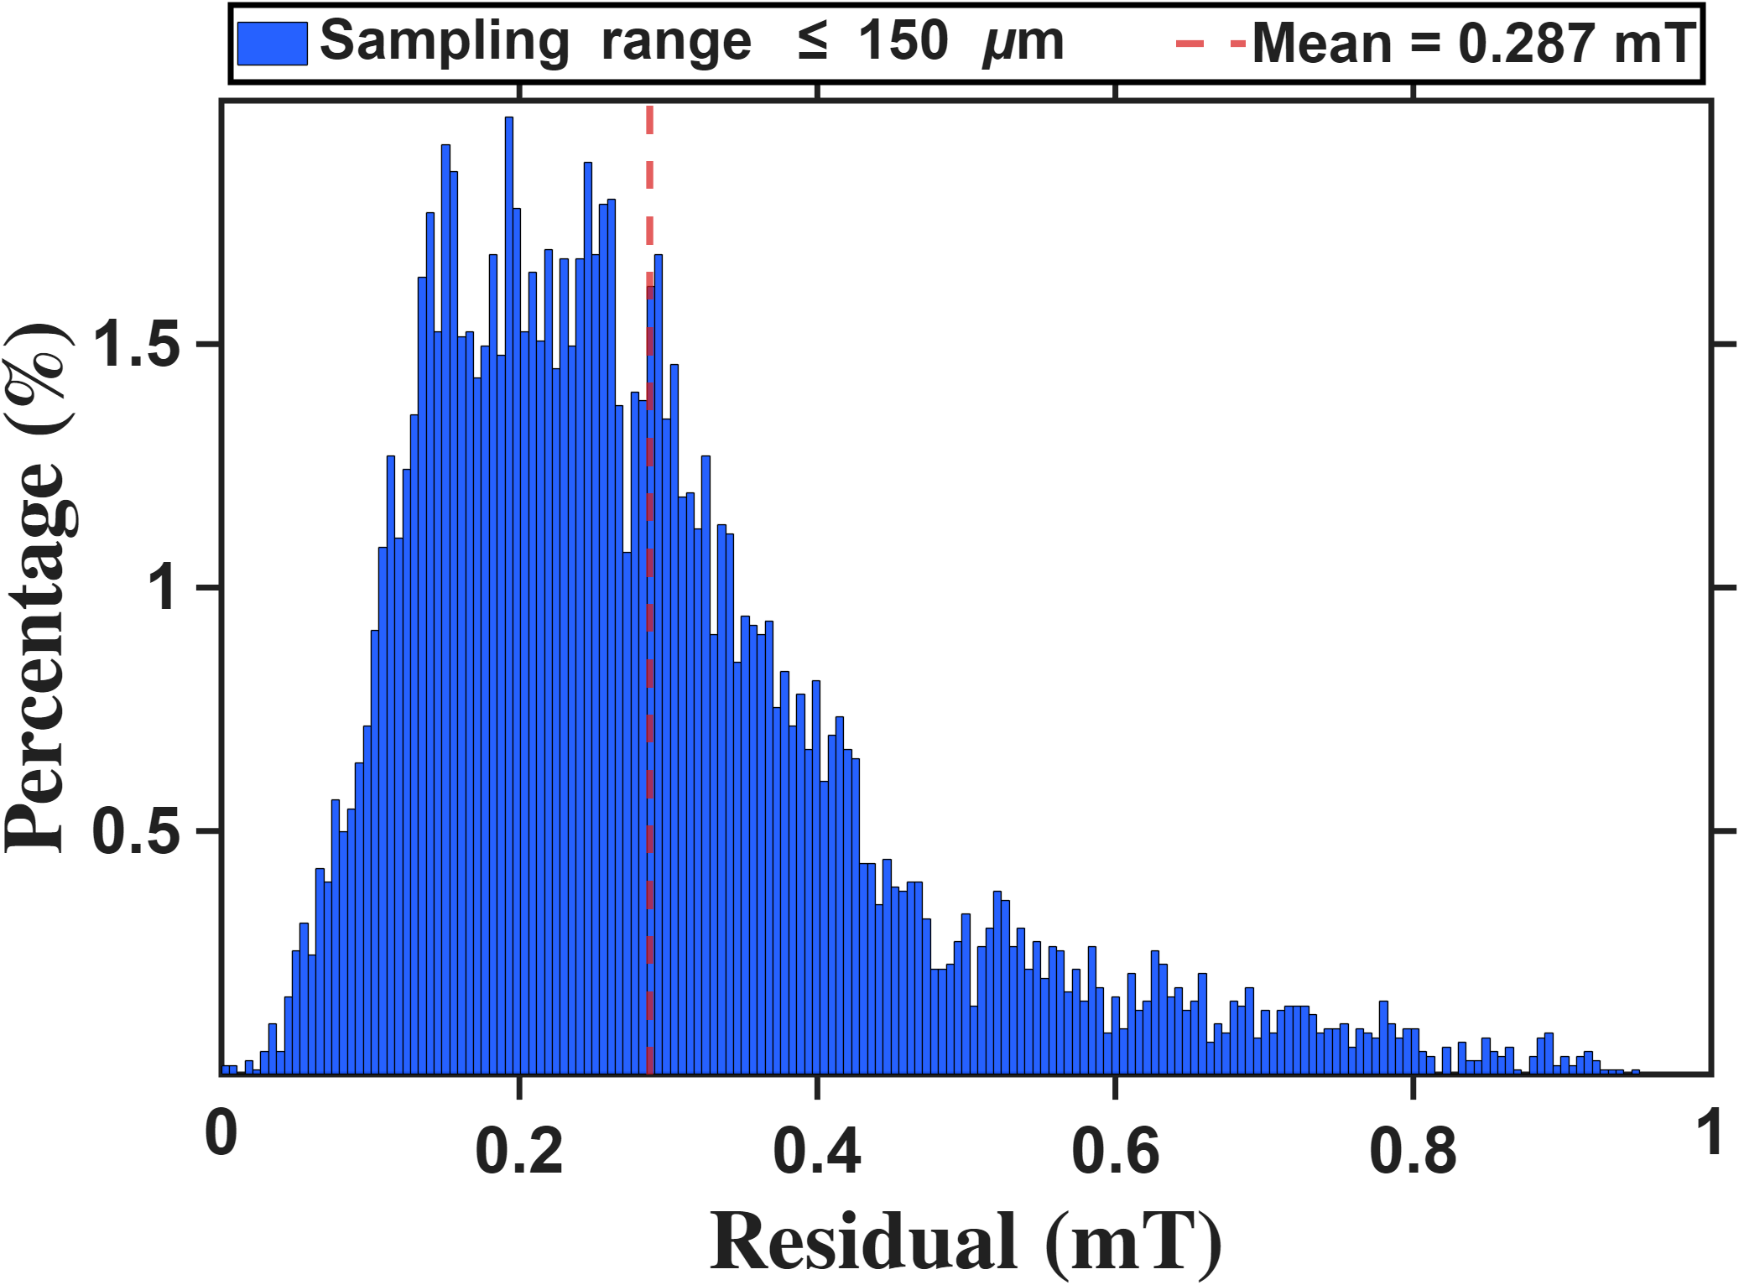
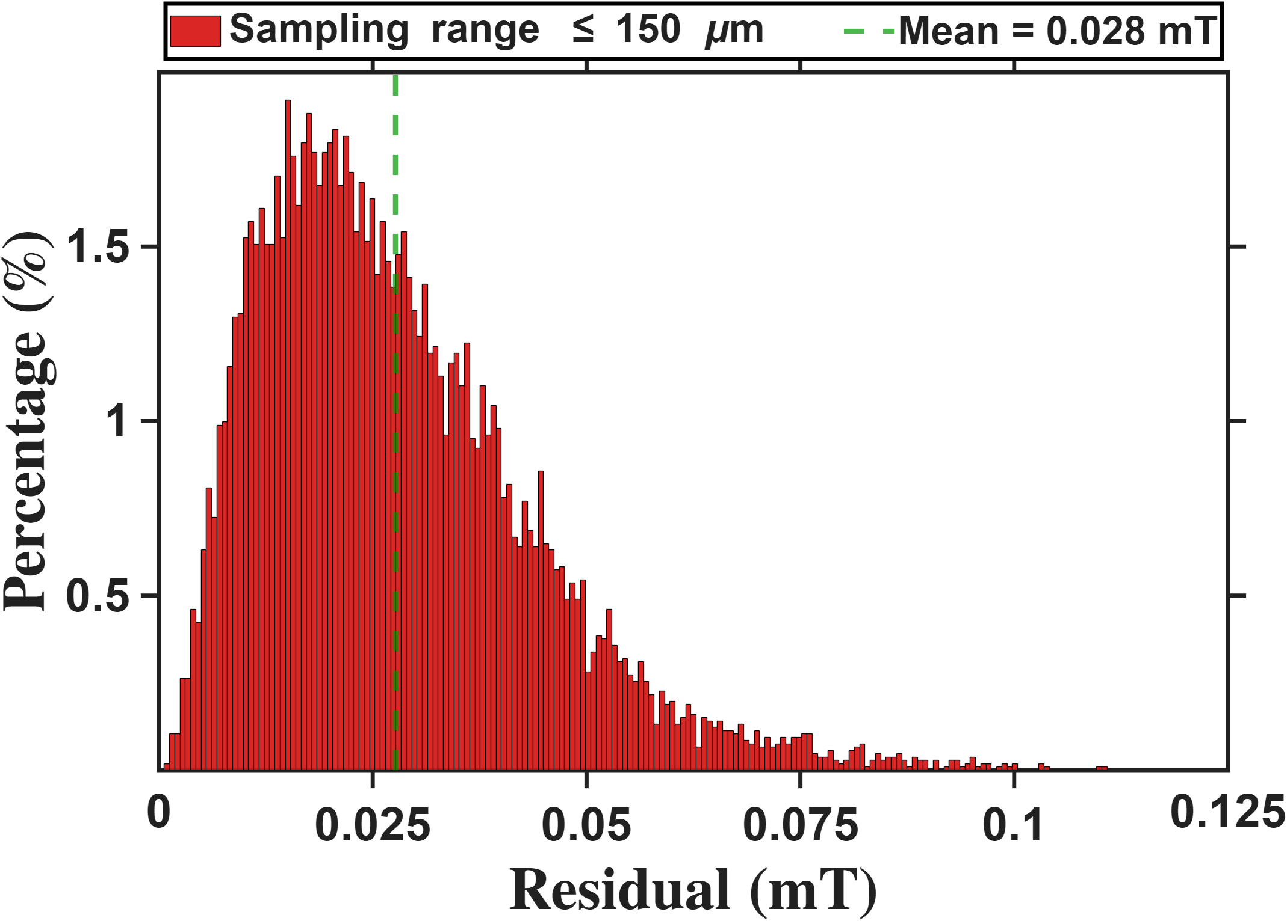
Reference
Histograms of the One-Parameter and Eighteen-Parameter Models within the Sampling Range $R≤150um$

Slide 14
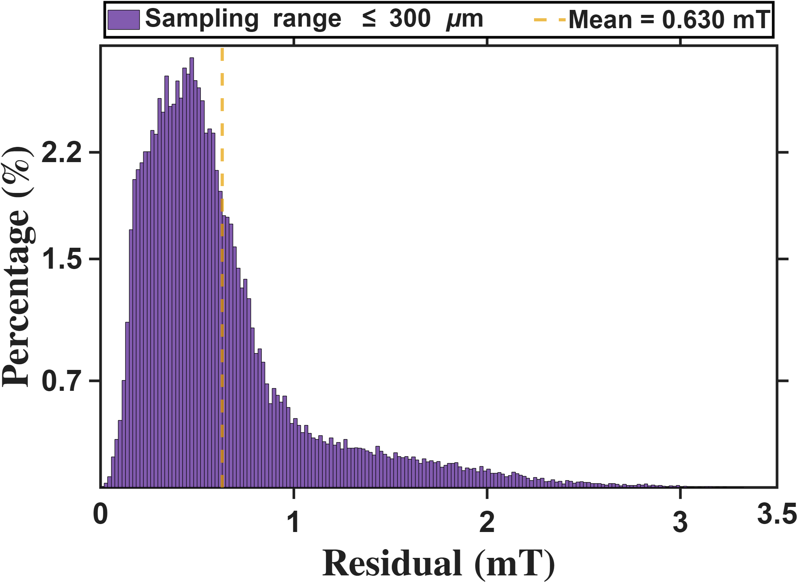
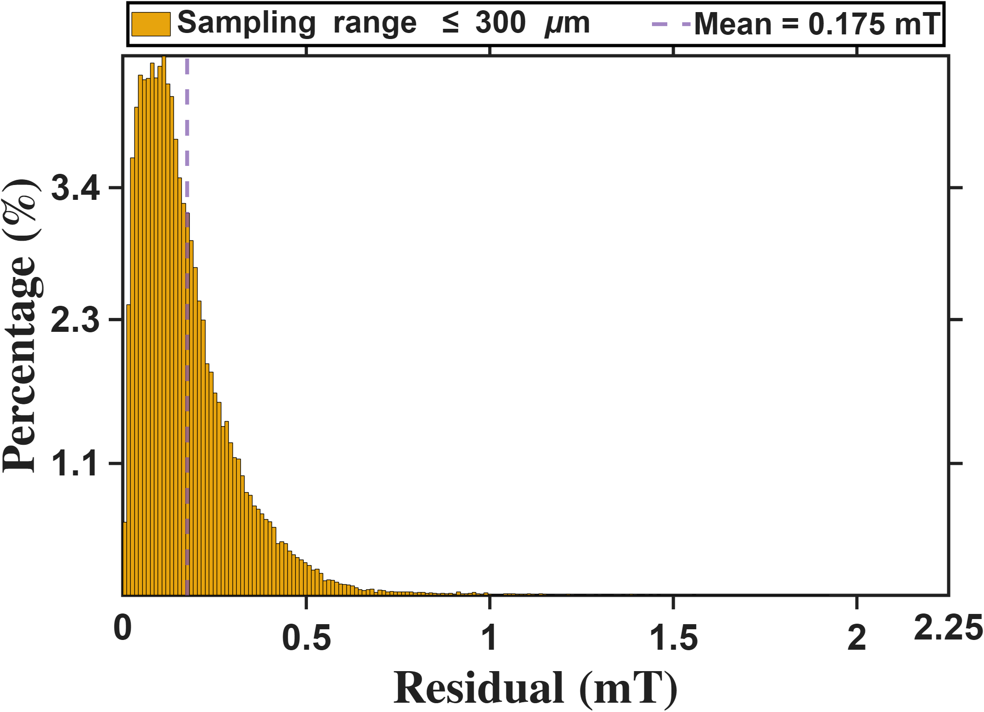
Reference
Histograms of the One-Parameter and Eighteen-Parameter Models within the Sampling Range $R≤300um$

Slide 15
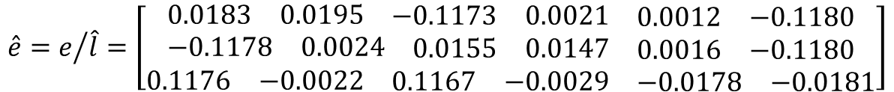
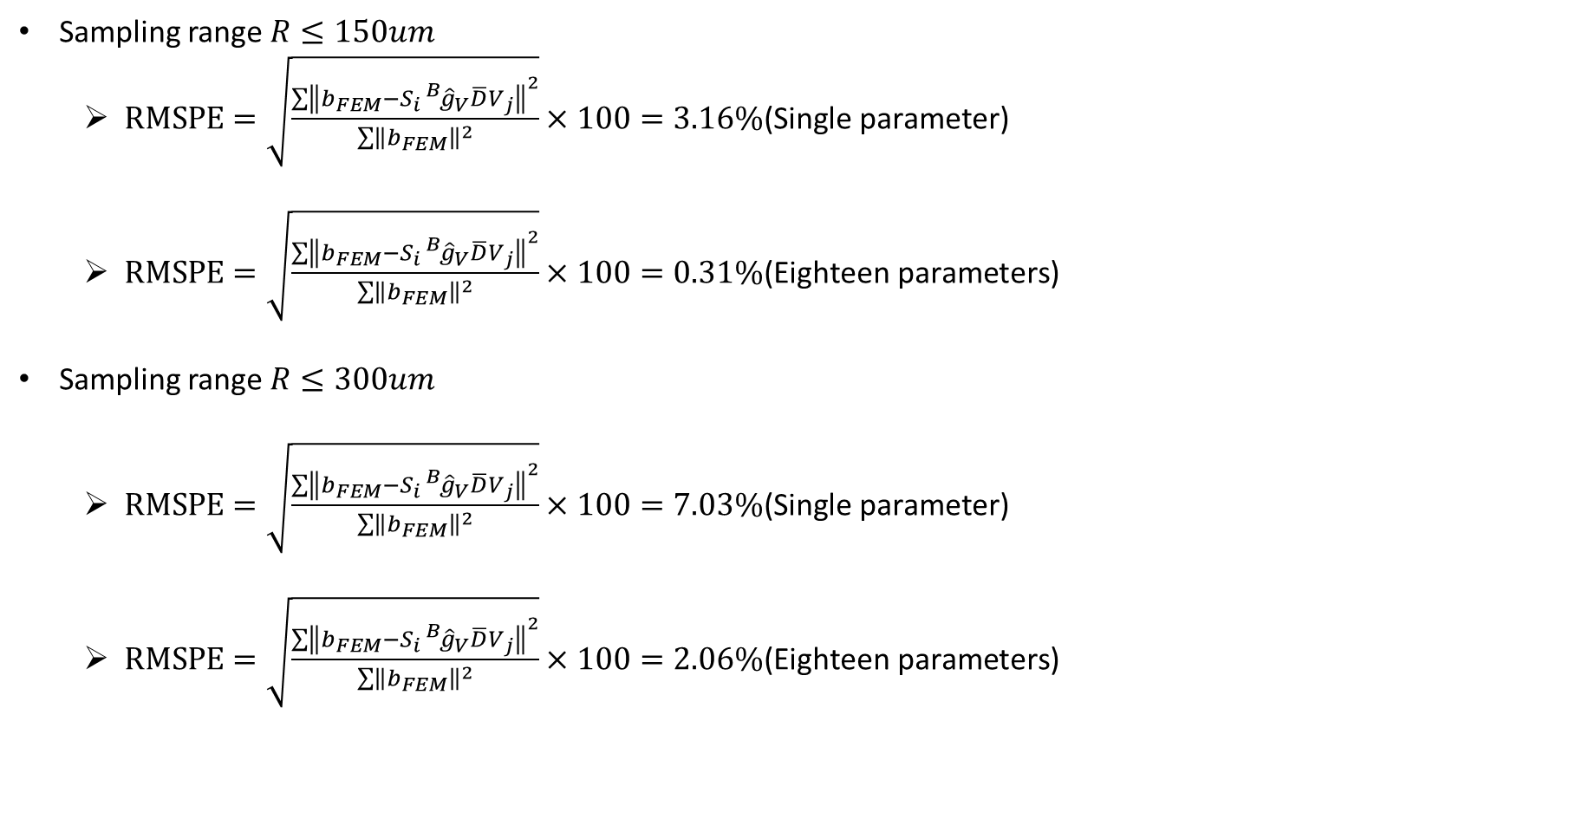
Reference
Sampling range $R≤150um$
$RMSPE=\sqrt{\frac{\sum{{\left\|b_{FEM}−S_{i}{}_{}^{B}{{\hat{g}}_{V}}\overline{D}V_{j}\right\|}^{2}}}{\sum{{\left\|b_{FEM}\right\|}^{2}}}}×100=3.16\%\text{(}\text{Single} \text{parameter}\text{)}$
$RMSPE=\sqrt{\frac{\sum{{\left\|b_{FEM}−S_{i}{}_{}^{B}{{\hat{g}}_{V}}\overline{D}V_{j}\right\|}^{2}}}{\sum{{\left\|b_{FEM}\right\|}^{2}}}}×100=0.31\%\text{(}\text{Eighteen} \text{parameters}\text{)}$
Sampling range $R≤300um$
$RMSPE=\sqrt{\frac{\sum{{\left\|b_{FEM}−S_{i}{}_{}^{B}{{\hat{g}}_{V}}\overline{D}V_{j}\right\|}^{2}}}{\sum{{\left\|b_{FEM}\right\|}^{2}}}}×100=7.03\%\text{(}\text{Single} \text{parameter}\text{)}$
$RMSPE=\sqrt{\frac{\sum{{\left\|b_{FEM}−S_{i}{}_{}^{B}{{\hat{g}}_{V}}\overline{D}V_{j}\right\|}^{2}}}{\sum{{\left\|b_{FEM}\right\|}^{2}}}}×100=2.06\%\text{(}\text{Eighteen} \text{parameters}\text{)}$
$$\hat{e}=e/{\hat{l}=\left[\begin{matrix}\begin{matrix}0.0183 & 0.0195 & \begin{matrix}−0.1173 & 0.0021 & \begin{matrix}0.0012 & −0.1180\end{matrix}\end{matrix}\end{matrix} \\ \begin{matrix}−0.1178 & 0.0024 & \begin{matrix}0.0155 & 0.0147 & \begin{matrix}0.0016 & −0.1180\end{matrix}\end{matrix}\end{matrix} \\ \begin{matrix}0.1176 & −0.0022 & \begin{matrix}0.1167 & −0.0029 & \begin{matrix}−0.0178 & −0.0181\end{matrix}\end{matrix}\end{matrix}\end{matrix}\right]}$$

