Slide 1
Final Presentation
The Movie-Chain-Runner Project
Sung Uk Ryu & Jimmy Zong
In collaboration with
Eugene Scanlon & Shashank Singh
June 27, 2013

Slide 2
Overview
Goal
Technology
Approach
  Background
  Schedule
  Methodology
Results
Summary
Overview Goal Technology Approach Results Summary

Slide 3
Goal
The Problem
  Find the “longest” list of overlapping titles in a list of movie titles.
Example: In the list
  Day of the Dead
  Live and Let Die
  Dead Poets’ Society
  Die Another Day
  The Last Samurai
The “longest” chain is
  “Live and Let Die Another Day of the Dead Poets’ Society.”
Overview Goal Technology Approach Results Summary

Slide 4
Technology Used
Python
Git
Bash
Longest-Path Algorithms
Overview Goal Technology Approach Results Summary

Slide 5
Approach - Background
Understand the nature of the problem
Decide on program language
Assign tasks to each members
Collaborate using Git
Overview Goal Technology Approach Results Summary

Slide 6
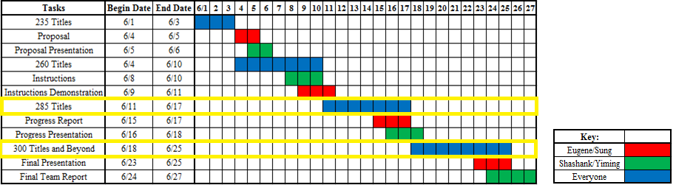
Approach - Schedule
Planned Schedule
< Initial Gantt Chart >
Overview Goal Technology Approach Results Summary

Slide 7
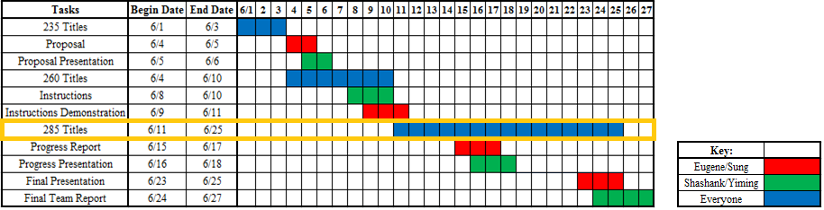
Approach - Schedule
Revised Schedule
< Revised Gantt Chart >
Overview Goal Technology Approach Results Summary

Slide 8
Overview
Goal
Technology
Approach
  Background
  Schedule
  Methodology
Results
Summary
Overview Goal Technology Approach Results Summary

Slide 9
Approach - Methodology
Algorithms that worked
  Brute Force
  Brute Force with Reversal
  Brute Force with Reversal and Insertion
  Brute Force with Reversal and Replacement
Algorithms that didn’t work
  Acyclic graphs
  Color-coding Algorithm
  Genetic Algorithms
Overview Goal Technology Approach Results Summary

Slide 10
Results
Did we succeed?
  Yes!
  301 Movie Titles, with 961 Words
Algorithms | Longest Chain
Brute Force | 243
Brute Force with Reversal | 277
Brute Force with Reversal and Insertion | 278
Brute Force with Reversal and Replacement | 301
< Longest Chain Found by Each Algorithm >
Overview Goal Technology Approach Results Summary

Slide 11
Summary
Recap
  Goal
  Technology
  Methodology
  Results
Lessons Learnt
  Brute force can approximate NP-hard problems decently
  Constant factors are also crucial for runtime
  Choice of data type in high level languages is important
Overview Goal Technology Approach Results Summary

Slide 12
Thank you!
Any questions?

