Slide 1
Process flow / cost estimation for Easter eggs

Slide 2
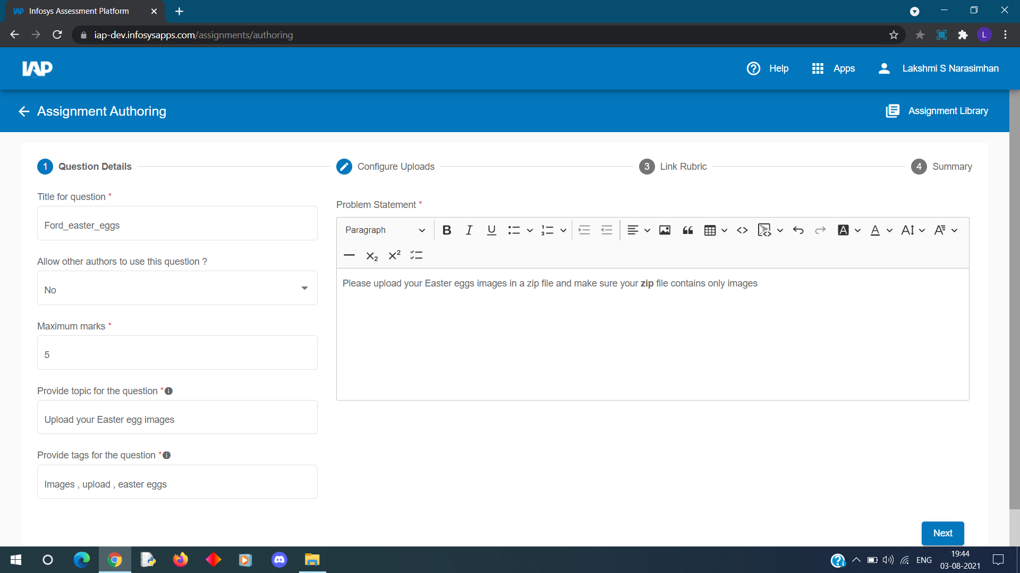
Creating a contest / Authoring a contest
An author will create an assignment in the ford instance.
Author can configure the contest accordingly .

Slide 3
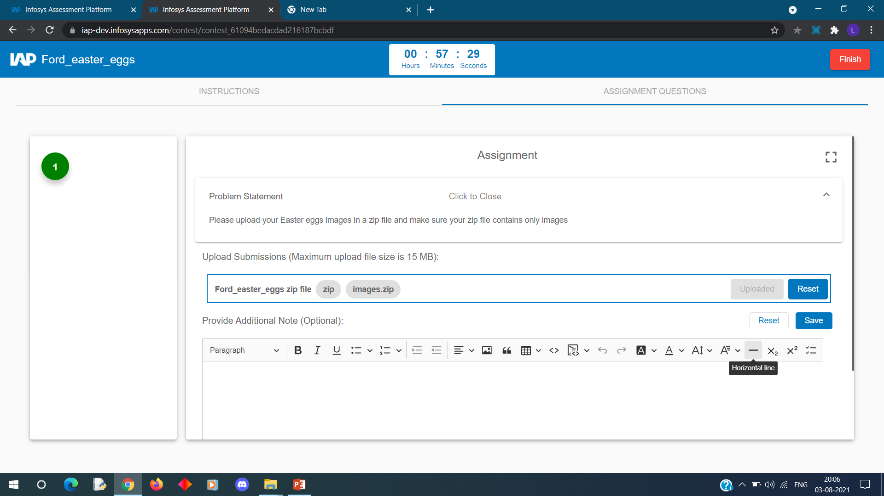
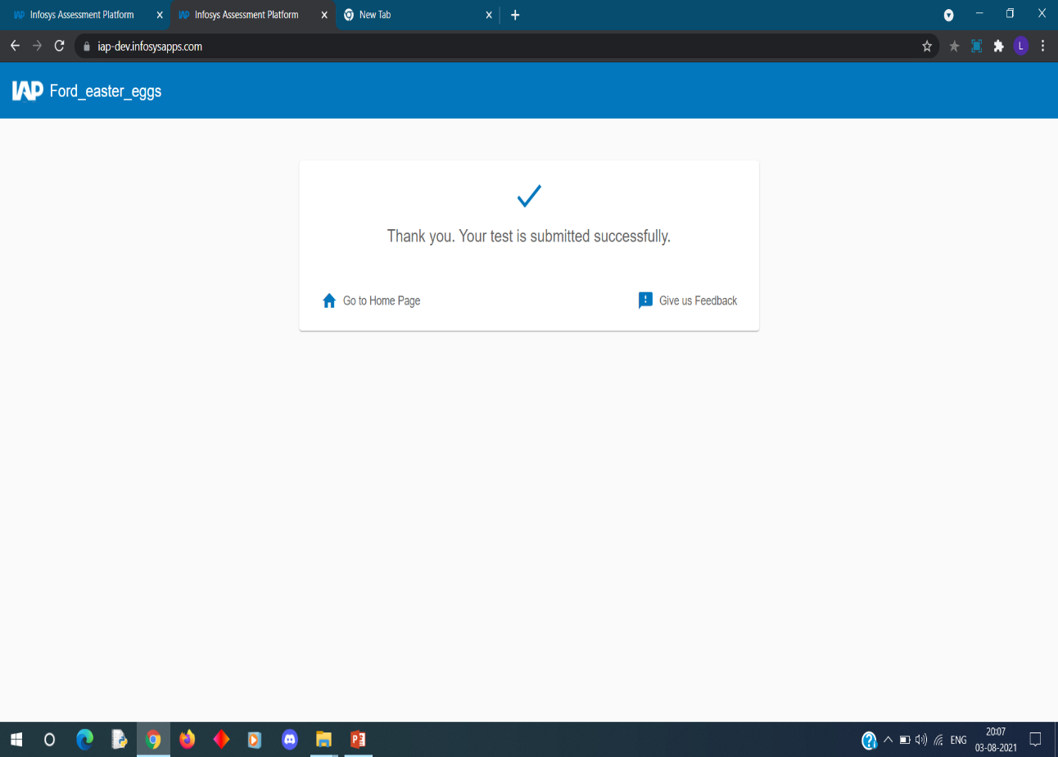
Once the zip file is uploaded , user has to click on save and then finish.
The zip file will be saved in cloud storage where it will be extracted .
And those images are processed in our trained ML model.

Slide 4
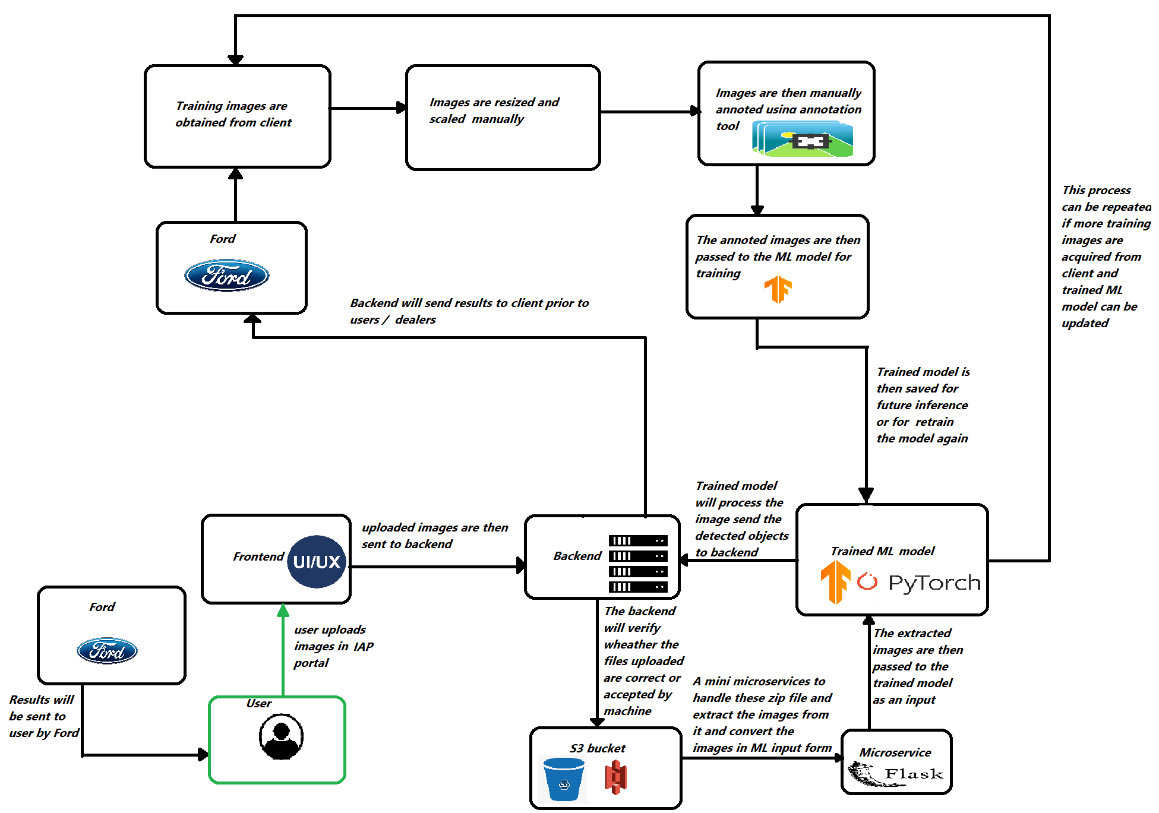
Architecture

Slide 5
Effort / Cost estimation
This process is split into two phases :-
Pre Training phase :-
Here images are manually obtained from client and are scaled , resized and annotated manually
It takes 1 hour to manually annotate 150 images
Minimum 30 – 50 images are required for each class
Machine used for training will be AWS EC2 instance :-
Instance name | On-Demand price (per hr.) | vCPU | Memory | Storage | Network speed
g4dn.xlarge | $0.579 | 4 | 16GB | 25 GB(max) | 25 Gb/s
g4dn.2xlarge (if required ) | $0.828 | 8 | 32GB | 25 GB(max) | 25 Gb/s

Slide 6
Before training , entire environment needs to be setup in AWS machine which might take 2 to 3 days
Once environment is installed then training will take almost 24 hours
2. Post training phase :-
No gpu instance is required , standard instance is sufficient for post training phase like :-t4g.xlarge (instance name)
Cost for the above instance is $0.0896 / hr

Slide 7
Results
Results can be displayed either to the user ‘s computer directly or it can be sent to the client .
It can be displayed in excel sheet with the result sorted according to score and time.
Results can also be evaluated manually if requested .

