Slide 1
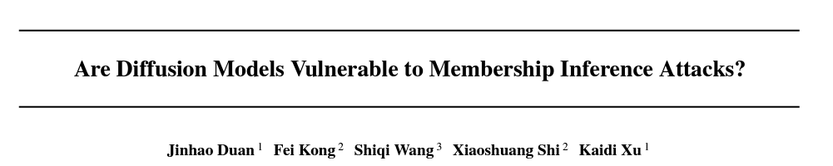
ICML 2023
Presenter：冉繼元

Slide 2
Outline
Introduction
Related work
Method
Experiment
Ablation study
Experiment-defence
Experiment-LDM
Conclusion

Slide 3
Introduction
Purpose: Apply Membership Inference attack on diffusion model.
Conventional MIA has poor result on diffusion model.
First work on MIA with diffusion model.

Slide 4
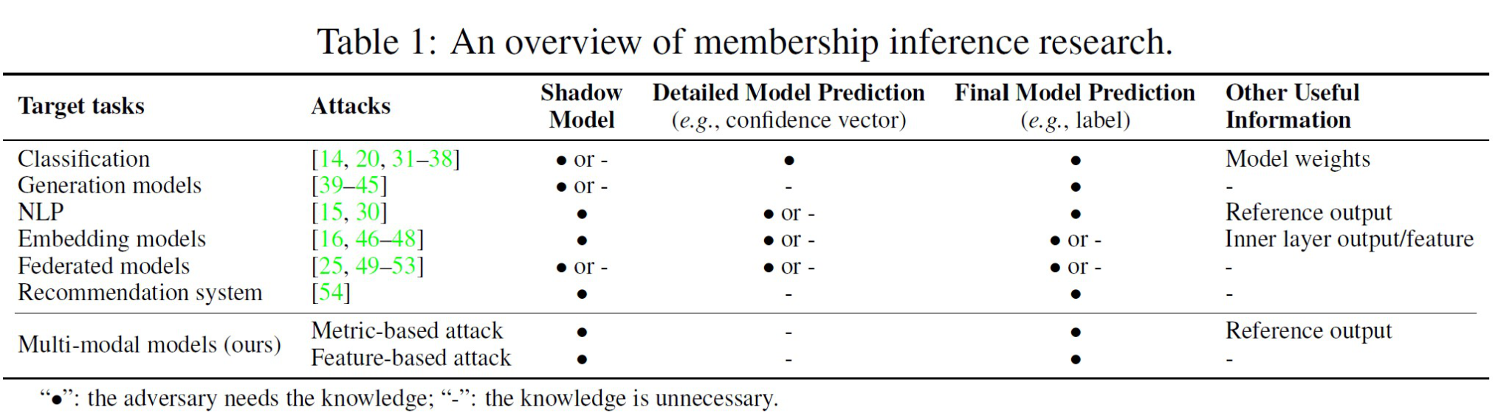
Introduction
Membership inference attack:
A kind of attack trying to test if a data is used for training a model or not. If this input is in the target model’s training dataset, we call it a member; otherwise, we call it a non-member.

Slide 5
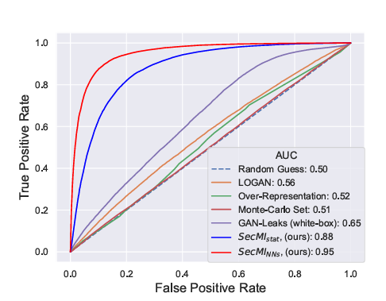
Introduction
Experiment shows most conventional MIA on GAN or VAE doesn’t perform well on diffusion model.

Slide 6
Introduction
Analysis:
1. Stronger evaluation: Old work evaluates the performance with limited size of member data(e.g. < 10%), while the author use 50%. (smaller dataset is easier to cause overfitting.)
2. Limited exploitation of diffusion model: Existing MIAs don’t exploit the property of diffusion model.
3. Diffusion model generalize better: All MIAs utilize the property of
, but after measure the FID between pθ and DM is 9.66 while pθ and DH is 9.85.

Slide 7
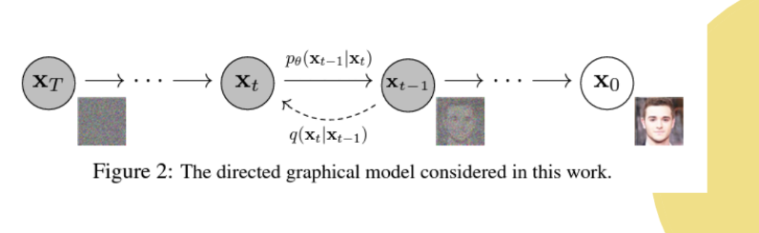
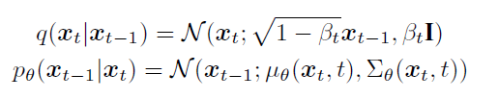
Related work
Diffusion model-DDPM

Slide 8




Method
Approximated MIA function:
Recall that the diffusion model training:
Through the membership exposure, we knows that the member set have smaller estimation error compared to hold-out set

Slide 9
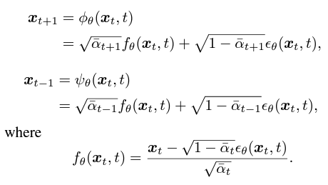

Method
Diffusion inversion

Slide 10

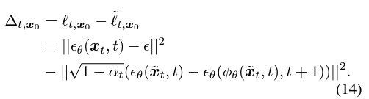
Method
For x0 ~ D
t-err definition:
Provement:

Slide 11
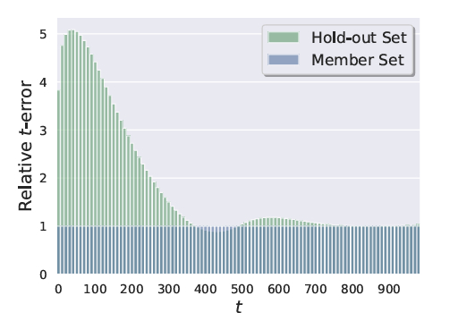
Method
t-err for memberset and hold-out set at each time step
A smaller t triggers more “memory”

Slide 12


Method
Inference:
Statistic-based inference:
Neural-Network-based inference:
Only take one time step t-err.

Slide 13
Experiment
For all dataset, randomly pick 50% of training samples as DM and the rest as DH.
Model: DDPM, train from scratch
Attack Model: Resnet-18, 20% of {DH, DM} as training samples.
Tsec = 100
Dataset: CIFAR10/100, STL10-U, Tiny-IN

Slide 14
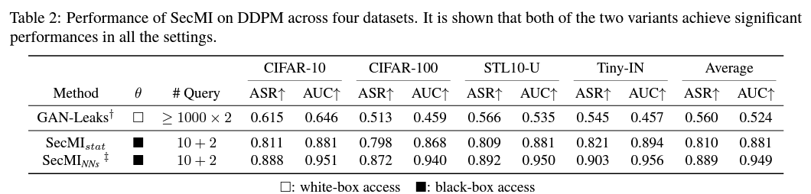
Experiment

Slide 15
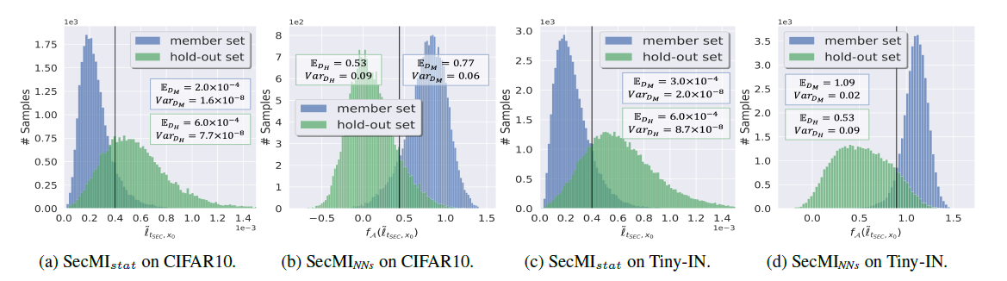
Experiment

Slide 16
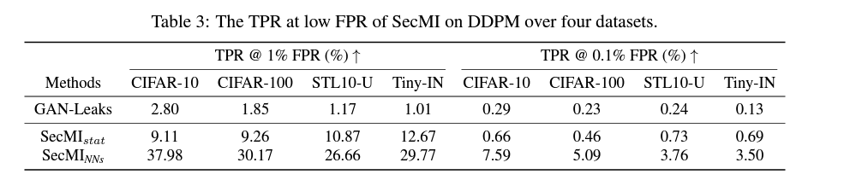
Experiment

Slide 17
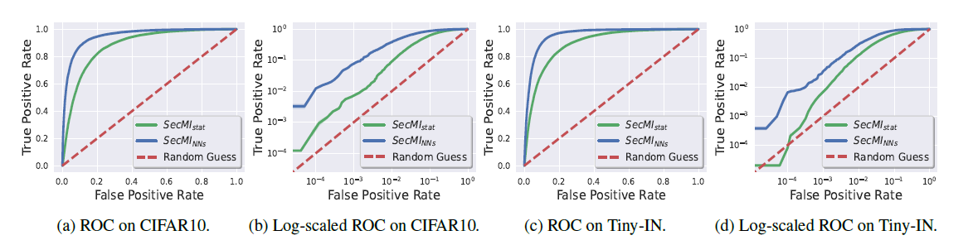
Experiment

Slide 18
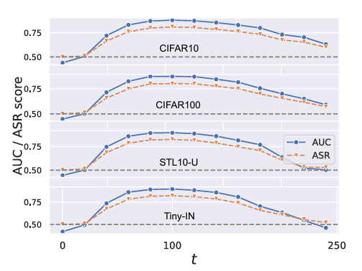
Ablation Study
Attack performance doesn’t sensitive to certain timesteps

Slide 19
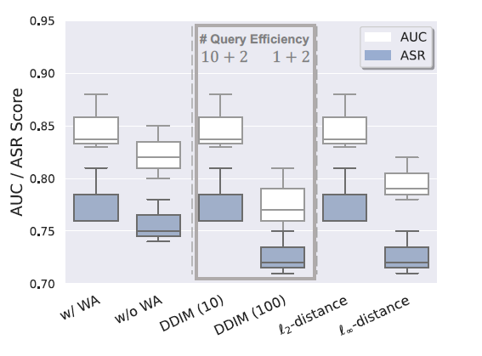
Ablation study
Attack performance doesn’t sensitive to certain timesteps

Slide 20
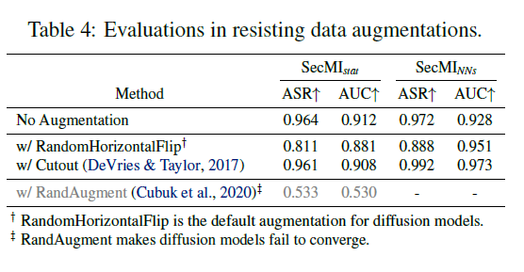
Experiment-Defence

Slide 21
Experiment-LDMs
Model: Stable-Diffusion.
Dataset: Pokemon, COCO2017-Val
Finetune: 15000, 150000 steps

Slide 22
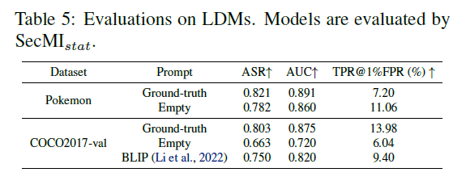
Experiment-LDMs
For different dataset, the effect of prompts are different
Might because the Pokemon dataset has highly centralized images and text, which is all the characters of PokemonGo with a very uniform style.
Even if the text is not accessible, the pseudo-prompt can still make SecMI applicable.

Slide 23
Conclusion
1. Investigate if Diffusion model is vulnerable to MIAs.
2. Summarize the existing methods and show them ineffective for diffusion model.
3. Propose SecMI and demonstrate its effectiveness

Slide 24
Limitation
1. Diffusion models are normally black-box API, and without the intermediate results, SecMI cannot work.
2. The effectiveness and sensitivity to a given demographic (or a subgroup of a dataset) is not investigated yet.
3. Although MIA is one of the most common privacy concern in academia, the scope of MIA is limited in the real world.

Slide 25
Questions
1. What’s the reason that the conventional MIAs have poor performance on diffusion model
2. Briefly explain the t-err

Slide 26
THANK YOU FOR LISTENING
Big data Analytics and Social Intelligent Computing
LABoratory

