Slide 1

Lecture 2:
MIPS
Processor Example

Slide 2
Outline
Design Partitioning
MIPS Processor Example
  Architecture
  Microarchitecture
  Logic Design
  Circuit Design
  Physical Design
Fabrication, Packaging, Testing
2: MIPS Processor Example

Slide 3
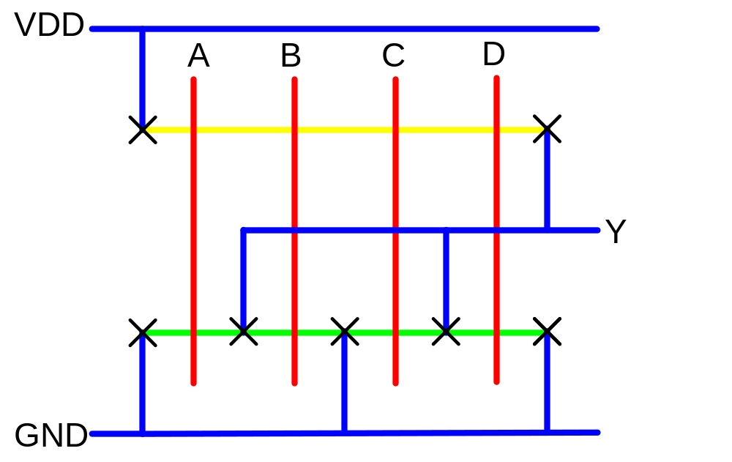
Activity 2
Sketch a stick diagram for a 4-input NOR gate
2: MIPS Processor Example

Slide 4
Coping with Complexity
How to design System-on-Chip?
  Many millions (even billions!) of transistors
  Tens to hundreds of engineers
Structured Design
Design Partitioning
2: MIPS Processor Example

Slide 5
Structured Design
Hierarchy: Divide and Conquer
  Recursively system into modules
Regularity
  Reuse modules wherever possible
  Ex: Standard cell library
Modularity: well-formed interfaces
  Allows modules to be treated as black boxes
Locality
  Physical and temporal
2: MIPS Processor Example

Slide 6
Design Partitioning
Architecture: User’s perspective, what does it do?
  Instruction set, registers
  MIPS, x86, Alpha, PIC, ARM, …
Microarchitecture
  Single cycle, multcycle, pipelined, superscalar?
Logic: how are functional blocks constructed
  Ripple carry, carry lookahead, carry select adders
Circuit: how are transistors used
  Complementary CMOS, pass transistors, domino
Physical: chip layout
  Datapaths, memories, random logic
2: MIPS Processor Example

Slide 7
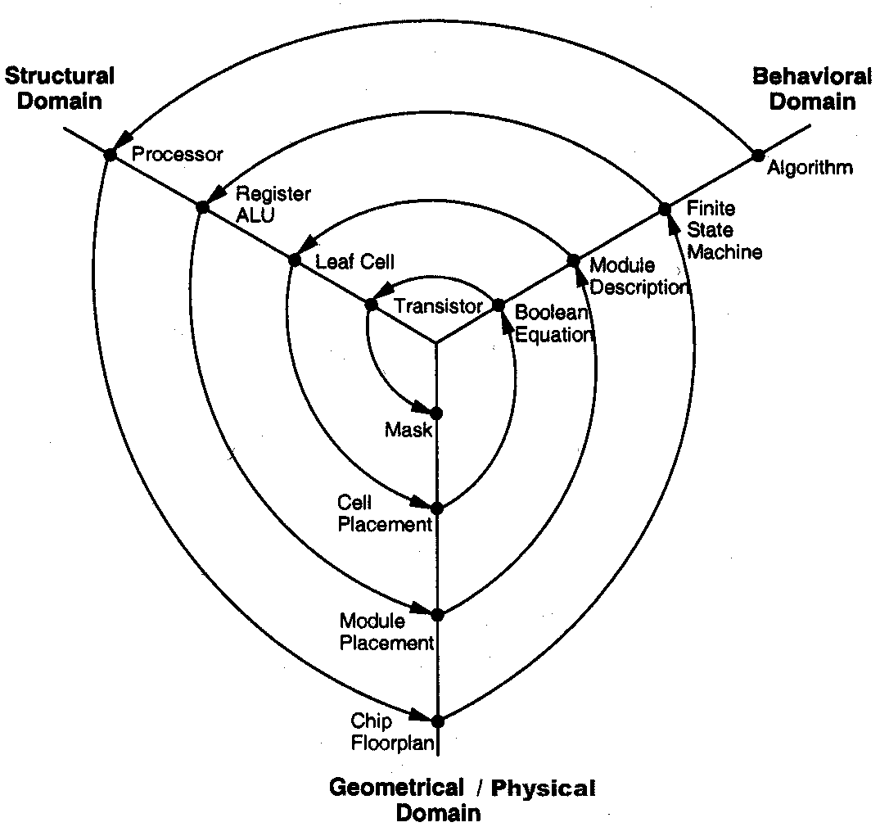
Gajski Y-Chart
2: MIPS Processor Example

Slide 8
MIPS Architecture
Example: subset of MIPS processor architecture
  Drawn from Patterson & Hennessy
MIPS is a 32-bit architecture with 32 registers
  Consider 8-bit subset using 8-bit datapath
  Only implement 8 registers ($0 - $7)
  $0 hardwired to 00000000
  8-bit program counter
You’ll build this processor in the labs
  Illustrate the key concepts in VLSI design
2: MIPS Processor Example

Slide 9
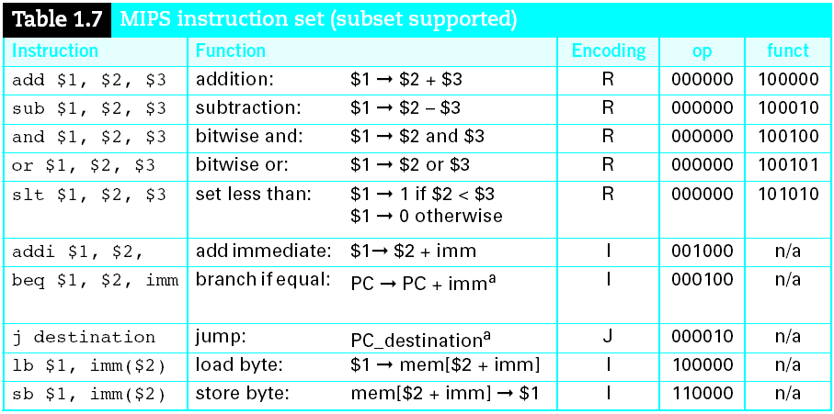
Instruction Set
2: MIPS Processor Example

Slide 10
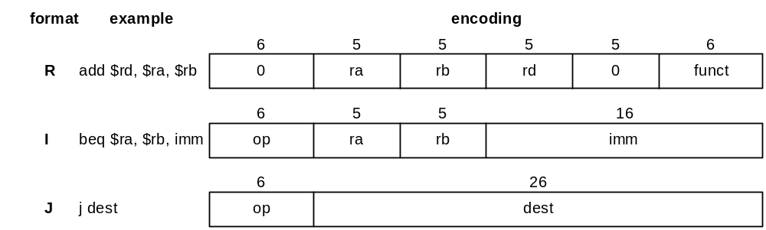
Instruction Encoding
32-bit instruction encoding
  Requires four cycles to fetch on 8-bit datapath
2: MIPS Processor Example

Slide 11
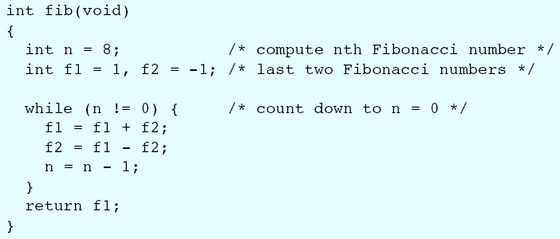
Fibonacci (C)
f₀ = 1; f₋₁ = -1
f_{n} = f_{n-1} + f_{n-2}
f = 1, 1, 2, 3, 5, 8, 13, …
2: MIPS Processor Example

Slide 12
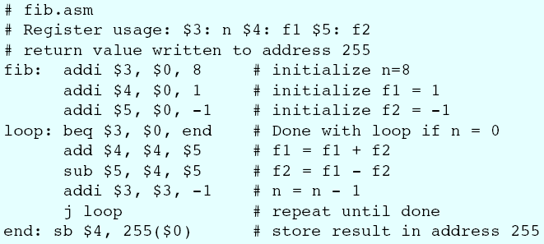
Fibonacci (Assembly)
1st statement: n = 8
How do we translate this to assembly?
2: MIPS Processor Example

Slide 13
Fibonacci (Binary)
1st statement: addi $3, $0, 8
How do we translate this to machine language?
  Hint: use instruction encodings below
2: MIPS Processor Example

Slide 14
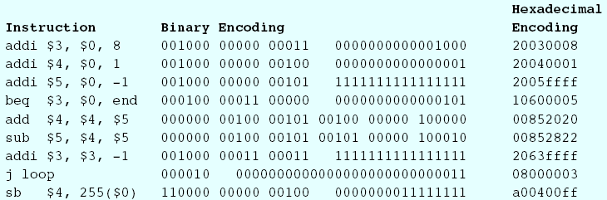
Fibonacci (Binary)
Machine language program
2: MIPS Processor Example

Slide 15
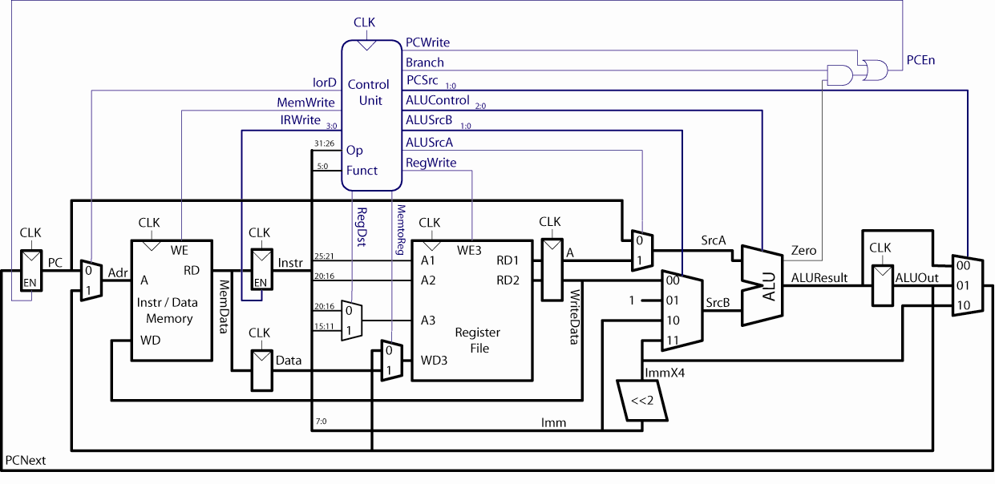
MIPS Microarchitecture
Multicycle μarchitecture ( [Paterson04], [Harris07] )
2: MIPS Processor Example

Slide 16
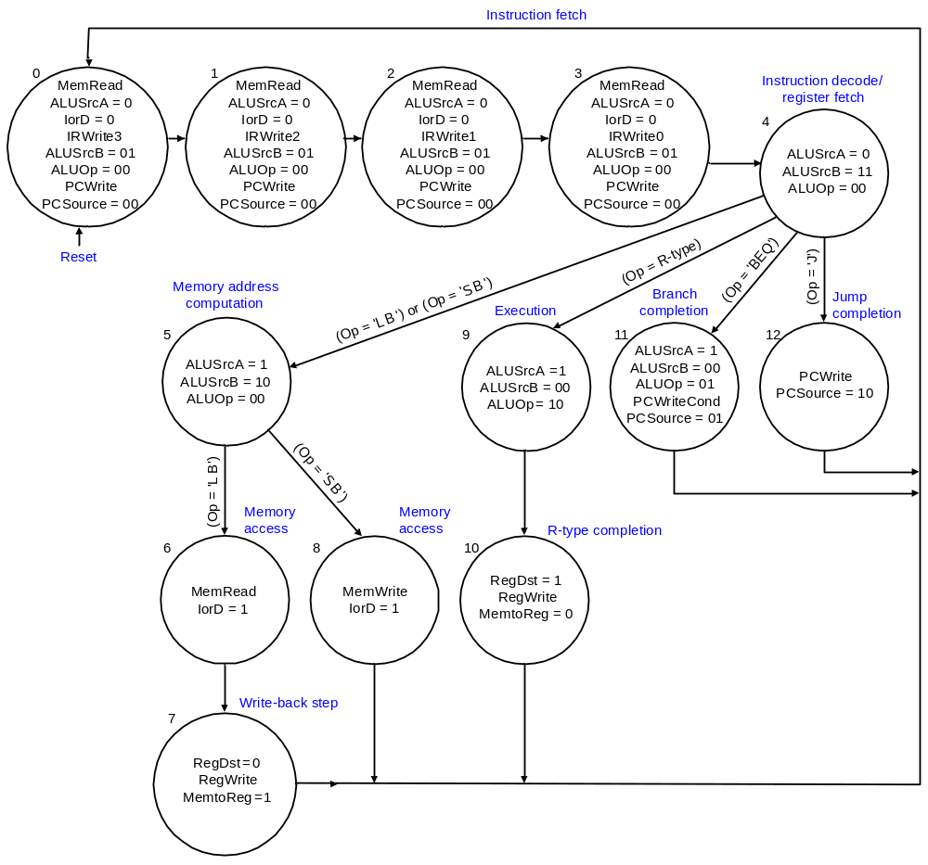
Multicycle Controller
2: MIPS Processor Example

Slide 17
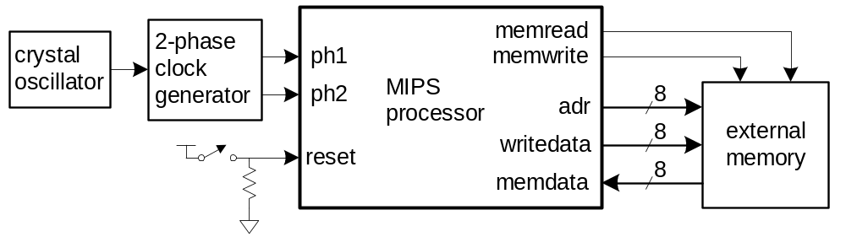
Logic Design
Start at top level
  Hierarchically decompose MIPS into units
Top-level interface
2: MIPS Processor Example

Slide 18
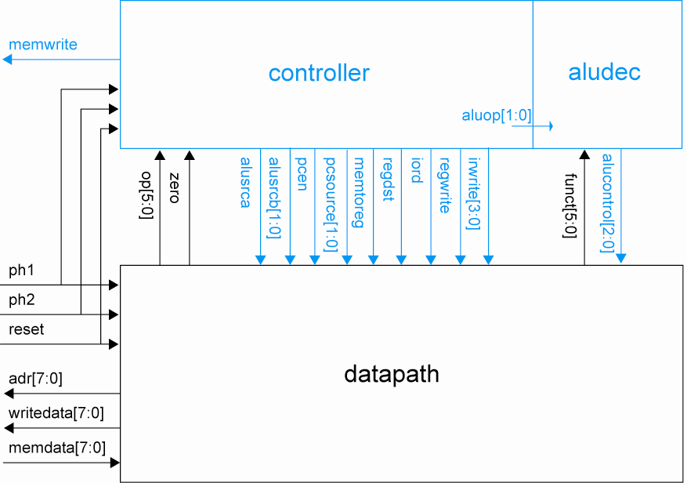
Block Diagram
2: MIPS Processor Example

Slide 19
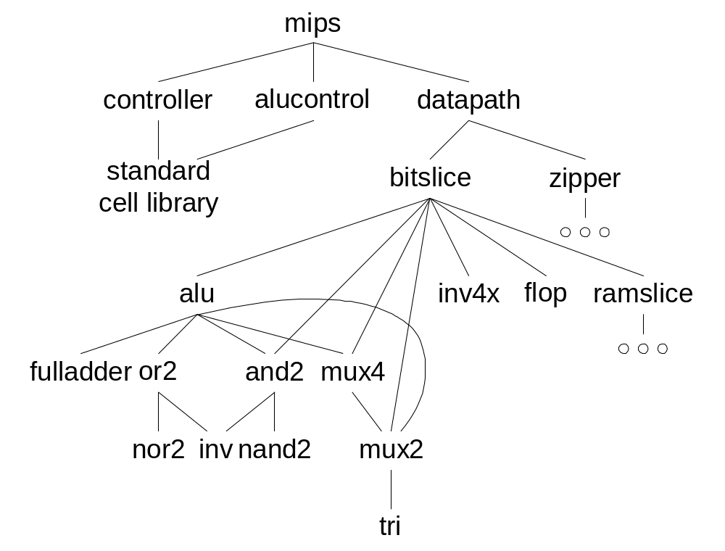
Hierarchical Design
2: MIPS Processor Example

Slide 20
HDLs
Hardware Description Languages
  Widely used in logic design
  Verilog and VHDL
Describe hardware using code
  Document logic functions
  Simulate logic before building
  Synthesize code into gates and layout
    Requires a library of standard cells
2: MIPS Processor Example

Slide 21
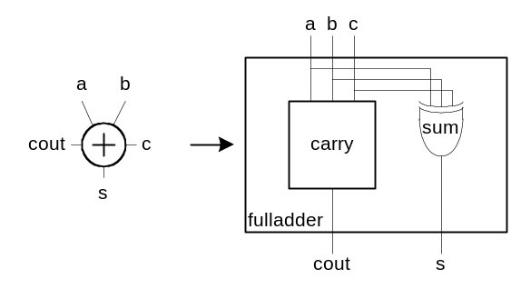
Verilog Example
module fulladder(input a, b, c,
output s, cout);
sum s1(a, b, c, s);
carry c1(a, b, c, cout);
endmodule
module carry(input a, b, c,
output cout)
assign cout = (a&b) | (a&c) | (b&c);
endmodule
2: MIPS Processor Example

Slide 22
Circuit Design
How should logic be implemented?
  NANDs and NORs vs. ANDs and ORs?
  Fan-in and fan-out?
  How wide should transistors be?
These choices affect speed, area, power
Logic synthesis makes these choices for you
  Good enough for many applications
  Hand-crafted circuits are still better
2: MIPS Processor Example

Slide 23
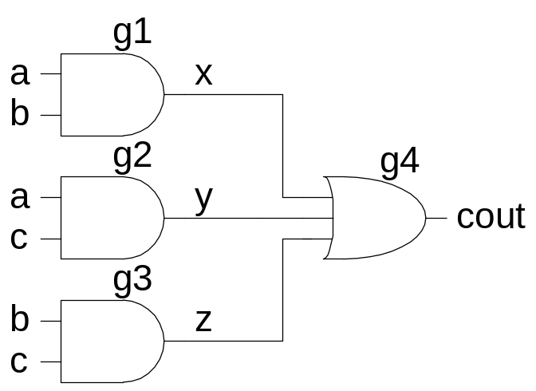
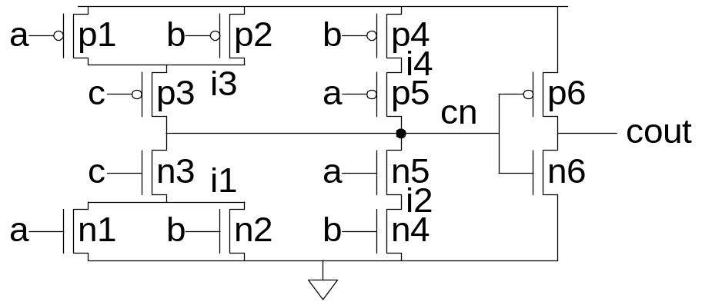
Example: Carry Logic
assign cout = (a&b) | (a&c) | (b&c);
Transistors? Gate Delays?
2: MIPS Processor Example

Slide 24
Gate-level Netlist
module carry(input a, b, c,
output cout)
wire x, y, z;
and g1(x, a, b);
and g2(y, a, c);
and g3(z, b, c);
or g4(cout, x, y, z);
endmodule
2: MIPS Processor Example

Slide 25
Transistor-Level Netlist
module carry(input a, b, c,
output cout)
wire i1, i2, i3, i4, cn;
tranif1 n1(i1, 0, a);
tranif1 n2(i1, 0, b);
tranif1 n3(cn, i1, c);
tranif1 n4(i2, 0, b);
tranif1 n5(cn, i2, a);
tranif0 p1(i3, 1, a);
tranif0 p2(i3, 1, b);
tranif0 p3(cn, i3, c);
tranif0 p4(i4, 1, b);
tranif0 p5(cn, i4, a);
tranif1 n6(cout, 0, cn);
tranif0 p6(cout, 1, cn);
endmodule
2: MIPS Processor Example

Slide 26
SPICE Netlist
.SUBCKT CARRY A B C COUT VDD GND
MN1 I1 A GND GND NMOS W=1U L=0.18U AD=0.3P AS=0.5P
MN2 I1 B GND GND NMOS W=1U L=0.18U AD=0.3P AS=0.5P
MN3 CN C I1 GND NMOS W=1U L=0.18U AD=0.5P AS=0.5P
MN4 I2 B GND GND NMOS W=1U L=0.18U AD=0.15P AS=0.5P
MN5 CN A I2 GND NMOS W=1U L=0.18U AD=0.5P AS=0.15P
MP1 I3 A VDD VDD PMOS W=2U L=0.18U AD=0.6P AS=1 P
MP2 I3 B VDD VDD PMOS W=2U L=0.18U AD=0.6P AS=1P
MP3 CN C I3 VDD PMOS W=2U L=0.18U AD=1P AS=1P
MP4 I4 B VDD VDD PMOS W=2U L=0.18U AD=0.3P AS=1P
MP5 CN A I4 VDD PMOS W=2U L=0.18U AD=1P AS=0.3P
MN6 COUT CN GND GND NMOS W=2U L=0.18U AD=1P AS=1P
MP6 COUT CN VDD VDD PMOS W=4U L=0.18U AD=2P AS=2P
CI1 I1 GND 2FF
CI3 I3 GND 3FF
CA A GND 4FF
CB B GND 4FF
CC C GND 2FF
CCN CN GND 4FF
CCOUT COUT GND 2FF
.ENDS
2: MIPS Processor Example

Slide 27
Physical Design
Floorplan
Standard cells
  Place & route
Datapaths
  Slice planning
Area estimation
2: MIPS Processor Example

Slide 28
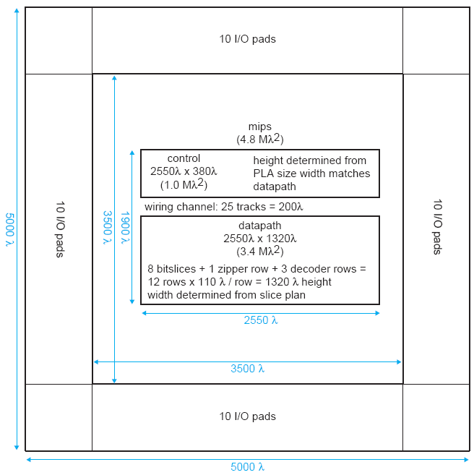
MIPS Floorplan
2: MIPS Processor Example

Slide 29
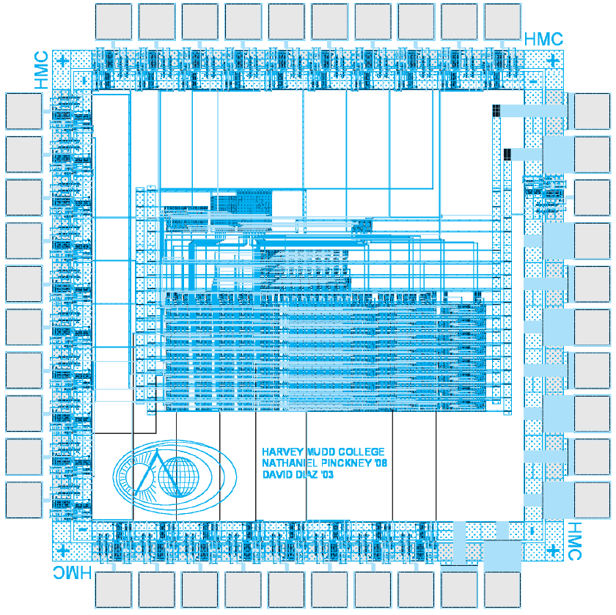
MIPS Layout
2: MIPS Processor Example

Slide 30
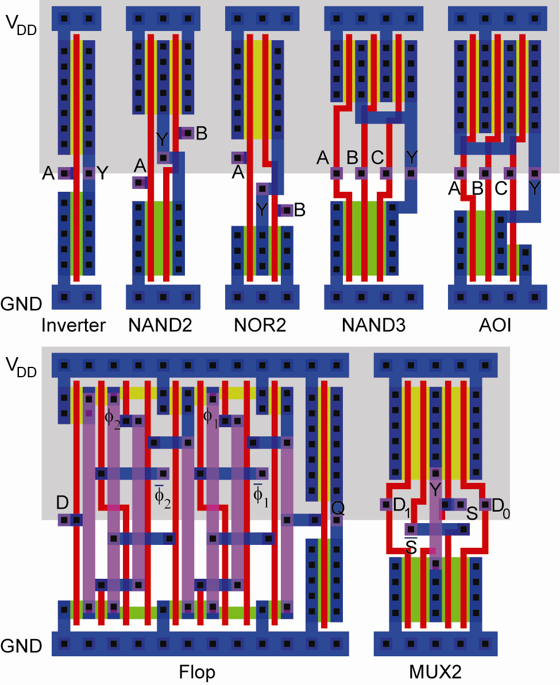
Standard Cells
Uniform cell height
Uniform well height
M1 V_{DD} and GND rails
M2 Access to I/Os
Well / substrate taps
Exploits regularity
2: MIPS Processor Example

Slide 31
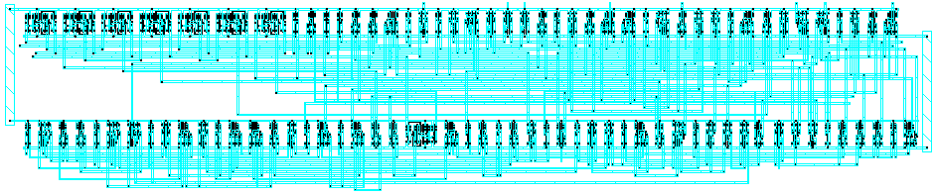
Synthesized Controller
Synthesize HDL into gate-level netlist
Place & Route using standard cell library
2: MIPS Processor Example

Slide 32
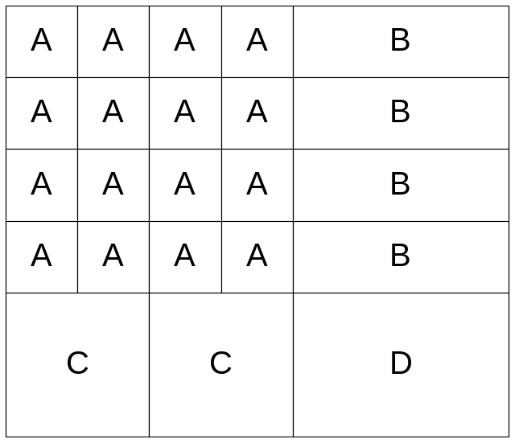
Pitch Matching
Synthesized controller area is mostly wires
  Design is smaller if wires run through/over cells
  Smaller = faster, lower power as well!
Design snap-together cells for datapaths and arrays
  Plan wires into cells
  Connect by abutment
    Exploits locality
    Takes lots of effort
2: MIPS Processor Example

Slide 33
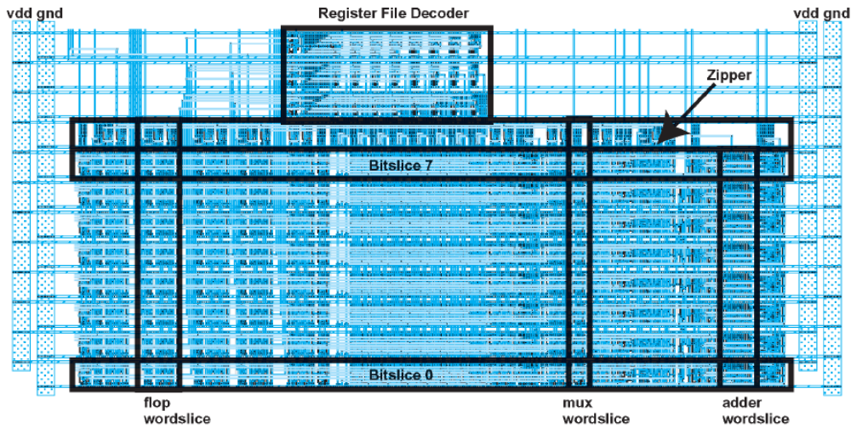
MIPS Datapath
8-bit datapath built from 8 bitslices (regularity)
Zipper at top drives control signals to datapath
2: MIPS Processor Example

Slide 34
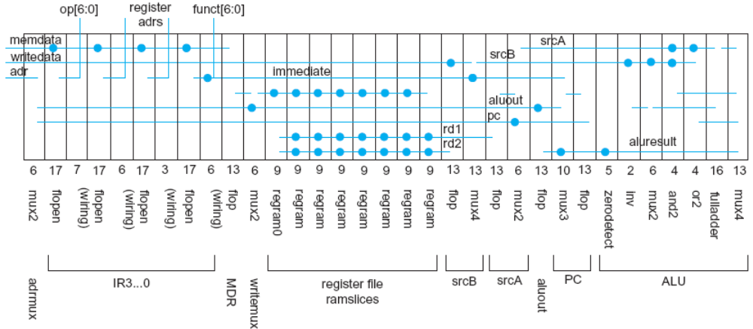
Slice Plans
Slice plan for bitslice
  Cell ordering, dimensions, wiring tracks
  Arrange cells for wiring locality
2: MIPS Processor Example

Slide 35
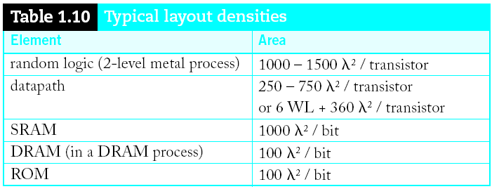
Area Estimation
Need area estimates to make floorplan
  Compare to another block you already designed
  Or estimate from transistor counts
  Budget room for large wiring tracks
  Your mileage may vary; derate by 2x for class.
2: MIPS Processor Example

Slide 36
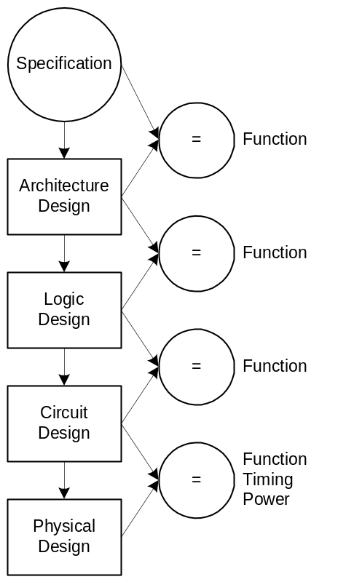
Design Verification
Fabrication is slow & expensive
  MOSIS 0.6μm: $1000, 3 months
  65 nm: $3M, 1 month
Debugging chips is very hard
  Limited visibility into operation
Prove design is right before building!
  Logic simulation
  Ckt. simulation / formal verification
  Layout vs. schematic comparison
  Design & electrical rule checks
Verification is > 50% of effort on most chips!
2: MIPS Processor Example

Slide 37
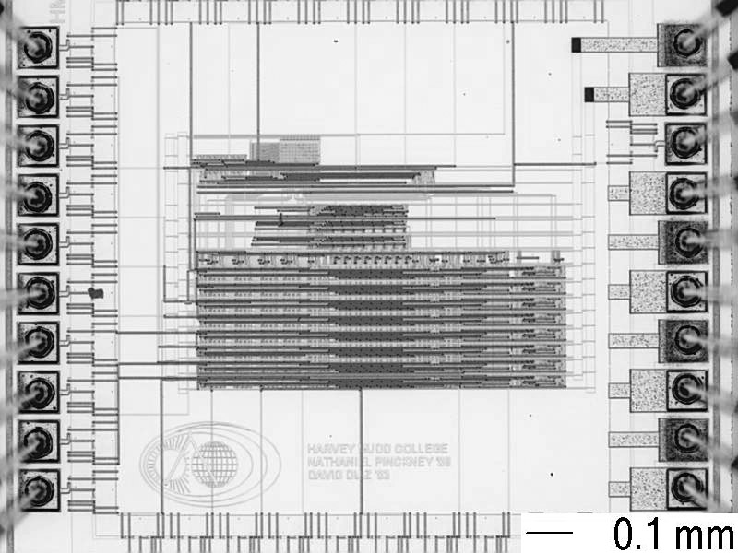
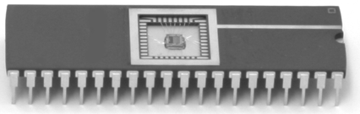
Fabrication & Packaging
Tapeout final layout
Fabrication
  6, 8, 12” wafers
  Optimized for throughput,
  not latency (10 weeks!)
  Cut into individual dice
Packaging
  Bond gold wires from die I/O pads to package
2: MIPS Processor Example

Slide 38
Testing
Test that chip operates
  Design errors
  Manufacturing errors
A single dust particle or wafer defect kills a die
  Yields from 90% to < 10%
  Depends on die size, maturity of process
  Test each part before shipping to customer
2: MIPS Processor Example

Slide 39
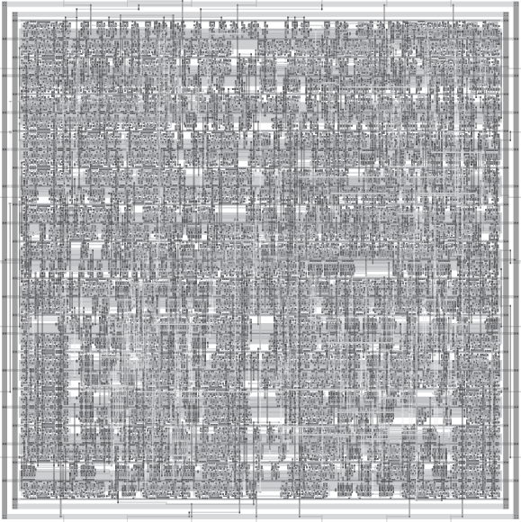
Custom vs. Synthesis
8-bit Implementations
2: MIPS Processor Example

Slide 40
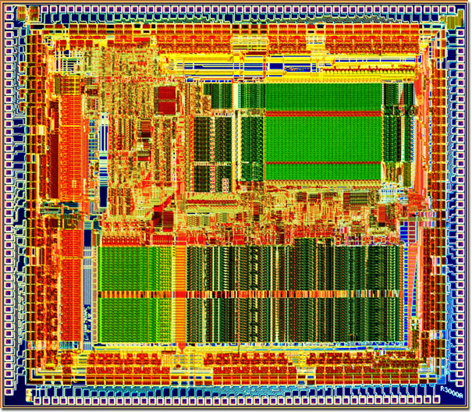
MIPS R3000 Processor
32-bit 2nd generation commercial processor (1988)
Led by John Hennessy (Stanford, MIPS Founder)
32-64 KB Caches
1.2 μm process
111K Transistors
Up to 12-40 MHz
66 mm² die
145 I/O Pins
V_{DD} = 5 V
4 Watts
SGI Workstations
http://gecko54000.free.fr/?documentations=1988_MIPS_R3000
2: MIPS Processor Example

