Slide 1

Department of Computer Science and Engineering
MACHINE LEARNING (25ECSC212)
IV Sem Year: 2026-27
Course Project Title: AIR QUALITY PREDICTION IN INDIA
Sl.no | Name | Roll.no | USN
1. | Shivakumar A Sindolli | 19 | 02FE24BCS049
2. | Avanti Chalake | 21 | 02FE24BCS052
3. | Mohammed Adil M Jamadar | 47 | 02FE24BCS145
4. | Akshata Karoshi | 48 | 02FE24BCS146
Under the guidance of : Dr. Satish Bhojannawar
Professor, Department of CSE

Slide 2
Contents
    Introduction
    Motivation
    Problem Statement
    Sustainable development goal
    Domain Understanding
    Dataset description
    Data Pre-processing
    Data Analysis and Visualisation
    Feature selection & engineering
    Model building and evaluation
    Key findings
    Conclusions
    References

Slide 3
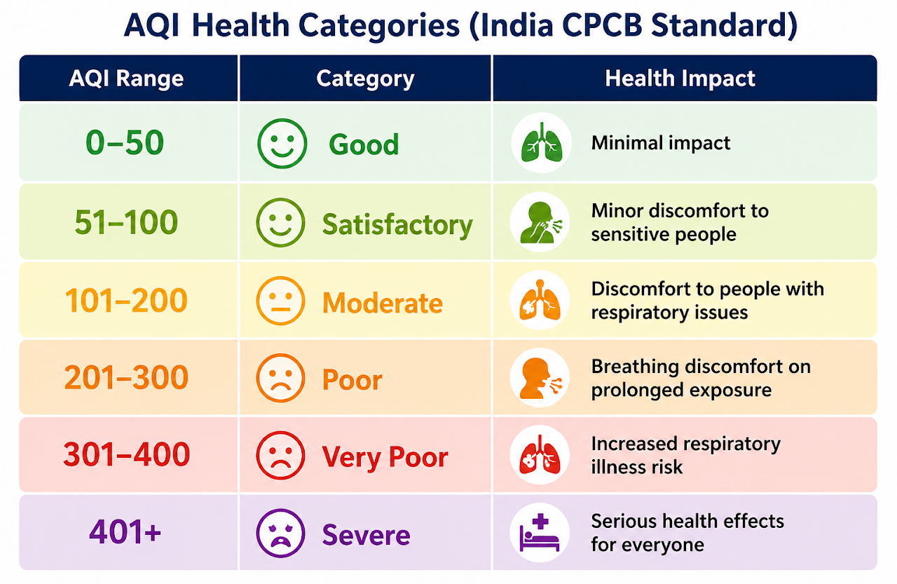
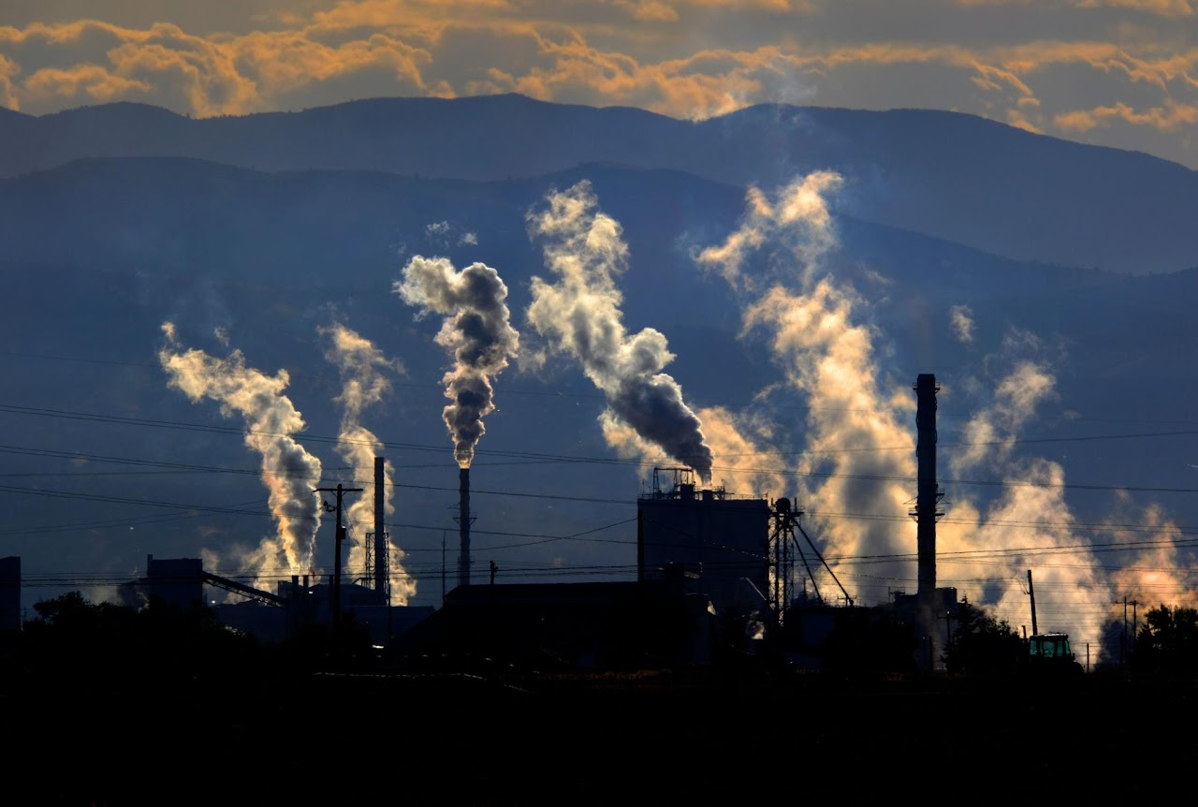
Introduction
Air pollution is one of the most significant environmental and public health challenges in India. The Air Quality Index (AQI), developed by the Central Pollution Control Board (CPCB), provides a standardized measure of air quality by combining multiple pollutant levels into a single value and health category.
This project uses Machine Learning techniques to predict AQI categories from historical air quality data collected across 26 Indian cities between 2015 and 2020. By analyzing pollutant concentrations and environmental patterns, the model helps classify air quality levels and supports early warnings, environmental planning, and informed decision-making for pollution control.

Slide 4
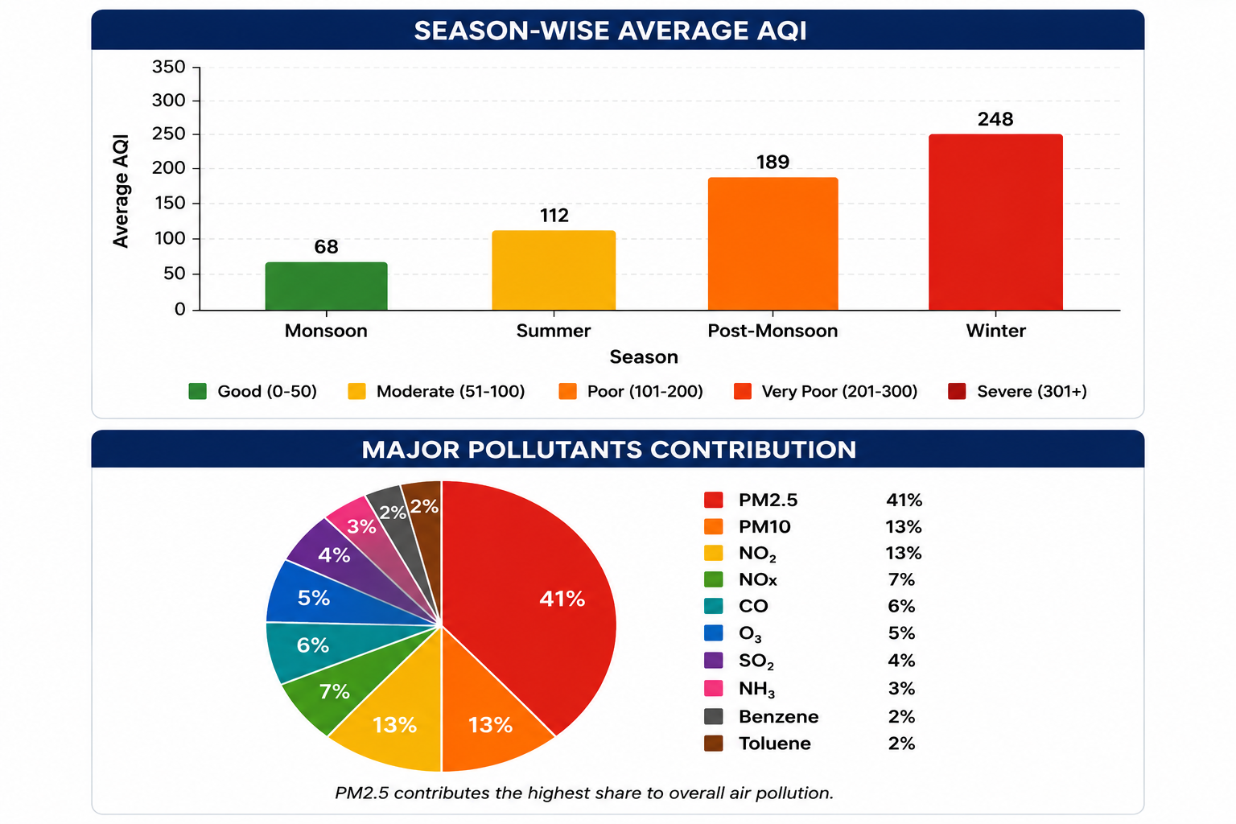
Motivation
• Increasing air pollution levels across India: Many cities experience Poor to Severe AQI levels due to rising industrialization, urbanization, and vehicle emissions.
• Need for early AQI prediction: Timely prediction of air quality can help authorities and citizens take preventive measures to reduce health risks.
• Availability of environmental data: Large-scale air quality datasets from monitoring stations enable data-driven analysis of pollution patterns.
• Support for environmental decision-making: Machine learning can assist policymakers in identifying pollution hotspots and planning effective control strategies

Slide 5
Problem statement
Air pollution in India requires intelligent systems for continuous monitoring and early warning. Traditional monitoring methods are often slow, expensive, and limited in predicting future air quality conditions.
This project uses Machine Learning to automatically predict AQI health categories from pollutant sensor data, helping to identify air quality levels more efficiently. The system supports faster monitoring, timely health alerts, and better environmental decision-making for pollution management.
Objectives:
Analyze India's air quality dataset using Exploratory Data Analysis (EDA).
Preprocess the data by handling missing values and class imbalance.
Create temporal and spatial features to improve prediction accuracy.
Train and compare Decision Tree, KNN, Logistic Regression, and Random Forest models.
Evaluate model performance and identify key pollutants influencing AQI levels.

Slide 6

    Sustainable Development Goal

Slide 7
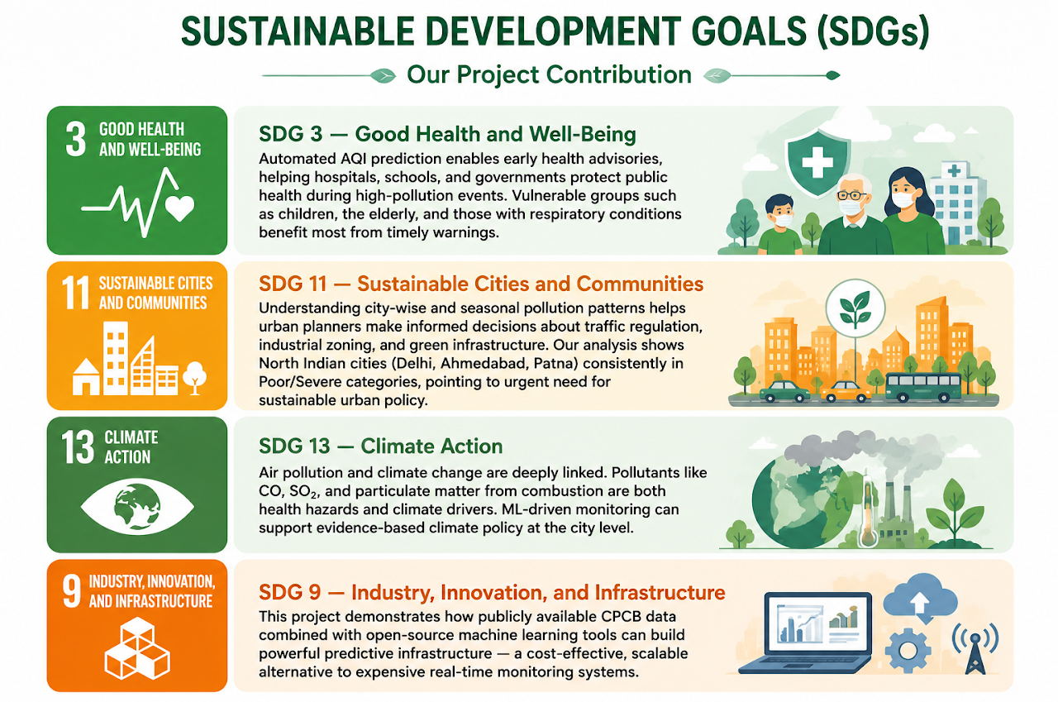
    Sustainable Development Goal
SDGs Addressed by This Project
This project directly contributes to the United Nations Sustainable Development Goals:
SDG 3 — Good Health and Well-Being Automated AQI prediction enables early health advisories, helping hospitals, schools, and governments protect public health during high-pollution events. Vulnerable groups such as children, the elderly, and those with respiratory conditions benefit most from timely warnings.
SDG 11 — Sustainable Cities and Communities Understanding city-wise and seasonal pollution patterns helps urban planners make informed decisions about traffic regulation, industrial zoning, and green infrastructure. Our analysis shows North Indian cities (Delhi, Ahmedabad, Patna) consistently in Poor/Severe categories, pointing to urgent need for sustainable urban policy.
SDG 13 — Climate Action Air pollution and climate change are deeply linked. Pollutants like CO, SO₂, and particulate matter from combustion are both health hazards and climate drivers. ML-driven monitoring can support evidence-based climate policy at the city level.
SDG 9 — Industry, Innovation, and Infrastructure This project demonstrates how publicly available CPCB data combined with open-source machine learning tools can build powerful predictive infrastructure — a cost-effective, scalable alternative to expensive real-time monitoring systems.

Slide 8
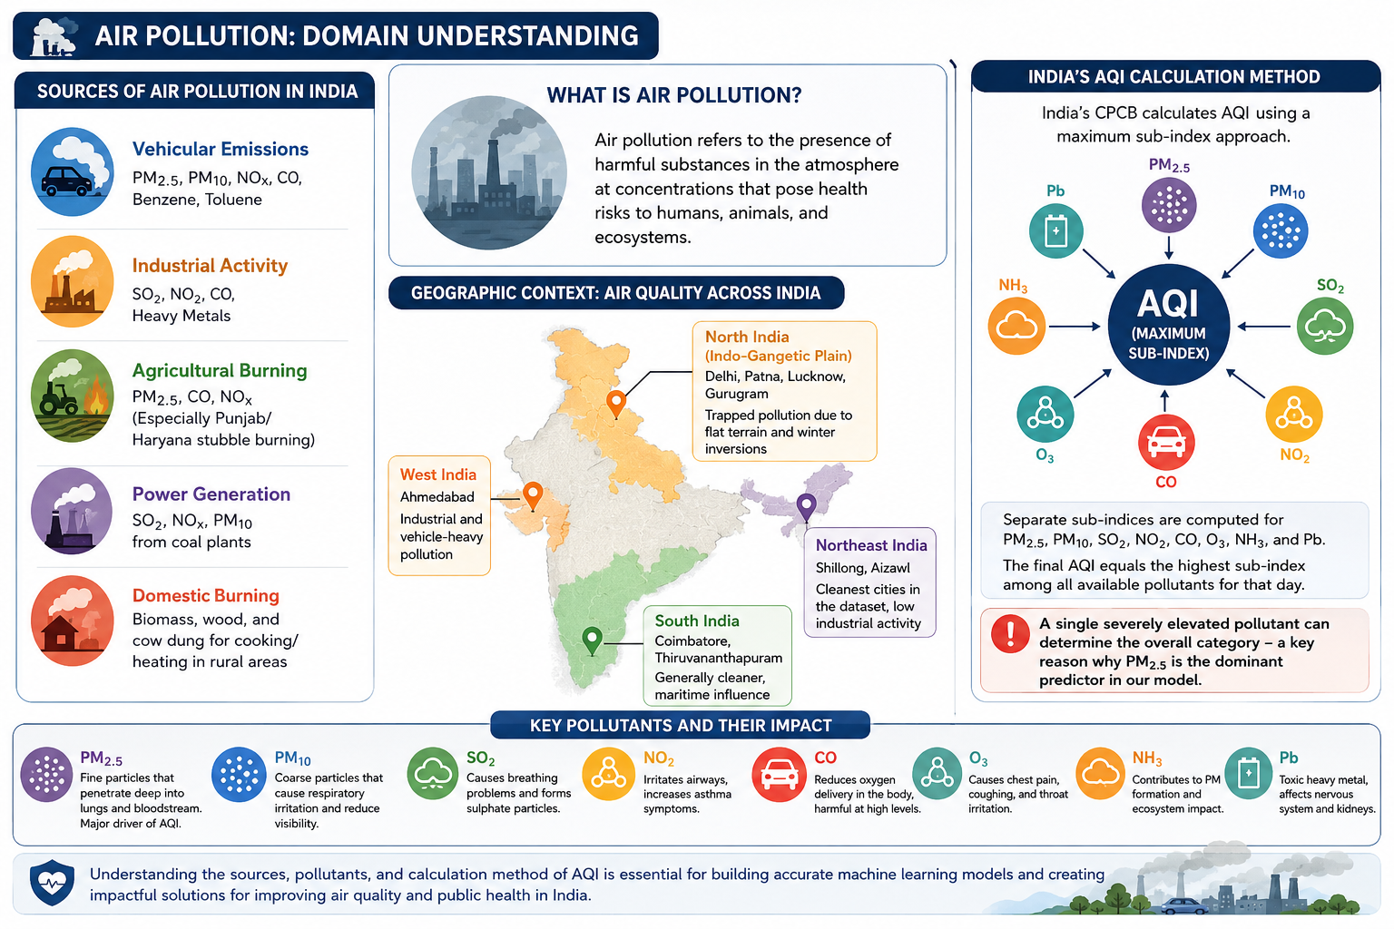
Domain Understanding

Slide 9
Domain Understanding
Air pollution refers to the presence of harmful substances in the atmosphere at concentrations that can negatively impact human health, animals, and the environment. In India, major pollution sources include:
Vehicular Emissions – PM2.5, PM10, NOx, CO, Benzene, Toluene
Industrial Activities – SO₂, NO₂, CO, heavy metals
Agricultural Burning – PM2.5, CO, NOx (stubble burning)
Power Generation – SO₂, NOx, PM10 from coal-based plants
Domestic Burning – Biomass, wood, and cow dung used for cooking and heating
India's AQI Calculation Method
The Central Pollution Control Board (CPCB) calculates AQI using a maximum sub-index approach.
Sub-indices are calculated for PM2.5, PM10, SO₂, NO₂, CO, O₃, NH₃, and Pb.
The highest sub-index determines the final AQI category.
A single highly elevated pollutant can significantly impact overall air quality.
PM2.5 is often the dominant pollutant influencing AQI levels.

Slide 10
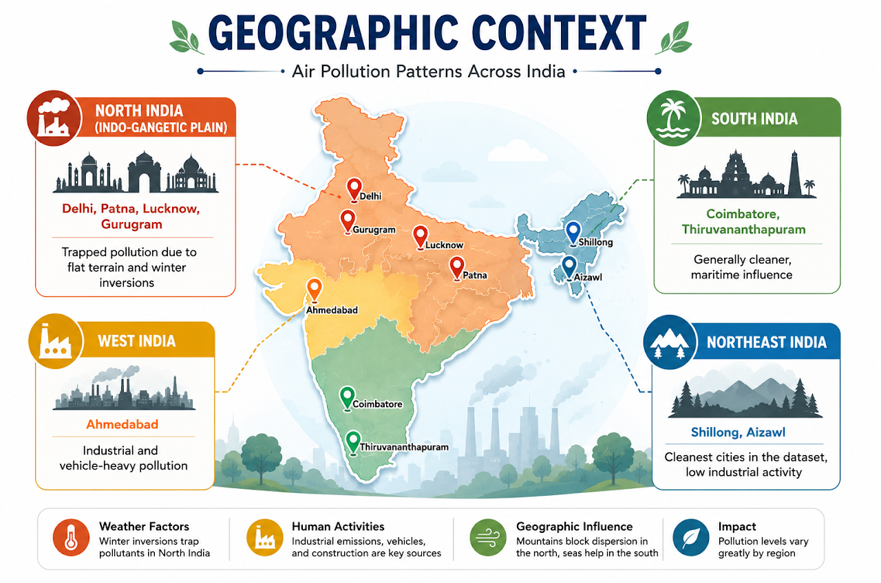
Domain Understanding
Geographic Context of Air Pollution in India
North India (Delhi, Patna, Lucknow, Gurugram)
High pollution due to dense population, industrial activity, crop burning, and winter inversions.
West India (Ahmedabad)
Significant industrial and vehicular emissions.
South India (Coimbatore, Thiruvananthapuram)
Generally cleaner air because of favorable climate and maritime influence.
Northeast India (Shillong, Aizawl)
Lowest pollution levels due to limited industrialization and better environmental conditions.

Slide 11
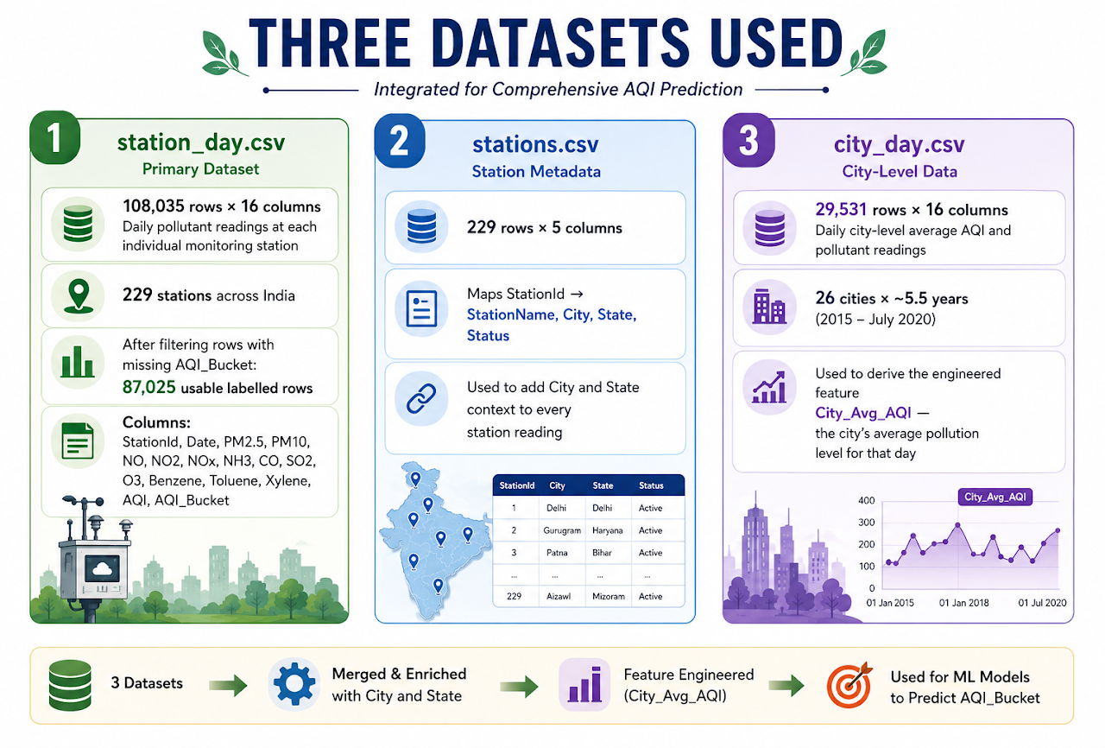
Dataset Description
Data Source
Central Pollution Control Board (CPCB), India Publicly available on Kaggle: India Air Quality Data Coverage: January 2015 – July 2020 | 26 Cities | 229 Monitoring Stations
Why Use Three Datasets?
station_day.csv provides 87,025 labelled rows versus only ~24,850 in city_day.csv. More data means a more robust, less-biased model. The city_day.csv contributes the city-level spatial context feature — telling the model the broader pollution environment that city experienced on that particular day.

Slide 12
Dataset description
There are 16 attributes
Attribute | Description
StationId | Unique identifier assigned to each air quality monitoring station.
Date | Date on which the pollutant measurements were recorded.
PM2.5 | Concentration of fine particulate matter with diameter less than 2.5 μm.
PM10 | Concentration of particulate matter with diameter less than 10 μm.
NO | Concentration of Nitric Oxide in the atmosphere.
NO₂ | Concentration of Nitrogen Dioxide, mainly from vehicle and industrial emissions.
NOx | Combined concentration of Nitrogen Oxides (NO and NO₂).
NH₃ | Concentration of Ammonia present in the air.
CO | Concentration of Carbon Monoxide produced from incomplete combustion.

Slide 13
Dataset description
Attribute | Description
SO₂ | Concentration of Sulfur Dioxide emitted from industries and power plants.
O₃ | Concentration of ground-level Ozone affecting air quality and health.
Benzene | Concentration of Benzene, a harmful volatile organic compound (VOC).
Toluene | Concentration of Toluene, a VOC released from fuels and industries.
Xylene | Concentration of Xylene, an aromatic hydrocarbon pollutant.
AQI | Numerical Air Quality Index value indicating overall pollution level.
AQI_Bucket | Air quality category (Good, Satisfactory, Moderate, Poor, Very Poor, Severe).

Slide 14
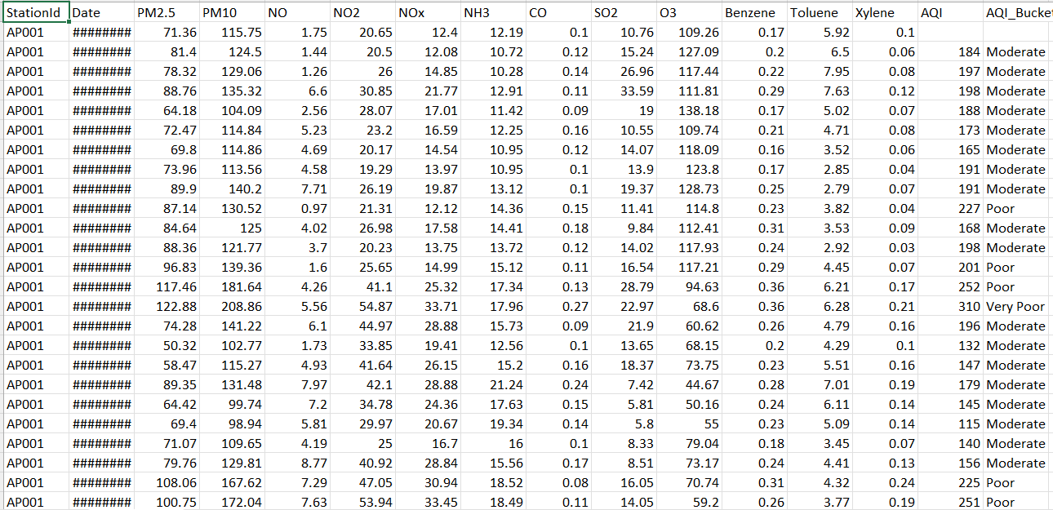
Sample data

Slide 15
Data Pre-processing
DATA CLEANING:
Data preprocessing is a method which involves various techniques to transform raw data into a clean, structured, and usable format. The main goal is to improve the quality of the data and to make it suitable for analysis.
- Methods used in our project:
DATA CLEANING:
- Handling Missing Values
- Error correction
DATA REDUCTION
-Dropping of columns

Slide 16
Data Pre-processing
Data preprocessing is a method which involves various techniques to transform raw data into a clean, structured, and usable format. The main goal is to improve the quality of the data and to make it suitable for analysis.
Methods used in our project
▪ Missing Value Handling
▪ Feature Selection
▪ Feature Engineering
▪ Class Imbalance Handling
▪ Feature Scaling
▪ Train-Test Split

Slide 17
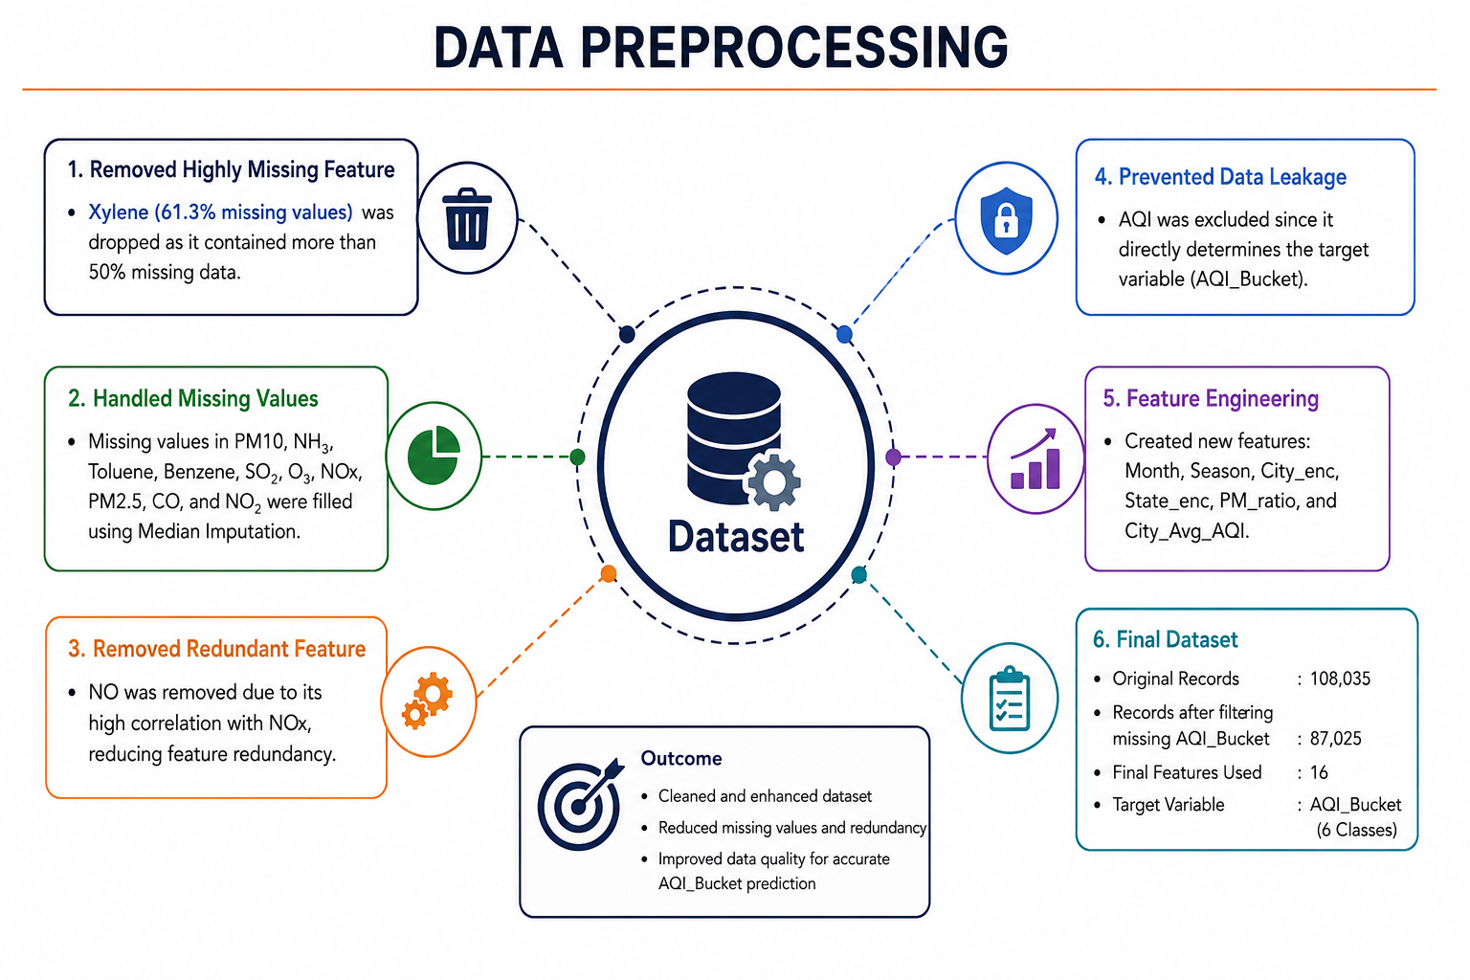
Data Pre-processing

Slide 18
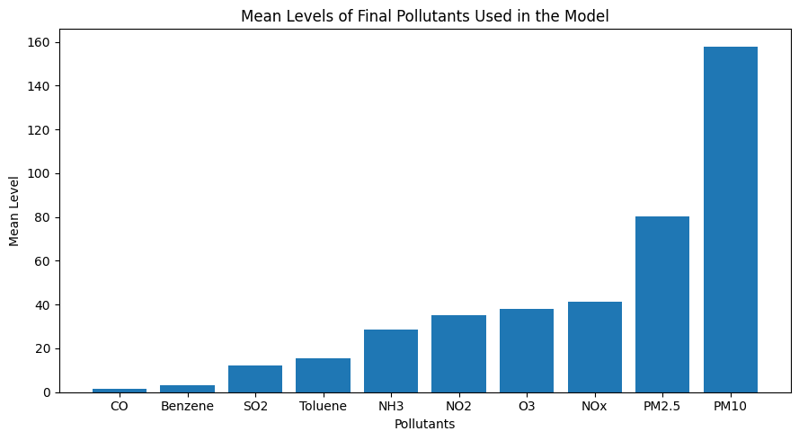
Data Analysis and Visualizations: Question and inferences
1. Identify which gases are more and less prevalent
X-axis: Represents the pollutants used in the study.
Y-axis: Represents the mean concentration of each pollutant.
PM10 and PM2.5 show the highest concentration levels, indicating their major contribution to air pollution.
NOx, O₃, and NO₂ have moderate concentrations and are important indicators of vehicular and industrial emissions.
CO, Benzene, SO₂, Toluene, and NH₃ have relatively lower concentration levels.
The results indicate that particulate matter (PM10 and PM2.5) plays a significant role in determining air quality and AQI classification.

Slide 19
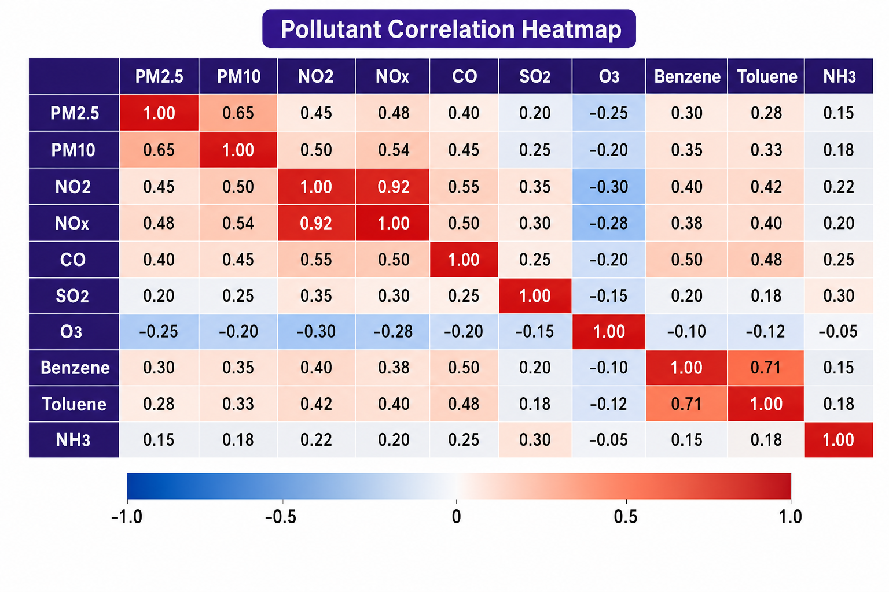
2. Analyze relationships between pollutants
PM2.5 is highly correlated with PM10 (0.65).
NO₂ is highly correlated with NOx (0.92).
Benzene is moderately correlated with Toluene (0.71).
CO is moderately correlated with NO₂ (0.55).
O₃ is negatively correlated with NO₂ (-0.30).

Slide 20
3. Key Pollutants and Correlations
Inference 1:
○ PM2.5 is the most important raw pollutant predictor affecting AQI classification.
Inference 2:
○ NO₂ and NOx show the strongest correlation (0.92), while PM2.5 and PM10 are also strongly correlated (0.65).

Slide 21
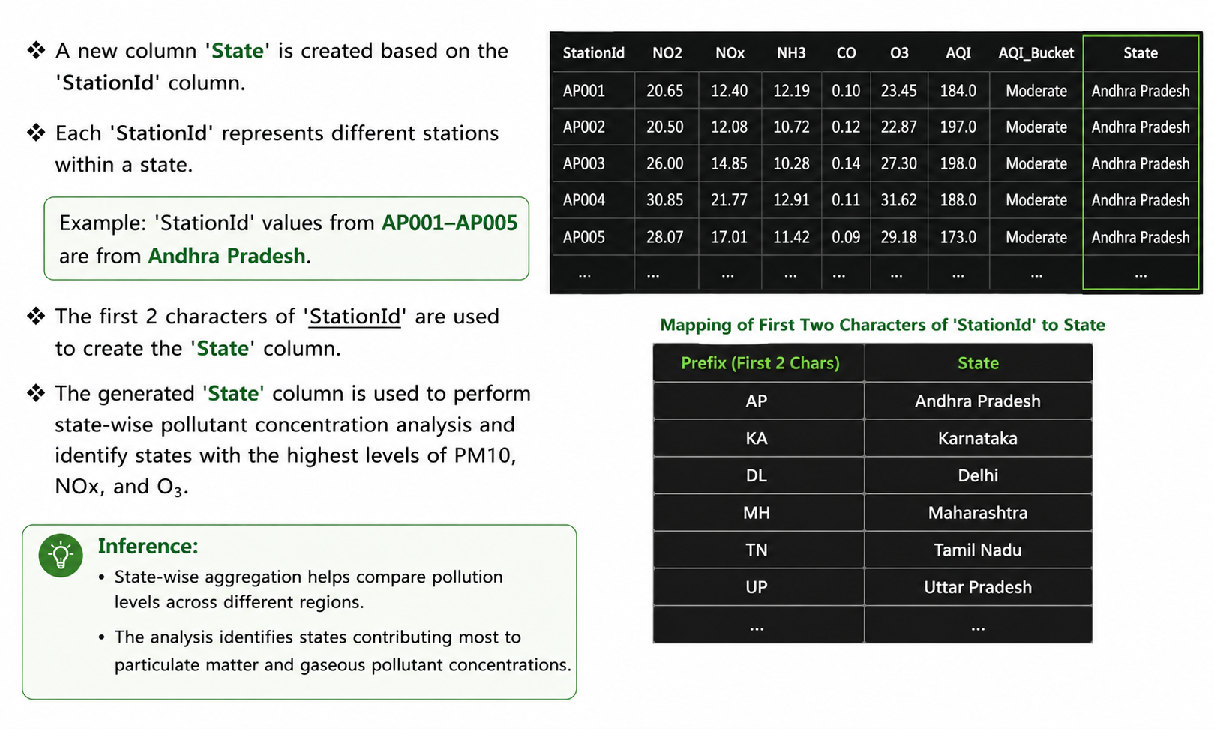
4. Which state has the highest concentration of PM10,NOx,O3 ?

Slide 22
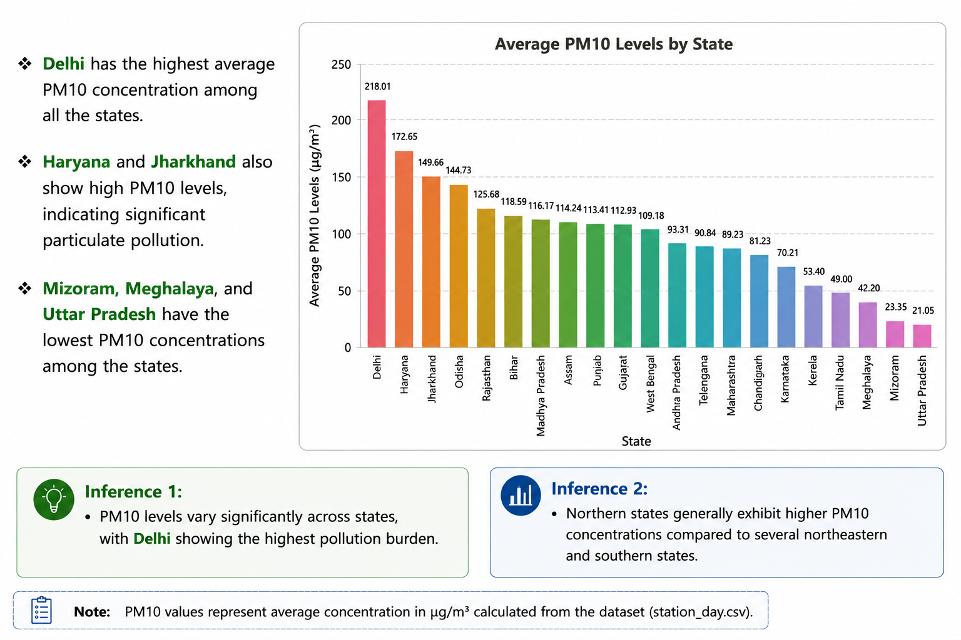
5. Which state has the highest concentration of PM10?

Slide 23
6. Why Delhi is common in all of the 3 major pollutants ?
Delhi's severe air pollution stems from:
High Vehicular Density: Over 3.4 million vehicles and urban growth drive significant emissions.
Industrial Emissions: Manufacturing and power plants emit pollutants like NOx.
Winter Inversions: Trapping pollutants close to the ground worsens air quality.
Geographical Density: Concentrates pollutants due to dense population.
Addressing these requires:
Stringent Regulations: Enforcing strict emission standards.
Continuous Monitoring: Essential for health protection.
Public Awareness: Vital for sustainable urban growth.
Inference:
• Delhi is the only state that consistently ranks among the highly polluted states across PM10, NOx, and O₃ analyses.
•This suggests that Delhi experiences a combination of particulate and gaseous pollution, resulting in higher overall pollution levels in the dataset.

Slide 24
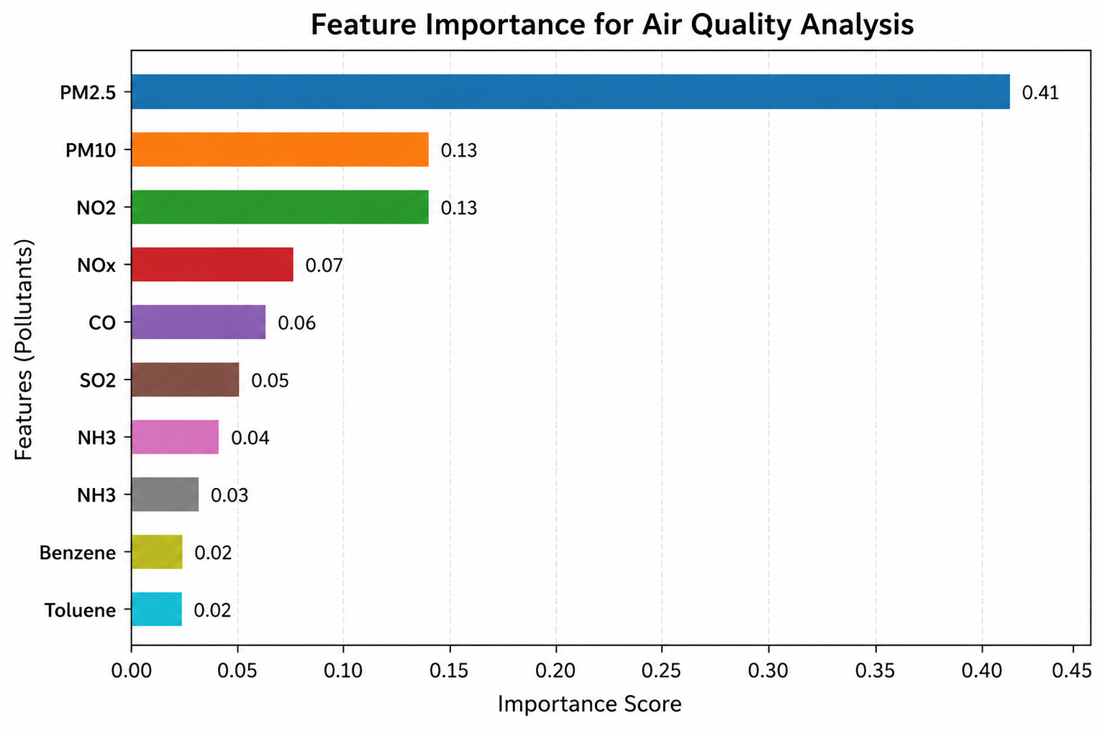
Feature Selection/Engineering
Key Observations
PM2.5 is the most important feature with the highest impact on AQI, having an importance score of 0.41.
PM10 and NO₂ are the next most influential pollutants, each with an importance score of 0.13.
NOx, CO, and O₃ also contribute significantly to air-quality assessment, with importance scores of 0.07, 0.06, and 0.05, respectively.
SO₂ has a moderate impact on AQI, with an importance score of 0.04.
NH₃, Benzene, and Toluene have comparatively lower importance scores (0.03, 0.02, and 0.02), indicating a smaller influence on the model.

Slide 25
Feature Selection/Engineering
Starting Features (Raw)
PM2.5, PM10, NO, NO2, NOx, NH3, CO, SO2, O3, Benzene, Toluene, Xylene
Features Dropped
Feature | Reason
NO | Near-perfect correlation with NOx (r > 0.9). Redundant —adds noise, not information
Xylene | 61.3% missing. Imputing this much data would introduce significant artificial bias
AQI | The station's own AQI directly determines AQI_Bucket — using it is data leakage. The model would learn a lookup table, not pollution patterns. Excluded entirely.

Slide 26
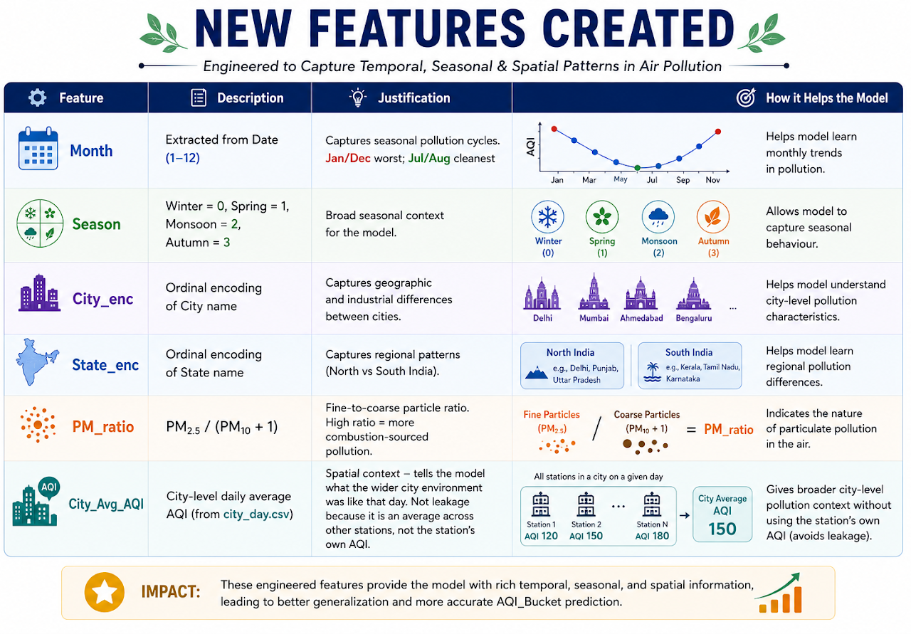
Feature Selection/Engineering

Slide 27
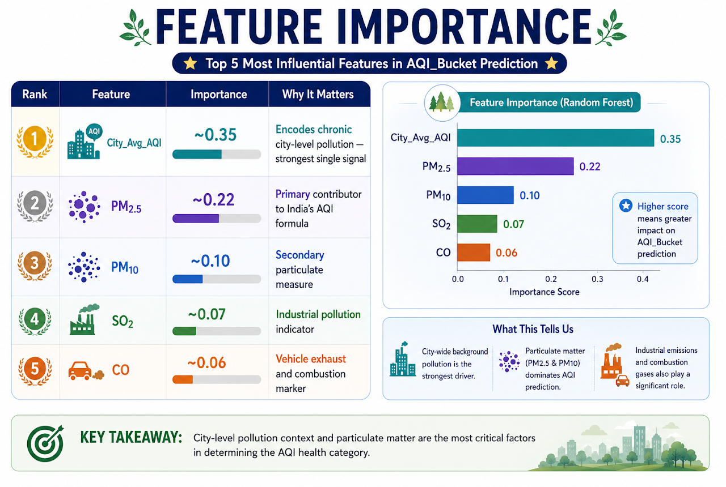
Feature Selection/Engineering
Final Feature Set (16 features)
PM2.5, PM10, NO2, NOx, NH3, CO, SO2, O3, Benzene, Toluene, Month, Season, City_enc, State_enc, PM_ratio, City_Avg_AQI
Key Insight:
City_Avg_AQI is the most powerful feature. Knowing a city's general pollution level on a given day is more informative than any individual raw pollutant reading. PM2.5 is the top raw pollutant — consistent with CPCB's formula which heavily weights the PM2.5 sub-index

Slide 28
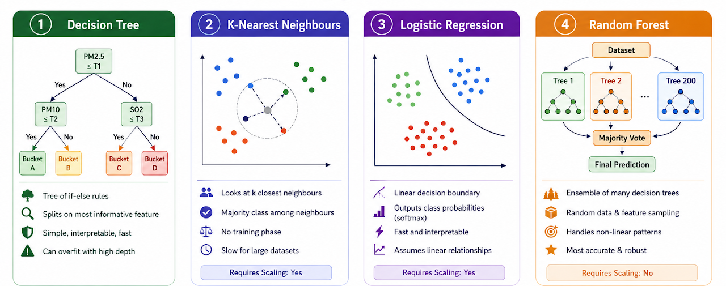
Model building

Slide 29
Model building
Model | Method | Key Parameter | Test Accuracy
Decision Tree | Tree-based classification | max_depth = 10 | 80.59%
KNN | 5 nearest neighbours | k = 5 | 77.22%
Logistic Regression | Linear classification | max_iter = 1000 | 75.50%
Random Forest | Ensemble of 200 trees | n_estimators = 200 | 84.35%
Selected Model | Reason
Random Forest | Highest test accuracy (84.35%) and best overall performance for AQI prediction.

Slide 30
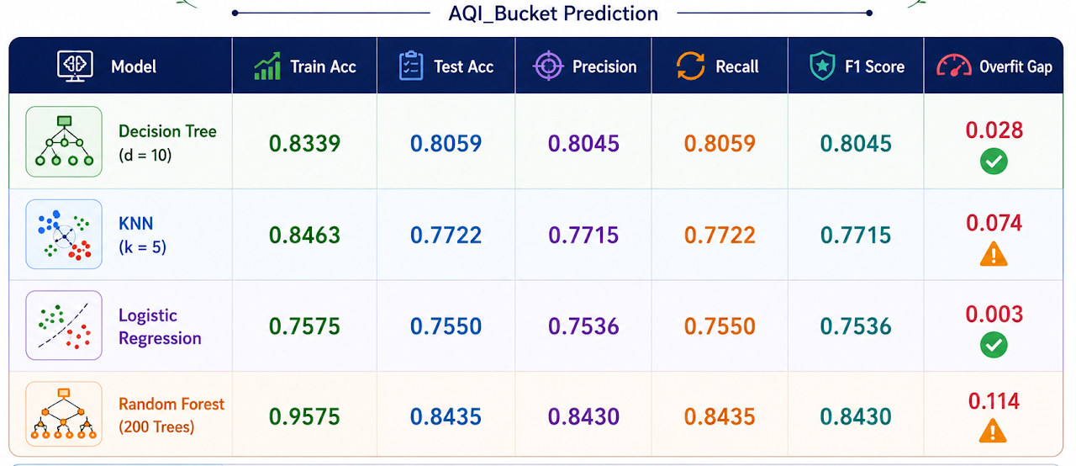
Performance Evaluation

Slide 31
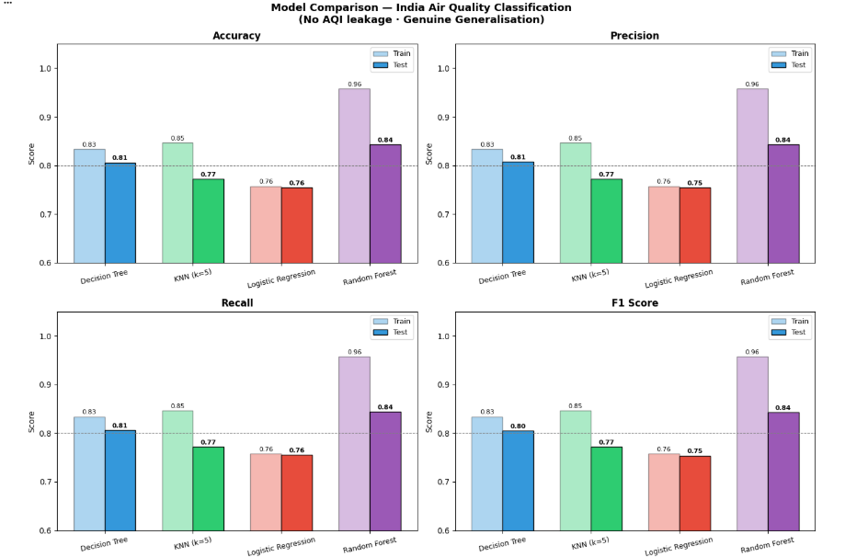
Performance Evaluation

Slide 32
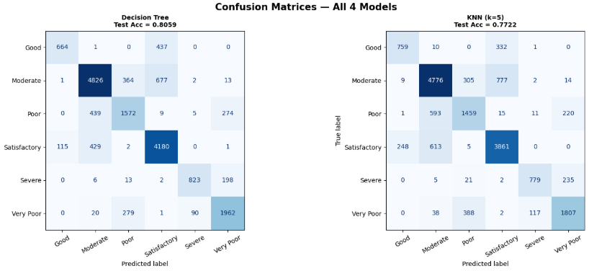
Performance Evaluation

Slide 33
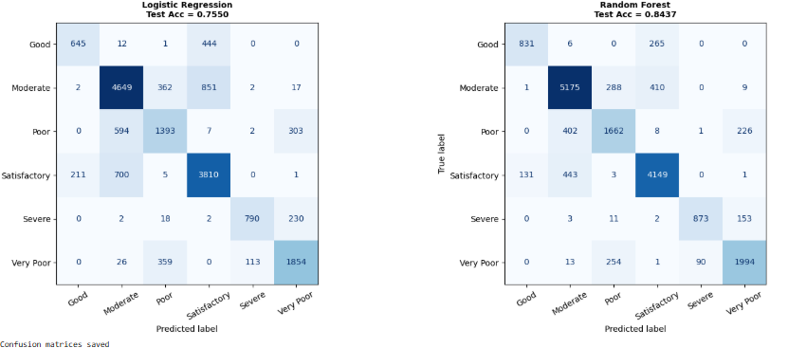
Performance Evaluation

Slide 34
Key Findings
Environmental Findings
Finding | Summary
North–South Divide | Northern cities show poorer AQI, while Southern and Northeastern cities generally maintain better air quality.
Winter Crisis | Air pollution peaks during November–January, with AQI often reaching Poor to Severe levels.
Monsoon Relief | June–August records the best air quality due to rainfall removing pollutants from the atmosphere.
PM2.5 Dominance | PM2.5 is the most influential pollutant and a major contributor to AQI variation.
City Context Matters | City-level average AQI is the strongest predictor, indicating that local pollution patterns significantly affect air quality.

Slide 35
Key Findings
ML Findings
Random Forest is the best model — 84.35% test accuracy, F1 0.843. It handles non-linear pollutant-AQI relationships and feature interactions naturally.
Decision Tree is the best single generalizable model — gap of only 0.028, with 80.59% test accuracy. It provides interpretable if-else rules.
Logistic Regression is the most stable model — near-zero overfit gap (0.003). But limited by linear class boundary assumption.
KNN struggles at scale — 0.074 gap and lower accuracy due to curse of dimensionality in 16-feature space.
Data quality is the bottleneck — all models hit similar ceilings due to overlapping class distributions, not algorithmic limitations.

Slide 36
Applications
Real-Time AQI Prediction: Predicts AQI categories for monitoring stations using pollutant data.
Public Health Protection: Helps issue health advisories and reduce exposure to harmful air pollution.
Pollution Monitoring: Assists authorities in tracking air-quality trends and identifying high-risk areas.
Urban Planning: Supports decision-making for emission control, traffic management, and environmental policies.
Seasonal Pollution Management: Helps implement preventive measures during high-pollution periods, especially winter.
Environmental Research: Enables analysis of pollution patterns across cities, states, and seasons.
Resource Optimization: Supports monitoring stations by estimating AQI when pollutant data is incomplete.
Scalable Solution: Can be extended to new cities and regions for nationwide air-quality assessment.

Slide 37
Conclusion
Successfully developed a multi-class AQI prediction system using real-world CPCB air quality data.
Achieved 84.35% test accuracy and 0.843 F1-score using the Random Forest model.
Cleaned, processed, and merged datasets to create a robust training dataset of 87,025 records.
Engineered useful features such as seasonal indicators, city-level AQI context, and PM ratio to improve model performance.
Identified PM2.5 and City_Avg_AQI as the most influential predictors of AQI category.
Revealed that North Indian cities experience higher pollution levels, especially during winter.
Demonstrated the effectiveness of machine learning for scalable air-quality monitoring and AQI prediction.
All four models showed good generalization with minimal overfitting, indicating reliable predictive performance.
The achieved accuracy reflects the natural overlap between AQI categories rather than a limitation of the models.

Slide 38
References
Central Pollution Control Board (CPCB), India — National Air Quality Index Guidelines, 2014. https://cpcb.nic.in
Kaggle — India Air Quality Data (CPCB). https://www.kaggle.com/datasets/rohanrao/air-quality-data-in-india
Breiman, L. (2001). Random Forests. Machine Learning, 45(1), 5–32.
Scikit-learn Documentation — https://scikit-learn.org
WHO (2022). Ambient Air Pollution: Pollutants. https://www.who.int/news-room/fact-sheets/detail/ambient-(outdoor)-air-quality-and-health
Pedregosa et al. (2011). Scikit-learn: Machine Learning in Python. JMLR 12, 2825–2830.
India Meteorological Department (IMD) — Seasonal classification reference.
KLE Technological University — Course: Web Technology (25ECSP207), Faculty: Prof. Satish Bhojannavar

Slide 39
Thank you

