Slide 1

PEERPOINT · SALT LAKE COUNTY SHERIFF'S OFFICE
Admin training
Invite Peer Support Members, manage accounts, content, and reports
For program administrators on admin.mypeerpoint.com
mypeerpoint.com · admin.mypeerpoint.com
Notes:
Welcome to Peer Point Admin training. This guide covers the Admin site: inviting Peer Support Members, managing accounts and Leaders, On Call oversight, the request queue for Sheriff’s Office employees, Content, and Reports. Remember: Peer Support Members provide support. Salt Lake County Sheriff’s Office employees are the people requesting help.

Slide 2
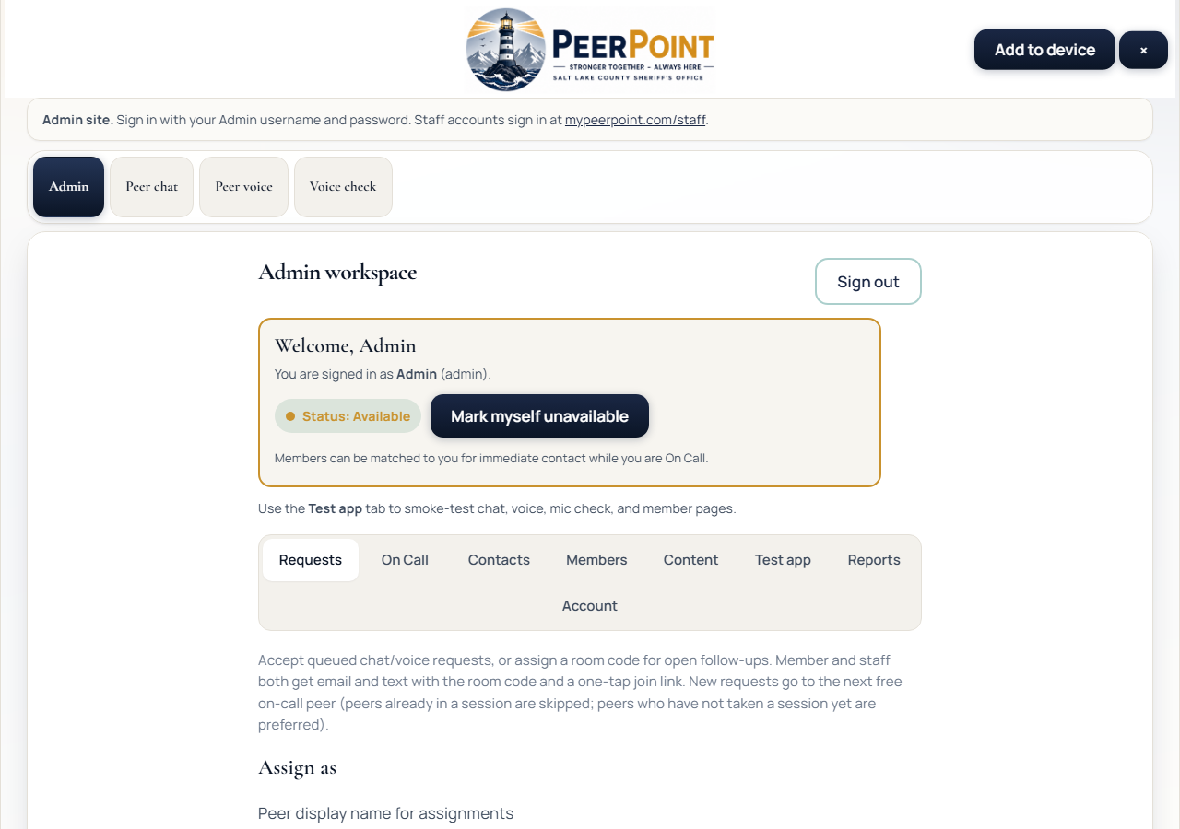
PEERPOINT · ADMIN
Admin workspace
admin.mypeerpoint.com
• Admin accounts only on this host
• Peer Support Members use mypeerpoint.com/staff
• Admins inherit staff queue rights
• Change seed password after first login
PEERPoint · Admin · Emergencies 911 · Crisis 988 · Peer line 801-548-8002 · 2/8
Notes:
Sign in at admin dot my Peer Point dot com. Production Admin host is for Admin accounts only. Peer Support Members sign in at my Peer Point dot com slash staff. Admins inherit staff queue rights. Change the seed Admin password after first login.

Slide 3
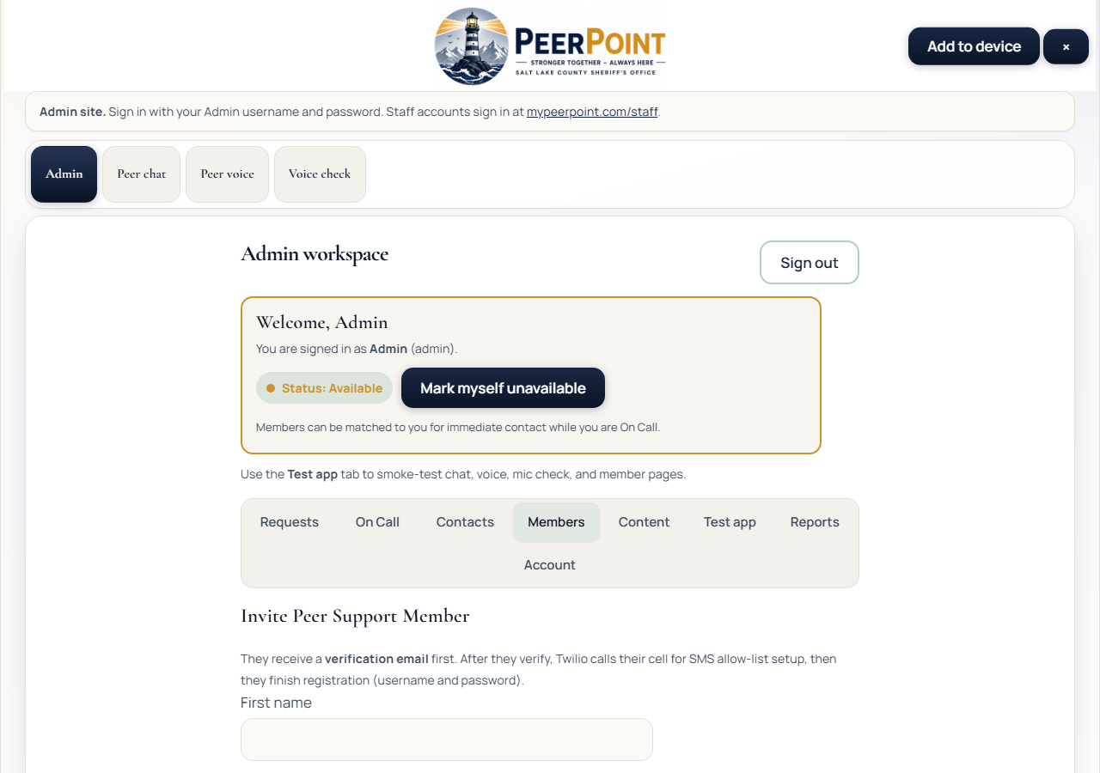
PEERPOINT · ADMIN
Members (Peer Support roster)
Invite + manage Peer Support Members
• Invite Staff or Admin Peer Support accounts
• Resend / Revoke pending invites
• Disable / Enable accounts
• Make Leader for coverage alerts
• Set Male / Female for matching
PEERPoint · Admin · Emergencies 911 · Crisis 988 · Peer line 801-548-8002 · 3/8
Notes:
The Members tab is the Peer Support Member roster — not Sheriff’s Office employees requesting help. Invite Staff or Admin access. Keep the invite link as a backup if email is delayed. Resend or Revoke pending invites. Disable or Enable accounts as needed. Make Leader for coverage-gap alerts, and set Male or Female for matching preferences.

Slide 4
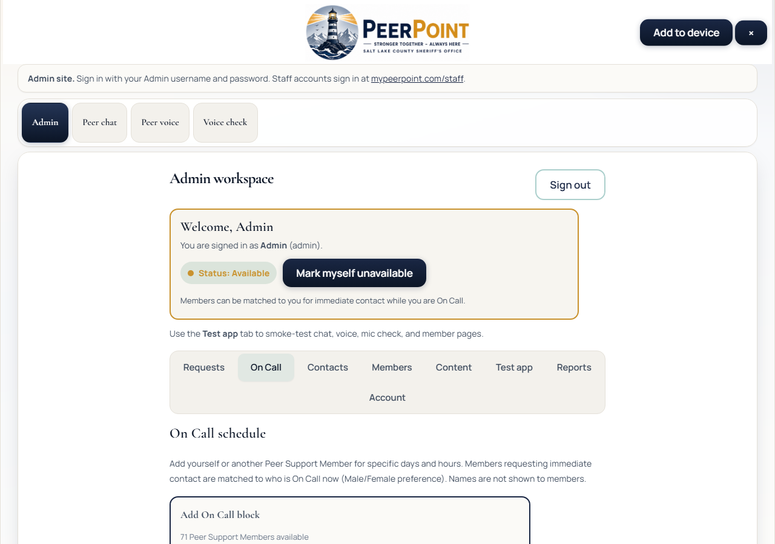
PEERPOINT · ADMIN
On Call (Admin)
Schedule any Peer Support Member
• Admins can schedule any Peer Support Member
• Require availability acknowledgment
• Keep coverage continuous for employees
PEERPoint · Admin · Emergencies 911 · Crisis 988 · Peer line 801-548-8002 · 4/8
Notes:
Admins can schedule any Peer Support Member on On Call. Require availability acknowledgment before saving blocks, and keep coverage continuous so Sheriff’s Office employees can get help.

Slide 5
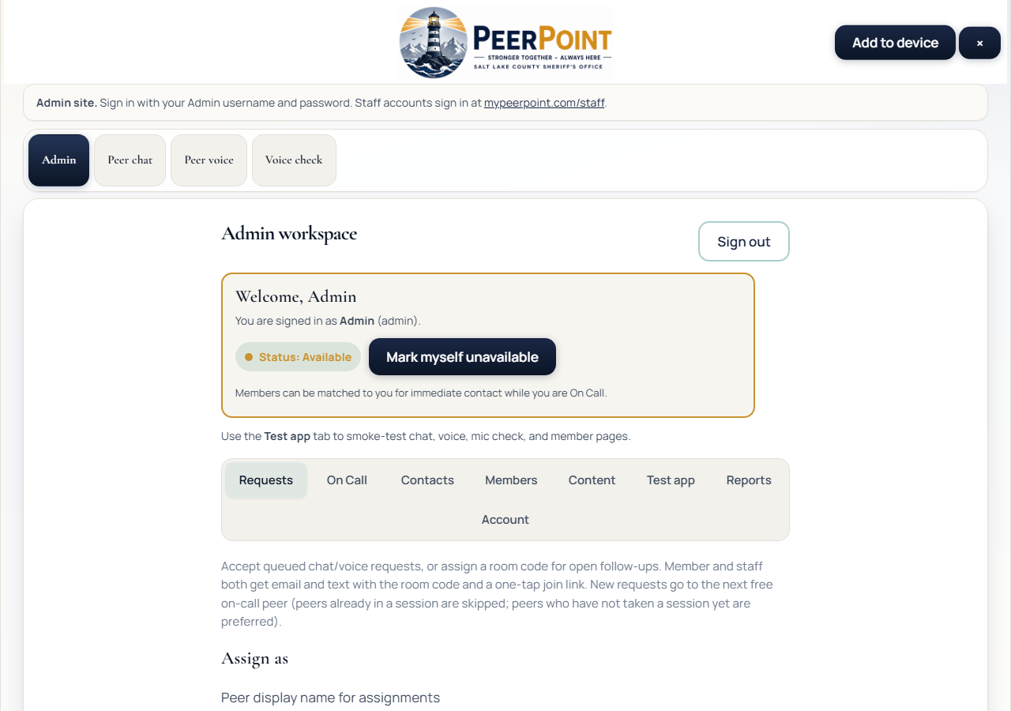
PEERPOINT · ADMIN
Requests queue
Employee requests + assignment
• Refresh for new employee requests
• Assign / accept flows
• Close completed requests
• Confirm alerts reach Peer Support Members
PEERPoint · Admin · Emergencies 911 · Crisis 988 · Peer line 801-548-8002 · 5/8
Notes:
Use the Requests queue for oversight of help requests from Sheriff’s Office employees: refresh for new work, assign or accept as needed, close completed requests, and confirm that in-app alerts and email or SMS reach Peer Support Members.

Slide 6
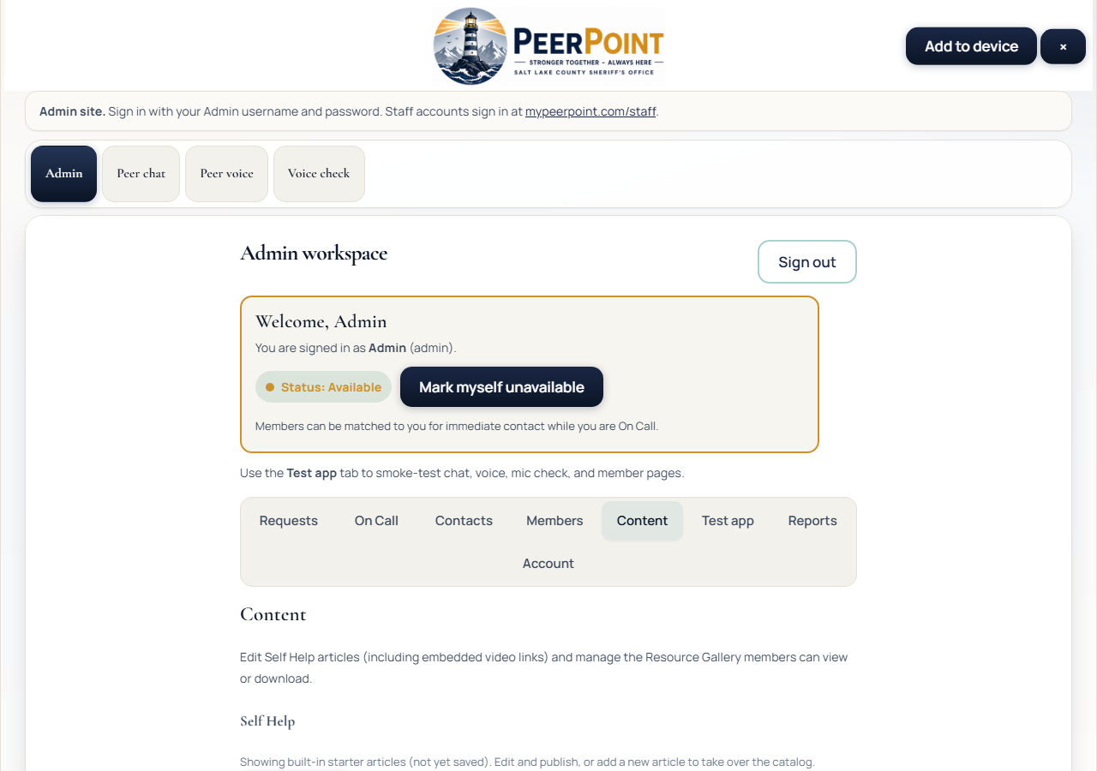
PEERPOINT · ADMIN
Content
Self Help + Resources
• Edit Self Help articles
• Embed video links
• Upload Resource Gallery files
• Publish or reset built-ins
PEERPoint · Admin · Emergencies 911 · Crisis 988 · Peer line 801-548-8002 · 6/8
Notes:
In Content, edit Self Help articles, embed video links, upload Resource Gallery files, and publish or reset to built-in articles when needed. Employees see this content on the member site.

Slide 7
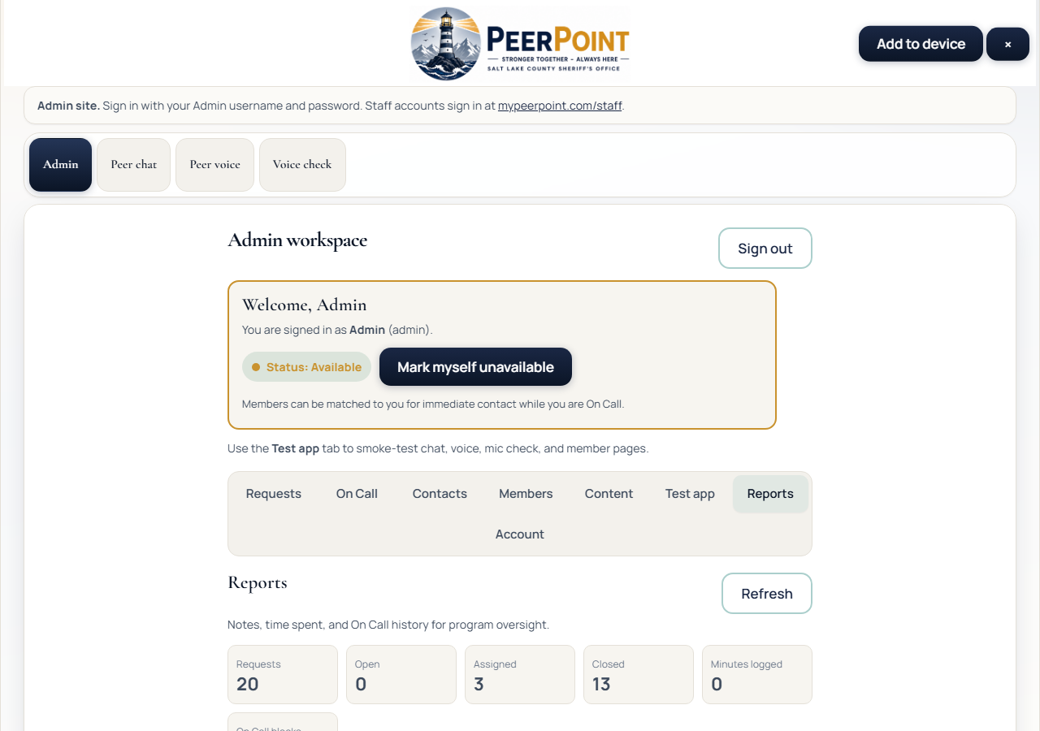
PEERPOINT · ADMIN
Reports
Program metrics
• Open / assigned / closed totals
• Minutes by Peer Support Member
• Notes and On Call history
• Refresh after staff log time
PEERPoint · Admin · Emergencies 911 · Crisis 988 · Peer line 801-548-8002 · 7/8
Notes:
Reports show open, assigned, and closed totals, minutes by Peer Support Member, notes, and On Call history. Refresh after Peer Support Members log notes or time.

Slide 8
PEERPOINT · ADMIN
Admin quick checklist
• Sign in at admin.mypeerpoint.com.
• Invite Peer Support Members / Admins; designate Leaders.
• Keep On Call coverage current.
• Monitor employee request queue + alert delivery.
• Maintain Content; review Reports.
PEERPoint · Admin · Emergencies 911 · Crisis 988 · Peer line 801-548-8002 · 8/8
Notes:
Admin checklist: sign in at admin dot my Peer Point dot com; invite Peer Support Members and Admins and designate Leaders; keep On Call current; monitor the employee request queue and alert delivery; maintain Content and review Reports. Thank you for running Peer Point for the team.

