Slide 1

PEERPOINT · SALT LAKE COUNTY SHERIFF'S OFFICE
Peer Support Leaders
Coverage, escalation, and keeping the team ready — with screenshots
For designated Peer Support Leaders
mypeerpoint.com · admin.mypeerpoint.com
Notes:
Welcome to Peer Point Leader training. Leaders are Peer Support Members with extra coverage responsibilities. You help make sure Sheriff’s Office employees can reach peer support when they need it.

Slide 2
PEERPOINT · LEADERS
What Leaders do
• Same day-to-day tools as Peer Support Members (queue, On Call, chat/voice).
• Extra: notified when coverage gaps happen or peers decline.
• Admins designate Leaders under Members (Make Leader).
• Help keep On Call filled and step in when employees are waiting.
PEERPoint · Leaders · Emergencies 911 · Crisis 988 · Peer line 801-548-8002 · 2/7
Notes:
Leaders have the same day-to-day tools as Peer Support Members — the queue, On Call, chat, and voice. Additionally, Leaders are notified when no free On Call peer is available, or when a peer declines. Admins designate Leaders under Members with Make Leader. Your job is to keep coverage filled and step in when a Sheriff’s Office employee is waiting.

Slide 3
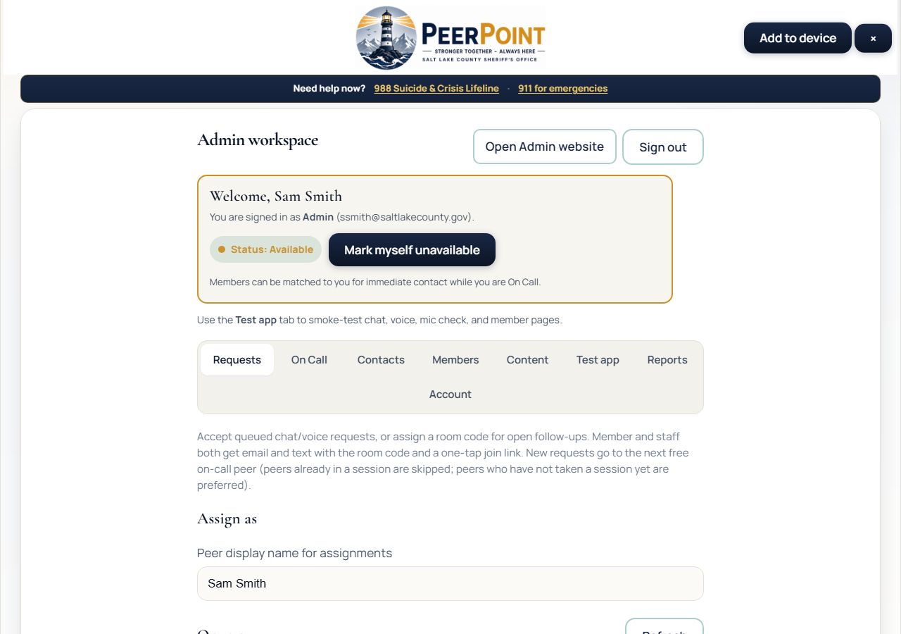
PEERPOINT · LEADERS
Staff workspace (Leaders use this too)
Daily starting point
• Stay Available when covering
• Watch Requests while On Call
• Respond quickly to waiting employees
PEERPoint · Leaders · Emergencies 911 · Crisis 988 · Peer line 801-548-8002 · 3/7
Notes:
Start in the staff workspace. Stay Available when you are covering, watch Requests while On Call, and respond quickly when a Sheriff’s Office employee is waiting.

Slide 4
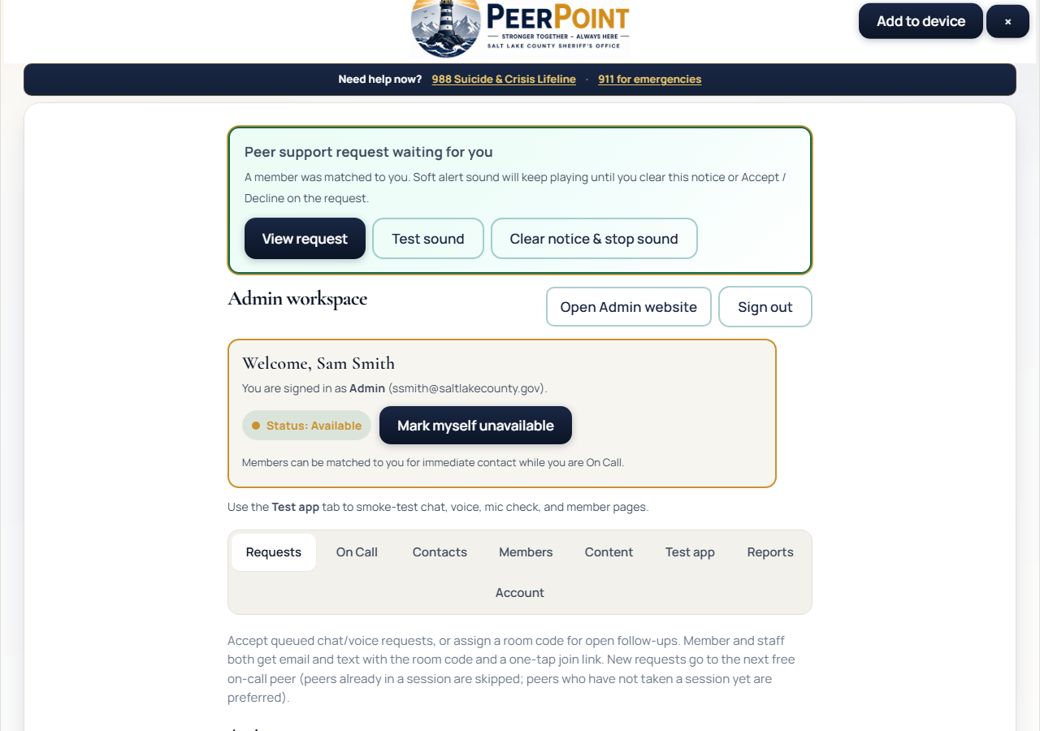
PEERPOINT · LEADERS
Assignment / coverage pressure
Don’t ignore blinking alerts
• If you are matched — Accept or Decline promptly
• Declines can notify Leaders
• Find backup coverage when needed
PEERPoint · Leaders · Emergencies 911 · Crisis 988 · Peer line 801-548-8002 · 4/7
Notes:
Do not ignore blinking assignment alerts. If you are matched, Accept or Decline promptly. Declines can notify Leaders — find backup coverage or take the request yourself when you can.

Slide 5
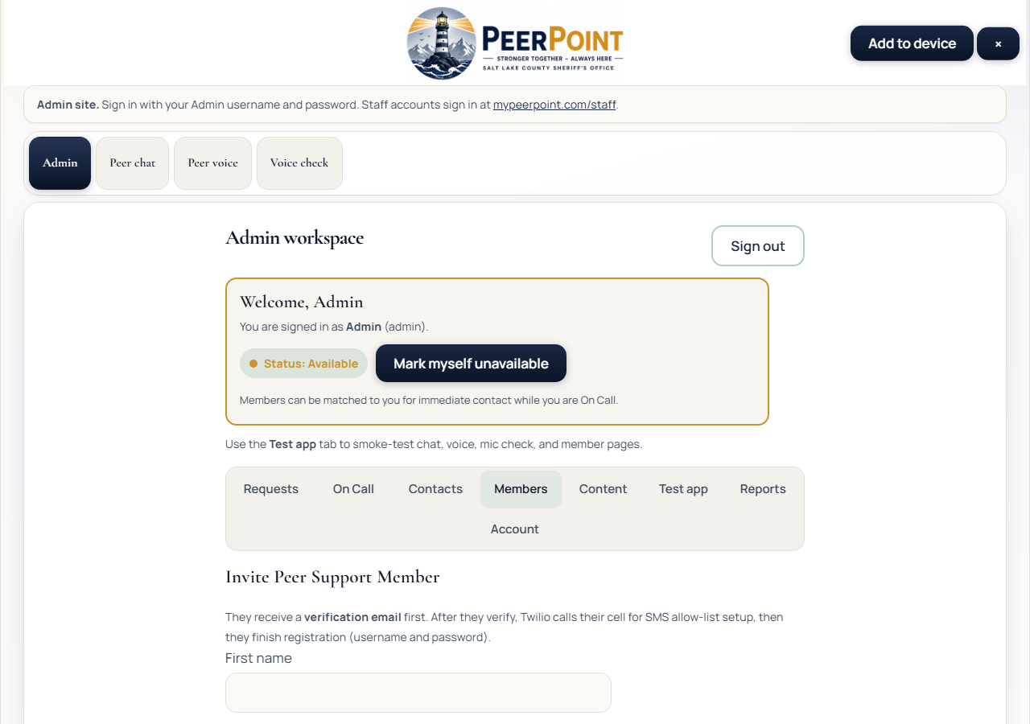
PEERPOINT · LEADERS
Peer Support Members roster (Admin view)
Leader designation lives here
• Admins mark Peer Support Leaders
• Confirm your Leader flag is set
• Help Peer Support Members finish setup / verify
PEERPoint · Leaders · Emergencies 911 · Crisis 988 · Peer line 801-548-8002 · 5/7
Notes:
Leader designation lives on the Members roster in the Admin site — that roster is Peer Support Members, not Sheriff’s Office employees requesting help. Confirm your Leader flag is set, and help teammates finish registration and phone verify so the team stays ready.

Slide 6
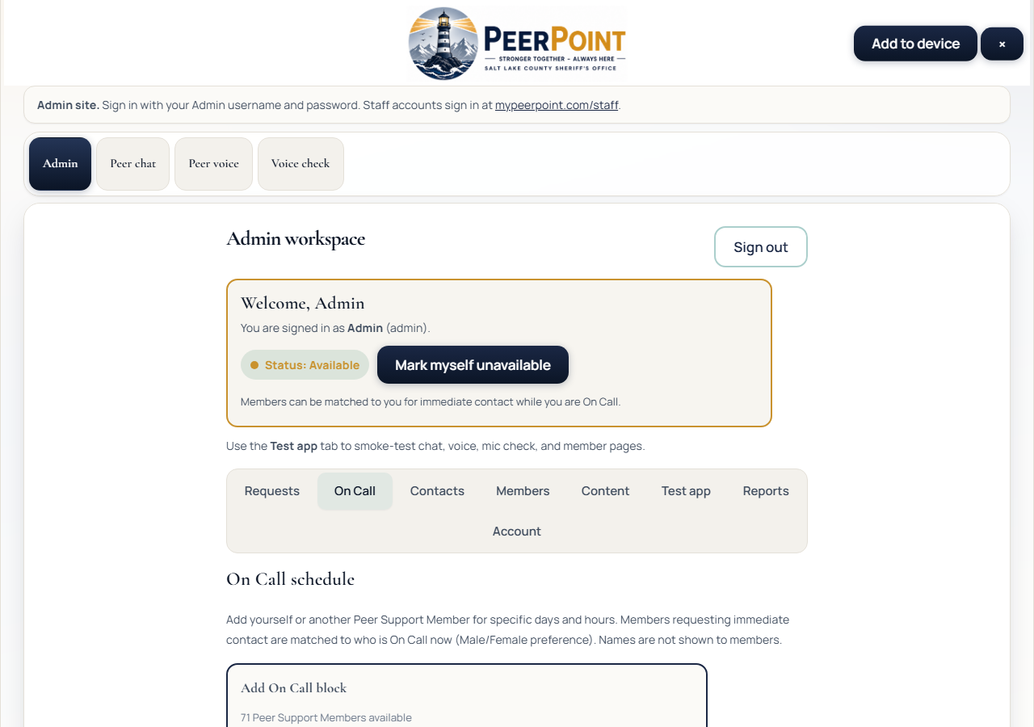
PEERPOINT · LEADERS
On Call coverage
Fill gaps before peak times
• Review today’s schedule
• Ask Peer Support Members to add blocks
• Admins can schedule others if needed
PEERPoint · Leaders · Emergencies 911 · Crisis 988 · Peer line 801-548-8002 · 6/7
Notes:
Review today’s On Call schedule and fill gaps before peak times. Ask Peer Support Members to add blocks, or ask an Admin to schedule coverage when needed.

Slide 7
PEERPOINT · LEADERS
Leader quick checklist
• Confirm Leader designation on the roster.
• Check On Call coverage each shift day.
• Act on gap / decline notifications quickly.
• Step in or find a Peer Support Member when an employee is waiting.
PEERPoint · Leaders · Emergencies 911 · Crisis 988 · Peer line 801-548-8002 · 7/7
Notes:
Leader checklist: confirm your designation; check On Call each shift day; act quickly on gap and decline notifications; step in or find a Peer Support Member when a Sheriff’s Office employee is waiting. Thank you for leading coverage for the team.

