Slide 1

PEERPOINT · SALT LAKE COUNTY SHERIFF'S OFFICE
Employee training
How to request peer support and use Peer Point — with screenshots
For Salt Lake County Sheriff’s Office employees requesting confidential peer support
mypeerpoint.com · admin.mypeerpoint.com
Notes:
Welcome to Peer Point training for Salt Lake County Sheriff’s Office employees. This short guide shows how to unlock the site, request peer support, and use chat or voice. Peer Support Members are the peers who provide that support. Take your time — you can pause and replay any slide.

Slide 2
PEERPOINT · EMPLOYEE
What Peer Point is (and is not)
• Peer Point connects Salt Lake County Sheriff’s Office employees with Peer Support Members.
• Peer Support Members are peers who work in the Peer Support program to help employees.
• It is not clinical care, therapy, or emergency services.
• Chat and voice are not recorded by the agency in this app.
• Crisis help stays visible: 988, 911, and the peer support line.
PEERPoint · Employee · Emergencies 911 · Crisis 988 · Peer line 801-548-8002 · 2/11
Notes:
Peer Point is peer support for Salt Lake County Sheriff’s Office employees. It connects you with Peer Support Members — peers who work within Peer Support to help employees. It is not clinical care, therapy, or emergency services. Chat and voice are not recorded by the agency in this app. If you are in immediate danger, call 911. For crisis support, call or text 988. The peer support line also stays available on the site.

Slide 3
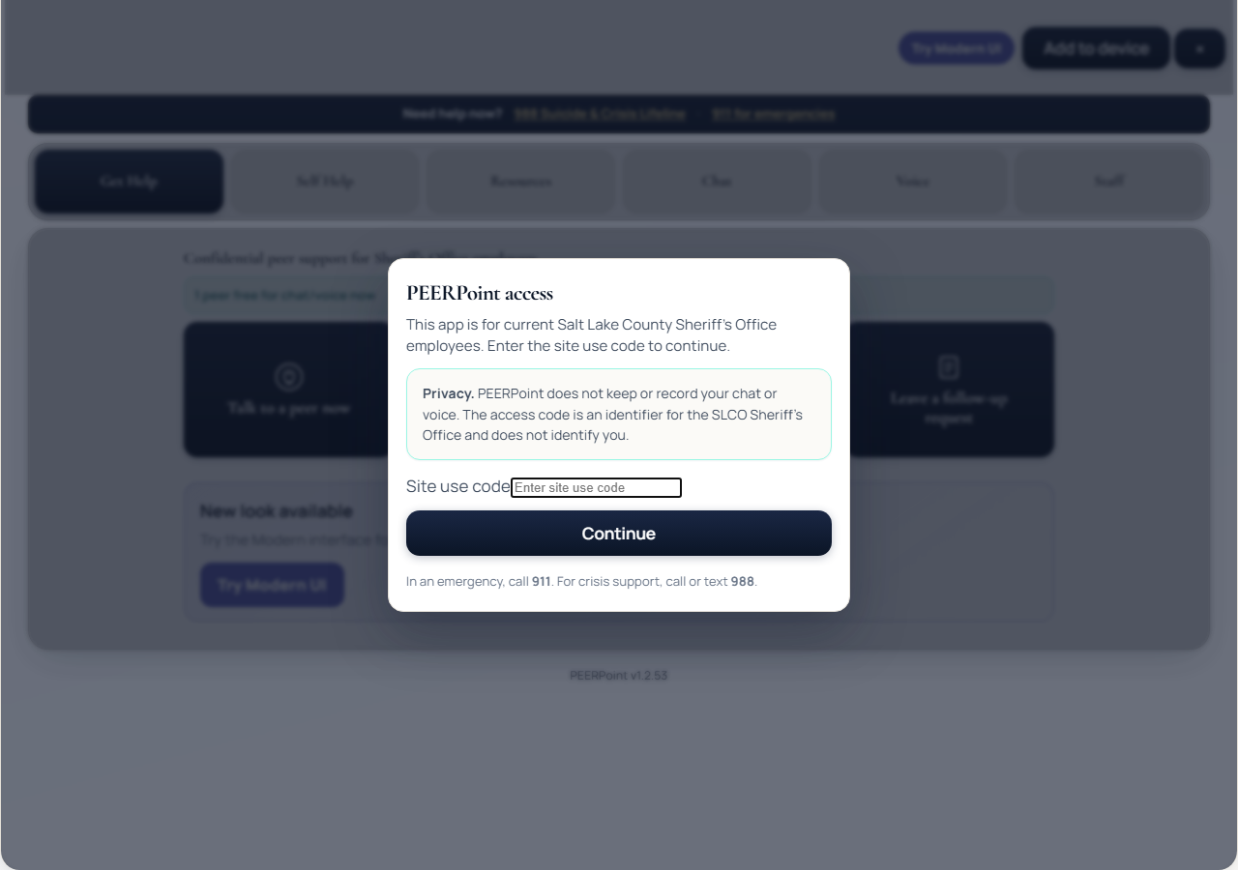
PEERPOINT · EMPLOYEE
Step 1 — Unlock the site
Site use code: slcoso
• Open https://mypeerpoint.com
• Site use code: slcoso
• Enter the code, then tap Continue
• Required each time you open the app
• Do NOT share this code outside the Sheriff’s Office
PEERPoint · Employee · Emergencies 911 · Crisis 988 · Peer line 801-548-8002 · 3/11
Notes:
Open my Peer Point dot com on your phone or computer. The site use code is S L C O S O — S-L-C-O-S-O. Enter that code, then tap Continue. You will need this code each time you open the app, including when it is installed on your home screen. Important: do not give this code to anyone outside the Sheriff’s Office. It is only for current Salt Lake County Sheriff’s Office employees. The code identifies the workplace — it does not identify you personally.

Slide 4
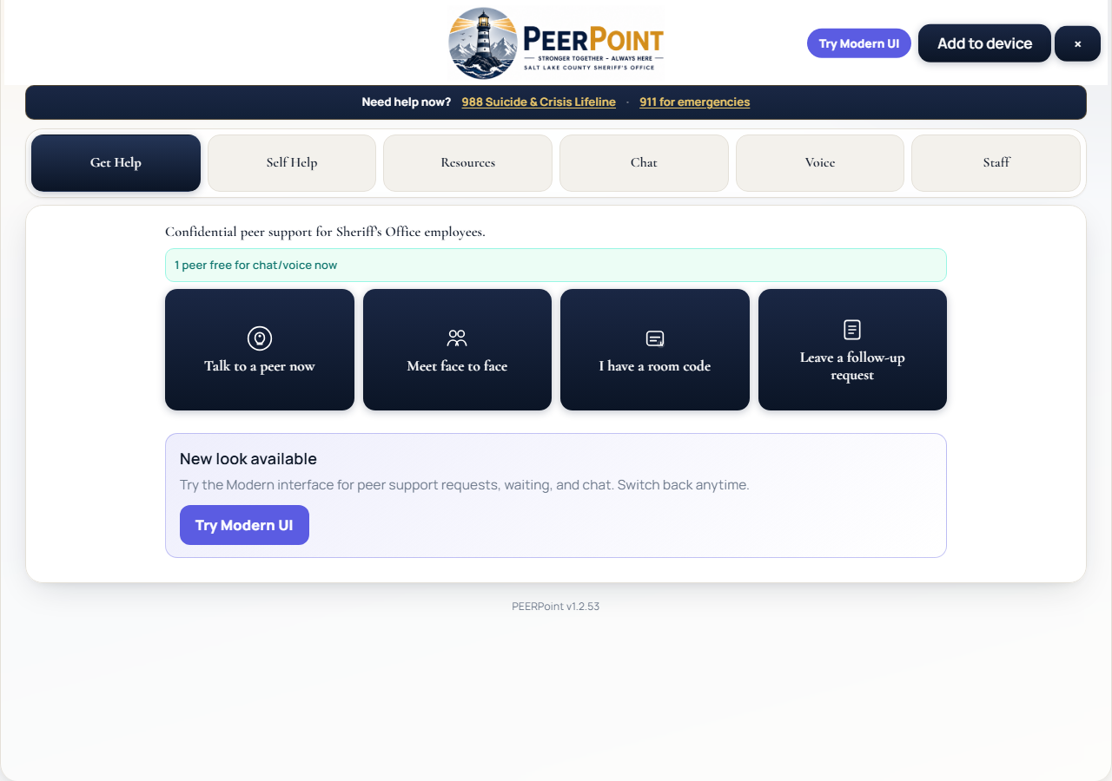
PEERPOINT · EMPLOYEE
Step 2 — Home / Get Help
Request peer support
• Choose Talk to a peer now or leave a follow-up request
• Phone + email are required
• Name is optional
• Confirm consent before submit
PEERPoint · Employee · Emergencies 911 · Crisis 988 · Peer line 801-548-8002 · 4/11
Notes:
After unlock, you land on Get Help. You can talk to a Peer Support Member now, meet face to face when available, join with a room code, or leave a follow-up request. Phone and email are required so Peer Support can reach you. Your name is optional. Confirm consent that this is peer support — not emergency care — before you submit.

Slide 5
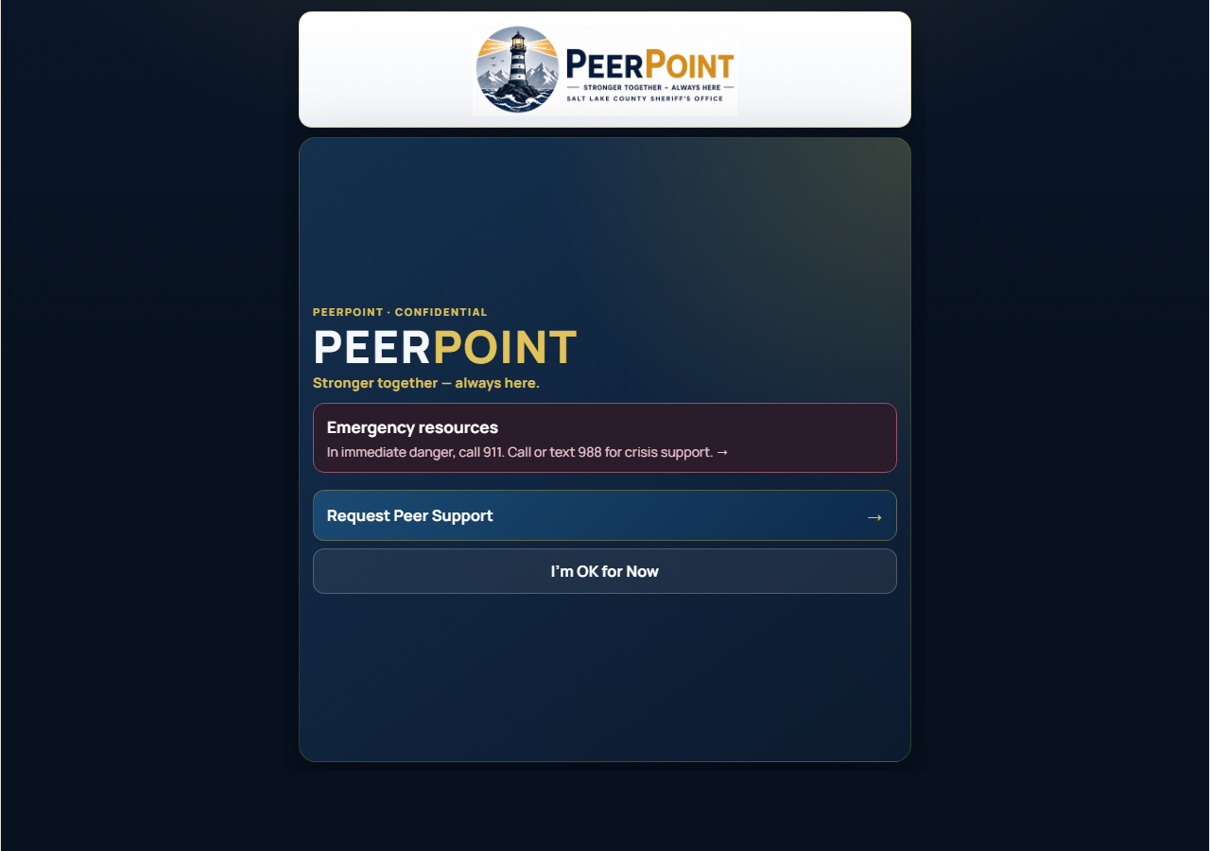
PEERPOINT · EMPLOYEE
Modern Home (optional)
Try Modern UI
• Same Peer Point — updated layout
• Home, Resources, Check-ins, More
• Request Help starts from here
PEERPoint · Employee · Emergencies 911 · Crisis 988 · Peer line 801-548-8002 · 5/11
Notes:
Optional: tap Try Modern UI for an updated layout with Home, Resources, Check-ins, and More. It is the same Peer Point. You can switch back anytime.

Slide 6
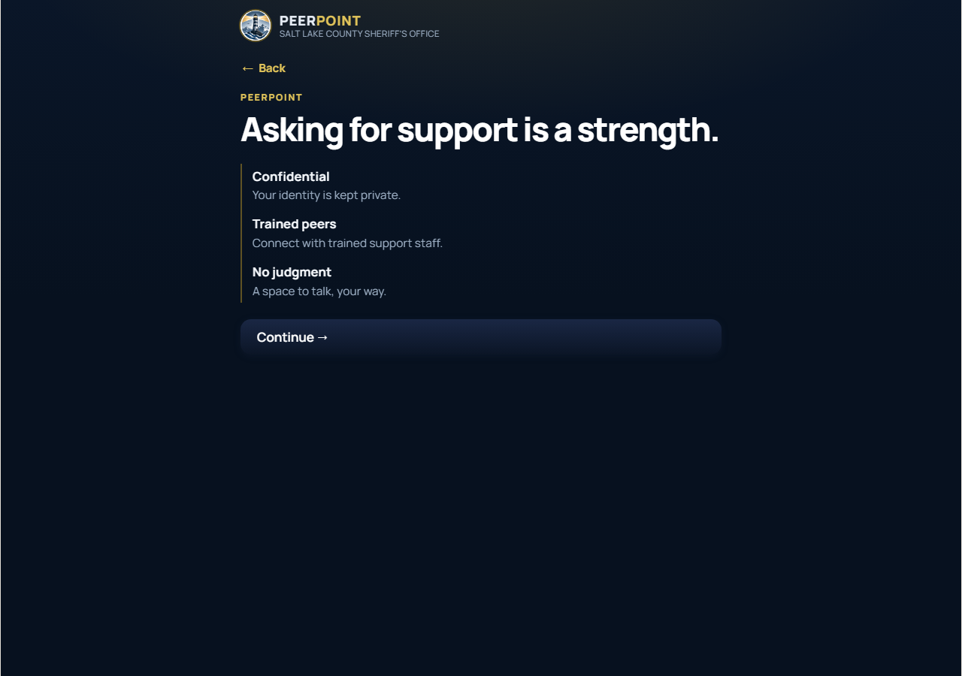
PEERPOINT · EMPLOYEE
Step 3 — Start a request
Request intro
• Pick chat, voice, form, or face-to-face
• Set peer preferences if offered
• Stay on the page for immediate contact
PEERPoint · Employee · Emergencies 911 · Crisis 988 · Peer line 801-548-8002 · 6/11
Notes:
Choose how you want contact — chat, voice, a form follow-up, or face-to-face. If preferences are offered, you can ask for anyone, a specific Peer Support Member, civilian or sworn, or male or female matching. For immediate chat or voice, stay on the page while an On Call Peer Support Member is notified.

Slide 7
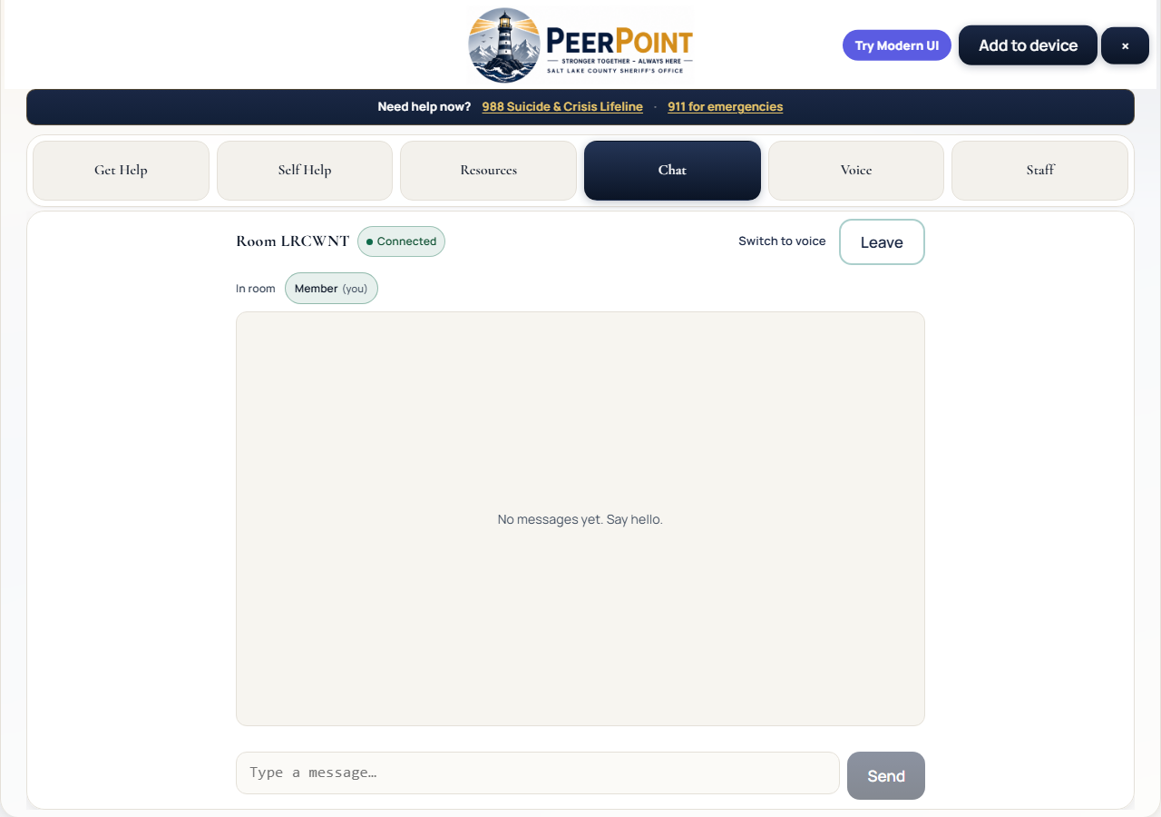
PEERPOINT · EMPLOYEE
Step 4 — Waiting in the room
Chat room connected
• You may wait briefly for a Peer Support Member
• Room code reconnects you if dropped
• Codes expire after 24 hours unused
PEERPoint · Employee · Emergencies 911 · Crisis 988 · Peer line 801-548-8002 · 7/11
Notes:
When a room opens, you will see Connected and may wait briefly for a Peer Support Member. If you get disconnected, use the same room code or join link to reconnect. Room codes expire after twenty-four hours with no use.

Slide 8
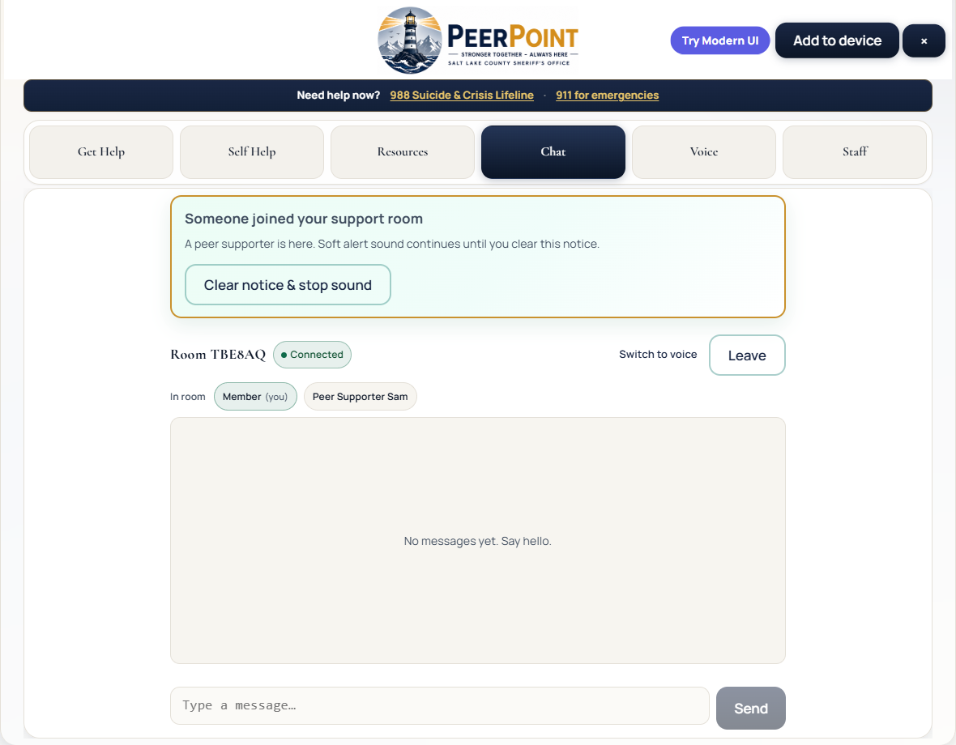
PEERPOINT · EMPLOYEE
Step 5 — Peer joined alert
Blinking banner + soft sound
• Banner appears when a Peer Support Member joins
• Soft alert may play (tap page once if muted by browser)
• Clear the notice when ready
PEERPoint · Employee · Emergencies 911 · Crisis 988 · Peer line 801-548-8002 · 8/11
Notes:
When a Peer Support Member joins, a blinking banner appears and a soft alert may play. Browsers sometimes block sound until you tap the page once — use Clear notice when you are ready. You can then chat, or switch to voice with the same room code.

Slide 9
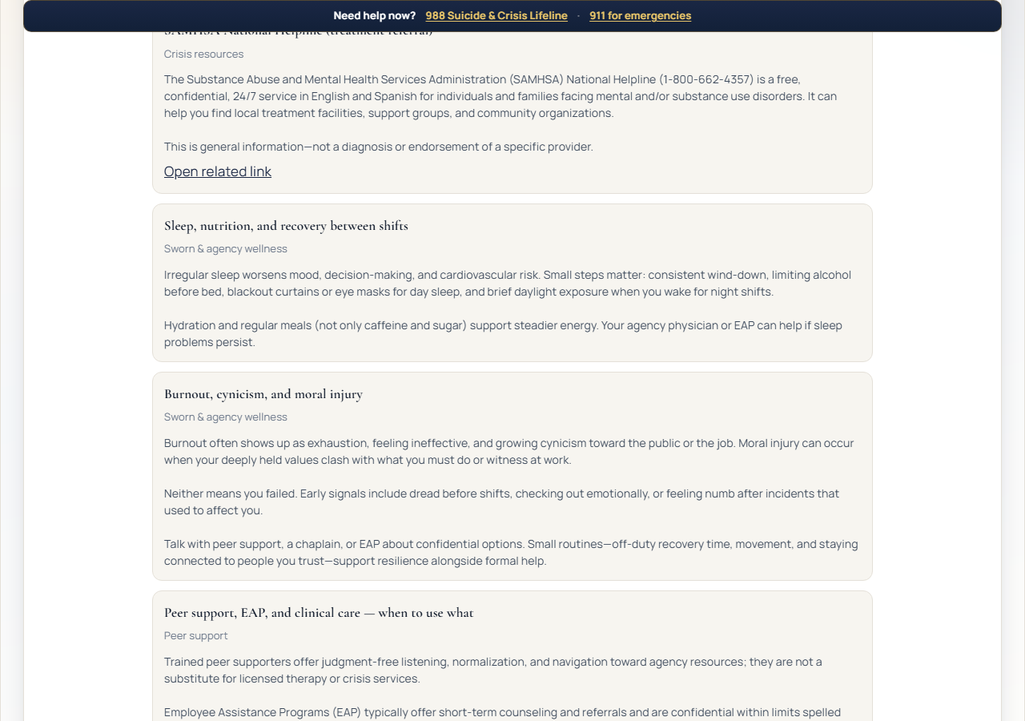
PEERPOINT · EMPLOYEE
Self Help
Articles anytime
• Works offline
• Nothing is sent when you read
• Not a substitute for 911 / 988
PEERPoint · Employee · Emergencies 911 · Crisis 988 · Peer line 801-548-8002 · 9/11
Notes:
Self Help articles are available anytime and work offline. Nothing is sent to a server when you read them. These tools support you — they do not replace 911 or 988 when you need crisis help.

Slide 10

PEERPOINT · EMPLOYEE
Resources
Videos & gallery
• Curated by Admins
• Includes coloring pages
• Use alongside peer support
PEERPoint · Employee · Emergencies 911 · Crisis 988 · Peer line 801-548-8002 · 10/11
Notes:
Resources may include videos, downloads, and coloring pages curated by Admins. Use them alongside peer support whenever you need a quieter grounding option.

Slide 11
PEERPOINT · EMPLOYEE
Employee quick checklist
• Unlock with site use code: slcoso (Sheriff’s Office only — do not share outside).
• Request Help → choose contact mode → submit.
• Wait for a Peer Support Member; watch for join banner / email / SMS.
• Chat or voice; reconnect with the same room code if needed.
• Use 911 / 988 when crisis care is needed.
PEERPoint · Employee · Emergencies 911 · Crisis 988 · Peer line 801-548-8002 · 11/11
Notes:
Quick checklist for Salt Lake County Sheriff’s Office employees: unlock with the site use code S L C O S O. Remember — do not share that code with anyone outside the Sheriff’s Office. Then request help and submit; wait for a Peer Support Member and watch for the join banner or email or text; use chat or voice and reconnect with the same room code if needed; and use 911 or 988 when crisis care is needed. Thank you for taking a few minutes to learn Peer Point.

