Slide 1

PEERPOINT · SALT LAKE COUNTY SHERIFF'S OFFICE
Staff / Peer Support Member
Sign in, On Call, accept requests, and support employees — with screenshots
For Peer Support Members who provide peer support to Sheriff’s Office employees
mypeerpoint.com · admin.mypeerpoint.com
Notes:
Welcome to Peer Point staff training. This guide walks Peer Support Members through sign-in, On Call, assignment alerts, and supporting Salt Lake County Sheriff’s Office employees in chat or voice. Peer Support Members provide peer support. Sheriff’s Office employees are the people requesting help.

Slide 2
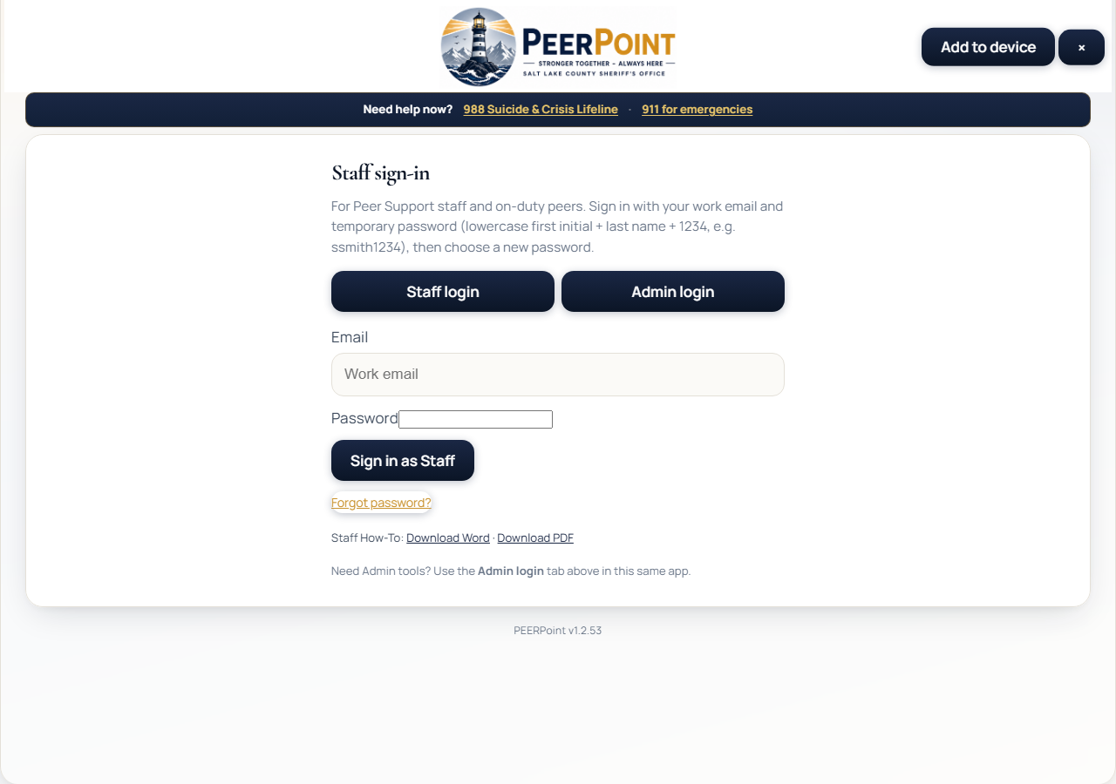
PEERPOINT · STAFF
Sign in
mypeerpoint.com/staff
• Use work email + password
• Not the Admin site
• Change temp password on first login
• Forgot password? Use the reset link
PEERPoint · Staff · Emergencies 911 · Crisis 988 · Peer line 801-548-8002 · 2/8
Notes:
Sign in at my Peer Point dot com slash staff — not the Admin site. Use your work email and password. If you received a temporary password, you must change it before using staff tools. Forgot password sends a one-hour reset link to your email.

Slide 3
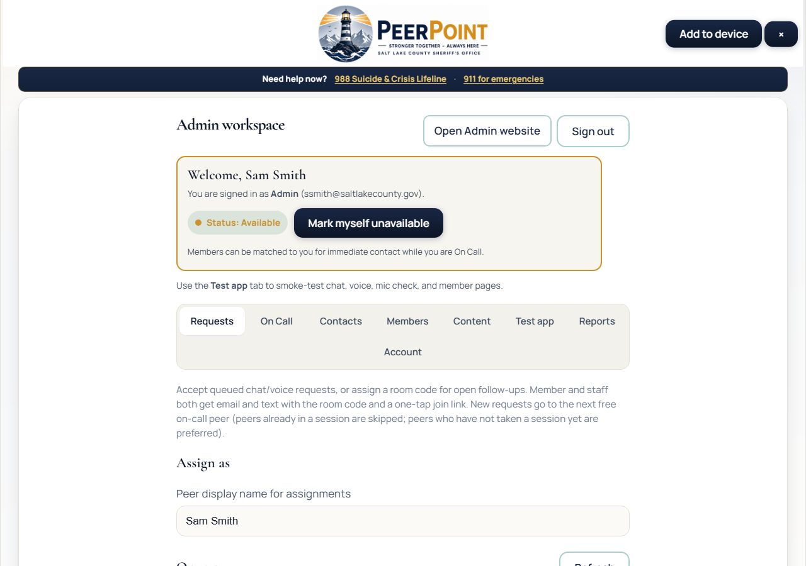
PEERPOINT · STAFF
Staff workspace
Availability + Requests
• Mark yourself Available when ready
• Set peer display name
• Refresh the queue as needed
• Session lasts ~12 hours
PEERPoint · Staff · Emergencies 911 · Crisis 988 · Peer line 801-548-8002 · 3/8
Notes:
In the staff workspace, mark yourself Available when you can take work, and set your peer display name for assignments. Refresh the Requests queue as needed. Your session lasts about twelve hours.

Slide 4
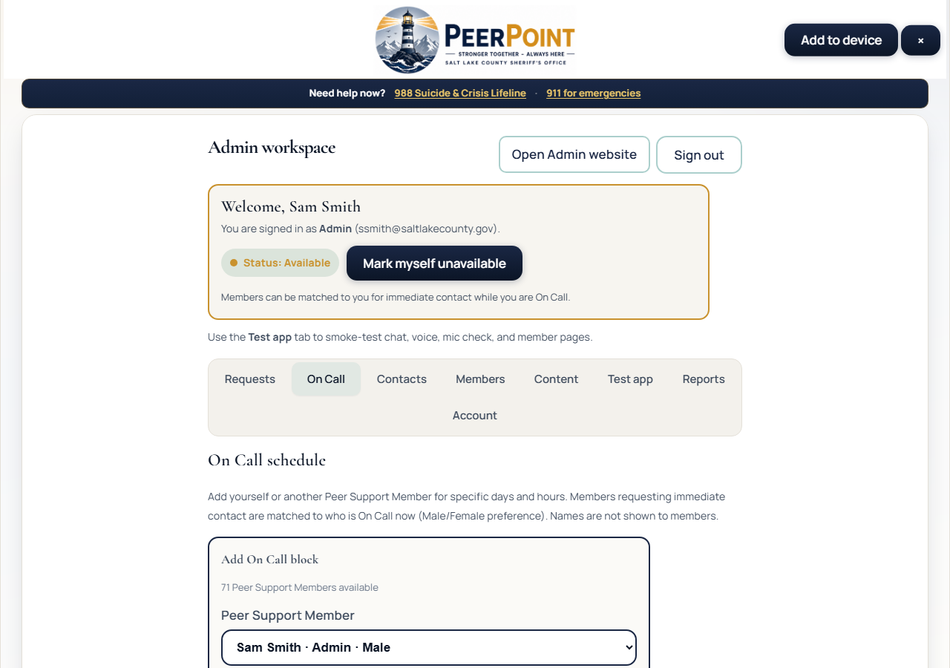
PEERPOINT · STAFF
On Call
Add coverage blocks
• Add day + start/end times
• Acknowledge availability
• Immediate requests match On Call Peer Support Members
• Peer Support Members schedule themselves
PEERPoint · Staff · Emergencies 911 · Crisis 988 · Peer line 801-548-8002 · 4/8
Notes:
Open the On Call tab and add blocks for the days and times you can cover. Acknowledge that you will be available during those times. Immediate chat and voice requests from Sheriff’s Office employees match On Call Peer Support Members, including sex preference when set. Peer Support Members schedule themselves; Admins can schedule others if needed.

Slide 5
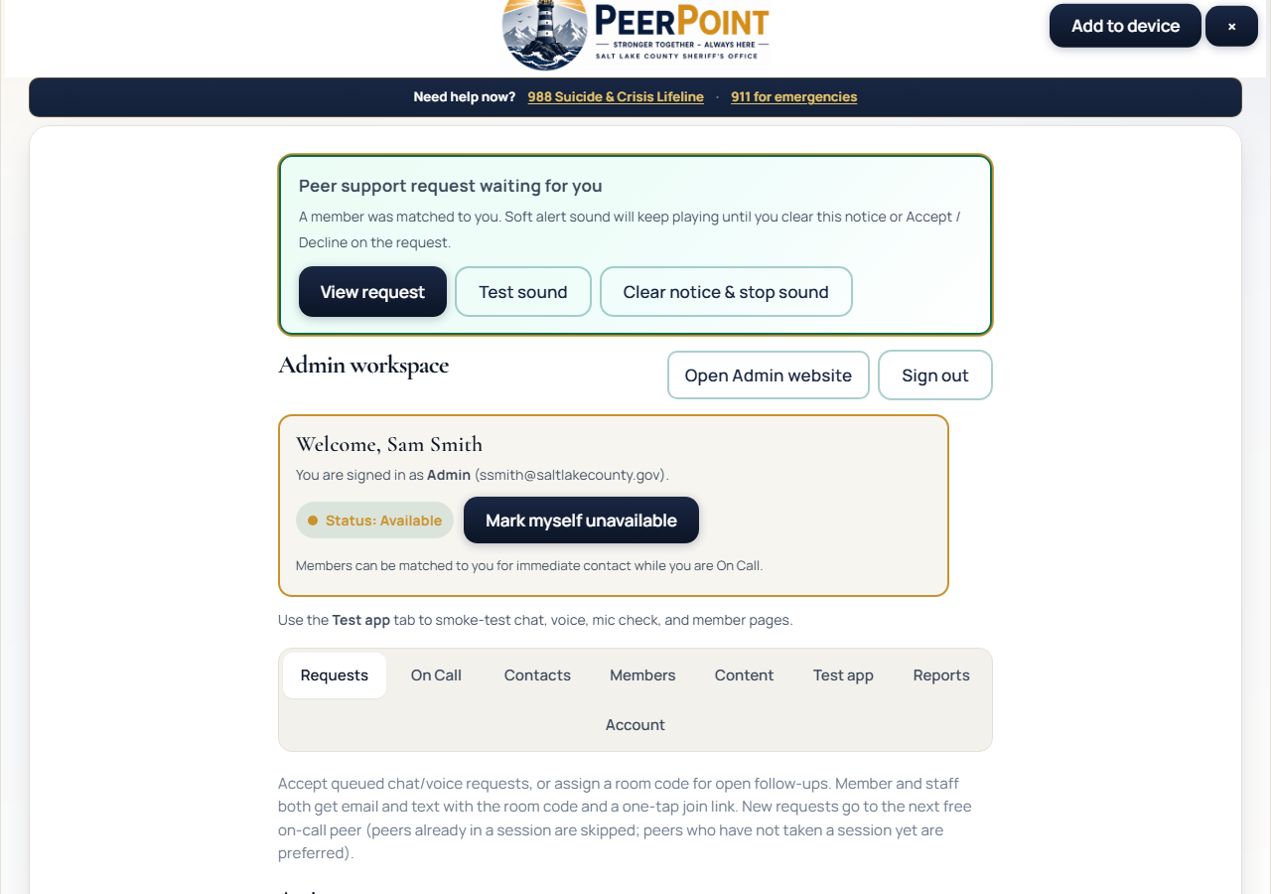
PEERPOINT · STAFF
Assignment alert
Blinking banner + sound loop
• Appears when an employee is matched to you
• Sound loops until Clear / Accept / Decline
• Use Test sound after login if needed
• Tab title also flashes
PEERPoint · Staff · Emergencies 911 · Crisis 988 · Peer line 801-548-8002 · 5/8
Notes:
When a Salt Lake County Sheriff’s Office employee is matched to you, a blinking banner appears and a soft alert loops until you Clear the notice, Accept, or Decline. The browser tab title also flashes so you notice if you are in another tab. If you do not hear sound, click the page once or use Test sound — browsers block audio until a gesture.

Slide 6
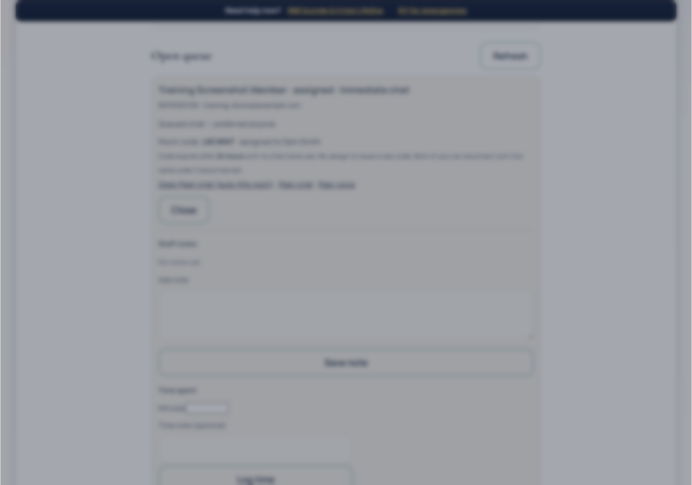
PEERPOINT · STAFF
After Accept
Request assigned
• Alert stops after Accept
• Open Peer chat / voice
• The employee may get email/SMS join link
• Share room code manually if needed
PEERPoint · Staff · Emergencies 911 · Crisis 988 · Peer line 801-548-8002 · 6/8
Notes:
Accept stops the alert and assigns the room. Open Peer chat or Peer voice. The employee may receive an email or text with a join link when configured. If delivery fails, share the room code manually. Codes expire after twenty-four hours unused.

Slide 7
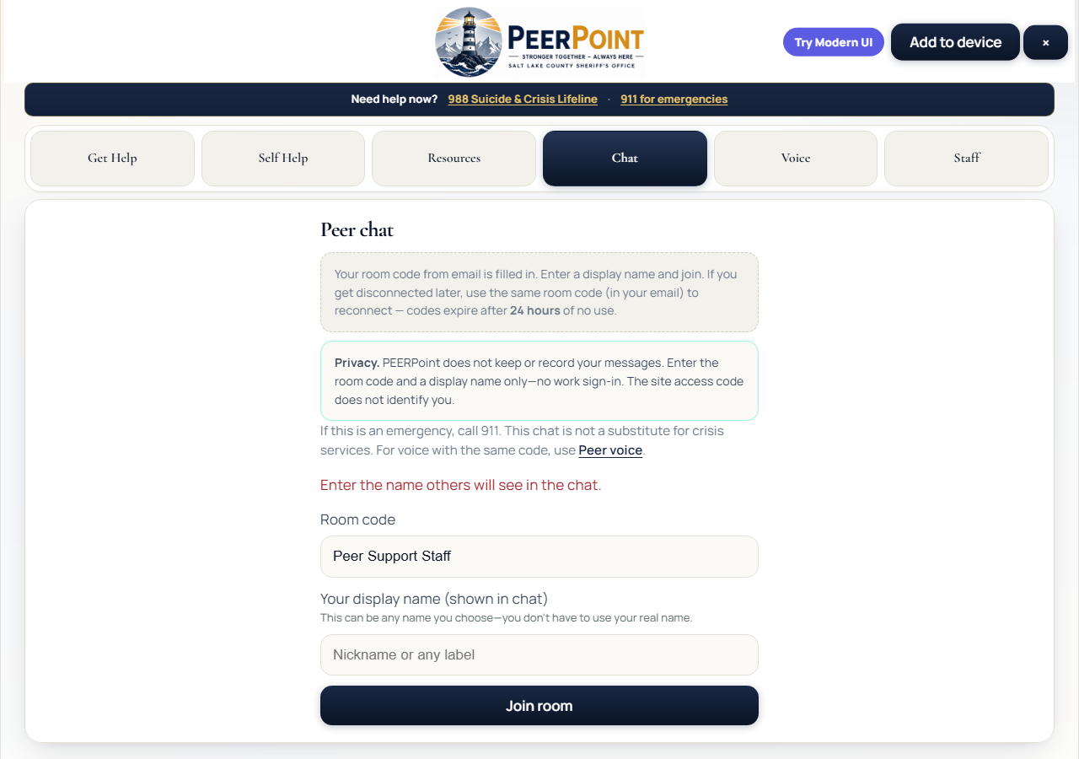
PEERPOINT · STAFF
In chat with the employee
Same room code
• Use any display name you prefer
• Soft chime on new messages
• Add notes + log time on the request
• Close the request when finished
PEERPoint · Staff · Emergencies 911 · Crisis 988 · Peer line 801-548-8002 · 7/8
Notes:
Join with any display name you are comfortable using. A soft chime plays on new messages. Add staff notes and log time on the request, then Close when finished. Do not paste room codes or employee details into public channels.

Slide 8
PEERPOINT · STAFF
Peer Support Member quick checklist
• Sign in → Available + On Call.
• Watch for blinking assignment alerts.
• Accept → join chat/voice → support the employee.
• Notes / time → Close → Sign out.
PEERPoint · Staff · Emergencies 911 · Crisis 988 · Peer line 801-548-8002 · 8/8
Notes:
Checklist for Peer Support Members: sign in, set Available, and add On Call; watch for blinking assignment alerts; Accept and join chat or voice; support the Sheriff’s Office employee; add notes and time; Close; then Sign out. Thank you for supporting your peers.

