Slide 1
Multi-Layered Malware Detection
and Threat Prevention System
B.Tech Project Presentation
Sangam Kumar Mishra (22CS01071)
Guide: Prof. Padmalochan Bera
Indian Institute of Technology Bhubaneswar
School of Electrical and Computer Sciences
April 2026

Slide 2
The Problem
Drones send images, videos, telemetry, and archives to edge networks.
Attackers can hide malware inside this data.
• Malware hides inside encrypted archives, nested containers, or metadata
• Running a full sandbox on every file is too slow
• A new drone has no history — cannot be scored on past behavior
• Attackers keep changing tactics — fixed rules become outdated
Goal: Build a multi-layer defense that catches malware at the entry point,
scores risk smartly, and adapts over time.

Slide 3
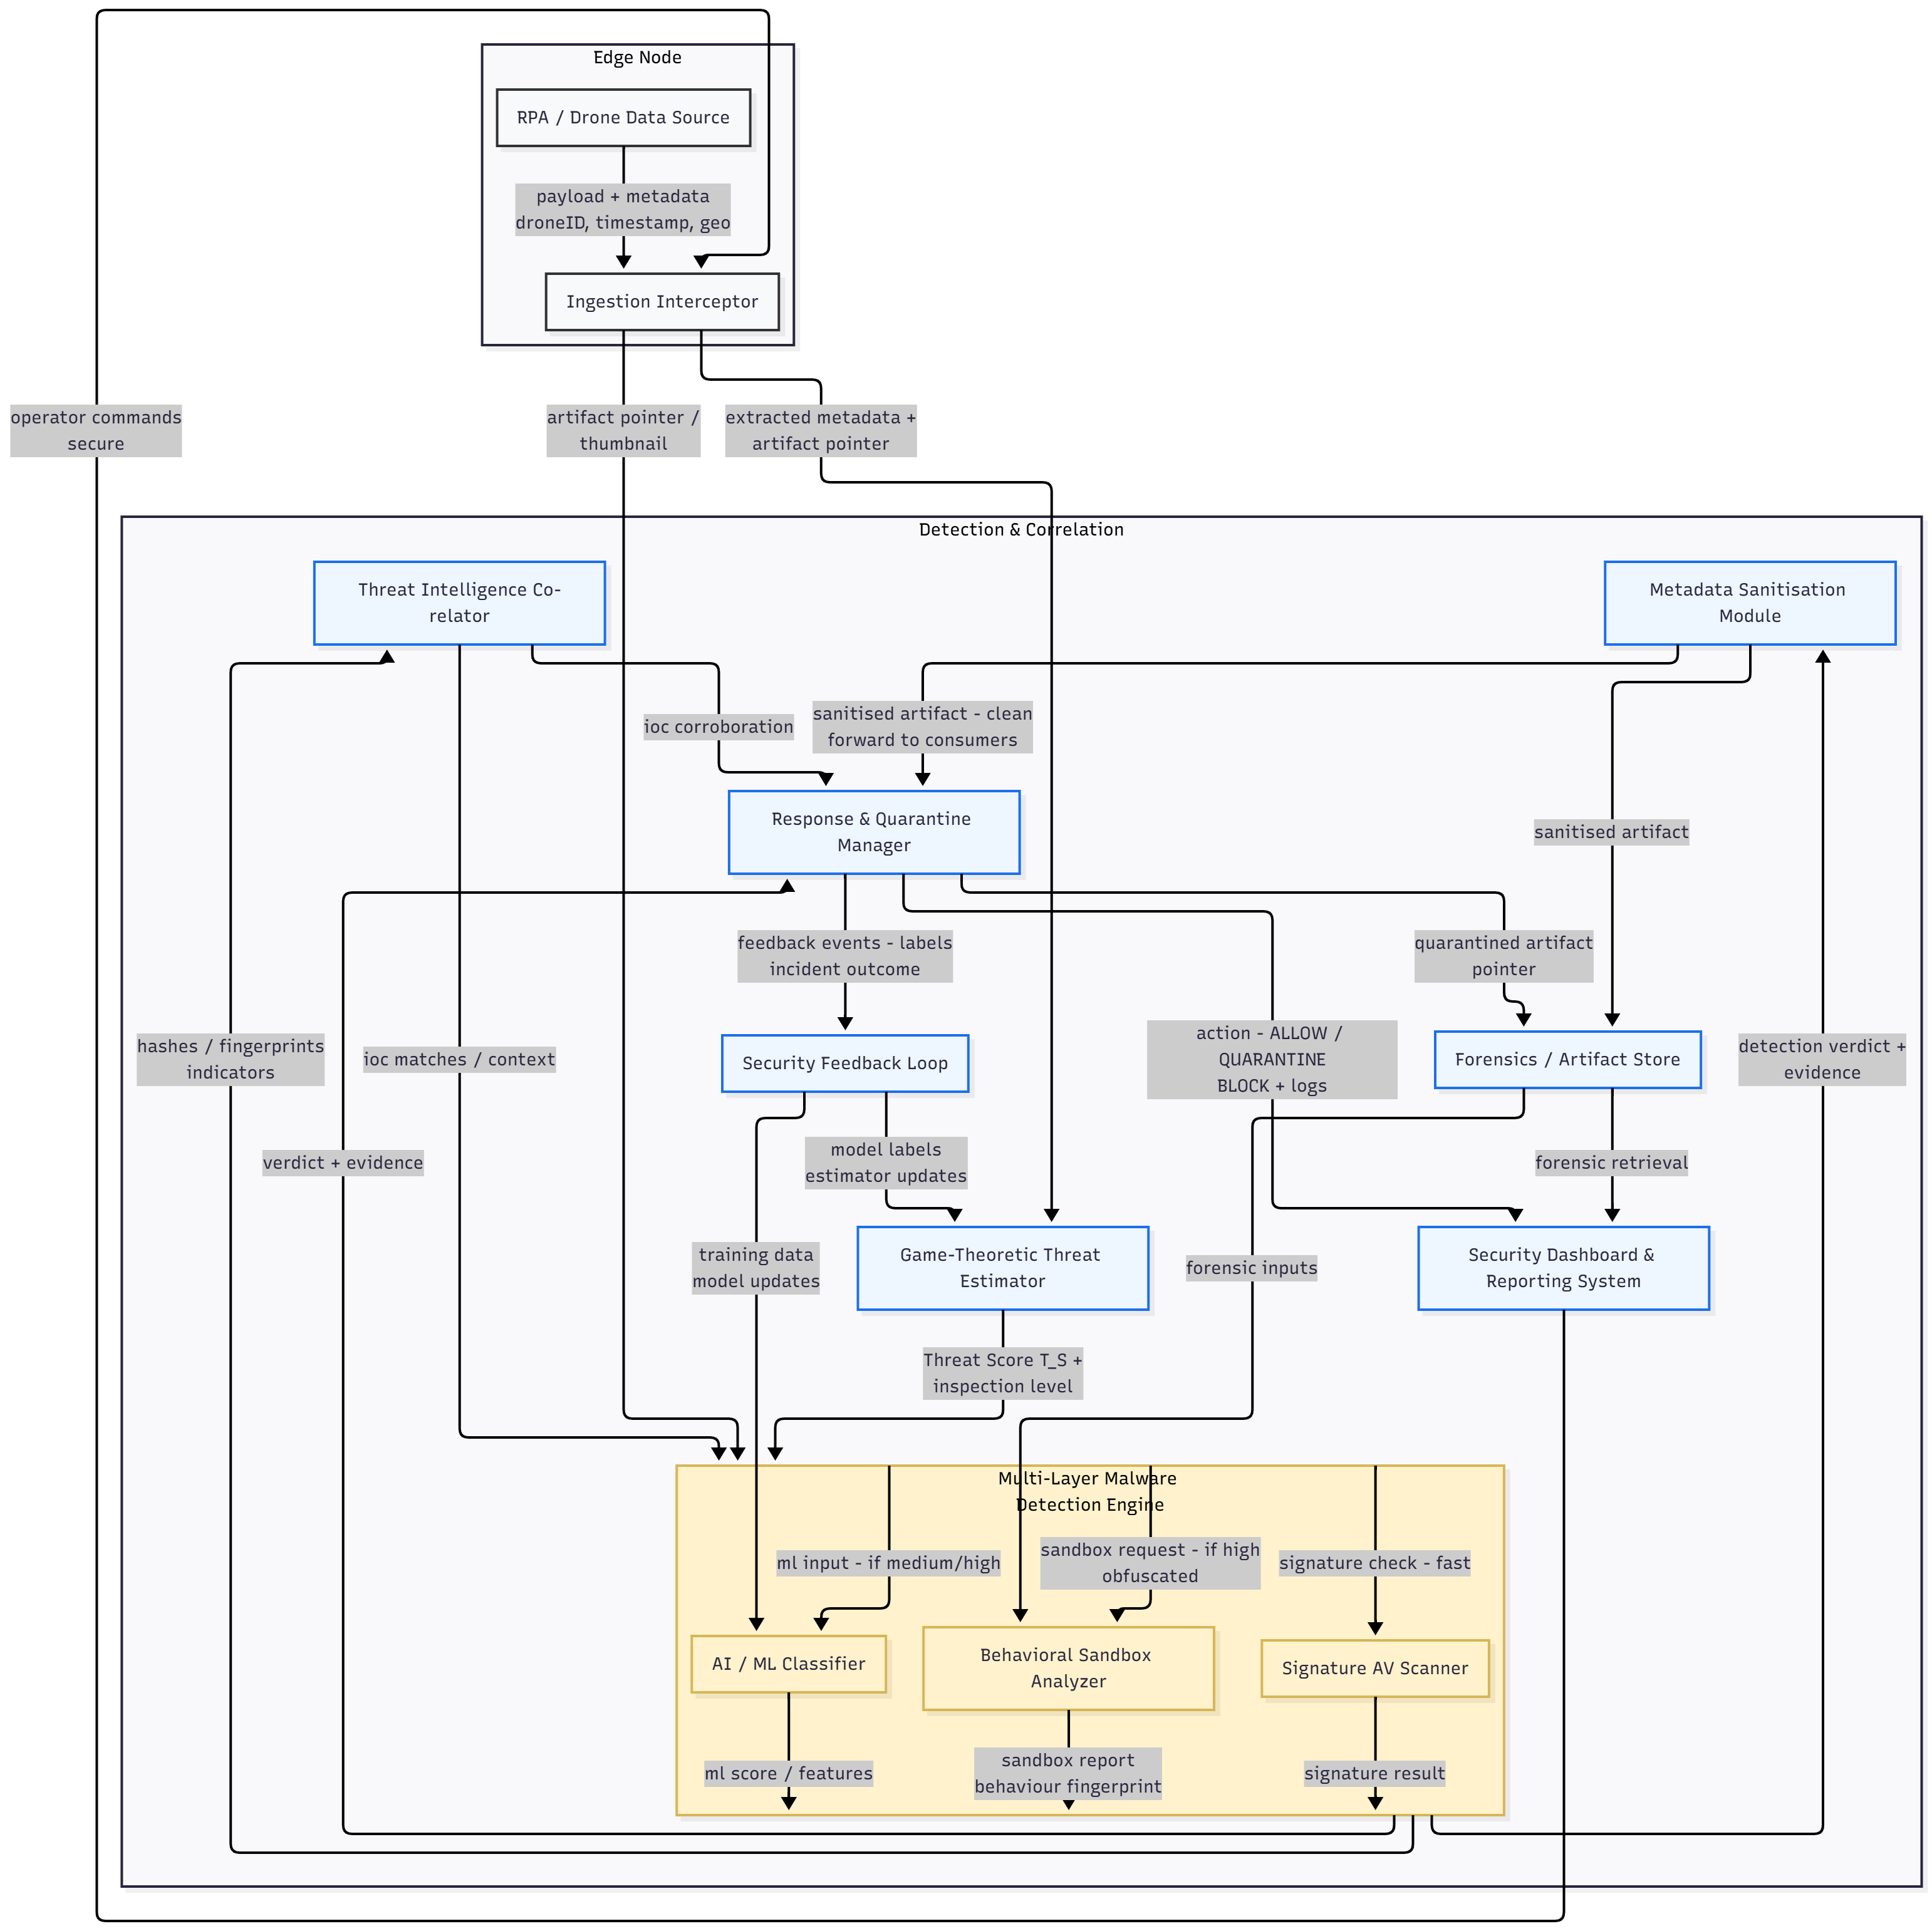
System Architecture
9 modules in the pipeline — 4 built in this project
My contributions
• Game-Theoretic Threat Estimator
• Ingestion Interceptor
• Sandbox Analyzer
• Metadata Sanitizer
269 unit tests across 4 modules
Other 5 modules have ready integration seams

Slide 4
Game-Theoretic Threat Estimator
Scores risk and picks the inspection depth
• Models inspection as a game between Defender and Attacker
• Defender picks: Signature scan / AI-ML / Sandbox
• Attacker picks: No attack / Inject / Obfuscated inject
• System finds the Stackelberg equilibrium — best defense knowing attacker's best response
• Three features that make it practical:
‣ Bayesian cold-start — new drones scored from zone + file type, no history needed
‣ Adaptive thresholds — Low/Med/High boundaries move based on live FPR and FNR
‣ Full audit trail — every factor can be inspected and replayed

Slide 5
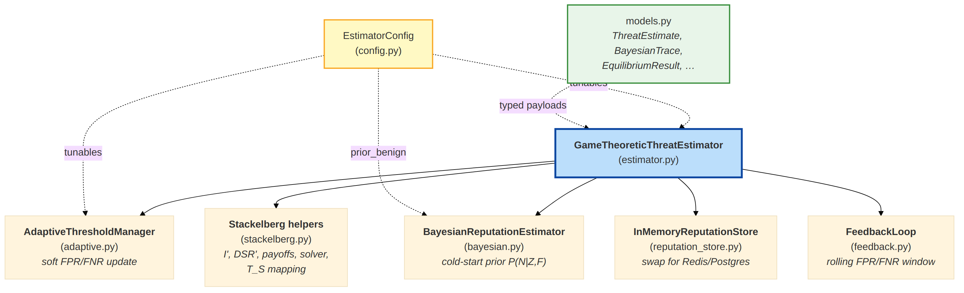
Threat Estimator: How It Works
Input
IngestResult from the Ingestion Interceptor
(drone ID, zone, file types, insecure flags)
Output
• Threat Score T_S (0 to 1)
• Inspection level: Low / Medium / High
• Ordered route: [signature], [signature, ml], or all three
Cold-start example
A ZIP file arrives from a risky zone. Prior P(benign) = 0.85
R = (0.85 x 0.12 x 0.08) / (0.00816 + 0.15 x 0.35 x 0.45) = 0.257
This low reputation (25.7%) pushes the submission toward deeper inspection.

Slide 6
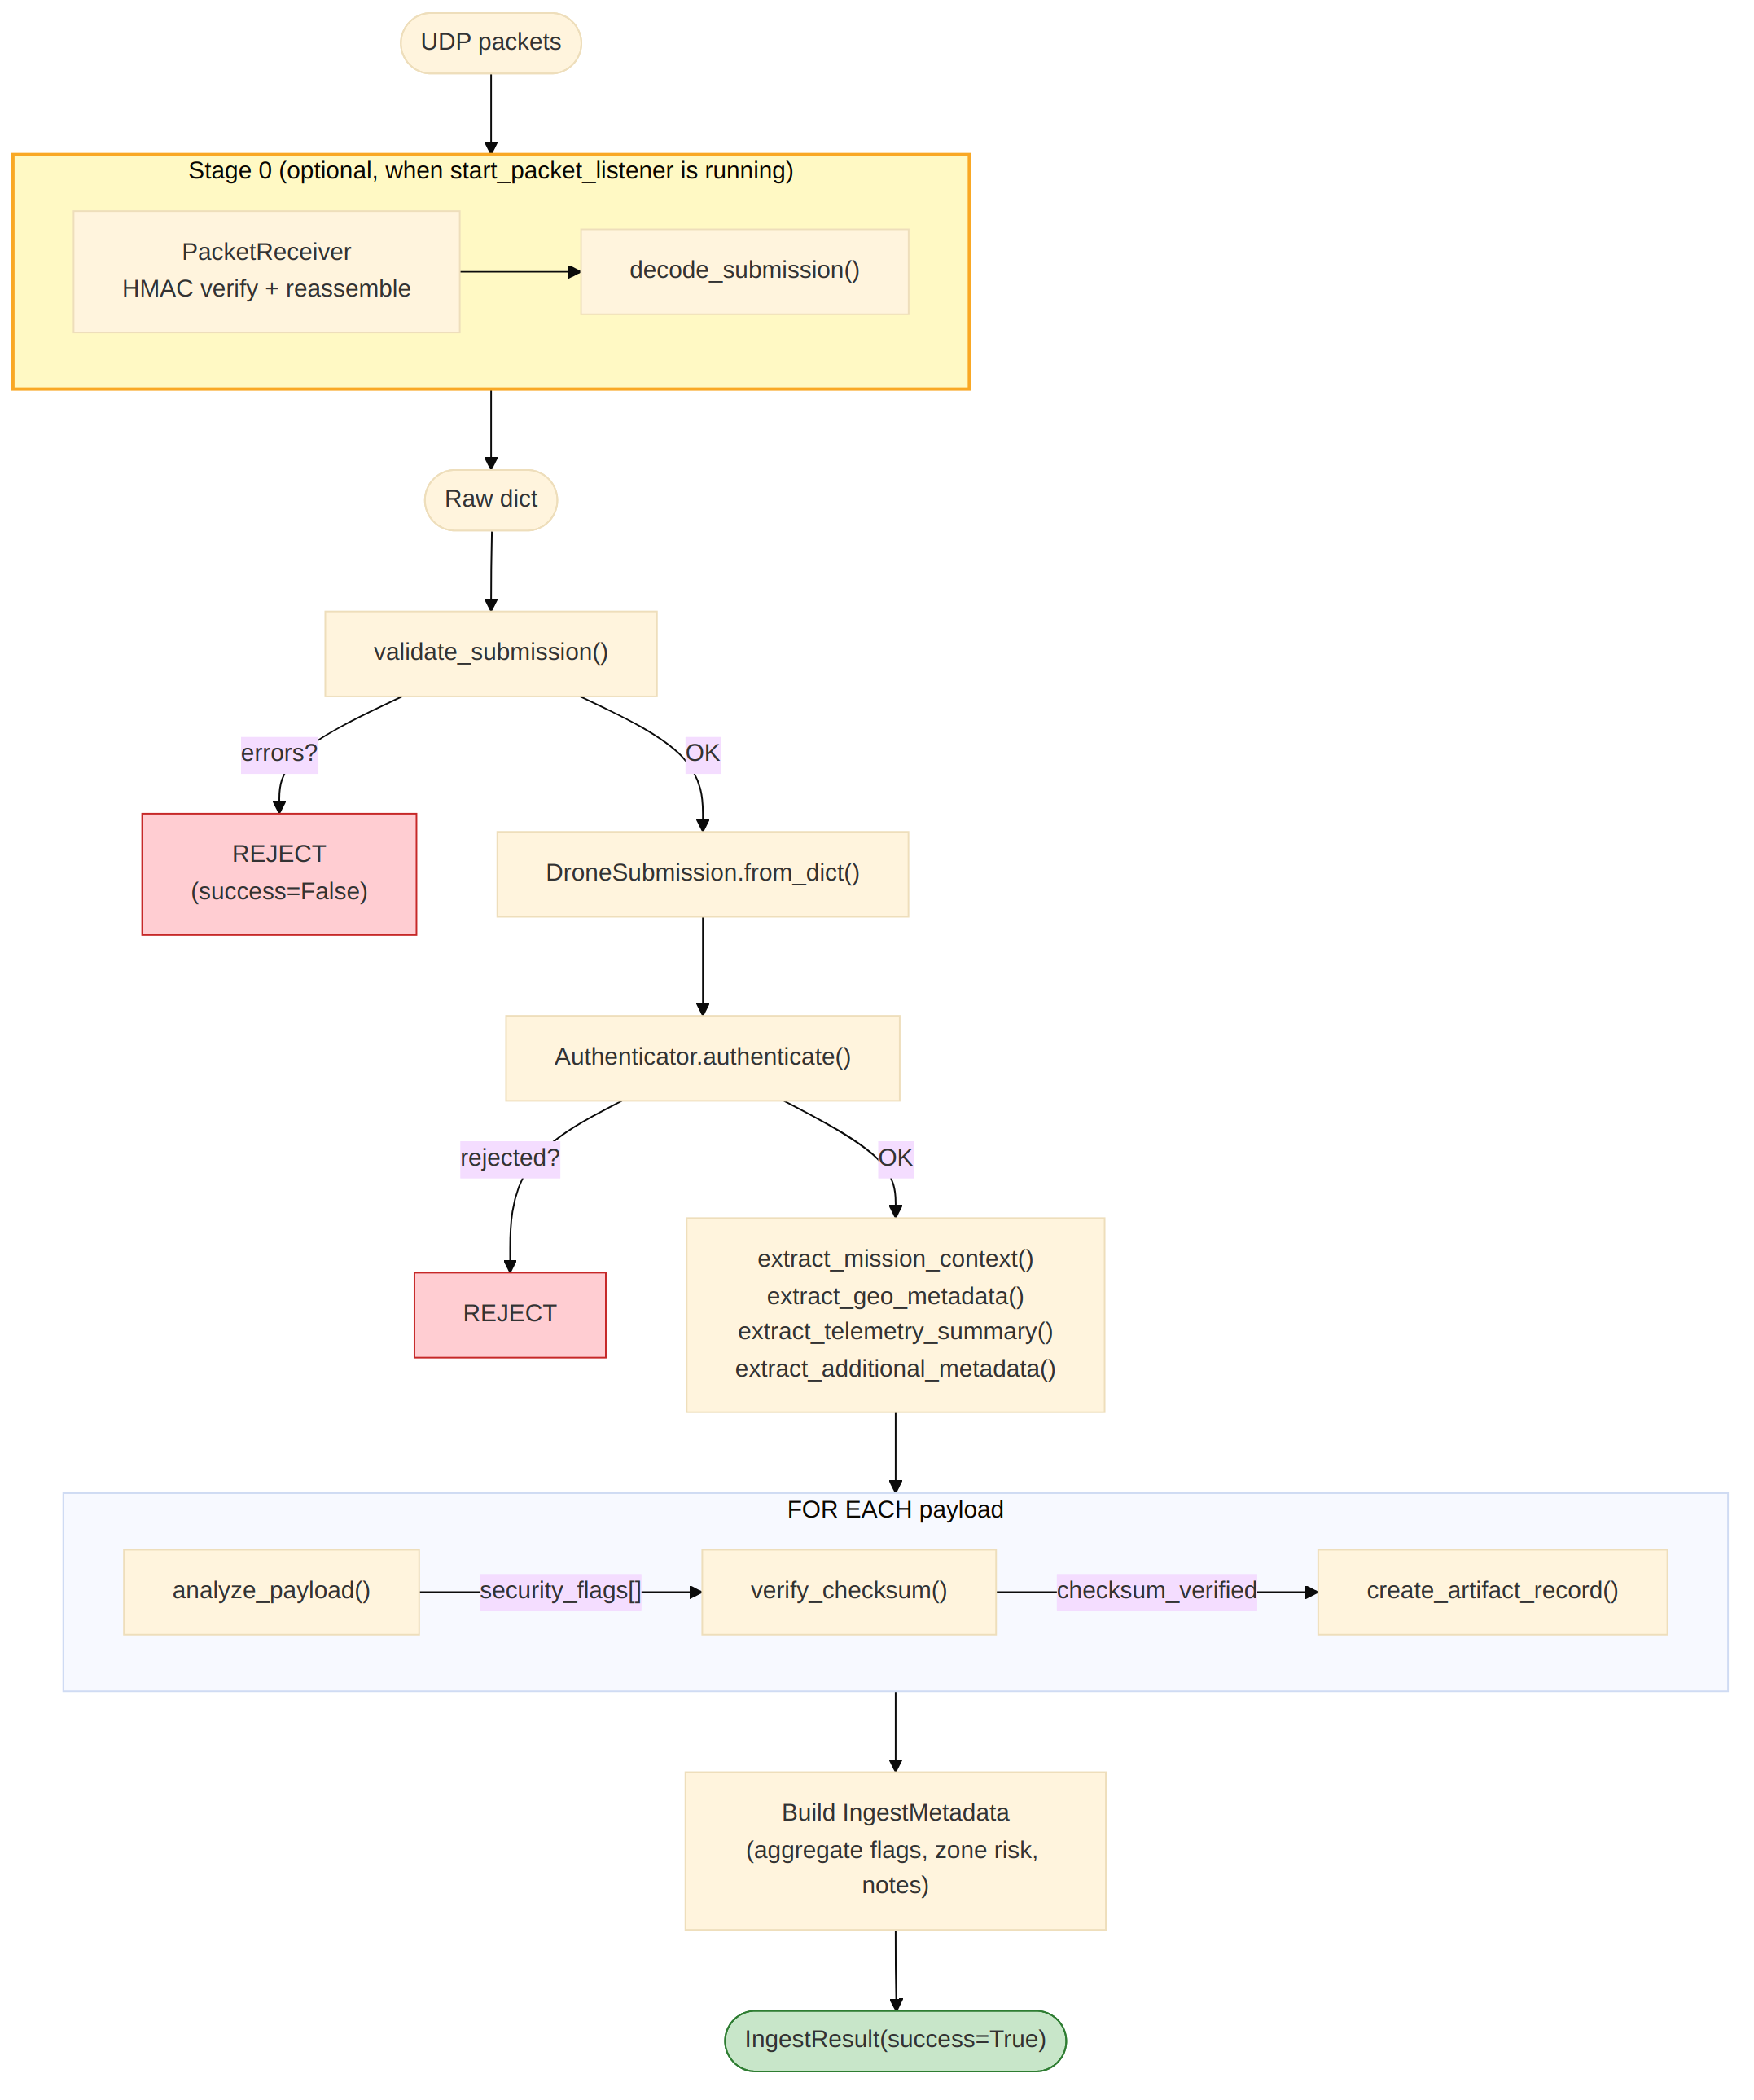
Ingestion Interceptor
The secure entry gate for drone data
• First line of defense — catches bad data early
• 8-stage pipeline:
‣ Packet reception (UDP + HMAC)
‣ Validation + Authentication
‣ Metadata extraction
‣ Payload analysis (encrypted, nested, large, suspicious MIME)
‣ Checksum verification
‣ Artifact creation + output assembly
• Supports operator uplink commands

Slide 7
Ingestion Interceptor: Input and Output
Input: Raw drone submission
Output: IngestResult
• drone_id, timestamp, mission_zone, geolocation
• List of payloads (filename, type, MIME, size, encryption)
• Optional: cryptographic signature
• ingest_metadata: drone ID, zone, flags, auth result
• artifact_records: one per file with ID, type, size, checksum
• errors / warnings
Example: Insecure flags extracted
• Sample A (normal video + image): no flags
• Sample B (encrypted nested ZIP): encrypted_payload, nested_archive
• Sample C (telemetry only): no flags
• Sample D (large survey video): large_binary

Slide 8
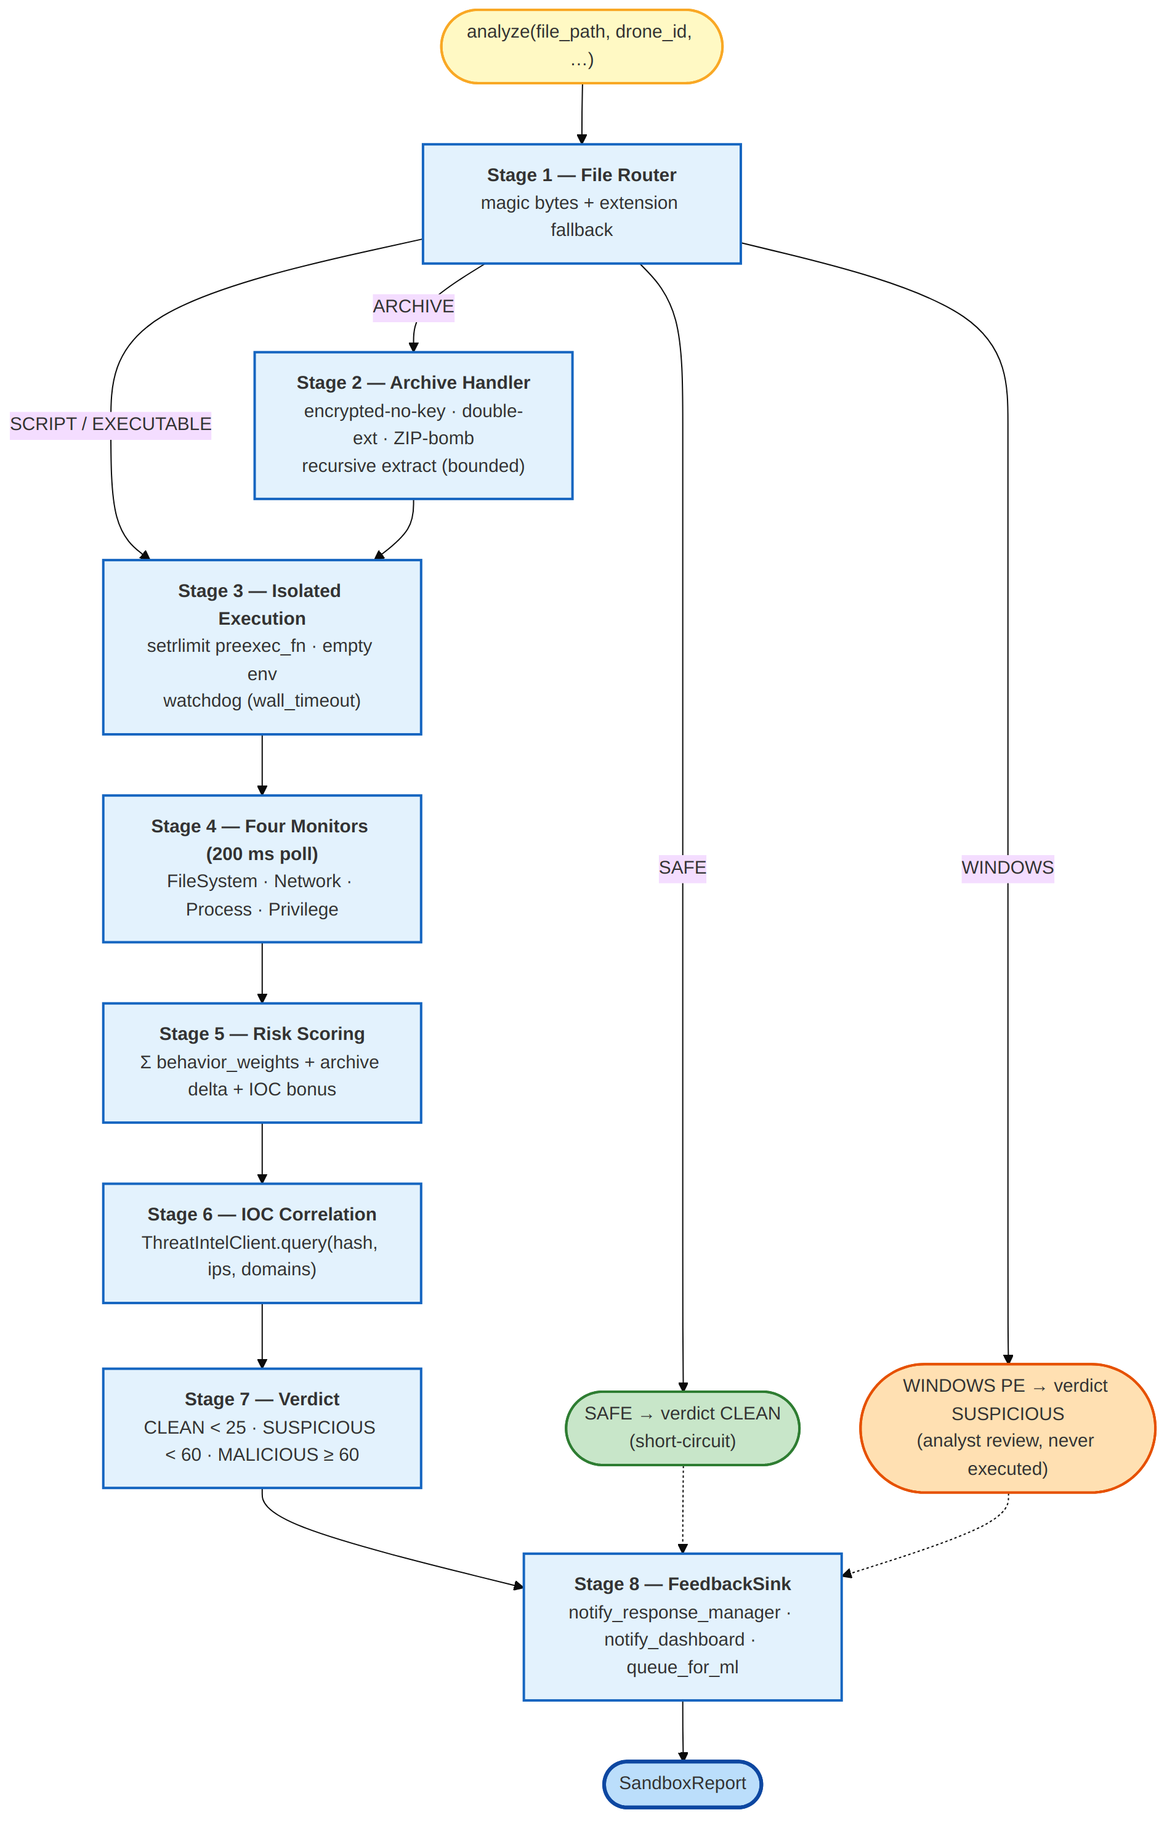
Sandbox Analyzer
Layer 3 — Dynamic behavioral analysis
Don't ask what a file looks like.
Ask what it actually does when it runs.
• Only runs when Threat Score is HIGH
• Runs files in a kernel-limited Linux sandbox
‣ 128 MB RAM, 20s CPU, 30s wall-clock, 50 processes max
• Watches behavior through 4 /proc monitors
• Scores actions by adding up risk weights
• Gives a verdict: Clean / Suspicious / Malicious

Slide 9
Sandbox: Monitors and Results
4 monitors poll every 200 ms
Demo results
• File System: files the process writes to
• Network: outbound connections (even failed ones)
• Process: child processes (bash, curl = suspicious)
• Privilege: capability changes, memory spikes
• Safe CSV: score 0 → CLEAN
• Disguised .jpg script: caught by magic bytes
• Archive with recon.jpg.sh: score 85 → MALICIOUS
• Python C2 callback: score 75 → MALICIOUS
• Windows .exe: → SUSPICIOUS
Key design decisions
• Magic bytes over extension: photo.jpg starting with #! is treated as a script
• Encrypted archive = suspicious: no password cracking, just flag it
• Kernel limits (setrlimit): the process cannot bypass OS-level caps

Slide 10
Metadata Sanitizer
Strips dangerous embedded metadata from files
• Images (EXIF): GPS, UserComment, camera serial
• PDFs: JavaScript, auto-open actions, embedded files
• Videos: tracking atoms, device identifiers
• Archives: hidden members, comments
Three modes, picked from T_S
• T_S >= 0.7 → Strip (remove all)
• T_S <= 0.3 → Audit-only (just log)
• Otherwise → Selective (remove dangerous fields only)
• Original file always preserved for forensic review
• Every change recorded with before/after SHA-256 hashes
• Post-sanitization check confirms the file is still valid

Slide 11
Integration and Results
How the 4 modules connect
Test suite
• Ingestion Interceptor → IngestResult
• Threat Estimator → T_S + inspection level
• If HIGH → Sandbox runs the file
• Metadata Sanitizer cleans files (mode from T_S)
• Verdict feeds back → reputation + thresholds update
• Ingestion Interceptor: 75 tests
• Metadata Sanitizer: 96 tests
• Threat Estimator: 48 tests
• Sandbox Analyzer: 50 tests
• Total: 269 tests, all passing
Key numbers
• Bayesian cold-start: R = 0.257 for ZIP from risky zone (matches reference)
• Adaptive thresholds drift correctly under FPR/FNR changes, then recover
• Sandbox: C2-callback script = 75 (MALICIOUS), safe CSV = 0 (CLEAN)
• Full end-to-end flow across 4 modules runs in under 2 seconds

Slide 12
Key Findings
• Zone + file type is enough for cold-start scoring — no history needed
• Adaptive thresholds stay stable under noisy feedback (small learning rate + safe clamps)
• Reading /proc gives a tamper-proof view — the process cannot fake what the kernel reports
• Encrypted archives should be flagged, not cracked — saves time, gives a cleaner threat model
• Traceable outputs (Bayesian traces, payoff matrices, event lists) make every decision auditable

Slide 13
Summary and Future Work
What was built
What comes next
• Threat Estimator: Stackelberg game + Bayesian prior + adaptive thresholds
• Ingestion Interceptor: 8-stage pipeline with UDP + HMAC + uplink
• Sandbox Analyzer: kernel-level isolation + 4 monitors + verdict
• Metadata Sanitizer: threat-score-driven mode + handler registry
• 269 tests, all passing
• Learn Bayesian CPTs from real feedback
• Mixed-strategy Stackelberg solver
• Redis/Postgres reputation store
• Ground-station adapters (MAVLink, DJI)
• Windows VM backend for sandbox
• Field evaluation on real drone feeds

Slide 14
Thank You
Questions?
Sangam Kumar Mishra | 22CS01071 | IIT Bhubaneswar

