Slide 1
E-learning About E-learning
Elza, Santa, Renāte, Brita Laura

Slide 2
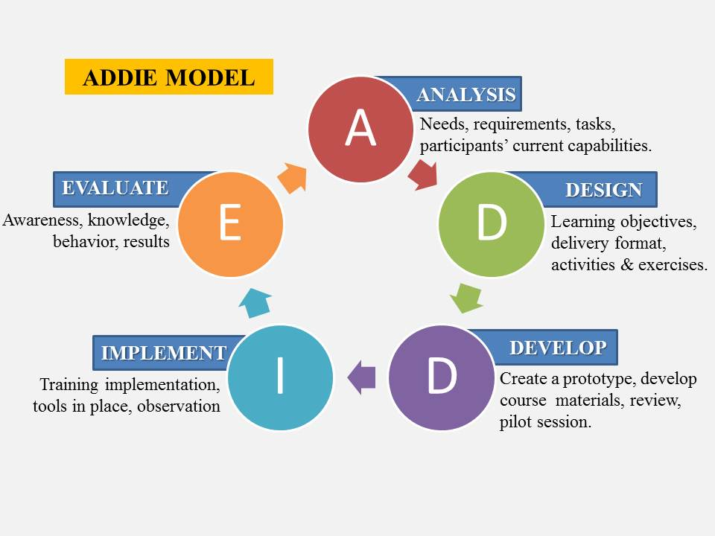
Model

Slide 3
Analysis stage
Audience:
Teachers/lecturers who have the need to understand what e-learning is. (another example: GDPR course)
Learning constraints:
Person has no previous experience with computers
Who does it: instructional designer

Slide 4
Design stage
Two learning objectives:
To create general understanding about what is e-learning
To create general understanding what are the steps in producing a course
Create storyboard > create prototype [includes instructional design and strategies] > create the whole course [create visual design of the course (animations, quizzes, pop-ups)]
In each stage QA (quality assurance) process is done to ensure quality, communication with subject matter experts
Who does it: graphical designer, animator, illustrator

Slide 5
Development stage
Create and assemble the course [implement all the interactivities and quizzes]
Who does it: programmers and production people

Slide 6
Implementation stage
Support and management in case some information changes
Put it on server so it is available for people to view, click through and learn
Who does it: production people

Slide 7
Evaluation stage
In the end of the course, there is an evaluation quiz that evaluates whether the person has reached the learning objectives.
It is evaluated in the scale of 10-100%.
At the end, as a gamification element, a reward is given.
Who does it: instructional designer, SME (subject matter expert)

Slide 8

Thank You

