Slide 1
高階合成技術於應用加速Application Acceleration with High-Level Synthesis
Lab A presentation – CH7 Design Optimization
110061608 吳承哲

Slide 2
Outline
Lab 1 - Optimizing a Matrix Multiplier
Case 1 - No optimization
Case 2 - Pipeline the Product Loop
Case 3 - Pipeline the Col Loop
Case 4 - Reshape the Arrays
Case 5 - Apply FIFO Interfaces
Case 6 - Pipeline the Function
Lab 2 - C Code Optimized for I/O Accesses
Updated version of C code used in Lab 1

Slide 3
Lab 1 - Optimizing a Matrix Multiplier

Slide 4
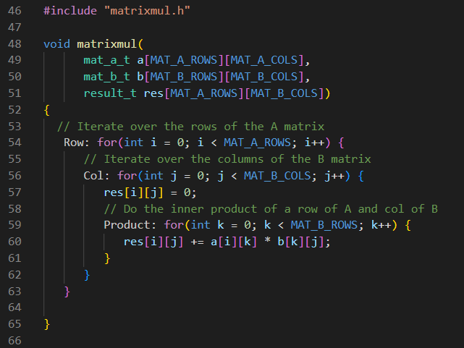
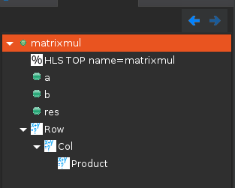
C code

Slide 5
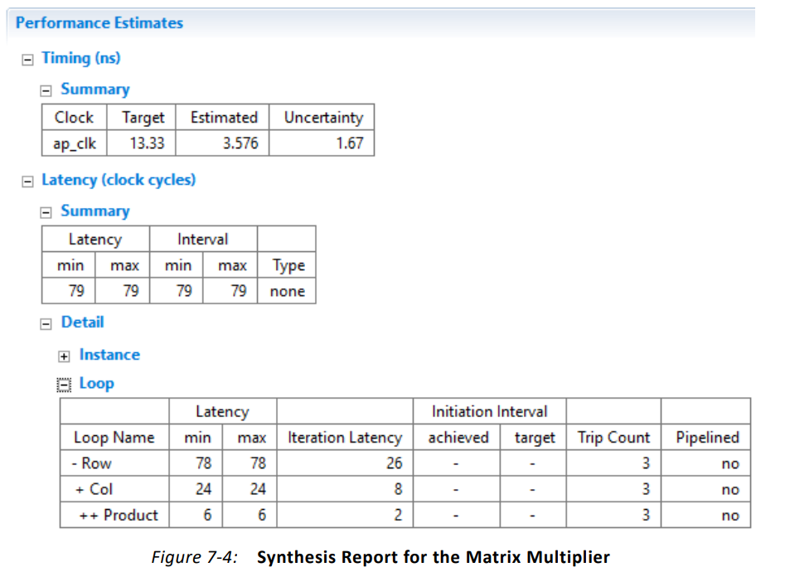
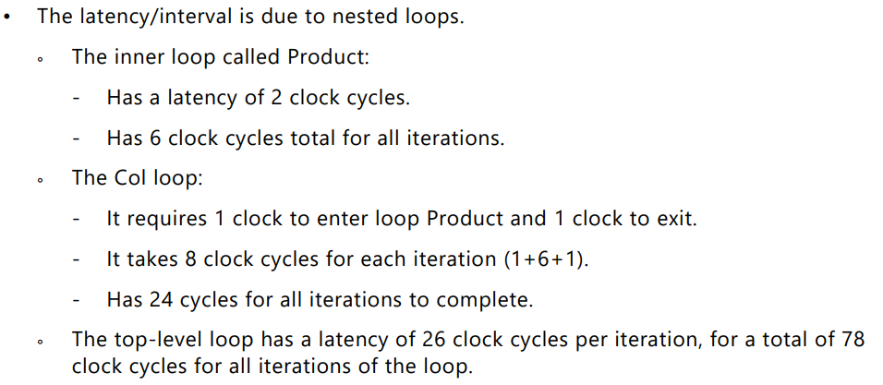
Case 1 - No optimization

Slide 6
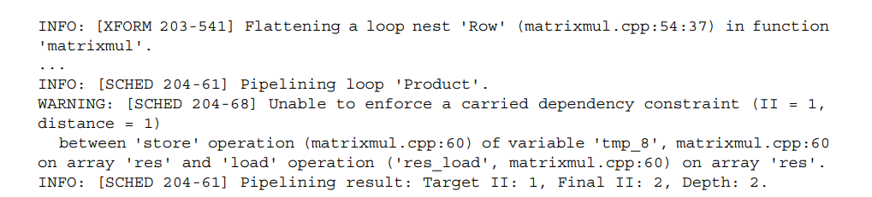
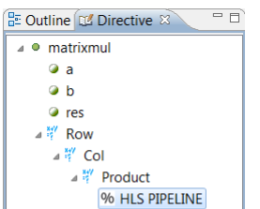
Case 2 - Pipeline the Product Loop

Slide 7
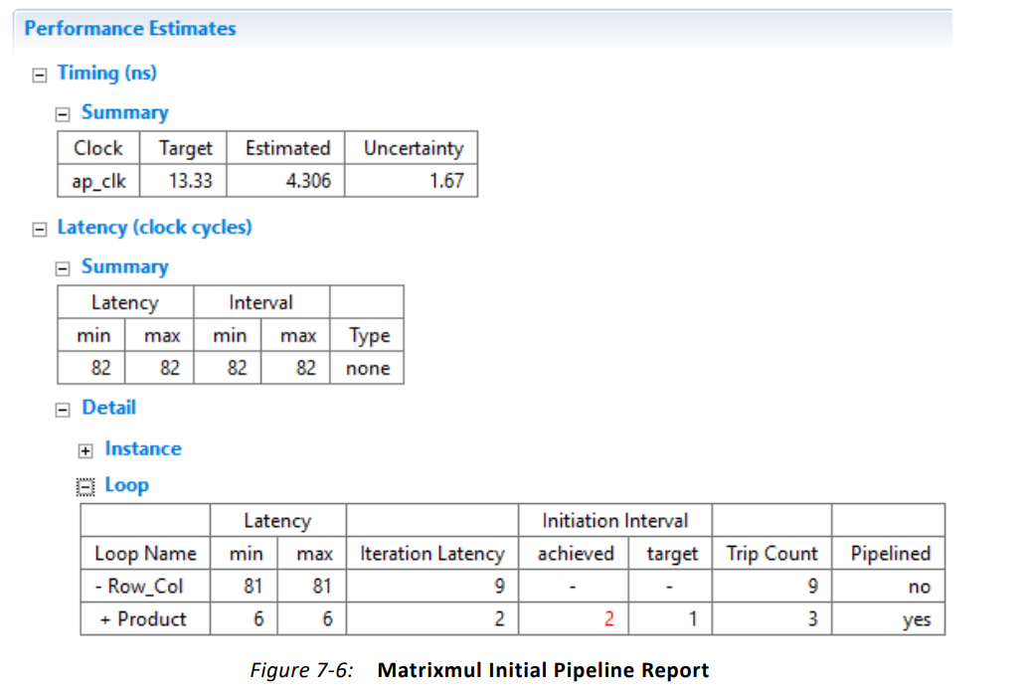

Slide 8
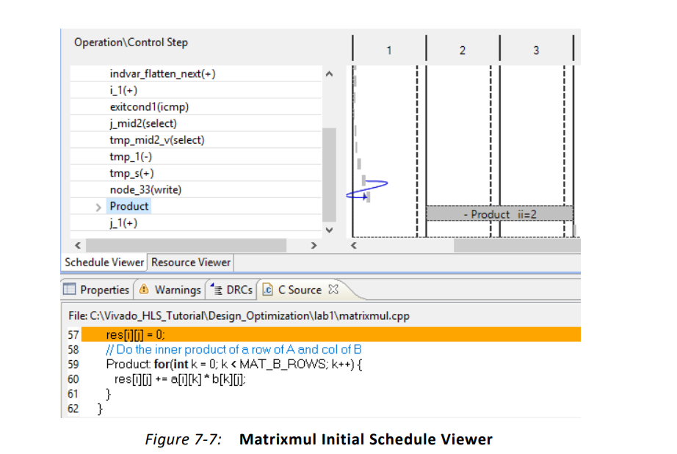
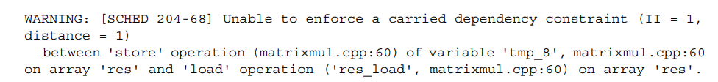

Slide 9
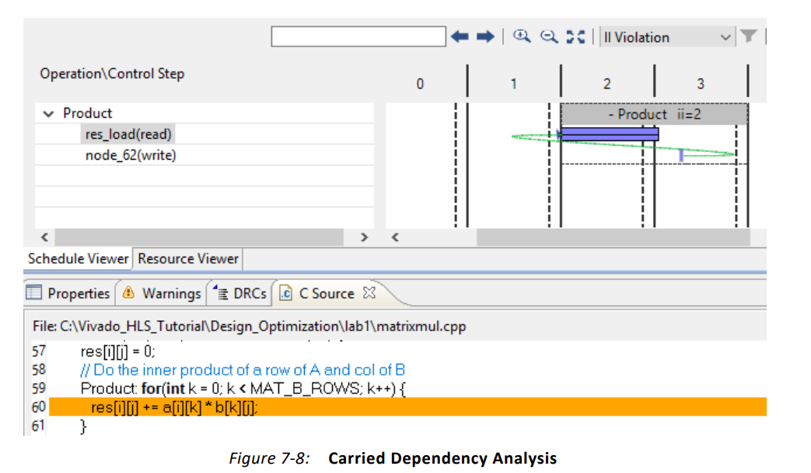
2nd read cannot occur until the 1st write has finished

Slide 10
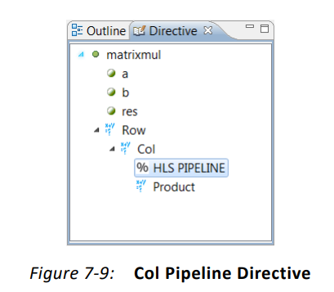
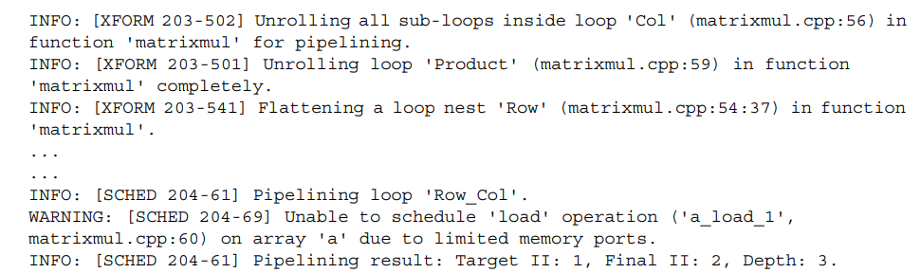
Case 3 - Pipeline the Col Loop

Slide 11
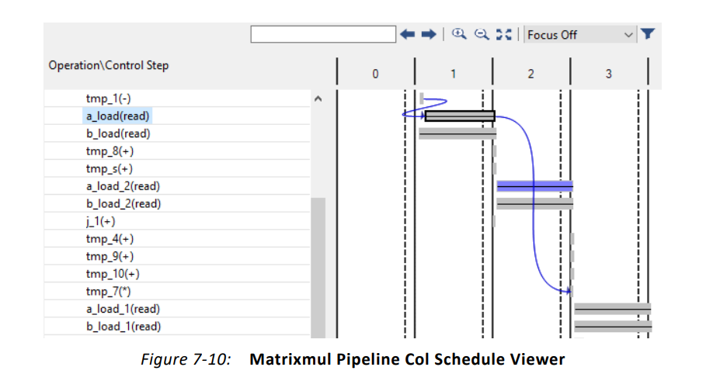
There are three read operations on array a. One operation in each state C1 through C3.

Slide 12
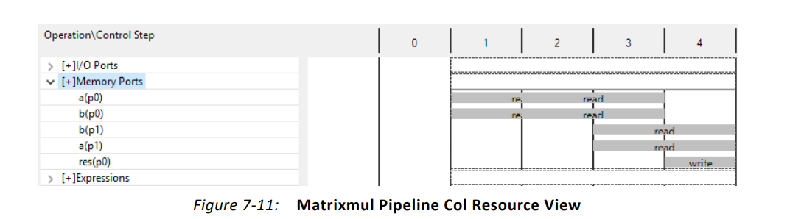
the 2-cycle read operations in state C1 overlap with those starting in state C2

Slide 13
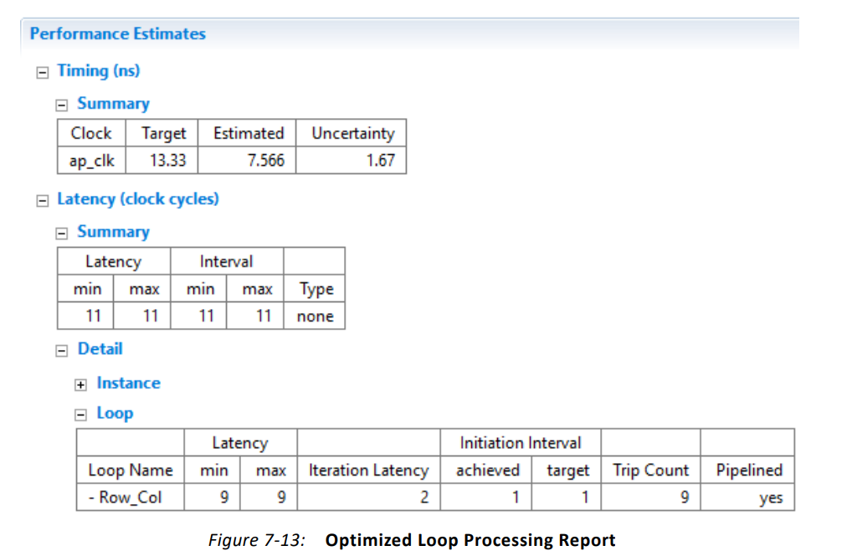
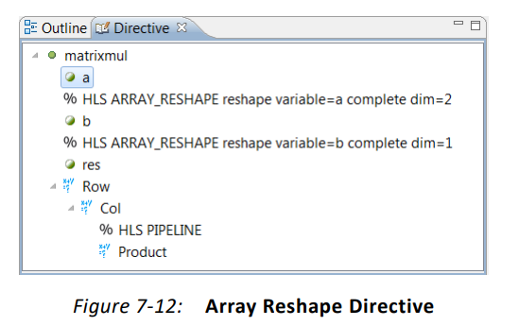
Case 4 - Reshape the Arrays

Slide 14
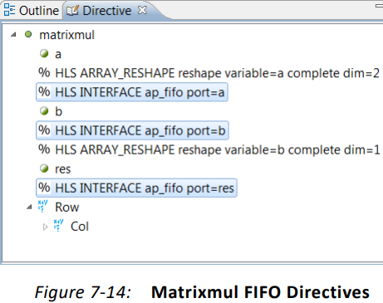
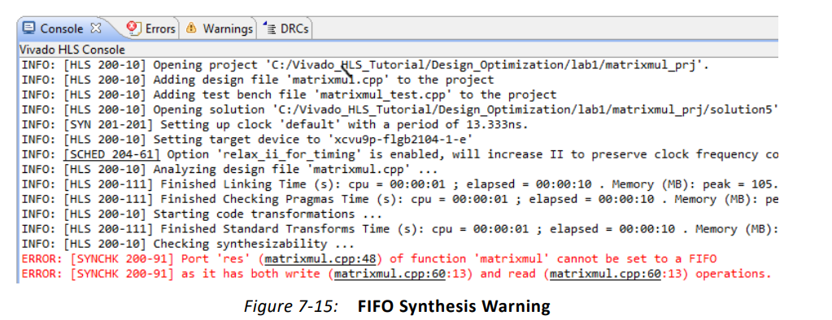
Case 5 - Apply FIFO Interfaces

Slide 15
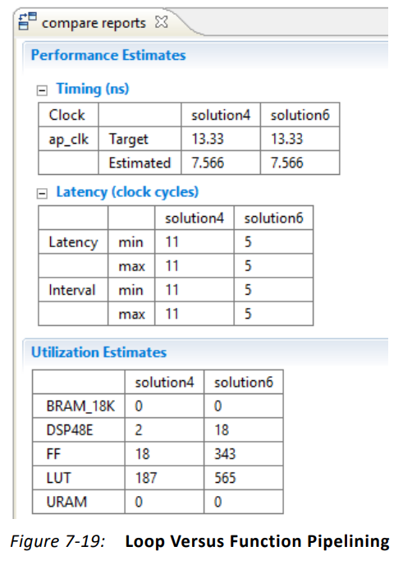
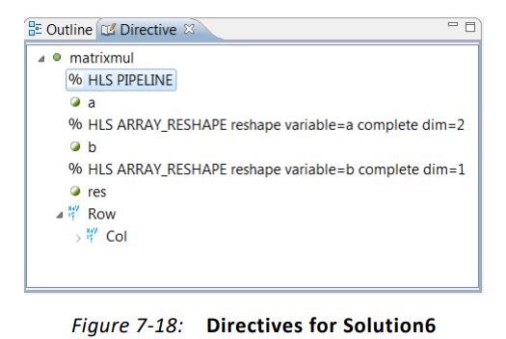
Case 6 - Pipeline the Function

Slide 16
Lab 2 – C Code Optimized for I/O Accesses

Slide 17
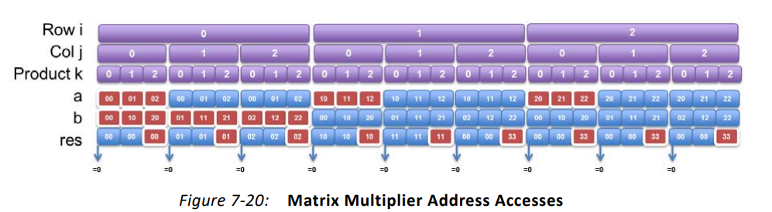
I/O access pattern for the code in Lab 1

Slide 18
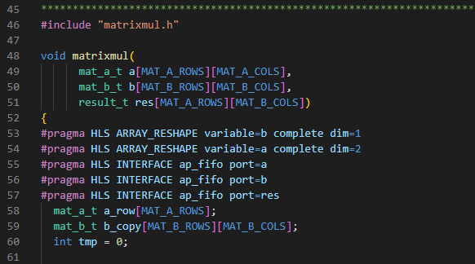
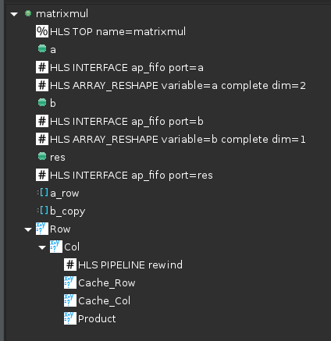
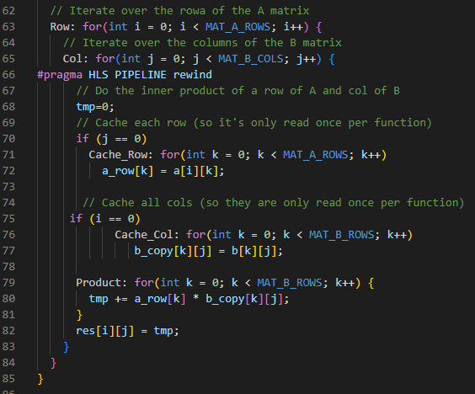
Updated version of C code used in Lab 1

Slide 19
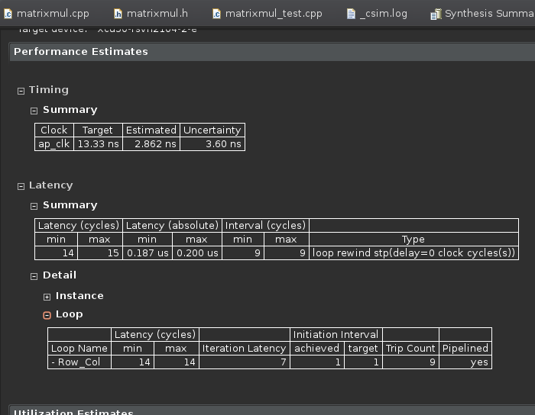

Slide 20
