Slide 1
高階合成技術於應用加速Application Acceleration with High-Level Synthesis
FIR-Filter Design optimization
110061608 吳承哲

Slide 2
Outline
FIR Introduction
FIR11_baseline
FIR128_baseline
FIR128_Q1：Variable Bitwidths
FIR128_Q2：Pipelining
FIR128_Q3：Removing Conditional Statements
FIR128_Q4：Loop Partitioning
FIR128_Q5：Memory Partitioning
FIR128_Q6：Best Design
Conclusion

Slide 3
FIR Introduction

Slide 4
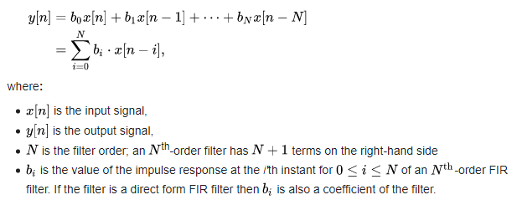
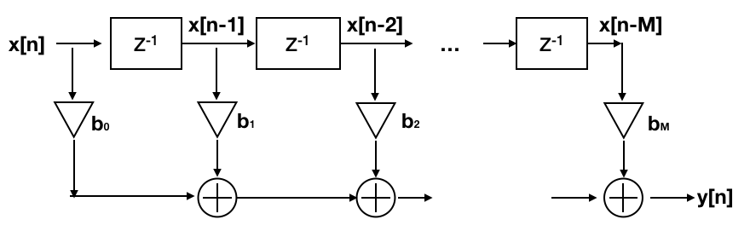

Slide 5
FIR11_baseline

Slide 6
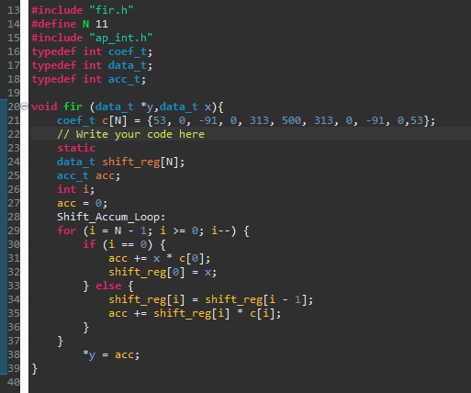
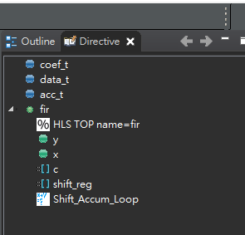
Code
Hierarchy

Slide 7
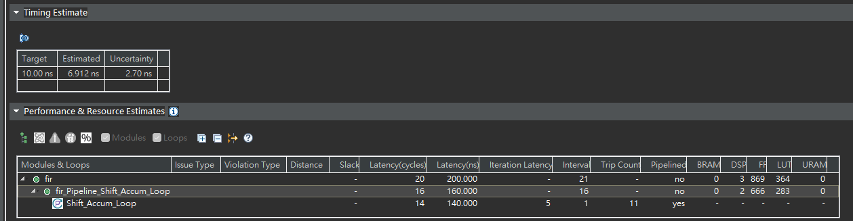
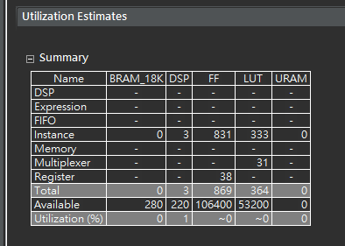
Performance
Utilization

Slide 8
FIR128_baseline

Slide 9
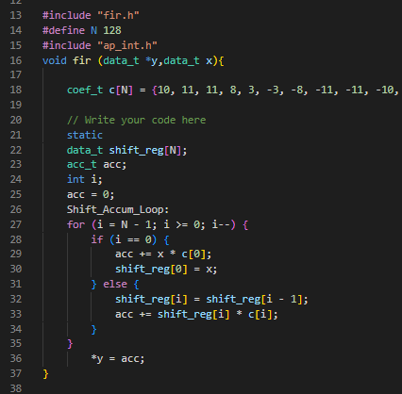
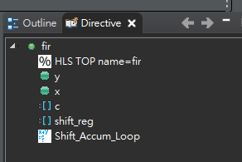
Code
Hierarchy

Slide 10
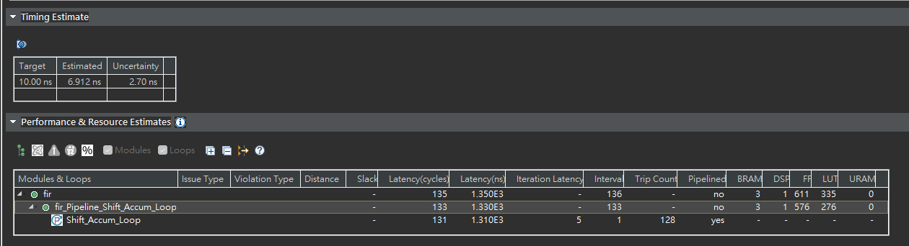
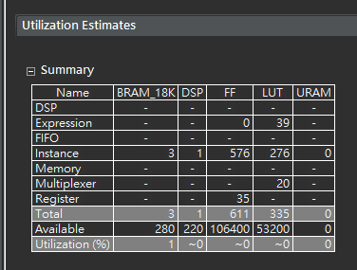
Performance
Utilization

Slide 11
FIR128_Q1：Variable Bitwidths

Slide 12
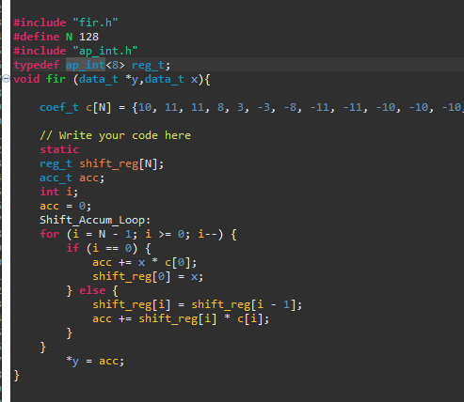
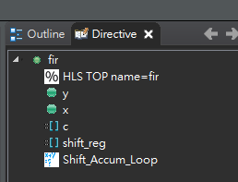
Code
Hierarchy

Slide 13
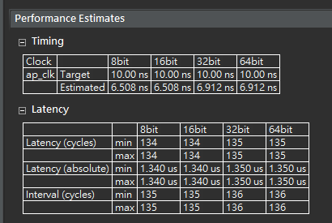
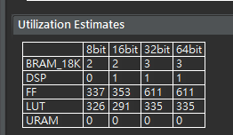
Performance
Utilization

Slide 14
FIR128_Q2：Pipelining

Slide 15
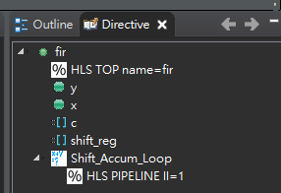
Code
Hierarchy

Slide 16
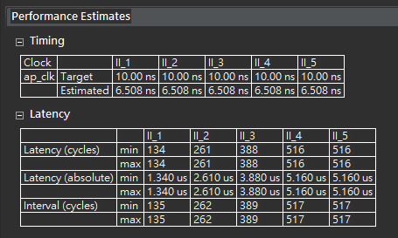
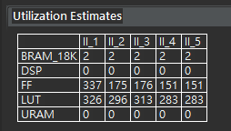
Utilization
Performance

Slide 17
FIR128_Q3：Removing Conditional Statements

Slide 18
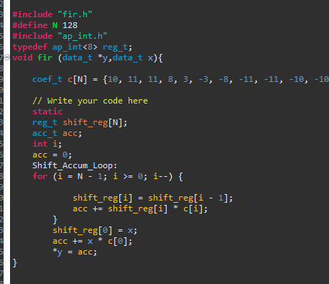
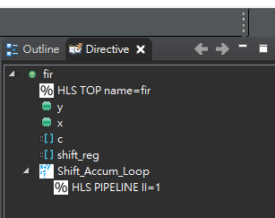
Hierarchy
Code

Slide 19
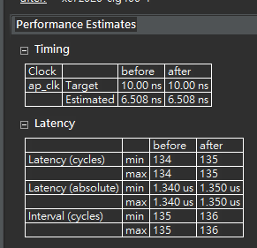
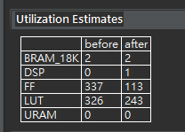
Performance
Utilization

Slide 20
FIR128_Q4：Loop Partitioning

Slide 21
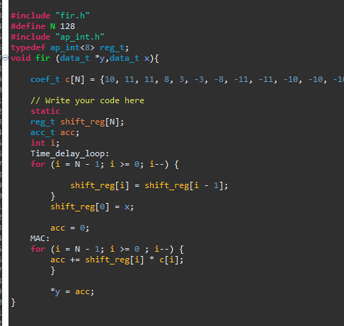
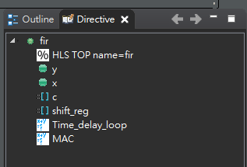
Code
Hierarchy

Slide 22
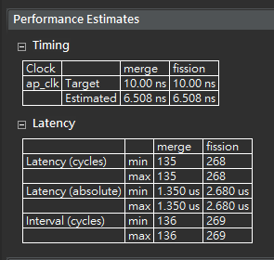
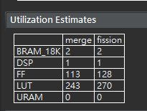
Performance
Utilization

Slide 23
FIR128_Q5：Memory Partitioning

Slide 24
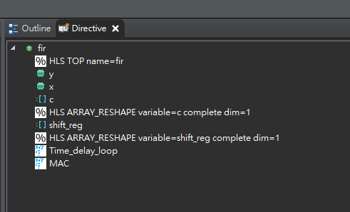
Code
Hierarchy

Slide 25
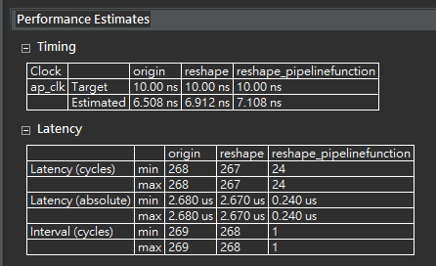
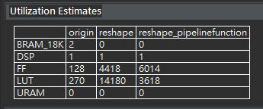
Performance
Utilization

Slide 26
FIR128_Q6：Best Design

Slide 27
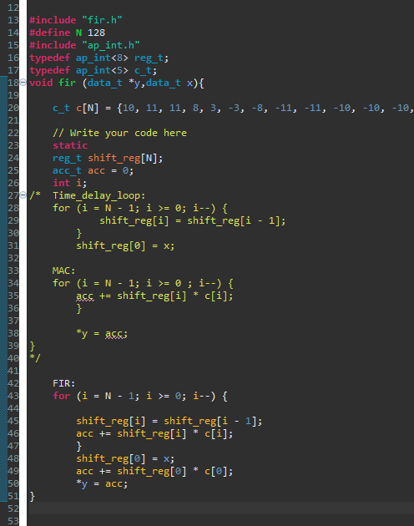
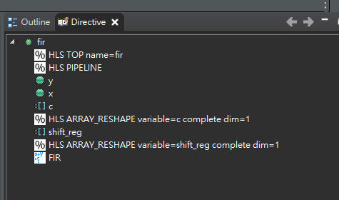
Code
Hierarchy

Slide 28
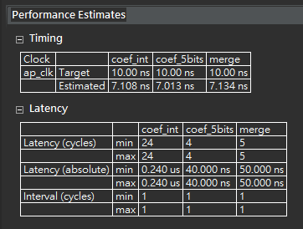
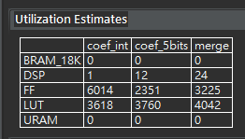
Performance
Utilization

Slide 29
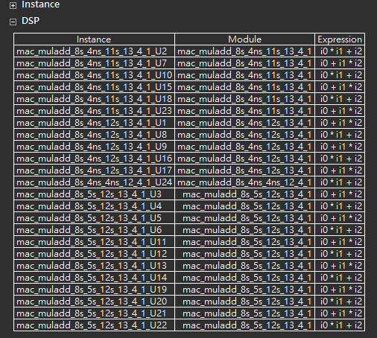
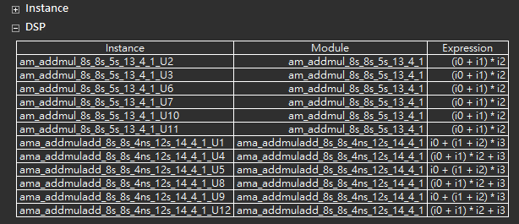
Merge_DSP
Fission_DSP

Slide 30
Thank you for listening.

