Slide 1
UART FIFO
紀皓洋

Slide 2
Hardware Hierarchy
Decode
UART
exmem
RX
RX_FIFO
CTRL
TX_FIFO
TX
BRAM
mprj_io[5]
mprj_io[6]

Slide 3
Schematic
UART
RX
RX_FIFO
CTRL
Rx
Rx_data
Irq
Frame_err
busy
i_data
Push
Pop
o_data
count
i_rx
i_wb_adr
i_wb_we
i_wb_dat
i_wb_sel
o_wb_ack
o_wb_dat
o_state
o_tx_start
o_rx_finish
i_wb_valid
i_frame_err
i_rx_busy
i_tx_busy
i_tx_start_clear
i_irq
TX
TX_FIFO
Tx
Clear_req
busy
Tx_data
Tx_start
o_data
i_data
Push
Pop
o_tx
UART_logic

Slide 4
FIFO specification
DATA_WIDTH = 8
DEPTH = 4
Notes:
FIFO 如果不夠裝 兩個解法 1. 增加FIFO深度 2. UARTtb送資料送慢一點 3.改善CPU運算速度讓TX來的急送完

Slide 5
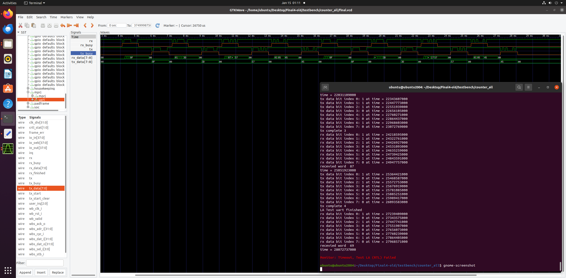
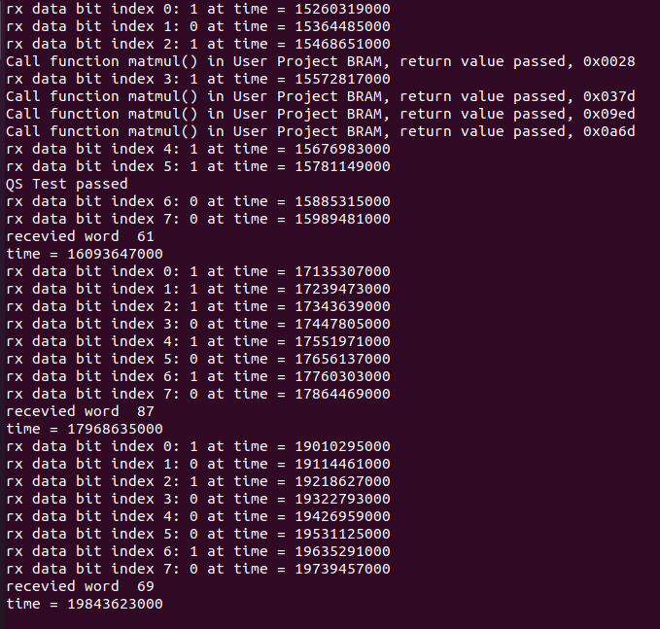
Simulation time
UART without FIFO
Simulation 28072737000ns
UART with FIFO
Simulation 19843623000ns

Slide 6
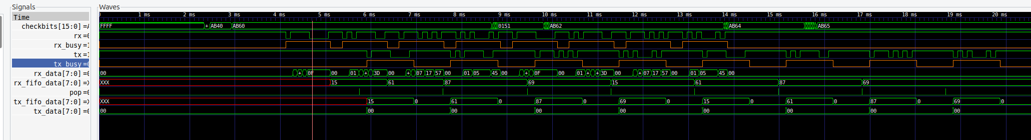
Waveform
UART without FIFO
UART with FIFO

Slide 7
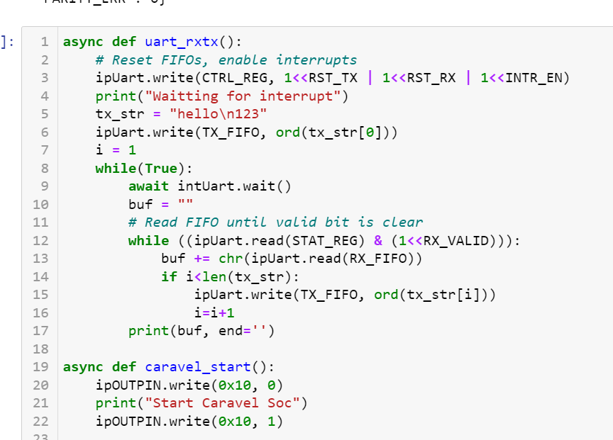
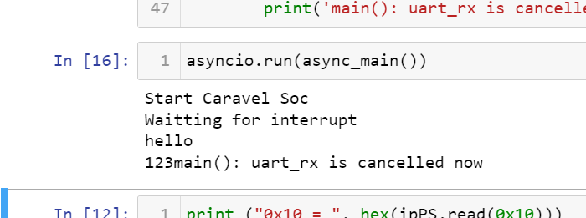
FPGA verification

Slide 8
SDRAM optimization
洪啓恩

Slide 9
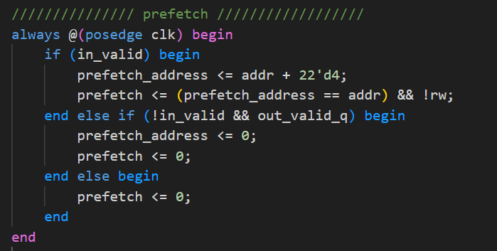
Prefetch scheme

Slide 10
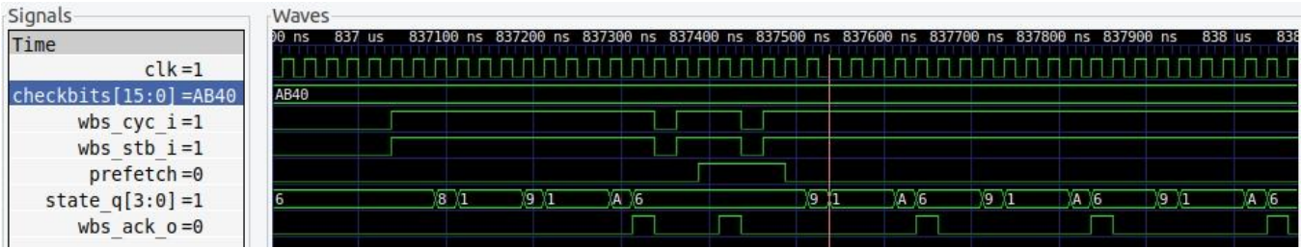
Wavefowm

Slide 11
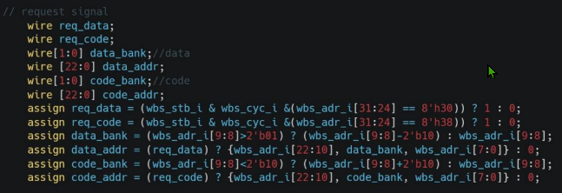
Code

Slide 12
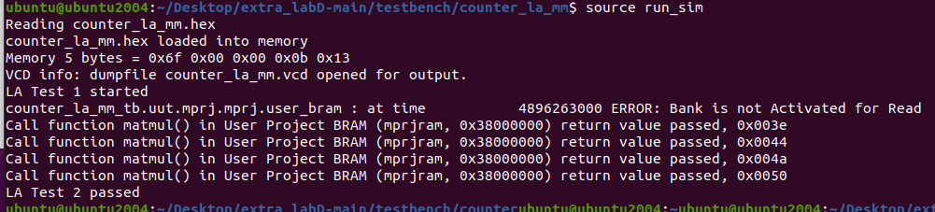
Result

