Slide 1


1
Horizontal bar
Important link
Login…
Login in
This point is Edit/add
User name
password
Next slide no 2.
submit
enter
eduction
hotel
hospital
Horizontal bar

Slide 2
2
Emergency
Title
Police
Station land mark
img
Fire Brigede
conct
img
Blood bank
cont
img
Railway Station
img

Slide 3
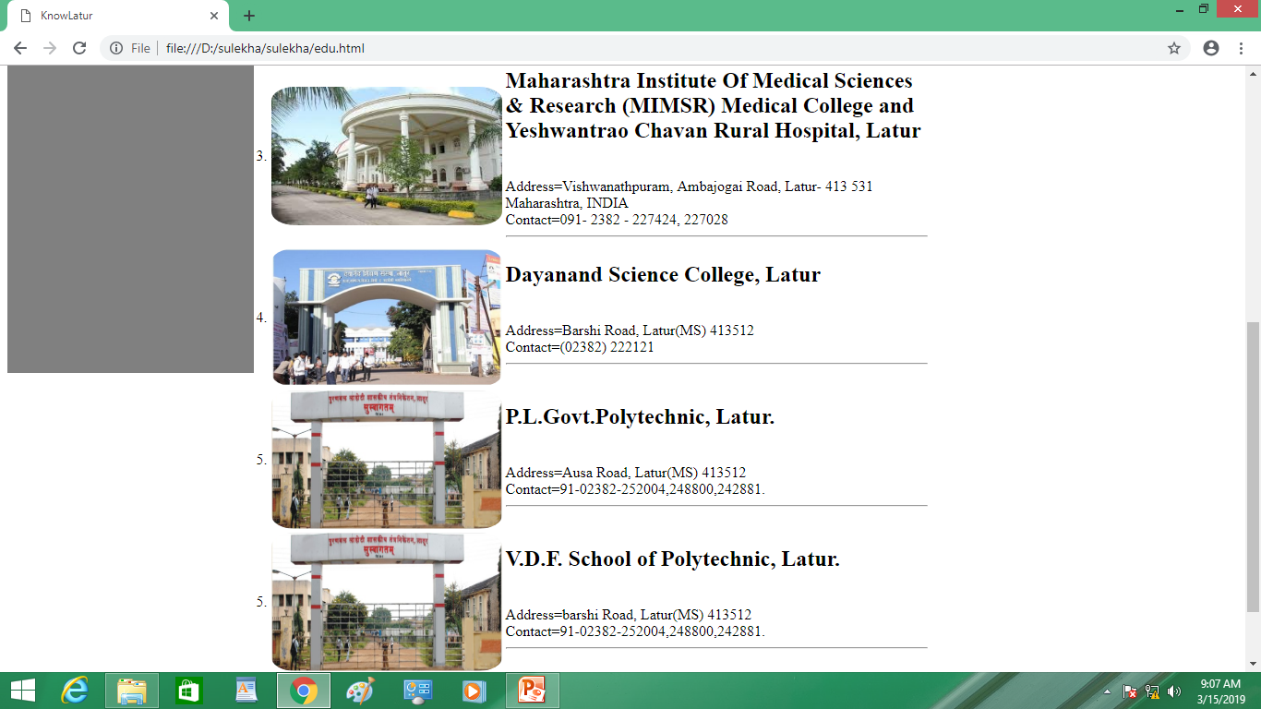
Scrolbar
3

Slide 4
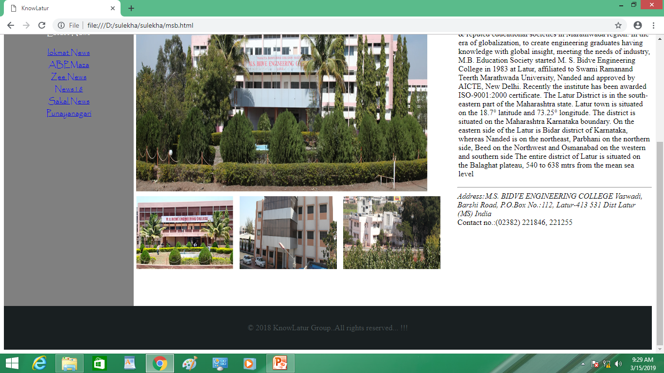
4
Location tag new & google tag
Location……………………

Slide 5
Picture move
5
Main window
Move here
Move here

Slide 6
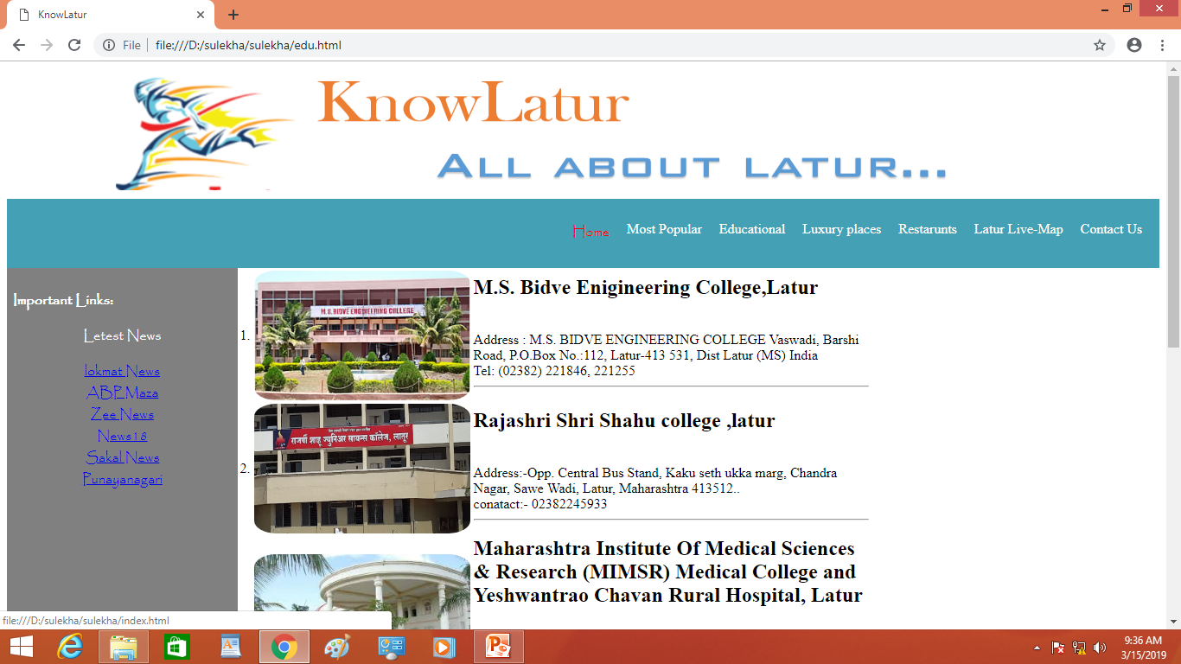
6
Offical website
Link……….

Slide 7
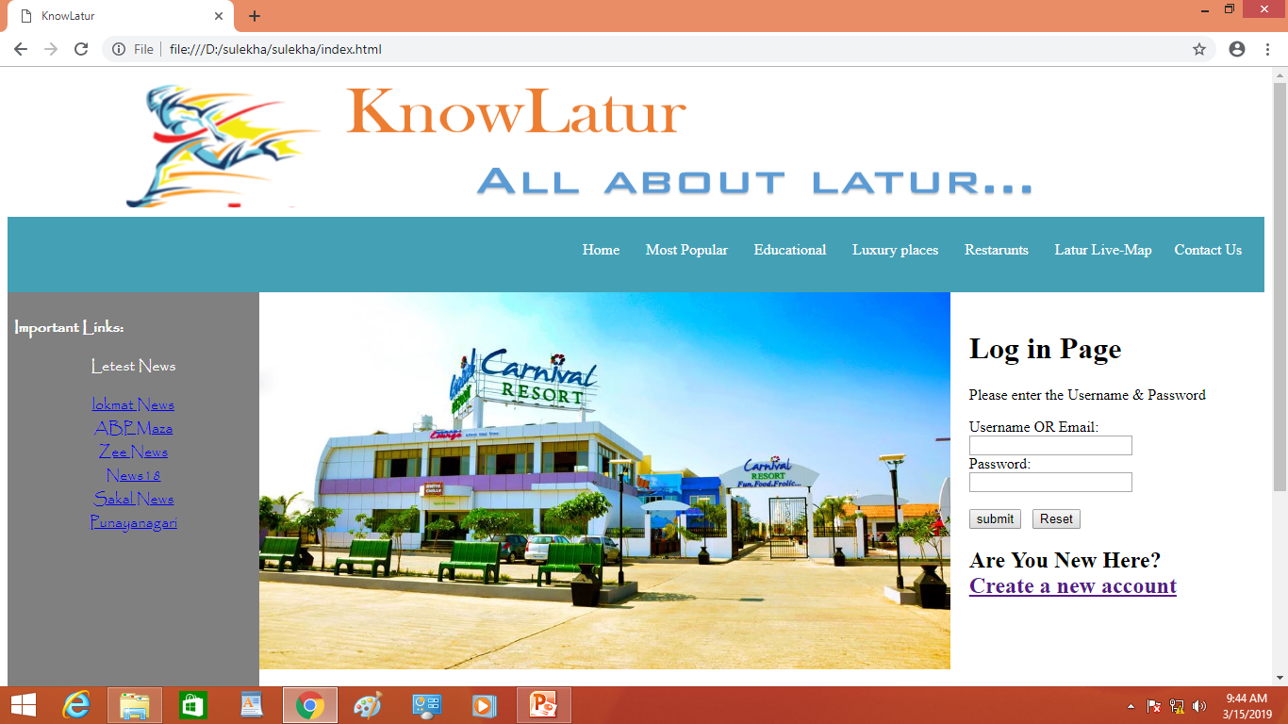
New pic add
7
New tag (marketing)
1.Golai
2.Shiwaji chwak
3.Vilasrav deshmuk
4.Crida sankulan

