Slide 1
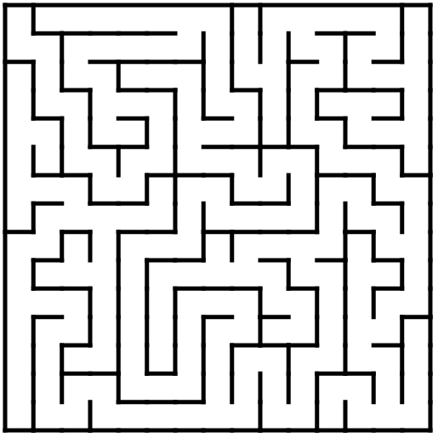
Unity ML-agent Learning Environment
Agent – action a_{t}
Override CollectObservation(VectorSensor sensor)
_{//environment 10x10 grid}
Sensor.addObservation(PositionOfFood) //closet food
Sensor.addObesrvation(currentCell)
Sensor.addObservaton(currentCellWall)
Agent – Extends Unity.MlAgents
Observation
Reward
Decision
Reward
setReward(1.0f) //for food
setReward(0.01) //for unexplored cell
setReward(-0.01) //for cell previously explored
Agent – action a_{t}
Override OnActionRecieved(ActionBuffer action)
Action
Discrete action space
0 – North
1 – South
2 – East
3 – West
transformPosition of agent
//One cell movement
+=New vector(moveX ,0, moveZ)
Communicator
Phyton API
Phyton trainer

