Slide 1
Blocked
Goal
Visited
Cell
Y_{t}
H - Cell State
Past Learning
X_{t} * W
Layer ₁ RNN
Recurrent Node
Maze Environment
Layer _{l} Dense
States Observations
x₁
y₁
Rewards
Action
x₂
Y2
Spatial
Memory
+
DNN
Model
x_{n}
X = Independent
Variable States
Y = Q Learning
values of Action
Input
Hidden Layers
Output
RL Model - Agent
Deep Neural Network

Slide 2
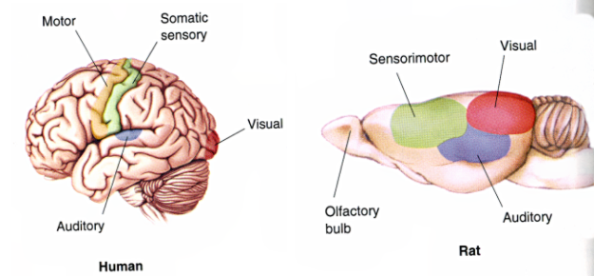
Human Brain
Rat Brain

