Slide 1
Django
A High-Level Python Web Framework

Slide 2
What is Django?
A high-level, open-source web framework written in Python.
Designed for rapid application development(RAD).
Django allows us to create database-driven websites.
Follows the "Model-View-Template" (MVT) architectural pattern.
An Object-Relational Mapper (ORM) for interacting with databases using Python code instead of raw SQL.
A powerful, auto-generated admin panel for managing data.
A URL dispatcher for routing requests to the correct functions.
Model
View
Template

Slide 3
Why Django?
Rapid Development: Django's "batteries-included" approach and its clean, organized structure significantly speed up the development process.
Security: Django takes security seriously.
It includes built-in protection against many common web vulnerabilities, such as:
Cross-Site Request Forgery (CSRF)
Cross-Site Scripting (XSS)
SQL Injection
Clickjacking
Scalability: Django is designed to be highly scalable. Many high-traffic sites, like Instagram, Pinterest, and Disqus, are built on Django, proving its ability to handle millions of users and requests.
"Don't Repeat Yourself" (DRY) Principle: Django encourages developers to avoid duplicating code.
The framework's design promotes reusable components, making your code cleaner, more efficient, and easier to maintain.

Slide 4
Installation of Django Framework

Slide 5
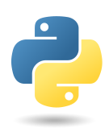
Steps Install Django
Install python
Python.org
https://www.python.org › downloads
Install Django
pip install django
pip show django
pip list

Slide 6
Django Cli command
Creating project using
django-admin startproject <project name>
Open the Project
cd <project name>
Creating application
py manage.py startup <app-name>
Run the application
Py manage.py runserver

Slide 7
Creation of Django Application

Slide 8
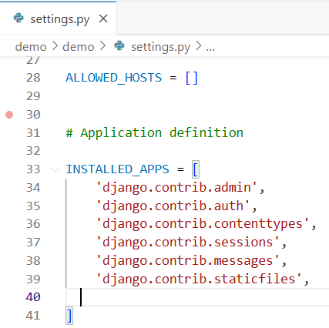
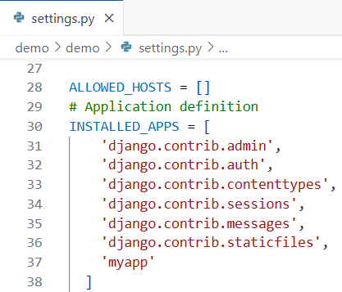
Step by Step Process
Create a folder
Open folder using VSCODE
Install Django : pip install django
Create project : C:\User\Arun\Desktop> django-admin startproject <project name>
Open the project : C:\User\Arun\Desktop\project name> cd <project name>
Create the app : C:\User\Arun\Desktop\project name> py manage.py startup <appname>
Add <app name> in settings.py INSTALLED_APPS with ,.
Example :
PS E:\DjangoApp> django-admin startproject demo
PS E:\DjangoApp> cd demo
PS E:\DjangoApp\demo> py manage.py startapp myapp
PS E:\DjangoApp\demo>
Add myapp in settings.py INSTALLED_APPS

Slide 9
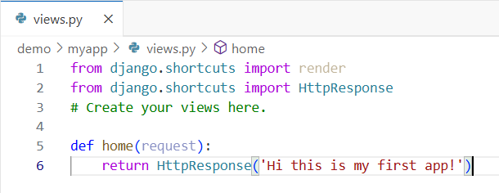
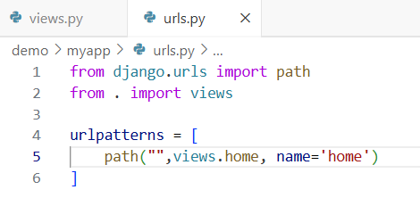
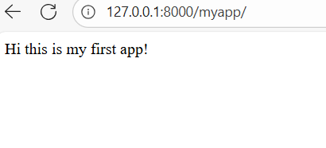
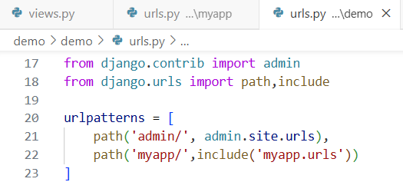
Step by Step process
Create a file urls.py in myapp
Define functions in views.py in myapp
Cerate path for the function in views.py to urls.py inside myapp
Add path in urlpatterns in projects urls.py
Run the application
Py manage.py runserver

Slide 10
manage.py: A command-line utility that lets you interact with this Django project in various ways. You can read all the details about manage.py in django-admin and manage.py.
myproject/: A directory that is the actual Python package for your project. Its name is the Python package name you’ll need to use to import anything inside it (e.g. mysite.urls).
myproject/__init__.py: An empty file that tells Python that this directory should be considered a Python package. If you’re a Python beginner, read more about packages in the official Python docs.
myproject /settings.py: Settings/configuration for this Django project. Django settings will tell you all about how settings work.
myproject /urls.py: The URL declarations for this Django project; a “table of contents” of your Django-powered site. You can read more about URLs in URL dispatcher.
myproject /asgi.py: An entry-point for ASGI-compatible web servers to serve your project. See How to deploy with ASGI for more details.
myproject /wsgi.py: An entry-point for WSGI-compatible web servers to serve your project. See How to deploy with WSGI for more details.

Slide 11
Thank you

