Slide 1
Python
Offline and Online Training

Slide 2
Introduction to Python
Python laid its foundation in the late 1980s.
The implementation of Python was started in December 1989 by Guido Van Rossum at Netherland.
In February 1991, Guido Van Rossum published the code (labeled version 0.9.0) .
In 1994, Python 1.0 was released with new features like lambda, map, filter, and reduce.
Python 2.0 added new features such as list comprehensions, garbage collection systems.

Slide 3
Introduction to Python
On December 3, 2008, Python 3.0 (also called "Py3K") was released.
It was designed to rectify the fundamental flaw of the language.
ABC programming language is said to be the predecessor of Python language.
The following programming languages influence Python:
  ABC language.
  Modula-3
  C language

Slide 4
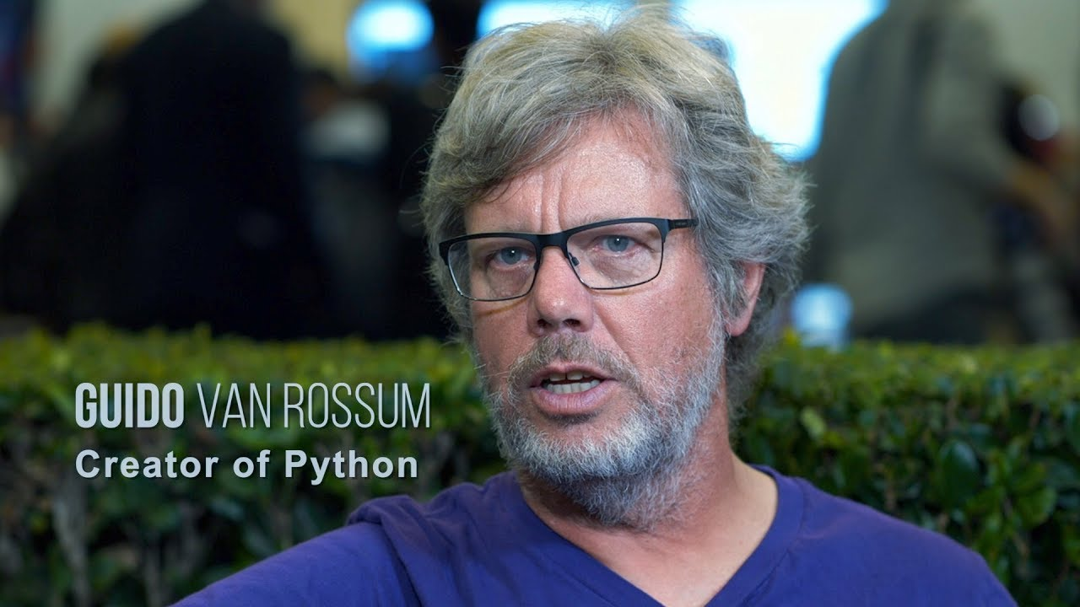

Slide 5
What is Python ?
Python is a high level programming language.
Python is a general-purpose.
Python is an object-oriented programming language(OOPS).
Python is a case sensitive language.
Python is free source.
Python is a dynamically typed language.
Python is a Portable.
Python is a interpreted language.
Python is a simple programming language.

Slide 6
Why python
Python can be used to develop software applications.
Python can be used to develop web application.
Python can be used to Develop AI and ML application.
Python can be used to Develop Data Science application.
Python has Large Standard Library.
It can be easily integrated with languages like C, C++, JAVA etc.

Slide 7
Python Applications
Instagram
Google
You tube
Spotify
Netflix
Uber
Dropbox
Pinterest
NASA etc….

Slide 8
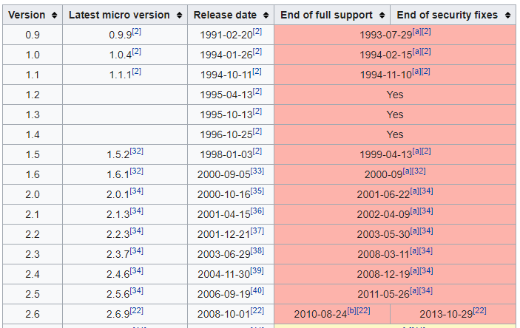
Version of python

Slide 9
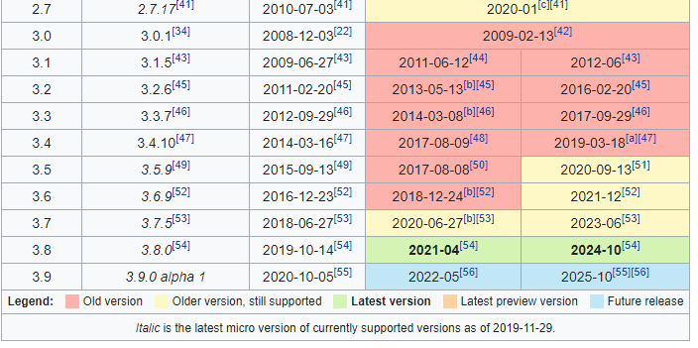

Slide 10

Python Installation

Slide 11
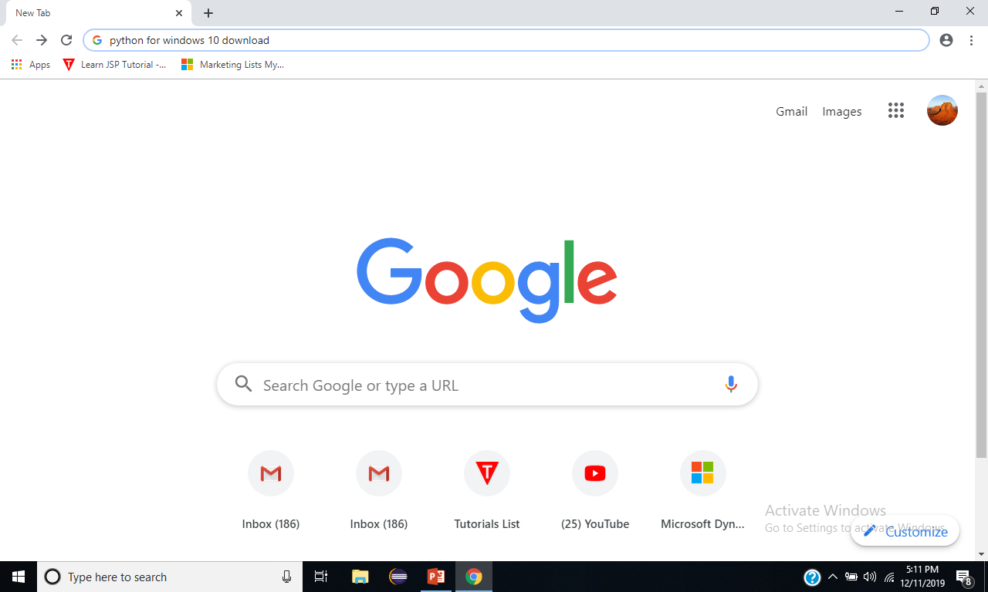

Slide 12
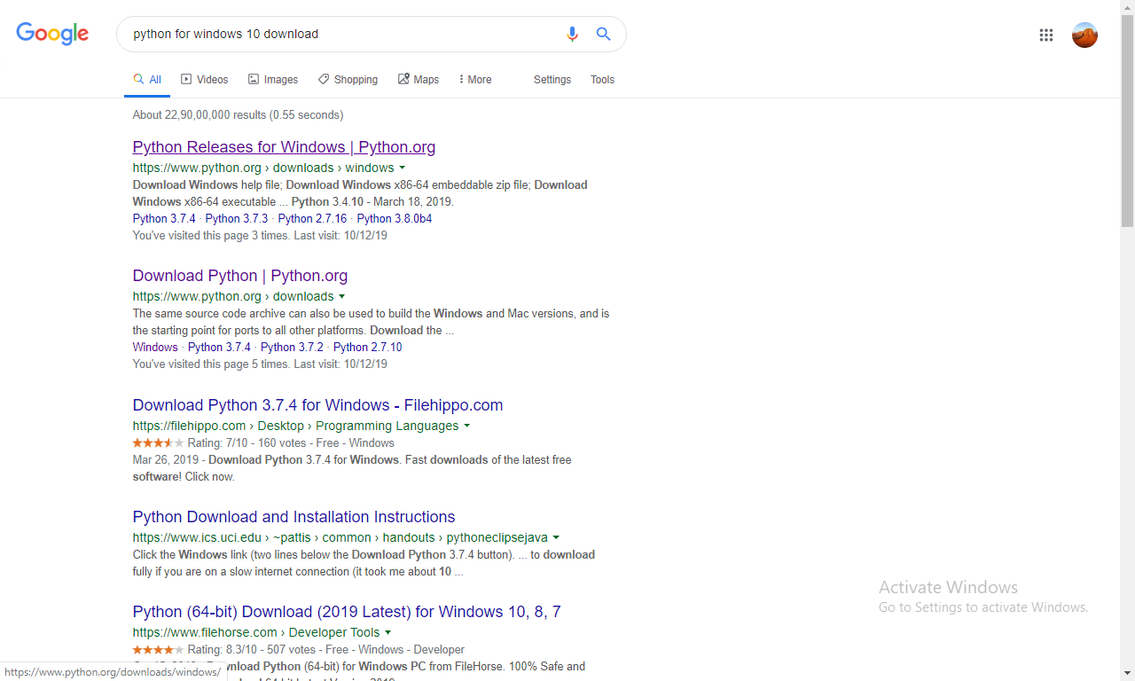

Slide 13
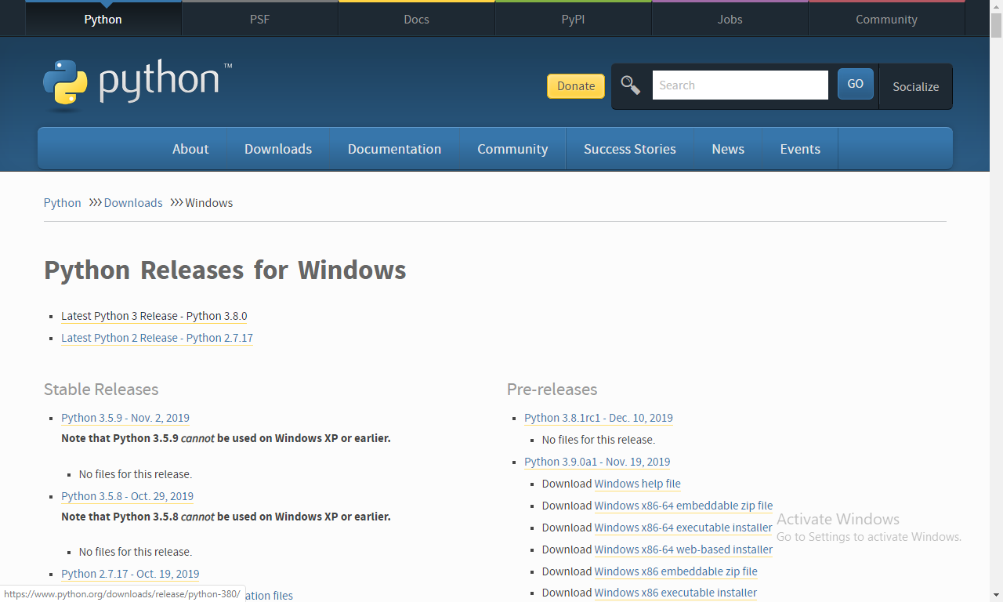

Slide 14
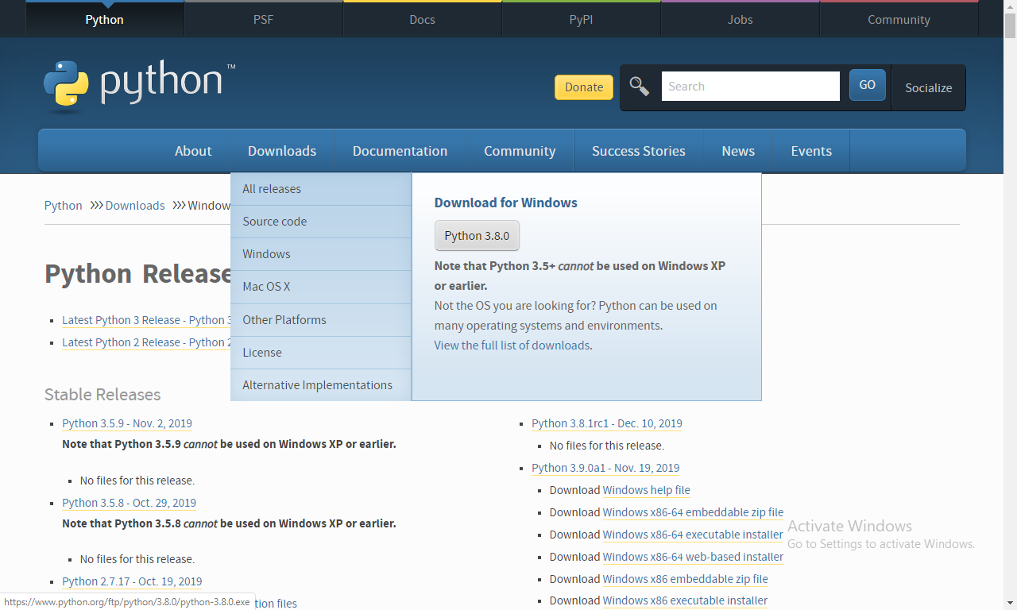

Slide 15
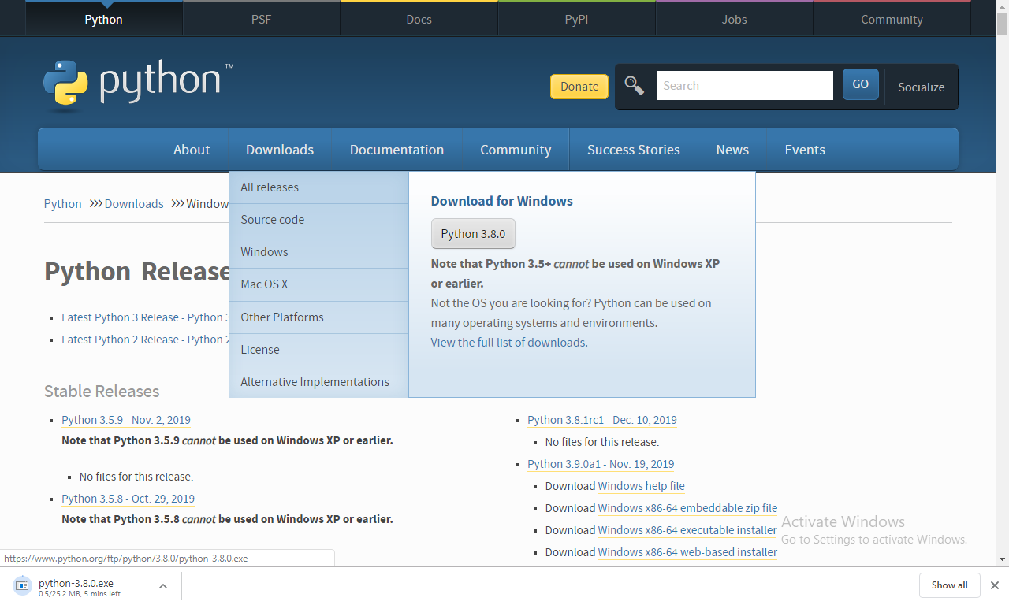

Slide 16
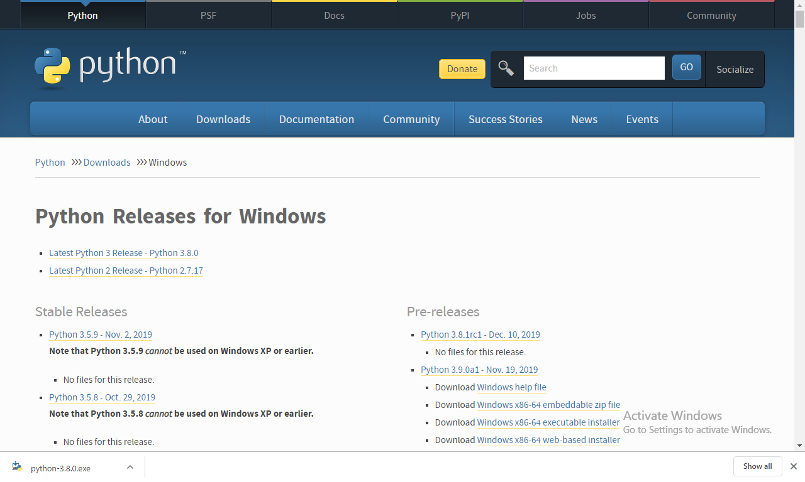

Slide 17
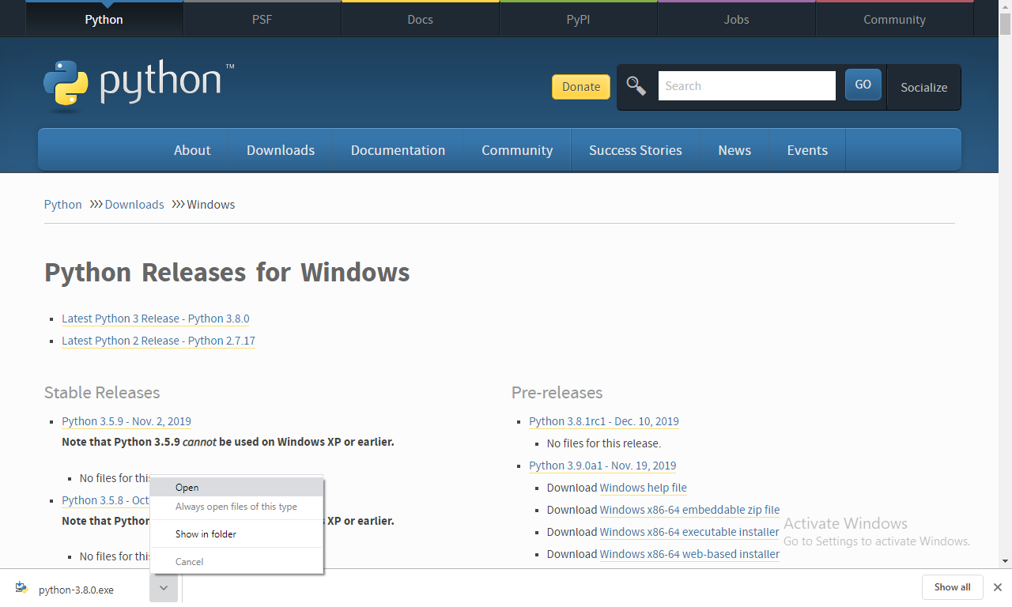

Slide 18
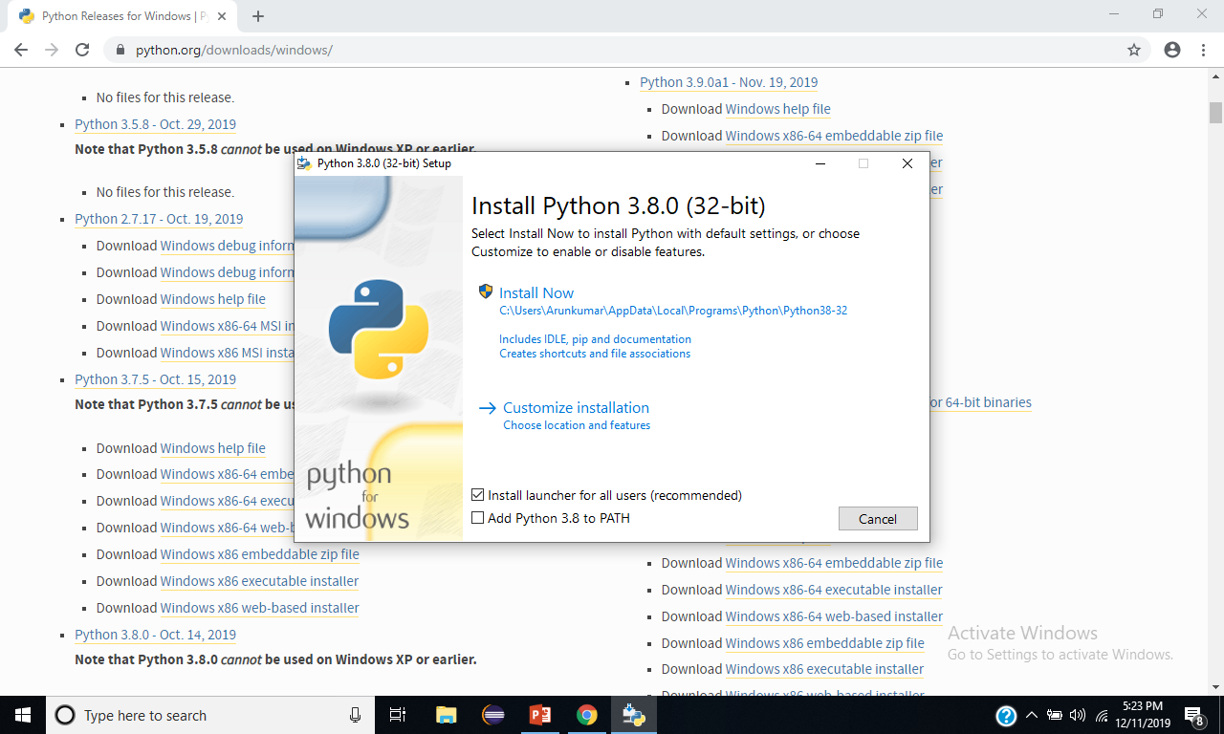

Slide 19
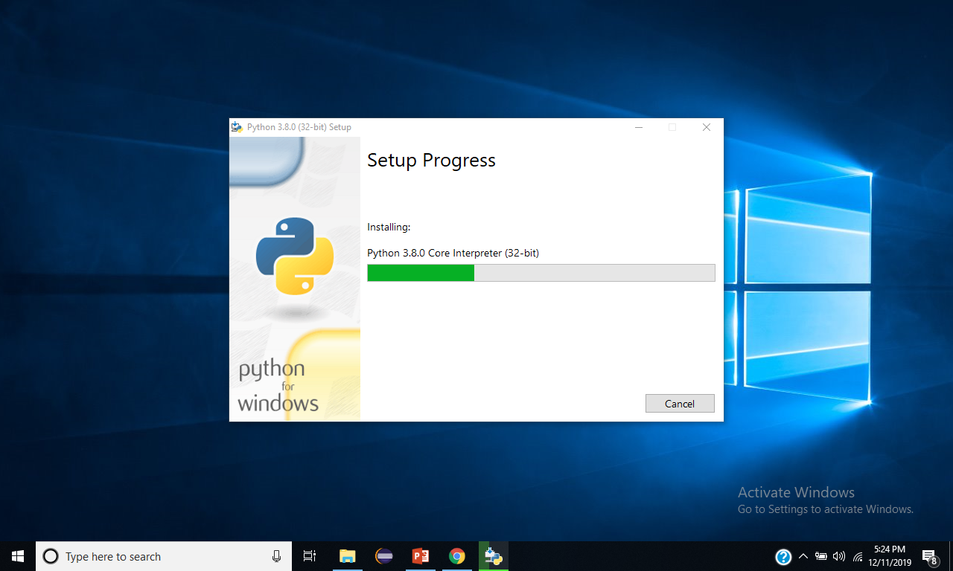

Slide 20
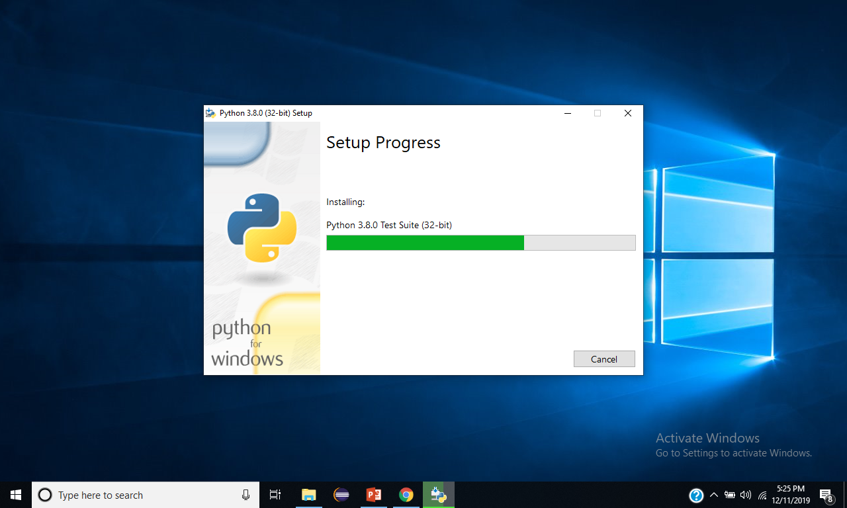

Slide 21
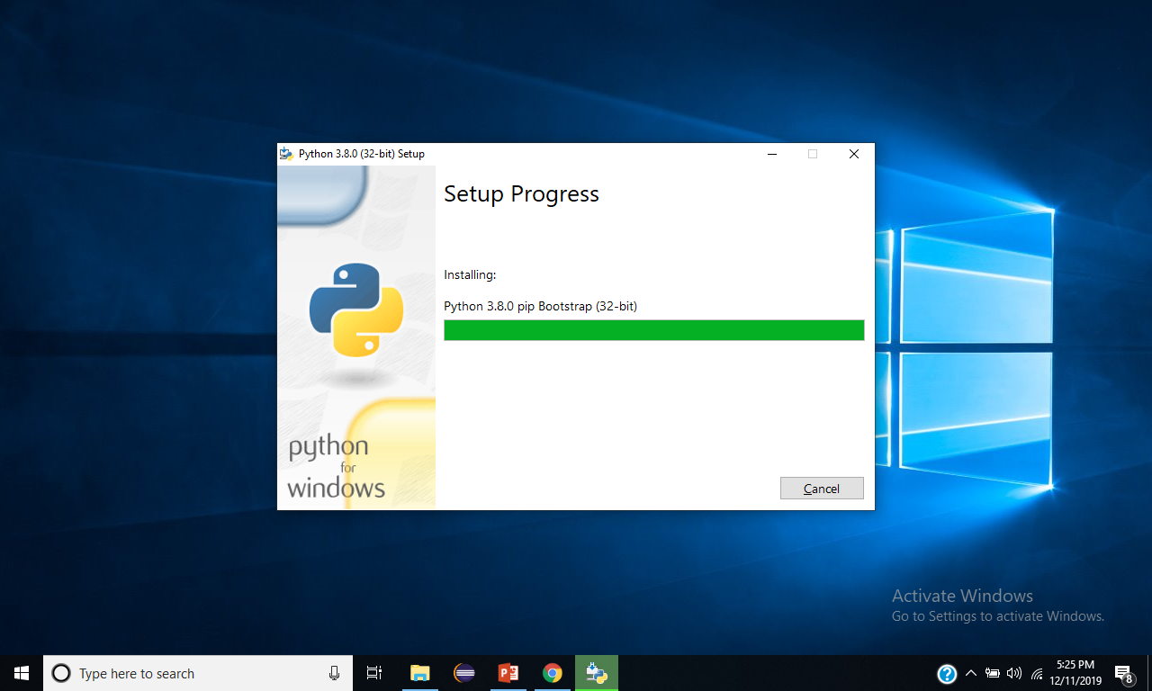

Slide 22
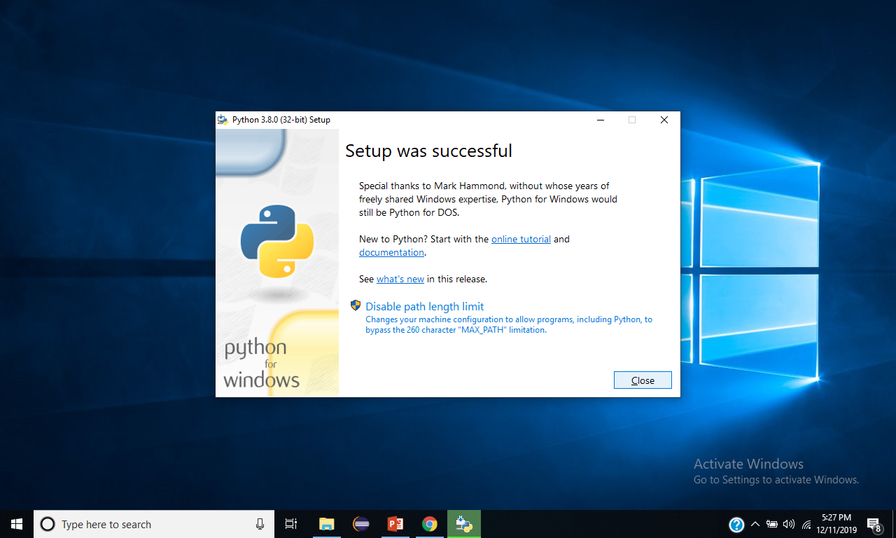

Slide 23


Slide 24
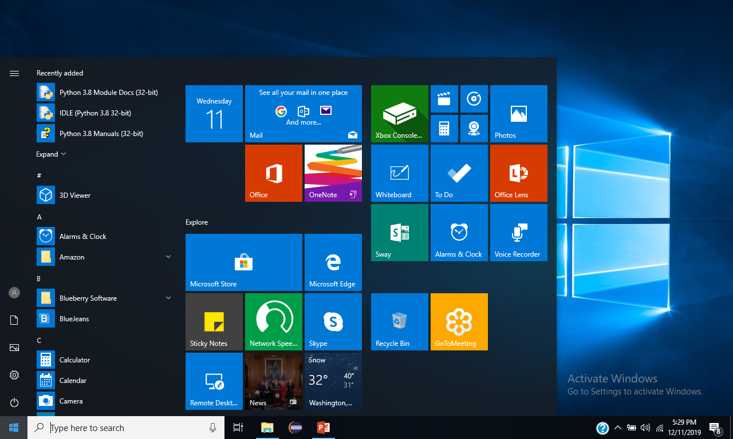

Slide 25
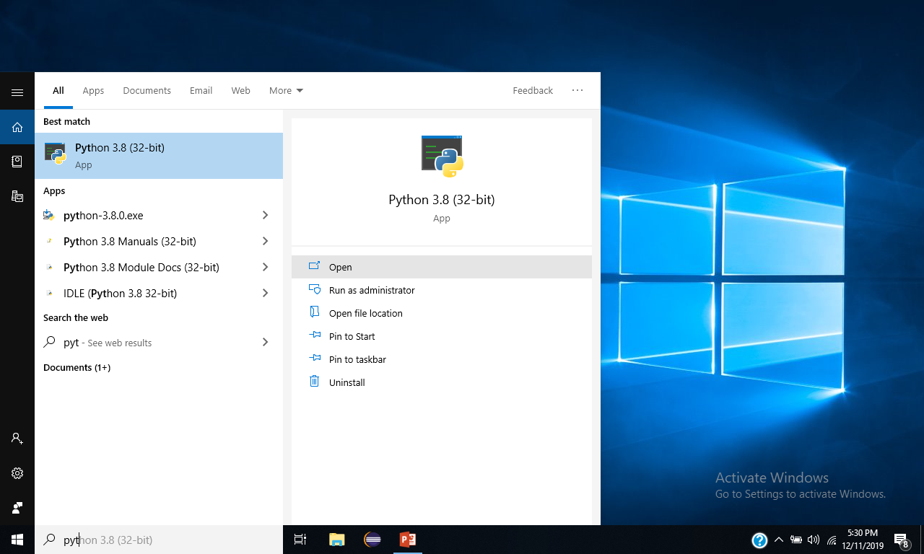

Slide 26
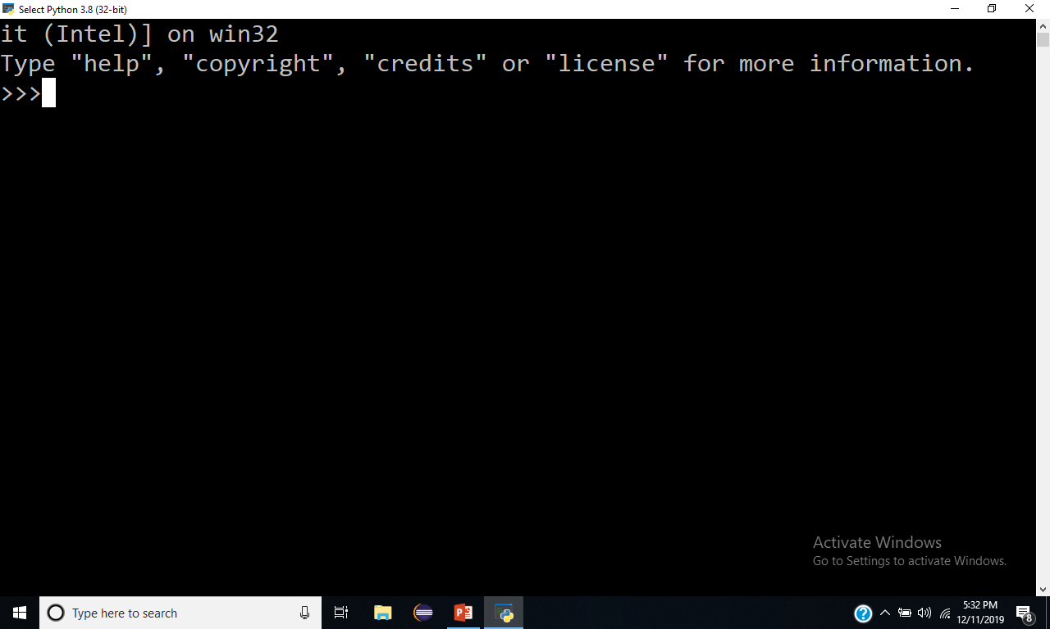

Slide 27
Execution Environments of
Python

Slide 28
Execution of the Python
Python programing can be executed using
Python command line
IDLE
Pycharm IDE
Pydev
Wing IDE
Spyder etc..

Slide 31
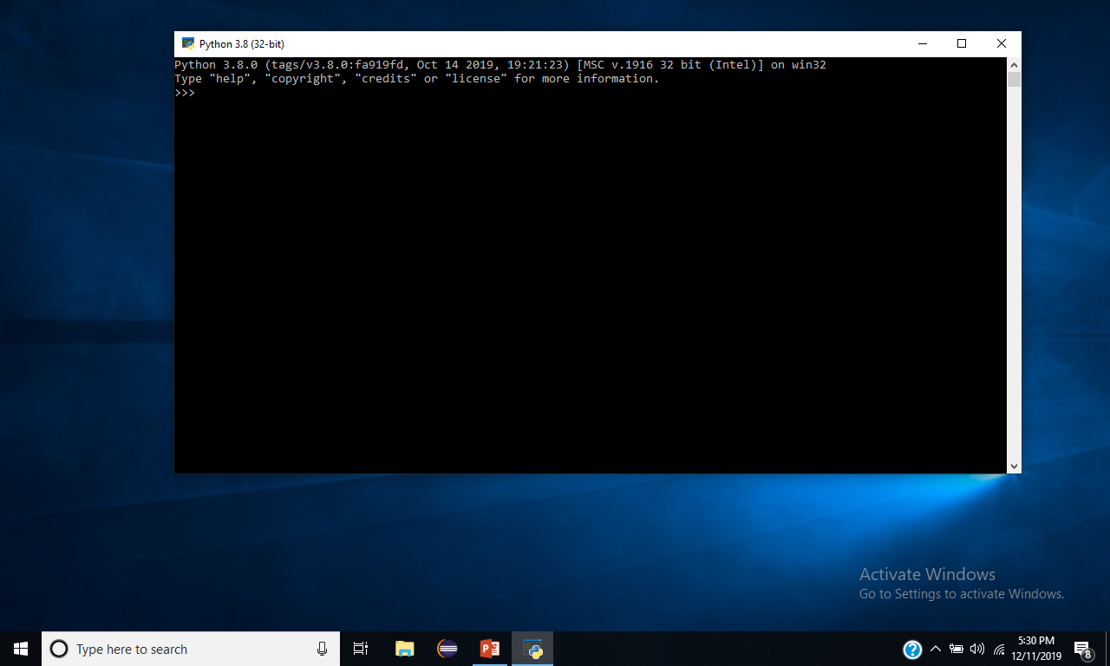

Slide 33
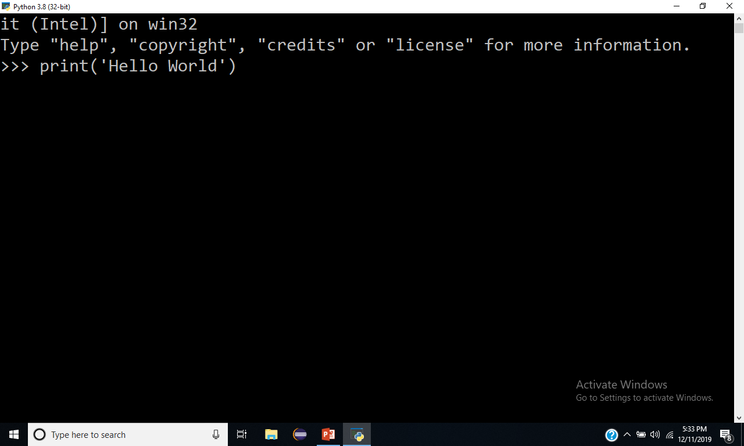

Slide 34
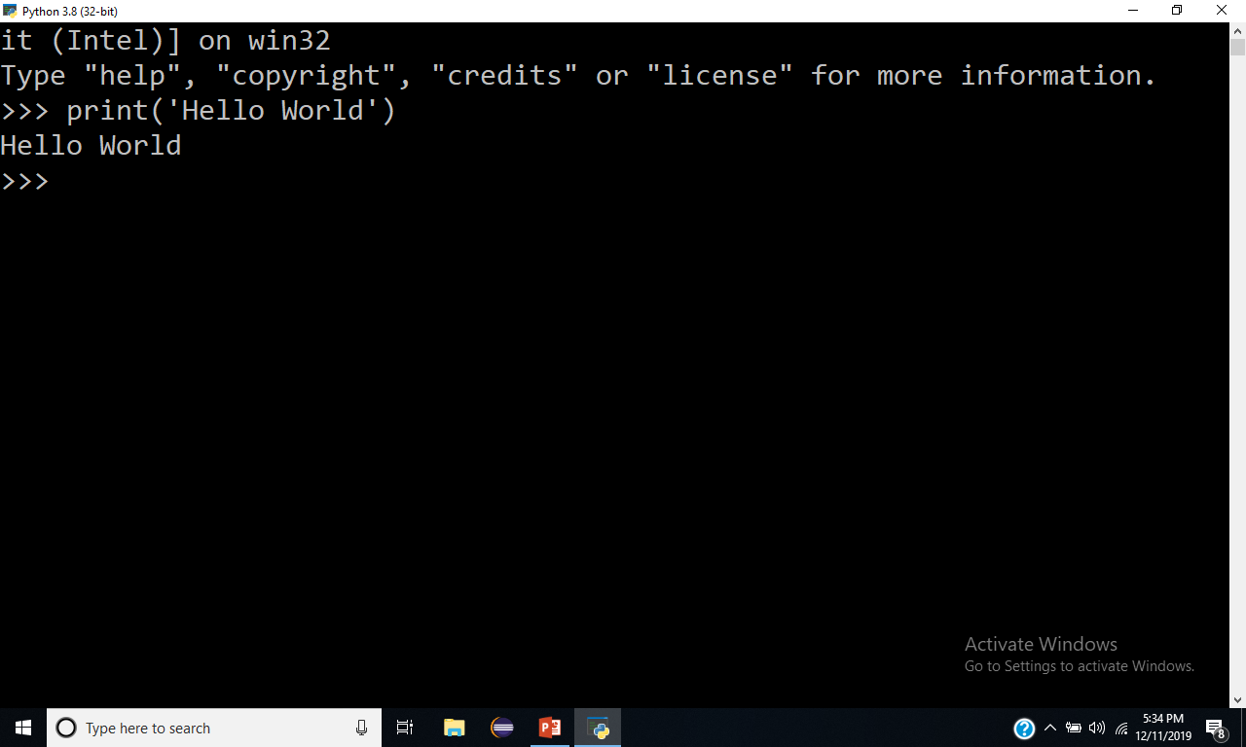

Slide 35
Execution using IDLE

Slide 36
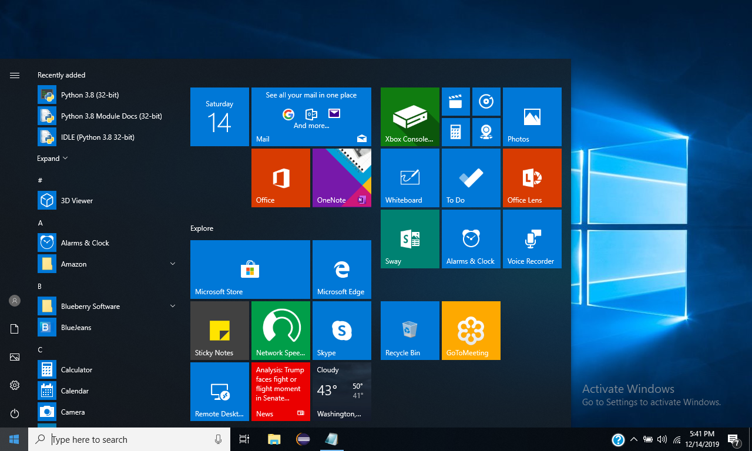

Slide 37
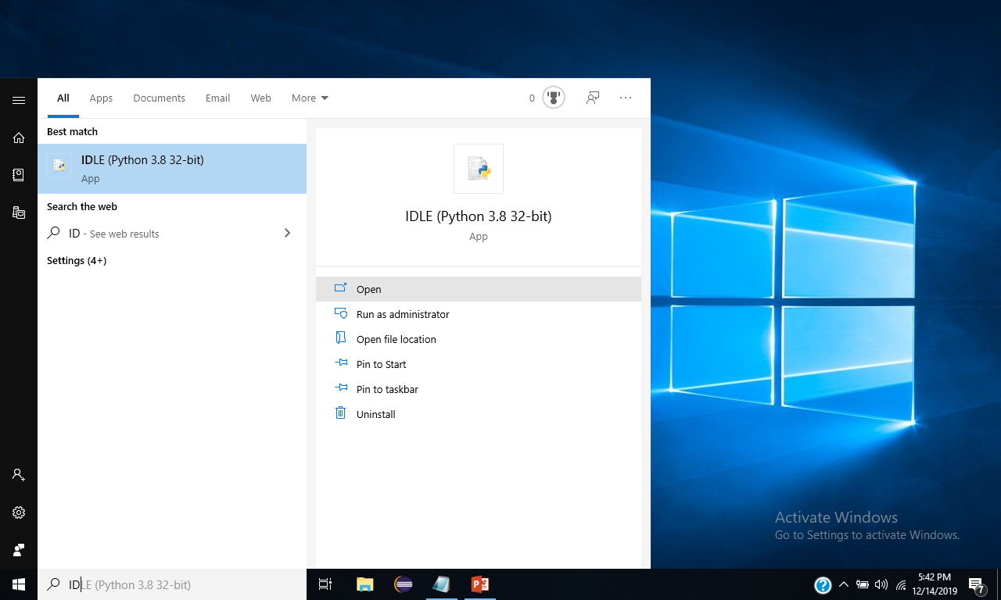

Slide 38
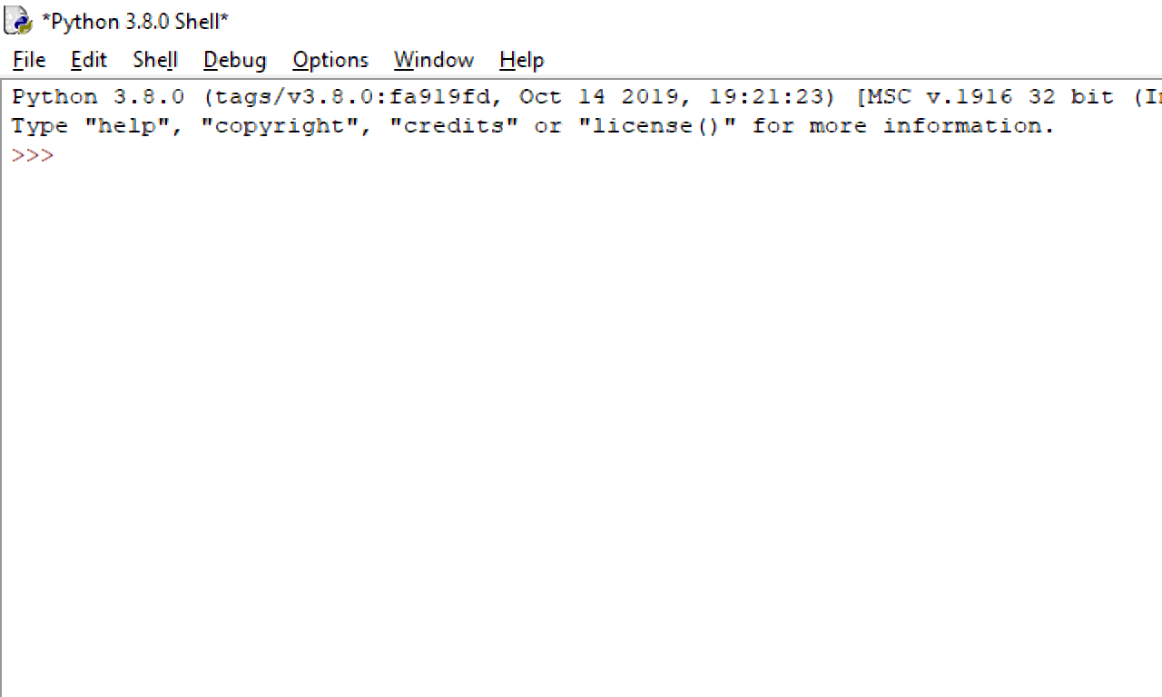

Slide 39
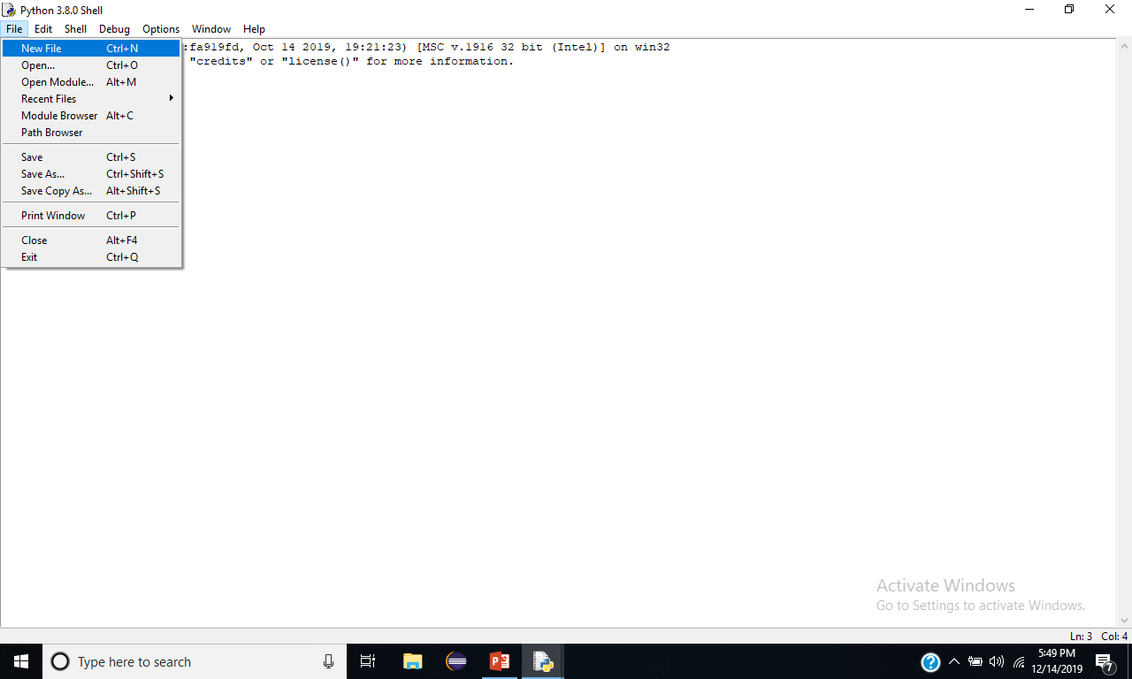

Slide 40
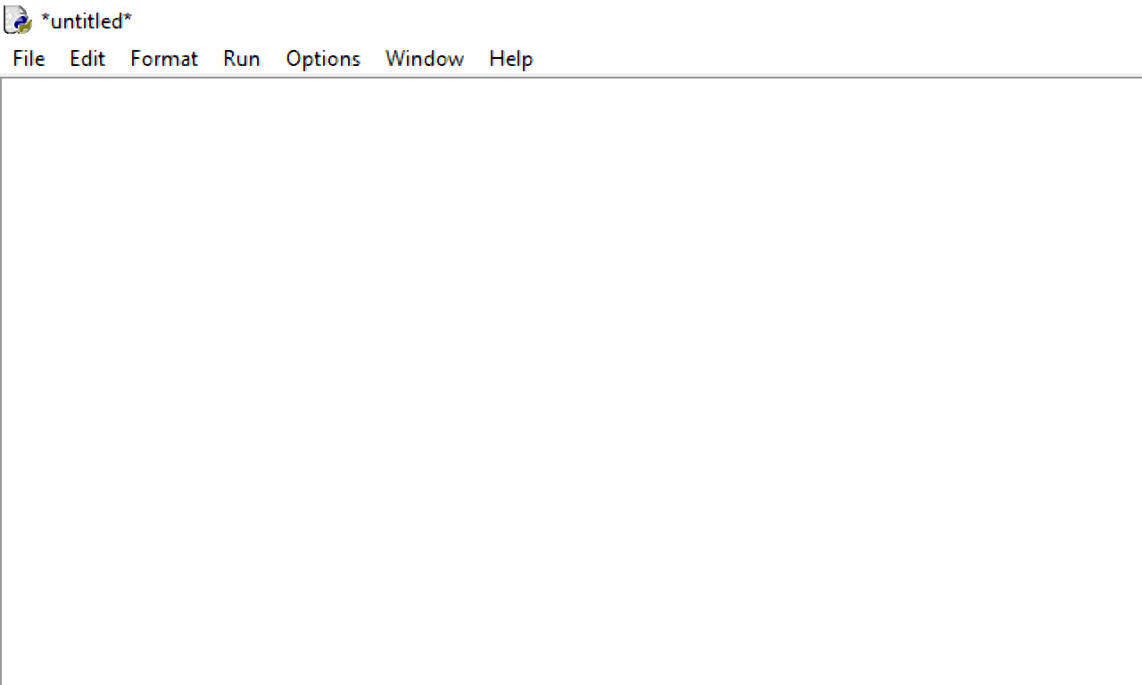
Print(‘welcome to Python programming’)
Print(‘Hi this IDLE Environment’)
Print(‘Welcome to all’)

Slide 41
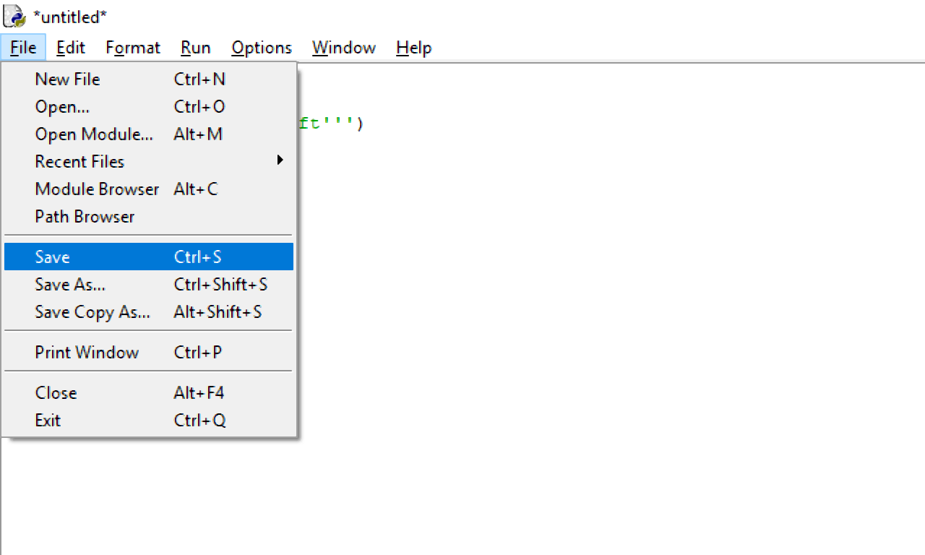

Slide 42
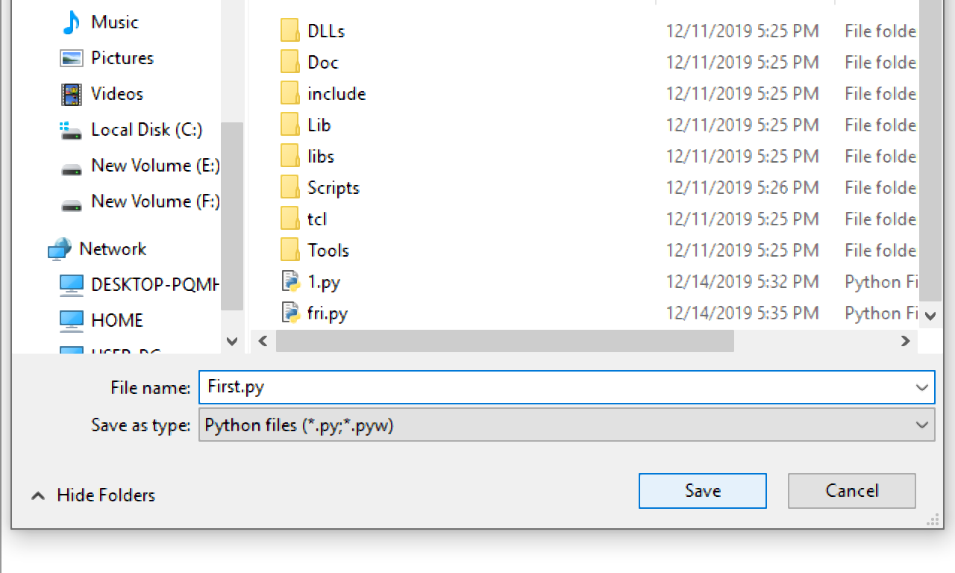

Slide 43
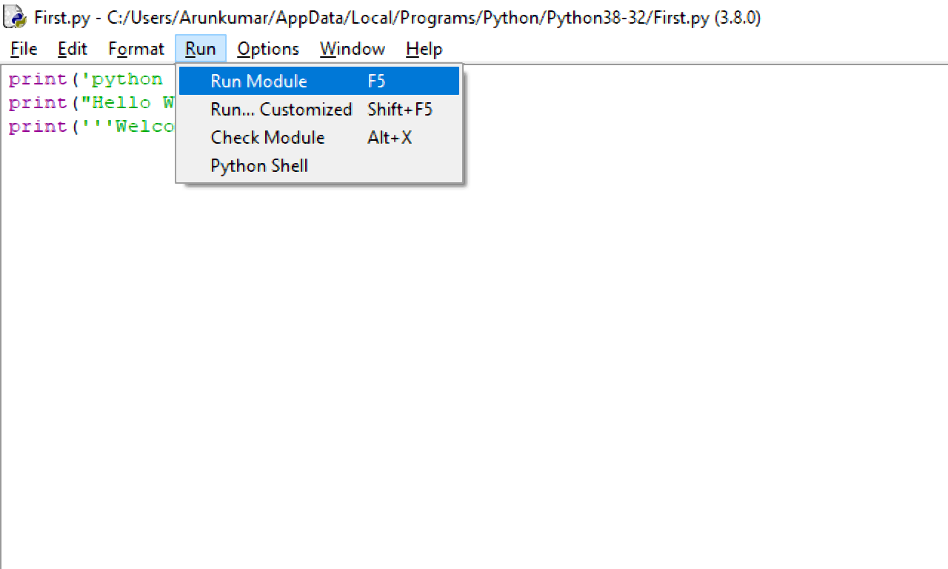

Slide 44
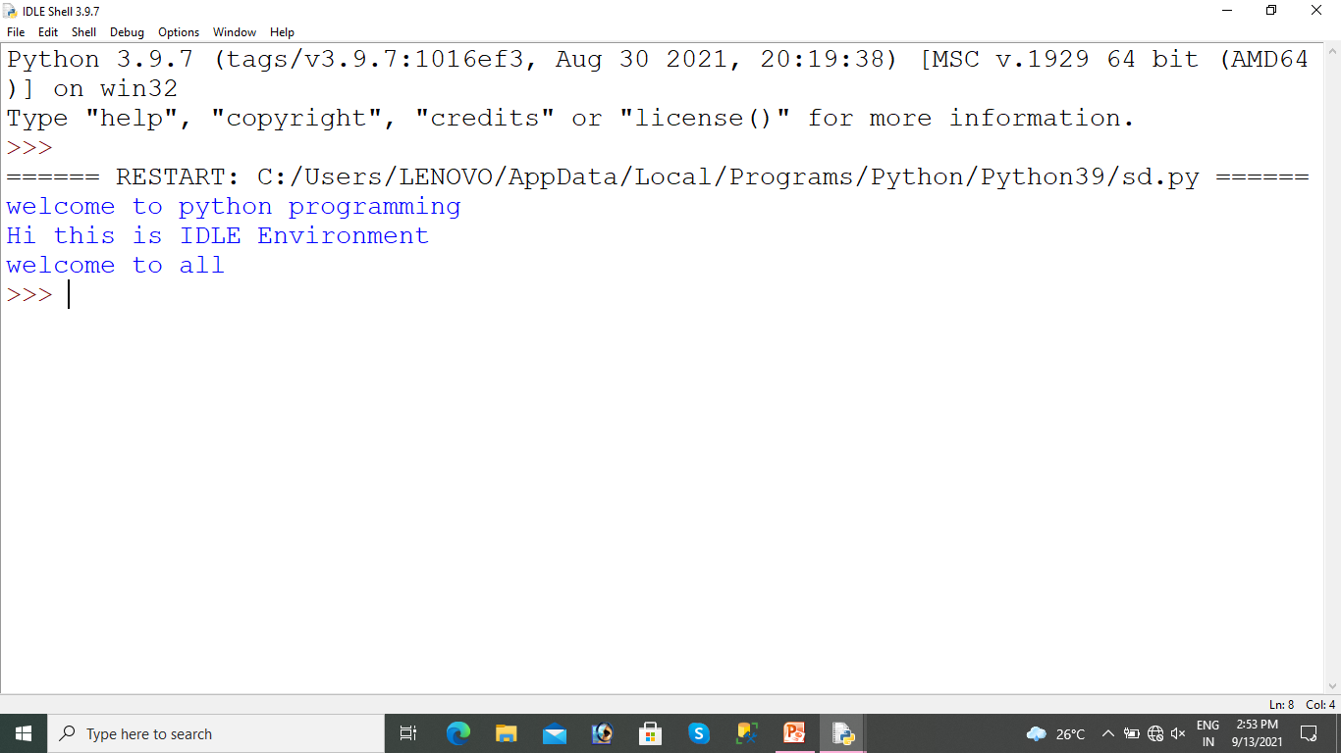

Slide 45
Comments in Python
Comments can be used to explain Python code.
Comments can be used to make the code more readable.
#→ can be used to comment the python coding .
‘’’ ‘’’ can be used form multiline comment.

Slide 46
Python Keywords (Python 3.12+)
In Python, keywords are reserved words that have special meanings and cannot be used as identifiers (such as variable names, function names, or class names).
  False await else import pass
  None break except in raise
  True class finally is return
  and continue for lambda try
  as def from nonlocal while
  assert del global not with
  async elif if or yield
  match case

Slide 47
Reserved keywords
Category | Examples
Boolean Values | True, False, None
Conditional | if, elif, else
Loops | for, while, break, continue
Exception Handling | try, except, finally, raise
Logical Operators | and, or, not
Function & Class | def, class, return, lambda
Importing | import, from, as
Context Management | with
Async Programming | async, await
Pattern Matching | match, case

Slide 48
Data Types

Slide 49
Data Types
Text Type : string
Numeric Types : int, float, complex
Sequence Types : list, tuple, range
Mapping Type : dict
Set Types : set, frozenset
Boolean Type : bool
Binary Types : bytes, bytearray, memoryview

Slide 50
Variables
Variables which can stores the data
Variable names must be written lower case , can’t start with number
Num, copy, name,
Faname, lname, mname, gen
first_name
=====================
Snakecase naming , camelCase
firstName
FirstName Pascal naming convtion
Meaningful names

Slide 51
X = 10
Y = 20
D = 5.6
F = ‘ou’
E = “nexsoft”
J = ‘’’Trainin’’’

Slide 52
Operators
Arithmetic operators
Assignment operators
Comparison operators(Relational Opeators)
Logical operators
Identity operators
Membership operators

Slide 53
Python Arithmetic Operators
Operator Name Example
+ Addition x + y
- Subtraction x - y
* Multiplication x * y
/ Division x / y
// Floor division x // y
% Modulus x % y
** Exponentiation x ** y

Slide 54
Assignment Operators
Operator Example Same
= x = 5 x = 5
+= x += 3 x = x + 3
-= x -= 3 x = x - 3
*= x *= 3 x = x * 3
/= x /= 3 x = x / 3
%= x %= 3 x = x % 3
//= x //= 3 x = x // 3
**= x **= 3 x = x ** 3

Slide 55
Python Comparison Operators
Operator Name Example
== Equal x == y
!= Not equal x != y
> Greater than x > y
< Less than x < y
>= Greater than or equal to x >= y
<= Less than or equal to x <= y

Slide 56
Python Logical Operators
Operator Description Example
and Returns True if both statements are true x < 5 and x < 10
or Returns True if one of the statements is true x < 5 or x < 4
not Returns False if the result is true, false if it is not(x < 5 and x < 10)

Slide 57
Python Identity Operators
Operator Description Example
is Returns true if both variables are the same object x is y
is not Returns true if both variables are not the same object x is not y

Slide 58
Python Membership Operators
Operator Description Example
in Returns true if both variables are the same object x in y
Not in Returns true if both variables are not the same object x not in y

