Slide 1

Part I-Chapter1 Introduction And Overview
Protocol
Network Protocol(Communication Protocol)
A set of rules to exchange message
The format of message
Protocol Software
The software that implements the Network Protocol
The appropriate actions required for each message
To ensure interoperability
Multiple entities in a network can communicate without any misunderstandings

Slide 2
Part I-Chapter1 Introduction And Overview
Network Protocols
Layering Model
The communication problem can be divided into pieces called layers
A protocol can be designed to corresponds to each layer
Each protocol only communicates with the protocol for the next highest layer and the next lowest
Protocol Suites
A complete, cooperative sets of protocols
Each protocol in a suite handles one aspect of the communication
They will work well together to handle the communication completely

Slide 3
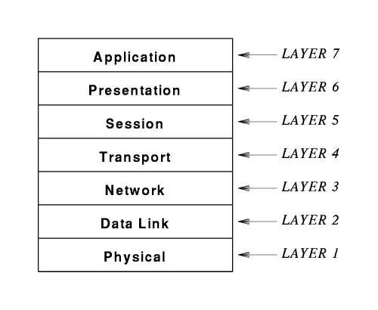
Part I-Chapter1 Introduction And Overview
Open Systems Interconnection Reference Model
Standardized by ISO
Software
Hardware
Software
Hardware

Slide 4
Part I-Chapter1 Introduction And Overview
OSI Hardware installed Host and Switch
Physical Layer
Transmission
Manchester Encoding for Ethernet
Transmission Media
Transmission Modes
Multiplexing And Demultiplexing
Modulation
Ethernet physical layer
Signals
Twisted Pair
Fiber

Slide 5
Part I-Chapter1 Introduction And Overview
OSI Hardware installed Host and Switch
Data Link Layer
Mac sublayer
Sending a frame based on CSMA/CD
LLC sublayer with Channel Coding
Demultiplexing a frame with a physical address
Frame
Reliability
Channel Coding
Automatic Repeat request(ARQ) Mechanism for frame
Sliding window for frame transmission
Ethernet frame
Bridge

Slide 6
Part I-Chapter1 Introduction And Overview
OSI Hardware installed Router
Network Layer
WAN Technologies
Routing
Suitable for multi hop networks

Slide 7
Part I-Chapter1 Introduction And Overview
OSI Software Run on The End Host
Transport
Session
How to identify the end process run on remote hosts
Presentation
How to keep the data bit order consistent for data on remote hosts
Application
Sender will divide the data into multiple frames
Receiver will reassemble the frames into the data
How to convert between raw data and network frames
How to using the data from remote host

Slide 8
Part I-Chapter1 Introduction And Overview
OSI Protocols & TCP/IP Protocols
OSI Protocols
They are designed by ISO huge standards bodies
TCP/IP Protocols
They were created by a small group of about a dozen researchers
TCP/IP protocols was technically superior to OSI protocols

Slide 9
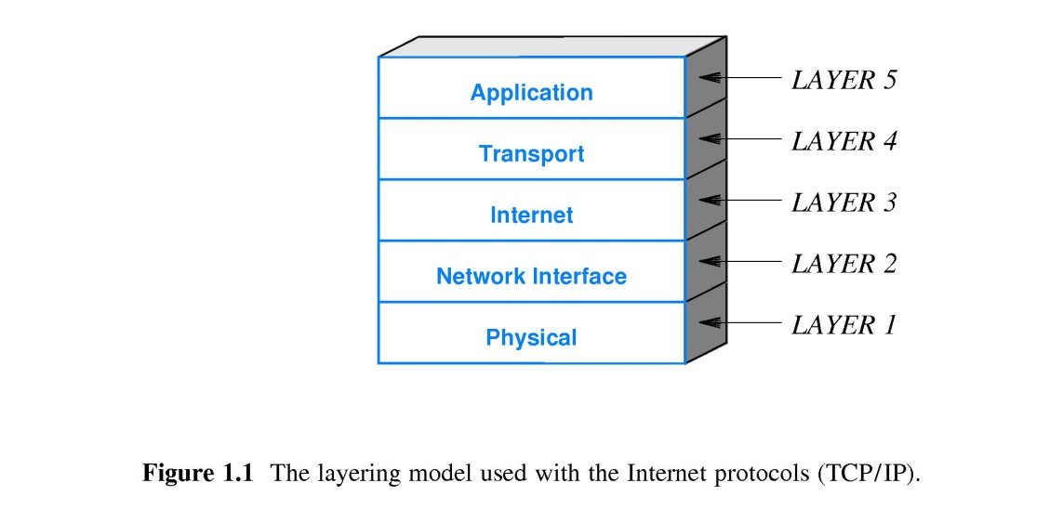
Part I-Chapter1 Introduction And Overview
TCP/IP Stack(Internet protocol)
Network card function for transmitting frames, which comes from OSI model
Network Interface Protocol
Network layer of OSI model
Link layer of OSI model
Physical layer of OSI model
TCP/IP Software
OSI hardware

Slide 10
Part I-Chapter1 Introduction And Overview
TCP/IP Stack(Internet protocol)
Internet Protocol(IP)
Virtual Network
The IP datagram format
The mechanisms used to forward IP datagrams
Transport Control Protocol(TCP)
Transport layer of OSI model
TCP segment which is a packet divided
Datalink layer of IP
Automatic Repeat request(ARQ) Mechanism for TCP segment
Sliding Window for TCP segment
Session layer of OSI model
Application Protocol
Presentation layer of OSI model
Application layer of OSI model
TCP Port Number which identify the process of communication
Socket API

Slide 11
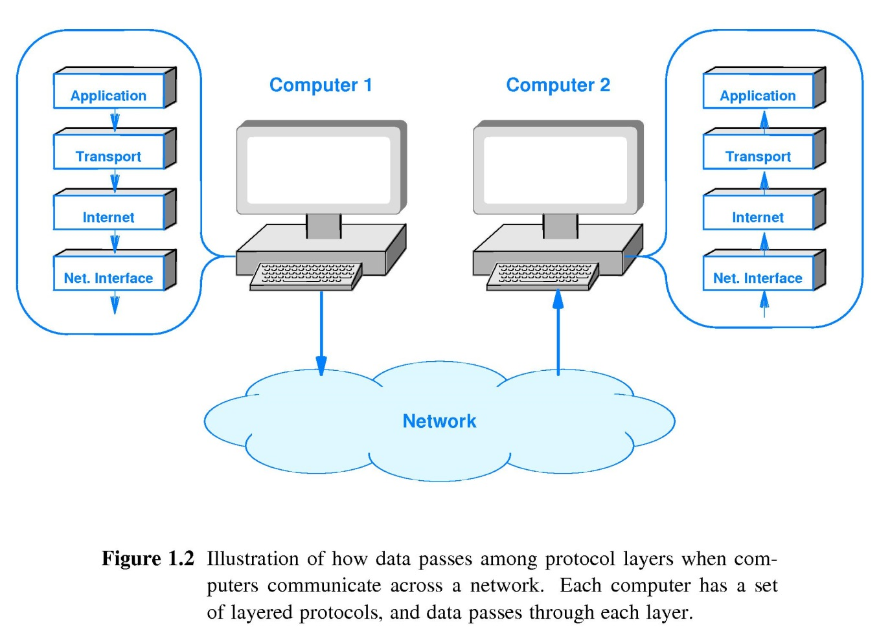
Part I-Chapter1 Introduction And Overview
TCP/IP Communication
The Conceptual Path of Data
Service
Protocol
Physical Communication

Slide 12
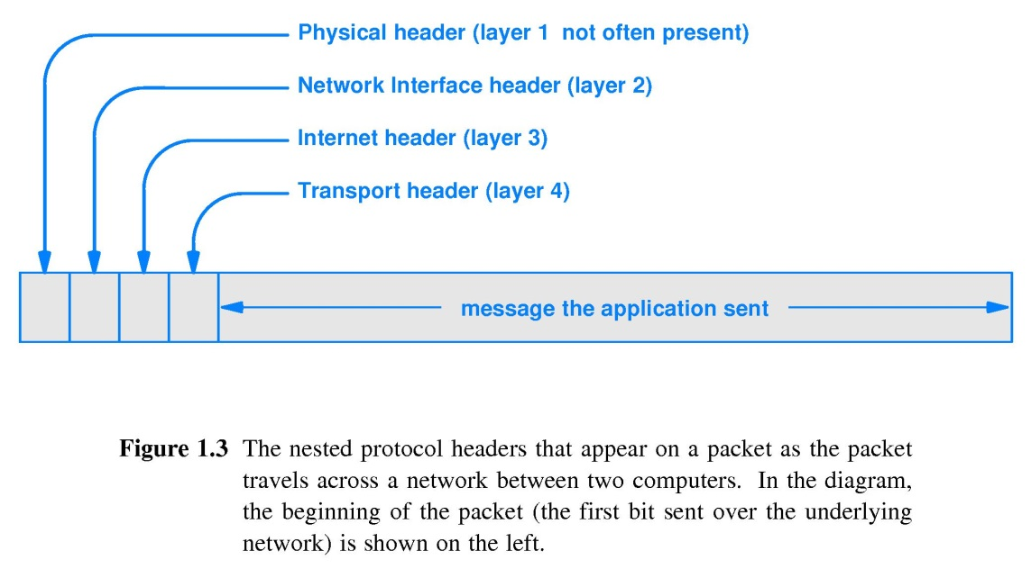
Part I-Chapter1 Introduction And Overview
Heads And Layers
Head
Additional information added by a protocol

