Slide 1

420344计算机网络
金伟祖
jinweizu@163.com
jinweizu@tongji.edu.cn
13391355632
601073174/42034401-计算机网络2023
济事楼314

Slide 2

Part1-Chapter1 Introduction
课程教学目标
课程教学目标1
了解计算机网络发展历史以及趋势研究现状；
课程教学目标2
理解二进制数据通信原理及工作机制
课程教学目标3
掌握OSI参考模型，熟悉以太网和无线网络等典型网络技术的传输协调机制；
理解电路网络和包交换网络的原理，充分了解网络技术发展的内在规律，具备自我学习和探索能力，以适应网络技术迅猛发展。
网络传输的基础

Slide 3
Part1-Chapter1 Introduction
课程教学目标
课程教学目标4
掌握TCP/IP网际互联模型，IP和TCP协议工作机制；
课程教学目标5
理解包过滤机制，掌握客户机服务器编程模型和SOCKET网络编程接口，熟悉HTTP等互联网应用协议规范；
课程教学目标6
掌握计算机网络各个层次操作系统关键算法；
主要涉及各类路由算法、滑动窗口与流量控制算法和密码加密算法。
IP数据包、UDP数据包和TCP段数据格式，
熟悉DNS和邮件传输协议等互联网应用基础协议

Slide 4
Part1-Chapter1 Introduction
课程考核
作业
笔试
60%
30%
期末考试
三次作业
出勤
10%

Slide 5
Part1-Chapter1 Introduction
注意事项
沟通
紧跟
课堂纪律
安静
邮箱：jinweizu@163.com
请假
及时解惑
注意章节编排次序
办公室：济事楼314
电话：13391335632
课程文档：\\10.60.41.1\Publicfiles\CourseDocuments_课程文档\ComputerNetwork_金伟祖
不使用手机

Slide 6
Part1-Chapter1 Introduction
《计算机网络实验 》课程
实验课时间
实验课地点
第一周—第十六周
济事楼330
每周一次
实验班
人员允许班之间调整
42014701：29，42014702：23，42014703：6，42014704：29，42014705：25，42014706：28
理想人数30

Slide 7
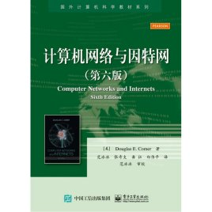
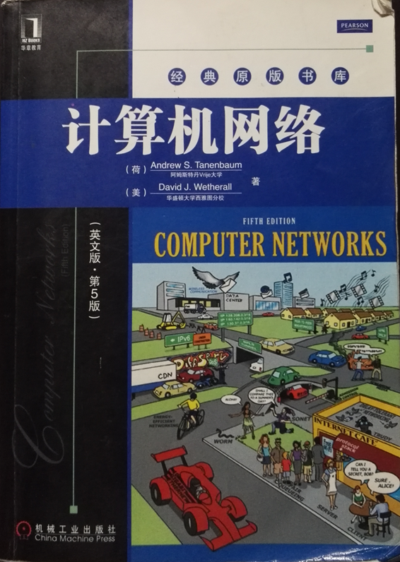
Part1-Chapter1 Introduction
教材
教材二
计算机网络.Andrew
教材一
计算机网络与因特网.Comer

Slide 8
Part1-Chapter1 Introduction
What is Computer Network
Computer Network is a collection of autonomous computers interconnected by a single technology
计算机网络是由通信线路互连而组成的网络系统
狭义定义《Computer Networks》教材2
广义定义(国内教材)

Slide 9
Part1-Chapter1 Introduction
Computer Network
The Internet网际互联
狭义计算机网络（物理网络）
Computer Networking
Network of networks
互联网应用：网站、邮件、导航、支付
主体是硬件
局部网络
广义计算机网络（网际网）
主体是软件
TCP/IP Protocols
Socket编程接口
《Internetworking with TCP/IP》
《TCP/IP Illustrated》
参考书
Notes:
课程实验：我们同时存在物理网络和IP网络，查看物理地址和IP地址。

Slide 10
Part1-Chapter1 Introduction
Topics
Computer network operation
Internet operation

Slide 11
Part1-Chapter1 Introduction
计算机网络与因特网
Breadth
Bottom-up Approach
Explanation of concept
Focus on the Internet
Features of the Textbook
Douglas Comer
Professor of Purdue University
Vice President of CISCO

Slide 12
Part1-Chapter1 Introduction
教学内容
Part 1
Part 3
网际互联
通信基础
物理网络
Part 2
Part 4
网络编程
TCP/IP协议模型
Socket编程
应用层编程(HTTP编程)
OSI开放系统互联参考模型
应用层协议

Slide 13
Part1-Chapter1 Introduction
The Examples Of Network
CATV
Telephone network
Highway
Mobile phone
Computer Network

Slide 14
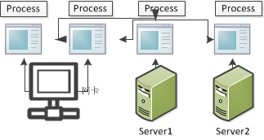
Part1-Chapter1 Introduction
The Endpoints of A Computer Network
A pair of processes on different computers
The address of an endpoint
Localhost:8080
IP:Port
Notes:
进程实验和端口实验

Slide 15
Part1-Chapter1 Introduction
计算机网络工程领域
Management Application
Hardware

Slide 16
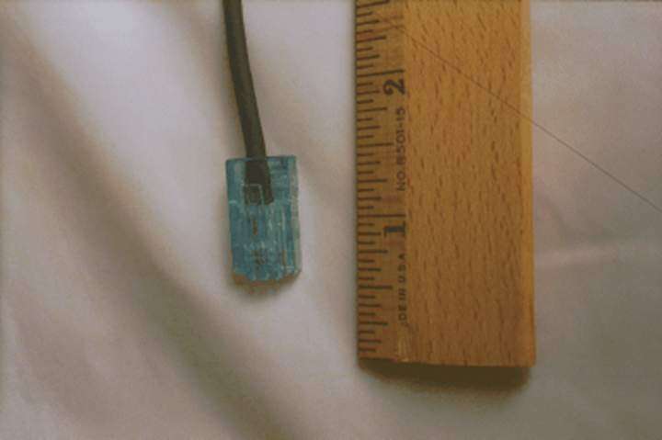
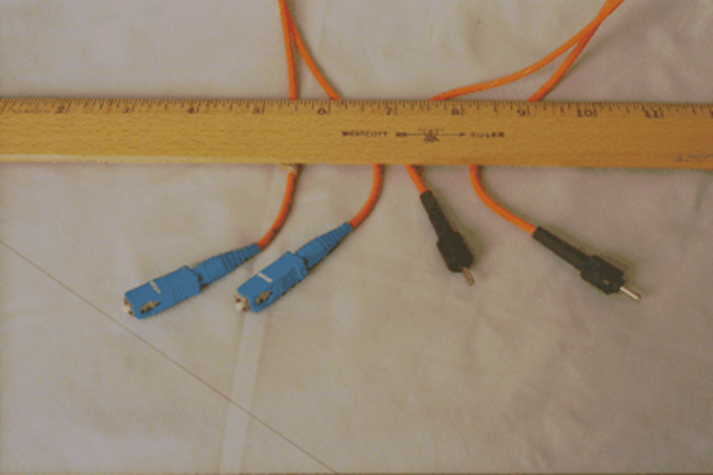
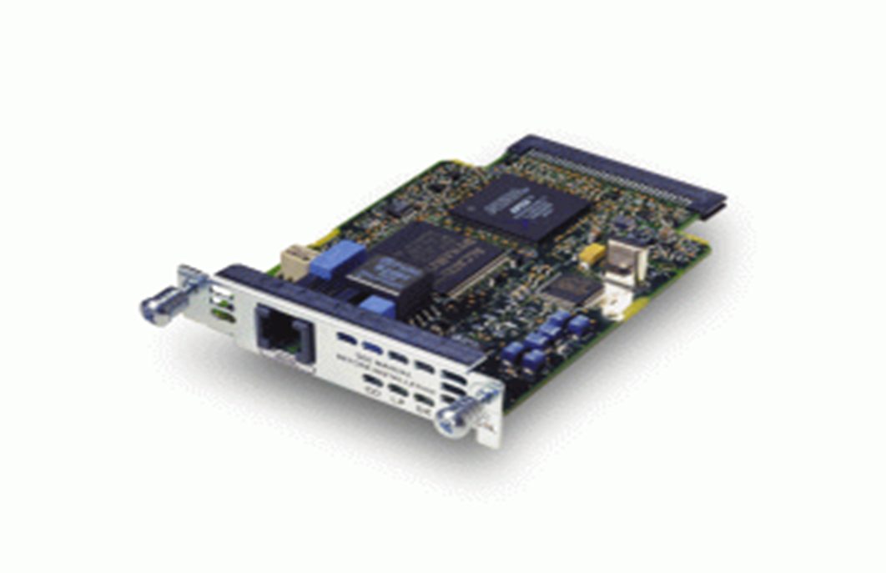
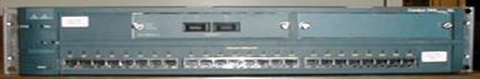
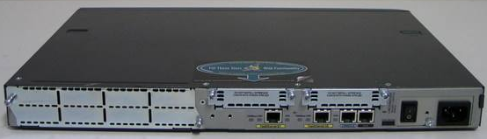
Part1-Chapter1 Introduction
Hardware
Cable
Network Interface Card
Switch
Router

Slide 17
Part1-Chapter1 Introduction
知识类型
基本理论
设备管理
协议数据包分析

Slide 18
Part1-Chapter1 Introduction
Growth of Network
From an esoteric research to an essential part of the infrastructure
In short, Computer networks are everywhere, such as School, Government, Military
A revolution

Slide 19
Part1-Chapter1 Introduction
Complexity In Network Systems
Many different technologies coexist
Lack of a single underlying theory
No simple and uniform terminology
Too many terminology

Slide 20
Part1-Chapter1 Introduction
Four Key Aspects Of Networking
Data Communication
Packet Switching And Networking Technologies
Internetworking With TCP/IP
Network Applications And Network Programming
Part 1 -通信基础
Part 2 -物理网络-OSI参考模型
Part 3-网际网-TCP/IP协议模型
Part 4 -应用层协议

Slide 21
Part1-Chapter1 Introduction
Data Communication
The domain of Electrical Engineering
The foundation of concepts on which the rest of networking is built
Somewhat irrelevant to our understanding of networking
The study of low-level mechanisms and technologies used to send information across a media

Slide 22
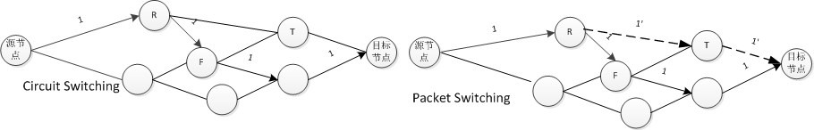
Part1-Chapter1 Introduction
Packet Switching And Network Technologies
Circuit Switching
The path of each switch is determined in advance and can’t be changed after the circuit is formed
Packet Switching
The data is divided into small blocks which is called packet
The path over any switching can be chosen freely by itself
Modern networks are all packet switches
Packet includes an identification of the intended recipient

Slide 23
Part1-Chapter1 Introduction
Internetworking With TCP/IP
Lies in their tolerance of heterogeneity
A Virtualization Approach
A network-independent packet
A network-independent identification scheme
IP datagram
IP Address

Slide 24
Part1-Chapter1 Introduction
Network Applications And Network Programming
Network Applications
Network Programming
Analogous to conventional programming
A programmer can create Internet application software without understanding the underlying network
An application program on one computer communicates across a network with an application program on another computer
Knowledge of the underlying network system allows a programmer to write better code

Slide 25
Part1-Chapter1 Introduction
Network Ownership
Public Network
Private Network
Use of the network is restricted to the corporate or individual
It is owned and operated by the Internet Service Provider(ISP) similar to a telephone service
电信
半封闭：校园网、企业网
移动
广电
Internet
Intranet
It can provide universal communication services to the Internet Content Provider(ICP)
完全封闭：政务网、军事网
联通
企事业官网

Slide 26
Part1-Chapter1 Introduction
Network Ownership
The Categories Of Private Networks
Customer
Small Office /Home Office(SOHO)
Small-To-Medium Business(SMB)
Large Enterprise
Enterprise network usual include both wired and wireless technologies
The least expensive LANs

Slide 27
Part1-Chapter1 Introduction
Communication protocol
The details for one aspect of computer communication to insure interoperability
Low-level details
Signals
Two entities in a network can communicate without any misunderstandings
The format of message
High-level mechanism

Slide 28
Part1-Chapter2 Internet Trends
Motivation At The Earliest?
Resource sharing
The peripheral device such as a printer or a disk
Communication
Large-scale computational power
No
Yes

Slide 29
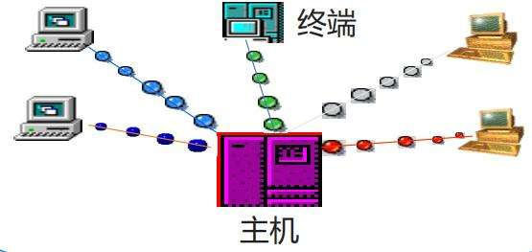
Part1-Chapter2 Internet Trends
Early computer
Terminals/Host Architecture
Host
Terminals

Slide 30
Part1-Chapter2 Internet Trends
Data Networking
It interconnect all computers to allow a researcher to use any computer
ARPANET
The first packet switching in the 1960s
The early Internet in the 1970s
Internet in the 1990s
Remote communication
between terminal and host through telephone line

Slide 31
Part1-Chapter2 Internet Trends
Internet History
1966, DARPA开始研究ARPAnet;
1969.9, 建立ARPAnet, 由4个节点组成；
1971，26 个节点；
1976，60个节点，100台主机；
1975, APRAnet投入营运；
1983，TCP/IP同UNIX联姻；分成MILNET和新APRAnet;
1990，Internet正式取代APRAnet

Slide 32
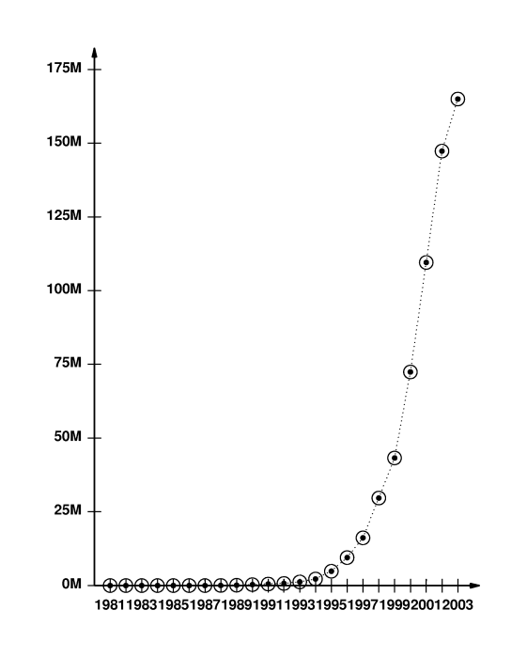
Part1-Chapter2 Internet Trends
Growth Of The Internet

Slide 33
Part1-Chapter2 Internet Trends
The Focus Of Internet
Resource sharing
Communication
Text
Graphics Image
Video Clips
Full-Motion Vedio

Slide 34
Part1-Chapter2 Internet Trends
The Transition of Traditional Communication System
Topic | Transition
Telephone System | Switch from analog to Voice over IP(VoIP)
Cable Television | Switch from analog delivery to IP
5G Cellular | Switch from analog to digital Cellular Services
Internet Access | Switch from wired to wireless access(WI-FI)
Data Access | Switch from centralized to distributed services(P2P)

Slide 35
Part1-Chapter2 Internet Trends
The new Application
Application | Significant For
High-quality teleconferencing | Business-to-business communication
Online banking and payments | Individuals,corporations,government
Sensor network | Environment, security, fleet tracking
Social networking | Consumers, volunteer organizations
Artificial Intelligence | Machine vision，intelligent search, theorem proving, game theory, robotcs,language and image understanding, genetic programming
Cloud computing | A customer only pays for resources that are actually used

