Slide 1

Part II Data Communications Basic
Part Contents
Overview Of Data Communications
Transmission Media
Transmission Modes
Modulation And Modem
Multiplexing And Demultiplexing

Slide 2
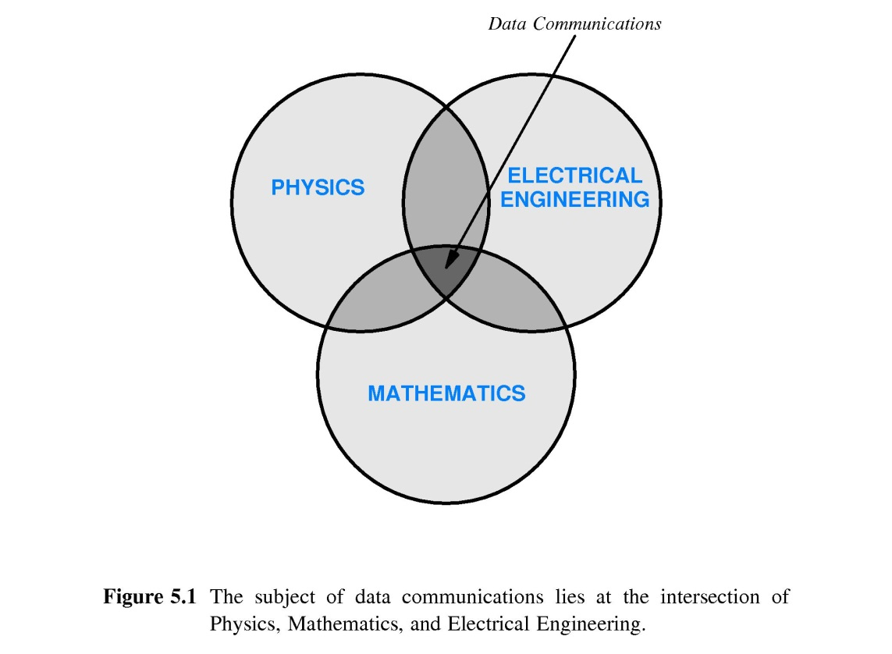
Part II-Chapter 5 Data Communications
Subject Of Data Communication

Slide 3
Part II-Chapter 5 Data Communications
Motivation And Scope
The source of information can be of arbitrary types
Transmission uses a physical system
Multiple sources of information can share the underlying medium

Slide 4
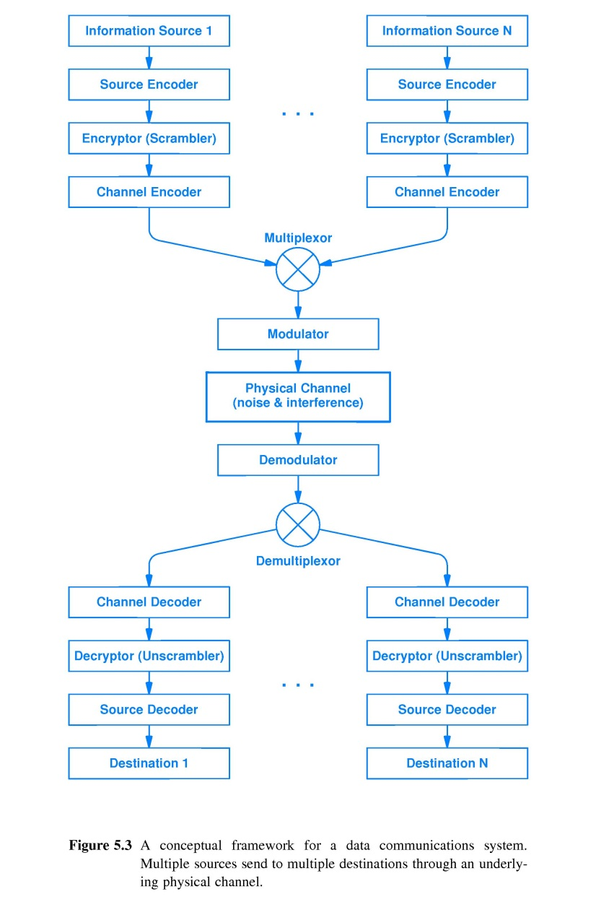
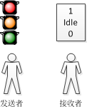
Part II-Chapter 5 Data Communications
Conceptual View Of Data Communication

Slide 5
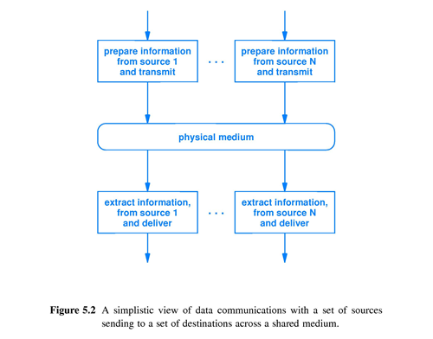
Part II-Chapter 5 Data Communications
Simple View Of Data Communication
二进制数据
无差错
高性能

Slide 6
Part II-Chapter 5 Data Communications
通信模型
单向性

Slide 7
Part II-Chapter 5 Data Communications
电信原理
电信利用电流（电压）或电磁波参数（如振幅、频率、相位）等物理信号的变化与检测达到通信目的
干扰源
信源
信道(信号/介质)
信宿
变换器
反变换器

Slide 8
Part II-Chapter 5 Data Communications
数据传输设计任务
信号
变换器
反变换器
传输差错控制与处理

Slide 9
Part II-Chapter 7 Transmission Media
Categories of Transmission Media
Guided Media
Security
Unguided Media
Mobile
Save the wire investment
Performance

Slide 10
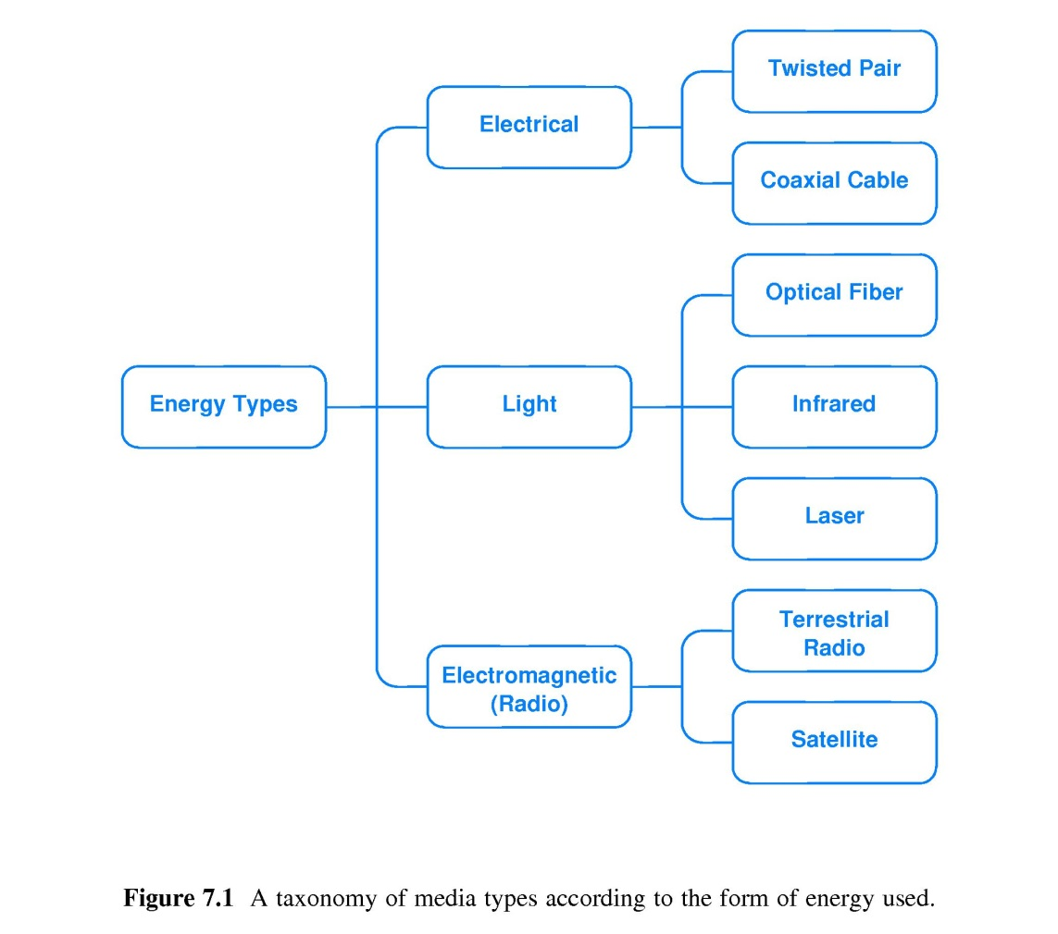
Part II-Chapter 7 Transmission Media
A Taxonomy of Media Types

Slide 11
Part II-Chapter 7 Transmission Media
Background Radiation And Electrical Noise
Random electromagnetic radiation
Noise
Shield
It permeates the environment
Metal absorbs radiation

Slide 12
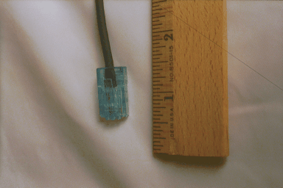
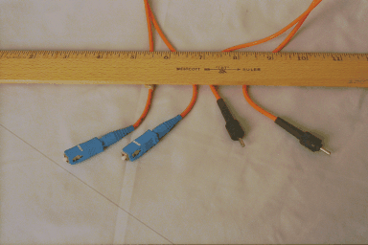
Part II-Chapter 7 Transmission Media
Guided Media
Twisted pair
Fiber
Coaxial cable

Slide 13
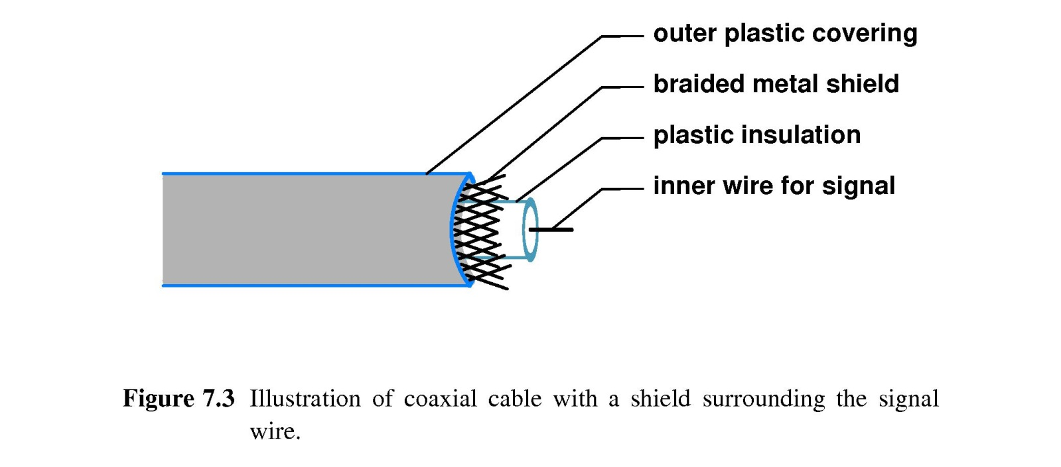
Part II-Chapter 7 Transmission Media
Coaxial cable

Slide 14
Part II-Chapter 7 Transmission Media
Copper Wires
Copper
Inexpensive
Electric Current
卡接技术：伸展性和传导性，易安装
High performance
Interference

Slide 15
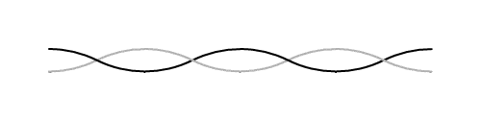
Part II-Chapter 7 Transmission Media
Twisted pair Copper Wires
Interference
Strength of signal
Position
Types of Twisted Pair
Shielded Twisted Pair(STP)
Unshielded Twisted Pair(UTP)

Slide 16
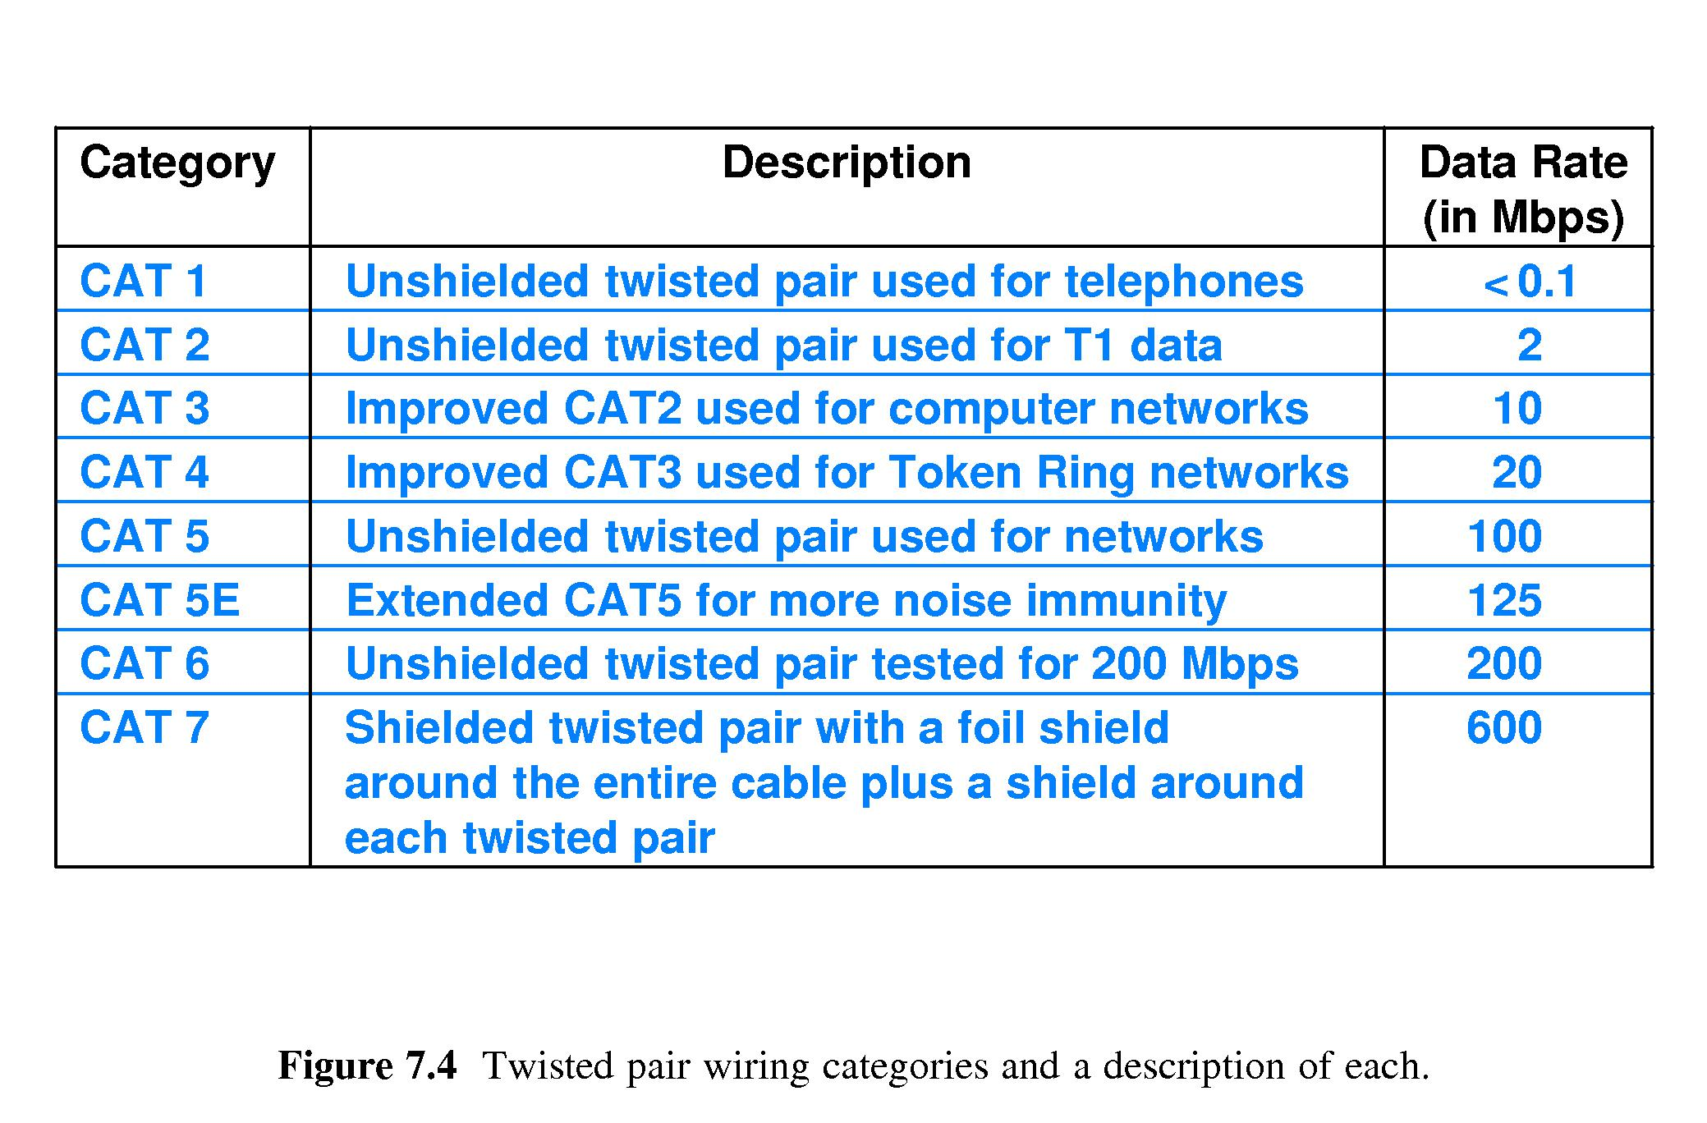
Part II-Chapter 7 Transmission Media
Categories of Twisted pair Cable

Slide 17
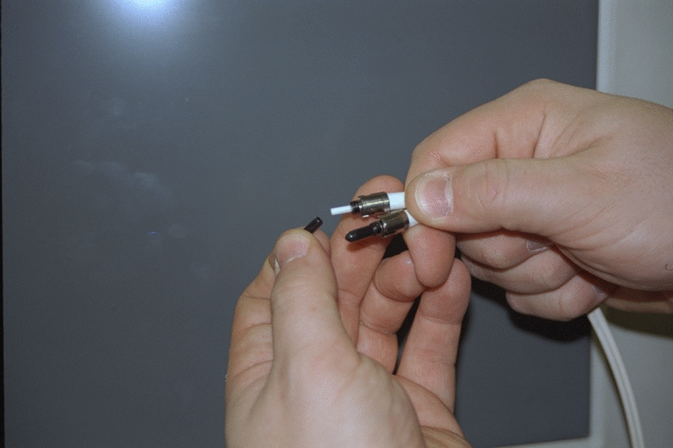
Part II-Chapter 7 Transmission Media
Optical Fibers
Glass or Transparent Plastic
No interference
Light
Much farther
Encode more information
Single
LED
Laser

Slide 18
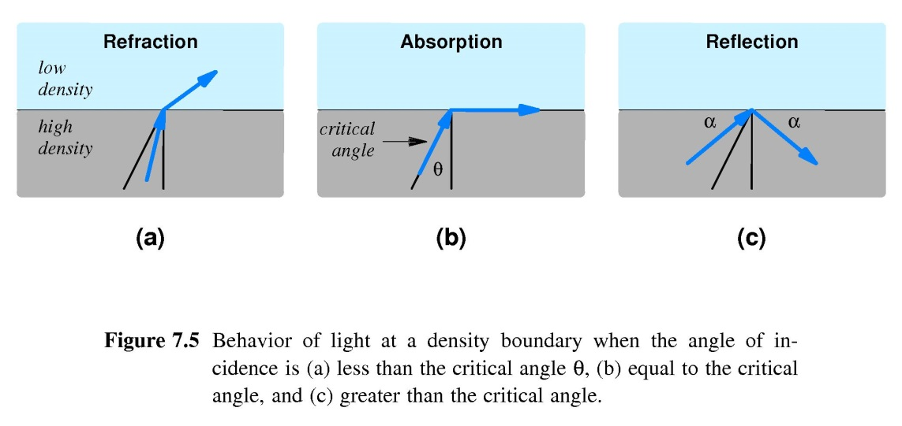
Part II-Chapter 7 Transmission Media
Optical Fibers
Behavior of Light at a density boundary
Disadvantage Of Optical Fibers
Difficult to install
融接技术,Easy to broken
Difficult to be repaired

Slide 19
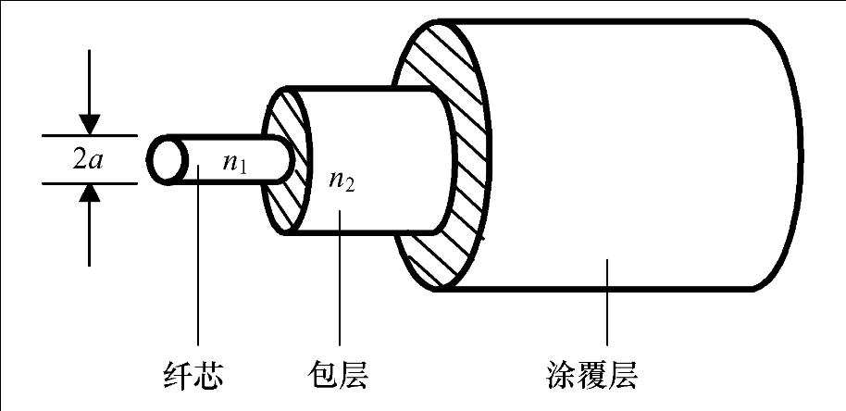
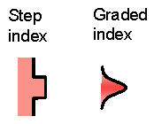
Part II-Chapter 7 Transmission Media
Optical Fibers
Types Of Optical Fibers
Multimode with some dispersion
Graded Index fiber with the least dispersion
Single Mode fiber with the least dispersion
A pulse of light can travel thousands of kilometers without becoming dispersed
Injection Laser Diode
Step Index fiber with low dispersion
Light Emitting Diode

Slide 20
Part II-Chapter 7 Transmission Media
Infrared
Infrared signal
More inexpensive than other unguided media
Easy to install
Limited to a small area
It is intended to connect a computer to a nearby peripheral such as a printer
A point-to-point communication technology

Slide 21
Part II-Chapter 7 Transmission Media
Point-To-Point Laser
A point-to-point communication technology
A beam of coherent light produced by a laser
Long distance
Easy to be blocked
Cannot penetrate vegetation

Slide 22
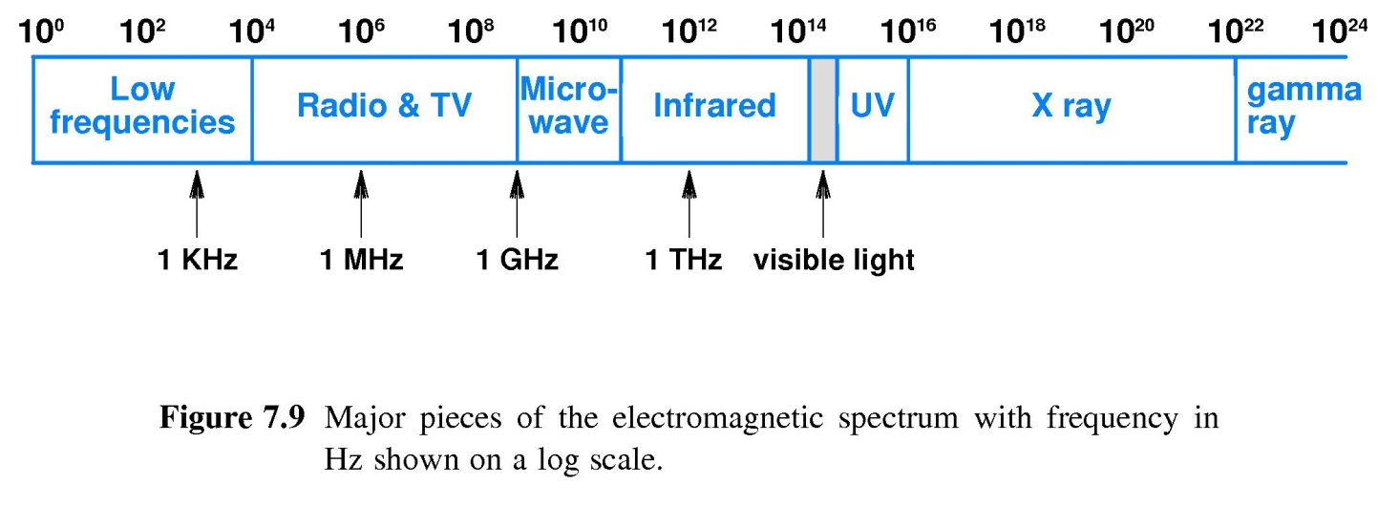

Part II-Chapter 7 Transmission Media
Radio Frequency
Air
Travel long distances and penetrate objects
Electromagnetic Spectrum
3KHz to 300GHz

Slide 23
Part II-Chapter 7 Transmission Media
Advantage Of Radio
Advantage
Inexpensive; need not wire but only antenna
Mobile
Disadvantage
Low security
Limited of frequency resource

Slide 24
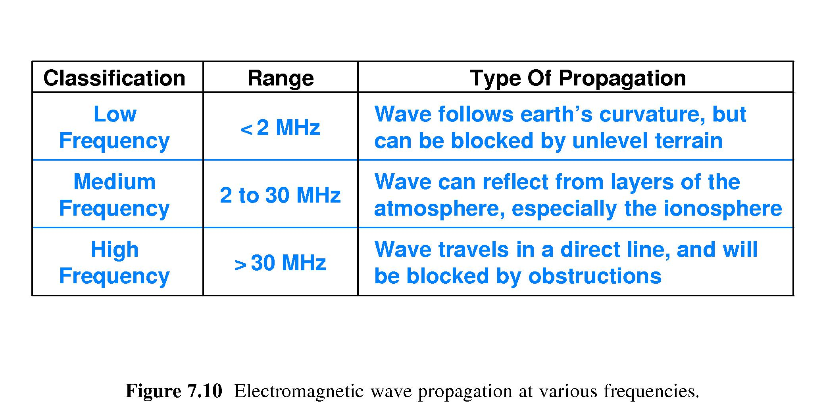
Part II-Chapter 7 Transmission Media
RF Signal Propagation

Slide 25
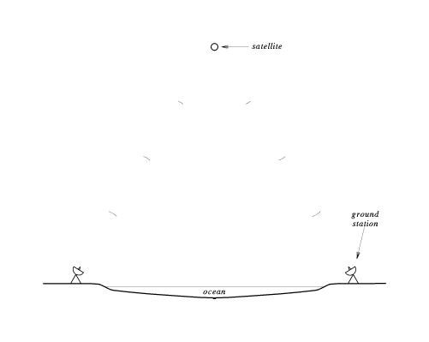
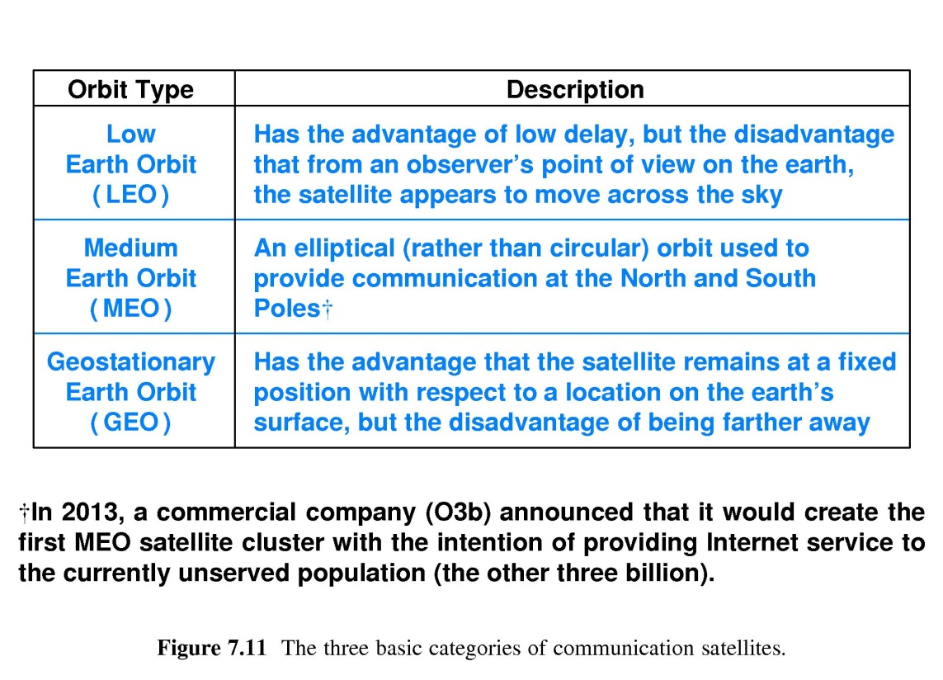
Part II-Chapter 7 Transmission Media
Satellites
Properties of Satellite
Combined With Radio
Long Distance
Expensive

Slide 26
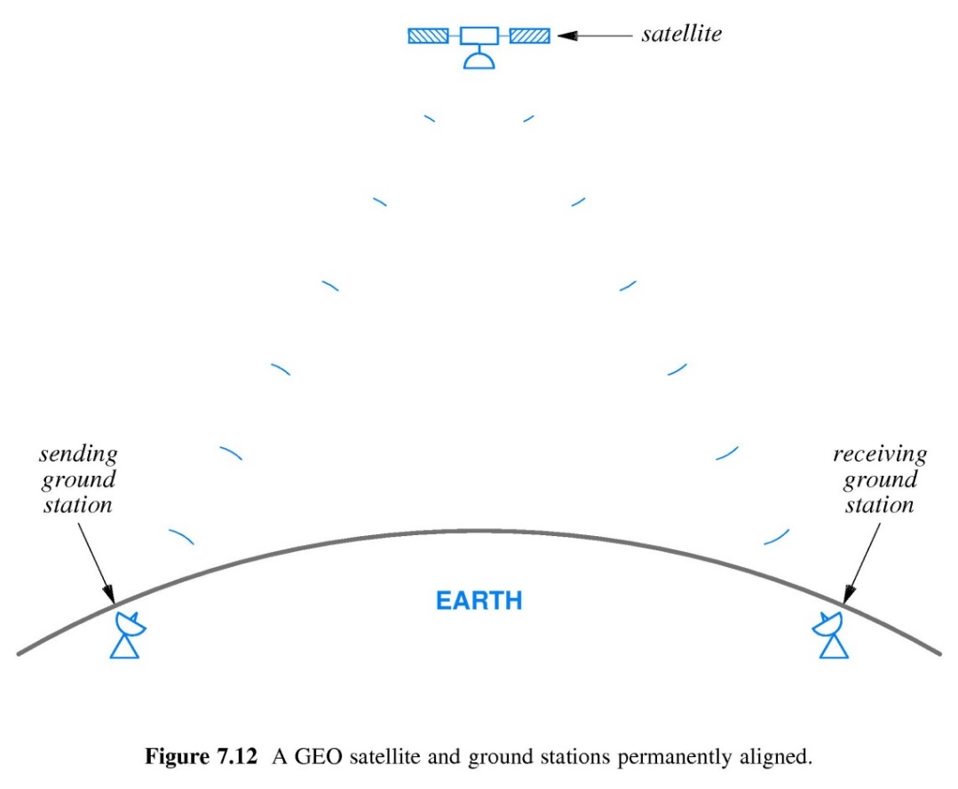
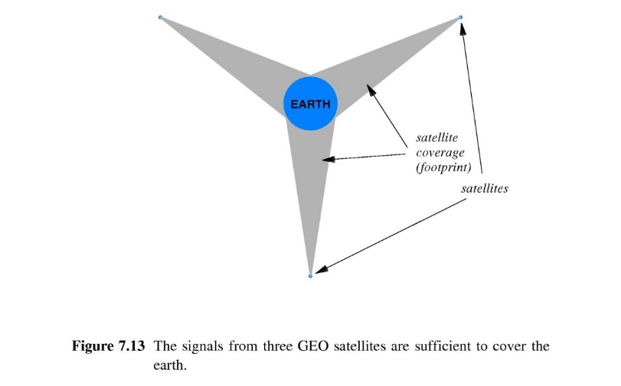
Part II-Chapter 7 Transmission Media
Geosynchronous Satellites
Properties
Synchronized with the rotation of the earth
GEO Coverage Of The Earth
A limited amount of “space”
35,785 kilometers Orbit
Minimum 3 satellites to cover earth
A delay of 0.2 seconds and Simple Control

Slide 27
Part II-Chapter 7 Transmission Media
Low Earth Orbit Satellites
500 to 2000 miles orbit
Faster than the rotation of the earth
Complex Control
A limited amount of “time”
Low Earth Orbit Satellite Arrays
A set of Low Earth Orbit Satellites
At least one satellite is available at any time
The members communicate with one another
Properties

Slide 28
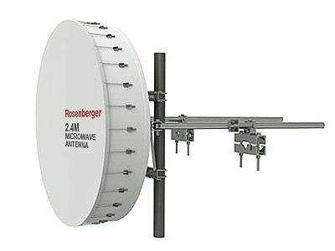
Part II-Chapter 7 Transmission Media
Microwave
Electromagnetic Radiation beyond the frequency range
Between 300MHz and 1GHz
Maximum distance 50 kilometers
Single direction, but easy to be blocked
Future Usage
Huawei 5G Cellular Technologies

Slide 29
Part II-Chapter 7 Transmission Media
The Performance Of Transmission Medium
Propagation delay
The time required for a signal to travers the medium
Channel Capacity
The maximum data rate that the medium can support
Bandwidth
The maximum rate that hardware can change a signal, measured in HZ

Slide 30
Part II-Chapter 7 Transmission Media
Nyquist Theorem
D=2*B*log₂K
K presents possible signal levels
D presents the maximum of channel capacity
B presents bandwidth

Slide 31
Part II-Chapter 7 Transmission Media
The Effect Of Noise On Communication
Noise
Small amounts of background interference
Effective channel capacity
The effective limit on the channel capacity

Slide 32
Part II-Chapter 7 Transmission Media
Shannon Theorem
C=B*log₂（1+S/N）
B presents bandwidth
S presents the average signal power
N presents the average noise power

Slide 33
Part II-Chapter 7 Transmission Media
Shannon Theorem
S/N
Signal-to-noise ratio
dB=10*log₁₀S/N
Example
dB=20→S/N=100
dB=30→S/N=1000
Decibels(dB)

Slide 34
Part II-Chapter 7 Transmission Media
The Voice Telephone System
Bandwidth
3000HZ
Signal-to-noise ratio
30db
C=3000* log₂（1+1000）
30Kps

Slide 35
Part II-Chapter 7 Transmission Media
The Significance of Theories
Nequist’s theorem
Shannon’s theorem
It encourages engineers to explore ways to encode bits on a signal
It informs engineers that no amount of clever encoding can overcome the laws of physics

