Slide 1

Part III-Chapter 19 Past Networking Technologies
Past Connection Technologies
Synchronous Optical Network(SONET)
Synchronous Digital Hierarchy(SDH)
The standard for the digital circuits used through the Internet
Trunk circuit
Optical Carrie Standard(OC) specify the signaling used on an optical fiber SONET ring

Slide 2
Part III-Chapter 19 Past Networking Technologies
Past Main Broadband Access Technologies
Digital Subscriber Line
Using existing telephone line
Data rate of 1 to 6 Mbps will be offered by depending on the distance
Cable Modem
Using existing cable television infrastructure
Date rate of up to 52Mbps will be shared among a set of users
Wireless Access
Wi-Fi
WiMAX
Cellular Communication Systems(3G and 4G)
无线上网卡
手机共享热点
Either access or backhaul

Slide 3
Part III-Chapter 19 Past Networking Technologies
Past Other Access Technologies
Very Small Aperture Satellite
A dish size of less than 3 meters
Incuring long delays
Power Line Communication（PLC）
Using existing power line
Although much research has been done, it has not enjoyed widespread deployment

Slide 4
Part III-Chapter 19 Past Networking Technologies
Past LAN Technologies
Ethernet
A bus network
Dominating the LAN market
Ethernet technologies had ever changed
IBM Token Ring
IEEE802.5
A ring network
Its throughput is 16Mbps
Fiber Distributed Data Interconnect
Another ring network

Slide 5
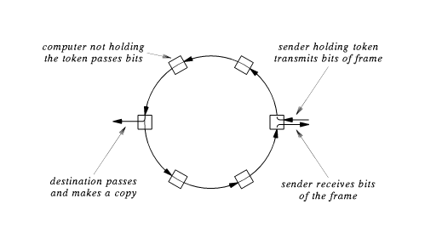
Part III-Chapter 19 Past Networking Technologies
Past LAN Technologies
IBM Token Ring
The frame will pass completely around the ring while it is being sent
The frame pass from the sender to the next computer，then to the next one and so on, until back at the sender
All stations forwards bits around the ring
The computer destined will make a copy of the frame
The sender can compare the data being received to the data being sent

Slide 6
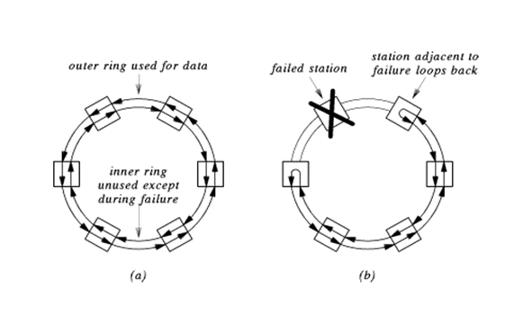
Part III-Chapter 19 Past Networking Technologies
Fiber Distributed Data Interconnect(FDDI)
Core LAN
It is usually used to connect LANs
Another Token Ring
First 100M LAN
Its transmission medium is fiber
A pair of counter-rotating rings to provide redundancy
200Km
Self-healing Mechanism
The reverse path can form a closed ring

Slide 7
Part III-Chapter 19 Past Networking Technologies
Past WAN Technologies
ARPANET
The first packet switched WANs
56Kbps
X.25
Frame Relay
SMDS
ATM
MPLS
ISDN

Slide 8
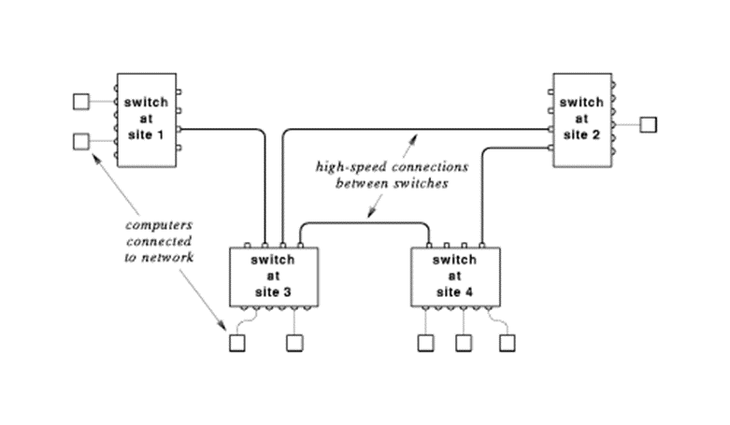
Part III-Chapter 19 Past Networking Technologies
Past WAN Technologies
X.25
CCITT X.25
Based to unreliable circuit
Traditional WAN design-an X.25 network consists of two or more X.25 packet switches
Connecting ASCII terminals to remote timesharing computers

Slide 9
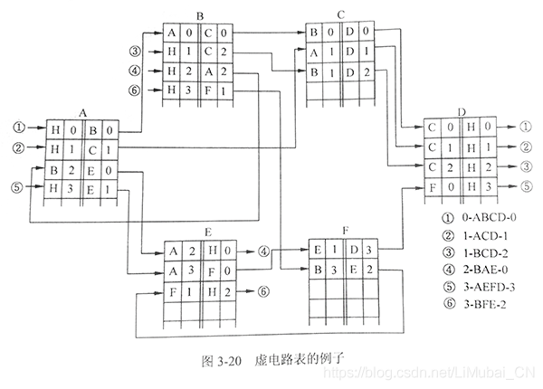
Part III-Chapter 19 Past Networking Technologies
X.25 Protocol
Packet Layer Protocol(PLP)
Network Layer
Switched Virtual Call(SVC)
Permanent Virtual Call(PVC)
Datalink Layer
Link Access Procedure-Balance (LAPB)
Frame
Slide window protocol Using Go-Back-N

Slide 10
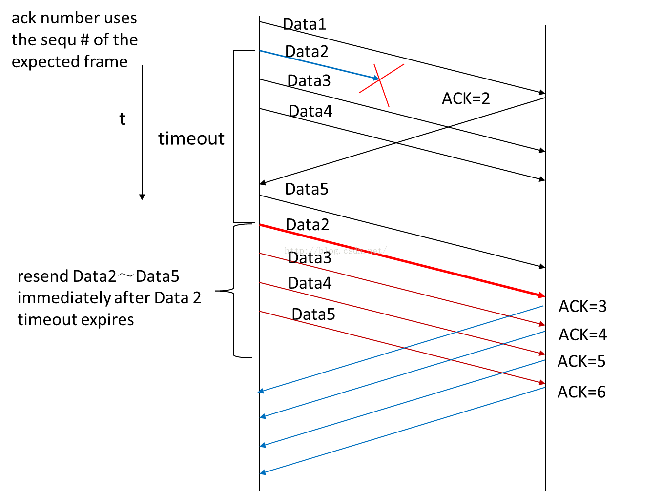
Part III-Chapter 19 Past Networking Technologies
Sliding Window Protocol Using Go-Back-N
The receiver
It discards all subsequent frames when a frame is damaged or lost
The Sender
It retransmits all unacknowledged frames after time out
It sends no acknowledgements
After sending a fame, It wait for acknowledge
After receiving any frame, It must send a short acknowledgement back

Slide 11
Part III-Chapter 19 Past Networking Technologies
X.25 Protocol
Low bandwidth
Physical Layer
X.121 address
区域、交换机PSE、模块号、端口号
20056003、20056114
9.6kbps—56kbps
X.25 map ip 202.38.154.2 20056003 bro
X.21Protocol

Slide 12
Part III-Chapter 19 Past Networking Technologies
Frame Relay
Improved version of X.25
Based to reliable circuit
Certified Information Rate(CIR)
4Mbps—100Mbps
No Network Layer
Datalink Layer
Link Access Procedure-D channel (LAPD)
No Reliable
Permanent Virtual Call(PVC)
Data Link Connection Identifier(DLCI)

Slide 13

Part III-Chapter 19 Past Networking Technologies
Switched Multi-megabit Data Service
SMDS
IEEE802.6 DQDB
Instead of voice traffic, SMDS designed to carry data
Connectionless
64Kbps—45Mbps
Topology

Slide 14
Part III-Chapter 19 Past Networking Technologies
Asynchronous Transfer Mode (ATM)
Alternative to the Internet
B-ISDN designed by telecommunication industry
Its goals will replace all WAN and LAN and lead to a completely uniform communication system worldwide
It handles video transmission as well as conventional voice telephone traffic
It integrates computer network, telephone network and television network

Slide 15
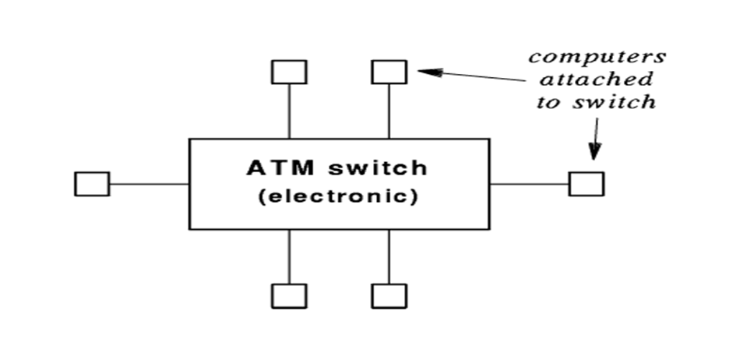
Part III-Chapter 19 Past Networking Technologies
ATM Switch
A start network
ATM switch acts as a central hub to which all computers attach
155Mbps，622Mbps，1Gbps
Optical fiber
The ATM communication channel is shared with TDM
First 1G LAN

Slide 16
Part III-Chapter 19 Past Networking Technologies
Asynchronous Transfer Mode
Cell
The ATM packet
Header: 5bytes
Data: 48bytes
Connection-Oriented Transmission
Before two computers can communicate，they must establish a connection and get the connection identifiers
Then, the sender places the connection identifier in each cell header and send the cells
When communication is complete，the connection must be terminated

Slide 17
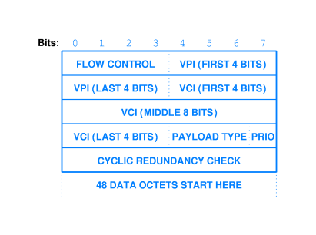
Part III-Chapter 19 Past Networking Technologies
ATM Connection
ATM Connection
ATM Circuit identification
Virtual Channel(VC)
Virtual Path(VP)
Cell Format
VC1
传输信道TP
VP
VP
VC2
VP
VP

Slide 18
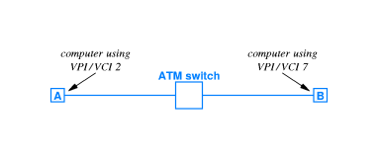
Part III-Chapter 19 Past Networking Technologies
The Mechanism Of ATM
A group of ATM switches
Label Switching
An ATM switch changes the VPI/VCI in each cell it hands
Forwarding Table
Incoming VPI/VCI
Outgoing Interface
Outgoing VPI/VCI

Slide 19
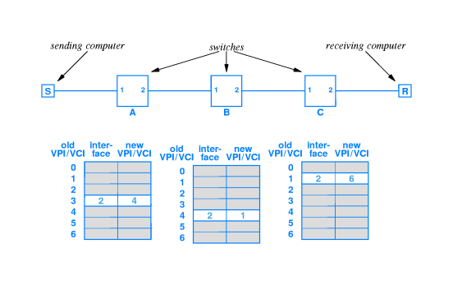
Part III-Chapter 19 Past Networking Technologies
An Example Trip Through An ATM Network
The source uses the circuit to send cell
Set up a circuit
The source must make a call at first that requires to setup its connection to the destination
ATM will establish its forwarding table
Label Switching will be performed
S，VPI/VCI=3→A，VPI/VCI=4→B，VPI/VCI=1→C，VPI/VCI=6
The circuit will be torn down immediately

Slide 20
Part III-Chapter 19 Past Networking Technologies
ATM Protocol
ATM
Physical Layer
ATM Adaptation Layer(AAL)
On the sending side, it accepts a block of data(up to 64kbytes)
It divides the block into cells and transfers the cells
On the receiving side，it accepts incoming cells，extracts data and delivers the original block
AAL5
Cell Label Switching
AAL
AAL
ATM
ATM
ATM
ATM
Physical
Physical
Physical
Physical

Slide 21
Part III-Chapter 19 Past Networking Technologies
ATM
Critique
Connection Setup Latency
Lack Of Efficient Broadcast
ATM’s overhead is higher
High cost
Complexity
ATM’s overhead is higher than 10 percent
Ethernet’s overhead is lower than 1 percent

Slide 22
Part III-Chapter 19 Past Networking Technologies
Multiprotocol Label Switching
Not a network system
An extra feature in conventional Internet routers
An MPLS router
Accepts Internet packets
Wrap the packet with a label
Send the resulting packet across a label switched path
Unwrap the packet

Slide 23
Part III-Chapter 19 Past Networking Technologies
Voice And Video Over IP(VoIP)
created by IETF
Session Initiation Protocol(SIP)
Interfacing the IP Telephony with the existing Public Switch Telephone Network(PSTN)
H.323 Standard
A thorny issue
created by ITU

Slide 24
Part III-Chapter 19 Past Networking Technologies
Software Defined Networking(SDN)
OpenFlow
It works with arbitrary vendor’s equipment
Network management software

