Slide 1

Part IV-Chapter24 Datagram Transport Service
End-To-End Protocol
End
An individual application program to be an endpoint of communication
IP treats a computer as an endpoint
IP cannot distinguish among multiple application programs running on the same computer
TCP/IP Transport Protocols
They can identify application program
Session layer of OSI model
Process1
Process2
Process3
Process4
Computer1
Computer2

Slide 2
Part IV-Chapter24 Datagram Transport Service
TCP/IP Transport Protocols
User Datagram Protocol
UDP is a connectionless transport protocol
Transmission Control Protocol
UDP provides a way for applications to send data without having to establish a connection
TCP is a connected transport protocol
TCP provides a way for applications to send data after having to establish a connection

Slide 3
Part IV-Chapter24 Datagram Transport Service
UDP Features
Connectionless Paradigm
Message-oriented Interface
UDP does not divide a message into multiple packets
UDP allows an application to delay an arbitrarily long time between the transmission of two messages
UDP does not maintain state
UDP does not use any control messages
Each UDP message must fit into a single IP datagram
End-to-end
It can distinguish among multiple application programs running on the same computer

Slide 4
Part IV-Chapter24 Datagram Transport Service
UDP Features
Best-effort delivery
Unreliable application
It can tolerate delivery errors
It does not detect or correct delivery problems
Voice or Video
High performance
Models Of UDP Interaction
1-to-many via IP multicast or broadcast

Slide 5
Part IV-Chapter24 Datagram Transport Service
Protocol Port Numbers
They are independent of the underlying operating system
The mapping between protocol port number and the process identifiers provided by OS
They can be used to identify an application program

Slide 6
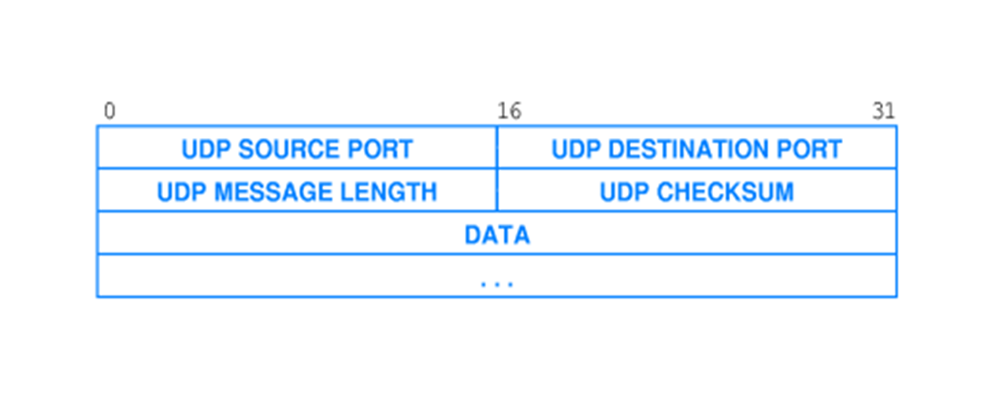
Part IV-Chapter24 Datagram Transport Service
User Datagram Format
Header
CHECKSUM is Optional
Payload
Application message

Slide 7
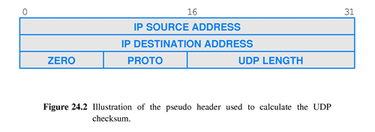
Part IV-Chapter24 Datagram Transport Service
UDP Pseudo Header
Checksum is extended
Source IP
Destination IP

Slide 8
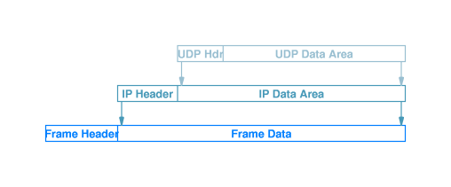
Part IV-Chapter24 Datagram Transport Service
UDP Encapsulation
The UDP datagram will be encapsulated in an IP datagram
IP Maybe perform fragmentation
Type=17

Slide 9
Part IV-Chapter25 Reliable Transport Service
Transmission Control Protocol
Control
Datalink layer of IP
Transmission
Transport layer of OSI model
Reliable Transport

Slide 10
Part IV-Chapter25 Reliable Transport Service
Transmission Control Protocol
TCP provides reliable transport service in Internet
Most internet applications are built to use TCP
Reliable Packets Transport
No loss
No delay
No duplication
No out-of-order
The data is divided into many packets to be sent
The packets must be delivered in exactly the same order

Slide 11
Part IV-Chapter25 Reliable Transport Service
Major TCP Features
Connection Orientation
End-To-End Communication
Each TCP connection has exactly two endpoints
Complete Reliability
Open a connection to a destination
Use the connection to transfer data
Close the connection
The data sent across a connection will be delivered exactly as sent, complete and in order
No multicast delivery

Slide 12
Part IV-Chapter25 Reliable Transport Service
Major TCP Features
Full Duplex Communication
Stream Interface
Data to flows in either direction
A continuous sequence of octets across a connection
Application program sends data at any time
TCP does not group data into records or messages

Slide 13
Part IV-Chapter25 Reliable Transport Service
Major TCP Features
Reliable Connection Startup
Graceful Connection Shutdown
Both sides have agreed to shut down the connection
Two applications reliably start communication
Before closing a connection, TCP ensures that all data has been delivered

Slide 14
Part IV-Chapter25 Reliable Transport Service
TCP Connections
The communication system provided by IP is connectionless IP
The illusion of a connection achieved by software
Virtual Connections
Connection-oriented
TCP
Connectionless IP

Slide 15
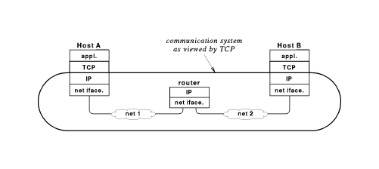
Part IV-Chapter25 Reliable Transport Service
TCP Communication System
Sender’s TCP
IP treats each TCP segments as payload to be transferred
Receiver’s TCP
It will divide an application data into multiple segments
It will reassemble these TCP segments into the application message in sequence

Slide 16
Part IV-Chapter25 Reliable Transport Service
Delivery Problems of Multi-segments
Unreliable delivery
Lost
Duplicated
Corrupted
Delayed
Out of order
End System Reboot
Replay error
Data overrun in heterogeneous End systems
It happens in host
Congestion
It happens in intermediate switches and routers

Slide 17
Part IV-Chapter25 Reliable Transport Service
Basic Delivery Problems
An Example of Out-of-order Delivery
Suppose a sequence of packets(分组) are sent
A shorter path becomes available immediately after the packet I has been sent
The network sends the packet i+1 along the shorter path
Packet i+1 arrives before packet i

Slide 18
Part IV-Chapter25 Reliable Transport Service
Sequencing Technique
Problems Solved
Out-Of-Order Delivery
Duplicate segment
Receiver
If it has arrived out of order, the packet will be added to the list
If its sequence has already been delivered or the sequence matches one of the packets waiting on the list, the packet will be discarded
sender
It attaches a sequence number to each packet
It process each pocket in sequence
If it is the next one expected, the packet will be delivered to the next highest layer, and then checks its list to see whether additional packets can also be delivered

Slide 19
Part IV-Chapter25 Reliable Transport Service
Positive Acknowledgement With Retransmission
An Automatic Repeat Request(ARQ) Mechanism
Sender takes responsibility for packet loss
Whenever it sends a packet，the sending protocol software starts a timer
If an acknowledgement(ACK) arrives before the timer expires，the sending cancels the timer
If the timer expires before an ACK arrives，the sending sends the another copy of the packet and starts the timer again
Receiver
Whenever a packet arrives intact，the receiving protocol software sends acknowledgement(ACK) back
Problem Solved
Lost Packets

Slide 20


Part IV-Chapter25 Reliable Transport Service
Replay Error
A packet from an old conversation might be accepted in a later conversation and the correct packet discarded as a duplicate
An Example Of Replay Error
The sequence number will be reused
Caused by long delay
TCP At 1:00 PM
Sending computer
Receiving computer
TCP At 1:05 PM
Sending computer
Receiving computer

Slide 21
Part IV-Chapter25 Reliable Transport Service
Unique Sequence Number Technique
Problem Solved
Reply Error
Unique Sequence Number
It must not be reused until a reasonable time has passed

Slide 22
Part IV-Chapter25 Reliable Transport Service
Flow Control Technique
Problems Solved
Types Of Flow Control Techniques
Stop-and-go Protocols
Sliding Window Protocols
Congestion
Stop-and-wait Protocols
The maximum amount of packets that can be sent before an ACK arrives
Flow Control
Data Overrun
TCP Layer
Data Link Layer for multi-hop network
Layers

Slide 23
Part IV-Chapter25 Reliable Transport Service
Stop-and-go Protocols
A sender
The receiver
It waits after transmitting each packet
It must respond an ACK message after receiving a packet
It can transmit the next packet after receiving the ACK
A Utopian Simplex Protocol
No sequence numbers or acknowledgements are used
A Simplex Stop-and-wait Protocol for a Noisy Channel
It does not handle either flow control or error correction
It prevents the sender from flooding the receiver with frames faster than the latter

Slide 24
Part IV-Chapter25 Reliable Transport Service
A Simplex Stop-and-wait Protocol for a Noisy Channel
It bound the maximum number of retransmissions
It can introduce duplicate packets if packet are delayed
Retransmission with Positive Acknowledgement
The Disadvantage
Extremely inefficient use of network capacity
The packet size is 1000octets
The throughput capacity is 2Mbps
The delay is 50milliseconds
The current throughput =1000*8/(50ms+50ms)=80Kbps
The current utilization=80Kbps/2*1000*Kbps=4%

Slide 25
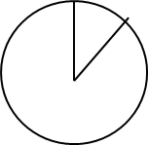
Part IV-Chapter25 Reliable Transport Service
Sliding Window Protocol
Sending window
Receiving window
The receiver maintains a set of sequence numbers corresponding to packets it is permitted to be accept
The sender maintains a set of sequence numbers corresponding to packets it is permitted to send
The sequence numbers within the sender’s window represent packets sent but as yet not acknowledged
Fixed window size is the maximum amount of packets that can be sent before an acknowledgement arrives

Slide 26
Part IV-Chapter25 Reliable Transport Service
Sliding Window Protocol
Sending window
Whenever a new packet arrives from the higher layer, the sender is given the next highest sequence number, the upper edge of the window is advanced by one
When an acknowledgement comes in, the lower edge is advanced by one
If the window ever grows to its maximum size, the sender must stop to send packet

Slide 27
Part IV-Chapter25 Reliable Transport Service
Sliding Window Protocol
Receiving window
Any packet falling within the window is put in its buffer
When a frame whose number is equal to the lower edge of the window is received，it is passed to the network layer, an acknowledgement is generated, and the window is rotated by one
The receiver’s window always remained at its initial size

Slide 28
Part IV-Chapter25 Reliable Transport Service
Data Link Layer in OSI Model
Framing
Mac Sublayer
LLC Sublayer
Error Control
Forward Error Correction(FEC) Mechanisms
Cyclic Redundancy Checks(CRC)
Automatic Repeat Request(ARQ) Mechanisms
Frame

Slide 29
Part IV-Chapter25 Reliable Transport Service
Data Link Layer in OSI Model
ATM Adaptation Protocols
AAL5 data is a block of data(up to 64kbytes)
Flow controls in Data link layer
Sliding Window Protocol Using Go-Back-N
Sliding Window Protocol Using Selective Repeat
On the sending side
On the receiving side
It accepts the ATM cells and reassemble them into the data block in sequence
It divides the block into ATM cells and transfers them
AAL
AAL
ATM
ATM
ATM
ATM
Physical
Physical
Physical
Physical

Slide 30
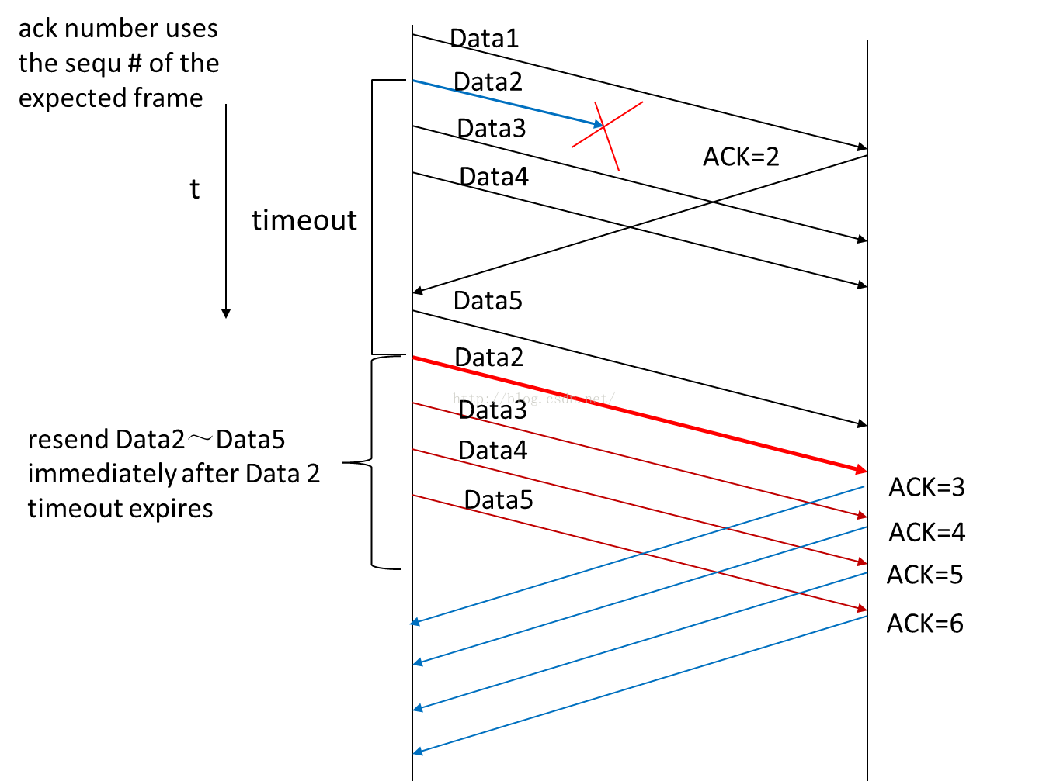
Part IV-Chapter25 Reliable Transport Service
Sliding Window Protocol Using Go-Back-N
The receiver
It discards all subsequent frames and sends no acknowledgements when a frame is damaged or lost
The Sender
It retransmits all unacknowledged frames after time out

Slide 31
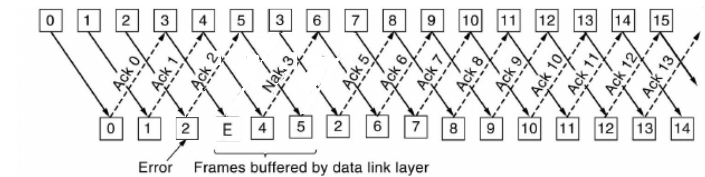
Part IV-Chapter25 Reliable Transport Service
Sliding Window Protocol Using Selective Repeat
The receiver
It send a negative acknowledgement(NAK) and buffers all subsequent frames when a frame is damaged or lost
It send a cumulative acknowledgement when a frame is received
The Sender
When an acknowledgement comes in for frame n, frame n-1,n-2 and so on are also automatically acknowledged
Only the oldest unacknowledged frame is retransmitted

Slide 32
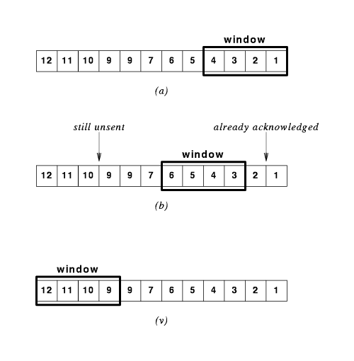
Part IV-Chapter25 Reliable Transport Service
Another illustration of Sliding Window

Slide 33
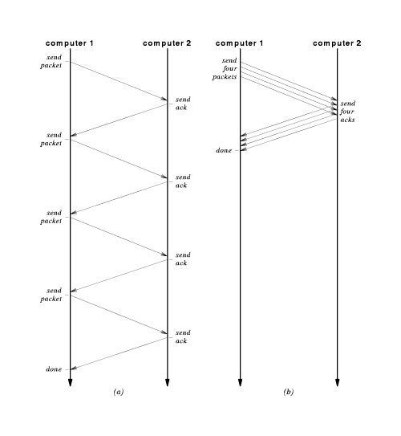
Part IV-Chapter25 Reliable Transport Service
Flow Control Technique
A Comparison for 4-packet Communication
Stop-and-go : 4*（N+N）=8N
Sliding window：N+N+ε=2N+ε
N represents the delay on one trip through network

Slide 34
Part IV-Chapter25 Reliable Transport Service
The Relationship of Sliding Window and Stop-and-go
Tw=Tg*W
Tw donates the throughput that can be achieved with a sliding window protocol
Tg donates the throughput that can be achieved with a stop-and-go protocol
W donates the window size
Tw=min(B,Tg*W)
B is the underlying hardware bandwidth

Slide 35
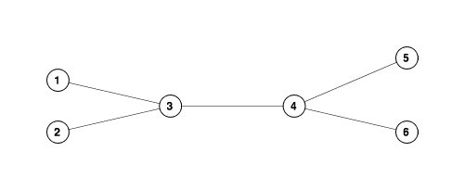
Part IV-Chapter25 Reliable Transport Service
Congestion
The data overrun happens at packet switch and router
An Example of the Congestion
Each connection has a bandwidth of 1.5Mbps
Node 1 sends a sequence of packets to node 5
node 2 sends a sequence of packets to node 6
Node3 places incoming packets from node 1 and 2 in a queue until they can be sent
The queue grows and the effective delay increases until Congestion collapse occurs
All node’s throughputs must be decreased by reducing their sliding window size
The entire network can become unusable

Slide 36
Part IV-Chapter25 Reliable Transport Service
Monitoring Congestion
Arrange for Intermediate System to inform senders when congestion occurs
All senders use their packet loss as an estimate of congestion
Switch or Router sends a special message to the source
Switch or Router sets a bit in the header of each packet that experiences delay
In modern network, most packet loss results from congestion, not hardware failure
Estimation Approach
Information Approaches

Slide 37
Part IV-Chapter25 Reliable Transport Service
Technique To Avoid Congestion
The sender reduces the packet rate temporarily when congestion occurs
The flow control mechanism
Sliding window protocols can achieve the same effect by temporarily reducing the window size

Slide 38
Part IV-Chapter25 Reliable Transport Service
The Art Of Protocol Design
Small design errors can result in incorrect operation, unnecessary packets, or delays
Protocol mechanisms can interact in unexpected ways
Dynamic Control of Sliding Window Size
Sliding Window slowly increase their use of bandwidth until the network begins to experience congestion
Sliding Window decrease use until the network becomes stable，and then begin to increase again
Dynamic Balance in Flow Control
Aggressive flow control can cause congestion
Conservative flow control can lower the thought more than necessary

Slide 39
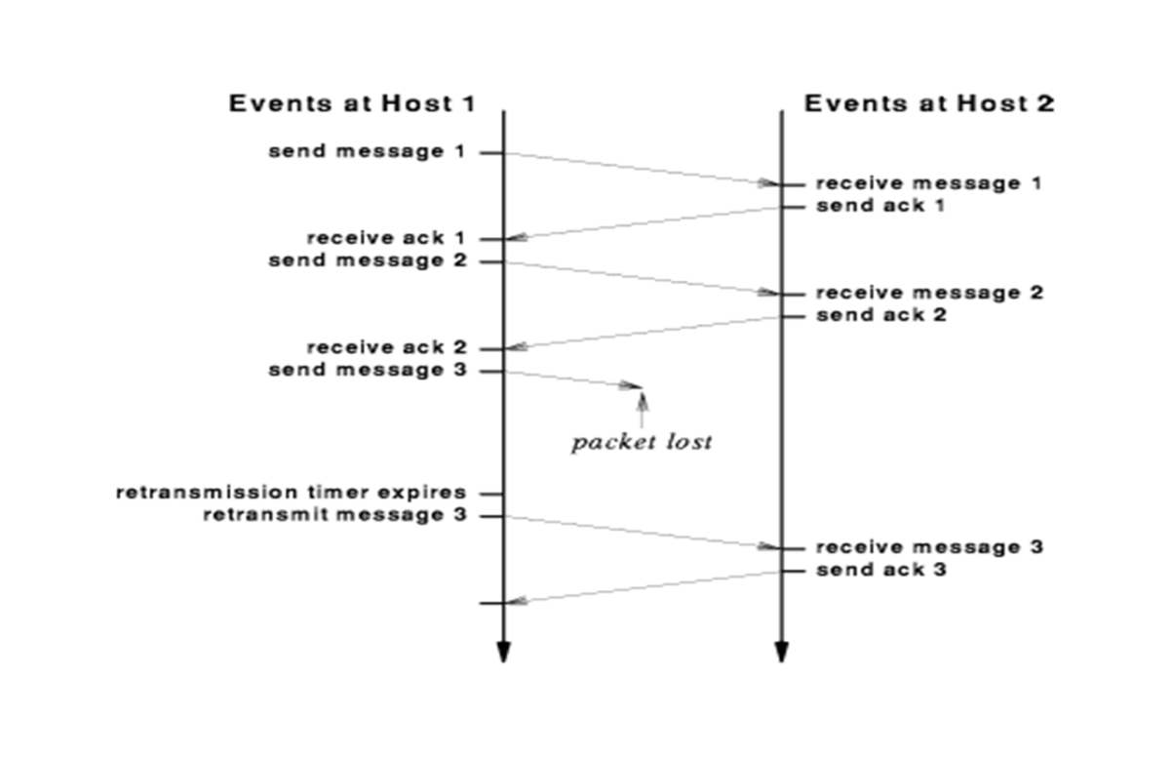
Part IV-Chapter25 Reliable Transport Service
The Question faced by TCP Retransmission
Retransmission Timeout(RTO)
It depends on the RTT(Round-trip time)
A fixed timeout would not operate well for an internet because RTT always change rapidly

Slide 40
Part IV-Chapter25 Reliable Transport Service
An Example of TCP Retransmission
Two programs on same computer communicates concurrently
One application can send data across a satellite channel to a computer in another country
Another application sends data across a LAN to a computer in the next room
A short retransmission timeout is suitable for a LAN but not for a long-distance satellite
A long retransmission timeout is suitable for a long-distance satellite but not for a LAN
The transmission delays along a given path to change rapidly

Slide 41
Part IV-Chapter25 Reliable Transport Service
Adaptive TCP Retransmission
TCP monitors current RTT on each connection
TCP estimates RTT(Round-trip time) for each active connection by measuring the time needed to receive a response
TCP generates a sequence of RTT estimates and uses a statistical function to produce a weighted average
TCP keeps an estimate of the variance
At last，TCP uses a linear combination of estimated mean and variance as a value for retransmission

Slide 42
Part IV-Chapter25 Reliable Transport Service
Adaptive TCP Retransmission
TCP Adapting Retransmission Timeout(RTO)
Using the variance helps TCP react quickly when RTT increases following a burst of packets
Using a weighted average helps TCP reset the RTO if the delay returns to a lower value after a temporary burst
When the RTT remains constant，TCP adjusts the RTO slightly above mean RTT
When the RTT start to vary，TCP adjusts the RTO to mean to accommodate peaks

Slide 43
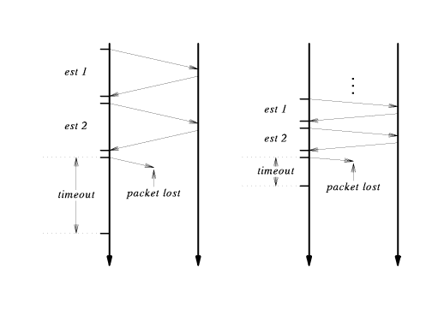
Part IV-Chapter25 Reliable Transport Service
An Example of Adaptive Retransmission

Slide 44
Part IV-Chapter25 Reliable Transport Service
TCP Window
Window Size
Window Advertisement
Positive window
Zero window
Measured in bytes
A notification sent by receiver that specifies the remaining buffer size of window
It becomes sender’s window

Slide 45
Part IV-Chapter25 Reliable Transport Service
TCP Window Scheme
When a connection is established
The receiver
The sender
Each end of the connection allocates a buffer to hold incoming data，and sends the size of the buffer to the other end
It will sends a positive Window Advertisement along with each acknowledgement after receiving a data
It will immedially transmit data until its window reaches zero

Slide 46
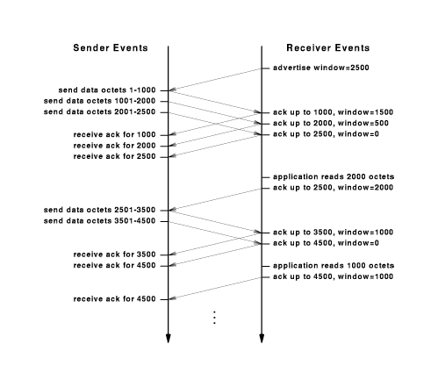
Part IV-Chapter25 Reliable Transport Service
An Example of TCP Window Scheme

Slide 47
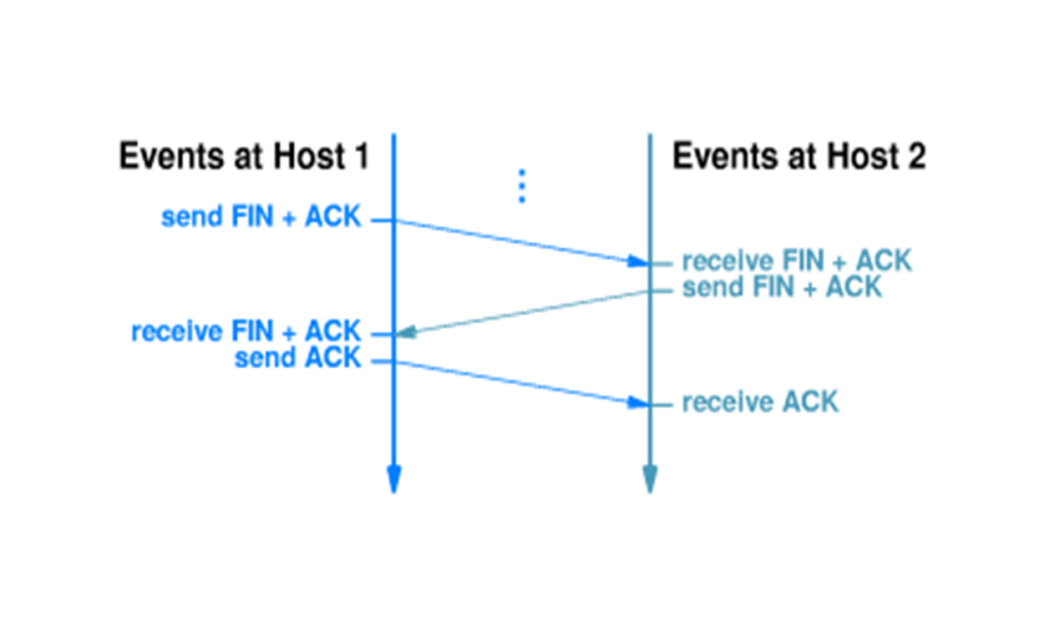
Part IV-Chapter25 Reliable Transport Service
Close A TCP Connection
Using Three-Way-Handshake
If Host 2 send ACK and close the connection, what happens?
Host 1 send ACK and close the connection after the second handshake

Slide 48
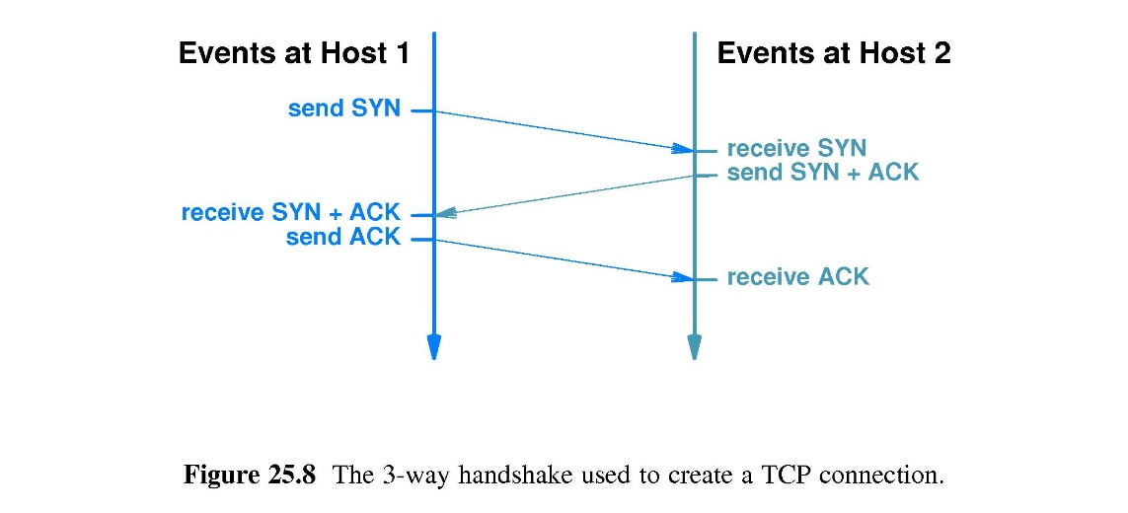
Part IV-Chapter25 Reliable Transport Service
Create A TCP Connection
Using Three-Way-Handshake
Each end generates a random 32-bit sequence number
If an application attempts to establish a new TCP connection after a computer reboots，TCP chooses a new random number
The pair of application programs can use TCP to communicate

Slide 49
Part IV-Chapter25 Reliable Transport Service
TCP Congestion Control
When congestion occurs
TCP can achieve a reduction in data rate by temporarily reducing the Congestion Window (cwnd)
TCP uses packet loss as a measure of congestion
TCP reduces the data rate
TCP does not compute a data rate

Slide 50
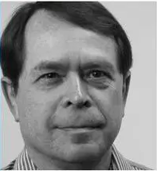
Part IV-Chapter25 Reliable Transport Service
TCP Congestion Control Algorithms
TCP Tahoe version
The first version created by Van Jacobson in 1988
TCP Reno Version
The second version published in 1990
TCP Vegas Version
The third version
TCP NewReno version
Adopted by the most operating systems now
New algorithms have always been the focus of research

Slide 51
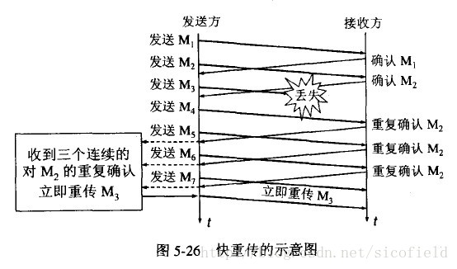
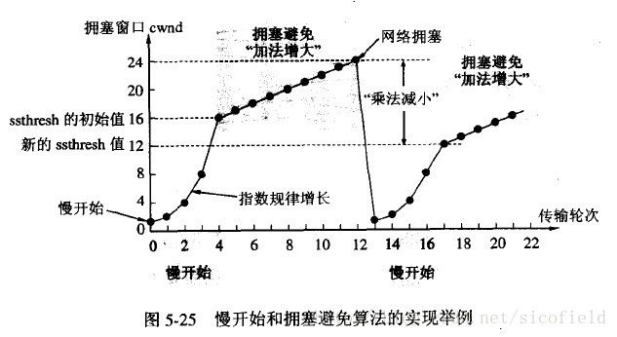
Part IV-Chapter25 Reliable Transport Service
TCP Tahoe Version
Slow start when starting a new connection
A single message will be sent
Two additional messages will be sent if the acknowledgement arrives without additional loss
The exponential increase continues until TCP is sending half of the receiver’s advertised windows
Congestion avoidance
Linear increase as long as soon as congestion does not occurs
Slow start again when delay occurs
Rapid retransmission
Retransmit the message lost immediately after receiving three duplicate ACK for one TCP (ACK) packet
Recovery

Slide 52
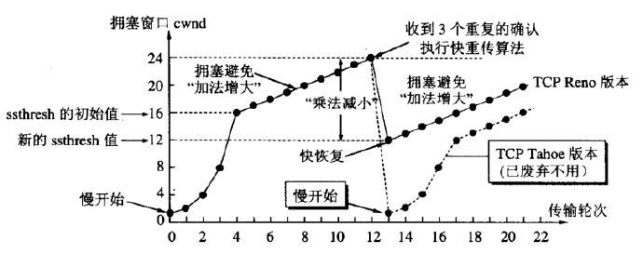
Part IV-Chapter25 Reliable Transport Service
TCP Reno Versions
Fast Recovery (Recovery revised)
Linear increase from half of the receiver’s advertised windows until delay occurs
Upgraded TCP Tahoe

Slide 53
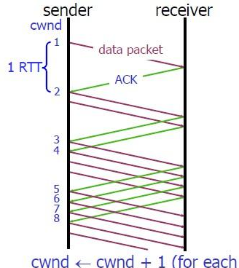
Part IV-Chapter25 Reliable Transport Service
TCP Vegas Version
Throughput Computation
BaseRTT is the least RTT
Expected=CWND/BaseRTT
Actual=CWND/RTT
Slow start when starting a new connection`
A single message will be sent
The exponential increase continues per two RTT until diff is greater than minThreshold
Congestion avoidance
diff=（Expected-Actual）*BaseRTT
minThreshold is the least Threshold of throughput difference
maxThreshold is the most Threshold of throughput difference
if diff<minThreshold then CWND=CWND+1
if diff>maxThreshold then CWND=CWND-1

Slide 54
Part IV-Chapter25 Reliable Transport Service
TCP NewReno
Fast Recovery revised
Linear increase from half of the receiver’s advertised windows until the Recovery ACK is received
The Advanced Version of Reno
Recovery ACK(RACK) is the ACK of last message

Slide 55
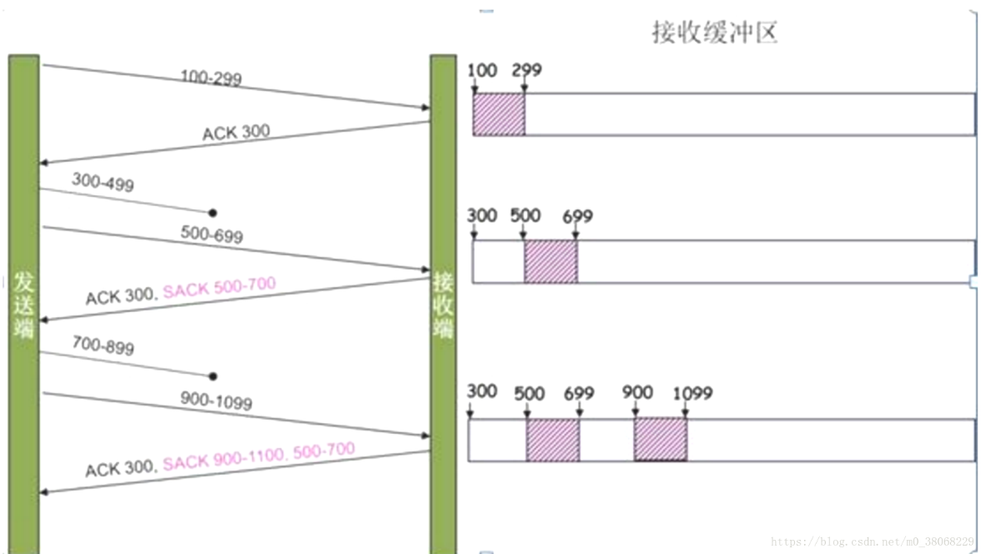
Part IV-Chapter25 Reliable Transport Service
Selective Acknowledgements(SACK) Mechanism
Selective Retransmission
The sender can retransmit just the missing pieces
An Acknowledgement scheme changed
The receiver specifies exactly which pieces of data missing
SACK

Slide 56
Part IV-Chapter25 Reliable Transport Service
Explicit Congestion Notification (ECN) Scheme
ECN(Explicit Congestion Notification)
Routers along the path monitor congestion and mark each TCP segment that passes over a congested network
When the receiver returns an ACK，it will tells the sender whether the acknowledged segment experienced congestion

Slide 57
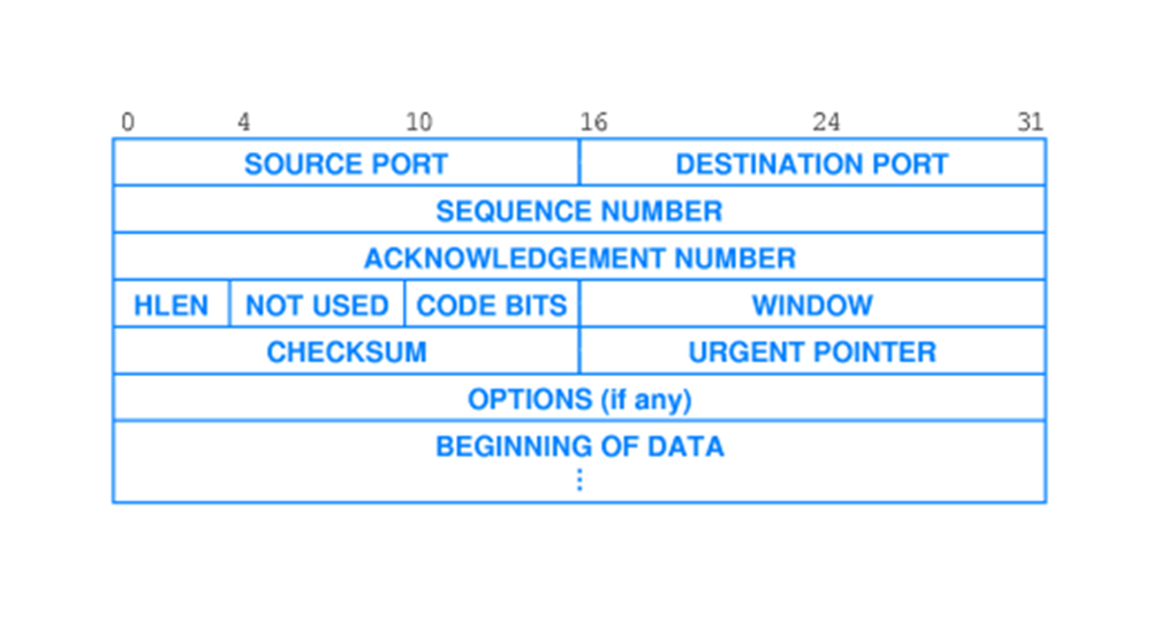
Part IV-Chapter25 Reliable Transport Service
TCP Segment Format
SEQUENCE NUMBER
ACKNOWLEDGEMENT NUMBER
Delayed ACK (最长能够延时500ms)
ISN（Initial Sequence Number）+第一个字节在整个字节流中的偏移
ISN+期望接收的对方发过来的字节编号
Cumulative ACK(累积确认)
Piggybacking
The acknowledgement is attached to the outgoing data frame

Slide 58
Part IV-Chapter25 Reliable Transport Service
TCP Segment Format
Code BITS
SYN is used to establish connections
ACK is used indicate that the Acknowledgement number is valid
FIN is used to release connections
RST is used to abruptly reset the connection
PSH is requested to deliver the data to application
URG is indicate if the Urgent pointer is in use
CWR is set to signal Congestion Window Reduced
ECN(Explicit Congestion Notification) is set to signal an ECN-Echo

Slide 59
Part IV-Chapter26 Reliable Transport Service
Example of TCP Segment Transmission
Four TCP Segments
The first and second TCP segment have been received
The third TCP segment lost and the fourth one received
The 1025-2048 bytes in byte stream
The 2049-3072 bytes in byte stream
The 0-1024 bytes in byte stream
Sequence number=ISN
ACK number=ISN+2049
Sequence number=ISN+2049
Sequence number=ISN+3073
ACK number=ISN+4097
The 3073-4096 bytes in byte stream
Sequence number=ISN+1025
ACK number=ISN+1025（非延迟，选项）

