Slide 1

Part 4 Chapter 26
Jin weizu
Jinweizu@tongji.edu.cn
13391355632

Slide 2

Part IV-Chapter26 Internet Routing And Routing Protocols
The Categories of IP Routing
IP Static Routing
IP Dynamic Routing
The system does not change routing table information unless an administrator manually alters them
The system can continuously updates the forwarding table to insure that each datagram follows an optimum route

Slide 3
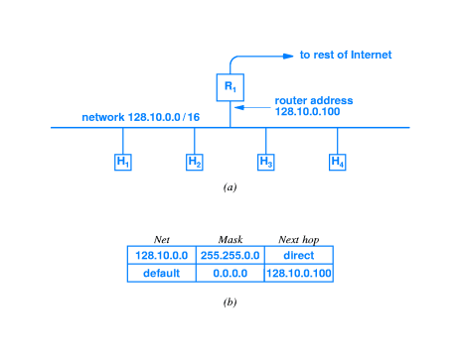
Part IV-Chapter26 Internet Routing And Routing Protocols
A Static Routing Table In Hosts
A single router connects the network to the rest of Internet
the direct network to which the host attaches
Default entry that directs all other traffic to a special router

Slide 4
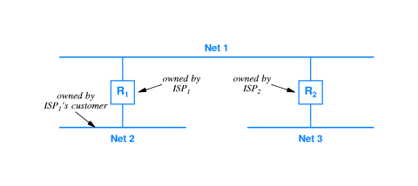
Part IV-Chapter26 Internet Routing And Routing Protocols
Static Routing In The Networks Interconnected
Each time an ISP adds a new customer’s network，the information must be passed to the other ISP
The manual process is far too slow to accommodate network failures

Slide 5
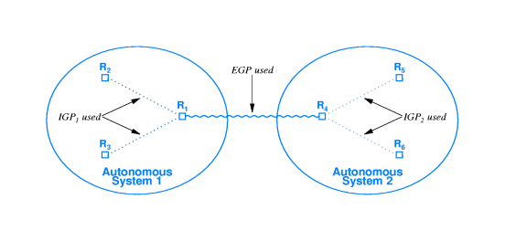
Part IV-Chapter26 Internet Routing And Routing Protocols
An Internet Routing Architecture
Routing between Autonomous Systems
Two-level routing hierarchy
Routing within an Autonomous System
Routers and networks in the Internet are divided into Autonomous Systems

Slide 6
Part IV-Chapter26 Internet Routing And Routing Protocols
Autonomous System
The group of routers
All routers are under control of one administrative authority and use the same Routing protocol
The Design of Autonomous System
Economic
Technical
Administrative
At least one router in each group summarizes the information passing it to other groups

Slide 7
Part IV-Chapter26 Internet Routing And Routing Protocols
The Categories of Internet Routing Protocols
Interior Gateway Protocols(IGPs)
Exterior Gateway Protocols(EGPs)
It can be used to exchange routing information by the routers within an autonomous system
It is easy to install and operate
It may limit the size or routing complexity of an autonomous system
It can be used to exchange routing information by the routers between different autonomous systems
It is usually more complex to install and operate than IGPs
It offer more flexibility and lower overhead

Slide 8
Part IV-Chapter26 Internet Routing And Routing Protocols
Routing Metrics
A measure of the path that routing software uses when choosing a route
The Examples of Routing Metrics
Throughput
It will be used by IGPs
It will not be used by EGPs
Delay
energy
Hop count
The combination of routing metrics

Slide 9
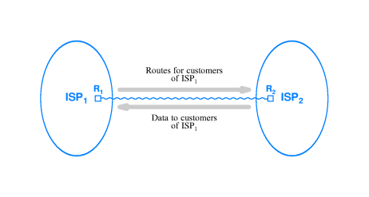
Part IV-Chapter26 Internet Routing And Routing Protocols
Routes And Data Traffic
The flow of data after a router in an ISP advertises routes
Before traffic can arrive destined for N, ISP1 must advertise a route to N

Slide 10
Part IV-Chapter26 Internet Routing And Routing Protocols
Border Gateway Protocol(BGP)
The most popular Exterior Gateway Protocol in the Internet
Routing Among Autonomous Systems
BGP-4
Provision For Policies
Facilities For Transit Routing
Using TCP as transport protocol

Slide 11
Part IV-Chapter26 Internet Routing And Routing Protocols
Routing Information Protocol(RIP)
An Interior Gateway Protocol
Hop count metric
Routing within an autonomous system
Using UDP Transport
Broadcast or multicast delivery
Support for default route propagating
Distance vector algorithm
Passive version for hosts

Slide 12
Part IV-Chapter26 Internet Routing And Routing Protocols
Routing Information Protocol(RIP)
Entry In Distance Vector Algorithm
(destination network, distance)
The distance is the number of Internet hops to the destination
The Default Route Of RIP
The organization merely needs to configure one of its routers to have a default
The organization usually chooses the router that connects to an ISP
RIP propagates the default route to all other routers in the organization

Slide 13
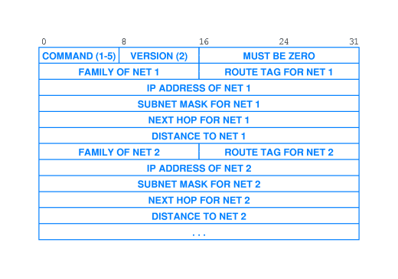
Part IV-Chapter26 Internet Routing And Routing Protocols
RIP Packet Format
(d_{A},d_{B},d_{C},d_{D},d_{E},d_{F})
Brief representation

Slide 14
Part IV-Chapter26 Internet Routing And Routing Protocols
Open Shortest Path First Protocol(OSFP)
Another Interior Gateway Protocol
Full CIDR And Subnet Support
Routing within an autonomous system
Authenticated message exchange
Imported routes
Link-state algorithm
Support for multi-access networks

Slide 15
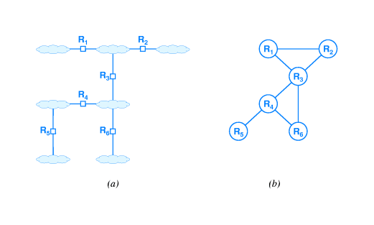
Part IV-Chapter26 Internet Routing And Routing Protocols
Open Shortest Path First Protocol(OSFP)
An Example Of OSFP
The link-status algorithm

Slide 16
Part IV-Chapter26 Internet Routing And Routing Protocols
Open Shortest Path First Protocol(OSFP)
Hierarchical Routing Of OSFP
OSPF allows an autonomous system to be partitioned for routing purpose
OSPF limits link-status broadcasts to routers within an area
OSPF allows communication between areas
One router in each area is configured to communicate with a router in one or more other areas

Slide 17
Part IV-Chapter26 Internet Routing And Routing Protocols
Intermediate System- Intermediate System
An Interior Gateway Protocol
It is originally designed by Digital Equipment Corporation to be part of DECNET V
Another Link-state algorithm
It was designed to propagate routes for OSI protocols
It has less overhead

Slide 18
Part IV-Chapter26 Internet Routing And Routing Protocols
IP Routing
Unicast Routing
Multicast Routing
Dynamic group membership
Anonymous senders
224.0.00-239.255.255.255
IP Multicast Addresses
Multicast target
Multicast source
The destination only supports unicast addresses
Route Table in Routers
An Unicast Address

Slide 19
Part IV-Chapter26 Internet Routing And Routing Protocols
Multicast Routing Semantics
Dynamic group membership scheme
Joining a multicast group at any time and begin receiving a copy of all packets sent to the group
Anonymous Senders Scheme
Neither a sender nor a receiver knows the identity or the number of group members
Routers and hosts do not know which applications will send a datagram to a group
Leaving a multicast group at any time

Slide 20
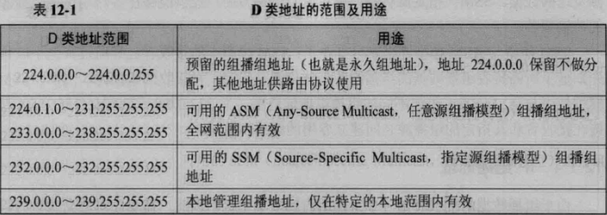
Part IV-Chapter26 Internet Routing And Routing Protocols
IP Multicast Addresses
Multicast model Addresses
ASM（Any-Source Multicast）/SFM（Source-Filtered Multicast)
SSM（Source-Specific Multicast)
Reserved Multicast Addresses
Local management multicast Address

Slide 21
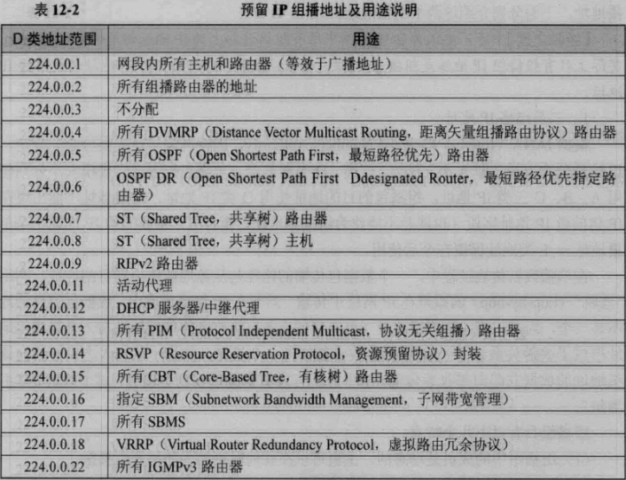
Part IV-Chapter26 Internet Routing And Routing Protocols
Reserved Multicast Addresses

Slide 22
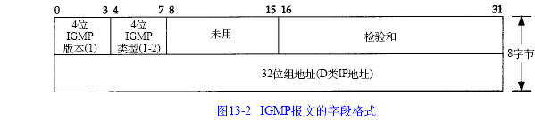
Part IV-Chapter26 Internet Routing And Routing Protocols
Internet Group Multicast Protocol(IGMP)
It is used for multicast group management between a host and a router
IGMP Packet Format
It allows applications to join a multicast group
It allows applications to exit a multicast group
Type
02:Report Operation
01:Query Operation
Multicast Group Address

Slide 23
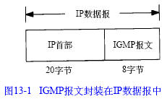
Part IV-Chapter26 Internet Routing And Routing Protocols
Internet Group Multicast Protocol(IGMP)
IGMP Encapsulation

Slide 24
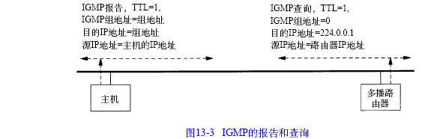
Part IV-Chapter26 Internet Routing And Routing Protocols
Internet Group Multicast Protocol(IGMP)
Host send an IGMP Report(type=0x2) to the router to apply to join a multicast group
Joining A Multicast Group
The router will put the host into the multicast group

Slide 25
Part IV-Chapter26 Internet Routing And Routing Protocols
Internet Group Multicast Protocol(IGMP)
Leaving A Multicast Group
The router will remove the host from the multicast group if a host does not send the report to answer the query
The router send an IGMP Queries(type=0x1) periodically to ask the hosts to determine whether remains in the multicast group

Slide 26
Part IV-Chapter26 Internet Routing And Routing Protocols
Multicast Routing Protocols
Flood-And-Prune
Configuration-And-Tunneling
Core-Based Discovery
Forwarding Techniques on Routers

Slide 27
Part IV-Chapter26 Internet Routing And Routing Protocols
Multicast Routing Protocols
Flood-And-Prune
It is ideal in a situation where the group is small and all members are attached to contiguous LANs
Initially, routers forward each datagram to all networks
If a router learns that no computers on a given network are members of the group, the router stops forwarding multicast to that network

Slide 28
Part IV-Chapter26 Internet Routing And Routing Protocols
Multicast Routing Protocols
Configuration-And-Tunneling
It is ideal in a situation where the group is geographically dispersed
A router at each site is configured to know about other sites
When a multicast datagram arrives, the router at a site transmits the datagram on all directly attached LANs via hardware multicast
The router then consults its configuration table to determine which other sites should

Slide 29
Part IV-Chapter26 Internet Routing And Routing Protocols
Multicast Routing Protocols
Core-Based Discovery
Some multicast routing protocols designate a core unicast address for each multicast groups
Whenever a router R1 receives a multicast datagram to a group , R1 encapsulates the multicast datagram in a unicast datagram and forwards it to the group’s core unicast address
The unicast datagram travels through the Internet to reach the router R2 that participates in the group
R2 obtains the multicast program from the unicast datagram and use multicast routing to forward it to the members of the group
It is ideal in a situation where multicast scales gracefully from a small group in one area to a large group with members at arbitrary locations
Requests to join the group follow the same pattern

Slide 30
Part IV-Chapter26 Internet Routing And Routing Protocols
Multicast Routing Protocols
Distance Vector Multicast Routing Protocol(DVMRP)
Core Based Trees(CBT)
Protocol Independent Multicast-Sparse Mode(PIM-SM)
It is based on Configuration-And-Tunneling
It performs local multicast and uses IP-in-IP encapsulation to send multicast datagrams from one site on the Internet to another
It is based on Core-Based Discovery
It builds a delivery tree from a central point for each group
It is based on Core-Based Discovery
It uses the same approach as CBT to form a multicast routing tree

Slide 31
Part IV-Chapter26 Internet Routing And Routing Protocols
Multicast Routing Protocols
Protocol Independent Multicast-Dense Mode(PIM-DM)
Multicast Extension To the Open Shortest Path First Protocol(MOSPF)
It is based on Flood-And-Prune
Routers use PIM-DM broadcast multicast packets to all locations within the organization
Each router that has no member of a particular group sends back a message to prune the multicast routing tree
It is designed to pass multicast routes among routers within an organization
It builds on Link-State routing approach

