Slide 1
Overview of DB2 10 on Linux, UNIX and Windows
DB2 10.5 Administration Workshop for Windows

Slide 2
Unit objectives
Describe the system platforms supported by the DB2 Family of products
Compare the features available with different DB2 LUW product editions
Select the appropriate DB2 client software to support application client or server systems
Choose a method to install your DB2 LUW product edition and plan migrations of existing DB2 LUW servers to the latest release

Slide 3
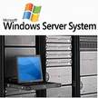


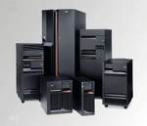
DB2 family product platforms
DB2 for Linux, UNIX and Windows
Operating Systems
AIX
Linux
Windows
Solaris
HP
DB2
DB2
DB2 for z/OS
DB2 for i
DB2
DB2

Slide 4
DB2: The scalable database
DB2 Advanced Enterprise Server Edition Suitable for transactional, warehouse, and mixed workloads. This edition also comes with a full complement of warehouse tools, Optim™ tools, and IBM® Data Studio | No CPU or memory limits
DB2 Enterprise Server Is suitable for transactional and mixed workloads.
DB2 Advanced Workgroup Edition This edition is the data server of choice for deployment in a departmental, workgroup, or medium-sized business environment. This edition also comes with a full complement of warehouse tools, Optim™ tools, and IBM® Data Studio | 16 CPU Cores, 128GB memory limits
DB2 Workgroup Server Ideal for departmental, workgroup, or medium-sized business environments.
DB2 Express DB2 data server, entry-level pricing, small and medium business | 8 CPU Cores, 64GB
DB2 Express-C Provides all the core capabilities of DB2 at no charge. Easy to use and embed. | 2 CPU Cores, 16GB

Slide 5
Examples of features and functions by DB2 LUW Editions
 | Express C | Express | Workgroup | Advanced Workgroup | Enterprise Server | Advanced Enterprise
Storage Optimization | No | No | No | Yes | No | Yes
DB2 pureScale | No | No | Offering | Yes | Offering | Yes
HADR | No | Yes | Yes | Yes | Yes | Yes
Column-organized Tables (BLU) | No | No | Offering | Yes | Offering | Yes
Multi-Temperature Storage | No | No | No | Yes | Yes | Yes
Temporal tables | Yes | Yes | Yes | Yes | Yes | Yes
Range Partitioned Tables | No | No | Yes | Yes | Yes | Yes
DB2 Workload Management | No | No | No | Yes | No | Yes
IBM Data Studio | Yes | Yes | Yes | Yes | Yes | Yes

Slide 6
Operating Systems supported by DB2 10.5 servers
AIX Operating Systems
Windows Operating Systems
AIX V6.1
AIX V7.1
Windows Workstation platforms
  Windows 7 (32-bit and 64-bit)
  Windows 8 (32-bit and 64-bit)
Windows Server platforms
  Windows 2008 (64-bit)
  Windows 2012 (64-bit)
Linux Operating Systems
Red Hat Enterprise Linux (RHEL) 5,6,7
SUSE Linux Enterprise Server (SLES) 10 , 11, 12
Ubuntu 12.0.4 & 14.04 LTS
HP-UX Operating Systems
HP-UX 11i v3 for HP
Solaris Operating Systems
Solaris 10 and 11 for UltraSPARC or SPARC64 servers
Solaris 10 for x64 servers
See IBM Knowledge Center for detailed listings and service levels required

Slide 7



DB2 server connectivity options
Database Administration
and
Application Development
IBM Data Server Client
Visual Tools (Data Studio)
Replication Admin Tool
CLP
All Applications
DB2 Servers
IBM Data Server Runtime Client
Replication CMD line
CLP
All Applications
ApplicationUsers
IBM Data Server
Driver Package
All Applications
DB2 CLPPlus
IBM Data Server Driver
for JDBC and SQLJ
Java Applications
IBM Data Server Driver
for ODBC and CLI

Slide 8
Upgrades to 10.5 from previous DB2 LUW releases
Upgrade from DB2 9.7, 9.8 or 10.1 directly to DB2 10.5
For any release prior to DB2 9.7, it is recommended to upgrade to the most recent fixpack of DB2 9.7, then to 10.5
DB2 LUW Pre-9.7
DB2 LUW 9.8
pureScale
DB2 LUW 9.7
DB2 LUW 10.1
DB2 LUW 10.5

Slide 9
Preparing to install DB2 database servers
Use the db2prereqcheck command to check the software and firmware prerequisites of a specific DB2 version
Installation prerequisites:
  Ensure that your system meets the necessary operating system, hardware, software, communications, disk, and memory requirements
  There are different prerequisites for AIX, HP-UX, Linux, Solaris, and Windows operating systems
Disk and memory requirements:
  Ensure appropriate amount of disk space is available for DB2 environment
  DB2 Setup wizard provides dynamic size estimates based on the components selected during a typical, compact, or custom installation
  On Linux and UNIX operating systems, 2 GB of free space in the /tmp directory is recommended
  Memory requirements are affected by the size and complexity of your database system, database activity, and the number of clients
  At a minimum, a DB2 database system requires 256 MB of RAM, 1 GB of RAM is recommended for improved performance.

Slide 10
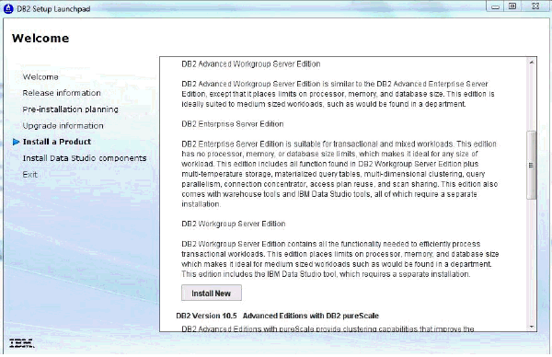
DB2 software installation methods
Installation Method | Windows | UNIX / Linux
DB2 Setup Wizard | Yes | Yes
Install Using Response File | Yes | Yes
db2_install command | No | Yes

Slide 11
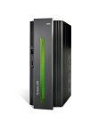
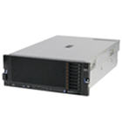
DB2 Connect V10.5
IBM DB2 Connect V10.5 provides robust connectivity
to IBM DB2 databases deployed:
- IBM System z
- IBM System i
Client based
applications
Application
Server UNIX
Client Systems
DB2 connect
function
Application
Server
DB2 Connect
Gateway Server
DB2 z/OS
Data sources
Both Direct Connections and Gateway Server Based Connections are supported

Slide 12
Unit summary
Describe the system platforms supported by the DB2 Family of products
Compare the features available with different DB2 LUW product editions
Select the appropriate DB2 client software to support application client or server systems
Choose a method to install your DB2 LUW product edition and plan migrations of existing DB2 LUW servers to the latest release

