Slide 1
DB2 Command Line Processor (CLP) and
GUI tools
DB2 10.5 Administration Workshop for Windows

Slide 2
Unit objectives
Utilize the DB2 Command Line Processor to run DB2 commands, SQL statements and command scripts
Invoke the CLPPlus command line processor to connect databases and to define, edit, and run statements, scripts, and commands
Describe the GUI tools available that support DB2 database administration and SQL execution with DB2 LUW servers

Slide 3
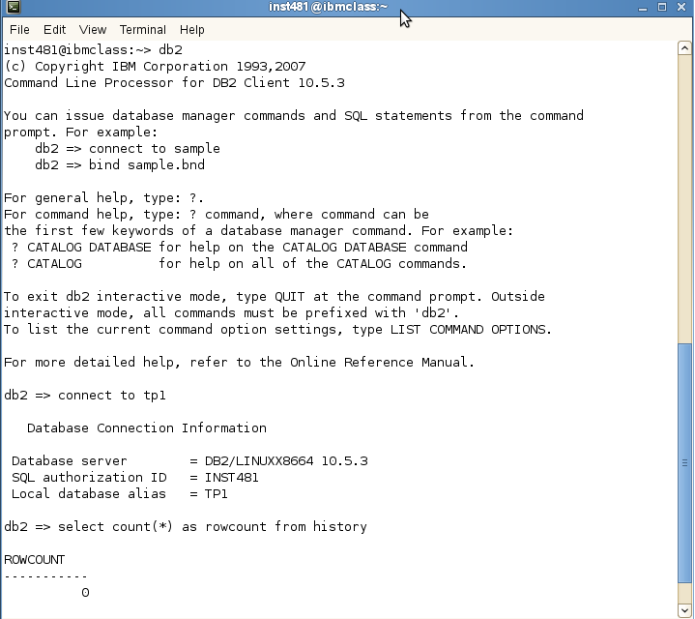
The DB2 CLP Command Line Processor

Slide 4
CLP syntax
db2
option-flag
db2-command
sql-statement
?
phrase
message
sql-state
class-code

Slide 5
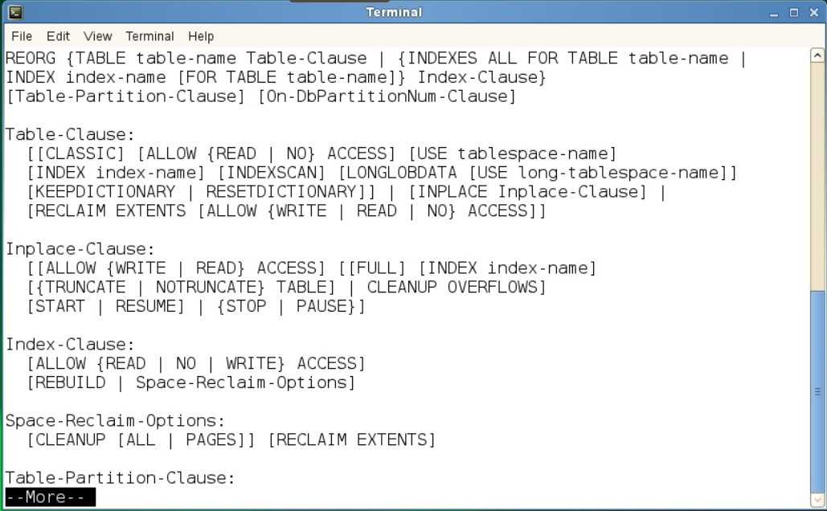
Using CLP to list DB2 command options
db2 ? REORG

Slide 6







Modes for using the DB2 CLP
Non-interactive mode
db2 connect to musicdb
db2 "select * from syscat.tables" more
(double quotes may be required)
Interactive mode
db2
db2=> connect to musicdb
db2=> select * from syscat.tables

Slide 7


Using an input file with the command line processor
Edit create.tab
--comment: db2 -svtf create.tab
connect to sample;
create table tab3
(name varchar(20) not null,
phone char(40),
salary dec(7,2));
select * from tab3;
commit work;
connect reset;
db2 -svtf create.tab
f: read statements from file
v: echo command text
t: file contains statement termination(;)
s: stop execution for errors

Slide 8
The CLPPlus command line processor
Support for establishing connections to databases when a database user ID and password are provided.
Buffer that can be used to store scripts, script fragments, SQL statements, SQL PL statements, or PL/SQL statements for editing and then execution. Text in the buffer can be listed, printed, edited, or run as a batch script.
Comprehensive set of processor commands can be used to define variables and strings that can be stored in the buffer.
Set of commands that retrieve information about the database and database objects.
Ability to store buffers or buffer output to a file.
Multiple options for formatting the output of scripts and queries.
Support for executing system-defined routines.
Support for executing operating system commands.
Option for recording the output of executed commands, statements, or scripts.

Slide 9
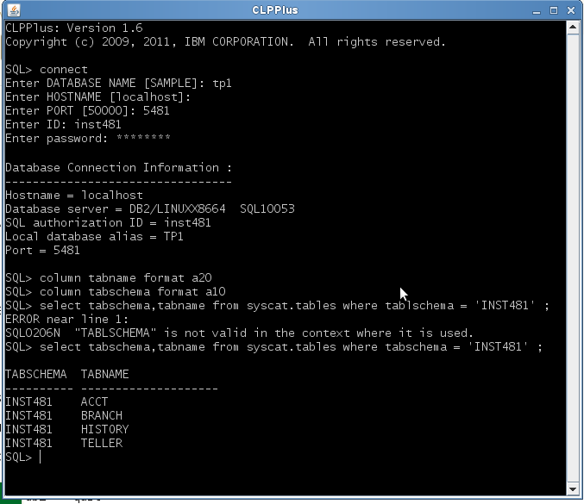

Example CLPPlus interactive SQL execution
Column statements can
set output format

Slide 10
DB2 GUI tools
IBM Data Studio 4.1.1 enhanced to support DB2 V10.5
Data Studio client simplifies DB2 database administration with task assistants to perform common database administration tasks.
Starting or stopping an instance or database
Configuring an instance or database
Backing up, restoring, recovering a database or table space
Unloading and loading data in a table
Create and Execute SQL scripts
Conversion of row organized tables to BLU Acceleration column organized tables
Latest BLU capabilities including Shadow tables
IBM Data Server Manager
Data Server Manager Enterprise Edition offers advanced capabilities including:
Enhanced monitoring
Centralized configuration management
Refined performance management
Query tuning with expert advice
IBM InfoSphere Optim Query Workload Tuner
Helps DBAs and SQL developers optimize the performance of SQL statements.
  Analysis of SQL workloads to estimate performance benefits for converting row organized tables to BLU Acceleration

Slide 11
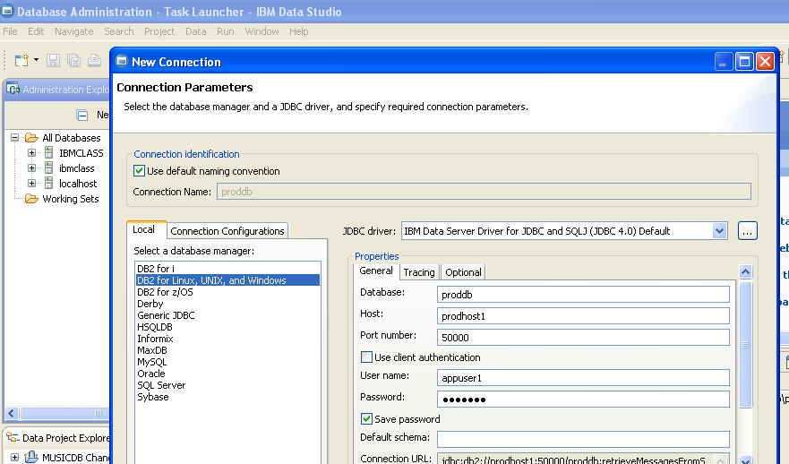


Data Studio: Database connection profiles
Set database connection
Set user name and password

Slide 12
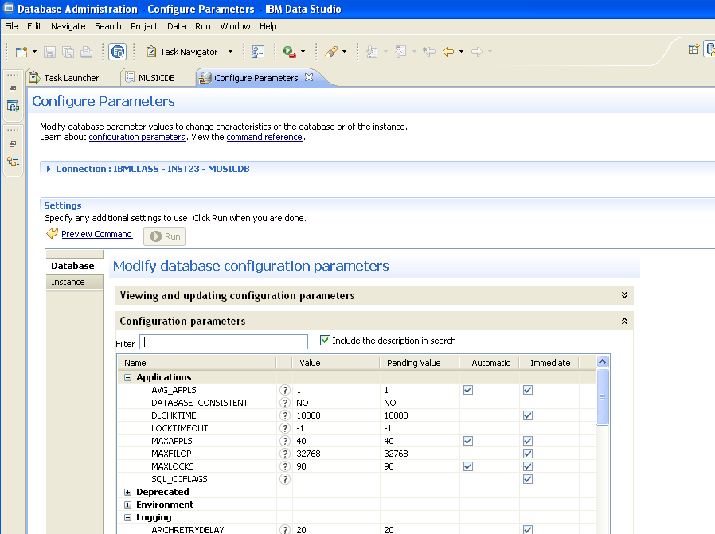
Data Studio: Setting configuration options

Slide 13
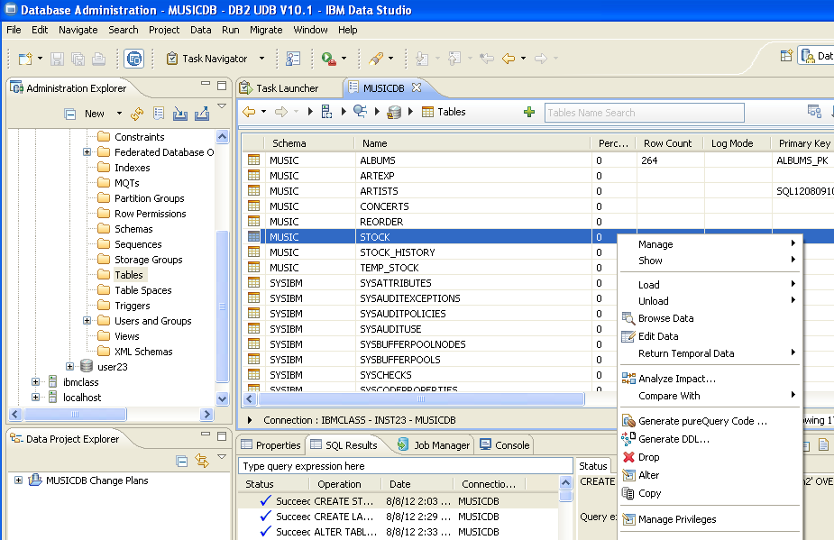

Data Studio: Selecting tasks for an object
Select the task for a database object

Slide 14
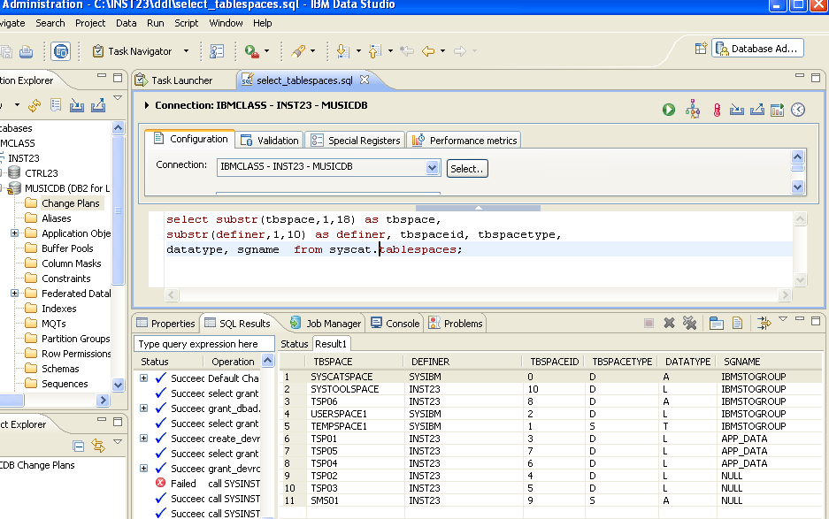







Data Studio: Running SQL scripts
A connection profile is selected for execution
Start Execution
SQL statements can be edited and syntax checked
SQL Script Results can be viewed

Slide 15

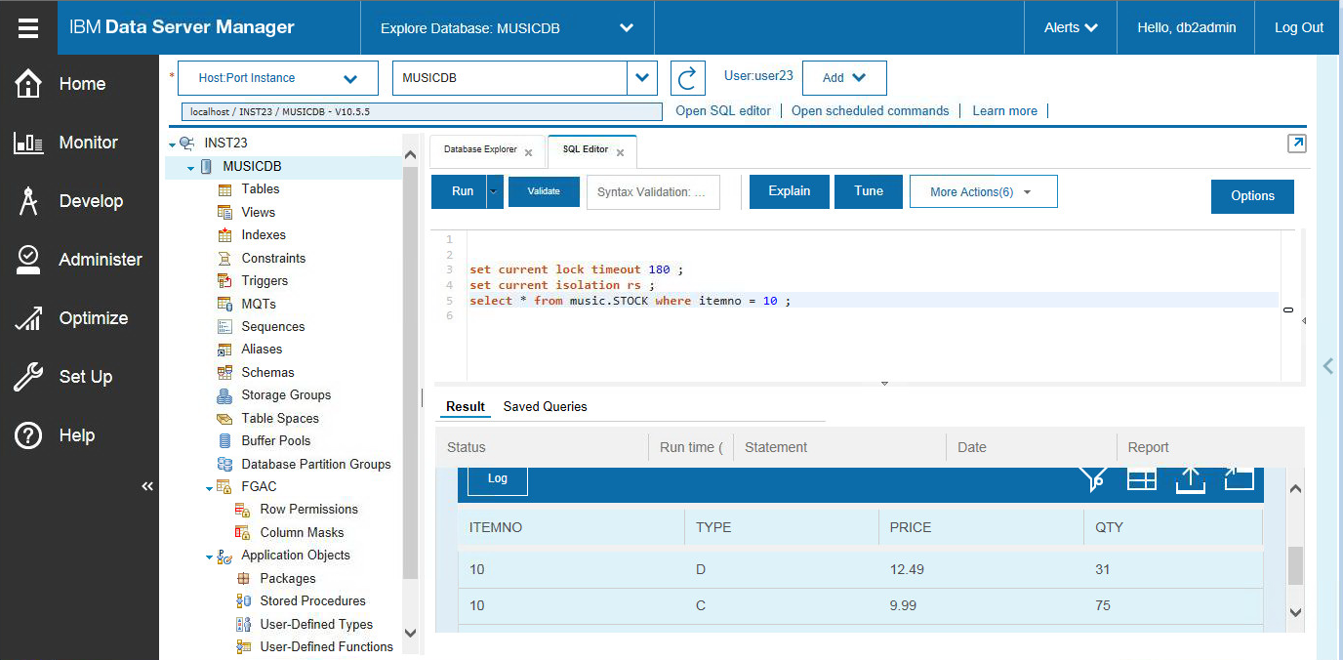






Data Server Manager: SQL Query Execution and Tuning
A database connection profile is selected for execution
Start Execution
SQL statements can be edited and syntax checked
SQL Script Results can be viewed

Slide 16
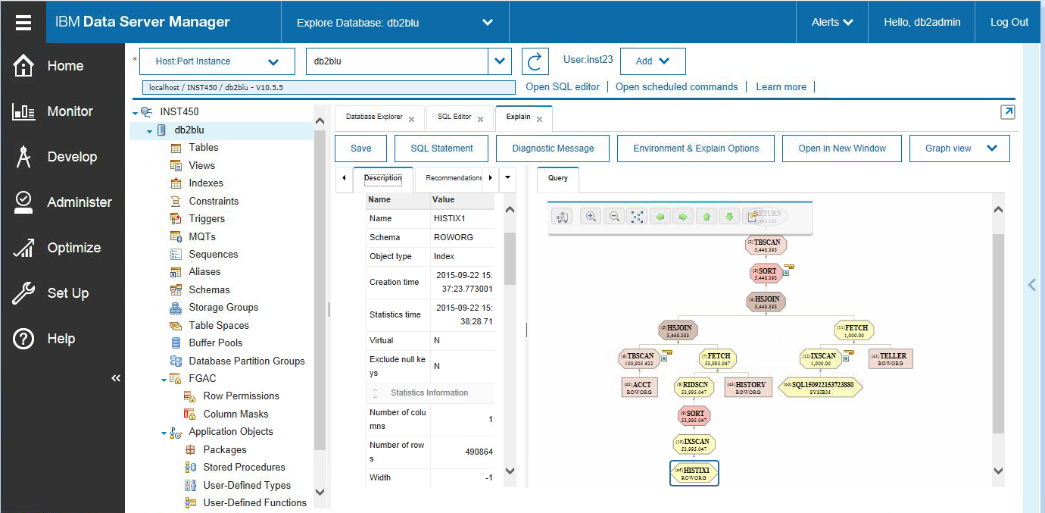
Data Server Manager: Visual Explain for SQL queries
Visual Explain shows access plan steps, sequence and estimated costs for execution

Slide 17
Unit summary
Utilize the DB2 Command Line Processor to run DB2 commands, SQL statements and command scripts
Invoke the CLPPlus command line processor to connect databases and to define, edit, and run statements, scripts, and commands
Describe the GUI tools available that support DB2 database administration and SQL execution with DB2 LUW servers

