Slide 1
The DB2 database manager instance
DB2 10.5 Administration Workshop for Windows

Slide 2
Unit objectives
Specify the key features of an instance
Create and drop a DB2 instance
Use db2start and db2stop commands to manage a DB2 instance
Display and set DB2 registry variables
Describe and modify the database manager configuration

Slide 3
What is an instance?
DB2 PRODUCT
Instance_1
Instance_2
DBM CFG
DBM CFG
DB CFG
DB CFG
DB_1
DB_3
Catalog
LOG
Catalog
LOG
DB CFG
DB_2
Catalog
LOG

Slide 4

The database manager instance
A database server could support multiple DB2 instances
Database Server
A DB2 instance could manage a single database
A DB2 instance can manage multiple databases
Database Manager inst1
Database Manager inst2
Database 1
Database 1
Database 2
Tablespace A
Tablespace B
Table 1
Table 2
Table 3
Table 4
connect to
Local User Application
Path+...
DB2INSTANCE=inst1
DB2INSTANCE designates the 'current' instance

Slide 5
Create and drop an instance
CREATE (different on Linux/UNIX and Windows):
  Prerequisites met?
  Creates the Instance
  Creates the SQLLIB subdirectory
  Creates needed directories in the SQLLIB subdirectory
  Creates the DBM CFG with defaults
    db2icrt –u <fencedID> <instance_name> (UNIX/Linux)
    db2icrt <instance_name> (Windows)
DROP:
  Instance must be stopped and no applications are allowed to be connected to the databases in this instance
  Does not remove (drop) databases
  Removes the Instance
    db2idrop <instance_name>

Slide 6
Starting and stopping an instance
To connect to a database, the DB2 instance must be started.
If a DB2 instance is stopped, all databases in the instance are unavailable for application connections.
A db2stop command will fail to stop the DB2 instance if there are active connections to any database unless the FORCE option is included:
      db2stop force
db2start
db2stop

Slide 7
DB2 registry and environment variables
Variables allow customization of the DB2 runtime processing to fit specific application needs
Variables for basic common configuration
  DB2COMM - must be set to TCPIP to enable tcp/ip client communication
  db2set db2comm=tcpip
  DB2FODC - This registry variable controls a set of troubleshooting-related parameters used in First Occurrence Data Collection (FODC)
Some variables alter DB2 internal processing
  DB2_REDUCED_OPTIMIZATION can adjust DB2 optimization processing
DB2_WORKLOAD can be set to provide a specific grouping of several registry variables with predefined settings
  DB2_WORKLOAD Values: 1C, CM, COGNOS_CS, FILENET_CM, INFOR_ERP_LN, MAXIMO, MDM, SAP, TPM, WAS, WC, or WP
  When DB2_WORKLOAD is set to ANALYTICS, DB2 will configure databases for BLU Acceleration processing with column-organized tables

Slide 8
The db2set command
Command | Result
db2set -lr | Display all supported registry variables.
db2set -all | Display all defined values for the current instance.
db2set -g DB2COMM=TCPIP | Set the DB2COMM registry variable to TCPIP for all instances pertaining to a particular installation.
db2set -i MYINST DB2COMM=TCPIP | Set the DB2COMM registry variable to TCPIP only for instance MYINST.
db2set -null DB2COMM | Set the DB2COMM registry variable to null at the default level. The default level is the instance level.
db2set DB2_ANTIJOIN= -immediate | Delete the current value of the registry variable DB2_ANTIJOIN so that it takes effect the next time the SQL statement is compiled.

Slide 9
Checking DB2 registry variables using SQL
The ENV_GET_REG_VARIABLES table function returns the DB2 registry settings. Syntax:
>>-ENV_GET_REG_VARIABLES--(--member--)------------><
For example, the registry variable DB2DBDFT, which specifies the database alias name to use for implicit connections, is set to CORP_1.
db2set db2dbdft=CORP_1
db2start
You can issue a query to show that registry variable setting:
  This query returns the following output:
select substr(reg_var_value,1,20) as VALUE, substr(reg_var_on_disk_value,1,20)
as ON_DISK_VALUE
from table(env_get_reg_variables(-1)) as T1
where reg_var_name = 'DB2DBDFT‘
VALUE ON_DISK_VALUE
-------------------- --------------------
CORP_1 CORP_1

Slide 10
Making changes to the database manager configuration
Check the current DBM settings using the GET DBM CFG command
Change DBM CFG options using the UPDATE DBM CFG command
    db2 update dbm cfg using svcename 50000
Some changes to the database manager configuration can not be applied immediately. These changes become effective only after DB2 is restarted using db2start
To see which parameter changes took effect dynamically and which ones did not, retrieve the DBM CFG and display the parameter details using the following commands:
    db2 attach to db2inst1
    db2 get dbm cfg show detail
Active and deferred DBM parameters can also be viewed using the db2pd command -dbmcfg option
    db2pd -dbmcfg

Slide 11
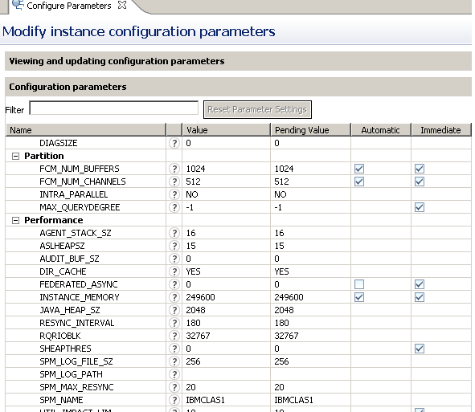
Database manager configuration using GUI tools

Slide 12
Demonstration 1
Create a new DB2 instance
Run the db2icrt command to create a new DB2 database manager instance.
Issue db2set and db2 update commands to configure the DB2 instance.
Utilize the db2start and db2stop commands to start and stop a DB2 instance.
Run db2pd commands to check the DB2 instance configuration and status.

Slide 13
Unit summary
Specify the key features of an instance
Create and drop a DB2 instance
Use db2start and db2stop commands to manage a DB2 instance
Display and set DB2 registry variables
Describe and modify the database manager configuration

