Slide 1
Creating database objects
DB2 10.5 Administration Workshop for Windows
Notes:
© Copyright IBM Corporation 2012

Slide 2
Unit objectives
Describe the DB2 object hierarchy
Create the following objects:
  Schema, Table, View, Alias, Index
Review the use of temporary tables
Explore the use and implementation of check constraints, referential integrity and triggers
Utilize BLU Acceleration, column-organized tables to improve analytics query performance
Explain the difference between system-period temporal tables and Application-period temporal tables
List the types of compression available for tables and indexes
Use the db2look utility to export database structures for future use

Slide 3



DB2 object hierarchy
Instance 1
dbm configuration file
SYSCATSPACE
DB configuration file
Log
Catalog
View1
Database 1
Log
Database 2
View2
STOGRP1
TSAS1
TSDMSLRG1
SYSCATSPACE
Table1
Table4
Table3
Catalog
Index1
View1
TSDMSREG2
TSAS2
TSDMSLRG3
Index31
USERSPACE1
Table2
BLOBs
Table2
Index32
Index2
IBMSTOGROUP

Slide 4
CREATE SCHEMA
A schema is a collection of named objects
A schema is also a name qualifier
The schema names 'INTERNAL' and 'EXTERNAL' make it easy to distinguish two different SALES tables (INTERNAL.SALES, EXTERNAL.SALES).
The schema name provides a way to group those objects logically, providing a way to use the same natural name for several objects, and to prevent ambiguous references to those objects.
Schemas also enable multiple applications to store data in a single database without encountering namespace collisions.
A schema can contain tables, views, nicknames, triggers, functions, packages, and other objects.
A schema is itself a database object.
The schema can be explicitly created using the CREATE SCHEMA statement, with the current user or a specified authorization ID recorded as the schema owner.
CREATE SCHEMA PAYROLL
AUTHORIZATION DB2ADMIN DATA CAPTURE NONE ;
A schema may also be implicitly created when another object is created, if the user has IMPLICIT_SCHEMA authority
A schema can be used to set a default DATA CAPTURE option for objects

Slide 5
Set current schema
Select from KEITH.EMPLOYEE:
  connect to musicdb user Keith;
  select * from employee;
Select from PAYROLL.EMPLOYEE
  set current schema = 'PAYROLL‘;
  select * from employee;

Slide 6
Using the Create Table statement
connect to musicdb;
create table artists
(artno smallint not null,
name varchar(50) with default 'abc',
classification char(1) not null,
bio clob(100K) logged,
picture blob( 10M) not logged compact)
in dms01
index in dms02
long in dms03;

Slide 7
Application temporary tables
Applications can utilize global temporary tables:
  Global temporary tables are stored in User temporary table spaces
  The associated data is deleted when the application connection ends
  Each connection accesses a private copy of the table, so it only sees data put into the table by that one connection
  Normal table locking is not needed for global temporary tables since the data is always limited to a single connection
  Declared Global Temporary table:
    These are defined during application execution using the
    DECLARE GLOBAL TEMPORARY TABLE statement
    No DB2 Catalog information is required
    The schema for a declared global temporary table is always ‘SESSION’
  Created Global Temporary table:
    These are defined using a CREATE GLOBAL TEMPORARY TABLE statement with a user selected schema
    The table and any associated indexes can be created before an application connection starts, but only the catalog definition exists
    The catalog definition is used when the application references the table
    Each application connection still works only with the data it stores in the table

Slide 8
Example of a declared temporary table
A system administrator creates the user temporary table space
CREATE USER TEMPORARY TABLESPACE "USR_TEMP_TS"
PAGESIZE 4 K MANAGED BY AUTOMATIC STORAGE
BUFFERPOOL IBMDEFAULTBP ;
The application uses SQL statements to declare and access the table
DECLARE GLOBAL TEMPORARY TABLE T1
LIKE REAL_T1
ON COMMIT DELETE ROWS
NOT LOGGED
IN USR_TEMP_TS;
INSERT INTO SESSION.T1
SELECT * FROM REAL_T1 WHERE DEPTNO=:mydept;
/* do other work on T1 */
/* when connection ends, table is automatically dropped */

Slide 9
Example of a created temporary table
A system administrator creates the user temporary table space and defines a global temporary table and indexes
CREATE USER TEMPORARY TABLESPACE "USR_TEMP_TS2"
PAGESIZE 4 K MANAGED BY AUTOMATIC STORAGE ;
CREATE GLOBAL TEMPORARY TABLE APP1.DEPARTMENT
LIKE PROD.DEPARTMENT
ON COMMIT DELETE ROWS
NOT LOGGED IN USR_TEMP_TS2;
CREATE INDEX APP1.DEPTIX1 ON APP1.DEPARTMENT (DEPTNO);
The application uses SQL statements to reference the temporary table; no DECLARE is needed
INSERT INTO APP1.DEPARTMENT
SELECT * FROM PROD.DEPARTMENT WHERE DEPTNO=:mydept;
SELECT * FROM APP1.DEPARTMENT WHERE LASTNAME = ‘STOPFER’

Slide 10
Table partitioning
Data organization scheme in which table data is divided across multiple storage objects called data partitions or ranges:
  Each data partition is stored separately
  These storage objects can be in different table spaces, in the same table space, or a combination of both
Benefits:
  Easier roll-in and roll-out of table data
  Allows large data roll-in (ATTACH) or roll-out (DETACH) with a minimal impact to table availability for applications
  Supports very large tables
  Indexes can be either partitioned (local) or non-partitioned (global)
  Table and Index scans can use partition elimination when access includes predicates for the defined ranges
  Different ranges can be assigned to table spaces in different storage groups for current data versus less used historical data

Slide 11
Example of a range partitioned table
The PARTITION BY RANGE clause defines a set of data ranges
CREATE TABLE PARTTAB.HISTORYPART ( ACCT_ID INTEGER NOT NULL ,
TELLER_ID SMALLINT NOT NULL ,
BRANCH_ID SMALLINT NOT NULL ,
BALANCE DECIMAL(15,2) NOT NULL ,
……….
TEMP CHAR(6) NOT NULL )
PARTITION BY RANGE (BRANCH_ID)
(STARTING FROM (1) ENDING (20) IN TSHISTP1 INDEX IN TSHISTI1 ,
STARTING FROM (21) ENDING (40) IN TSHISTP2 INDEX IN TSHISTI2 ,
STARTING FROM (41) ENDING (60) IN TSHISTP3 INDEX IN TSHISTI3 ,
STARTING FROM (61) ENDING (80) IN TSHISTP4 INDEX IN TSHISTI4 ) ;
CREATE INDEX PARTTAB.HISTPIX1 ON PARTTAB.HISTORYPART (TELLER_ID)
PARTITIONED ;
CREATE INDEX PARTTAB.HISTPIX2 ON PARTTAB.HISTORYPART (BRANCH_ID)
PARTITIONED ;
In this example, the data objects and index objects for each data range are stored in different table spaces
The table spaces used must be defined with the same options, such as type of management, extent size and page size

Slide 12
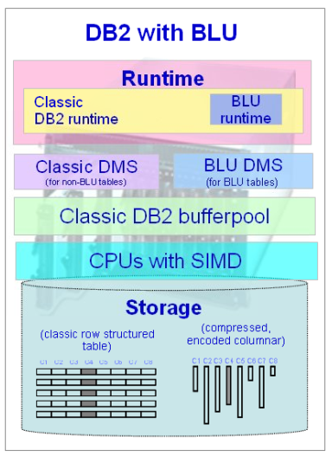
What is DB2 with BLU Acceleration?
Large order of magnitude benefits for analytic query processing
  Performance
  Storage savings
  Time to value
New technology in DB2 for analytic queries
  CPU-optimized unique runtime handling
  Unique encoding for speed and compression
  Unique memory management
  Columnar storage, vector processing
  Built directly into the DB2 kernel
Revolution or evolution
  BLU tables coexists with traditional row tables
    in same schema, storage, and memory
  Query any combination of row or BLU tables
  Easy conversion of tables to BLU tables
    Change everything, or change incrementally

Slide 13













BLU Acceleration: Columnar storage
DB2 uses separate set of extents and pages for each column
  Each table column is assigned to a set of pages
  Each page is filled with data from a single column, the number of rows
  with data in a page would vary
TSN
0
1
2
3
4
5
6
7
8
9
10
11
…
John
John
Piconne
Piconne
47
47
01111
18 Main Street
01111
18 Main Street
MA
Springfield
MA
Springfield
Susan Nakagawa
Susan Nakagawa
32
32
95113
455 N. 1
95113
455 N. 1
St.
St.
CA
st
CA
st
San Jose
San Jose
Sam Gerstner
Sam Gerstner
55
55
43601
911 Elm St.
43601
911 Elm St.
OH
Toledo
OH
Toledo
Chou Zhang
Chou Zhang
22
22
90047
300 Grand Ave
90047
300 Grand Ave
CA
Los Angeles
CA
Los Angeles
Mike Hernandez
TSN:
Tuple
Sequence Number
Mike Hernandez
43
43
90033
404
90033
404
Escuela
Escuela
St.
St.
CA
Los Angeles
CA
Los Angeles
Pamela Funk
Pamela Funk
29
Page
29
97075
166 Elk Road #47
97075
166 Elk Road #47
OR
Beaverton
OR
Beaverton
Rick Washington
Rick Washington
78
78
27605
5661 Bloom St.
27605
5661 Bloom St.
NC
Raleigh
NC
Raleigh
Ernesto Fry
Ernesto Fry
35
35
85701
8883 Longhorn Dr.
85701
8883 Longhorn Dr.
AZ
Tucson
AZ
Tucson
Whitney Samuels
Whitney Samuels
80
80
91117
14 California Blvd.
91117
14 California Blvd.
CA
Pasadena
CA
Pasadena
Carol Whitehead
Carol Whitehead
61
61
95014
1114 Apple Lane
95014
1114 Apple Lane
CA
Cupertino
CA
Cupertino

Slide 14
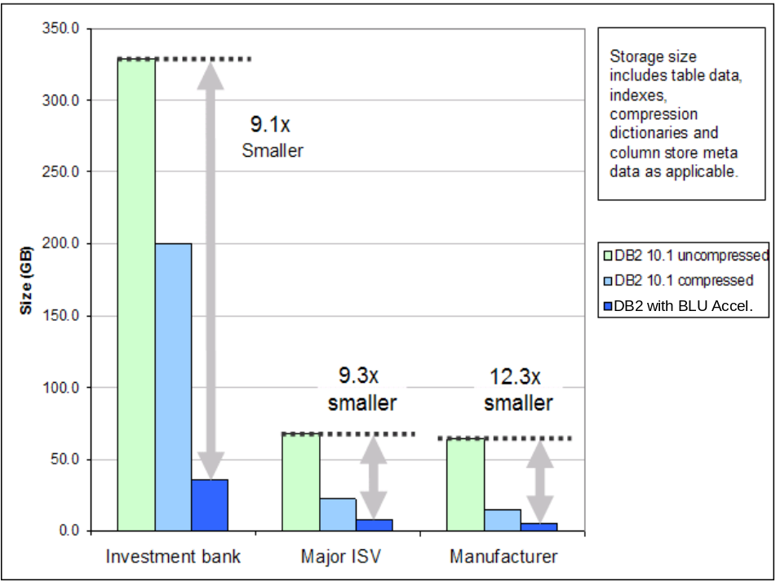
Storage savings using BLU Acceleration
Multiple examples of data requiring substantially less storage
  95% smaller than uncompressed data size
  Fewer objects required – no storage required for indexes, aggregates, etc
Multiple compression techniques
  Processing takes place on compressed data
Compression algorithm adapts to the data

Slide 15
BLU Acceleration: simple to implement and use
A single DB2 registry variable can be used to implement DB2 BLU acceleration
Setting DB2_WORKLOAD=ANALYTICS before a database is created
  Allow AUTOCONFIGURE to set database configuration and memory allocations
  Sets database page size to 32K
Setting DB2_WORKLOAD=ANALYTICS for an existing database
  Run AUTOCONFIGURE command
  Verify that sort heap, utility heap, and Buffer pools are large
db2set DB2_WORKLOAD=ANALYTICS

Slide 16
What happens when you create a new column-organized table?
Use a standard CREATE TABLE statement
  CREATE TABLE JTNISBET.STAFF (
  ID SMALLINT NOT NULL,
  NAME VARCHAR(9),
  . . . .
  COMM DECIMAL(7,2) )
  ORGANIZE BY COLUMN
  IN TSPACED INDEX IN TSPACEI ;
A system generated page map index is associated with the column-organized table
  The index contains one entry for each page in the table
  Index has a generated name like SQL130617115333860 and uses the schema of the base table
A system generated ‘synopsis table’ is associated with the column-organized table
  The synopsis table can be used as a ‘rough’ index to skip pages based on SQL predicates
  A synopsis has a generated name like SYN130617110037170122_HISTORY and uses the schema of SYSIBM

Slide 17
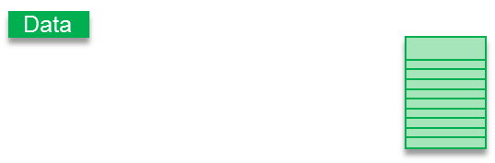








BLU Acceleration illustration 10TB query in seconds
The System: 32 cores, 1TB memory, 10TB table with 100 columns and 10 years of data
The Query: How many “sales” did we have in 2010?
  SELECT COUNT(*) from MYTABLE where YEAR = ‘2010’
The Result: In seconds or less as each CPU core examines the equivalent of just 8MB of data
Data
Data
Data
Data
Data
Data
Data
Data
Data
Data
Data
Actionable Compression
reduces to 1TB
In-memory
Column Processing
reduces to 10GB
Data Skipping
reduces to 1GB
10TB data
Parallel Processing
32MB linear scan
on each core via
Vector Processing Scans as fast as
8MB through SIMD
Result in
seconds or less
Data
Data
Data

Slide 18
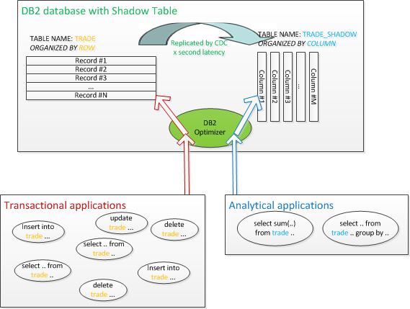
Shadow Tables can be used to accelerate Analytics query processing in an OLTP Database
Row-organized tables can process all SQL that changes data and SELECT statements expected to perform well
Column-organized tables can process some SQL queries to improve
performance

Slide 19
Shadow table characteristics
A shadow table is a column-organized copy of a row-organized table that includes all columns or a subset of columns.
Shadow tables are implemented as materialized query tables (MQTs) that are maintained by replication.
Using shadow tables, you can get the performance benefits of BLU Acceleration for analytic queries in an online transaction processing (OLTP) environment.
Shadow tables are maintained by IBM InfoSphere Change Data Capture for DB2 LUW, a component of the InfoSphere Data Replication product.
  InfoSphere CDC asynchronously replicates DML statements that are applied on the source table to the shadow table.
By default, all applications access the source tables.
  Queries are automatically routed to the source table (row-organized) or the shadow table (column-organized copy of the source table) based on estimated costs
  A latency-based algorithm is available to prevent applications from accessing the shadow table when the latency is beyond the user-defined limit.

Slide 20
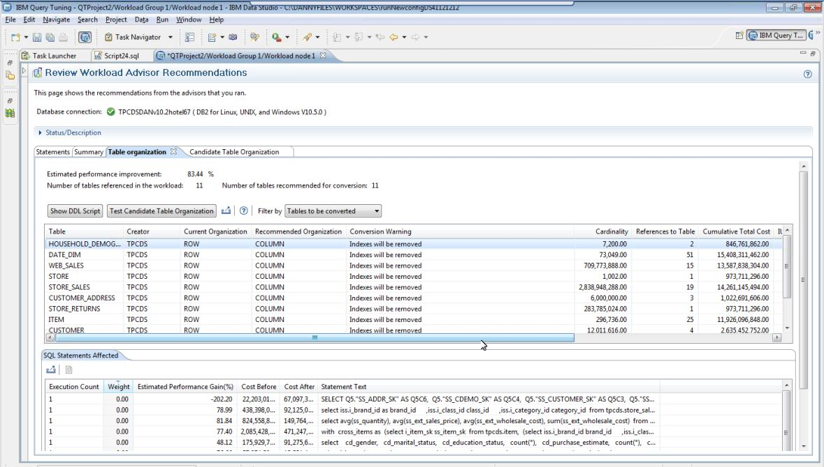
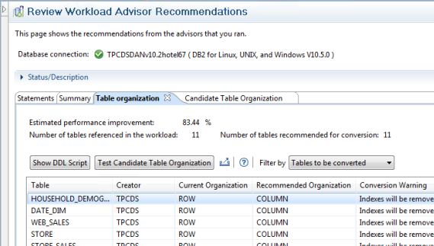
BLU Acceleration: Workload Advisor
Advisor identifies candidate tables for conversion to columnar format.
Analyzes SQL workload and estimates execution cost on row- and column-organized tables.

Slide 21
Create View statement
CONNECT TO TESTDB;
CREATE VIEW EMPSALARY
AS SELECT EMPNO, EMPNAME, SALARY
FROM PAYROLL, PERSONNEL
WHERE EMPNO=EMPNUMB AND SALARY > 30000.00;
SELECT * FROM EMPSALARY
EMPNO EMPNAME SALARY
------ ----------------- ----------
10 John Smith 1000000.00
20 Jane Johnson 300000.00
30 Robert Appleton 250000.00

Slide 22
Create Alias statement
Cannot be the same as an existing table, view, or alias
To create an alias of ADMIN.MUSICIANS for the table ADMIN.ARTISTS
  CREATE ALIAS ADMIN.MUSICIANS FOR ADMIN.ARTISTS;
To create a public alias called TABS for the catalog view SYSCAT.TABLES
  CREATE PUBLIC ALIAS TABS FOR SYSCAT.TABLES

Slide 23

Create index statements
Create a unique index based on one column
  CREATE UNIQUE INDEX DBA1.EMPNO ON DBA1.EMPLOYEE (EMPNO ASC)
  PCTFREE 10
  ALLOW REVERSE SCANS
  PAGE SPLIT SYMMETRIC
  COLLECT SAMPLED DETAILED STATISTICS ;
Create a non-unique index that will be used to cluster data sequence
  CREATE INDEX ITEM ON STOCK (ITEMNO) CLUSTER ;
Create a unique index based on one column that includes extra columns to support index-only strategies
  CREATE UNIQUE INDEX EMPIDX ON EMPLOYEE (EMPNO)
  INCLUDE (LASTNAME, FIRSTNAME) ;
Index statistics can be collected during index creation

Slide 24
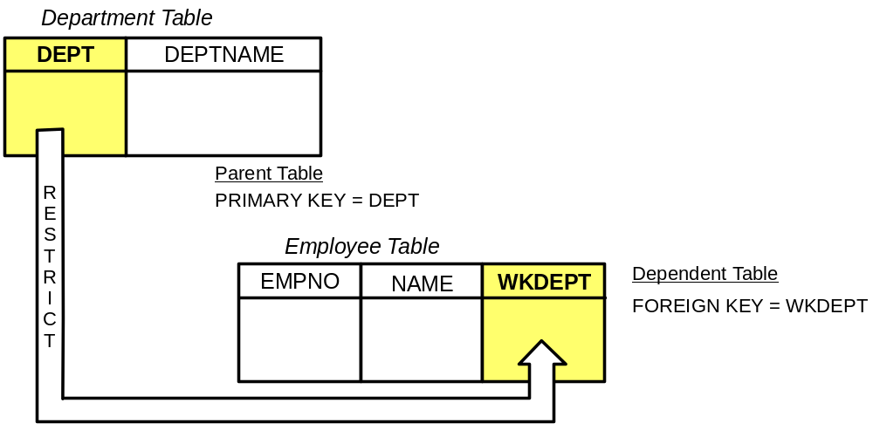
Overview of referential integrity
Place constraints between tables
Constraints specified with Create and Alter table statements
Database services enforce constraints: inserts, updates, deletes
Removes burden of constraint checking from application programs

Slide 25
Referential integrity: CREATE TABLE statement
CREATE TABLE DEPARTMENT
(DEPTNO CHAR(3) NOT NULL,
DEPTNAME VARCHAR(29) NOT NULL,
MGRNO CHAR(6),
ADMRDEPT CHAR(3) NOT NULL,
LOCATION CHAR(16),
PRIMARY KEY (DEPTNO))
IN RESOURCE
CREATE TABLE EMPLOYEE
(EMPNO CHAR(6) NOT NULL PRIMARY KEY,
FIRSTNME VARCHAR(12) NOT NULL,
LASTNAME VARCHAR(15) NOT NULL,
WORKDEPT CHAR(3),
PHONENO CHAR(4),
PHOTO BLOB(10m) NOT NULL,
FOREIGN KEY DEPT (WORKDEPT)
REFERENCES DEPARTMENT ON DELETE NO ACTION)
IN RESOURCE

Slide 26


Unique key considerations
Multiple keys in one table can be Foreign Key targets
Deferral of unique checking until end of statement processing
  UPDATE EMPTAB SET EMPNO=EMPNO + 1
CREATE TABLE PAY.EMPTAB
(EMPNO SMALLINT NOT NULL PRIMARY KEY,
NAME CHAR(20),
DRIVERLIC CHAR(17) NOT NULL,
CONSTRAINT DRIV_UNIQ UNIQUE(DRIVERLIC)
)IN TBSP1 ;
Unique indexes PAY.DRIV_UNIQ and SYSIBM.yymmddhhmmssxxx
created Columns must be NOT NULL

Slide 27

Check constraints: definition
CREATE TABLE SPEED_LIMITS
(ROUTE_NUM SMALLINT,
CANADA_SL INTEGER NOT NULL,
US_SL INTEGER NOT NULL
CHECK (US_SL <=65) ) ;
ALTER TABLE SPEED_LIMITS
ADD CONSTRAINT SPEED65
CHECK (US_SL <=65) ;

Slide 28
Create a trigger statement
Example: a trigger could insert a new row into one tables if an update
on another table resulted in a column value falling below a defined
threshold.
CREATE TRIGGER MUSIC.REORDER
AFTER UPDATE
OF QTY ON MUSIC.STOCK
REFERENCING NEW AS N
FOR EACH ROW MODE DB2SQL
WHEN (N.QTY <=5)
INSERT INTO MUSIC.REORDER VALUES (N.ITEMNO, CURRENT TIMESTAMP) ;

Slide 29
Manage and query time-based data using temporal tables
Use temporal tables associated with Time Travel Query to assign
time-based state information to your data.
  Data in tables that do not use temporal support represents the present
  Data in temporal tables is valid for a period defined by the database system, customer applications, or both
System-period temporal tables
  DB2 can automatically store the history of a table
  The history table contains deleted rows or the original values of rows that have been updated so you can query the past state of your data
Application-period temporal tables
  You can also assign a date range to a row of data to indicate when it is deemed to be valid by your application or business rules
Bi-temporal tables
  Combine application-period (ATT) and system-period (STT) capabilities

Slide 30


How to define a system-period temporal table
CREATE a table with a SYSTEM_TIME attribute
CREATE the history table
ADD VERSIONING to the system-period temporal table to establish a link to the history table
CREATE TABLE travel(
trip_name CHAR(30) NOT NULL PRIMARY KEY,
destination CHAR(12) NOT NULL,
departure_date DATE NOT NULL,
price DECIMAL (8,2) NOT NULL,
sys_start TIMESTAMP(12) NOT NULL generated always as row begin implicitly hidden,
sys_end TIMESTAMP(12) NOT NULL generated always as row end implicitly hidden,
tx_start TIMESTAMP(12) generated always as transaction start id implicitly hidden,
PERIOD SYSTEM_TIME (sys_start, sys_end)) in travel_space;
Captures the begin and end times
when the data in a row is current
CREATE TABLE travel_history like travel in hist_space;
ALTER TABLE travel ADD VERSIONING USE HISTORY TABLE travel_history;

Slide 31


Query using a system-period temporal table
Query the past: what trips were available on 03/01/2012 for less than $500?
  Current date = May 1, 2012
Query the present: what trips are currently available to Brazil?
Query the past and the present: In 2011, how many different tours
were offered?
SELECT trip_name FROM travel FOR SYSTEM_TIME AS OF ’03/01/2012’
WHERE price < 500.00
SELECT trip_name FROM travel WHERE destination = ‘Brazil’
Defaults to the current table only and functions as if you added
FOR SYSTEM TIME AS OF CURRENT DATE
SELECT COUNT (DISTINCT trip_name) FROM travel
FOR SYSTEM_TIME BETWEEN ’01/01/2011’ AND ’01/01/2012’

Slide 32
Example of an application-period temporal table
The policy_info table stores the insurance coverage level for a customer
  The BUSINESS_TIME period-related columns (bus_start and bus_end) indicate when an insurance coverage level is valid
  A PRIMARY KEY declaration is used when creating the policy_info table, ensuring that overlapping periods of BUSINESS_TIME are not allowed.
  This means that there cannot be two versions of the same policy that are valid at the same time.
  CREATE TABLE POLICY_INFO
      ( POLICY_ID CHAR(4) NOT NULL,
      COVERAGE INT NOT NULL,
      BUS_START DATE NOT NULL,
      BUS_END DATE NOT NULL,
      PERIOD BUSINESS_TIME(BUS_START, BUS_END),
      PRIMARY KEY(POLICY_ID, BUSINESS_TIME WITHOUT OVERLAPS)
  );

Slide 33
Using an application-period temporal table
Query with FOR BUSINESS_TIME AS OF specified
SELECT policy_id, coverage, bus_start, bus_end
FROM policy_info
FOR BUSINESS_TIME AS OF '2008-07-15'
where policy_id = 'A123‘
Query with FOR BUSINESS_TIME FROM...TO specified
SELECT policy_id, coverage, bus_start, bus_end
FROM policy_info
FOR BUSINESS_TIME FROM '2008-01-01' TO '2008-06-15'
where policy_id = 'A123‘
The coverage for policy A123 shows an increase from 12000 to 16000 on July 1 (2008-07-01), but an earlier increase to 14000 is missing:
UPDATE policy_info
FOR PORTION OF BUSINESS_TIME
FROM '2008-06-01' TO '2008-08-01‘
SET coverage = 14000 WHERE policy_id = 'A123';

Slide 34
Data row compression summary
Data row compression was introduced in DB2 9.1
COMPRESS option for CREATE and ALTER TABLE is used to specify compression
Compression uses a static dictionary:
  Dictionary stored in data object, about 100K in size
  Compression Dictionary needs to be built before a row can be compressed
  Dictionary can be built or rebuilt using REORG TABLE offline, which also compresses existing data
  A dictionary is built automatically when a table reaches a threshold size (about 2 MB). This applies to SQL INSERT as well as IMPORT and LOAD (DB2 9.5).
Compression is intended to:
  Reduce disk storage requirements
  Reduce I/Os for scanning tables
  Reduce buffer pool memory for storing data
Compression for Indexes, Temporary data and XML data was added in DB2 9.7

Slide 35







Adaptive compression with DB2 10
Adaptive compression is an enhancement to the classic row compression found in DB2 9.7
  Compress rows by using a combination of two types of dictionaries
    Global static table-level dictionary
    Local page -level dictionaries
Benefits
  Page level dictionaries adapt to data skew over a period
  of time
    No REORGs required to maintain high
    compression ratio as data changes
  Less disk space for data and logs
    2x storage savings for tables
    over Classic Row Compression
    5x-8x overall table compression
  Reduced I/O - Fewer pages to process
TABLE
DB2 page
Static table
level dictionary
Dynamic page
level dictionary
DB2 page
DB2 page
Dynamic page
level dictionary
Dynamic page
level dictionary
Better compression ratios than Classic Row Compression
Over time reduces need of a REORG to find locally recurring patterns

Slide 36

How Does Adaptive Compression Work? Step 1
[1]
California
Step 1: Compression with static table level dictionary
Table-level compression symbol
dictionary containing globally
recurring patterns
Table-level dictionary can only be
rebuilt during classic table REORG
  Involves re-compressing all data
[2]
San
[3]
Jose
[4]
Francisco
Christine
Haas
(408) 463-1234
555 Bailey Avenue
San Jose
California
95141
[5]
Avenue
John
Thompson
(408) 463-5678
555 Bailey Avenue
San Jose
California
95141
[6]
Street
Jose
Fernandez
(408) 463-1357
555 Bailey Avenue
San Jose
California
95141
[7]
Road
Margaret
Miller
(408) 463-2468
555 Bailey Avenue
San Jose
California
95141
Bruce
Kwan
(408) 956-9876
4400 North 1st Street
San Jose
California
95134
James
Geyer
(408) 956-5432
4400 North 1st Street
San Jose
California
95134
Linda
Hernandez
(408) 956-9753
4400 North 1st Street
San Jose
California
95134
Compression with global table static dictionary
Theodore
Mills
(408) 927-8642
650 Harry Road
San Jose
California
95134
Susan
Stern
(408) 927-9630
650 Harry Road
San Jose
California
95134
James
Polaski
(415) 545-1423
425 Market Street
San Francisco
California
94105
John
Miller
(415) 545-5867
425 Market Street
San Francisco
California
94105
James
Walker
(415) 545-4132
425 Market Street
San Francisco
California
94105
Elizabeth
Brown
(415) 545-8576
425 Market Street
San Francisco
California
94105
Sarah
Johnson
(415) 545-1928
425 Market Street
San Francisco
California
94105
Christine
Haas
(408) 463-1234
555 Bailey [5]
[2][3]
[1]
95141
John
Thompson
(408) 463-5678
555 Bailey [5]
[2][3]
[1]
95141
[3]
Fernandez
(408) 463-1357
555 Bailey [5]
[2][3]
[1]
95141
Margaret
Schneider
(408) 463-2468
555 Bailey [5]
[2][3]
[1]
95141
Bruce
Kwan
(408) 956-9876
4400 North 1st [6]
[2][3]
[1]
95134
James
Geyer
(408) 956-5432
4400 North 1st [6]
[2][3]
[1]
95134
Linda
Hernandez
(408) 956-9753
4400 North 1st [6]
[2][3]
[1]
95134
Theodore
Mills
(408) 927-8642
650 Harry [7]
[2][3]
[1]
95134
Susan
Stern
(408) 927-9630
650 Harry [7]
[2][3]
[1]
95134
James
Polaski
(415) 545-1423
425 Market [6]
[2][4]
[1]
94105
John
Miller
(415) 545-5867
425 Market [6]
[2][4]
[1]
94105
James
Walker
(415) 545-4132
425 Market [6]
[2][4]
[1]
94105
Elizabeth
Miller
(415) 545-8576
425 Market [6]
[2][4]
[1]
94105
Sarah
Johnson
(415) 545-1928
425 Market [6]
[2][4]
[1]
94105

Slide 37

How Does Adaptive Compression Work? Step 2
Step 2: Compression w/ Page-Level Dictionaries
(1) | ernandez
(2) | (408) 463-
(3) | (408) 956-
(4) | 555 Bailey [5] [2][3] [1] 5141
(5) | 4400 North 1st [6] [2][3] [1] 5134
Christine | Haas | (2)1234 | (4)
John | Thompson | (2)5678 | (4)
Ellen | F(1) | (2)1357 | (4)
Margaret | Schneider | (2)2468 | (4)
Bruce | Kwan | (3)9876 | (5)
James | Geyer | (3)5432 | (5)
Linda | H(1) | (3)9753 | (5)
Christine
Haas
(408) 463-1234
555 Bailey [5]
[2][3]
[1]
5141
John
Thompson
(408) 463-5678
555 Bailey [5]
[2][3]
[1]
5141
Ellen
Fernandez
(408) 463-1357
555 Bailey [5]
[2][3]
[1]
5141
Margaret
Schneider
(408) 463-2468
555 Bailey [5]
[2][3]
[1]
5141
Page level dictionary
Data page
Bruce
Kwan
(408) 956-9876
4400 North 1st [6]
[2][3]
[1]
5134
James
Geyer
(408) 956-5432
4400 North 1st [6]
[2][3]
[1]
5134
(1) | James
(2) | John
(3) | Mill
(4) | (408) 927-
(5) | (408) 956-
(6) | 650 Harry [7] [2][3] [1] 5134
(7) | 425 Market [6] [2][4] [1] 4105
Linda
Hernandez
(408) 956-9753
4400 North 1st [6]
[2][3]
[1]
5134
[9]odore
Mills
(408) 927-8642
650 Harry [7]
[2][3]
[1]
5134
Susan
Stern
(408) 927-9630
650 Harry [7]
[2][3]
[1]
5134
[9]odore | (3)s | (4)8642 | (6)
Susan | Stern | (4)9630 | (6)
(1) | Polaski | (5)1423 | (7)
(2) | (3)er | (5)9876 | (7)
(1) | Walker | (5)4132 | (7)
[8] | (3)er | (5)8576 | (7)
Sarah | (2)son | (5)1928 | (7)
James
Polaski
(415) 545-1423
425 Market [6]
[2][4]
[1]
4105
Data page
John
Miller
(415) 545-9876
425 Market [6]
[2][4]
[1]
4105
James
Walker
(408) 956-4132
425 Market [6]
[2][4]
[1]
4105
Page level dictionary
[8]
Miller
(408) 956-8576
425 Market [6]
[2][4]
[1]
4105
Sarah
Johnson
(408) 956-1928
425 Market [6]
[2][4]
[1]
4105
Page-level compression dictionaries contain locally frequent patterns
Page-level compression dictionary building and rebuilding is fully automatic
Algorithm optimized for compressing data already compressed by
table-level dictionary
Page-level compression dictionaries are stored as special records in
each page

Slide 38
db2look examples
To capture all of the DDL for a database (includes all tables, views, RI, constraints, triggers, and so on):
  db2look -d proddb -e -o statements.sql
  {Edit the output file and change the database name}
  db2 -tvf statements.sql
To capture the DDL for one table in particular (table1 in this example):
  db2look -d proddb -e -t table1 -o statements.sql
  {Edit the output file and change the database name}
  db2 -tvf statements.sql
To capture the DDL for all of the tables belonging to a particular schema (db2user in this example):
  db2look -d proddb -e -z db2user -o statements.sql
  {Edit the output file and change the database name}
  db2 -tvf statements.sql

Slide 39
Demonstration 1
Creating database objects
Create a set of tables using the Data Server Manager to build the CREATE TABLE statement or using saved DDL in a file.
Create indexes for tables using the CREATE INDEX statement.
Create views and alias objects using SQL statements in a file.
Create foreign key and check constraints for a table using SQL statements in a file.
Use the db2look utility to extract database object definitions from a DB2 database.

Slide 40
Unit summary
Describe the DB2 object hierarchy
Create the following objects:
  Schema, Table, View, Alias, Index
Review the use of temporary tables
Explore the use and implementation of check constraints, referential integrity and triggers
Utilize BLU Acceleration, column-organized tables to improve analytics query performance
Explain the difference between system-period temporal tables and Application-period temporal tables
List the types of compression available for tables and indexes
Use the db2look utility to export database structures for future use

