Slide 1
Moving data
DB2 10.5 Administration Workshop for Windows

Slide 2
Unit objectives
Discuss using the INSERT SQL statement to populate tables
Explain the differences between IMPORT and LOAD processing
Explain the EXPORT, IMPORT, and LOAD command options
Create and use Exception Tables and Dump-Files
Check table status using LOAD QUERY
Describe the ANALYZE phase of LOAD command processing used for loading BLU Acceleration, column-organized tables.
Check the Load Pending and Set Integrity Pending status for a table
Use the SET INTEGRITY command
Discuss the db2move and db2look commands
Use the ADMIN_MOVE_TABLE procedure to move a table to different table spaces
List some of the features of the Ingest utility for continuous data ingest

Slide 3
Review INSERT statement
The SQL INSERT statement can insert one or more rows of data into tables, nicknames, or views:
  SQL overhead is imposed, such as obeying RI, or Check Constraints, or Uniqueness, or executing triggers.
  As INSERTs occur, the activity is also stored in logs
The SQL INSERT might not be the best or fastest method to load massive amounts of data into a database
Example inserts:
INSERT INTO ARTISTS (artno, name,classification)
values (100, 'Patti & Cart Wheels', 'S') ;
INSERT INTO EMPTEMP SELECT * FROM EMPLOYEE ;

Slide 4
EXPORT command syntax (Basic)
EXPORT TO
filename
OF
filetype
,
,
LOBS TO
lob-path
LOBFILE
filename
. . .
MODIFIED BY
filetype-mod
select-statement
MESSAGES
message-file

Slide 5
EXPORT command example
Exports data from database tables to file
  SELECT statement can reference tables, views, alias and can include joins, GROUP BY and ORDER BY
Check message for error or warning messages
  db2 connect to musicdb
  db2 export to artexprt of ixf messages artmsg
  select artno, name from music.artists
DB2
MUSICDB
EXPORT
artexprt
MUSIC.ARTISTS

Slide 6
IMPORT command syntax (Basic)
IMPORT FROM
filename
OF
filetype
. . .
,
LOBS FROM
lob-path
ALLOW NO ACCESS
ALLOW WRITE ACCESS
MODIFIED BY
filetype-mod
COMMITCOUNT
n/
RESTARTCOUNT
n
MESSAGES
message-file
Automatic
INSERT
INTO
table-name
,
INSERT_UPDATE
(
insert-column
REPLACE
)
REPLACE_CREATE
CREATE
INTO
table-name
,
| tblspace-specs |
(
insert-column
)
tblspace-specs
|
|
IN
tablespace-name
INDEX IN
INDEX IN
tablespace-name
tablespace-name
LONG IN
tablespace-name

Slide 7
Import utility example
db2 import from myfile.ixf of ixf messages msg.txt
insert into staff
SQL3150N The H record in the PC/IXF file has product "DB2 01.00", date
“20140220", and time "140848".
SQL3153N The T record in the PC/IXF file has name "myfile",
qualifier " ", and source " ".
SQL3109N The utility is beginning to load data from file "myfile".
SQL3110N The utility has completed processing. "58" rows were read from the
input file.
SQL3221W ...Begin COMMIT WORK. Input Record Count = "58".
SQL3222W ...COMMIT of any database changes was successful.
SQL3149N "58" rows were processed from the input file. "58" rows were
successfully inserted into the table. "0" rows were rejected.

Slide 8
Differences between IMPORT and LOAD
IMPORT | LOAD
Slow when moving large amounts of data Creation of table/index supported with IXF format Import into tables, views, aliases Option to ALLOW WRITE ACCESS All rows logged Triggers fired, constraints enforced Inserts can use space freed by deleted rows | Faster for large amounts of data Tables and indexes must exist Load into tables only Existing data can still be seen by read applications Minimal logging; can make copy Triggers not fired; unique constraints enforced, RI and check constraints via SET INTEGRITY LOAD builds new extents

Slide 9
Load processing phases
Analyze phase
  Applies only to column-organized table
  Used to build column compression dictionaries
Load phase:
  Input records are read, formatted and written to the target table containers and to the Load copy (optional)
  Index keys are inserted into sorts
Build phase – Indexes are built
Delete phase
  Duplicates are removed from unique indexes
Index Copy phase
  If copy is needed to replace the index object with its shadow copy
  (ALLOW READ ACCESS)

Slide 10
Load processing for column-organized tables
This processing requires a significantly larger amount
of database utility heap memory compared to row organized tables
Pass 1 ANALYZE PHASE
Only if dictionaries need to be built
Build histograms to track value frequency
Input
Source
Convert raw data from row-organized format to column-organized format
Build column compression dictionaries
Pass 2 LOAD PHASE
User Table
Input
Source
Convert raw data from row-organized format to column-organized format
Compress values. Build data pages. Update synopsis Build keys for page map index and any unique indexes.
Synopsis Table
Index keys

Slide 11
LOAD command syntax (Basic)
,
LOAD
FROM
file
OF
ASC
CLIENT
pipe
DEL
device
IXF
cursorname
CURSOR
MODIFIED BY
filetype-mod
. . .
SAVECOUNT
n
ROWCOUNT
n
WARNINGCOUNT
n
MESSAGES
msg-file
INSERT
INTO
table-name
,
REPLACE
RESTART
(
insert-column
)
FOR EXCEPTION
table-name
TERMINATE
ALLOW NO ACCESS
ALLOW READ ACCESS
| statistics options |
|copy options|
USE
tablespace-name
| set integrity pending options |
LOCK WITH FORCE

Slide 12
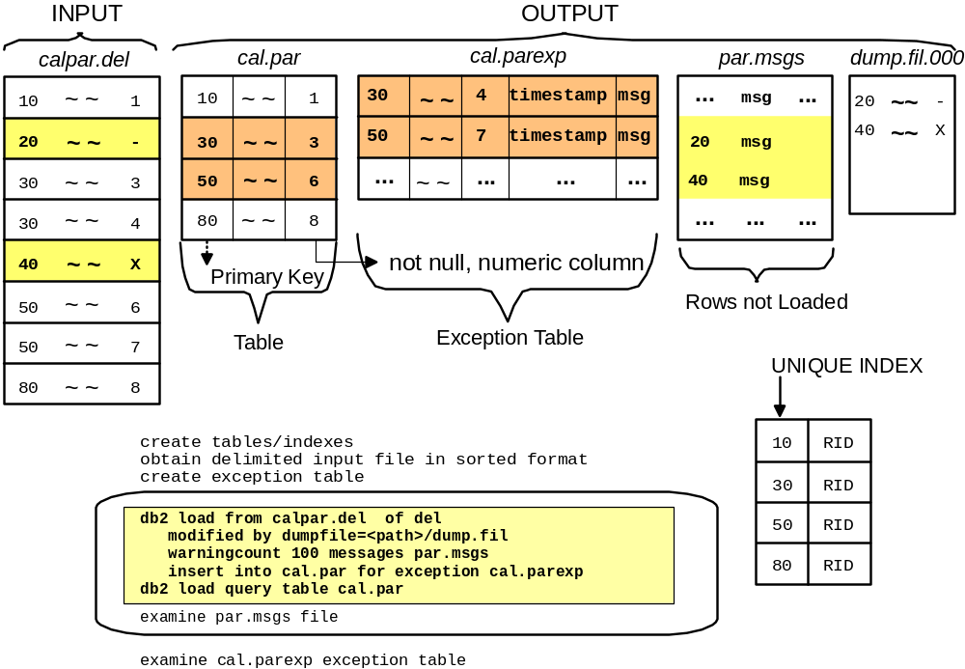
LOAD scenario

Slide 13
Rules and methods for creating Exception Tables
The first n columns are the same
No constraints and no trigger definitions
n + 1 column TIMESTAMP
n + 2 column CLOB (32 KB)
user INSERT privilege
CREATE TABLE T1EXC LIKE T1
ALTER TABLE T1EXC
ADD COLUMN TS TIMESTAMP
ADD COLUMN MSG CLOB(32K)
CREATE TABLE T1EXC AS
(SELECT T1.*,
CURRENT TIMESTAMP AS TS,
CLOB('', 32767) AS MSG
FROM T1)
DEFINITION ONLY

Slide 14
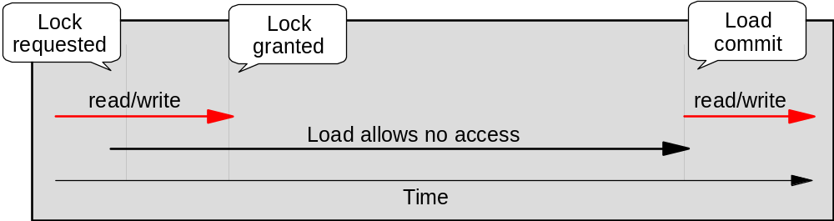
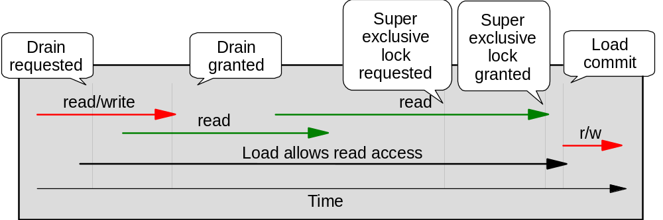
Offline versus Online Load
ALLOW NO ACCESS
ALLOW READ ACCESS

Slide 15
Table states
(Load pending, Set Integrity Pending)
LOAD QUERY TABLE <table-name>
Tablestate:
  Normal
  Set Integrity Pending
  Load in Progress
  Load Pending
  Reorg Pending
  Read Access Only
  Unavailable
  Not Load Restartable
  Unknown
Table can be in several states at same time
  Tablestate:
    Set Integrity Pending
    Load in Progress
    Read Access Only

Slide 16
Checking Load status: Load query
db2 load query table inst481.loadhist1
SQL3501W The table space(s) in which the table resides will not be placed in
backup pending state since forward recovery is disabled for the database.
SQL3109N The utility is beginning to load data from file
"/home/inst481/datamove/savehist.del".
SQL3500W The utility is beginning the "LOAD" phase at time "05/12/2014
02:44:13.967160".
SQL3519W Begin Load Consistency Point. Input record count = "0".
SQL3520W Load Consistency Point was successful.
SQL3519W Begin Load Consistency Point. Input record count = "10248".
...
SQL3519W Begin Load Consistency Point. Input record count = "51450".
SQL3520W Load Consistency Point was successful.
SQL0289N Unable to allocate new pages in table space "LOADTSPD".
SQLSTATE=57011
SQL3532I The Load utility is currently in the "LOAD" phase.
Number of rows read = 51450
Number of rows skipped = 0
Number of rows loaded = 51450
Number of rows rejected = 0
Number of rows deleted = 0
Number of rows committed = 51450
Number of warnings = 0
Tablestate:
Load Pending

Slide 17
Load monitoring: LIST UTILITIES
db2 LIST UTILITIES SHOW DETAIL
ID = 4
Type = LOAD
Database Name = MUSICDB
Member Number = 0
Description = [LOADID: 18.2014-05-12-02.48.55.850877.0 (11;4)]
[*LOCAL.inst481.120512063958] ONLINE LOAD DEL AUTOMATIC INDEXING INSERT NON-RECOVERABLE
INST481 .LOADHIST1
Start Time = 05/12/2014 02:48:55.869016
State = Executing
Invocation Type = User
Progress Monitoring:
Phase Number = 1
Description = SETUP
Total Work = 0 bytes
Completed Work = 0 bytes
Start Time = 05/12/2014 02:48:55.869085
Phase Number = 2
Description = LOAD
Total Work = 10000 rows
Completed Work = 10000 rows
Start Time = 05/12/2014 02:49:07.057958
Phase Number [Current] = 3
Description = BUILD
Total Work = 2 indexes
Completed Work = 2 indexes
Start Time = 05/12/2014 02:49:07.36690

Slide 18
Load Pending state: Recovering from LOAD failure
Restart the Load:
  Check Messages files
  Use Restart option
  Load operation automatically continues from last consistency point in Load or Build phase
    or Delete phase if ALLOW NO ACCESS
Replace the whole table
  LOAD ... REPLACE
Terminate the Load:
  If LOAD ... INSERT, returns table to state preceding Load
If LOAD ... REPLACE, table will be truncated to an empty state
  Create backup copy prior to Load to return to state preceding Load
Do not tamper with Load temporary files

Slide 19
Backup Pending state: COPY options
When loading data and forward recovery is enabled:
  COPY NO (default)
    During load, Backup pending and Load in progress
    After load, Backup Pending
  COPY YES
    Load has made Copy not Backup pending
  NONRECOVERABLE
    No copy made and no backup required
Load Copy file naming conventions
Databasealias.Type.Instancename.DBPART000.Timestamp.number
Type:
0=Full Backup
3=Table Space Backup
4 =Copy from Table Load

Slide 20
Set Integrity Pending table state
Load turns OFF constraint checking:
  Leaves table in Set Integrity Pending state
  If parent table is in Set Integrity Pending, then dependents may also be in Set Integrity Pending
  LOAD INSERT, ALLOW READ ACCESS
    Loaded table in Set Integrity Pending with read access
  LOAD INSERT, ALLOW NO ACCESS
    Loaded table in Set Integrity Pending with no access
  LOAD REPLACE, SET INTEGRITY PENDING CASCADE DEFERRED
    Loaded table in Set Integrity Pending with no access
  LOAD REPLACE, SET INTEGRITY PENDING CASCADE IMMEDIATE
    Loaded table and descendant Foreign Key tables are in Set Integrity Pending with no access

Slide 21
SET INTEGRITY command syntax (Basic)
. . .
SET INTEGRITY
,
FOR
table-name
OFF
IMMEDIATE CHECKED
| exception-clause |
,
FOR
table-name
ALL
IMMEDIATE UNCHECKED
,
FOREIGN KEY
CHECK
exception-clause
,
|
FOR EXCEPTION
IN
table-name
USE
table-name
|

Slide 22
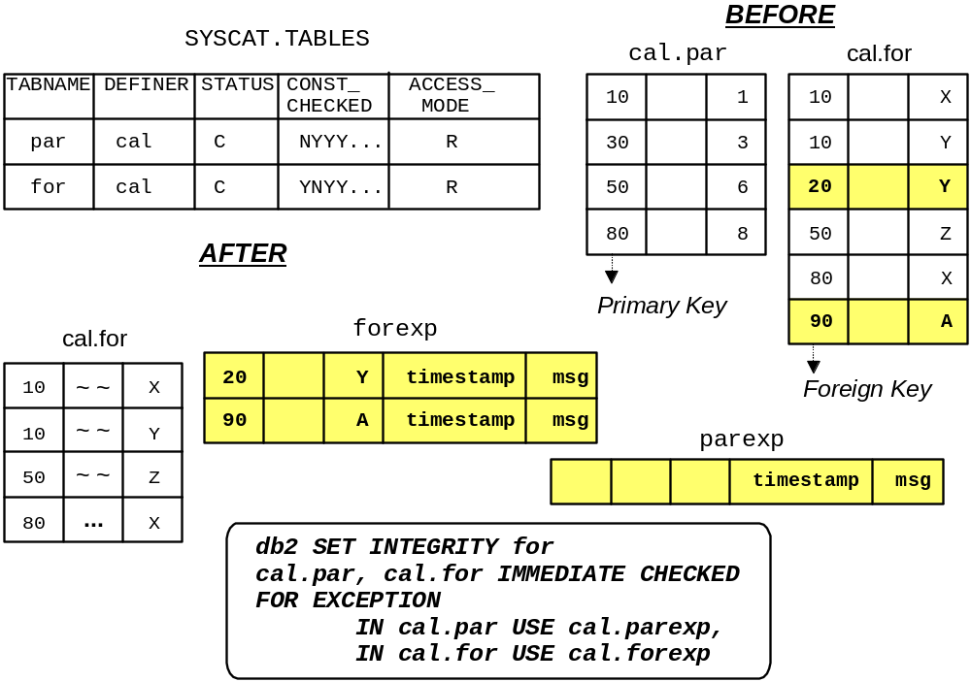
Example – Running Set Integrity

Slide 23
Meaningful steps for LOAD
Create tables and indexes
Create exception tables
Sort data
Back up TS/DB (if using REPLACE)
Consider freespace
Load .... for Exception ... Savecount ... Warningcount...
Examine xx.msg and dumpfile (after LOAD completes)
Examine exception tables (after LOAD completes)
Back up table space if log retain=recovery and COPY NO
Set Integrity for .... (only if table in Set Integrity Pending state)
Update statistics (if necessary)

Slide 24

db2move utility
Facilitates the moving/copying of large numbers
of tables between databases
Can be used with db2look to move/copy
a database between different platforms
(for example, AIX to Windows).
Usage: db2move <dbName> EXPORT/IMPORT/LOAD/COPY [options]
EXPORT: The system catalogs are queried, a list of tables is
compiled (based on the options), and the tables are exported in IXF format -- additionally, a file called db2move.lst is created
IMPORT: The db2move.lst file is used to import the IXF files
created in the EXPORT step
LOAD: The db2move.lst file is used to load the PC/IXF data files
created in the EXPORT step
COPY: Duplicates schema(s) into a target database
Tables

Slide 25
db2move COPY option
Copy one or more schemas between DB2 databases
  Uses a -co option to specify:
    Target Database:
    "TARGET_DB <db name> [USER <userid> USING <password>]"
    MODE:
      DDL_AND_LOAD - Creates all supported objects from the source schema, and populates the tables with the source table data. Default
      DDL_ONLY -Creates all supported objects from the source schema, but
      does not repopulate the tables.
      LOAD_ONLY- Loads all specified tables from the source database to the target database. The tables must already exist on the target.
    SCHEMA_MAP: Allows user to rename schema when copying to target
    TABLESPACE_MAP: Table space name mappings to be used
    Load Utility option: COPY NO or Nonrecoverable
    Owner: Change the owner of each new object created in the target schema

Slide 26
db2move COPY schema examples
To duplicate schema schema1
from source database dbsrc
to target database dbtgt, issue:
  db2move dbsrc COPY -sn schema1 -co TARGET_DB dbtgt
  USER myuser1 USING mypass1
To duplicate schema schema1
from source database dbsrc
to target database dbtgt and
rename the schema to newschema1 on
the target and map source table space ts1
to ts2 on the target, issue:
  db2move dbsrc COPY -sn schema1 -co TARGET_DB dbtgt
  USER myuser1 USING mypass1
  SCHEMA_MAP ((schema1,newschema1))
  TABLESPACE_MAP ((ts1,ts2), SYS_ANY))
Database dbsrc
db2move
Database dbtgt
Output files generated:
COPYSCHEMA.msg COPYSCHEMA.err LOADTABLE.msg LOADTABLE.err
These files are timestamped.

Slide 27
Online Table Move stored procedure
The ADMIN_MOVE_TABLE procedure is designed to move data from a source table to a target table with a minimal impact to application access
  Changes that can be made using ADMIN_MOVE_TABLE:
    New Data, Index or Long table spaces, which could have a different page size, extent size or type of table space management (like moving from SMS to Automatic Storage)
    Data compression could be implemented during the move
    MDC clustering can be added or changed
    Range partitions can be added or changed
    Distribution keys can be changed for Database partitioned tables
    Columns can be added, removed or changed
    Convert a row-organized table to column-organized
  Multiple phased processing allows write access to the source table except for a short outage required to swap access to the target table

Slide 28
ADMIN_MOVE_TABLE: Processing phases
SYSTOOLS.ADMIN_MOVE_TABLE
1
INIT PHASE
tabschema | tabname | key | value
Create triggers,target, staging tables
SOURCE
TABLE
TARGET
TABLE
2
c₁ | c₂ | … | c_{n}
COPY PHASE
c₁ | c₂ | … | c_{n}
3
REPLAY PHASE
INSERT
INSERT
c₁ | c₂ | … | c_{n}
DELETE
DELETE
Rows with keys present in staging table are
re-copied from source table
UPDATE
UPDATE
Online
Workload
Keys of
row changed by online workload
captured via
triggers
4
SWAP PHASE
STAGING
TABLE
Rename Target -> Source

Slide 29
ADMIN_MOVE_TABLE procedure methods
There are two methods of calling ADMIN_MOVE_TABLE:
  One method specifies the how to define the target table.
  >>-ADMIN_MOVE_TABLE--(--tabschema--,--tabname--,---------------->
  >--data_tbsp--,--index_tbsp--,--lob_tbsp--,--mdc_cols--,-------->
  .-,-------.
  V |
  >--partkey_cols--,--data_part--,--coldef--,----options-+--,----->
  >--operation--)------------------------------------------------><
  The second method allows a predefined table to be specified as the target for the move.
  >>-ADMIN_MOVE_TABLE--(--tabschema--,--tabname--,---------------->
  .-,-------.
  V |
  >--target_tabname--,----options-+--,--operation--)-------------><

Slide 30
Example: Move a table to new table space
CALL SYSPROC.ADMIN_MOVE_TABLE ( 'INST481', 'LOADHIST1', 'TSHISTM1','TSHISTM2','TSHISTM2',
NULL,NULL,NULL,NULL, 'COPY_USE_LOAD,FORCE','MOVE')
KEY VALUE
-------------------------------- -------------------------------
AUTHID INST481
CLEANUP_END 2014-05-12-02.58.44.712855
CLEANUP_START 2014-05-12-02.58.44.464132
COPY_END 2014-05-12-02.58.35.933404
COPY_OPTS LOAD,WITH_INDEXES,NON_CLUSTER
COPY_START 2014-05-12-02.58.29.844891
COPY_TOTAL_ROWS 110000
INDEXNAME LHIST1IX1
INDEXSCHEMA INST481
INDEX_CREATION_TOTAL_TIME 0
INIT_END 2014-05-12-02.58.28.012105
INIT_START 2014-05-12-02.58.24.682107
REPLAY_END 2014-05-12-02.58.43.853669
REPLAY_START 2014-05-12-02.58.35.939140
REPLAY_TOTAL_ROWS 0
REPLAY_TOTAL_TIME 3
STATUS COMPLETE
SWAP_END 2014-05-12-02.58.44.322158
SWAP_RETRIES 0
SWAP_START 2014-05-12-02.58.43.861629
UTILITY_INVOCATION_ID 0100000009000000080000000000000000002014051202582802481400000000
VERSION 10.05.0000

Slide 31
Using ADMIN_MOVE_TABLE to convert row-organized tables to a column-organized table
The ADMIN_MOVE_TABLE procedure can be used to convert row-organized tables to a column-organized table
To indicate conversion to a column-organized table you can specify ORGANIZE BY COLUMN as an option of ADMIN_MOVE_TABLE
For example:
call admin_move_table('TEST','ACCT2','AS2','AS2','AS2',
'ORGANIZE BY COLUMN', '','','','COPY_USE_LOAD','MOVE')
Specify COPY_USE_LOAD option to move data using a LOAD utility to generate the Column Dictionaries
Target table could be pre-defined as a column-organized table
Any Unique or Primary Key indexes on the source table will be added to the column-organized target table as enforced Unique or Primary Key constraints

Slide 32
Ingest Utility - for Continuous Data Ingest
The ingest utility is a high-speed client-side DB2 utility that streams data from files and pipes into DB2 target tables.
The ingest utility ingests pre-processed data directly or from files output by ETL tools or other means
It can run continually and thus it can process a continuous data stream through pipes.
The data is ingested at speeds that are high enough to populate even large databases in partitioned database environments
An INGEST command updates the target table with low latency in a single step
Uses row locking, so it has minimal interference with other user activities on the same table
These ingest operations support the following SQL statements: INSERT, UPDATE, MERGE, REPLACE, and DELETE
Other important features of the ingest utility include:
  Commit by time or number of rows.
  Support for copying rejected records to a file or table, or discarding them
  Support for restart and recovery.
The INGEST command supports the following input data formats:
  Delimited text
  Positional text and binary
  Columns in various orders and formats

Slide 33
Ingest command examples - Insert
The following example inserts data from a delimited text file with fields separated by a comma (the default).
The fields in the file correspond to the table columns.
INGEST FROM FILE my_file.txt
FORMAT DELIMITED
(
$field1 INTEGER EXTERNAL,
$field2 DATE 'mm/dd/yyyy',
$field3 CHAR(32)
)
INSERT INTO my_table
VALUES($field1, $field2, $field3);

Slide 34
Ingest command examples - Update
The following examples update the table rows whose primary key matches the corresponding fields in the input file.
INGEST FROM FILE my_file.txt
FORMAT DELIMITED
(
$key1 INTEGER EXTERNAL,
$key2 INTEGER EXTERNAL,
$data1 CHAR(8),
$data2 CHAR(32),
$data3 DECIMAL(5,2) EXTERNAL
)
UPDATE my_table
SET (data1, data2, data3) = ($data1, $data2, $data3)
WHERE (key1 = $key1) AND (key2 = $key2);

Slide 35
INGEST utility - Configuration parameters
Parameter | Range | Default | Description
COMMIT_COUNT | 0 to max 32-bit integer | 0 | Number of rows each flusher writes in a single transaction before issuing a commit.
COMMIT_PERIOD | 0 to 2,678,400 (31 days) | 1 second | Number of seconds between committed transactions.
NUM_FLUSHERS_ PER_PARITITON | See below. | See below. | Number of flushers to allocate for each database partition (0 means 1 flusher for all partitions)
NUM_FORMATTERS | 1 to max number of threads | max(1, (number of logical CPUs)/2) | The number of formatter threads.
PIPE_TIMEOUT | 0 to 2,678,400 seconds (31 days) | 600 seconds (10 minutes) | The maximum number of seconds to wait for data when the input source is a pipe (0 means wait indefinitely).
RETRY_COUNT | 0 to 1000 | 0 | The number of times to retry a failed (but recoverable) transaction.
RETRY_PERIOD | 0 to 2,678,400 seconds (31 days) | 0 | The number of seconds to wait before retrying a failed (but recoverable) transaction.
SHM_MAX_SIZE | 1 to available memory | 1 GB | Max size of IPC shared memory in bytes.

Slide 36
INGEST - Restart (1 of 2)
By default ingest jobs are restartable
If the utility terminates due to an error or a crash, you can use the job ID to restart it from the last commit point
The utility generates a job ID of the form DB21001:yyyymmdd.hhmmss.uuuuuu.sssss.ttttt, where
  DB21001 refers to DB2 V10.1
  yyyymmdd.hhmmss.uuuuuu is the utility start time
  sssss is the tablespace ID (from the catalog) as a positive integer
  ttttt is the table ID (from the catalog) as a positive integer
You can also specify a job ID on the RESTART parameter

Slide 37
INGEST - Restart (2 of 2)
Restart information is stored in a separate table (SYSTOOL.INGESTRESTART) that you create once
(similar to explain tables)
  To create the restart table
  CALL SYSPROC.SYSINSTALLOBJECTS('INGEST', 'C', NULL, NULL)
  The table does not contain copies of the data, only some counters to keep track of which records have been ingested
Restart is designed to have minimal overhead
You can also specify:
  RESTART CONTINUE to restart a previously failed job
  (and clean up the restart data)
  RESTART TERMINATE to clean up the restart data from a failed job you don't plan to restart
  RESTART OFF to suppress saving of restart information
  (in which case the ingest job is not restartable)

Slide 38
Monitoring INGEST using INGEST LIST and
INGEST GET STATS
=> INGEST LIST
Ingest job ID = DB2100000:20101116.123456.234567:34567:45678
Ingest temp job ID = 4
Database Name = MYDB
Input type = FILE
Target table = MY_SCHEMA.MY_TABLE
Start Time = 01/10/2012 11:54:45.773215
Running Time = 00:02:03
Number of records processed = 30,000
=> INGEST GET STATS FOR 4 EVERY 3 SECONDS
Ingest job ID = DB2100000:20101116.123456.234567:34567:45678
Database = MYDB
Target table = MY_SCHEMA.MY_TABLE
Overall Overall Current Current
ingest rate write rate ingest rate write rate Total records
(records/second) (writes/second) (records/second) (writes/second)
---------------- --------------- --------------- ---------------- ----------------
3333 65432 76543 87654 108765
3334 75432 86543 97654 118765
3335 85432 96543 107654 128765
etc (new row every 3 seconds until INGEST command ends)

Slide 39
When to use INGEST rather than LOAD
Use INGEST when any of the following is true
  You need other applications to update the table while it is being loaded
  The input file contains fields you want to skip over
  You need to specify an SQL statement other than INSERT
  You need to specify an SQL expression (to construct a column value from field values)
  You need to recover and continue on when the utility gets a recoverable error

Slide 40
When to use LOAD rather than INGEST
Use LOAD when any of the following is true
  You don't need other applications to update the table while it is being loaded
  You need to load a table that contains XML or LOB columns
  You need to load from cursor or load from a device
  You need to load from a file in IXF format
  You need to load a GENERATED ALWAYS column or SYSTEM_TIME column with the data specified in the input file

Slide 41
Demonstration 1
Moving data
Use the DB2 IMPORT command to load data into a DB2 table.
Run the INGEST command to efficiently load data into a DB2 table.
Invoke the LOAD utility to process input files and load data into DB2 tables.
Run SET INTEGRITY commands to resolve the set integrity pending conditions resulting from loading data into tables with constraints defined using a LOAD utility.

Slide 42
Unit summary
Discuss using the INSERT SQL statement to populate tables
Explain the differences between IMPORT and LOAD processing
Explain the EXPORT, IMPORT, and LOAD command options
Create and use Exception Tables and Dump-Files
Check table status using LOAD QUERY
Describe the ANALYZE phase of LOAD command processing used for loading BLU Acceleration, column-organized tables.
Check the Load Pending and Set Integrity Pending status for a table
Use the SET INTEGRITY command
Discuss the db2move and db2look commands
Use the ADMIN_MOVE_TABLE procedure to move a table to different table spaces
List some of the features of the Ingest utility for continuous data ingest

