Slide 1
Database maintenance, monitoring and problem determination
DB2 10.5 Administration Workshop for Windows

Slide 2
Unit objectives
Plan the use of RUNSTATS, REORGCHK and REORG utilities for maintaining database efficiency
Configure the DB2 instance to set the location for diagnostic data and message severity levels for basic problem analysis
Describe the methods that can be used for monitoring database and application activity including db2pd commands, Event Monitors and using SQL statements to access statistics
Describe the function of EXPLAIN and use this facility to assist basic analysis
Use the db2advis command to analyze a workload for potential performance improvements
Use the db2fodc command to collect diagnostic data for a system hang

Slide 3
Database Maintenance activities
Collecting table and index statistics
  The RUNSTATS command collects statistics for tables and indexes that are used to build efficient access plans
  New statistics can be manually collected when tables are loaded with new data or application update and delete rows.
  The database can be configured to automatically collect new statistics based on rates of changes and access
Tables and indexes can be reorganized
  The REORG command can be used to reorganize table and indexes either online or offline
  Reorganization may be used to improve the storage efficiency and reduce access costs
  The REORGCHK command can be used to suggest tables and indexes that would benefit from reorganization
  REORG can be used to implement compression for tables and indexes

Slide 4
RUNSTATS command examples
Collect basic statistics on the table and all indexes using sampling for the detailed index statistics collection:
RUNSTATS ON TABLE employee AND SAMPLED DETAILED INDEXES ALL
Collect table statistics on 1.5 percent of the data pages and index statistics on 2.5 percent of the index pages. Both table data pages and index pages are sampled:
RUNSTATS ON TABLE employee AND INDEXES ALL TABLESAMPLE SYSTEM(1.5) INDEXSAMPLE SYSTEM(2.5)
Collect statistics on table, with distribution statistics on columns empid, empname and empdept and the two indexes Xempid and Xempname. Distribution statistics limits are set individually for empdept, while the other two columns use a common default:
RUNSTATS ON TABLE employee WITH DISTRIBUTION ON COLUMNS (empid, empname, empdept NUM_FREQVALUES 50 NUM_QUANTILES 100) DEFAULT NUM_FREQVALUES NUM_QUANTILES 10 AND INDEXES Xempid, Xempname

Slide 5

Using REORGCHK to find tables that would benefit from reorganization
db2 reorgchk on schema auto
Table statistics:
F1: 100 * OVERFLOW / CARD < 5
F2: 100 * (Effective Space Utilization of Data Pages) > 70
F3: 100 * (Required Pages / Total Pages) > 80
SCHEMA NAME CARD OV NP FP ACTBLK TSIZE F1 F2 F3 REORG
------------------------------------------------------------------------------------
Table: AUTO.HIST1
AUTO HIST1 137619 0 4174 5427 - 9770949 0 44 76 -**
Table: AUTO.HIST2
AUTO HIST2 39612 0 1601 1602 - 2812452 0 43 99 -*-
Table: AUTO.HIST3
AUTO HIST3 136880 0 4918 4919 - 9718480 0 49 99 -*-
------------------------------------------------------------------------------------
* Indicates the potential for benefit from reorganization

Slide 6
Using REORGCHK to find indexes that would benefit from reorganization
Index statistics:
F4: CLUSTERRATIO or normalized CLUSTERFACTOR > 80
F5: 100 * (Space used on leaf pages / Space available on non-empty leaf pages) > MIN(50, (100 - PCTFREE))
F6: (100 - PCTFREE) * (Amount of space available in an index with one less level / Amount of space
required for all keys) < 100
F7: 100 * (Number of pseudo-deleted RIDs / Total number of RIDs) < 20
F8: 100 * (Number of pseudo-empty leaf pages / Total number of leaf pages) < 20
SCHEMA.NAME INDCARD LEAF ELEAF LVLS NDEL KEYS LEAF_RECSIZE NLEAF_RECSIZE
--------------------------------------------------------------------------------------------------
Table: RG.HIST1
Index: RG.HIST1IX1
137619 346 0 3 0 60728 4 4
Index: RG.HIST1IX2
137619 315 0 3 0 44671 4 4
Table: RG.HIST2
Index: RG.HIST2IX1
39612 337 0 3 0 25363 4 4
Table: RG.HIST3
Index: RG.HIST3IX1
136880 320 2 3 0 50 2 2
LEAF_PAGE_OVERHEAD NLEAF_PAGE_OVERHEAD F4 F5 F6 F7 F8 REORG
----------------------------------------------------------------
822 822 3 93 58 0 0 *----
822 822 3 93 64 0 0 *----
822 822 4 31 175 0 0 ***--
984 984 27 69 95 0 0 *----

Slide 7
Reorg Utility examples
Reorganize a table and all indexes offline using a temporary table space and rebuild the compression dictionary
reorg table rgcomp.history1 use tempspace1 resetdictionary
Reorganize a table online
reorg table rg.hist2 index rg.hist2ix1 inplace allow write access
Reorganize the indexes for a table, online
reorg indexes all for table rg.hist2 allow write access
Reorganize one partition of a range partitioned table
reorg table parttab.historypart INDEX PARTTAB.HISTPIX2 on data partition part0

Slide 8

Autonomic utilities
DB2 databases can be configured to automatically perform database maintenance:
  Periodic RUNSTATS ( Database CFG auto_runstats ) DEFAULT ON
    Real-time RUNSTATS ( Database CFG auto_stmt_stats ) DEFAULT ON
    Automatic Statistics collection for Statistical Views (Database auto_stats_views)
    Sampled Automatic RUNSTATS (Database auto_sampling )
  Automatic table and index reorganization ( Database CFG auto_reorg )
    Off by default for new databases
  Automatic database backup ( Database CFG auto_db_backup )
    Off by default for new databases
Database level policies set time windows when processing is permitted and utility options like table size limits for reorganization and tables to include or exclude

Slide 9
Monitoring a DB2 database
Database monitoring is a vital activity for the maintenance of the performance and health of your database
DB2 collects information so you can perform the following types of tasks:
  Forecast hardware requirements based on database usage patterns.
  Analyze the performance of individual applications or SQL queries.
  Track the usage of indexes and tables.
  Pinpoint the cause of poor system performance.
  Assess the impact of optimization activities, for example, altering database manager configuration parameters, adding indexes, or modifying SQL queries.
Commands for monitoring: db2pd, LIST APPLICATIONS
Monitoring using SQL statements
Capture information for analysis using EVENT monitors

Slide 10
db2pd - Monitor and troubleshoot DB2
-applications -agents -transactions -bufferpools -logs -locks
-tablespaces -dynamic -static -fcm -mempools -memsets
-dbmcfg -dbcfg -catalogcache -sysplex -tcbstats -reorg
-recovery -reopt -osinfo -hadr -utiltiies -workloads
-workclasses -thresholds -serviceclasses -ha -statisticscache -wlocks
db2pd -db tp1 -bufferpools
Database Member 0 -- Database TP1 -- Active -- Up 0 days 00:28:44 -- Date 02/06/2013 15:45:43
Bufferpools:
First Active Pool ID 1
Max Bufferpool ID 4
Max Bufferpool ID on Disk 4
Num Bufferpools 8
Address Id Name PageSz PA-NumPgs BA-NumPgs BlkSize NumTbsp … Automatic
0x909EC9D0 1 IBMDEFAULTBP 4096 2000 0 0 5 … False
0x909F4D40 2 TP1H16K 16384 1000 0 0 2 … False
0x909FD0B0 3 TP1ADATA 4096 7000 0 0 1 … False
0x90A05420 4 TP1AINDX 4096 6000 0 0 1 … False
0x909CBC10 4096 IBMSYSTEMBP4K 4096 16 0 0 0 … False
0x909D3F80 4097 IBMSYSTEMBP8K 8192 16 0 0 0 … False
0x909DC2F0 4098 IBMSYSTEMBP16K 16384 16 0 0 0 … False
0x909E4660 4099 IBMSYSTEMBP32K 32768 16 0 0 0 … False

Slide 11


Using db2pd to check reorg statistics when a reorg fails to complete
Report shows REORG did not complete Build phase processing
db2pd –db MUSICDB -reorg
Database Member 0 -- Database MUSICDB -- Active -- Up 0 days 00:00:46 -- Date 2013-10-24-09.23.24.781628
Table Reorg Information:
Address TbspaceID TableID PartID MasterTbs MasterTab TableName Type IndexID TempSpaceID
0x00007F6C60937C78 11 4 n/a n/a n/a HIST1 Offline 1 11
Table Reorg Stats:
Address TableName Start End PhaseStart
0x00007F6C60937C78 HIST1 10/24/2013 09:22:40 10/24/2013 09:22:42 10/24/2013 09:22:41
MaxPhase Phase CurCount MaxCount Status Completion
4 Build 1967 5426 Stopped

Slide 12
Using DB2 table functions in SQL statements for Monitoring (1 of 2)
Use monitor table functions to collect and view data for systems, activities, or data objects.
Data for monitored elements are continually accumulated in memory
You can choose to receive data for a single object (for example, a table TABLE1) or for all objects
Monitoring system information - Encompasses the complete volume of work and effort expended by the data server to process application requests
  For example using MON_GET_CONNECTION or MON_GET_DATABASE
Monitoring activities -In the context of SQL statements, the term activity refers to the execution of the section for a SQL statement
  For example using MON_GET_ACTIVITY_DETAILS or MON_GET_PKG_CACHE_STMT

Slide 13
Using DB2 table functions in SQL statements for Monitoring (2 of 2)
Monitoring data objects -The data object monitoring perspective provides information about operations performed on data objects
  For example MON_GET_TABLE, MON_GET_INDEX and MON_GET_BUFFERPOOL
Monitor Locking - You can retrieve information about locks
  For example using MON_GET_LOCKS and MON_GET_APPL_LOCKWAIT
Monitoring system memory
  You can retrieve information about system memory usage using MON_GET_MEMORY_SET or MON_GET_MEMORY_POOL

Slide 14
Using the MON_GET_TABLE function for table performance statistics
select varchar(tabname,15) as table,
varchar(tabschema,10) as schema,
rows_read, table_scans, rows_inserted, rows_updated from
table(MON_GET_TABLE('INST411',null,-1)) as mtab
where rows_read > 100 order by rows_read desc
TABLE SCHEMA ROWS_READ TABLE_SCANS ROWS_INSERTED ROWS_UPDATED
--------------- ---------- ----------- ------------- ------------- ------------
HISTORY INST411 1168373 5 3365 0
ACCT INST411 650174 4 0 3365
TELLER INST411 9730 0 0 3365
BRANCH INST411 3365 0 0 3365
4 record(s) selected.

Slide 15
Monitoring wait times for active connections using MON_GET_CONNECTION
SELECT application_handle as appl_id ,
total_wait_time ,
pool_read_time, pool_write_time,
log_disk_wait_time,
lock_wait_time
FROM TABLE(MON_GET_CONNECTION(NULL,-1) )
ORDER BY total_wait_time
Check for total wait time
And most common reasons for delays
APPL_ID TOTAL_WAIT_TIME POOL_READ_TIME POOL_WRITE_TIME
-------------------- -------------------- -------------------- --------------------
247 486 292 1
248 166662 82517 5205
250 166702 83088 4695
249 166897 81330 5341
251 166953 82397 4840
LOG_DISK_WAIT_TIME LOCK_WAIT_TIME
-------------------- --------------------
0 0
73175 897
72975 718
74581 1059
74166 1158

Slide 16
LIST APPLICATIONS command
db2 LIST APPLICATIONS FOR DATABASE db_alias SHOW DETAIL
Auth Id Application Name Appl. Application Id
Handle
-------- -------------------- -------- ---------------------------
INST00 db2bp_32 78 *LOCAL.inst00.000327220543
Seq#
Number of
Coordinating Coordinating Status Status
Agents
Node Number pid/thread Change Time
---- ---------- ------------ ------------ -------------- --------------
0001 1 0 230 UOW Waiting Not Collected
Node
DBName
DB Path
------- ------- --------------------------------------
0 MUSICDB /home/inst00/inst00/NODE0000/SQL00001/

Slide 17
DB2 Event Monitors
The CREATE EVENT MONITOR statement defines a monitor that will record certain events that occur when using the database, the definition of each event monitor also specifies where the database should record the events.
Examples of event monitor types:
Activities – this can be used to capture the statistics for SQL statements executed
Locking – can be used to track deadlocks, lock timeouts and lock waits
Package cache – saves the statistics from dynamic and static statements when they are removed from database memory
Statistics – saves the statistics for various workload management categories, like workloads and service classes
Threshold violations – used to record workload management threshold violation events that occur when using the database
Unit of work. Record transaction level statistics when a unit of work completes
Change History - can record events for changes to configuration parameters, registry variables, and the execution of DDL statements and utilities.

Slide 18
CREATE and use an activities Event Monitor
To create an activities event monitor called wlmactivity that saves information in a set of tables:
CREATE EVENT MONITOR wlmactivity
FOR ACTIVITIES WRITE TO TABLE
CONTROL (TABLE CONTROL_wlmactivity in tp1event ),
ACTIVITY (TABLE ACTIVITY_wlmactivity in tp1event ), ACTIVITYSTMT (TABLE ACTIVITYSTMT_wlmactivity in tp1event ), ACTIVITYVALS (TABLE ACTIVITYVALS_wlmactivity in tp1event );
To begin collecting events with this event monitor
SET EVENT MONITOR wlmactivity STATE 1
To stop collecting events with this event monitor
SET EVENT MONITOR wlmactivity STATE 0

Slide 19
Sample Activities Monitor report
SELECT wlm_activity.QUERY_CARD_ESTIMATE,
wlm_activity.ROWS_RETURNED,
abs(wlm_activity.QUERY_CARD_ESTIMATE - wlm_activity.ROWS_RETURNED) as estimate_error,
wlm_activity.POOL_DATA_L_READS + wlm_activity.POOL_INDEX_L_READS as logical_reads,
wlm_activity.TOTAL_SORTS,
substr(wlm_stmt.STMT_TEXT,1,100) as sql_text
FROM ACTIVITYSTMT_WLMACTIVITY AS wlm_stmt,
ACTIVITY_WLMACTIVITY AS wlm_activity
WHERE wlm_stmt.APPL_ID = wlm_activity.APPL_ID
AND wlm_stmt.ACTIVITY_ID = wlm_activity.ACTIVITY_ID
AND wlm_stmt.UOW_ID = wlm_activity.UOW_ID
ORDER BY 3 DESC
QUERY_CARD_ESTIMATE ROWS_RETURNED ESTIMATE_ERROR LOGICAL_READS TOTAL_SORTS SQL_TEXT
-------------------- -------------- --------------- ---------------- ---------------- -----------------
9857 27694 17837 30208 1
SELECT BRANCH_ID, TELLER_ID, ACCT_ID, BALANCE, ACCTNAME FROM HISTORY WHERE BRANCH_ID < 20 AND
103232 107634 4402 2401 2
SELECT BRANCH_ID, TELLER_ID, ACCT_ID, BALANCE, ACCTNAME FROM HISTORY WHERE TELLER_ID BETWE
5136 1471 3665 743 2
SELECT BRANCH_ID, TELLER_ID, ACCT_ID, BALANCE, ACCTNAME FROM HISTORY WHERE BRANCH_ID = 50
5136 1471 3665 743 2
SELECT * FROM HISTORY WHERE BRANCH_ID = 50 ORDER BY TELLER_ID ASC
5 18 13 53 1
SELECT * FROM HISTORY WHERE BRANCH_ID = 10 and teller_id = 200

Slide 20
DB2 Optimizer
SQL STATEMENTS
Optimizer checks authorizations, determines
what data is requested, and from statistics,
determines an access plan
ALTERNATE
COST
ALGORITHMS
STATISTICS
DB2
CATALOG
Then selects one
The Optimizer Chooses:
The order in which tables are accessed
Which index to use
The join method
The type of scan required
PACKAGE
(Access Path)

Slide 21

Design Advisor
Assists in finding the right indexes, MQTs or MDC:
  Based on workload
  Virtual indexes
Reduce complexity of performance analysis and tuning
db2advis command estimates benefits of suggested changes
?
New INDEXES
?
Materialized
Query Table
Multidimensional
Clustering
Tables
?
Distribution Key selection for
Table in a Partitioned Database
?

Slide 22
Design Advisor: db2advis command
db2advis -d tp1 -i advisesql.txt -disklimit 3 -o newindex.ddl > adviseout.txt
execution started at timestamp 2012-05-08-12.35.56.878972
found [5] SQL statements from the input file
Recommending indexes...
total disk space needed for initial set [ 5.780] MB
total disk space constrained to [ 3.000] MB
Trying variations of the solution set.
Optimization finished.
1 indexes in current solution
[5055.0000] timerons (without recommendations)
[3055.0000] timerons (with current solution)
[39.56%] improvement
--
-- LIST OF RECOMMENDED INDEXES
-- ===========================
-- index[1], 0.403MB
CREATE INDEX "INST481 "."IDX1205081644270" ON "INST481 "."HISTORY"
("TELLER_ID" ASC, "BRANCH_ID" DESC) ALLOW REVERSE
SCANS COLLECT SAMPLED DETAILED STATISTICS;
COMMIT WORK ;
-- RECOMMENDED EXISTING INDEXES
-- ============================
-- RUNSTATS ON TABLE "INST481 "."HISTORY" FOR SAMPLED DETAILED INDEX "INST481 "."HISTIX1" ;
-- COMMIT WORK ;
Estimated Performance Improvement
Sample DDL for
Solutions

Slide 23
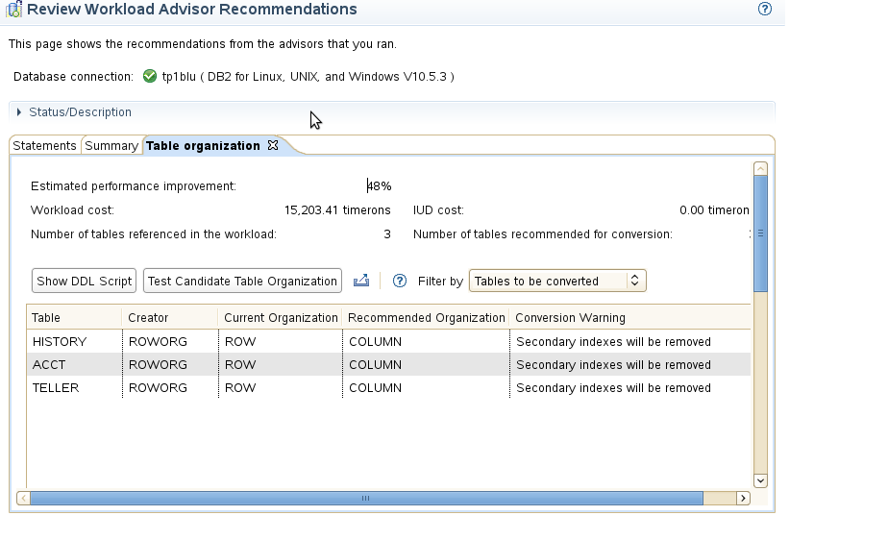
Using Infosphere Optim Query Workload Tuner to estimate performance benefits for BLU Acceleration
Suggests converting three tables
to BLU Acceleration will reduce costs 48%

Slide 24
EXPLAIN facility tools
Requirements
Visual
Explain
SQL Access to Explain Tables
db2exfmt
db2expln
GUI interface
Text output
Quick and dirty static SQL
analysis
Static SQL supported
Dynamic SQL supported
CLI applications supported
Requires Explain Tables
Detailed optimizer
information
Suited for analysis of
multiple statements
Information available from
within application

Slide 25
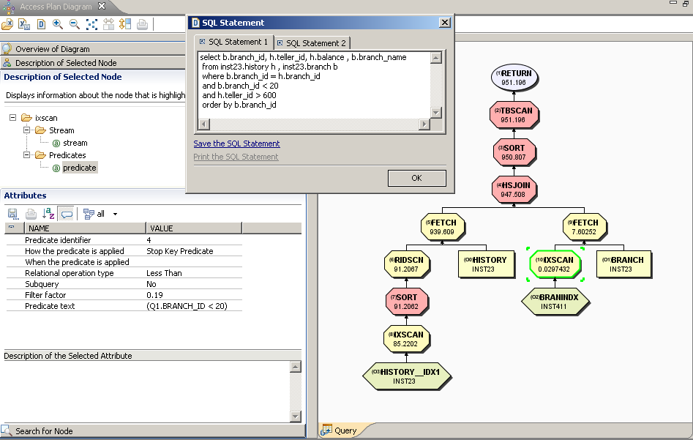
Visual Explain access plan for SQL
Original query
text
Result with
costs
Operator
node
Table
Reference
Object node
(index)

Slide 26
db2exfmt – detailed text explain report
Original Statement:
------------------
SELECT
BRANCH_ID,
TELLER_ID,
ACCT_ID,
BALANCE,
ACCTNAME
FROM test.HISTORY
WHERE branch_id = 20 and
teller_id between 100 and 180
Rows
RETURN
( 1)
Cost
I/O
|
162.025
FETCH
( 2)
33.3962
4.89539
/---+----\
162.025 200000
IXSCAN TABLE: TEST
( 3) HISTORY
13.7123 Q1
2
|
200000
INDEX: TEST
HISTIX
Q1
Estimated result cardinality
Estimated cost
Cumulative
Estimated I/O cost Cumulative
Access Plan:
-----------
Total Cost: 33.3962
Query Degree: 1
Cumulative Total Cost: 33.3962
Cumulative CPU Cost: 536896
Cumulative I/O Cost: 4.89539
Cumulative Re-Total Cost: 0.227469
Cumulative Re-CPU Cost: 437796
Cumulative Re-I/O Cost: 0
Cumulative First Row Cost: 20.3397
Estimated Bufferpool Buffers: 5.89539

Slide 27
Creating Explain tables
Sample DDL for Explain and Design Advisor provided in a file named EXPLAIN.DDL:
  Found in sqllib/misc
  Add IN <tablespace-name> to each CREATE TABLE
Use SYSINSALLOBJECTS procedure
Syntax
  >>-SYSINSTALLOBJECTS--(--tool-name--,--action--,---------------->
  >--tablespace-name--,--schema-name--)--------------------------><
  To create a new set of explain tables
  db2 CALL SYSPROC.SYSINSTALLOBJECTS(‘EXPLAIN','C', ‘TSEXPLAIN’, ‘DBA1’)
  To migrate a set of explain tables to a new release
  db2 CALL SYSPROC.SYSINSTALLOBJECTS(‘EXPLAIN',‘M', NULL , ‘DBA1’)

Slide 28
Automatic database memory management
To enable self tuning memory management
db2 update db cfg using SELF_TUNING_MEM ON
Database Overflow Buffer
Database Overflow Buffer
DB Heap
(log buffer)
Catalog Cache
Utility Heap
DB Heap
(log buffer)
Catalog Cache
Utility Heap
Package Cache
Sort Memory
Locklist
Package Cache
Sort Memory
Locklist
Buffer Pools
Buffer Pools
BP 1
BP 2
BP 3
BP 4
BP 1
BP 2
BP 3
BP 4
db2 UPDATE DB CFG FOR SALESDB USING LOCKLIST AUTOMATIC
db2 ALTER BUFFERPOOL BP3 SIZE AUTOMATIC

Slide 29
Monitoring Database memory usage using the table function MON_GET_MEMORY_POOL
SELECT VARCHAR(MEMORY_POOL_TYPE,20) AS POOL_TYPE, MEMORY_POOL_USED, MEMORY_POOL_USED_HWM
FROM TABLE (MON_GET_MEMORY_POOL ('DATABASE',NULL,NULL) ) AS TMEM
POOL_TYPE MEMORY_POOL_USED MEMORY_POOL_USED_HWM
-------------------- -------------------- --------------------
UTILITY 65536 65536
PACKAGE_CACHE 524288 917504
XMLCACHE 131072 131072
CAT_CACHE 393216 393216
BP 16908288 16908288
BP 52166656 52166656
BP 851968 851968
BP 589824 589824
BP 458752 458752
BP 393216 393216
SHARED_SORT 196608 262144
LOCK_MGR 2228224 2228224
DATABASE 60489728 60489728

Slide 30
Configuration for Diagnostic files
DBM configuration parameters
NOTIFY LEVEL: (0-4, default 3)
0 — No administrative notification messages captured
1 — Fatal or unrecoverable errors
2 — Immediate action required
3 — Important information, no immediate action required
4 — Informational messages
DIAGLEVEL: (0-4, default 3)
0 — No diagnostic data captured
1 — Severe errors only
2 — All errors
3 — All errors and warnings
4 — All errors, warnings, and
informational messages
DIAGPATH: Valid directory path, might contain
  Notification file
  Error log
  Dump files
  Trap files
DIAGSIZE: Can be used to limit size for diagnostic messages
If DIAGSIZE is > 0 a set of diagnostic message files are used
Naming used: db2diag.x.log and <instance>.x.nfy

Slide 31

db2diag.log message examples
2012-05-12-02.44.16.760595-240 E46785G1135 LEVEL: Error
PID : 14465 TID : 2877287328 PROC : db2sysc 0
INSTANCE: inst481 NODE : 000 DB : MUSICDB
APPHDL : 0-7 APPID: *LOCAL.inst481.120512063958
AUTHID : INST481 HOSTNAME: ibmclass
EDUID : 36 EDUNAME: db2lfrm0 0
FUNCTION: DB2 UDB, buffer pool services, sqlbAllocateExtent, probe:987
MESSAGE : ADM6044E The DMS table space "LOADTSPD" (ID "11") is full. If this is an autoresize or automatic storage DMS tablespace, the maximum table space size may have been reached or the existing containers or storage paths cannot grow any more. Additional space can be added to the table space by either adding new containers or extending existing ones using the ALTER TABLESPACE SQL statement. If this is an autoresize or automatic storage DMS table space, additional space can be added by adding containers to an autoresize table space or by adding new storage paths to the storage group it is using.
2012-05-12-02.44.16.889302-240 I57251G525 LEVEL: Severe
PID : 14465 TID : 2896161696 PROC : db2sysc 0
INSTANCE: inst481 NODE : 000 DB : MUSICDB
APPHDL : 0-7 APPID: *LOCAL.inst481.120512063958
AUTHID : INST481 HOSTNAME: ibmclass
EDUID : 18 EDUNAME: db2agent (MUSICDB) 0
FUNCTION: DB2 UDB, database utilities, call_sqluvload, probe:1748
MESSAGE : Load Error: Load failed for table INST481 .LOADHIST1 in tablespace 11

Slide 32
Diagnostic Log Analysis tool: db2diag
Command line tool for filtering and formatting db2diag.log files:
  Complex set of options, reflecting wide variety of filtering and analysis
  Ability to use grep-like filtering to reduce the number of records returned
Changes to DB2 registry variables (db2set) and DB or DBM configuration parameters are logged to db2diag.log file as event records.
To display severe errors logged for the last three days, enter: db2diag -gi "level=severe" -H 3d
To display all log messages not matching the pdLog pattern for the funcname field, enter:
db2diag -g 'funcname!=pdLog'

Slide 33
First occurrence data capture (FODC)
FODC is a facility to capture information on the first occurrence of a DB2 server problem
A package of information is created when a problem occurs on the DB2 server
FODC package provided by customer to DB2 support
db2support tool used to collect the package
Helps maximize the chances that DB2 support will be able to help resolve the problem after the first occurrence
You can use the db2fodc command to perform a first occurrence data collection

Slide 34
db2fodc - DB2 first occurrence data collection command
db2fodc command can be used for manual first occurrence data collection (FODC) on problems that cannot trigger automatic FODC, such as hangs or severe performance problems.
  The db2fodc tool captures data, to be included in the FODC package, and places it inside an FODC package directory
  Either in the default diagnostic path or in an FODC directory path you specify using the -fodcpath parameter
Examples:
  To collect data from a specific database:
    db2fodc –db SAMPLE -hang
    Data collection is restricted to database SAMPLE. A new directory prefixed with FODC_Hang_ is automatically created under the current diagnostic path.
  To collect data during a performance issue from a specific database using the full collection script:
    db2fodc –db SAMPLE -perf full
    Data collection is restricted to database SAMPLE. A new directory prefixed with FODC_Perf_ is created under the current diagnostic path

Slide 35
Obtaining a DB2 trace using db2trc
The db2trc command controls the trace facility provided with DB2.
The trace facility records information about operations and formats this information into a readable form.
Keep in mind that there is additional processor usage when a trace is running so enabling the trace facility might impact your system's performance.
In general, IBM Software Support and development teams use DB2 traces for troubleshooting
It is important to know how to correctly turn on tracing and how to dump trace files, just in case you are asked to obtain them.
You will need one of SYSADM, SYSCTRL or SYSMAINT authority to use db2trc
The following is an example of the common sequence of db2trc commands:
db2trc on -l 8M
db2trc clr
<Execute problem recreation commands>
db2trc dump db2trc.dmp
db2trc off
db2trc flw db2trc.dmp <filename>.flw
db2trc fmt db2trc.dmp <filename>.fmt
db2trc fmt -c db2trc.dmp <filename>.fmtc

Slide 36

Need more information?
CL463: DB2 10.5 for LUW Advanced Database Administration with DB2 BLU Acceleration (five days with labs)
CL413: DB2 for LUW Performance Tuning and Monitoring Workshop (four days with labs)

Slide 37
Demonstration 1
Using DB2 tools for performance
Use an explain tool to analyze the access plan for an SQL statement.
Create an index for a table to reduce processing costs for SQL.
Invoke the DB2 Design Advisor to suggest new indexes for an SQL workload.
Use the DB2 RUNSTATS and REORG commands to reorganize a table based on an index and collect new catalog statistics.

Slide 38
Unit summary
Plan the use of RUNSTATS, REORGCHK and REORG utilities for maintaining database efficiency
Configure the DB2 instance to set the location for diagnostic data and message severity levels for basic problem analysis
Describe the methods that can be used for monitoring database and application activity including db2pd commands, Event Monitors and using SQL statements to access statistics
Describe the function of EXPLAIN and use this facility to assist basic analysis
Use the db2advis command to analyze a workload for potential performance improvements
Use the db2fodc command to collect diagnostic data for a system hang

