Slide 1
Locking and concurrency
DB2 10.5 Administration Workshop for Windows
Notes:
© Copyright IBM Corporation 2012

Slide 2
Unit objectives
Explain why locking is needed
List objects that can be locked
Describe and discuss the various lock modes and their compatibility
Explain four different levels of data protection
Set isolation level and lock time out for current activity
Explain lock conversion and escalation
Describe the situation that causes deadlocks
Create a LOCKING EVENT monitor to collect lock related diagnostics
Set database configuration options to control locking event capture

Slide 3
Why perform locking?
Anomaly | Description
Dirty Write | A transaction modifies uncommitted data that was modified by another transaction which has not yet performed a COMMIT or ROLLBACK
Dirty Read | A transaction reads data that was modified by another transaction which has not yet performed a COMMIT or ROLLBACK
Fuzzy Read Non-repeatable Read | A transaction that reads data does not see the same data which it had seen earlier.
Phantom Read | A transaction that is reading data sees new data later in the same transaction. This occurs when another transaction inserts or updates data that would satisfy the transactions query
DB2 Applications request an isolation level based on need to avoid these anomalies

Slide 4
Objects that might be locked
Table space locks are mainly used to control concurrent execution for utilities like BACKUP, LOAD, REORG
For standard tables, DB2 will acquire a table lock and might also perform row locking
For Multidimensional Cluster (MDC) tables, locking might also be performed at the block (extent) level
For range-partitioned tables, locking might be performed at the data partition level
Table
Lock
Row Locks
Table
Lock
Block
Locks
Row Locks
Table
Lock
Data Range lock
Row Locks

Slide 5
Table lock modes
IN Intent None
IS Intention Share
IX Intention eXclusive
SIX Share with Intention eXclusive
S Share
U Update
X eXclusive
Z superexclusive
Row Locking also used
Strict Table Locking
(See next page)

Slide 6
Row lock modes
Row Lock
Minimum* Supporting
Table Lock
S
Share
IS
U
Update
IX
X
eXclusive
IX
W
Weak exclusive
IX
NS
Next key Share
IS
NW
Next key Weak exclusive
IX
DB2 does not need to acquire
Row locks
if one of these locks is held at a higher level (table,block)
S, U, X, or Z

Slide 7
Lock mode compatibility
MODE OF
MODE OF LOCK B
LOCK A
IN
IS
S
IX
SIX
U
X
Z
IN
YES
YES
YES
YES
YES
YES
YES
NO
IS
YES
YES
YES
YES
YES
YES
NO
NO
S
YES
YES
YES
NO
NO
YES
NO
NO
Table Locks
IX
YES
YES
NO
YES
NO
NO
NO
NO
SIX
YES
YES
NO
NO
NO
NO
NO
NO
U
YES
YES
YES
NO
NO
NO
NO
NO
X
YES
NO
NO
NO
NO
NO
NO
NO
Z
NO
NO
NO
NO
NO
NO
NO
NO
LOCK
MODE OF LOCK B
A
MODE
S
U
X
W
NS
NW
S
YES
YES
NO
NO
YES
NO
U
YES
NO
NO
NO
YES
NO
Row Locks
X
NO
NO
NO
NO
NO
NO
W
NO
NO
NO
NO
NO
YES
NS
YES
YES
NO
NO
YES
YES
NW
NO
NO
NO
YES
YES
NO

Slide 8
Selecting isolation levels (1 of 2)
An isolation level determines how data is locked or isolated from other processes while the data is being accessed
DB2 provides different levels of protection to isolate data:
  Uncommitted read (UR)
  Cursor stability (CS) – (default) locking behavior depends on CUR_COMMIT in database configuration:
    ON: Read-only access will not acquire row level locks
    AVAILABLE: Applications can select currently committed mode to avoid row locking
    DISABLE: Read-only access will acquire row level locks (Pre-DB2 9.7 mode)
  Read stability (RS)
  Repeatable read (RR)

Slide 9
Selecting isolation levels (2 of 2)
Isolation level can be specified for a session, a client connection, or an application before a database connection, or for a specific SQL statement:
  For embedded SQL: The level is set at bind time
  For dynamic SQL: The level is set at run time
  SELECT … WITH UR | CS | RS | RR
      select * from prod.department with UR
  SET CURRENT ISOLATION
      Set current isolation RS

Slide 10
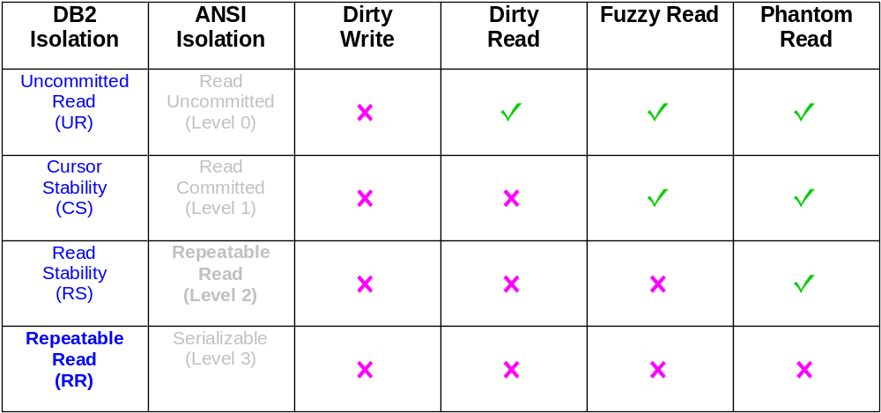
DB2 and ANSI isolation levels:
How anomalies are allowed or prevented

Slide 11
Locking for read-only access
Isolation Level | Locking methods for Read-only access | Access allowed to uncommitted changes
Uncommitted Read | IN – Table lock No Row locks for Read-Only access Uncommited rows accessed from buffer pool | Yes
Cursor Stability Using Currently Committed | IS – Table lock No Row locks for Read-only access Old version of rows with uncommitted changes read from log records | No
Cursor Stability Not using Currently Committed | IS - Table lock NS Row lock held on current row in result set Lock wait used to delay access to uncommitted changes, in buffer pool. | No
Read Stability | IS - Table lock NS Row locks held on result set until commit Lock wait used to delay access to uncommitted changes, in buffer pool. | No
Repeatable Read | IS - Table lock S Row locks held on all rows accessed until commit Lock wait used to delay access to uncommitted changes, in buffer pool. | No

Slide 12
How Currently Committed works for CS isolation
Application A
Updates several rows
New data in buffer pool
Application B
Reads Committed rows using log data when needed
Buffer pools
Log Buffer
200 new
300 new
Read Only
200 old
200 new
201 new
301 new
Committed
Update
Log Reader
Log Writer
100
101
Uncommitted
Update
I/O Servers
Page Cleaners
Active Log Files
100
300 old
300 new
300 old
301 new
201 new
201 new
201 old
301 new
301 old
101
200 old
Table space
Containers
Archived logs will not be accessed
to retrieve committed data row

Slide 13
LOCK TABLE statement
IS
IX
S
X
S
Database Manager
X
S
determined strategy
X
Application issues:
LOCK TABLE name
IN MODE
SHARE
EXCLUSIVE
S
X
—or—
Administrator alters table:
ALTER TABLE test.department
LOCKSIZE {TABLE | ROW}

Slide 14
Setting LOCKLIST and MAXLOCKS to control
Lock escalations
LOCKLIST and MAXLOCKS can be configured as AUTOMATIC to use
DB2 self tuning memory management
m
e
a
x
locklist
x
c
l
e
. . . . . . . . . .
o
e
X
c
d
X
k
e
maxlocks
s
d
. . . . . . . . .
X
IX
X
ESCALATING APPLICATION
OTHER APPLICATIONS
X
X
IX
l
X
o
locklist
c
f
k
u
. . . . . . . . . . . .
l
l
. . . . . . . . . .
i
l
. . . . . . . . . . . .
s
t

Slide 15
Lock wait and timeout
Database CFG
option
locktimeout
12
30
9
3
I just want
that one!
6
-1
x
x
x
x
x
x
LOCK
HOG
x
W A I T !
x
x
x
x
x
x
x
x
If the application hogging the locks
does not COMMIT or ROLLBACK,
other applications wait until lock is
available or timeout exceeded
Applications can use the SET CURRENT LOCK TIMEOUT statement to override
the database configuration default.

Slide 16
Using db2pd to look for active lock wait conditions
db2pd -db musicdb -wlock detail
Database Member 0 -- Database MUSICDB -- Active -- Up 0 days 00:08:39 -- Date 2014-09-11-10.17.36.928742
Locks being waited on :
AppHandl [nod-index] TranHdl Lockname Type Mode Conv Sts
679 [000-00679] 3 090004001B0001000000000052 RowLock ..X G
688 [000-00688] 11 090004001B0001000000000052 RowLock .NS W
CoorEDU AppName AuthID AppID TableNm SchemaNm AppNode
523 db2bp INST28 *LOCAL.inst28.140911140857 STOCK MUSIC ibmclass
554 db2bp USER28 *LOCAL.inst28.140911141135 STOCK MUSIC ibmclass

Slide 17




Deadlock causes and detection
LOCKLIST
 | A
 | B
UPDATE … artists
WHERE ARTNO = 10
UPDATE … albums
WHERE ARTNO = 10
wait
UPDATE … albums
WHERE ARTNO = 10
wait
UPDATE … artists
WHERE ARTNO = 10
DB2 checks the locklist for wait conditions that can create a deadlock between two or more applications
dlchktime
10000
milliseconds

Slide 18
Monitoring active lock waits with SQL
select substr(lw.hld_application_name,1,10) as "Hold App",
substr(lw.hld_userid,1,10) as "Holder",
substr(lw.req_application_name,1,10) as "Wait App",
substr(lw.req_userid,1,10) as "Waiter",
lw.lock_mode ,
lw.lock_object_type ,
substr(lw.tabname,1,10) as "TabName",
substr(lw.tabschema,1,10) as "Schema",
lw.lock_wait_elapsed_time
as "waiting (s)"
from
sysibmadm.mon_lockwaits lw ;
Who is holding the lock?
Who is waiting on the lock?
How long is the wait?
Hold App Holder Wait App Waiter LOCK_MODE LOCK_OBJECT_TYPE TabName Schema waiting (s)
---------- ---------- ---------- ---------- --------- ------------------ -------- ------- -----------
db2bp INST461 db2bp INST461 X TABLE HIST1 CLPM 61

Slide 19
Using SQL to monitor Lock escalations, deadlocks and timeouts for active connections
Select substr(conn.application_name,1,10) as Application,
substr(conn.system_auth_id,1,10) as AuthID,
conn.num_locks_held as "# Locks",
conn.lock_escals as "Escalations",
conn.lock_timeouts as "Lock Timeouts",
conn.deadlocks as "Deadlocks",
(conn.lock_wait_time / 1000) as "Lock Wait Time"
from table(MON_GET_CONNECTION(NULL,-1)) as conn ;
APPLICATION AUTHID # Locks Escalations Lock Timeouts
----------- ---------- -------------------- -------------------- ------------------
db2bp INST461 2 0 0
db2bp INST461 2 1 0
db2bp INST461 3 0 0
Deadlocks Lock Wait Time
-------------------- --------------------
0 0
0 0
0 209

Slide 20
Lock Event Monitoring: Part 1
DB2 provides a LOCKING Event monitor that can be used to capture diagnostic information
The data collection can be configured at the database level:
  Deadlocks
    mon_deadlock - Controls the generation of deadlock events at the database
    level for the Lock Event Monitor.
  Lock timeouts
    mon_locktimeout - Controls the generation of lock timeout events at the database level for the Lock Event Monitor.
  Lock waits longer than a defined limit:
    mon_lockwait - Controls the generation of lock wait events at the database
    level for the Lock Event Monitor.
    mon_lw_thresh - Controls the amount of time spent in lock wait before an
    event for mon_lockwait is generated.
Collection options for lock events can be set based on DB2 WLM workload definitions

Slide 21
Lock Event Monitoring: Part 2
Create a table based LOCKING Event Monitor
  create event monitor MON_LOCKS for locking
  write to table autostart
Set database configuration options to control lock diagnostics.
For example, to collect data from lock waits longer than three seconds:
db2 update db cfg for salesdb using mon_lockwait with_history
db2 update db cfg for salesdb using mon_lw_thresh 3000000
Use the LOCKING Event Monitor
  set event monitor MON_LOCKS state 1
  ( run applications to generate locking events)
  set event monitor MON_LOCKS state 0

Slide 22
Using SQL query with Locking Event monitor data
select participant_no,
varchar(auth_id,10) as auth_id,
varchar(appl_name,20) as appl_name,
varchar(table_name,12) as tabname,
varchar(table_schema,12) as tabschema,
lock_object_type , participant_type ,
lock_status
from lock_participants_mon_locks
where event_type='LOCKTIMEOUT'
PARTICIPANT_NO AUTH_ID APPL_NAME TABNAME TABSCHEMA LOCK_OBJECT_TYPE PARTICIPANT_TYPE LOCK_STATUS
-------------- -------- --------- ------ --------- ---------------- ---------------- -----
1 USER20 db2bp STOCK MUSIC ROW REQUESTER 2
2 INST20 db2bp OWNER 0
1 USER20 db2bp STOCK MUSIC ROW REQUESTER 2
2 INST20 db2bp OWNER 0
4 record(s) selected

Slide 23
Demonstration 1
Investigating DB2 locking
Explain how SET ISOLATION can be used to select an isolation level for an application and the effect that selection can have on results returned for SQL statements.
Use the db2pd commands to monitor locks being held by active applications and current lock wait conditions.
Monitor a lock wait condition using the Data Server Manager application.
Create a LOCKING event monitor to capture diagnostic information about lock related events.

Slide 24
Unit summary
Explain why locking is needed
List objects that can be locked
Describe and discuss the various lock modes and their compatibility
Explain four different levels of data protection
Set isolation level and lock time out for current activity
Explain lock conversion and escalation
Describe the situation that causes deadlocks
Create a LOCKING EVENT monitor to collect lock related diagnostics
Set database configuration options to control locking event capture

