Slide 1
ADS -2
Linked-list & Doubly Linked-list
Kaster Nurmukan

Slide 2
Agenda
Linked-list
Compare Array vs Linked-list
Linked-list Type
Doubly linked List
Examples

Slide 3
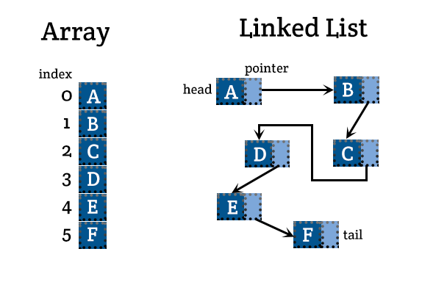
Array and Linked List
Notes:
* 1. https://open4tech.com/array-vs-linked-list-vs-hash-table/
* 2. Insert by index ,https://www.geeksforgeeks.org/how-to-insert-an-element-at-a-specific-position-in-an-array-in-c/

Slide 4
Why need compare the two
“I can store data in Array instead of Linked List!”
but there are several key differences between an array and a linked list. Two main difference are how they use memory and the time complexity of certain methods.

Slide 5
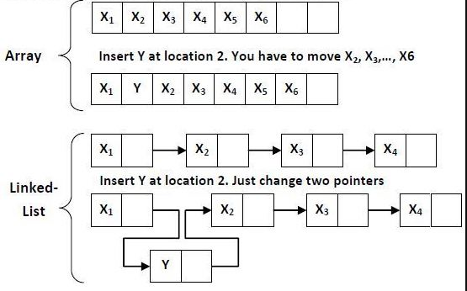
Compare efficiency from Memory Location view

Slide 6
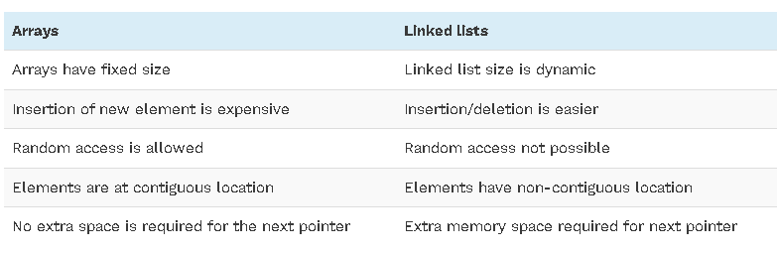
Arrays And Linked Lists
General overview Comparison
Notes:
*1. https://www.softwaretestinghelp.com/https://www.geeksforgeeks.org/how-to-insert-an-element-at-a-specific-position-in-an-array-in-c/https://www.geeksforgeeks.org/how-to-insert-an-element-at-a-specific-position-in-an-array-in-c/linked-list/

Slide 7
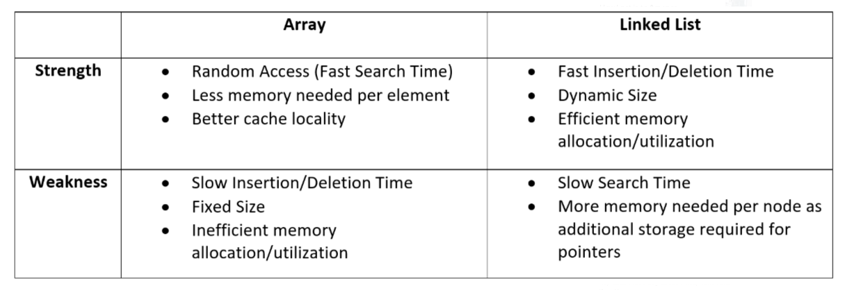
Arrays And Linked Lists
Pros and Cons
Notes:
*1. https://towardsdatascience.com/linked-lists-vs-arrays-78746f983267

Slide 8
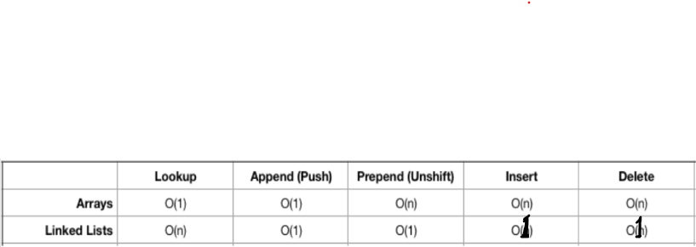
Arrays And Linked Lists
Time Complexity of certain methods
Notes:
* 1. https://medium.com/@ytsuji91/data-structures-in-javascript-part-1-linked-lists-94301942499d

Slide 9

Singly Linked List
Store a list of tasks
list of items in reverse order. Example: Quick Sort
Notes:
https://www.programiz.com/dsa/linked-list-types
https://github.com/KasterNur/ADS/tree/master/linkedList

Slide 10

Doubly Linked List
Bi-directional
Has extra a pointer: previous pointer (Compare to Single type )
Allows for fast insertion and deletion of elements.

Slide 11
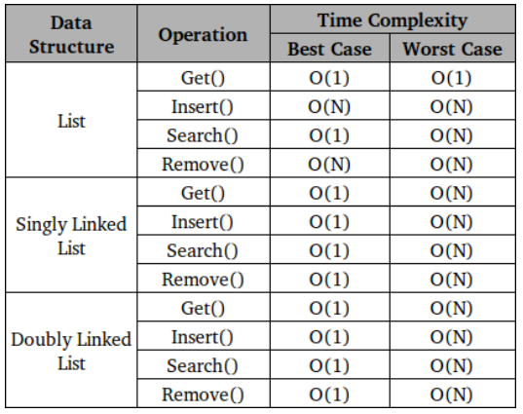
List vs Singly Linked List vs Doubly Linked List
Notes:
https://www.oreilly.com/library/view/c-data-structures/9781788835213/da0ebfd6-8155-4974-a535-4a4959c65553.xhtml

Slide 12

Circular Linked List
A circular linked list can be either singly linked or doubly linked.
for singly linked list, next pointer of last item points to the first item
In the doubly linked list, prev pointer of the first item points to the last item as well.
Notes:
*1. https://www.programiz.com/dsa/linked-list-types

