Slide 1
ADS 5 : Heap vs Priority Queue
By Kaster Nurmukan

Slide 2
Agenda
Heap –based on Complete Tree
Priority Queue - Abstract Data Structure
Priority Queue vs Heap
Heap Vs BST
Code analysing
QA

Slide 3
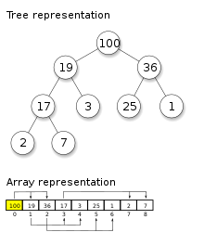
Heap
Tree based DS ,
Complete Tree
Highest (or lowest) priority element is always stored at the root
not a sorted structure
Type
Max-heap
Min-Heap
Notes:
https://www.programiz.com/dsa/complete-binary-tree
https://en.wikipedia.org/wiki/Heap_(data_structure)
https://www.programiz.com/dsa/heap-data-structure#heapify

Slide 4
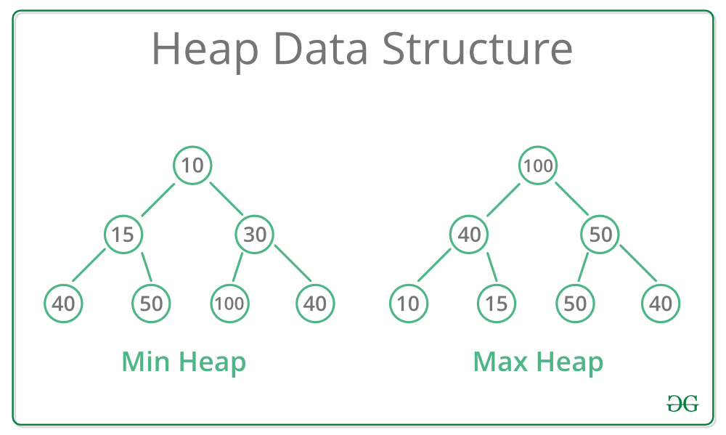
Heap
Notes:
https://en.wikipedia.org/wiki/Heap_(data_structure)
https://www.geeksforgeeks.org/heap-data-structure/

Slide 5
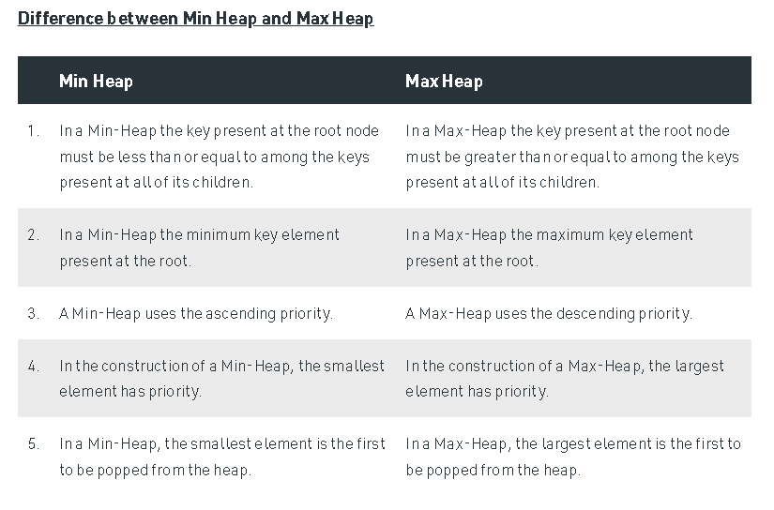
Notes:
https://www.geeksforgeeks.org/difference-between-min-heap-and-max-heap/

Slide 6
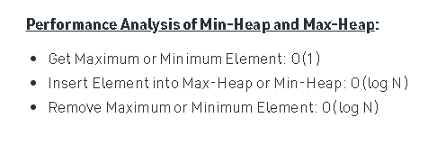
Heap Algorithm Complexity
Notes:
https://www.geeksforgeeks.org/difference-between-min-heap-and-max-heap/

Slide 7
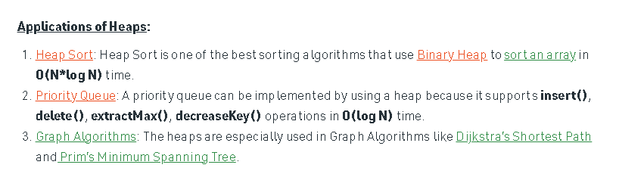
Heaps Applications
Notes:
https://www.geeksforgeeks.org/difference-between-min-heap-and-max-heap/

Slide 8
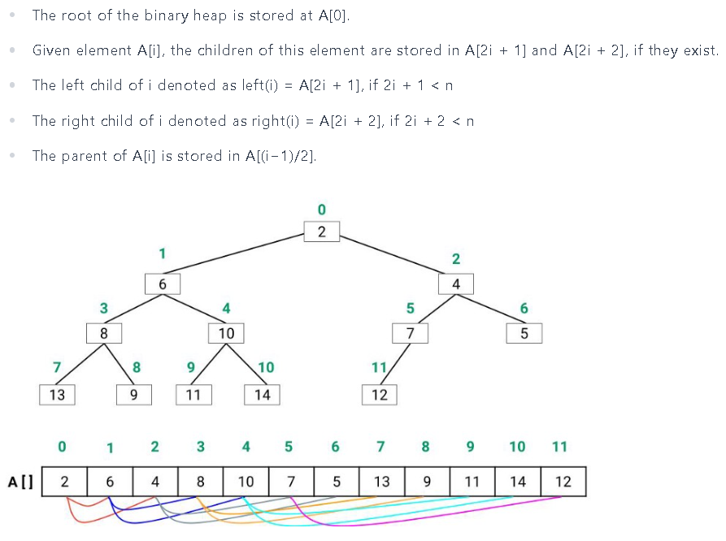
Heap Algorithm
Notes:
https://www.enjoyalgorithms.com/blog/introduction-to-heap-data-structure

Slide 9
Priority Queue
priority queue is an abstract data-type ,
Many Implementation:
Array
Linked-List
Heap (best)
BST
Queue & priority number
Notes:
https://www.geeksforgeeks.org/priority-queue-set-1-introduction/

Slide 10
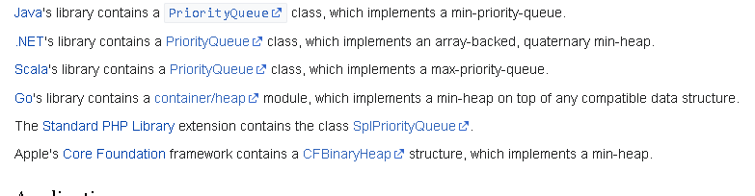
liberays
The Standard Template Library (STL), and the C++ 1998 standard, specifies std::priority_queue

Slide 11
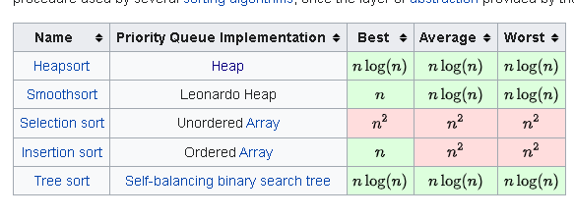
Implementation of Priority Queue
usually inefficient
unsorted list (O(1) insertion time)
highest priority. (O(n) pull time)
Usual implementation
Heap
BST
Notes:
https://en.wikipedia.org/wiki/Priority_queue
https://en.wikipedia.org/wiki/Priority_queue#Equivalence_of_priority_queues_and_sorting_algorithms

Slide 12
Priority Queue, BST vs Heap
We can build a Binary Heap in O(n) time. Self Balancing BSTs require O(nLogn) time to construct
Searching an element in self-balancing BST is O(Logn) which is O(n) in Binary Heap.
We can print all elements of BST in sorted order in O(n) time, but Binary Heap requires O(nLogn) time.
Notes:
https://www.geeksforgeeks.org/priority-queue-using-binary-heap/
https://www.geeksforgeeks.org/why-is-binary-heap-preferred-over-bst-for-priority-queue/

Slide 13
QA
Thanks

