Slide 1
ADS 6 : HeapSort Vs Quicksort
By Kaster Nurmukan

Slide 2
Agenda
HeapSort
QuickSort
Masure
N(log₂n)
HeapSort VS QuickSort
Code analysing
QA

Slide 3
Who much fast sort algorithm ? Problem
2^6 =64 , 2^7 =128 log₂100 ~~ 6.xxx 100 element ->sort-> 100* log₂100=100*6.5 = 650
100 ->~~ 650 times for only sorting .
Linear search 99
Sort ->Quick worse case 100* 100 =10,000
Total cost findingBinary(QuicSort) -> log₂ 100 + Quick Average 100* 6.5 = 6.5+ 650 ~~660
1,000,000 -> sort -> n log₂n-> 1,000,000 *20 =20,000,000
Total cost find = 20,000,000 +20 ~~
Find something (how much I spend) = best sort + use Binary search

Slide 4
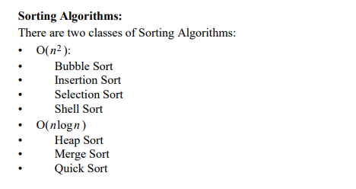
Sort Algorithms

Slide 5
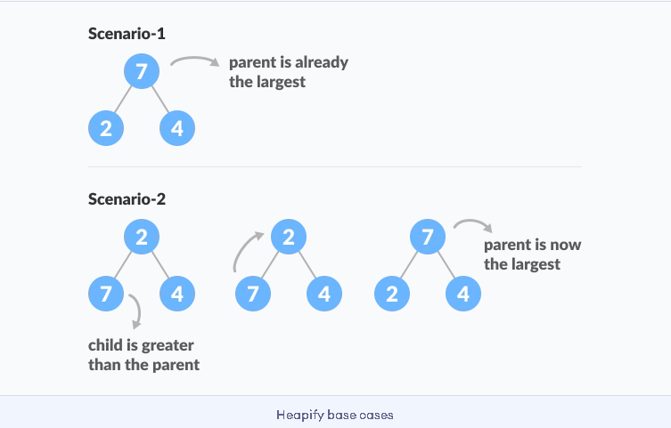
HeapSort
Based on Heap
BT -> Complete Binary Tree
Tranform -> Heap Max
Heapify
Notes:
https://www.programiz.com/dsa/heap-sort#:~:text=Heap%20Sort%20Complexity&text=Heap%20Sort%20has%20O(nlog,case%2C%20and%20worst%20case).
https://www.geeksforgeeks.org/heap-sort/

Slide 6
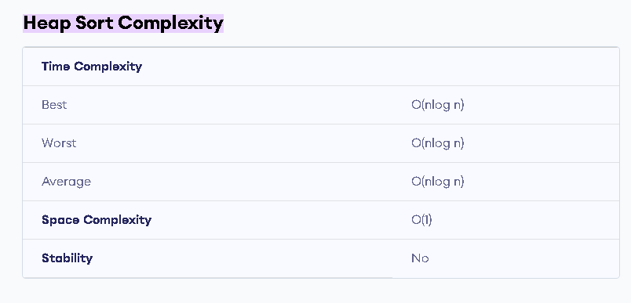
HeapSort Algorithm

Slide 7
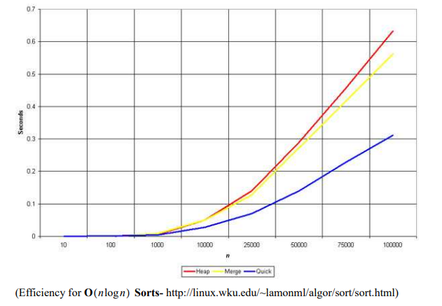
Heap vs Merge Vs Quick

Slide 8
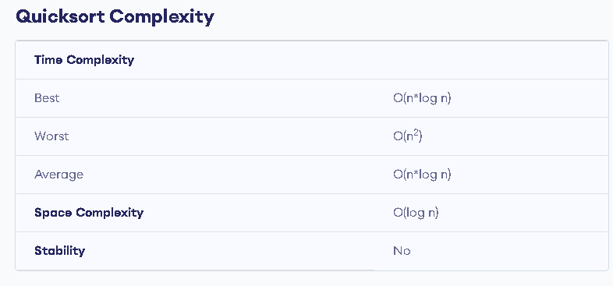
QuickSort
divide and conquer approach
pivot element (p) p < l & p > r
Partition
swap
Notes:
https://www.programiz.com/dsa/quick-sort
https://www.geeksforgeeks.org/quicksort-for-linked-list/
https://www.softwaretestinghelp.com/quick-sort/

Slide 9
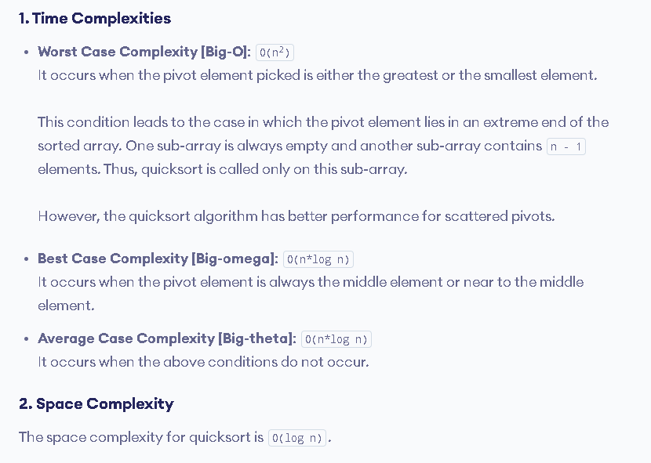
QuickSort Alogirthm

Slide 10
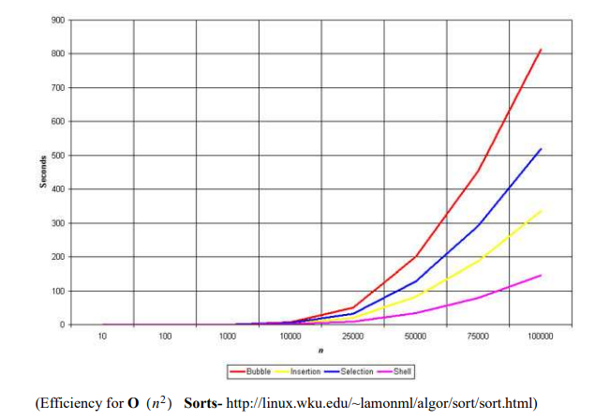
Sort Algorithms
Notes:
http://www-cs-students.stanford.edu/~rashmi/projects/Sorting

Slide 11
QA
Thanks

