Slide 1
Lecture 6
Quick Sort

Slide 2
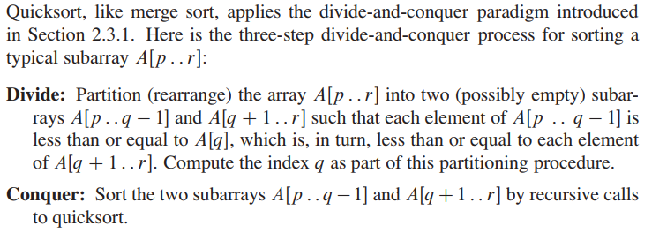
Quick sort

Slide 3
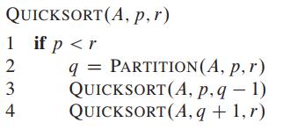
Quicksort procedure
To sort an entire array A, the initial call is Quicksort(A; 1; A.length).

Slide 4
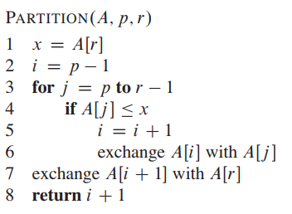
Partition
The key to the algorithm is the Partition procedure, which rearranges the subarray A[p..r] in place.

Slide 5
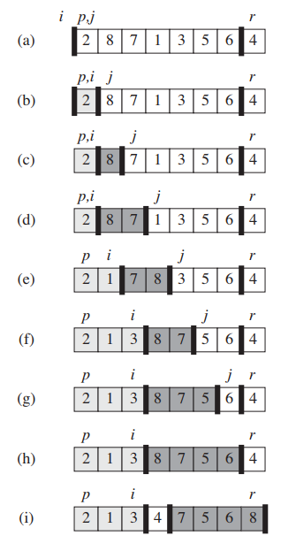
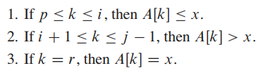
Example

Slide 6

Performance of quicksort
The worst-case behavior for quicksort occurs when the partitioning routine produces one subproblem with n - 1 elements and one with 0 elements.
The partitioning costs O(n) time thus:

Slide 7

Performance of quicksort
In the most even possible split, PARTITION produces two subproblems, each of size no more than n/2. In this case, quicksort runs much faster.

Slide 8

Average case scenario
Suppose, for example, that the partitioning algorithm always produces a 9-to-1 proportional split, which at first blush seems quite unbalanced. We then obtain the recurrence:

Slide 9
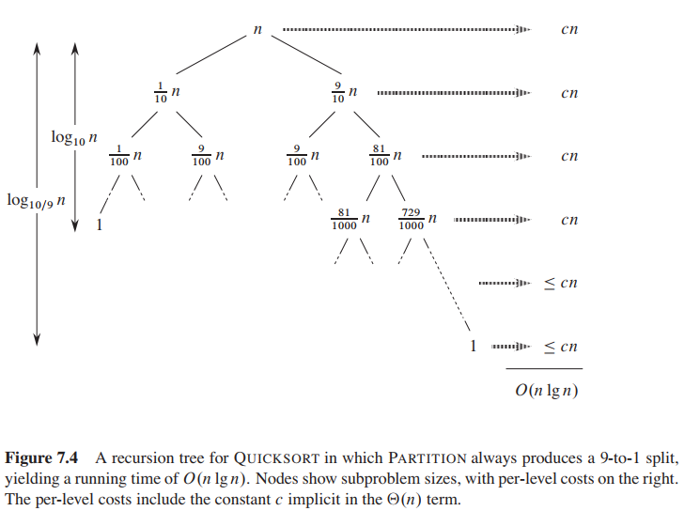



Average case scenario

Slide 10
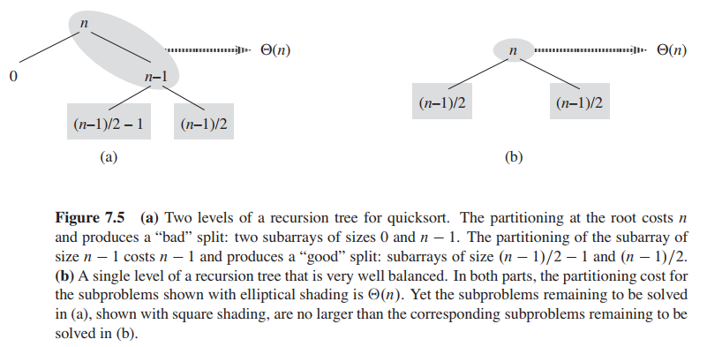
Intuition for average case scenario

Slide 11
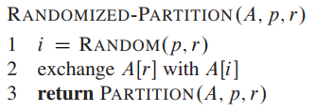
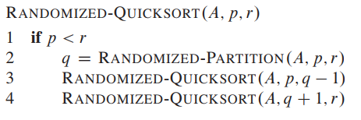
Randomized Partition
In Section 5.3, we randomized our algorithm by explicitly permuting the input. We could do so for quicksort also, but a different randomization technique, called random sampling, yields a simpler analysis. Instead of always using A[r] as the pivot, we will select a randomly chosen element from the subarray A[p..r]. We do so by first exchanging element A[r] with an element chosen at random from A[p..r].

