Slide 1
ADS 4 : BT& BST(Binary Search Tree )
By Kaster Nurmukan

Slide 2
Agenda
Binary Search Tree
BST VS BT(Binary Tree)
The Algorithm Complexity
AVL , RBT
Code analysing
QA

Slide 3
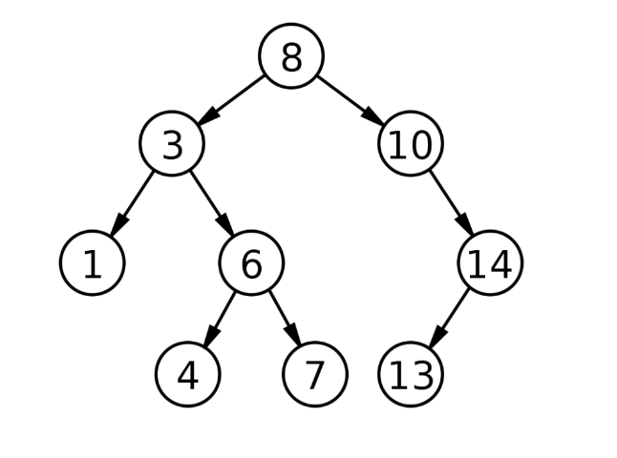
BST also called as “Ordered Binary Tree”
Notes:
https://www.upgrad.com/blog/binary-tree-vs-binary-search-tree/#:~:text=A%20Binary%20Tree%20is%20a%20non%2Dlinear%20data%20structure%20in,be%20of%20that%20particular%20structure.

Slide 4
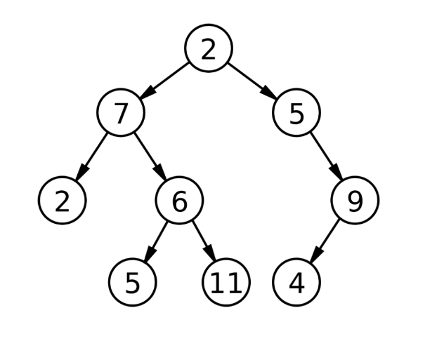
Binary Tree
Notes:
https://www.upgrad.com/blog/binary-tree-vs-binary-search-tree/#:~:text=A%20Binary%20Tree%20is%20a%20non%2Dlinear%20data%20structure%20in,be%20of%20that%20particular%20structure

Slide 5
Terminologies used in Binary Tree
Node, Root Node, Parent Node, Child Node,
Leaf Node:
Depth of a node
Height of the tree h= long2(n)
Binary Tree Type: Complete Binary Tree, Full binary Tree, perfect binary tree, balanced binary Tree, Degenerate Binary Tree
In perfect BT: n = 2^{h+1}-1
Notes:
https://www.upgrad.com/blog/binary-tree-vs-binary-search-tree/#:~:text=A%20Binary%20Tree%20is%20a%20non%2Dlinear%20data%20structure%20in,be%20of%20that%20particular%20structure.
https://www.upgrad.com/blog/5-types-of-binary-tree/

Slide 6
Properties Of Binary Search Tree
The left subtree of a node has nodes which are only lesser than that node’s key.
The right subtree of a node has nodes which are only greater than that node’s key.
Each node has distinct keys and duplicates are not allowed in Binary Search Tree.
The left and right subtree must also be a binary search tree.

Slide 7
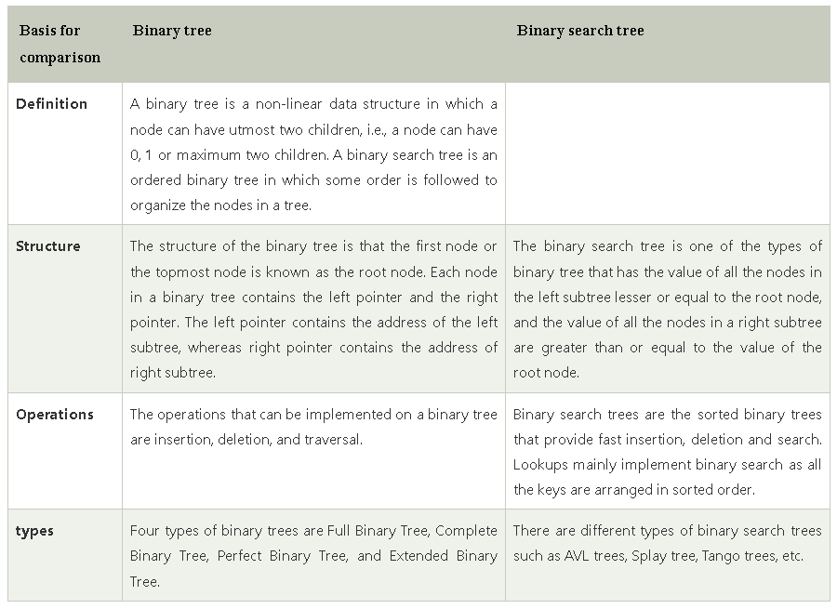
BT vs BST
Notes:
https://www.javatpoint.com/binary-tree-vs-binary-search-tree

Slide 8
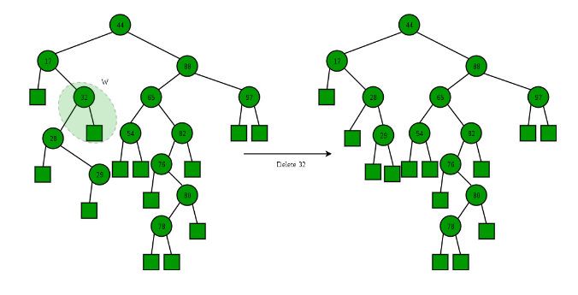
BST Deletion
Notes:
https://www.geeksforgeeks.org/binary-search-tree-set-2-delete/?ref=lbp

Slide 9
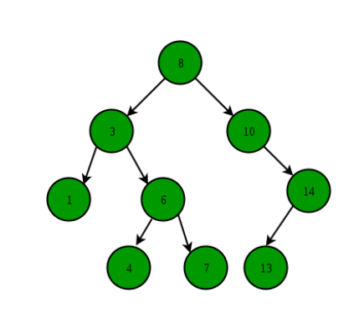
BST Search and Insertion
Notes:
https://www.geeksforgeeks.org/binary-search-tree-set-1-search-and-insertion/?ref=lbp

Slide 10
BST Application
Application:
TreeSet, TreeMap, and Hashmap in the Java Collections Library,
Linux kernel -> file/memory mapping.
k-means clustering, and text-mining

Slide 11
AVL Tree
AVL tree is also known as the height-balanced tree
Application :
in-memory sorts of sets and dictionaries. AVL trees are also used extensively in database applications in which insertions and deletions are fewer but there are frequent lookups for data required
Notes:
https://lifeindatastructures.wordpress.com/2017/10/27/efficient-binary-search-trees/
https://www.baeldung.com/cs/red-black-tree-vs-avl-tree
https://www.guru99.com/avl-tree.html
https://www.softwaretestinghelp.com/avl-trees-and-heap-data-structure-in-cpp/#:~:text=in%20the%20program.-,Applications%20Of%20AVL%20Trees,frequent%20lookups%20for%20data%20required.

Slide 12
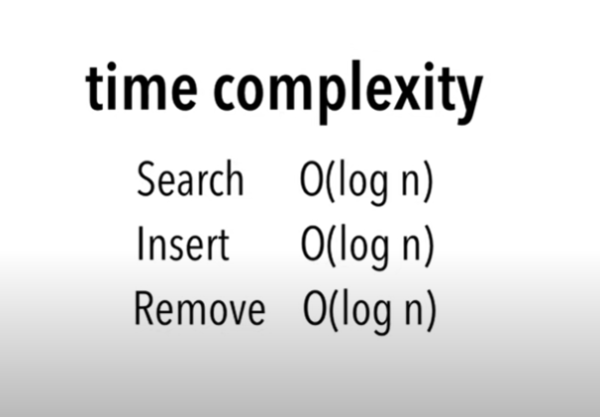
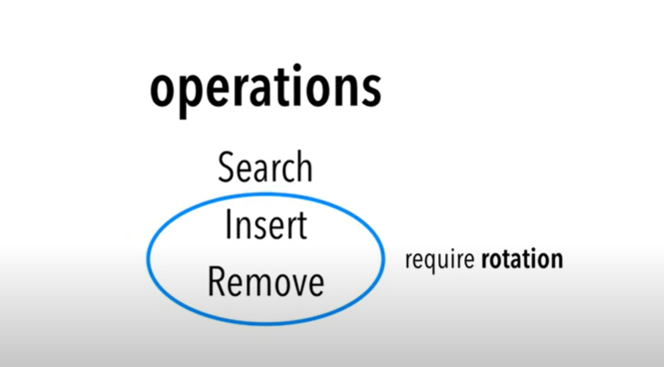
Notes:
https://www.youtube.com/watch?v=qvZGUFHWChY

Slide 13
Red-Black Trees
known as a roughly height-balanced tree
In order to rebalancing after each operation apply :
some rotations
recolor the nodes
four data: the node’s value, left subtree pointer, right subtree pointer, and a variable to store the color code of the node
Notes:
https://lifeindatastructures.wordpress.com/2017/10/27/efficient-binary-search-trees/
https://www.baeldung.com/cs/red-black-tree-vs-avl-tree
https://www.baeldung.com/cs/red-black-trees

Slide 14
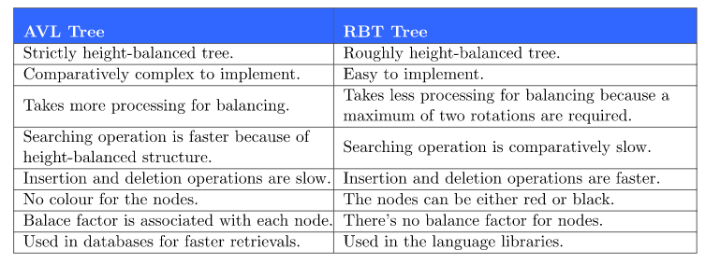
Difference AVL vs RBT
Notes:
https://www.baeldung.com/cs/red-black-tree-vs-avl-tree

Slide 15
QA
Thanks

