Slide 1
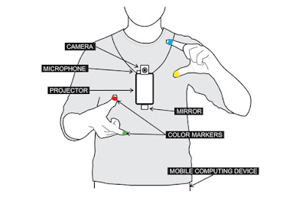

Proof of concept
https://www.youtube.com/watch?v=YrtANPtnhyg

Slide 2

Proof of concept
https://trackingjs.com

