Slide 1


Slide 2
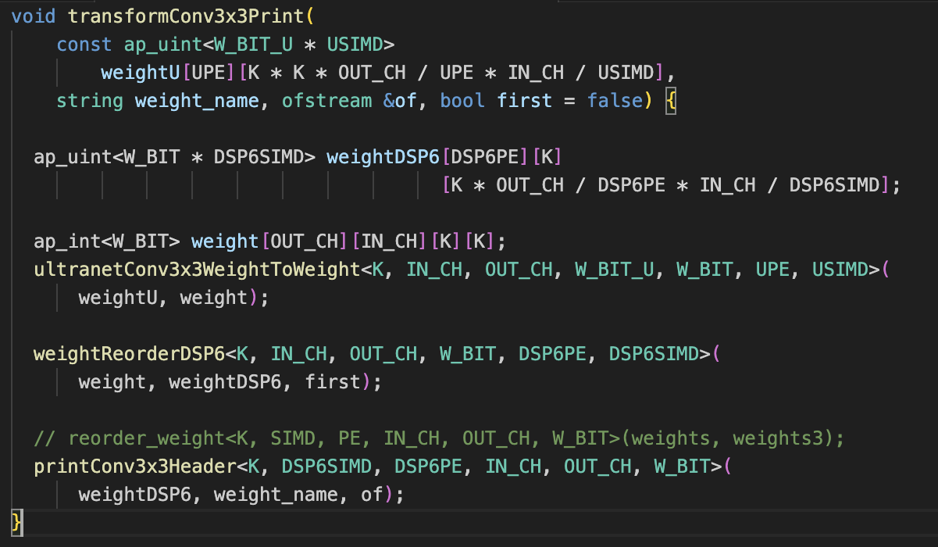
transformConv3x3Print
weightU(2D) → weight(4D) → weightDSP6(3D) → Print
ultranetConv3x3WeightToWeight weightReorderDSP6 printConv3x3Header

Slide 3
transformConv3x3Print
This function, `transformConv3x3Print`, transforms the weights from the UltraNet format into the DSP6 format, and then prints these weights into a file. The function takes four parameters:
1. `weightU`: This is a 2-dimensional array of weights in the UltraNet format. The data type is `ap_uint<W_BIT_U * USIMD>`, meaning it is an array of unsigned integers each of bit-width `W_BIT_U * USIMD`. `USIMD` is the SIMD (Single Instruction, Multiple Data) factor for UltraNet.
2. `weight_name`: This is a string representing the name of the weights. This name will be used when printing the weights into the file.
3. `of`: This is an output file stream to which the weights will be printed.
4. `first`: This is a boolean variable which indicates whether the weights are in the first pass or the second pass during reordering.
The function starts by declaring two multidimensional arrays `weightDSP6` and `weight`. The `weightDSP6` is for holding the weights after they are converted to the DSP6 format, and `weight` is for holding the weights after they are converted from the UltraNet format to a standard format.
The function then calls `ultranetConv3x3WeightToWeight` to convert the weights from the UltraNet format to a standard format. The resulting weights are stored in the `weight` array.
Next, the function calls `weightReorderDSP6` to reorder the weights from the standard format to the DSP6 format. The reordered weights are stored in the `weightDSP6` array.
Finally, the function calls `printConv3x3Header` to print the weights in the `weightDSP6` array to the output file. The weights are printed along with their corresponding `weight_name`.
In essence, the `transformConv3x3Print` function is a pipeline that transforms the weights from the UltraNet format into the DSP6 format, and then prints these transformed weights into a file.

Slide 4
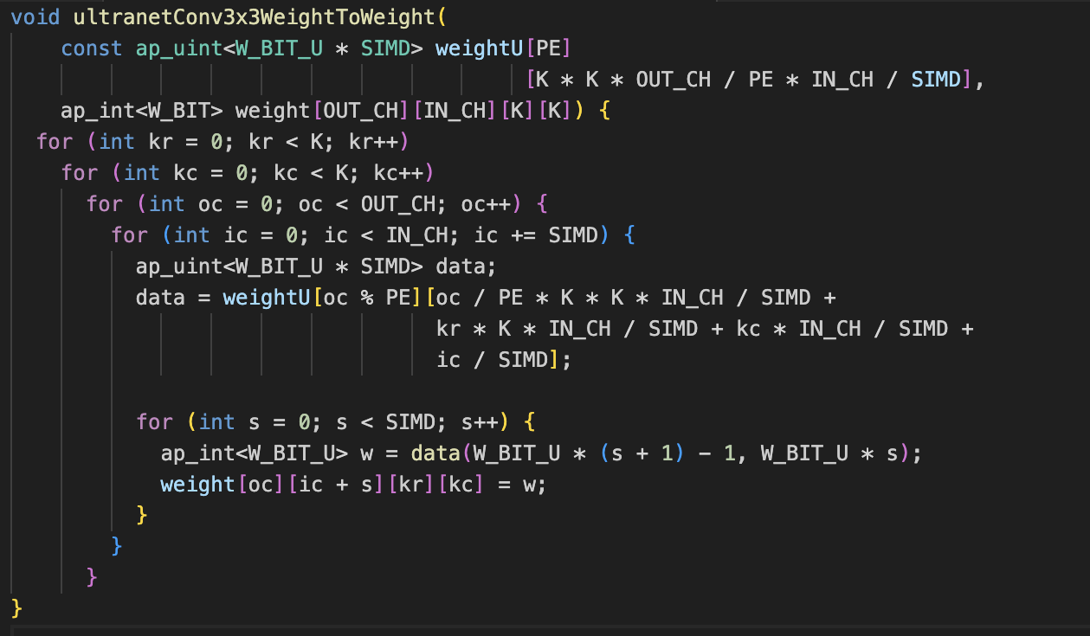
ultranetConv3x3WeightToWeight

Slide 5
ultranetConv3x3WeightToWeight
The `ultranetConv3x3WeightToWeight` function converts the weights of a 3x3 convolutional layer from the ultranet to a more general format
Here's a breakdown of the function:
- The function parameters are two 4D weight arrays, `weightU` and `weight`. `weightU` is an input parameter which contains the weights in the ultranet format. `weight` is an output parameter where the converted weights will be stored.
- The main body of the function consists of nested loops that iterate over each weight in the 4D weight arrays. `kr` and `kc` iterate over the kernel height and width respectively. `oc` iterates over the output channels, and `ic` iterates over the input channels.
- Inside the innermost loop, the function first calculates the index of the current weight in the `weightU` array. This calculation involves dividing and modulating the output channel index (`oc`) by the number of processing elements (`PE`), as well as multiplying and adding several other indices and constants. This complex index calculation is likely designed to match the specific layout of the weights in the ultranet architecture.
- After calculating the index, the function extracts the weight from the `weightU` array and stores it in the `data` variable.
- The function then enters another loop that iterates over each bit of the weight (there are `SIMD` bits). Inside this loop, the function extracts a bit from the `data` variable and stores it in the `w` variable.
- Finally, the function stores the extracted bit in the `weight` array at the corresponding position.

Slide 6
weightU[oc % PE][oc / PE * K * K * IN_CH / SIMD + kr * K * IN_CH / SIMD + kc * IN_CH / SIMD + ic / SIMD]
oc % PE - This expression indexes into the specific processing element (PE) for the current output channel (oc). The % operator is the modulo operator, which returns the remainder of oc divided by PE. This means that the output channels will be evenly distributed among the processing elements.
oc / PE * K * K * IN_CH / SIMD - Here, integer division is used to group output channels into blocks, one for each PE. Each block's size is given by K * K * IN_CH / SIMD, which represents the total number of weights associated with one output channel.
kr * K * IN_CH / SIMD + kc * IN_CH / SIMD - This part of the expression is used to index into the correct kernel position (kr, kc) within the block for the current output channel.
ic / SIMD - This last part is used to index into the correct input channel within the kernel. The input channels are grouped into blocks of size SIMD.

Slide 7
weightDSP6[oc % PE][kr][oc / PE * K * IN_CH / SIMD + kc * IN_CH / SIMD + ic / SIMD]
oc % PE: This operation ensures that the output channels are distributed evenly across the processing elements (PE). The % operator is the modulo operator, which returns the remainder of the division of oc by PE. This results in a round-robin distribution of output channels across the processing elements.
kr: This represents the row index of the convolution kernel.
oc / PE * K * IN_CH / SIMD + kc * IN_CH / SIMD + ic / SIMD: This complex expression is used to compute the offset within the third dimension of the array, for a given weight. The division by PE ensures the weights are distributed across the processing elements. The multiplication by K and IN_CH and division by SIMD accounts for the shape of the convolution kernel and the level of SIMD parallelism. The terms kc * IN_CH / SIMD + ic / SIMD further add to this offset based on the kernel column index and the input channel index.

Slide 8
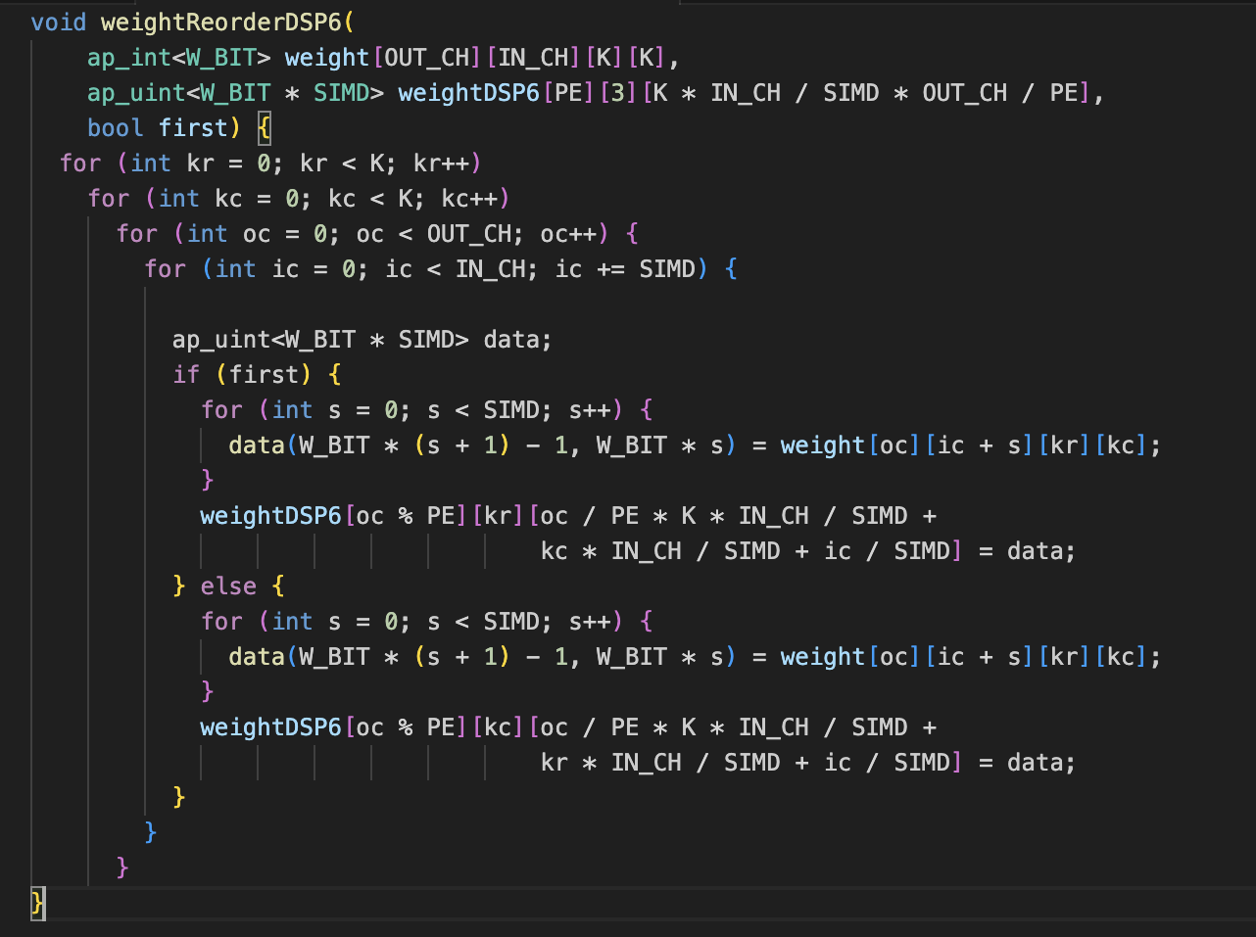



weightReorderDSP6

Slide 9
weightReorderDSP6
Function Arguments: The function takes four arguments:
weight[OUT_CH][IN_CH][K][K] : A four-dimensional array of weights for a convolutional layer. OUT_CH denotes the number of output channels, IN_CH denotes the number of input channels, and K represents the kernel size.
weightDSP6[PE][3][K * IN_CH / SIMD * OUT_CH / PE]: A three-dimensional array to store the reordered weights. Here, PE denotes the number of processing elements, SIMD denotes the number of elements that will be processed simultaneously, and OUT_CH and IN_CH are as before.
first: A boolean variable which determines the specific manner in which weights are reordered.
Nested loops: The function consists of four nested loops iterating over K rows (kr), K columns (kc), OUT_CH output channels (oc), and IN_CH input channels (ic) with a step size of SIMD which allows for simultaneous processing of SIMD elements.
Data Processing: The function defines an ap_uint named data with W_BIT * SIMD bits. W_BIT is the bit width of the fixed-point number and SIMD represents the number of these numbers that are processed together. data is designed to hold SIMD number of weights together.
First pass: If first is true, the function will first load SIMD number of weights from the weight array into data. The weights are accessed from the weight array with the calculated indices and assigned to a slice of data with appropriate indices. The weights are loaded in the order they appear in the weight array.
Data Assignment: The function then assigns data to a specific position in the weightDSP6 array, determined by a complex indexing scheme involving oc, PE, K, IN_CH, SIMD, kr, and kc. This allows for the efficient mapping of weights for DSP and PE architecture.
Second pass: If first is false, the function follows a similar process, but the order of the weight elements in the weightDSP6 array differs, determined by the value of kc instead of kr.
Here's a step by step explanation of the logic of weightReorderDSP6:
Four nested loops: The outermost loops iterate over the kernel size (KxK), and the inner loops iterate over the output and input channels. The loop over the input channels (ic) has a step size of SIMD. This is because the weights are grouped together for simultaneous processing, which is the very essence of SIMD operations.
Data grouping: For each combination of output channel, input channel, and kernel position, the function creates a group of SIMD weights. This group of weights is stored in the data variable, which is an unsigned integer with a bit width of SIMD * W_BIT. Here, W_BIT represents the bit width of the weights.
Weight reordering: The function then maps this group of weights to the weightDSP6 array. The precise position in this array is determined by the current output channel (oc), the current positions within the kernel (kr or kc depending on the value of first), and the current group of input channels (ic). The weights are distributed across the PEs (hence the oc % PE and oc / PE parts of the indices) to balance the computational load and ensure all PEs are fully utilized.
First and second pass: The boolean argument first determines how the weights are grouped together and where they are placed in the weightDSP6 array.

Slide 10
weightU[oc % PE][oc / PE * K * K * IN_CH / SIMD + kr * K * IN_CH / SIMD + kc * IN_CH / SIMD + ic / SIMD]
oc % PE - This expression indexes into the specific processing element (PE) for the current output channel (oc). The % operator is the modulo operator, which returns the remainder of oc divided by PE. This means that the output channels will be evenly distributed among the processing elements.
oc / PE * K * K * IN_CH / SIMD - Here, integer division is used to group output channels into blocks, one for each PE. Each block's size is given by K * K * IN_CH / SIMD, which represents the total number of weights associated with one output channel.
kr * K * IN_CH / SIMD + kc * IN_CH / SIMD - This part of the expression is used to index into the correct kernel position (kr, kc) within the block for the current output channel.
ic / SIMD - This last part is used to index into the correct input channel within the kernel. The input channels are grouped into blocks of size SIMD.

Slide 11
ap_uint<W_BIT * SIMD> weightDSP6[PE][3][K * IN_CH / SIMD * OUT_CH / PE]
if W_BIT_U equals 8 and SIMD equals 4, data will be a 32-bit unsigned integer, and w will be an 8-bit integer. On the first iteration of the loop (where s equals 0), w will be equal to the least significant 8 bits of data. On the second iteration (where s equals 1), w will be equal to the next 8 bits of data, and so on.
The arguments to this method are the high and low bit positions to be extracted, with the high bit at W_BIT_U * (s + 1) - 1 and the low bit at W_BIT_U * s

Slide 12
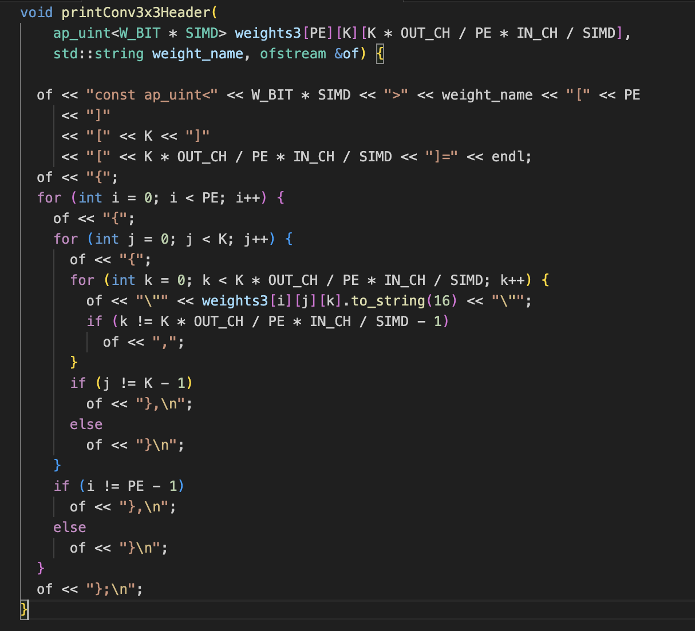





printConv3x3Header
1. The function `printConv3x3Header` takes three arguments: `weights3` which is a three-dimensional array of weights, `weight_name` which is a string representing the name of the weight matrix, and `of` which is a reference to an output file stream object.
2. The function first writes the declaration of the weight matrix to the output file using the `<<` operator to write to the file. The declaration includes the type of the matrix (`ap_uint<W_BIT * SIMD>`) and the size of each dimension, based on `PE`, `K`, `OUT_CH`, `IN_CH`, and `SIMD`. The string `weight_name` is used as the name of the matrix. This results in a string that looks like a C++ array declaration.
3. The function then enters three nested for-loops, iterating over each dimension of the weight matrix in turn.
4. Within the innermost loop, the function writes each weight value to the file in hexadecimal format. The `ap_uint::to_string` function is used to convert each weight to a hexadecimal string. If the current weight is not the last in its dimension, a comma is added after the weight for proper formatting.
5. After the innermost loop, the function checks whether it's at the last element of the second dimension (`j`). If it's not, it adds a closing brace and a comma, otherwise, it just adds a closing brace.
6. After the second-innermost loop, the function checks whether it's at the last element of the outermost dimension (`i`). If it's not, it adds a closing brace and a comma, otherwise, it just adds a closing brace.
7. At the end, it closes the whole declaration with a semicolon.

Slide 13
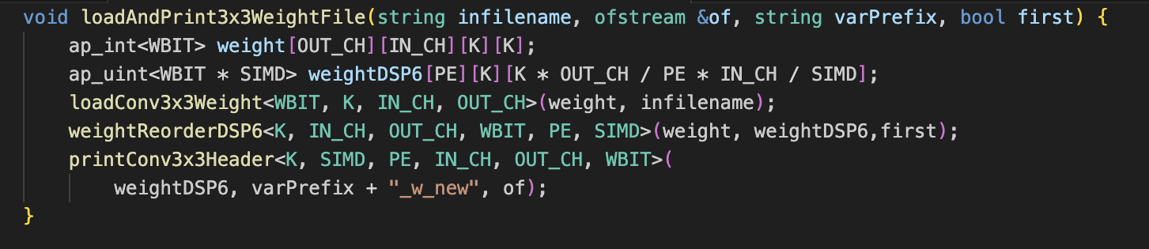
This function loads the weights of 3x3 convolution layer, from a file, reorder the weights (using weightReorderDSP6 , and prints them in the format defined by printConv3x3Header

Slide 14
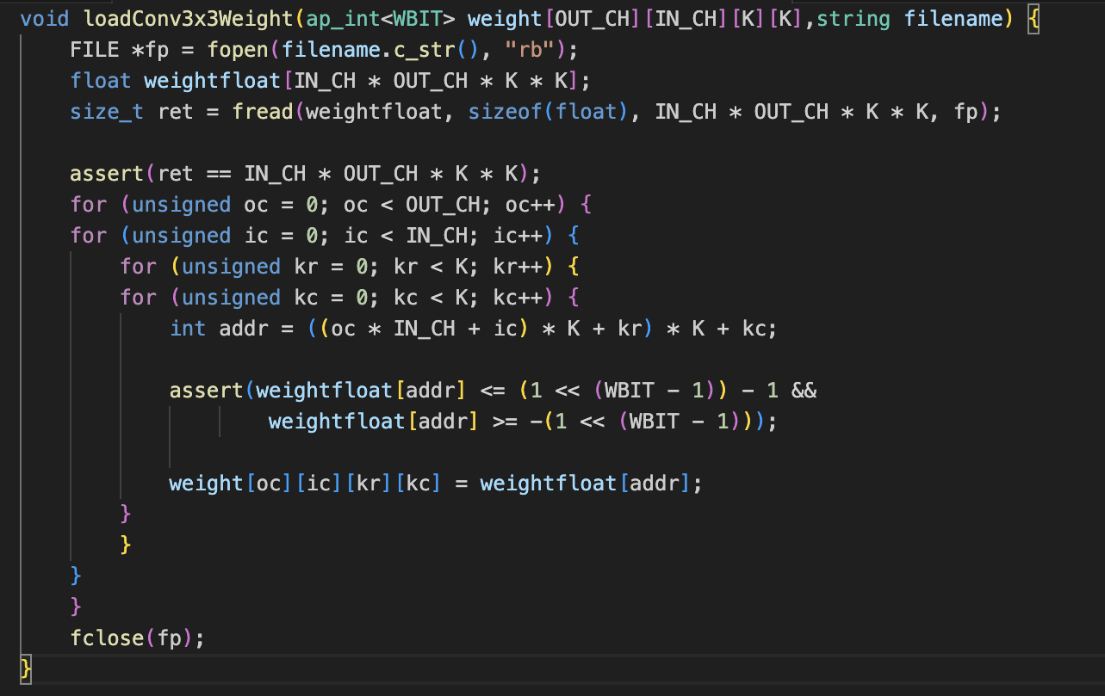
Read weights from file: The function defines a one-dimensional array weightfloat to store the weights as they are read from the file. It then uses the fread function to read the weights from the file into weightfloat. The fread function takes four arguments: the array to read into, the size of each element to read, the number of elements to read, and the file pointer. It reads IN_CH * OUT_CH * K * K elements of size sizeof(float) from the file, and returns the number of elements actually read.
Assert the number of weights read: An assert statement is used to check that the number of weights read from the file matches the expected number (IN_CH * OUT_CH * K * K). If this is not the case, the program will terminate with an error message.
Copy and type cast weights into the ap_int array: The function then uses a set of nested loops to iterate over the weights in weightfloat and copy them into the corresponding positions in the weight array. It computes the index (addr) into weightfloat corresponding to each position in weight and assigns the value at that index to the ap_int array. Before doing this, it asserts that the value at weightfloat[addr] is within the range that can be represented by an ap_int with WBIT bits.

