Slide 1
PROGRESS REPORT
12/08/2023
Presented by: Suhas Somashekar

Slide 2
Tasks completed
Optimal Systolic Array Configuration
Matrix Multiplication Optimization
Gemini Integration
TVM Custom Operations
Miscellaneous tasks

Slide 3
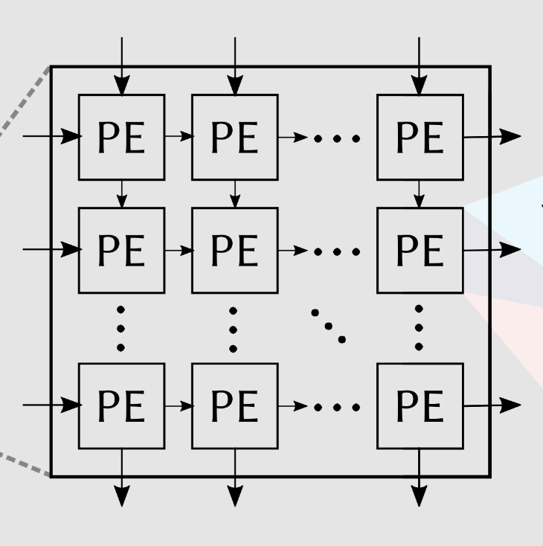

Optimal Systolic Array Configuration
Objective: Find the best systolic array configuration for optimal energy and cycle efficiency.
Best Configs
For minimum energy consumption:
M = [16]
N= [16]
For minimum cycles:
M = [64]
N= [128]
Design space:
M=[8,16,32,64,128]
N=[8,16,32,64,128]
DNN model
Our Implementation:
A tool for exploring and identifying optimal configurations based on different scenarios
An exhaustive search in the design space by compiling and evaluating each configuration
Record the parameters like the number of cycles, energy consumption, and other calculations for each configuration
Identify the best configurations focusing on minimizing energy consumption and computation cycles.
Future Possibilities:
In case of large design space, implement genetic algorithms like simulated annealing to decrease computation time
Implement more measurement parameters based on requirements.
Notes:
A systolic array configuration of m×n refers to an array with m rows and n columns of processing elements. Each processing element usually performs a simple operation, like multiplication or addition, and passes data to its neighboring elements in a coordinated fashion, akin to the rhythmic contraction of a heart (hence the name "systolic").

Slide 4
Matrix Multiplication Optimization
Objective: Optimize tiling and parallelism configuration for matrix multiplication in a given graph. (Useful in Transformers)
Requirements:
Find the values of optimal tile size and parallelism parameters for efficient resource usage.
BRAM config
data_size: 16
bram_width: 18
bram_depth: 1024
bram_count: 6840
Best parameters
Parallelism_n: 152
Parallelism_m: 16
Tiling_n: 2584
Tiling_m: 2704
Iterative search for all parameters based on constraints
Find the parameters that maximize BRAM utilization
Our Implementation:
Utilizes a specialized algorithm that inputs our BRAM configuration and the model's graph object.
Iteratively searches for optimal parameters.
Aims to achieve a harmonious balance between the computational and memory models.
Parameters are selected based on their ability to maximize BRAM utilization

Slide 5
Integration with Gemini
Objective: Enhance compatibility with Gemini accelerator.
Requirements:
C code: code is tailored for running a specific CNN model on the Gemini accelerator
Param file: header file that defines parameters, weights, biases, input, and output arrays for the layers of a CNN model
Our Implementation:
1) CPP file generation: This program accepts a graph object from our compiler and generates code tailored to specific layer types and operations, ensuring seamless compatibility with Gemini's architecture.
2) Param file generation: This function can take any standard pre-trained model from the internet and convert its weights into a format that's compatible with Gemini. We also apply quantization to the weights
Currently Supported Operations:
Convolution, Fully Connected, Add, Global Averaging/Pooling
Future Scope:
While we currently support a foundational set of operations and layers, we plan to expand this support to encompass a broader spectrum of operations.

Slide 6
TVM Custom operations
Objective: Integrate custom operations into Pytorch and TVM and make parsing of complex and custom models easier
PyTorch Implementation:
Implement & Register Custom Op in C++.
Compile Custom Op into a shared library.
Integrate Custom Op into PyTorch models
TVM Integration:
Define Custom Op attributes and type relations.
Register Custom Op as a new operation in Relay.
Implement Custom Op computation logic.
Link Custom Op compute function with Relay's strategy.
Create Relay call node and Python API hook.
Our Implementation:
Custom Ops integration is a complex task with multiple steps
We have extensively studied the TVM’s codebase and documentation
We have created comprehensive documentation to guide users for future implementation because existing resources are limited
Future Scope:
Offer support for more custom operations
Makes it easier to implement operation fusion (fused operations as custom operations)
TVM Frontend Modification:
Update PyTorch Frontend in TVM for LTQ.
Implement a converter for LTQ in TVM.
Model Conversion & IR Visualization:
Convert PyTorch Model to TorchScript, then to TVM Relay IR.
Display and verify Relay IR.

Slide 7
Miscellaneous tasks
1. Compiler Update and Integration:
- Successfully updated and integrated our compiler for compatibility with TVM, transitioning from version 0.11.0 to 0.14.0.
2. Front-End Graph Architecture Development for Transformer Model:
- Authored and implemented the front-end graph architecture specifically for Transformers within our compiler framework.
3. Code Optimization Support:
- Actively involved in identifying and updating redundant code segments to enhance overall system efficiency.
4. Integration of Energy Calculations:
- Successfully integrated code for precise energy consumption calculations.
5. FPS Calculation Code:
- Authored a robust code module for calculating Frames Per Second (FPS) during single execution instances, aiding in performance analysis.
6. Ultranet Model Code Generation:
- Developed and implemented code generation for the Ultranet model, focusing on a streaming architecture approach.

Slide 8
Thank You

Slide 9
Appendix

Slide 10
Energy calculations in our compiler
Dynamic Energy Calculation: Dynamic energy consumption occurs when the system performs tasks actively.
Core Dynamic Energy: This is calculated based on the number of total cycles (self.total_cycles) minus memory stall cycles (self.mem_stall_cycles). Each cycle consumes core_dyn_cost amount of energy.
Buffer and DRAM Dynamic Energy: For each buffer (write buffer, input buffer, boundary buffer, output buffer) and DRAM, the energy consumption is calculated by multiplying the number of reads and writes by their respective energy costs per operation (like wbuf_read_cost, ibuf_write_cost, etc.).
Leakage Energy Calculation: Leakage energy refers to the energy consumed by components when they are not actively switching but are powered on. In our code, however, the leakage energy is effectively set to zero (leak_energy = self.total_cycles * leak_cost * 0) and does not contribute to the total energy calculation.
Total Energy Calculation: The total energy consumption is the sum of the dynamic energy (dyn_energy) and the leakage energy (leak_energy).
The formula used for calculating the dynamic energy for each component is:
Dynamic Energy=(Number of Operations)×(Energy Cost per Operation),
where "Number of Operations" can be reads or writes for a particular buffer/DRAM, and "Energy Cost per Operation" is the energy cost associated with each read or write operation.
Unit: picojoules (pJ) per bit
Note: leak_cost, core_dyn_cost, wbuf_read_cost, wbuf_write_cost, ibuf_read_cost, ibuf_write_cost, bbuf_read_cost, bbuf_write_cost, obuf_read_cost, obuf_write_cost needs to be defined properly for accurate measurement

