Slide 1
PROGRESS REPORT
12/08/2023
Presented by: Suhas Somashekar

Slide 2
Tasks completed
Optimal Systolic Array Configuration
Matrix Multiplication Optimization
Gemini Integration
TVM Custom Operations
Miscellaneous tasks

Slide 3
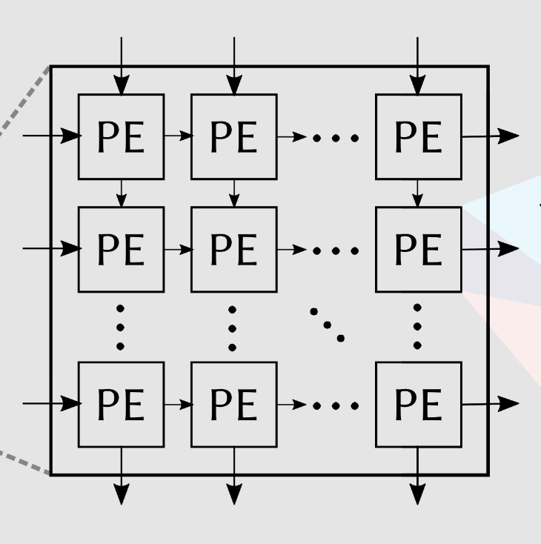

Optimal Systolic Array Configuration
Objective: Find the best systolic array configuration for optimal energy and cycle efficiency.
Best Configs
For minimum energy consumption:
M = [16]
N= [16]
For minimum cycles:
M = [64]
N= [128]
Design space:
M=[8,16,32,64,128]
N=[8,16,32,64,128]
DNN model
Our Implementation:
A tool for exploring and identifying optimal configurations based on different scenarios
An exhaustive search in the design space by compiling and evaluating each configuration
Record the parameters like the number of cycles, energy consumption, and other calculations for each configuration
Identify the best configurations focusing on minimizing energy consumption and computation cycles.
Future Possibilities:
In case of large design space, implement genetic algorithms like simulated annealing to decrease computation time
Implement more measurement parameters based on requirements.
Notes:
We have developed a program to optimize the systolic array configuration, the best systolic array configuration in this case refers to the value of M and N. Previously, our compiler utilized default values, typically set at M, N = 32x32. However, we've advanced our capabilities, enabling us to ascertain the most effective configuration for a particular model and hardware setup. Our approach begins by defining a search space in the context of the given model and hardware configurations. As illustrated in the image, this search space encompasses a range of potential, desirable M and N values. We then prepare our compiler accelerator to test each combination of M and N. The compiler runs on all valid configurations, during which we measure various performance parameters. Once we've gathered all the necessary data, we can pinpoint the optimal configuration for different scenarios. For instance, we're currently showcasing configurations that achieve the lowest energy consumption and those that require the fewest processing cycles.
Looking forward, there's potential to enhance this implementation by expanding our search space. To streamline the process of identifying the best configuration, we can employ advanced techniques like genetic algorithms, including simulated annealing. These intelligent search algorithms offer a more efficient alternative to traditional exhaustive search methods.
Additionally, we can broaden our criteria by defining more performance measurements for determining the most suitable configuration. This approach not only improves accuracy but also tailors the configuration to specific performance goals.
A systolic array configuration of m×n refers to an array with m rows and n columns of processing elements. Each processing element usually performs a simple operation, like multiplication or addition, and passes data to its neighboring elements in a coordinated fashion, akin to the rhythmic contraction of a heart (hence the name "systolic").

Slide 4
Matrix Multiplication Optimization
Objective: Optimize tiling and parallelism configuration for matrix multiplication in a given graph. (Useful in Transformers)
Requirements:
Find the values of optimal tile size and parallelism parameters for efficient resource usage.
BRAM config
data_size: 16
bram_width: 18
bram_depth: 1024
bram_count: 6840
Best parameters
Parallelism_n: 152
Parallelism_m: 16
Tiling_n: 2584
Tiling_m: 2704
Iterative search for all parameters based on constraints
Find the parameters that maximize BRAM utilization
Our Implementation:
Utilizes a specialized algorithm that inputs our BRAM configuration and the model's graph object.
Iteratively searches for optimal parameters.
Aims to achieve a harmonious balance between the computational and memory models.
Parameters are selected based on their ability to maximize BRAM utilization
Notes:
Next, I will move into the matrix multiplication optimizations we have implemented, which are particularly beneficial for transformer models that rely heavily on matrix multiplication (mat mul). To enhance mat mul efficiency, it is crucial to identify key parameters that lead to optimal performance. Our focus is on three main areas: Parallelism_n, Parallelism_m, and Tiling sizes.
Parallelism_n refers to the number of processing elements (PEs) deployed in the systolic array for matrix multiplication. Each PE is responsible for computing distinct elements of the resultant matrix. By increasing parallelism in the n dimension, we facilitate more parallel computations, thereby boosting overall processing speed.
Parallelism_m, on the other hand, governs the vector width or granularity of each processing element. This parameter determines how many data points each PE can process at once. Fine-tuning parallelism_m is a balancing act; it impacts matrix multiplication efficiency by striking a balance between computational throughput and resource utilization, particularly on FPGA platforms.
Tiling sizes relate to the row and column sizes of the input matrix handled in a single tile. In setting these sizes, we are mindful of several constraints and goals. A key objective is to align or minimize the disparity between the memory model and the computation model. In simpler terms, we aim to reduce the gap between memory latency and computation latency. Achieving an optimal configuration means balancing the time taken to compute a piece of data with the time required to fetch the next piece. A significant lag in either aspect can lead to bottlenecks. For example, high memory latency could result in PEs idly waiting for data, diminishing overall efficiency.
Another goal is to maximize BRAM (Block Random Access Memory) utilization. With these optimization targets in mind, we conduct an iterative search over these parameters. Through this process, we identify the most effective factors, which then guide us in configuring our hardware for more efficient calculations. This methodical approach ensures that we optimize our matrix multiplication processes, particularly in the context of transformer models, to achieve the best possible performance.

Slide 5
Integration with Gemini
Objective: Enhance compatibility with Gemini accelerator.
Requirements:
C code: code is tailored for running a specific CNN model on the Gemini accelerator
Param file: header file that defines parameters, weights, biases, input, and output arrays for the layers of a CNN model
Our Implementation:
1) CPP file generation: This program accepts a graph object from our compiler and generates code tailored to specific layer types and operations, ensuring seamless compatibility with Gemini's architecture.
2) Param file generation: This function can take any standard pre-trained model from the internet and convert its weights into a format that's compatible with Gemini. We also apply quantization to the weights
Currently Supported Operations:
Convolution, Fully Connected, Add, Global Averaging/Pooling
Future Scope:
While we currently support a foundational set of operations and layers, we plan to expand this support to encompass a broader spectrum of operations.
Notes:
I’ll talk about Gemini, a systolic-array-based matrix multiplication accelerator. Our objective was to integrate our compiler with Gemini, enabling it to efficiently run models. To operate a model on Gemini, two primary components are necessary: the C code and a parameter file.
The C code is specifically tailored to run a certain Convolutional Neural Network (CNN) model on the Gemini accelerator. It's custom-designed for each model to ensure optimal performance. Alongside this, the parameter file is a crucial element. It's essentially a header file that defines various parameters, including weights, biases, and input and output arrays for the layers of the CNN model.
Our team has developed a program that transforms our graph object, derived from our model examples, into the specific code required for Gemini. We're currently supporting a range of operations such as Convolution, Fully Connected layers, Add, and Global Averaging/Pooling.
Regarding the parameter file generation, Gemini necessitates the file and weights in a particular format. We've successfully tackled this challenge, enabling the conversion of any standard pre-trained model from the internet into a format that is compatible with Gemini. This development significantly broadens the range of models that can be utilized with Gemini.
Looking ahead, we plan to expand our support to include more operations and accommodate a wider variety of models.

Slide 6
TVM Custom operations
Objective: Integrate custom operations into Pytorch and TVM and make parsing of complex and custom models easier
PyTorch Implementation:
Implement & Register Custom Op in C++.
Compile Custom Op into a shared library.
Integrate Custom Op into PyTorch models
TVM Integration:
Define Custom Op attributes and type relations.
Register Custom Op as a new operation in Relay.
Implement Custom Op computation logic.
Link Custom Op compute function with Relay's strategy.
Create Relay call node and Python API hook.
Our Implementation:
Custom Ops integration is a complex task with multiple steps
We have extensively studied the TVM’s codebase and documentation
We have created comprehensive documentation to guide users for future implementation because existing resources are limited
Future Scope:
Offer support for more custom operations
Makes it easier to implement operation fusion (fused operations as custom operations)
TVM Frontend Modification:
Update PyTorch Frontend in TVM for LTQ.
Implement a converter for LTQ in TVM.
Model Conversion & IR Visualization:
Convert PyTorch Model to TorchScript, then to TVM Relay IR.
Display and verify Relay IR.
Notes:
In our project, we faced challenges because our compiler and front end primarily supported standard operations, This put us at a disadvantage when dealing with custom operations. Implementing these custom operations is a complex process and there is a lack of extensive documentation and support available online, and a lot of things could go wrong in this process.
However, in our specific case, we achieved a significant milestone by successfully integrating a custom operation, Learned Threshold Quantization (LTQ), from PyTorch into TVM. This integration was multifaceted, involving the implementation in PyTorch, modifications in TVM Relay, and ensuring that the operation was correctly converted and represented in TVM's Intermediate Representation (IR). The slide here illustrates the various steps required to integrate a custom operation like LTQ.
Now, Leveraging our experience from implementing LTQ, we have created comprehensive documentation and detailed instructions, complete with examples. This guidance is designed to facilitate the seamless integration of different operations in the future. This development is a game changer for us. It opens up the possibility of easily implementing more custom operations, providing support for complex and custom models. Additionally, it lays the groundwork for us to define our own custom operations, such as in operation fusion.

Slide 7
Miscellaneous tasks
1. Compiler Update and Integration:
- Successfully updated and integrated our compiler for compatibility with TVM, transitioning from version 0.11.0 to 0.14.0.
2. Front-End Graph Architecture Development for Transformer Model:
- Authored and implemented the front-end graph architecture specifically for Transformers within our compiler framework.
3. Code Optimization Support:
- Actively involved in identifying and updating redundant code segments to enhance overall system efficiency.
4. Integration of Energy Calculations:
- Successfully integrated code for precise energy consumption calculations.
5. FPS Calculation Code:
- Authored a robust code module for calculating Frames Per Second (FPS) during single execution instances, aiding in performance analysis.
6. Ultranet Model Code Generation:
- Developed and implemented code generation for the Ultranet model, focusing on a streaming architecture approach.

Slide 8
Thank You

Slide 9
Appendix

Slide 10
Energy calculations in our compiler
Dynamic Energy Calculation: Dynamic energy consumption occurs when the system performs tasks actively.
Core Dynamic Energy: This is calculated based on the number of total cycles (self.total_cycles) minus memory stall cycles (self.mem_stall_cycles). Each cycle consumes core_dyn_cost amount of energy.
Buffer and DRAM Dynamic Energy: For each buffer (write buffer, input buffer, boundary buffer, output buffer) and DRAM, the energy consumption is calculated by multiplying the number of reads and writes by their respective energy costs per operation (like wbuf_read_cost, ibuf_write_cost, etc.).
Leakage Energy Calculation: Leakage energy refers to the energy consumed by components when they are not actively switching but are powered on. In our code, however, the leakage energy is effectively set to zero (leak_energy = self.total_cycles * leak_cost * 0) and does not contribute to the total energy calculation.
Total Energy Calculation: The total energy consumption is the sum of the dynamic energy (dyn_energy) and the leakage energy (leak_energy).
The formula used for calculating the dynamic energy for each component is:
Dynamic Energy=(Number of Operations)×(Energy Cost per Operation),
where "Number of Operations" can be reads or writes for a particular buffer/DRAM, and "Energy Cost per Operation" is the energy cost associated with each read or write operation.
Unit: picojoules (pJ) per bit
Note: leak_cost, core_dyn_cost, wbuf_read_cost, wbuf_write_cost, ibuf_read_cost, ibuf_write_cost, bbuf_read_cost, bbuf_write_cost, obuf_read_cost, obuf_write_cost needs to be defined properly for accurate measurement

