Slide 1

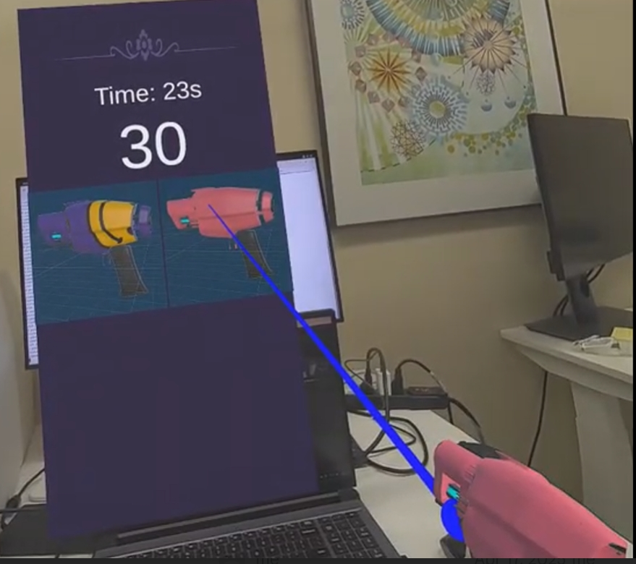
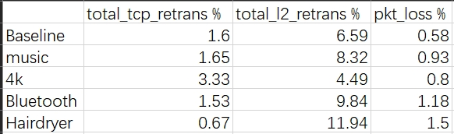
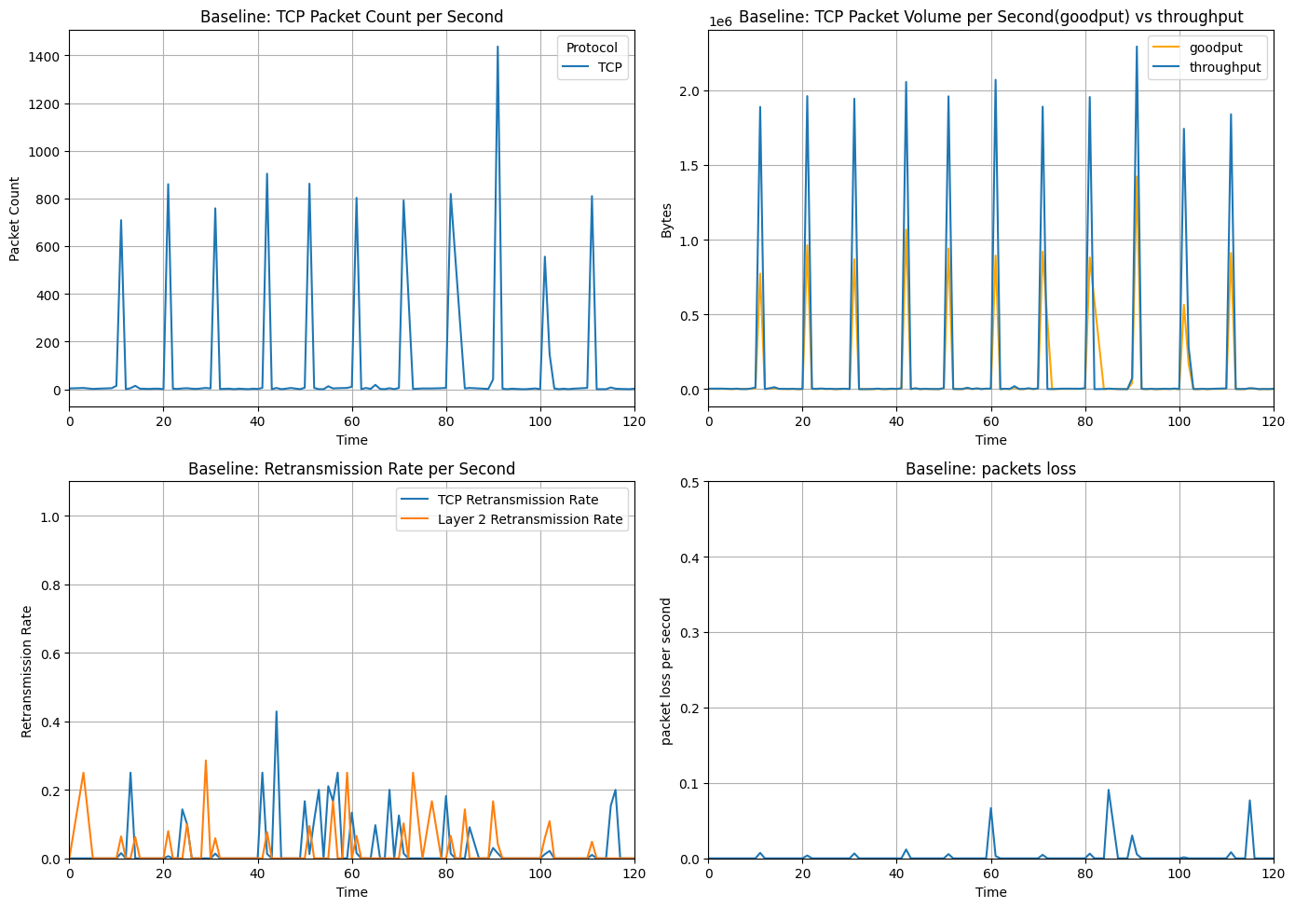
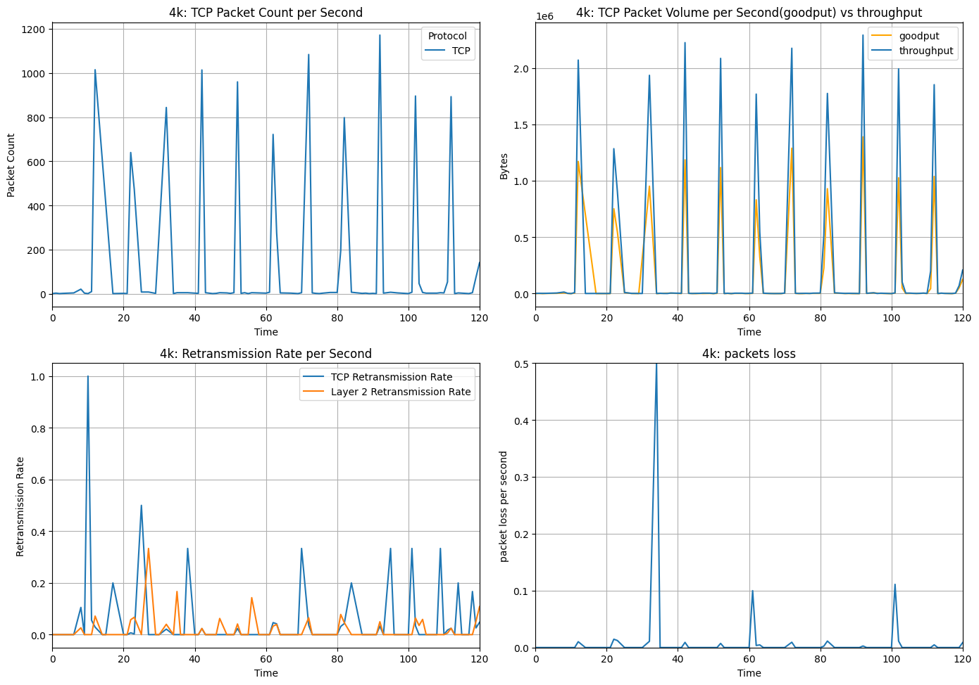
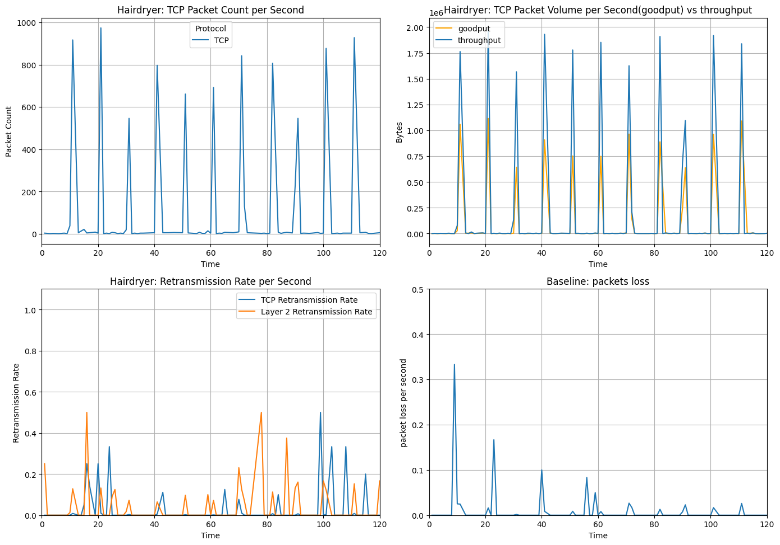
Network Performance Measurement in the context of a Mixed Reality Game
Ruifeng Xu University of Wisconsin | Weijun Pan University of Wisconsin
Motivation
Typosquatting domains are purposely registered to capture traffic from similar top domains.
These domains have been verified to be related to domain parking and cybersecurity issues.
A comprehensive analysis to report the phenomenon of typosquatting domains in these years.
Related Work
Cheng analyzed five major social VR platforms, identifying scalability issues due to increasing network resource consumption as the number of users grows. Their study highlights the impact of avatar data forwarding on BW and latency constraints.
He, L’s experiments showed that Bluetooth audio streaming devices substantially increase the BER in 802.11b networks.
Methodology
Build and deploy the MR Shooting Game in Oculus Quest3. Players have the option to customize the appearance of their weapon by selecting different skins.
The weapon skins are textures downloaded from the server in Real-time. The player’s data synchronizes with the server regularly.
We use tcpdump to capture and analyze all upstream and downstream network packets under different scenarios
Motivation & Research Questions
Mixed Reality (MR) has gained significant global attention, yet research on network performance in MR applications remains limited.
What are the key network performance bottlenecks and constraints in MR environments, and how can they be systematically measured and characterized?
What strategies can be employed to optimize network efficiency in MR environments?
Approach
Step #1: Identification – utilize search to find maps of physical locations
Step #2: Transcription – multiple methods to automate data entry
Step #3: Verification – ensure that data reflects latest network maps
Hypothesis: Physical sites are limited in number and fixed in location.
Data
We use tcpdump to collect network traffic under 5 different scenarios: Baseline, Baseline + Music, Baseline + 4k Video, Baseline + Bluetooth, Baseline + Hairdryer
We play the shooting game for 120s and change gun’s skin every 10s to trigger packet transmission
The data is collected in a clean environment, while only Oculus Quest3 and the interference device are connected to the router.
Key Results
Our analysis focuses on network metrics including packet count, goodput/throughput, TCP/Layer 2 retransmissions, and packet loss across all experimental scenarios:
Physical interference (e.g., Bluetooth signals and hairdryers) significantly degrades Layer 2 performance, directly increasing MAC-layer retransmission.
Bandwidth-intensive devices operating on the same network(e.g. 4k) induce congestion-driven bottleneck. This contention elevates TCP retransmissions.
Conclusions and Future Work
Conclusion: Our findings reveal that network performance degradation in MR environments stems from two distinct sources: physical interference (e.g., hairdryers) disrupts Layer 2 reliability through electromagnetic noise, while bandwidth contention (e.g., 4K video) induces transport-layer congestion.
Future works: 1. stress-test MR applications under extreme conditions 2. multi-player MR scenarios, which demand scalable bandwidth and dynamic adaptation to network fluctuations, warrant investigation

